Slide 1
ME 315 : Project Midterm
By Kailash Senthilkumar, Lokesh Sriram, Yuchen Fu
10/11/2024

Slide 2
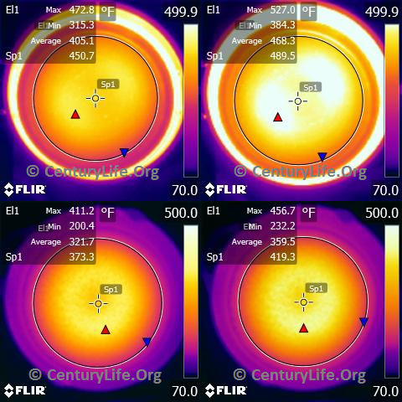
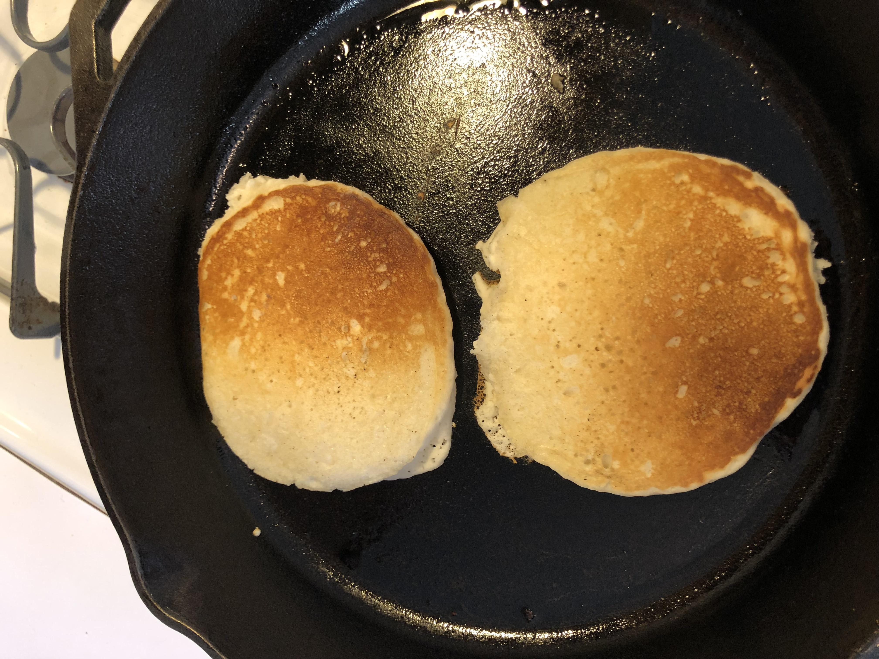
Introduction:
Research Question: How does heat distribution uniformity differ among stainless steel pans with and without copper core?
Objective: To determine which pan material offers the most uniform heat distribution by analyzing spreading resistance and temperature uniformity.
Real World Impact: Insights can enhance cooking efficiency and food quality, benefiting both consumers and cookware manufacturers.
Hypothesis: Aluminum pans will demonstrate the lowest spreading resistance and most uniform heat distribution due to their high thermal conductivity.
Methodology Overview: Utilize infrared imaging and thermocouples to measure temperature distribution across different pan materials during heating.

Slide 3
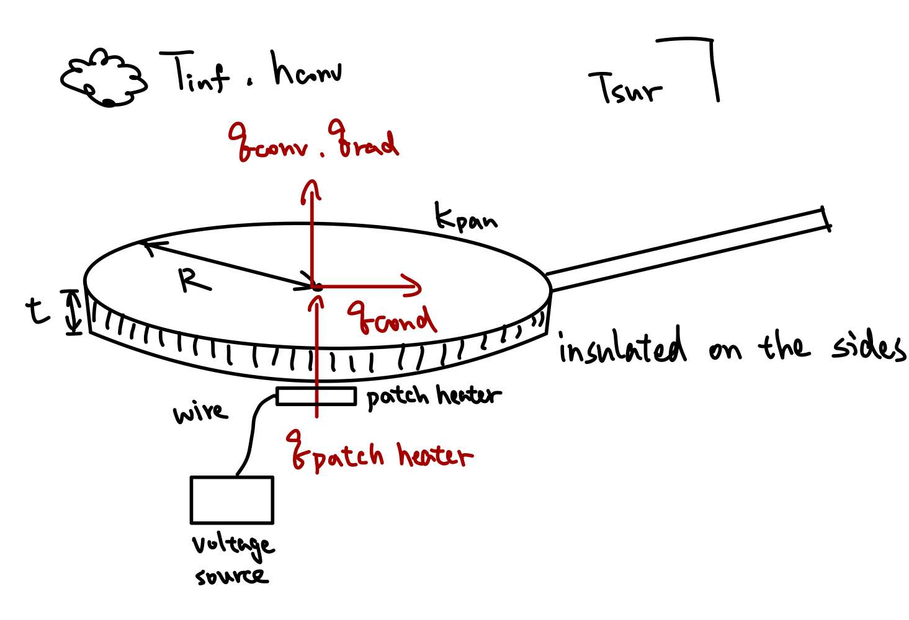
Methods and Experiments
Introduction:
This experiment compares the experimentally measured heat distribution across core and non core pans with a theoretically derived heat transfer model. The goal is to assess the cost-effectiveness of different pan compositions.
Equipment:
One pan made with stainless steel and the other made with stainless steel and copper core
Patch heater
IR camera
High-temperature black spray paint
Thermocouples and data logger
Styrofoam
Thermal paste
Variable Voltage Supply

Slide 4
Methods and Experiments
Procedure:
Experimental Setup: Spray black paint on each pan’s surface; assume it’s a black body with its emissivity equal to 1. Attach a patch heater to the center on the bottom of each pan, treating it as a uniform heat source. Embed a thermocouple with thermal paste at the center on the surface of each pan to monitor when the system reaches steady state. Insulate each pan on the sides using Styrofoam
Data Collection: The dimensions of the pan (radius and thickness) will be measured prior to heating.Once the pan reaches steady state, take a thermal image from the top of the pan using an IR camera. Temperatures are recorded along the radial direction, from the center to the edge of the pan, to create a heat distribution profile.
Analysis: Compare the temperature difference between the center and the edges of the pans. Evaluate the cost and the temperature difference to determine which material offers the best value in terms of heat distribution and cost efficiency.
Theoretical Comparison: The experimental temperature profiles are validated by comparing them with the theoretically derived temperature profile along the radial direction. This will be done by plotting both the experimental and analytical radial temperature profiles

Slide 5
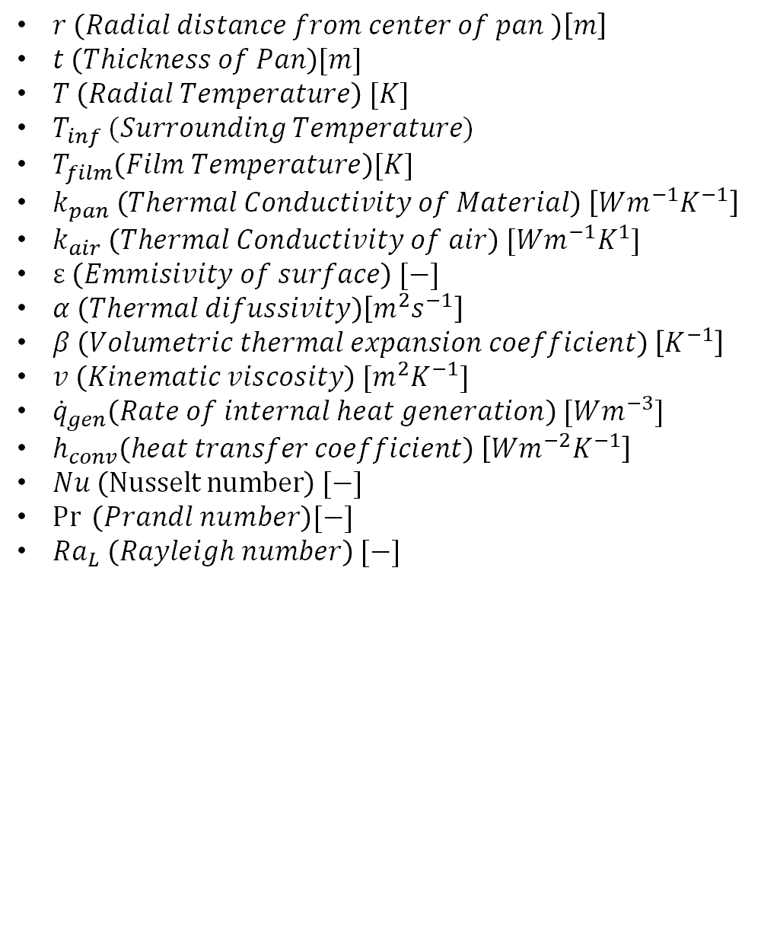
Analysis:
Variables:
Assumptions:
$r \left(Radial distance from center of pan \right)\left[m\right]$
$t \left(Thickness of Pan\right)[m]$
$T \left(Radial Temperature\right) [K]$
$T_{inf} (Surrounding Temperature)$
$T_{film}\left(Film Temperature\right)[K]$
$k_{pan} \left(Thermal Conductivity of Material\right) \left[Wm^{−1}K^{−1}\right]$
$k_{air} \left(Thermal Conductivity of air\right) [Wm^{−1}K^{1}]$
$ε \left(Emmisivity of surface\right) [−]$
$α \left(Thermal difussivity\right)\left[m^{2}s^{−1}\right]$
$β \left(Volumetric thermal expansion coefficient\right) \left[K^{−1}\right]$
$v \left(Kinematic viscosity\right) [m^{2}K^{−1}]$
${\dot{q}}_{gen}\left(Rate of internal heat generation\right) [Wm^{−3}]$
$h_{conv}\left(heat transfer coefficient\right) \left[Wm^{−2}K^{−1}\right]$
$Nu \left(Nusselt number\right) [−]$
$\operatorname{Pr}{ \left(Prandl number\right)[−]}$
$Ra_{L} \left(Rayleigh number\right) [−]$
1-D radial heat conduction
No convection heat loss from the sides of the pans (insulated sides)
Patch heater provides a uniform heat source
The emissivity of the pans is 1 after applying the black paint on the surface
Contact resistance between patch heater is negligible
Gray surface
Large surrounding
Constant air properties
Constant material properties (k)
The pan surface is dry
No mass transfer involved
Modeling convection and radiation as uniform negative heat generation

Slide 6

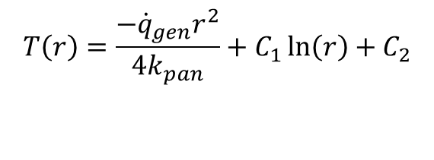


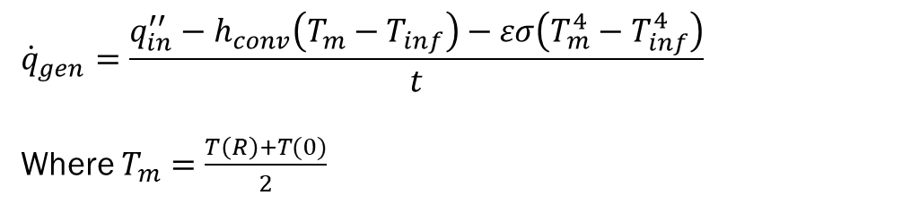
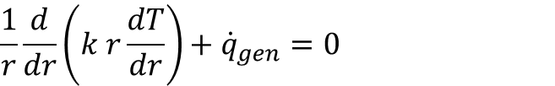
Analysis:
Governing Equation:
Free Convection Analysis (Flat Hot Plate):
$$\frac{1}{r}\frac{d}{dr}\left(k r\frac{dT}{dr}\right)+{\dot{q}}_{gen}=0$$
$$h=\frac{Nu ∗k_{air}}{L} [L=D=2r]$$
$$Ra_{L}=\frac{gβ\left(T_{m}−T_{inf}\right)D^{3}}{vα} ,β=\frac{1}{T_{film}}$$
$${If 10}^{4}≤Ra_{L}≤{10}^{7},\operatorname{Pr}{≥0.7}$$
$$Nu=0.54Ra_{L}^{\frac{1}{4}}$$
$${If 10}^{7}≤Ra_{L}≤{10}^{9},all Pr$$
$$Nu=0.15Ra_{L}^{\frac{1}{3}}$$
$$\left[Note :Air properties evaluated at T_{film}=\frac{T_{m}+T_{inf}}{2}\right]$$
$$T\left(r\right)=\frac{−{\dot{q}}_{gen}r^{2}}{4k_{pan}}+C_{1}\ln\left(r\right)+C_{2}$$
$${\dot{q}}_{gen}=\frac{{q_{in}^{′′}−h}_{conv}\left(T_{m}−T_{inf}\right)−εσ\left(T_{m}^{4}−T_{inf}^{4}\right)}{t}$$
Where $T_{m}=\frac{T\left(R\right)+T(0)}{2}$
Boundary Conditions:
$$T\left(r\right){\left.​\right|}_{r=0}=T_{center,IR}$$
$$T\left(r\right){\left.​\right|}_{r=R}=T_{edge,IR}$$

Slide 7
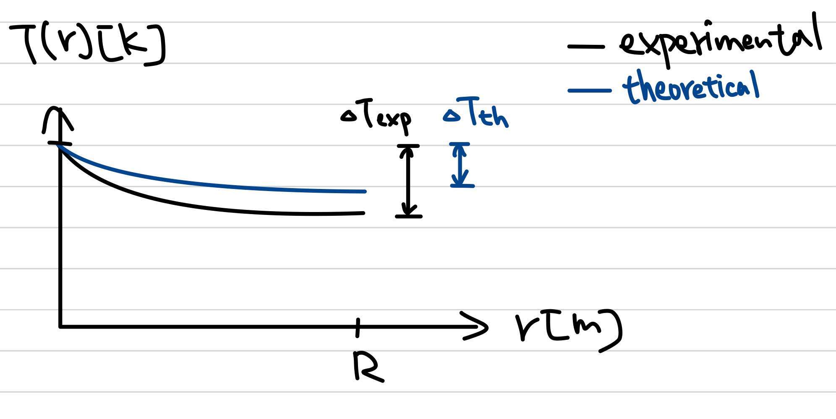
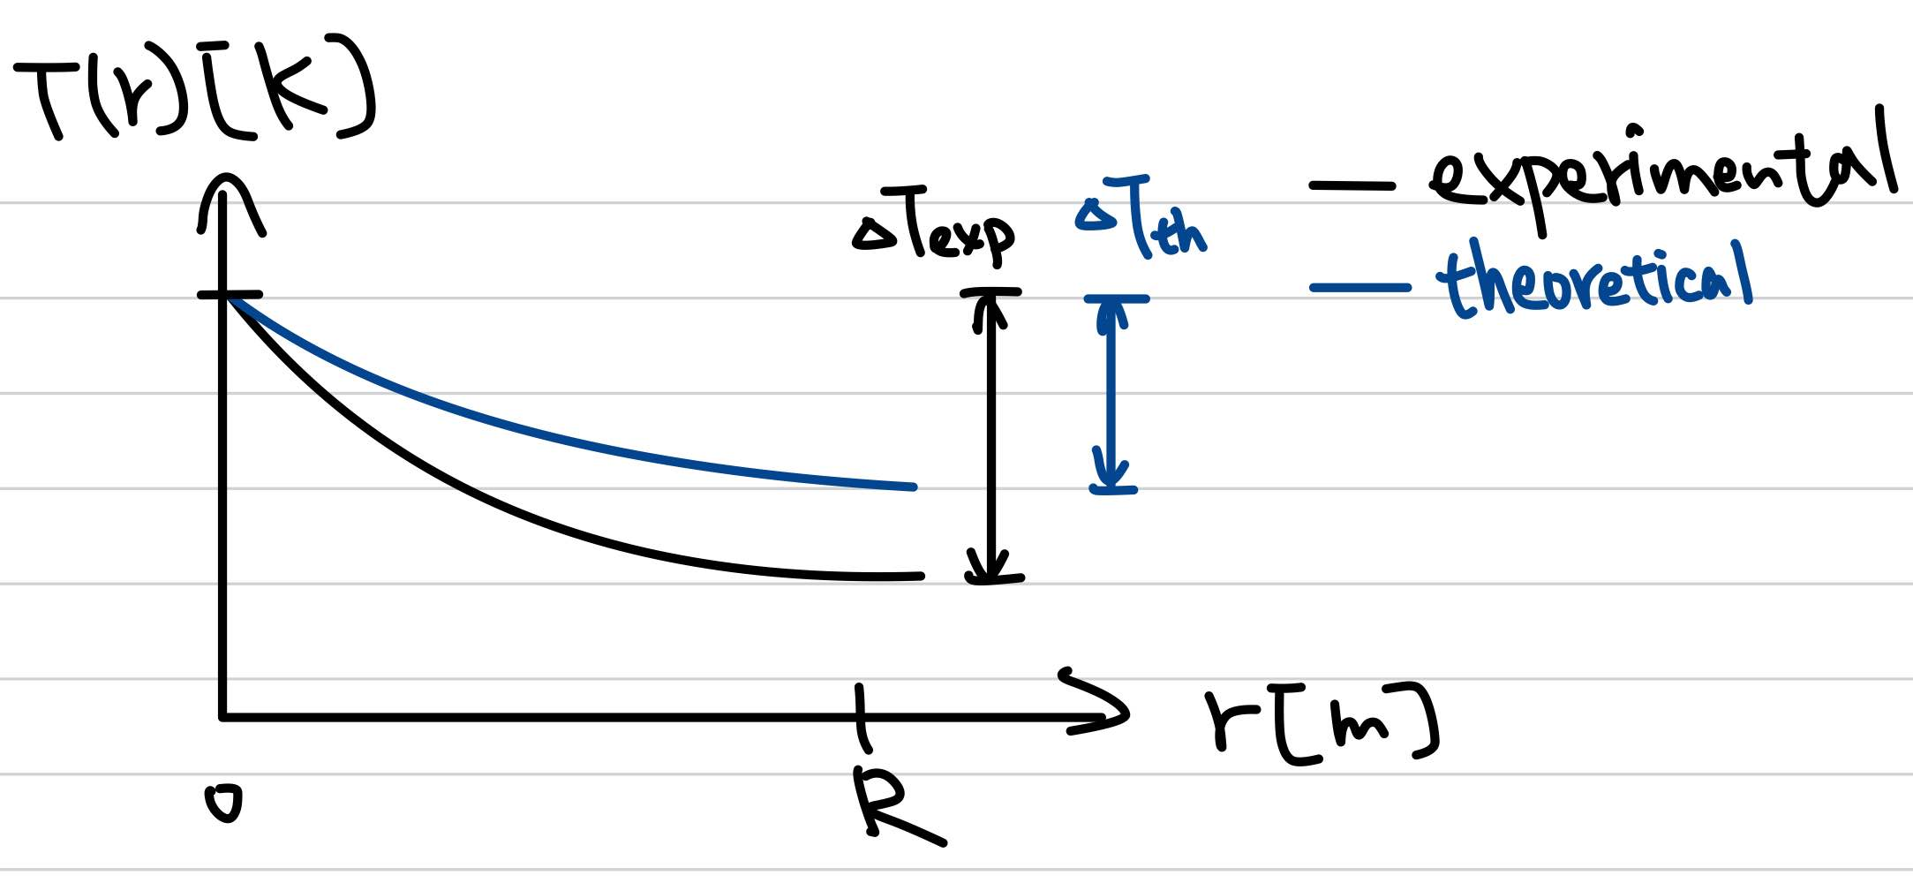
Expected Results
With Core Results
Without Core Results

Slide 8
Thank You

