Slide 1
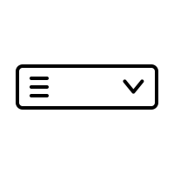






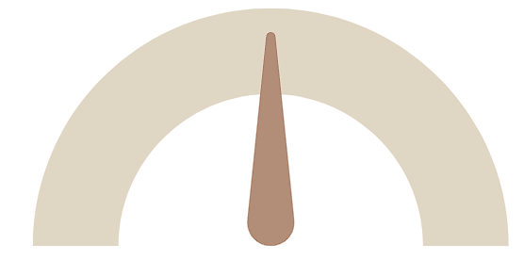
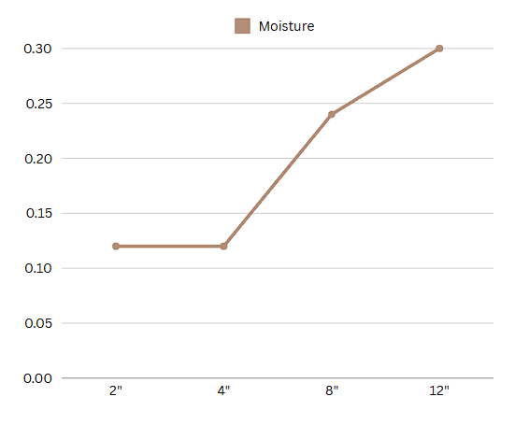
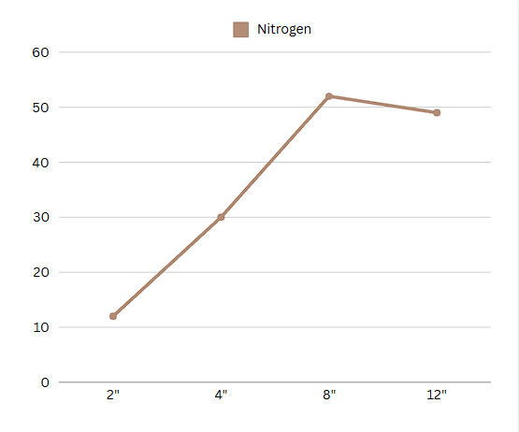
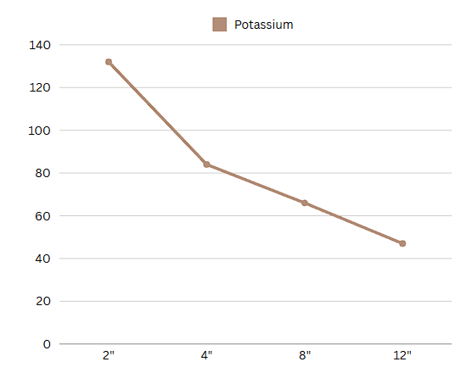
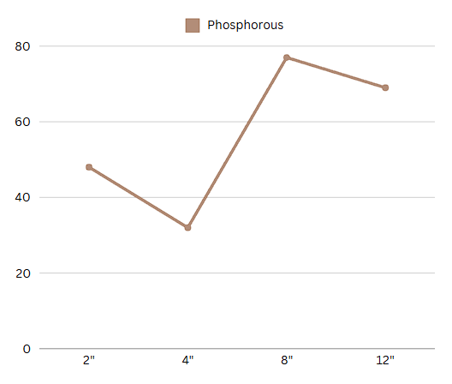
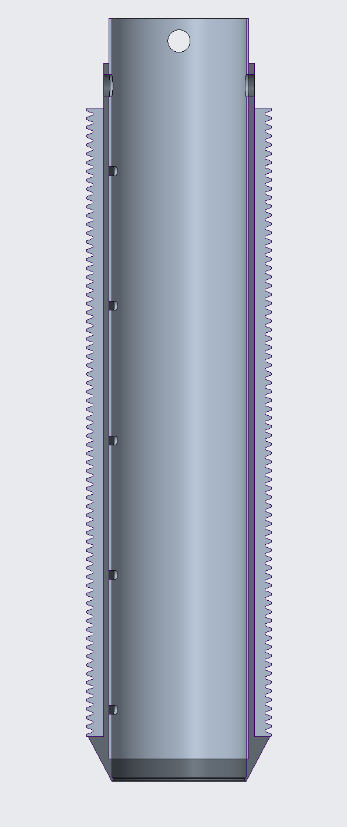


A Down2Earth (D2E)
Company
Read & Update Data
Clear Data
Select Depth Measurements
2”
Soil Depth Properties at Depth of 2 inches
Soil-IQ Analytics Platform
0.2
50
mg/kg
115
mg/kg
123
mg/kg
Moisture
Nitrogen
Potassium
Phosphorous
Select Depths to Extract
2”
4”
Data-Driven Insights
📈 Dual-Line Chart: Overlay moisture percentage and nitrogen concentration over time to show if excess water is leading to nutrient depletion (Potential Leaching Risk)
🗺️ Heatmap or Contour Map: To Show different NPK and moisture levels across the field. 🎯 Zone-Based Fertilization: Highlight areas needing extra nutrients and overlay recommended fertilizer application rates.
📊 Predictive Yield Graph: Show expected yield under current soil conditions vs. an optimized scenario with recommended nutrient adjustments.
8”
12”

