Slide 1
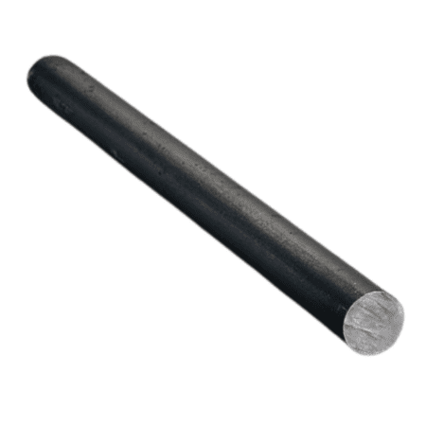






y
$$R_{y}$$
x
$$W_{t}$$
z
$$B_{y}$$
$$R_{z}$$
x = 0.375”
$$W_{tz}$$
$$B_{z}$$
x = 2.75”
3”

