Slide 1

AI-DRIVEN DRONE DETECTION AND TRACKING
BY,
Ismail Suleiman
Koushik G
Lokesh V
Phaneendra Chandu
Rajeev M
Venkatesh N P S

Slide 2
PROBLEM STATEMENT
The rise of low-cost drones used by enemy forces presents a significant challenge to military operations.
These drones are increasingly deployed for surveillance, delivering explosives, and disrupting communications, posing a serious threat to both personnel and critical infrastructure.
However, traditional countermeasures, such as using expensive missiles, are not practical or sustainable when dealing with these low-cost threats. This leads to a situation where it becomes too costly to defend against these threats effectively.

Slide 3
Define Success
What else are you working toward?
In addition to tracking enemy drones in real-time, consider working on making the system adaptable for different environments (urban vs. rural) or scalable for multiple drone detection simultaneously.
You could also explore integrating the system with existing defense mechanisms or communication systems.
What will make this work successful?
Success will be determined by how efficiently the system can detect, track, and provide actionable data on enemy drones in real-time. Consider aspects like the accuracy of detection, response time, and system reliability under different conditions.

Slide 4
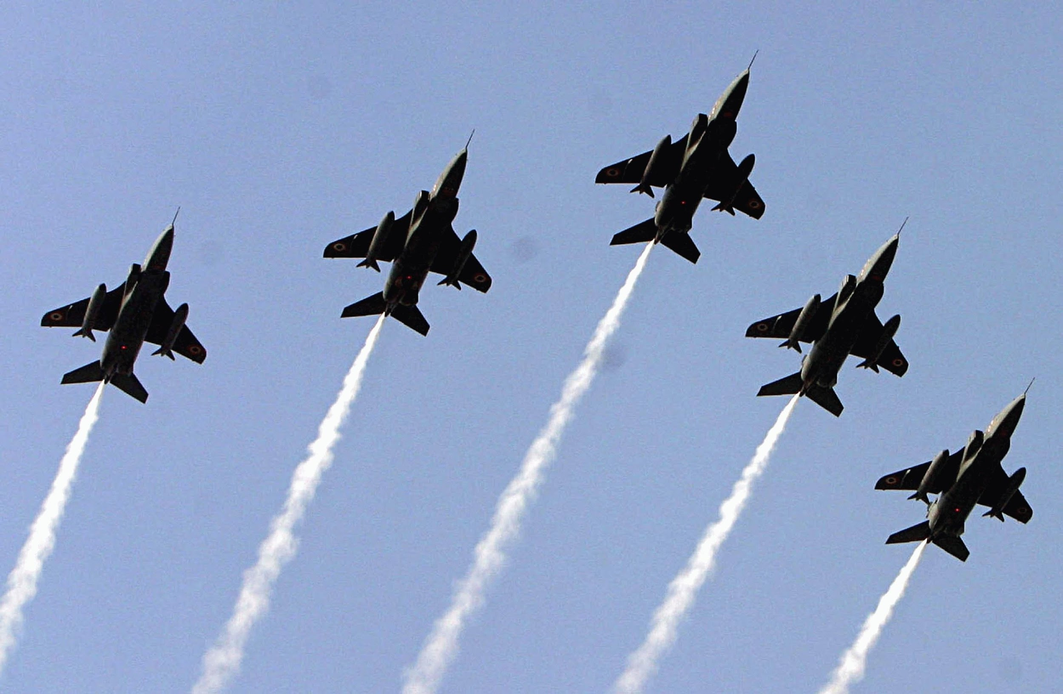
3. What are the measures of success?
Accuracy Rate: Percentage of drones correctly identified as threats.
Latency: Time taken between drone detection and alerting the defense system.
User Adoption: Number of defense personnel or organizations that utilize the system, or the number of times the system is deployed successfully in real-world scenarios.

Slide 5


How Might We (HMW) Questions:
HMW questions can drive focused ideation and help uncover creative solutions for detecting and tracking drones. Here are a couple of relevant HMW questions for your project:
HMW reduce the cost of drone detection and tracking to make it more scalable for defense systems?
HMW integrate AI technologies to ensure real-time, accurate tracking of enemy drones in various terrains and weather conditions?
These questions break down the challenges and open avenues for brainstorming possible solutions that are both innovative and feasible.

Slide 6
VISION CONE
AI-Driven Drone Detection and Tracking for Defense Systems
Perspectives
Multi-sensor data
Edge computing
AI model improvements
Real-time response
Swarm AI
Object tracking
CNN
Past
Now
AI-based detection
Future
Radar and infrared
Cost limitation
Autonomous
Vision
Future systems could detect and neutralize enemy drones quickly and cost-effectively, using AI for movement prediction.
Retropolation

Slide 7
The Present (Now)
AI is used for drone detection, but current systems face high costs and struggle with smaller drones.
Existing technologies like radar, thermal cameras, and AI-based models (YOLO, Faster R-CNN) are expensive or not optimized for military defense.
The Past
Drones were originally developed for surveillance; past detection systems used radar and infrared, but struggled with smaller drones.
Deep learning models like CNNs, YOLO, and MobileNet revolutionized real-time drone tracking.

Slide 8
The Future (Vision for 5-10 Years)
AI will improve to detect drones with more accuracy, speed, and real-time neutralization of threats.
Advanced sensors (LiDAR, thermal cameras) combined with AI will enhance precision and range in detection.
Retropolation and Perspectives
Future systems could detect and neutralize enemy drones quickly and cost-effectively, using AI for movement prediction.
Technological needs include advancements in edge computing, improved AI models, and integration with military hardware.

