Slide 1
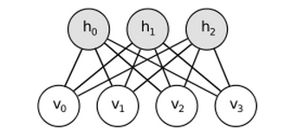
Introduction to RBM
陈杰
20130322

Slide 2


EBM（Energy Based Model)
Energy-based models associate a scalar energy to each configuration of the variables of interest.
Energy-based probabilistic models define a probability distribution through an energy function, as follows

Slide 3



EBMs with hidden units
增加隐含单元h之后的概率分布
定义free energy函数
改写原分布

Slide 4
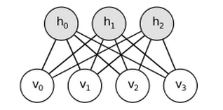


RBM（Restricted Boltzmann Machines）
能量函数：
Free energy：

Slide 5

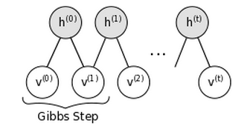
Sampling in an RBM
类似MCMC的过程
第i个随机变量只与它前面的那个随机变量有关。

