Slide 1

IOT BASED SMART ENERGY MONITORING SYSTEM
PROJECT TEAM : PROJECT GUIDE :
1.P. LOKESH - 20BQ1A04C9 MR. M. SRINIVASA RAO
2.S.BALAJI - 21BQ5A0419 Assistant Professor
3.T.SUJITH - 20BQ1A04H2 M.TECH
4.U.MARIYA BABU - 20BQ1A04H5

Slide 2
CONTENTS
INTRODUCTION
BLOCK DIAGRAM
FLOW CHART
COMPONENTS
CIRCUIT DIAGRAM
CLOUD INTEGRATION
ADVANTAGES
CONCLUSION

Slide 3
INTRODUCTION
The objective is to create a system that can monitor and analyze energy consumption in real-time, providing users with valuable insights into their energy usage patterns.
The energy monitor collects data from various sources, such as electricity meters and smart plugs.

Slide 4
ABSTRACT
This project focuses on the development of an IOT-based smart energy monitor using a Raspberry Pi. The objective is to create a system that can monitor and analyze energy consumption in real-time, providing users with valuable insights into their energy usage patterns. By leveraging the capabilities of the Raspberry Pi, along with additional sensors and communication modules, the energy monitor collects data from various sources, such as electricity meters and smart plugs. The collected data is then processed and visualized using a web-based interface, allowing users to track their energy consumption, set energy-saving goals, and receive notifications or alerts for abnormal usage. The IOT aspect enables remote monitoring and control, enabling users to access and manage the system from anywhere using their smart phones or other devices. This project showcases the potential of Raspberry Pi and IOT technologies in creating energy-efficient solutions and promoting sustainable practices.

Slide 5
Current Sensor
Arduino Uno
Raspberry-pi 3B+
ThingSpeak
Voltage
Output Power Display

Slide 6
FLOW CHART:
Energy from single Appliance or Overall building
Inputs from smart plugs or energy meters
Current Sensor
Voltage
Arduino Uno
Raspberry-pi 3 B+
ThingSpeak
Output Power
Display

Slide 7
COMPONENTS
Raspberry Pi 3 b+
Arduino Uno
YHDC SCT-013-000
2.5 A 5 V MicroUSB Power Adapter
2 W 10 K Resistor (1)
2 W 3.3 K Resistor (1)
50 V 10uf Capacitor
Bread Board
Jumper Wire

Slide 8
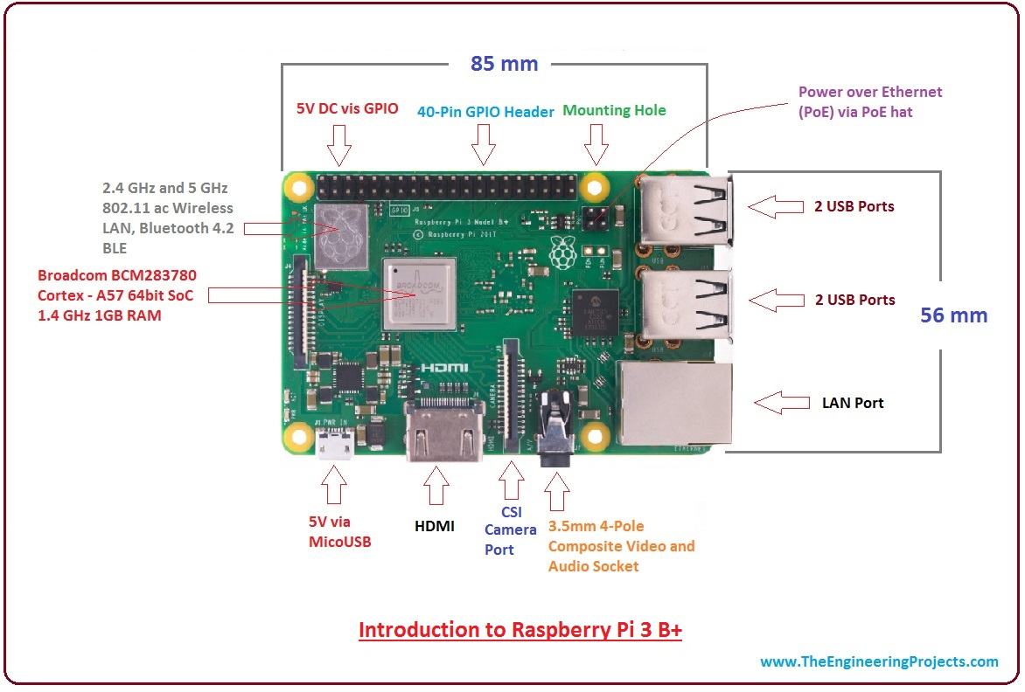
Raspberry Pi 3 B+ Model

Slide 9
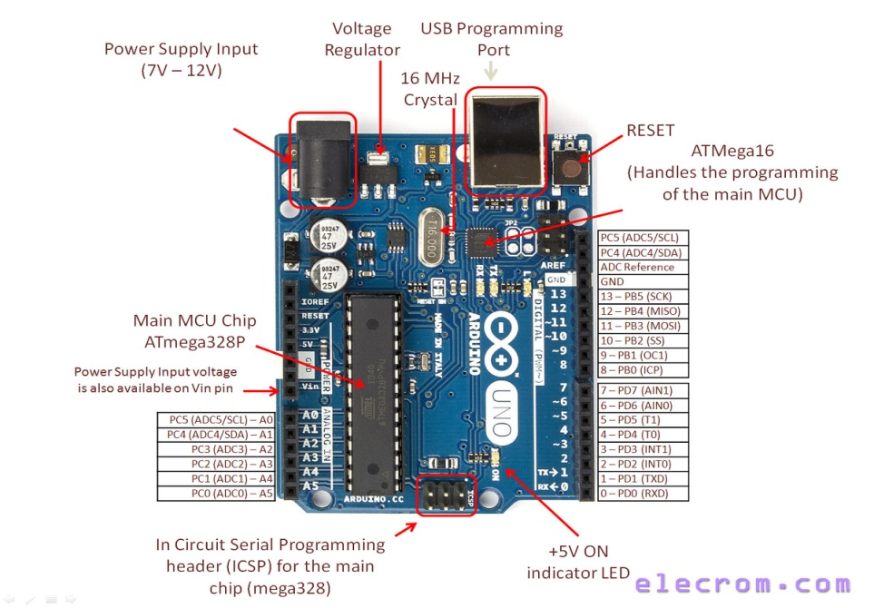
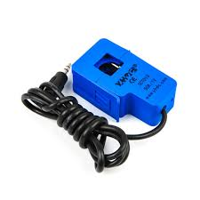
Arduino Uno:
The Arduino Uno is a popular microcontroller board designed for prototyping and educational purposes. It is based on the Atmega328P microcontroller and is part of the Arduino platform, known for its simplicity and ease of use. Arduino Uno is commonly used in projects involving robotics, home automation, data logging, sensor interfacing, and more.
YHDCSCT-013-000:
Current Sensor that can measure up to 100A, depending on the version you buy. The sensor transforms the current passing through the wire on which it is clamped into a small current which is then fed into the ADC via a network of voltage dividers.

Slide 10
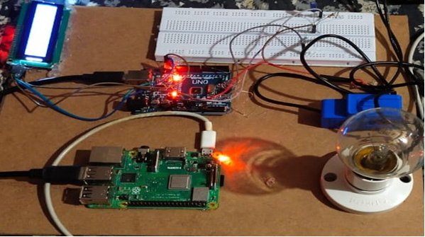
CIRCUIT DIAGRAM

Slide 11
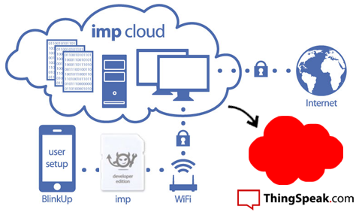
CLOUD INTEGRATION :
As data is acquired from the sensors, it is seamlessly transmitted to a cloud platform for storage and visualization.
Cloud platforms play a vital role in managing and making data accessible from virtually anywhere.
ThingSpeak allows you to aggregate, visualize and analyze live data streams in the cloud.
Visualize your sensor data in real-time.
Run your IoT analytics automatically based on schedules or events.
It provides a user-friendly interface for data visualization and management.
Data can be organized into feeds, making it easy to track different energy parameters over time.

Slide 12
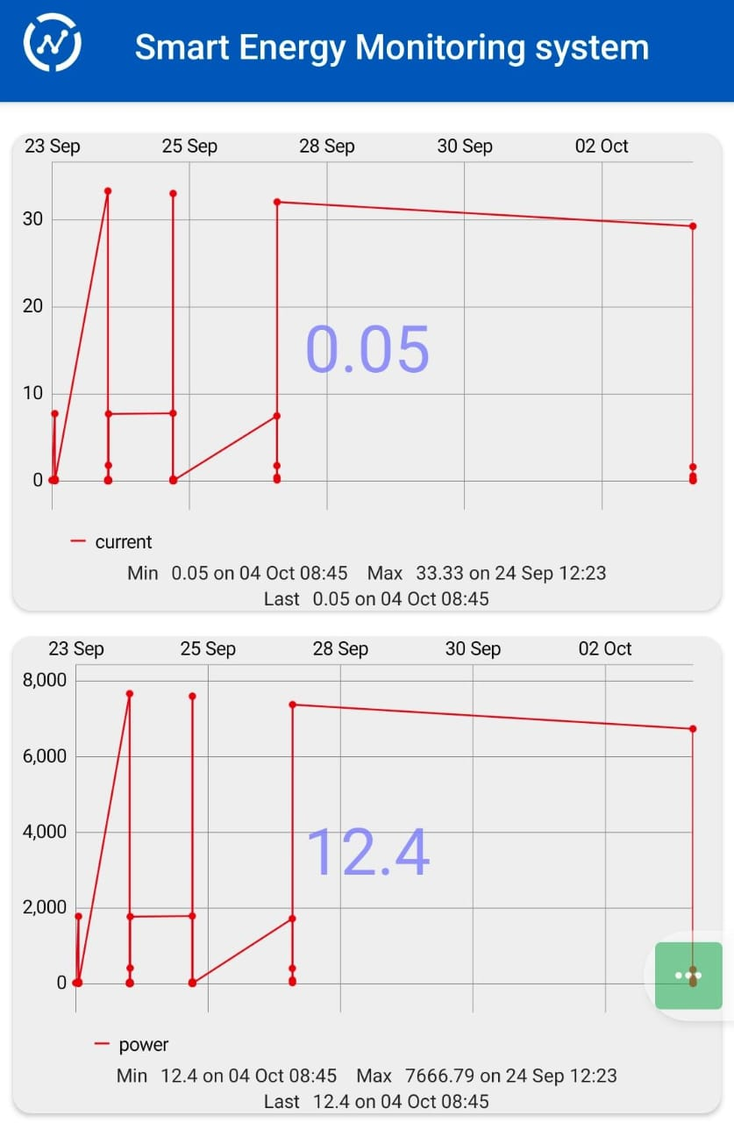
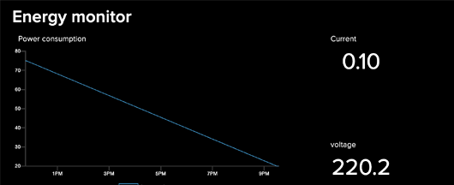
The collected data is then processed and visualized using a web-based interface, allowing users to track their energy consumption, set energy-saving goals, and receive notifications or alerts for abnormal usage.

Slide 13
ADVANTAGES :
1.Energy Efficiency
Cost Savings
Remote Monitoring
Demand Response
Predictive Maintenance
Data-Driven Decisions

Slide 14
CONCLUSION
By identifying energy wastage and encouraging responsible energy usage, they contribute to both environmental sustainability and financial savings. As technology continues to evolve, addressing these challenges and maximizing the advantages of smart energy monitoring systems will be essential in realizing their full potential and creating a more energy-conscious and sustainable future.

Slide 15


