Slide 1
IBM University Engagement Project Submission
“Exploring the Power of Agentic AI with IBM Granite and LangFlow”

Slide 2

Project Tile – AI-Powered Travel Planner Agent using IBM Granite
Domain of Project – Artificial Intelligence (AI) & Travel Technology
Student Name | Recent Passport Photo | Email ID | Mobile number [WhatsApp]
LOKIN V |  | VELLOKIN2004@GMAIL.COM | 8883734263

Slide 3
Problem Statement -
Problem Statement: Travel Planner Agent
The Challenge
Planning a trip involves multiple decisions such as choosing destinations, managing budgets, selecting accommodations, arranging transportation, and creating itineraries. Travelers often spend significant time searching across different platforms for reliable information. This process can be overwhelming, especially when trying to balance preferences, costs, and time constraints.
The Objective
Develop an AI-powered Travel Planner Agent that helps users plan trips efficiently and intelligently. The solution should:
• Generate personalized travel itineraries based on user preferences, budget, duration, and interests.
• Recommend suitable destinations, hotels, and transportation options.
• Provide budget-friendly travel suggestions and cost optimization.
• Create day-wise travel schedules for a smooth travel experience.
• Offer local attraction and food recommendations.
• Suggest transportation methods such as flights, trains, buses, and local travel options.
• Deliver travel tips and guidance to enhance the overall travel experience.
The system should leverage IBM Granite Models and LangFlow to provide intelligent, personalized, and user-friendly travel planning assistance.

Slide 4
Technology Used
Technology Used
• LangFlow – Used to design and manage the AI workflow.
• IBM watsonx.ai – Used to access and deploy IBM Granite models.
• IBM Granite Foundation Model – Used to generate personalized travel plans and recommendations.
• IBM Cloud Lite – Provides the cloud platform for running the solution.
• Prompt Engineering – Used to structure user queries and generate accurate travel itineraries.
• Generative AI – Used for itinerary creation, hotel recommendations, transportation suggestions, and travel guidance.
I used LangFlow + IBM watsonx.ai + Granite Models

Slide 5
Proposed Solution -
Proposed Solution – AI-Powered Travel Planner Agent
The proposed solution is an AI-powered Travel Planner Agent built using LangFlow, IBM watsonx.ai, and IBM Granite Models. The system helps users plan trips efficiently by generating personalized travel itineraries based on destination, budget, trip duration, number of travelers, and interests.
The Travel Planner Agent analyzes user preferences and provides day-wise travel schedules, hotel recommendations, transportation suggestions, budget optimization, and travel tips. The solution uses IBM Granite models to understand user requirements and generate intelligent, customized travel plans in real time.
LangFlow is used to design and manage the workflow, while IBM watsonx.ai provides access to Granite foundation models for reasoning and content generation. The system simplifies travel planning by offering a single platform for itinerary creation and travel guidance.
Overall, the solution acts as a smart virtual travel assistant that saves time, improves decision-making, and enhances the travel experience through personalized recommendations.

Slide 6
Langflow component Used -
LangFlow Components Used
1. Chat Input
- Accepts user travel details such as source, destination, budget, duration, travelers, and interests.
2. Prompt Template
- Structures user input into a format that IBM Granite can understand and process effectively.
3. IBM watsonx.ai
- Connects to the IBM Granite foundation model and generates intelligent travel plans.
4. IBM Granite Model
- Analyzes user preferences and creates personalized itineraries, hotel recommendations, and travel suggestions.
5. Chat Output
- Displays the generated travel plan and recommendations to the user.
6. API Request (Optional)
- Can be used for future integration of weather, maps, hotel, or travel information services

Slide 7
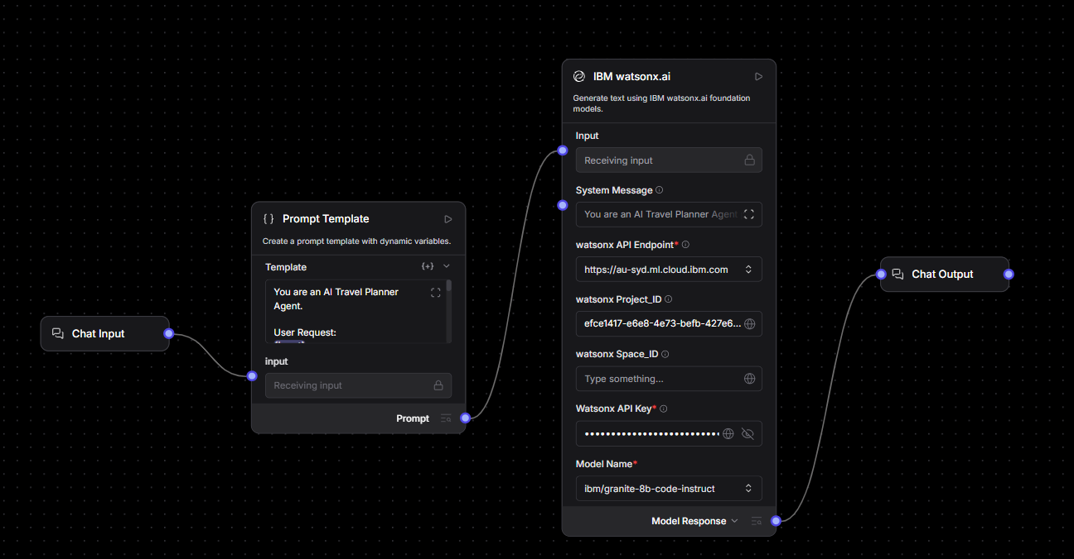
Langflow workflow -

Slide 8
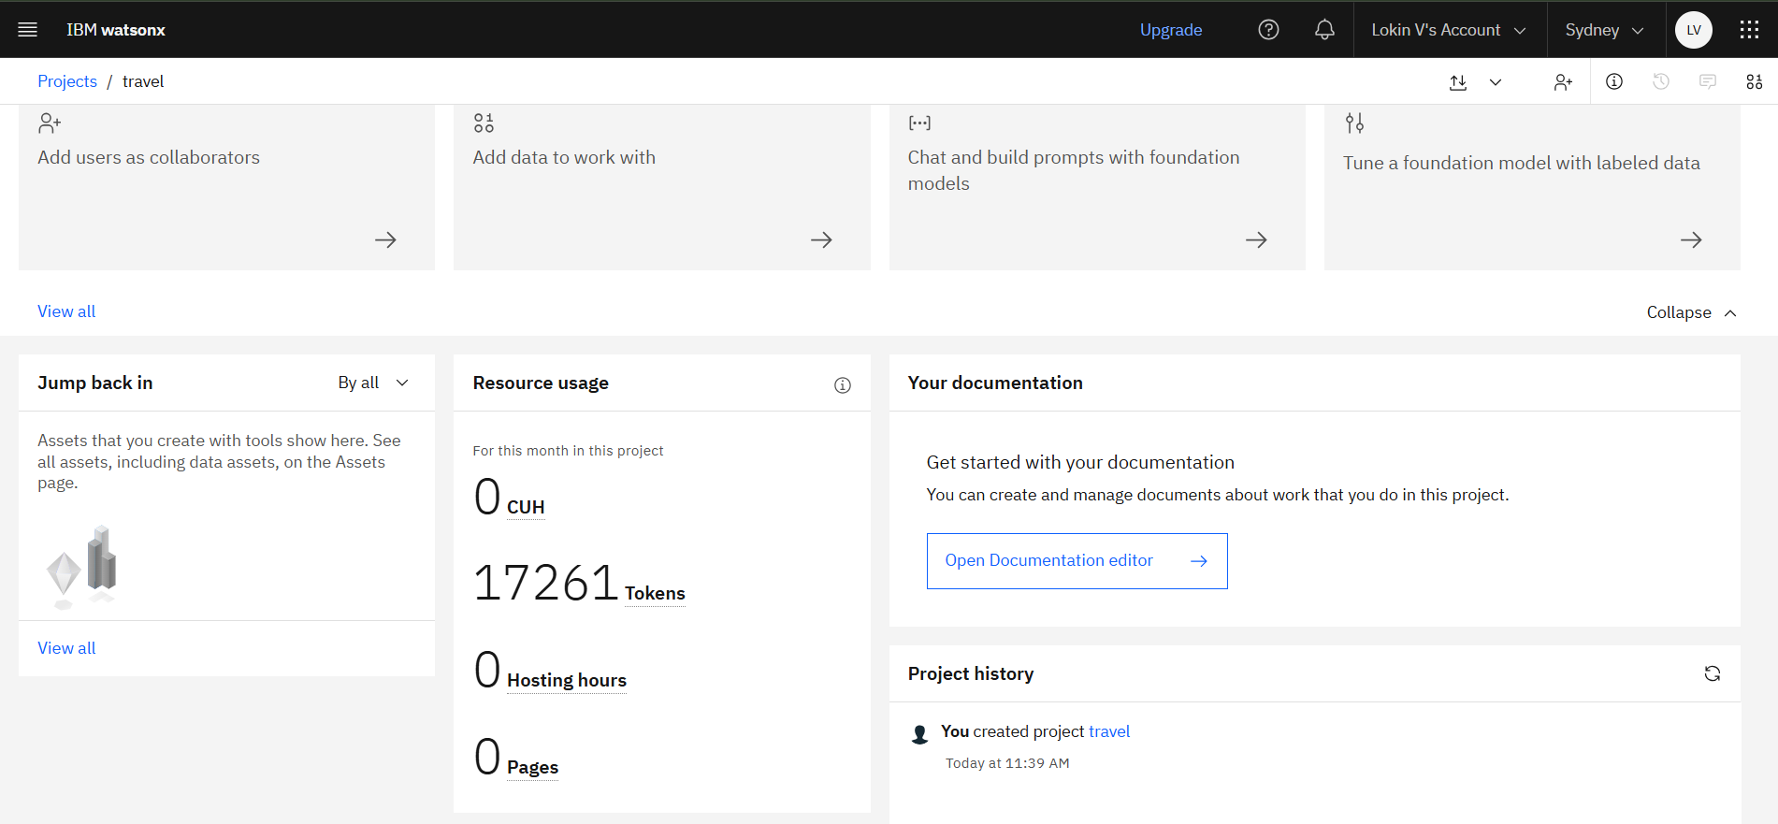

Slide 9
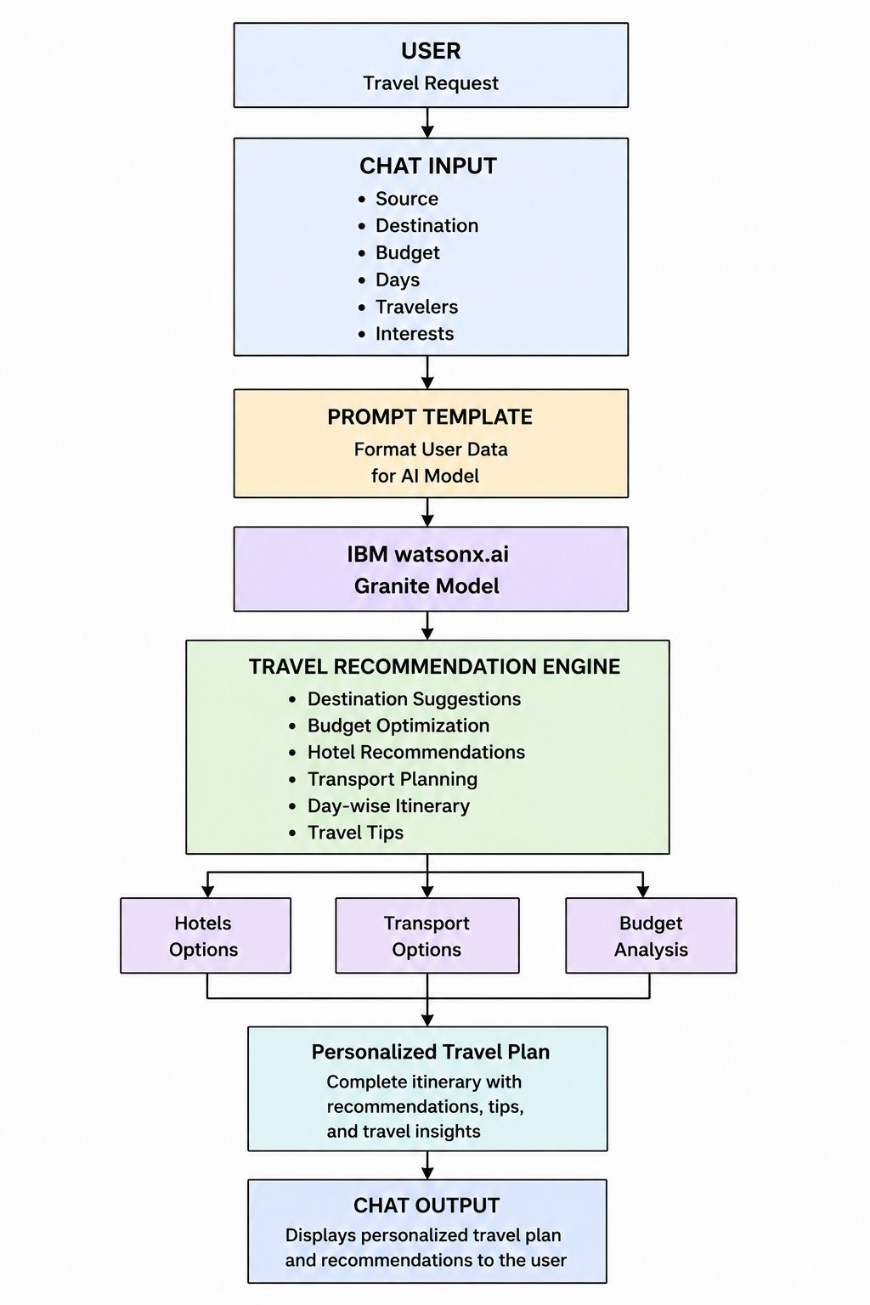
Architecture blueprint

Slide 10

Role of Agentic AI in the solution
Role of Generative AI in the Solution
Generative AI plays a central role in the AI Travel Planner Agent by enabling intelligent and personalized travel recommendations. The system uses IBM watsonx.ai and Granite Foundation Models to analyze user inputs such as source location, destination, budget, number of travelers, travel duration, and interests.
Based on these inputs, the Generative AI model generates a customized travel itinerary that includes destination recommendations, hotel suggestions, transportation options, estimated expenses, and travel tips. The model understands natural language queries and produces human-like responses, making the travel planning process simple and interactive.
Generative AI also helps optimize travel plans according to user constraints, ensuring that recommendations remain relevant, budget-friendly, and personalized. By automating itinerary creation and travel decision-making, the solution reduces manual effort and enhances the overall user experience.
Thus, Generative AI serves as the core intelligence layer of the system, transforming user requirements into a complete and actionable travel plan.

Slide 11
Technology Used
Langflow platform -For designing and orchestrating multi-agent workflows visually
IBM Grainte model - for eg – ibm-granite-3-2-8b – For natural language understanding, reasoning, and personalization
IBM Cloud – It provides the infrastructure to build, deploy, and scale the Nutrition Agent efficiently. IBM Cloud enables a reliable, secure, and scalable environment for deploying the Nutrition Agent.
RAG– RAG to fetch real data first, then generate intelligent answers, making the Nutrition Agent more trustworthy and effective.
IBM Watsonx.ai - For model deployment, embeddings, and AI governance
Vector Database (FAISS/Chroma) – For RAG-based nutritional data retrieval

Slide 12
Novelty and Uniqueness
The proposed Nutrition Agent stands out by combining Agentic AI, RAG, and personalization into a single intelligent system.
Multi-Agent Intelligence – Instead of a single chatbot, multiple specialized agents collaborate to deliver accurate and context-aware nutrition guidance.
RAG-Based Accuracy – Integrates real-time data retrieval with AI generation, reducing misinformation and ensuring trustworthy recommendations.
Hyper-Personalization – Tailors diet plans based on health conditions, cultural preferences, and fitness goals.
Real-Time Feedback Loop – Continuously adapts recommendations based on daily food logs and user behavior.
Multi-Modal Input – Supports text, voice, and image-based meal tracking for better usability.
Preventive Healthcare Focus – Goes beyond diet planning to provide disease-specific nutrition advice.
Scalable & Enterprise-Ready – Built on IBM watsonx.ai with IBM Granite models, ensuring reliability and governance.
This makes the solution a smart, adaptive, and proactive digital nutritionist, not just a static diet recommendation tool.

Slide 13
Git Hub Link
· Please create public github repository (Enable Add README button while creating repository) with format –
Please test and Paste the working Github URL –
Make sure you have Uploaded following three files into your github repository 1) app.json file , 2) yourproblemstatement.pdf file 3) your projectpresntation.pptx file 4)any other files
·
·
·

Slide 14
Future Scope
1.Integration with Wearables & Health Devices –
The system can be integrated with smartwatches and fitness trackers to collect real-time data such as steps, calories burned, heart rate, and sleep patterns. This will enable the Nutrition Agent to provide more accurate and dynamic diet recommendations based on actual user activity and health metrics.
2.AI-Powered Voice Assistant & Multilingual Support –
Enhancing the system with a voice-enabled assistant and support for multiple languages will improve accessibility. Users can interact naturally in their preferred language, making the solution more inclusive and suitable for diverse populations, especially in regions with varied linguistic backgrounds.
·
·
·

Slide 15


