Slide 1
IBM University Engagement Project Submission
“Exploring the Power of Agentic AI with IBM Granite and LangFlow”

Slide 2

Project Tile – AI-Powered Travel Planner Agent using IBM Granite
Domain of Project – Artificial Intelligence (AI) & Travel Technology
Student Name | Recent Passport Photo | Email ID | Mobile number [WhatsApp]
LOKIN V |  | VELLOKIN2004@GMAIL.COM | 8883734263

Slide 3
Problem Statement -
Problem Statement: Travel Planner Agent
The Challenge
Planning a trip involves multiple decisions such as choosing destinations, managing budgets, selecting accommodations, arranging transportation, and creating itineraries. Travelers often spend significant time searching across different platforms for reliable information. This process can be overwhelming, especially when trying to balance preferences, costs, and time constraints.
The Objective
Develop an AI-powered Travel Planner Agent that helps users plan trips efficiently and intelligently. The solution should:
• Generate personalized travel itineraries based on user preferences, budget, duration, and interests.
• Recommend suitable destinations, hotels, and transportation options.
• Provide budget-friendly travel suggestions and cost optimization.
• Create day-wise travel schedules for a smooth travel experience.
• Offer local attraction and food recommendations.
• Suggest transportation methods such as flights, trains, buses, and local travel options.
• Deliver travel tips and guidance to enhance the overall travel experience.
The system should leverage IBM Granite Models and LangFlow to provide intelligent, personalized, and user-friendly travel planning assistance.

Slide 4
Technology Used
Technology Used
• LangFlow – Used to design and manage the AI workflow.
• IBM watsonx.ai – Used to access and deploy IBM Granite models.
• IBM Granite Foundation Model – Used to generate personalized travel plans and recommendations.
• IBM Cloud Lite – Provides the cloud platform for running the solution.
• Prompt Engineering – Used to structure user queries and generate accurate travel itineraries.
• Generative AI – Used for itinerary creation, hotel recommendations, transportation suggestions, and travel guidance.
I used LangFlow + IBM watsonx.ai + Granite Models

Slide 5
Proposed Solution -
Proposed Solution – AI-Powered Travel Planner Agent
The proposed solution is an AI-powered Travel Planner Agent built using LangFlow, IBM watsonx.ai, and IBM Granite Models. The system helps users plan trips efficiently by generating personalized travel itineraries based on destination, budget, trip duration, number of travelers, and interests.
The Travel Planner Agent analyzes user preferences and provides day-wise travel schedules, hotel recommendations, transportation suggestions, budget optimization, and travel tips. The solution uses IBM Granite models to understand user requirements and generate intelligent, customized travel plans in real time.
LangFlow is used to design and manage the workflow, while IBM watsonx.ai provides access to Granite foundation models for reasoning and content generation. The system simplifies travel planning by offering a single platform for itinerary creation and travel guidance.
Overall, the solution acts as a smart virtual travel assistant that saves time, improves decision-making, and enhances the travel experience through personalized recommendations.

Slide 6
Langflow component Used -
LangFlow Components Used
1. Chat Input
- Accepts user travel details such as source, destination, budget, duration, travelers, and interests.
2. Prompt Template
- Structures user input into a format that IBM Granite can understand and process effectively.
3. IBM watsonx.ai
- Connects to the IBM Granite foundation model and generates intelligent travel plans.
4. IBM Granite Model
- Analyzes user preferences and creates personalized itineraries, hotel recommendations, and travel suggestions.
5. Chat Output
- Displays the generated travel plan and recommendations to the user.
6. API Request (Optional)
- Can be used for future integration of weather, maps, hotel, or travel information services

Slide 7
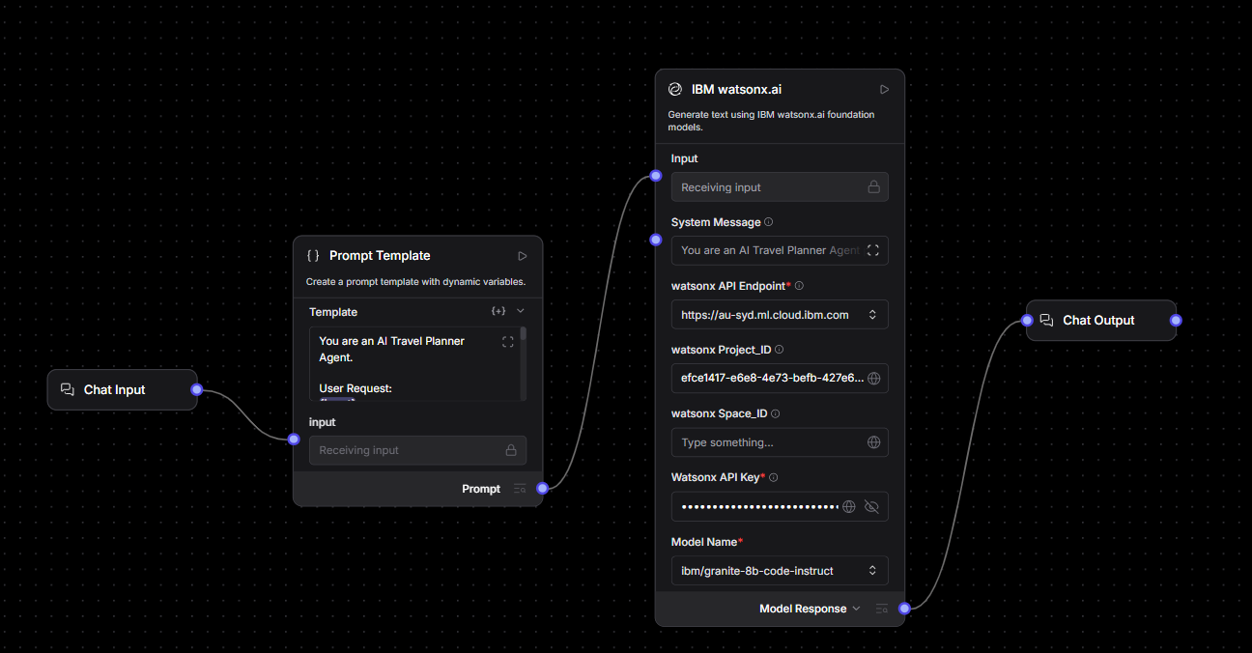
Langflow workflow -

Slide 8
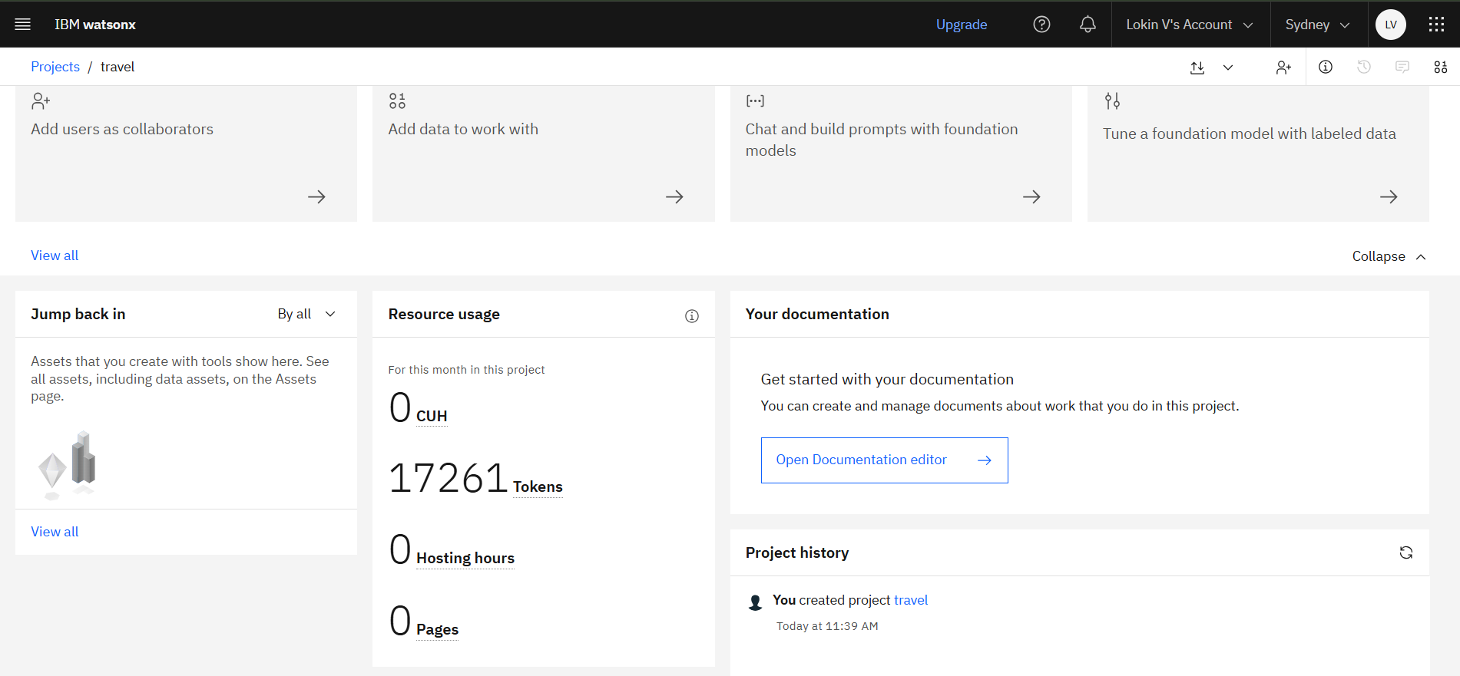

Slide 9
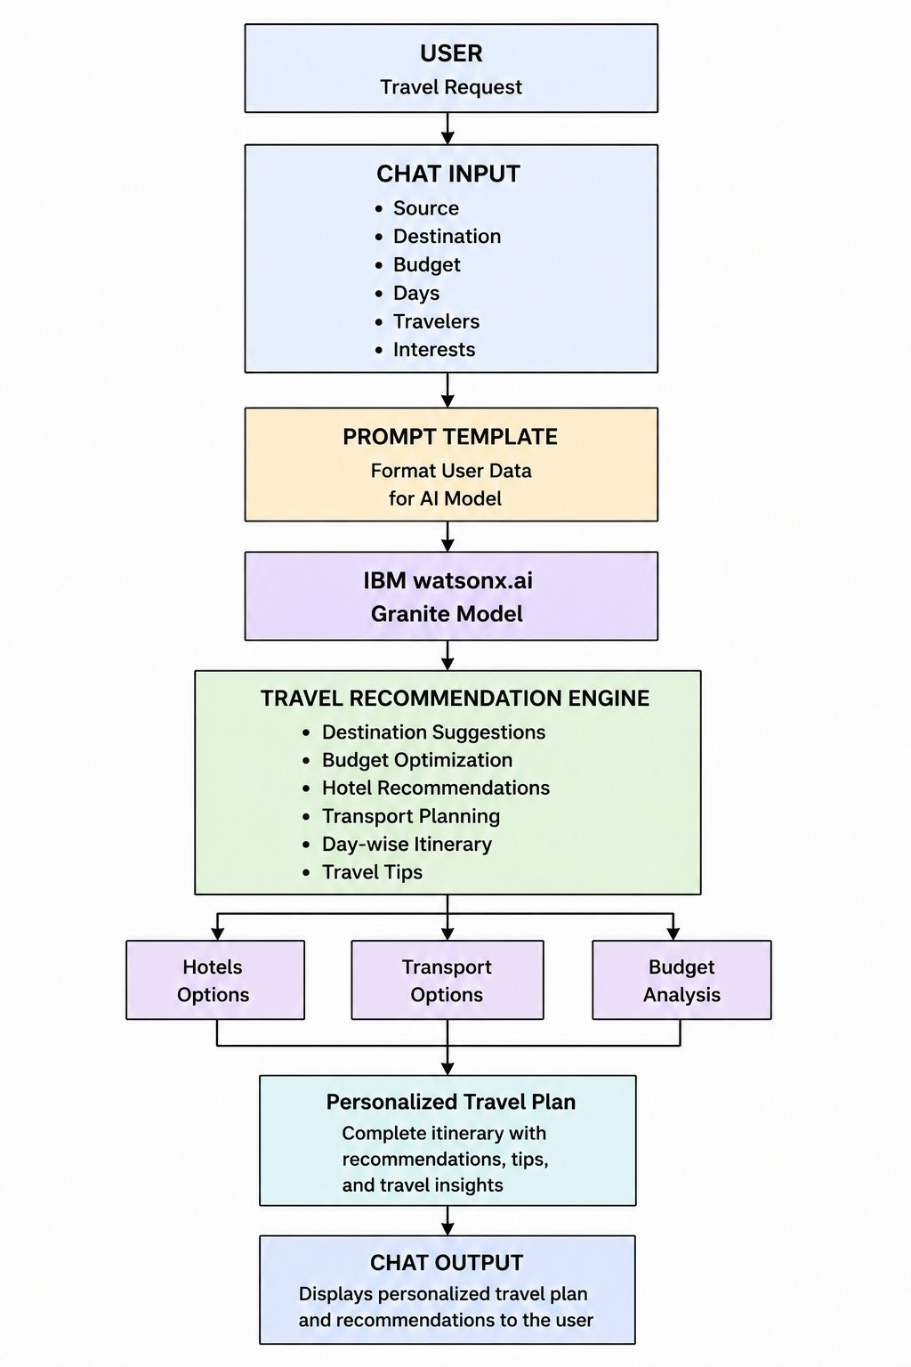
Architecture blueprint

Slide 10

Role of Agentic AI in the solution
Generative AI plays a central role in the AI Travel Planner Agent by enabling intelligent and personalized travel recommendations. The system uses IBM watsonx.ai and Granite Foundation Models to analyze user inputs such as source location, destination, budget, number of travelers, travel duration, and interests.
Based on these inputs, the Generative AI model generates a customized travel itinerary that includes destination recommendations, hotel suggestions, transportation options, estimated expenses, and travel tips. The model understands natural language queries and produces human-like responses, making the travel planning process simple and interactive.
Generative AI also helps optimize travel plans according to user constraints, ensuring that recommendations remain relevant, budget-friendly, and personalized. By automating itinerary creation and travel decision-making, the solution reduces manual effort and enhances the overall user experience.
Thus, Generative AI serves as the core intelligence layer of the system, transforming user requirements into a complete and actionable travel plan.

Slide 11
Technology Used
1. LangFlow – Visual workflow builder used to design and connect AI components.
2. IBM watsonx.ai – AI platform used to access and deploy foundation models.
3. IBM Granite Model – Large Language Model used for generating personalized travel plans.
4. Prompt Engineering – Used to structure user inputs and guide AI responses.
5. REST APIs – Used for integrating external travel and location information.
6. Python – Backend programming language supporting AI workflow execution.
7. JSON – Data format used for API communication and data exchange.
8. Chat Interface – Enables users to interact with the AI Travel Planner Agent.

Slide 12
Novelty and Uniqueness
The proposed AI Travel Planner Agent provides an intelligent and personalized approach to travel planning by combining Generative AI, IBM watsonx.ai, and LangFlow. Unlike traditional travel applications that require users to search multiple websites for information, the system generates a complete travel plan through a single conversational interface.
The uniqueness of the solution lies in its ability to understand user preferences such as budget, destination, travel duration, number of travelers, and interests, and automatically create customized travel itineraries. The system also recommends suitable hotels, transportation options, budget estimates, and travel tips in real time.
By leveraging IBM Granite Foundation Models, the solution delivers human-like recommendations and adapts plans according to individual requirements. The visual workflow implementation using LangFlow enables rapid development, transparency, and scalability.
This integration of conversational AI, personalized recommendations, and automated itinerary generation makes the solution innovative, user-friendly, and highly practical for modern travelers.

Slide 13
Git Hub Link
working Github URL – https://github.com/lokinvel/AI-Travel-Agent.git
·
·
·

Slide 14
Future Scope
The AI Travel Planner Agent can be enhanced with several advanced features in the future. Real-time weather integration can be added to provide weather-aware travel recommendations and activity planning. The system can also integrate live flight, train, and hotel booking APIs to enable end-to-end travel management.
Future versions may include multilingual support, allowing users to interact in different languages. GPS and map integration can provide nearby attractions, restaurants, and navigation assistance. User profiles and travel history can be stored to deliver more personalized recommendations.
The solution can further be extended with predictive analytics to suggest optimal travel dates, estimate expenses more accurately, and identify trending destinations. Mobile application deployment and voice-based interaction can improve accessibility and user experience.
These enhancements will transform the AI Travel Planner Agent into a comprehensive smart travel assistant capable of providing real-time, personalized, and intelligent travel planning services.
·
·
·

Slide 15


