Slide 1
Data Structures and Algorithms -3 (25CS2103E)
Route Planning Application
Team Members
K. Yaminisai (2520030380)
L. Lekhana (2520030364)
Under the Esteemed Guidance of
Swathi mam, Assistant Professor, Dept. of CSE, KLH

Slide 2
Contents
Abstract
Introduction
Literature survey
Problem Statement and Objectives
Hardware and Software requirements
Results
Conclusion
Future Scope

Slide 3
Abstract
Graph-based route optimisation
Locations are vertices and roads are weighted edges (distance / travel cost).
Dynamic Programming with Bitmask State Compression solves the Travelling Salesperson Problem (TSP): the minimum-cost tour that visits every selected location once and returns to the start.
Demonstrates graphs, DP, bitmasks, state-space optimisation and route reconstruction.
O(n²·2ⁿ)
Time complexity
O(n·2ⁿ)
Space complexity
6 locations
Weighted graph
Cost 42
Optimal tour found

Slide 4
Introduction
Finding an efficient route through many locations is a core optimisation problem in transportation, delivery planning and navigation. This project models the network as a weighted graph and uses Bitmask Dynamic Programming to find the minimum route cost.
1. Graph representation
Locations = vertices
Connections = weighted edges
Efficient representation of route networks
2. DP optimisation
Visited locations stored as bitmask states
Sub-problem results are reused
Computes the minimum route cost
3. Route output
Parent states stored
Optimal tour reconstructed
Route visualised on the graph

Slide 5
Literature Survey
Concept | Description
Dynamic Programming | Splits a problem into overlapping subproblems and stores results for reuse
Travelling Salesperson Problem | Minimum-cost tour visiting every location once and returning to the start
Bitmask DP | Binary bits mark visited locations, so each subset is one integer
Hamiltonian Path | Path visiting every vertex exactly once – basis of route optimisation
Route Optimisation Apps | Delivery planning, transportation networks, multi-location routing
Gap identified: shortest-path methods only connect a source to a destination, whereas this project optimises a complete tour through multiple locations.

Slide 6
Problem Statement and Objectives
Problem statement
Finding a route that visits all locations exactly once and returns to the start gets very hard as locations increase
A systematic method is needed to track visited locations, evaluate route states and find the minimum-cost tour
Objectives
Represent locations and roads as a weighted graph
Represent visited locations with a binary bitmask
Apply DP to store and reuse optimal subproblems
Solve the multi-location route problem as TSP
Reconstruct and display the optimal route
Analyse DP states and complexity
Provide an interactive route visualisation

Slide 7
Flow Chart
Input Locations
Select Starting Location
Model Network as Weighted Graph
Generate Bitmask States
Initialize DP Table dp[mask][cur]
Explore Unvisited Locations
No
Display Route + Minimum Cost
Reconstruct Optimal Tour
Return to Starting Location
All Locations Visited?
Store Parent State
Update Minimum Route Cost
Yes
How it works: the bitmask marks visited locations; dp[mask][current] stores the minimum cost to reach the current location for that visited set. This repeats until all locations are visited, then the tour is rebuilt from parent states.

Slide 8
Results
Cost matrix (weights between 6 locations)
Optimal tour (start = Hyderabad)
 | HYD | SEC | MDH | GCB | KPH | UPL
HYD | 0 | 9 | 12 | 14 | 11 | 8
SEC | 9 | 0 | 7 | 13 | 10 | 6
MDH | 12 | 7 | 0 | 5 | 9 | 11
GCB | 14 | 13 | 5 | 0 | 6 | 10
KPH | 11 | 10 | 9 | 6 | 0 | 7
UPL | 8 | 6 | 11 | 10 | 7 | 0
HYD
UPL
KPH
GCB
MDH
SEC
HYD
+8
+7
+6
+5
+7
+9
42
Minimum cost
384
DP states n·2ⁿ
111111
Final mask (63)
Locations (n) | 2ⁿ masks | n·2ⁿ states | Optimal cost
3 | 8 | 24 | 28
4 | 16 | 64 | 35
5 | 32 | 160 | 38
6 | 64 | 384 | 42
Observations
Locations, edges, masks and DP states handled
Route reconstructed and drawn on the graph
States double with every extra location
Time O(n²·2ⁿ), space O(n·2ⁿ)

Slide 9
Hardware and Software requirements
Hardware requirements
Standard PC / laptop
Dual-core processor or better
Minimum 4 GB RAM
Keyboard and mouse
Display monitor
Software requirements
OS: Windows / Linux / macOS
Languages: HTML5, CSS3, JavaScript
IDE: VS Code
Browser: Chrome / Edge
Algorithm: Bitmask DP
Problem model: TSP

Slide 10
Conclusion
Graph + DP
Graph representation and Dynamic Programming solve a practical route optimisation problem.
Bitmask states
Visited locations are stored as bitmasks, so optimal subproblems are computed efficiently.
TSP result
The system finds a minimum-cost tour through every selected location – cost 42 for the 6-location network.
DSA concepts shown
Graphs, state compression, DP, route reconstruction and complexity analysis.

Slide 11
Future Scope
Larger networks
Support more locations
Multiple routes
Offer several optimised options
Extra constraints
Maximum distance or time limits
Logistics
Extend to delivery route planning
Dynamic weights
Changing travel conditions
Better visuals
DP states and route transitions
Advanced techniques
Handle larger instances
Full system
An intelligent route planning product

Slide 12
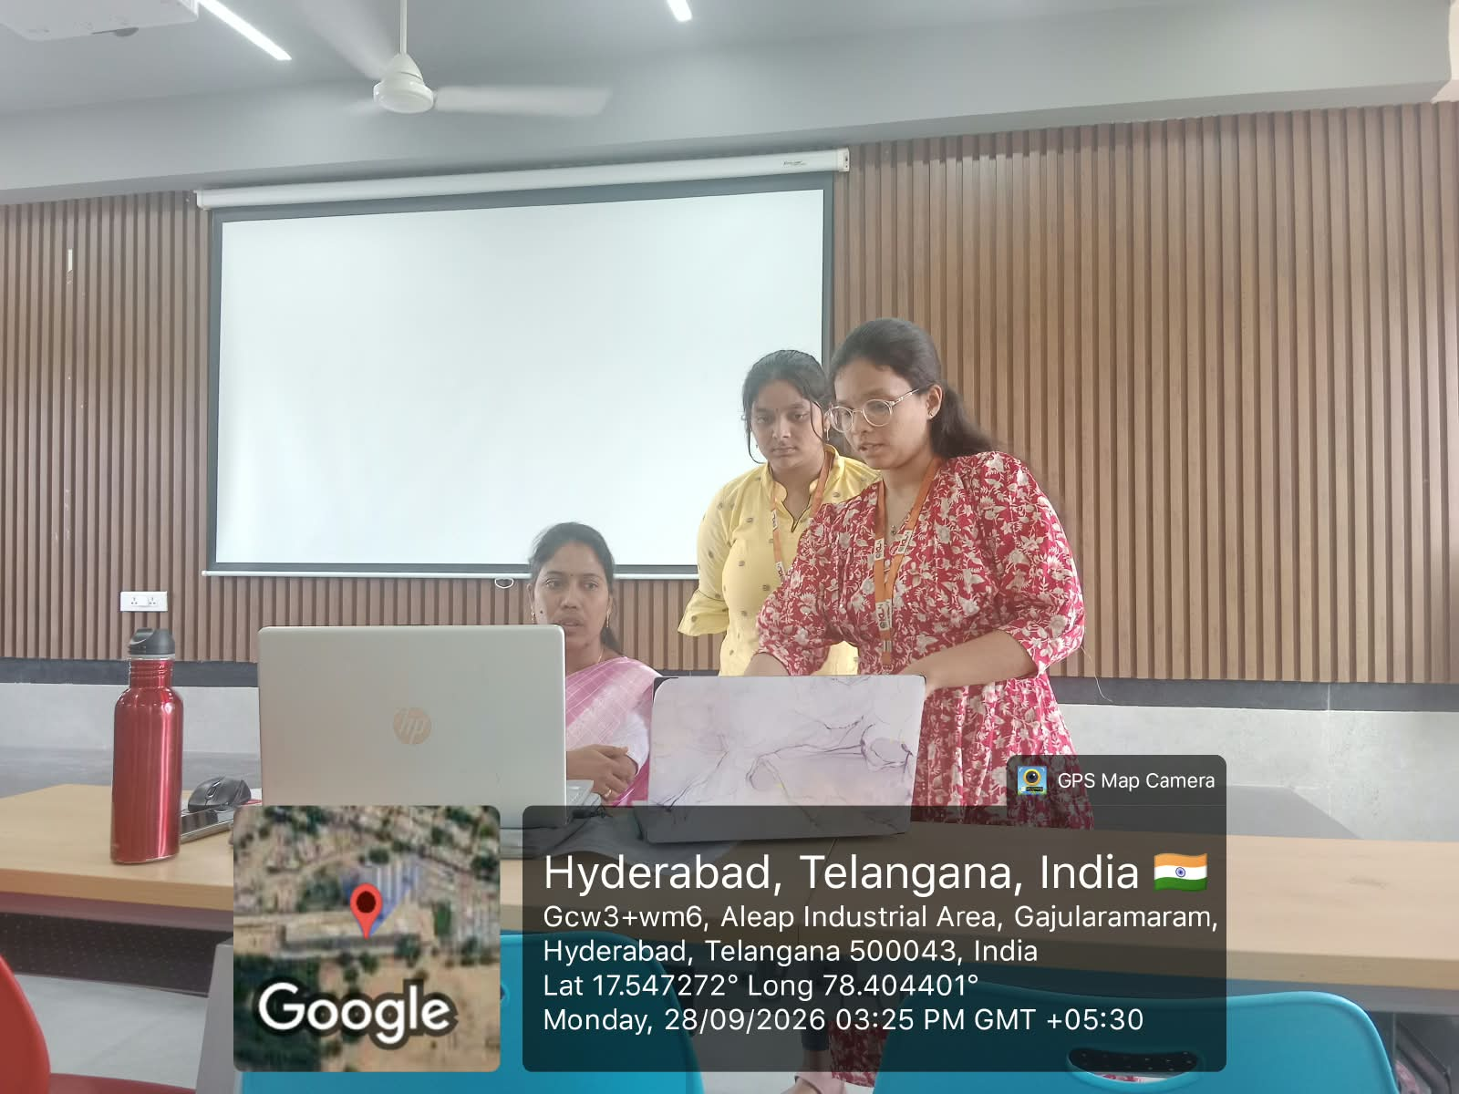
Geo-Tagged Photo

Slide 13
Thank you

