Slide 1
Chinese Restaurants in NYC
The Battle of
Neighbourhoods

Slide 2
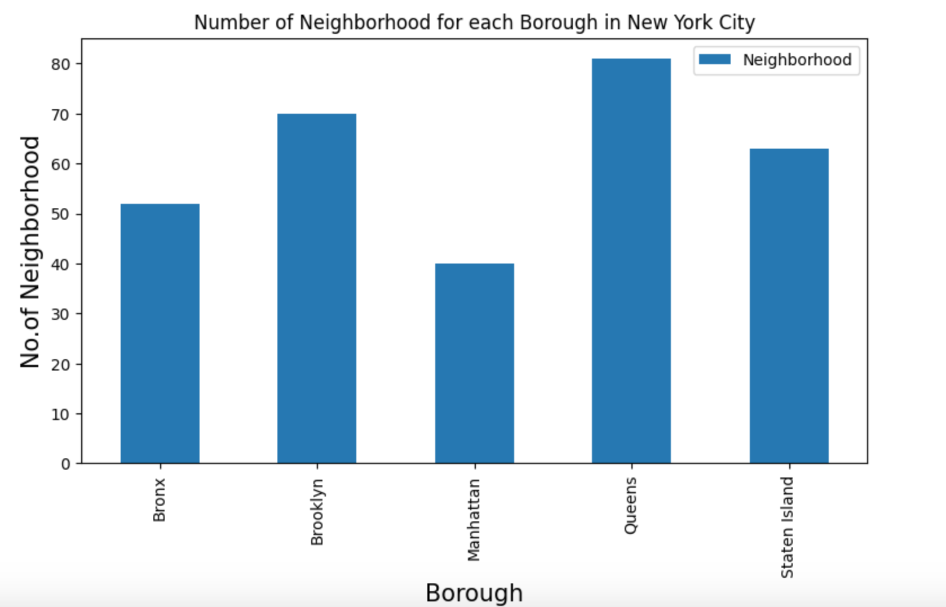
Neighbourhoods
Queens has most neighbourhoods, while Manhattan has least

Slide 3
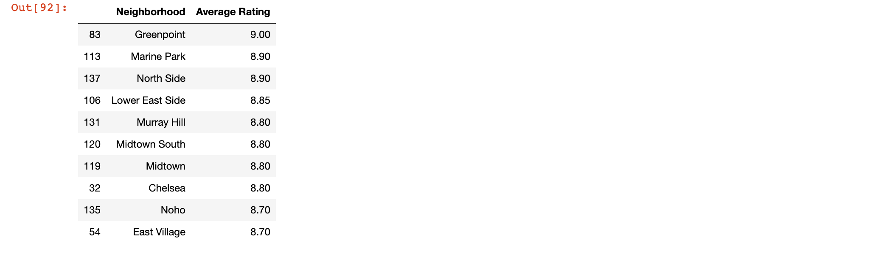
Rating
There over 20 neighbourhoods has 8.0 or above average Rating, Greenpoint rank first.

Slide 4
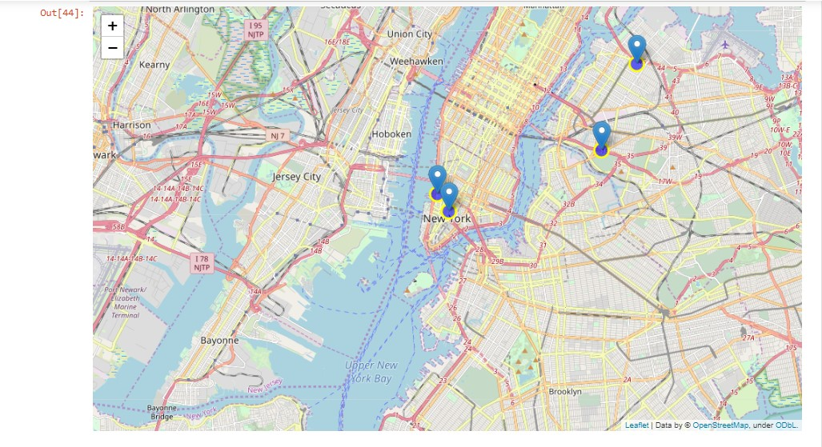
Best hood
Top 5 neighbourhoods based on average rating

Slide 5
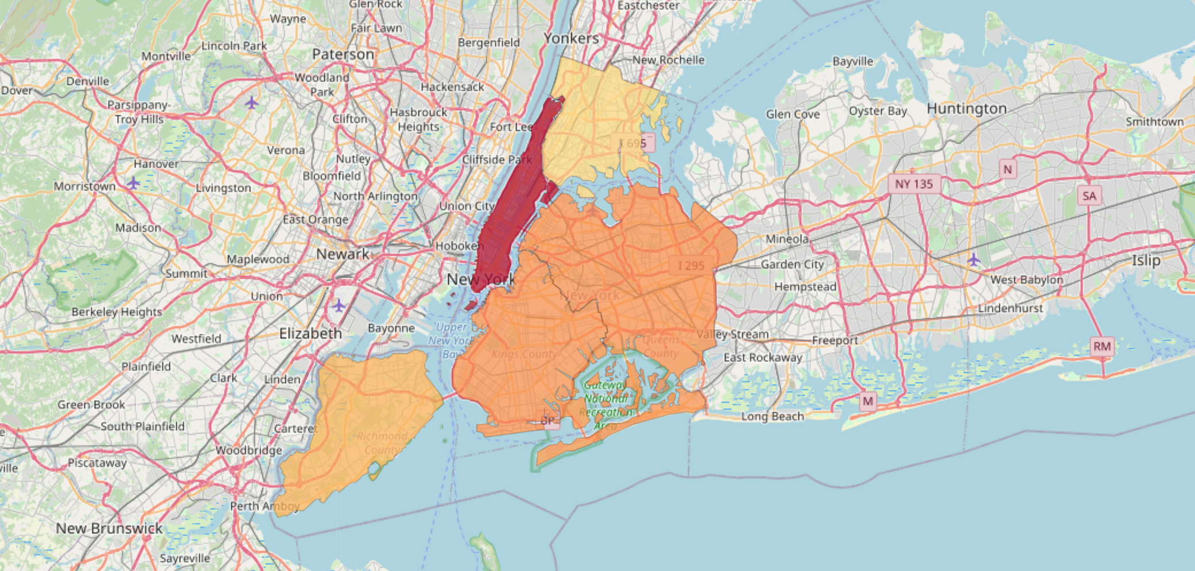
Borough
The Borough map based on rating

