Slide 1
Data Sci-Bot
Internal Guide :
Dr. P. Deepalakshmi
Team Members:
G. Lok Sundar
N. Yaswanthi
Babloo Kumar

Slide 2
Abstract:
In this project, we will try to build an AI-based Sci-bot which will do the whole Data Scientist process on its own and it will tell the Final Data Analysis Observation to the Stakeholder/client.

Slide 3
Literature Survey:
S.No | Paper | Author | Journal | Description
1 | Learning Feature Engineering for Classification | Fatemeh Nargesian, Horst Samulowitz, Udayan Khurana Elias B. Khalil, Deepak Turaga | Proceedings of the Twenty-Sixth International Joint Conference on Artificial Intelligence (IJCAI-17) | In this paper, they discussed the automated feature engineering techniques. Existing approaches to automating this process rely on either transformed feature space exploration through evaluation-guided search or explicit expansion of datasets with all transformed features followed by feature selection. Such approaches incur high computational costs in runtime and/or memory. For this, they presented a novel technique, called Learning Feature Engineering (LFE).

Slide 4
S.No | Paper | Author | Journal | Description
1 | Bayesian Optimization with Unknown Search Space | Huong Ha, Santu Rana, Sunil Gupta, Thanh Nguyen, Hung Tran-The, Svetha Venkatesh | 33rd Conference on Neural Information Processing Systems (NeurIPS 2019) | In this paper, they Implemented the new way of optimizing the features space which is unknown to the best fit data can do. To address this problem, they propose a systematic volume expansion strategy for Bayesian optimization. They devise a strategy to guarantee that in iterative expansions of the search space, our method can find a point whose function value within Epsilon of the objective function maximum. Without the need to specify any parameters, our algorithm automatically triggers a minimal expansion required iteratively.

Slide 5
Existing system :
Presently The automation is Limited to Machine Learning it didn’t come to Data Science still Researches are going on to automate the Data Scientist Process
At present all the Data analysis part is done by human Physically, and the time required for the project also up to one month for each case study.

Slide 6
Issues In existing System:
High Investment- since the data scientist salary is a high company has to pay more to data scientists.
Time taking – Data scientists are to be trained for up to 6 months to work in real-time companies.
Error/Mistakes– Humans may do mistakes sometimes.
Need a Domain Expertise to create a story for Stake Holders.

Slide 7
Proposed System:
The Main Goal is to create a Bot that can use the data and Prepare an Analysis story on it as Data Scientists do.
In this project we are particularly doing on Case study on Employee attrition.
In this our Sci-bot takes the data in and it does all the Data analysis part by itself and finally it creates a story on its self and explains it to the stakeholders/clients.
In the AI algorithm the Sci-bot takes the best algorithm for the problem using Auto-Machine Learning Methods.
It will automatically take the best parameters for each algorithm using a grid search and Bayesian optimization Technique.
Finally to the client everything is internal but the final output is a story that the client will understand.

Slide 8
Advantages of Proposed Work:
It can replace human work of Data Scientist.
No work place for Data Scientist’s.
Errorless : Humans may do mistakes but machines doesn’t.
Money Efficient, One time buy algorithms it will run for the entire life.

Slide 9
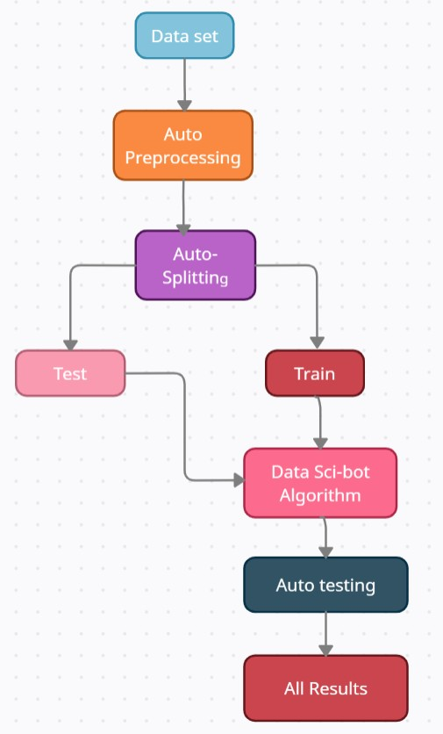
Data Flow Diagrams:

Slide 10
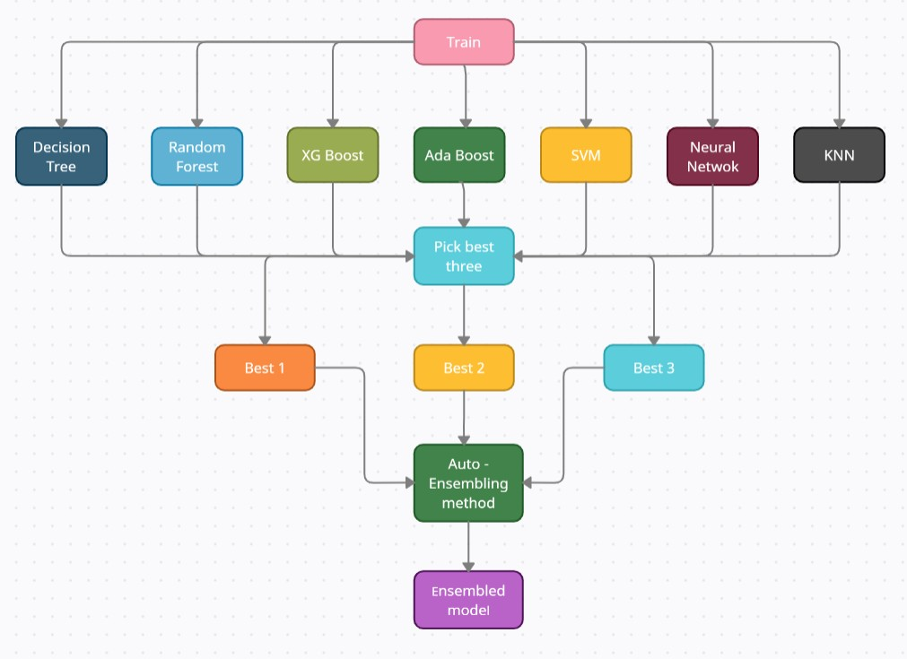

Slide 11
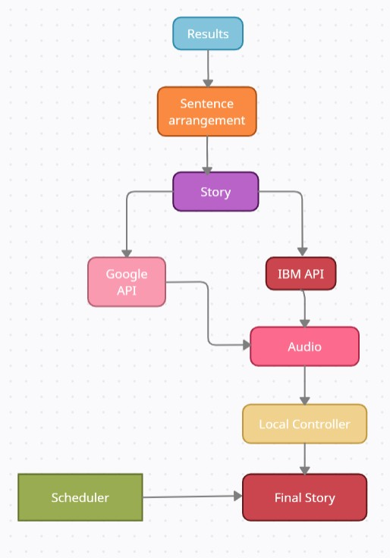

Slide 12
Algorithms used:
Decision Tree Classifier
Random Forest Classifier
Extra Trees Classifier
Light Gradient Boosting Machine
Gradient Boosting Classifier
Ada Boost Classifier
Quadratic Discriminant Analysis
Logistic Regression
Naive Bayes
Ridge Classifier
Linear Discriminant Analysis
SVM - Linear Kernel
K Neighbors Classifier

Slide 13
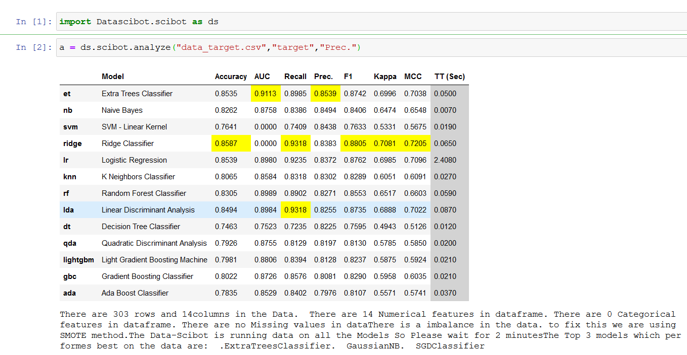
Result
Its an audio file.

Slide 14
Software requirement specification:
Windows 10 or above with high computational power.
Python 3.0 or above
Jupyter notebook, Spyder ,Anaconda platforms
Voice software for telling stories.

Slide 15
Roles And responsibilities:
N.Yaswanthi – Build the basic Machine Learning Model and Data Analysis Process.
Babloo Kumar – Automate the Machine Learning model and Data Analysis Process.
G.Lok Sundar – Automates the Optimization of Machine Learning algorithms and also Writes an algorithm to create a story and let the machine to tell the story to the stakeholder/client.

Slide 16
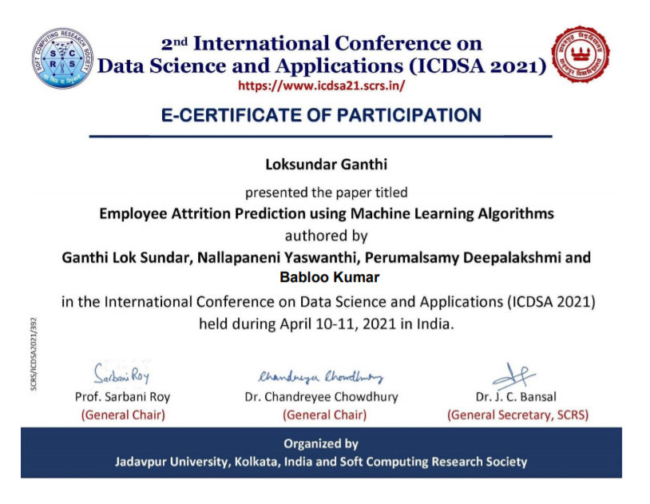
Publications

Slide 17
Thank You

