Slide 1
Job-a-thon

Slide 2
I tried all my knowledge into Solving Problem
Even I didn’t get the Expected rank see my flow of work as a fresher sir and consider me.

Slide 3
Data CLEANING
Steps we followed for data cleaning are as follows:-
Parsing
Normalization
Matching
Consolidating

Slide 4
Data imputing
To prepare a dataset for XGB we need to fix missing values, and we can fix missing values by applying machine learning to that dataset! If we consider a column with missing data as our target variable, and existing columns with complete data as our predictor variables, then we may construct a machine learning model using complete records as our train and test datasets and the records with incomplete data as our generalization target. This is a fully scoped-out machine learning problem.

Slide 5
Data visualization
Data visualization is the graphical representation of information and data. By using visual elements like charts, graphs, and maps.
Data visualization tools provide an accessible way to see and understand trends, outliers, and patterns in data.

Slide 6
Features selection
Mutual info classification
Chi square method

Slide 7
Model selection
Model selection is the process of choosing one among many candidate models for a predictive modeling problem.
There may be many competing concerns when performing model selection beyond model performance, such as complexity, maintainability, and available resources.
The two main classes of model selection techniques are probabilistic measures and resampling methods.

Slide 8
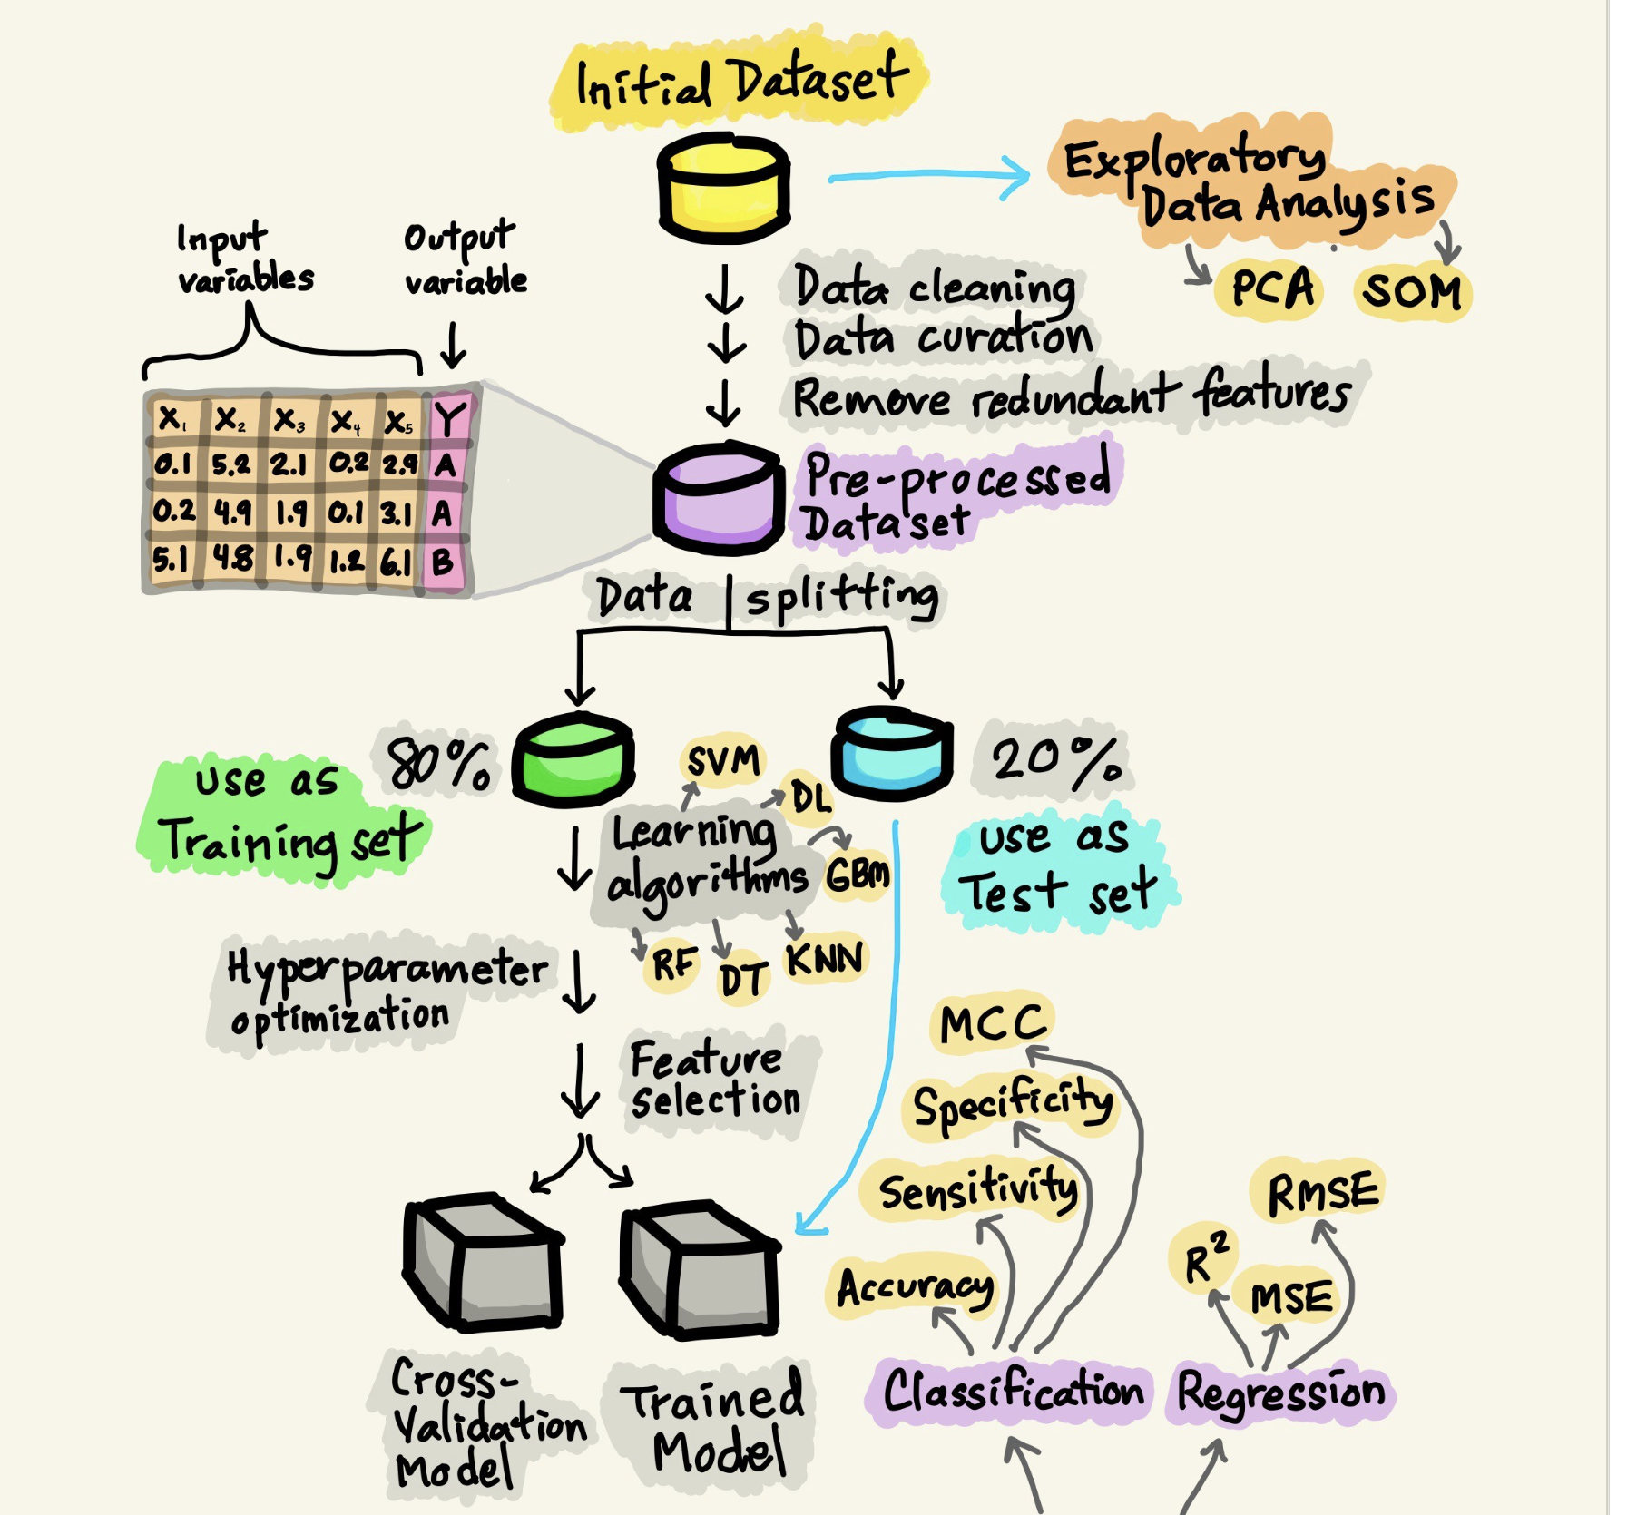
Model building

Slide 9
Models used
XGB
Random Forest
Neural Network
AdaBoost
GaussianNB

