Slide 1
MULTIPLEXER

Slide 2
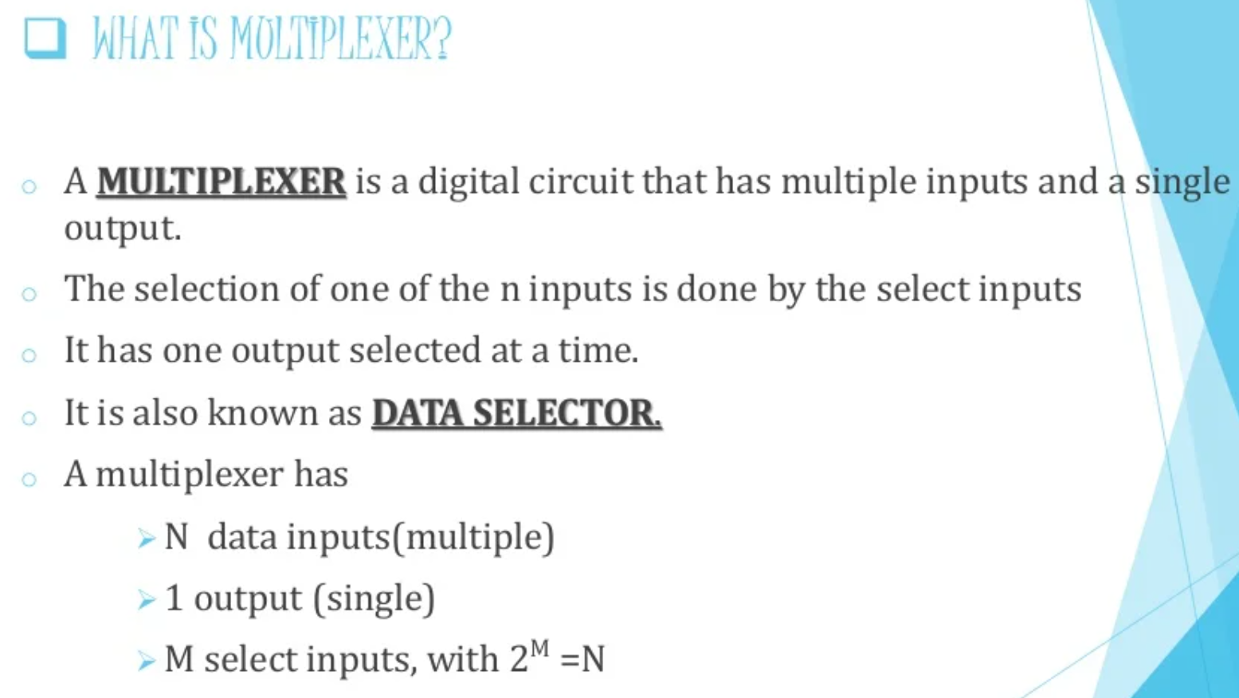

Slide 3
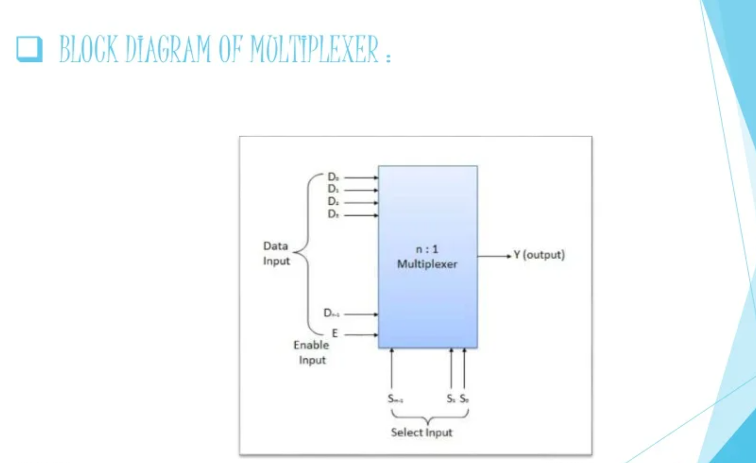

Slide 4
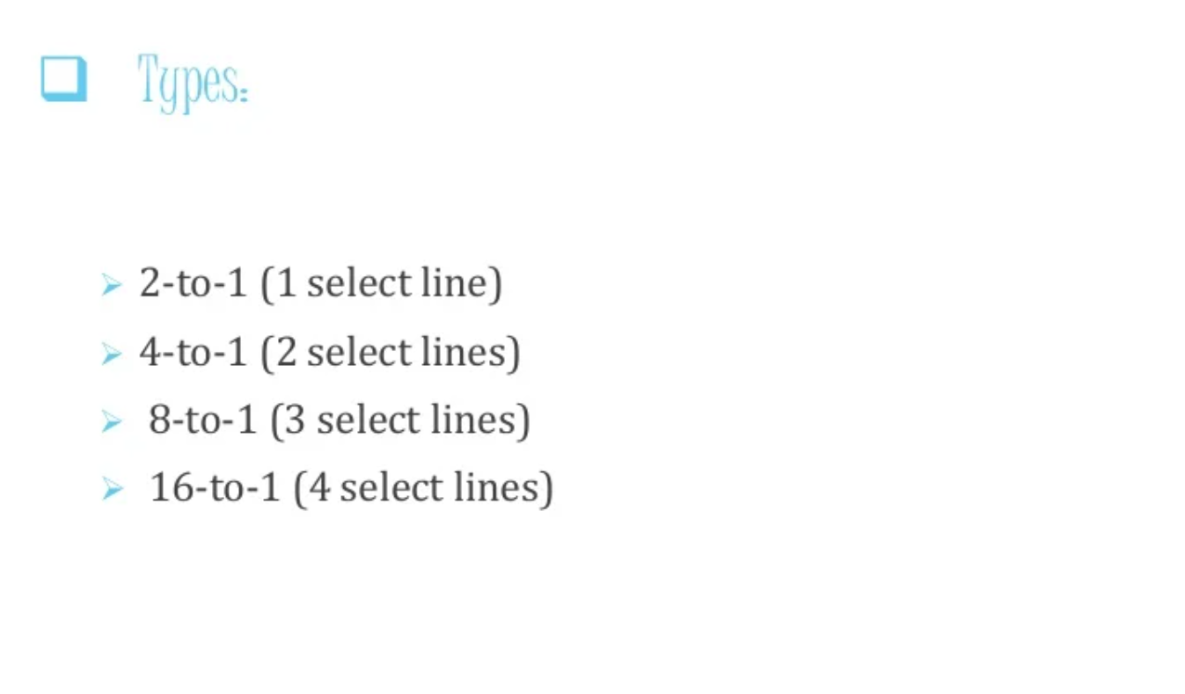

Slide 5
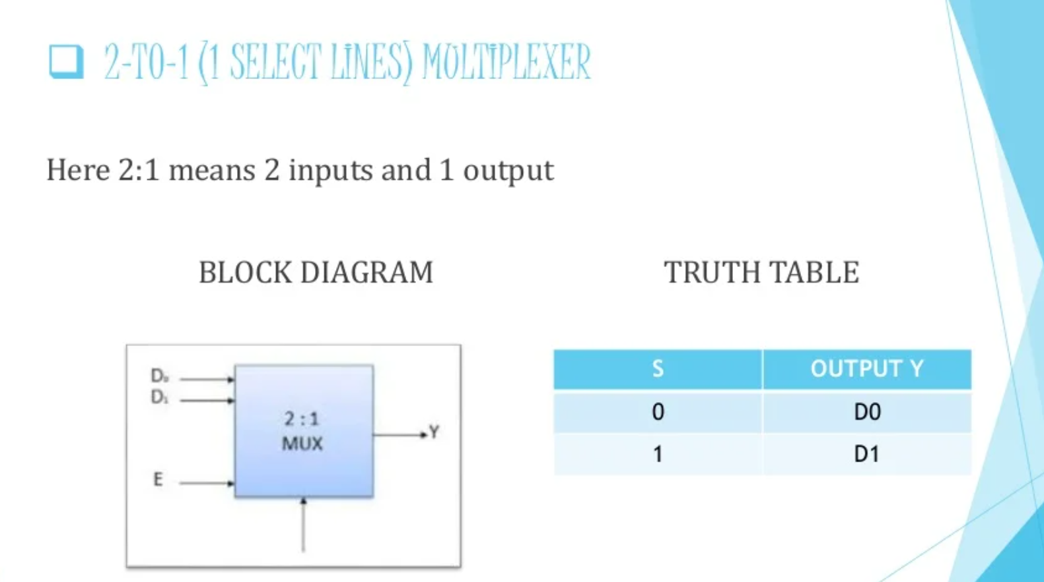

Slide 6
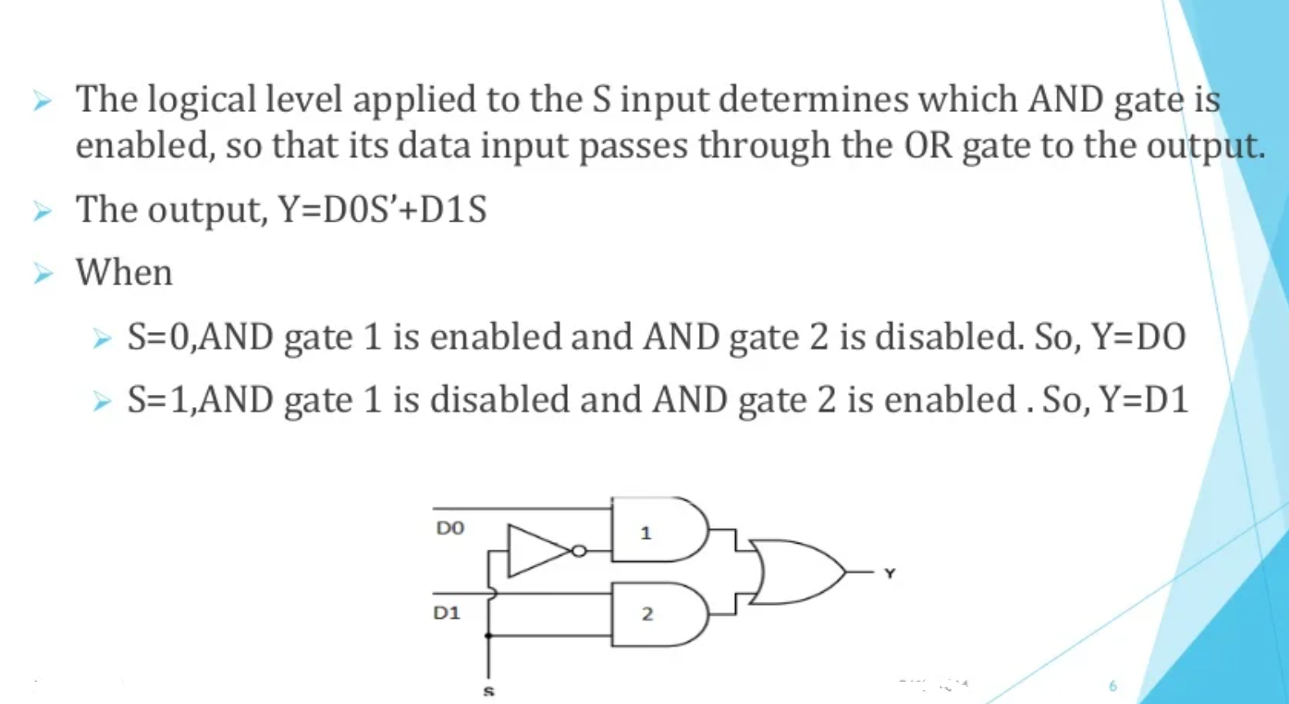

Slide 7
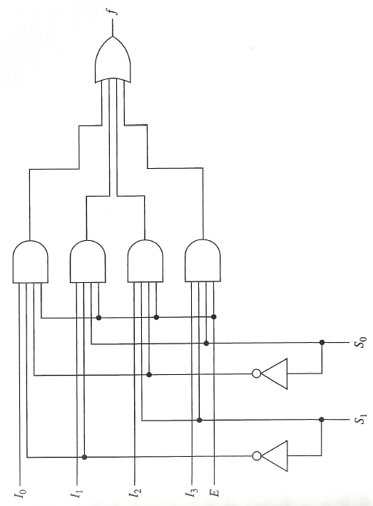
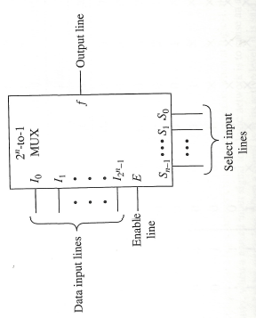
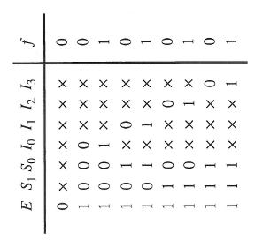
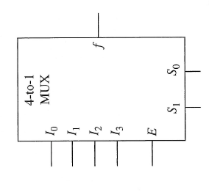
Realization of 4-to-1 line multiplexer
Symbol
Logic Diagram
Truth Table

Slide 8
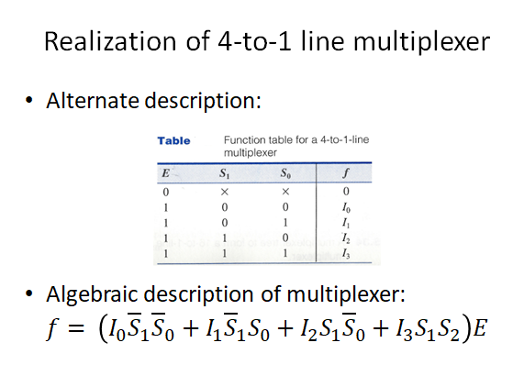

Slide 9
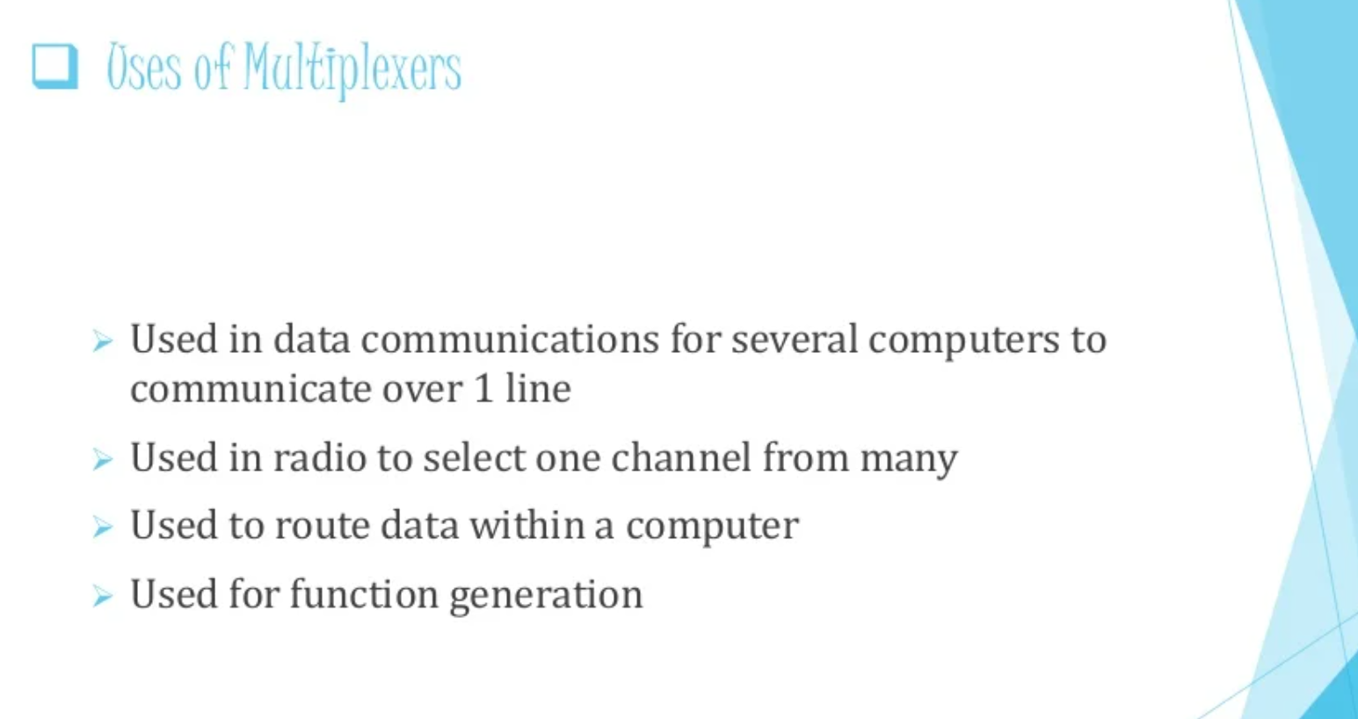

Slide 10
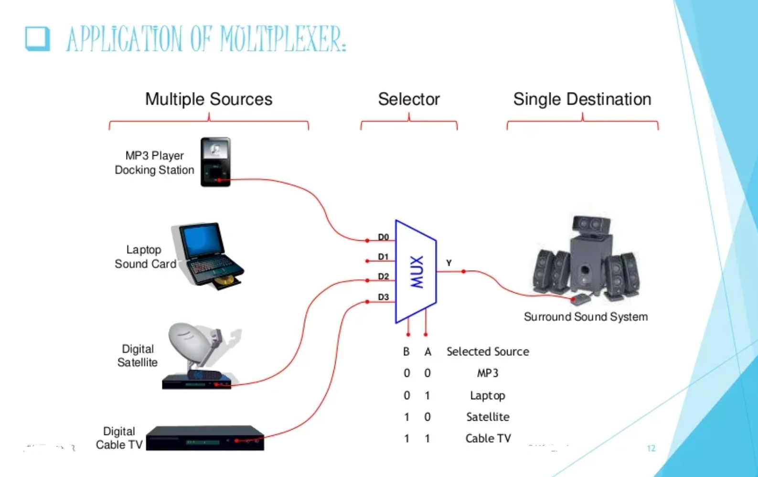

Slide 11

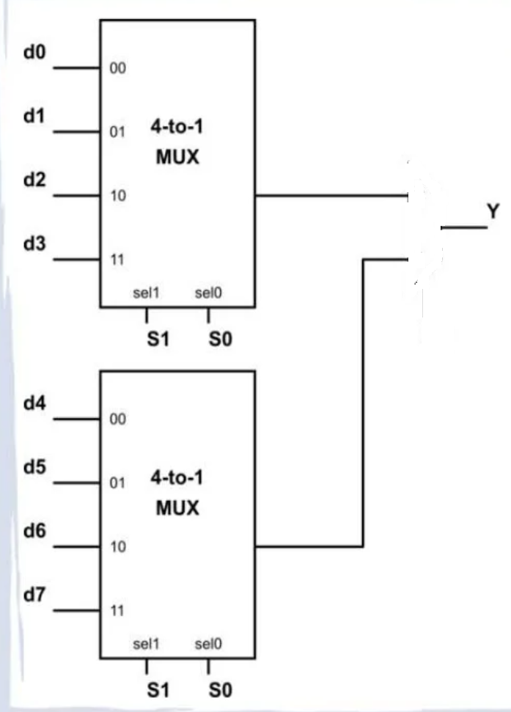
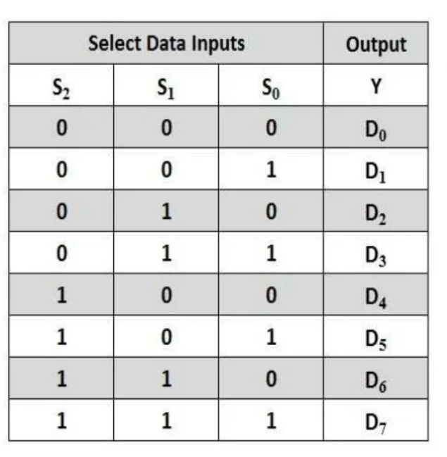


E
E

Slide 12
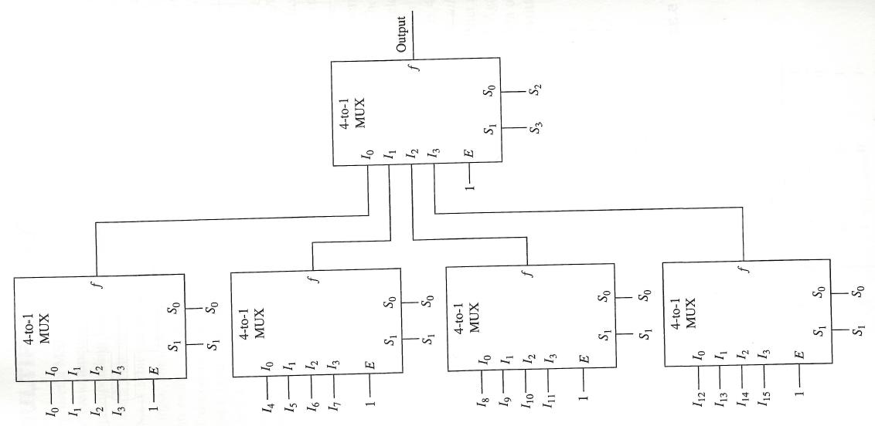
Design of 16:1 Mux using 4:1 Mux

Slide 13
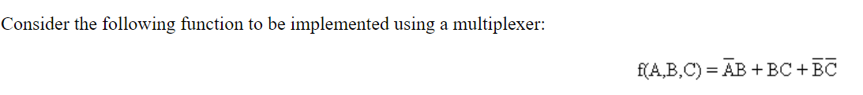
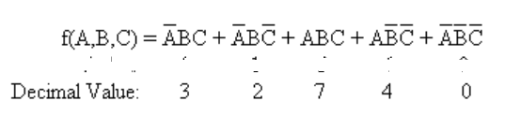
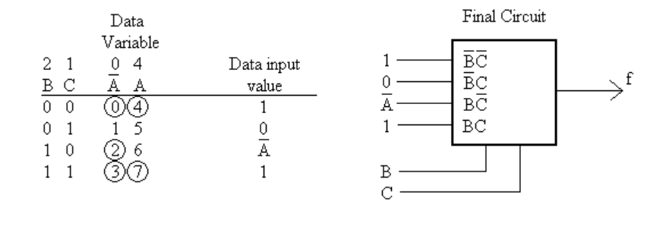
S₁
S₀

Slide 14
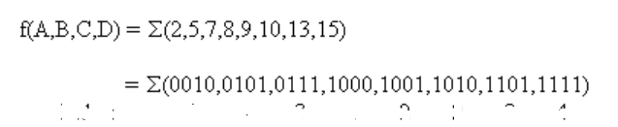
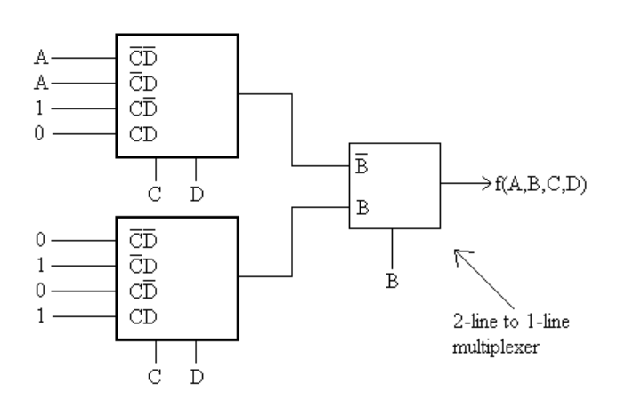
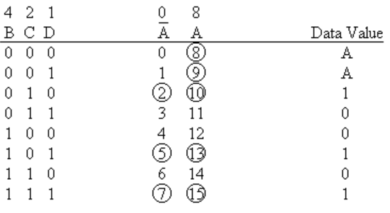
Implement using 4:1 Mux and 2:1 Mux
S₁
S₀
S₀
S₁
S₀

Slide 15
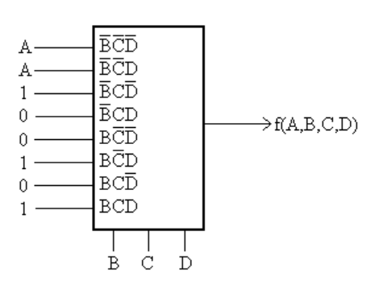
Implement the same question using 8:1 Mux
S₂
S₁
S₀

Slide 16
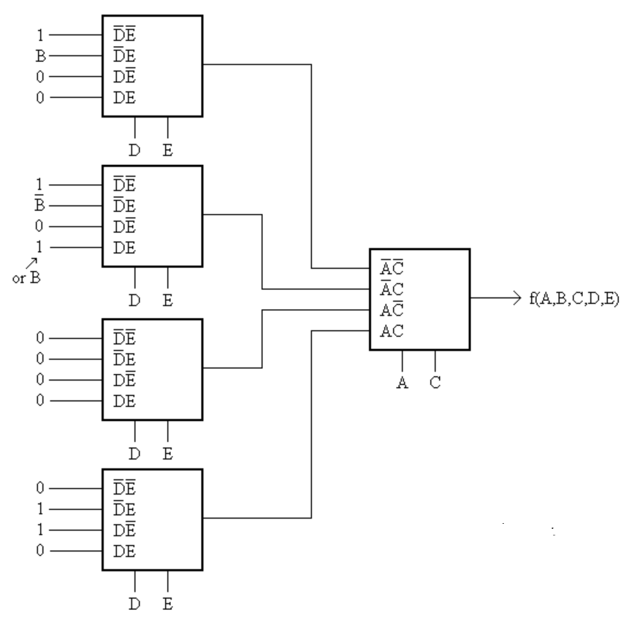
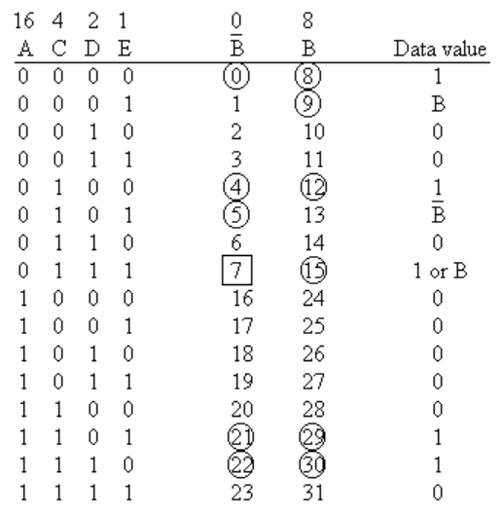
Implement using 4:1 Mux
S₁
S₀
S₁
S₀
S₁
S₀
S₁
S₀
S₁
S₀

Slide 17
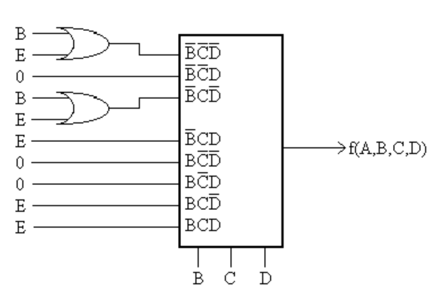
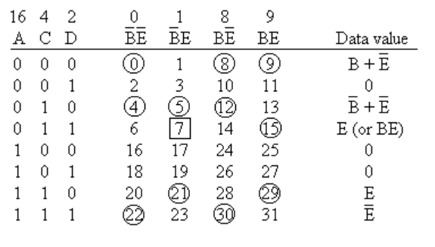
Implement the same question using 8:1 Mux
S₂
S₁
S₀

Slide 18
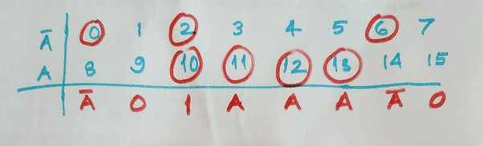
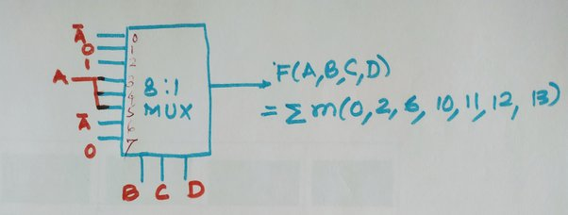
F(A,B,C,D)=∑m(0,2,6,10,11,12,13)+∑d(3,8,14)
Case 1: Without don't care

Slide 19
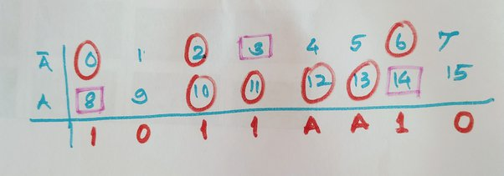
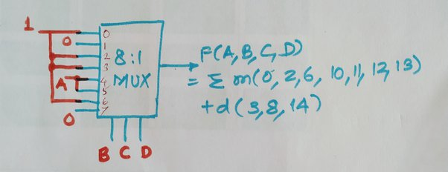
Case 2: With don't care condition (taking X=1)

Slide 20
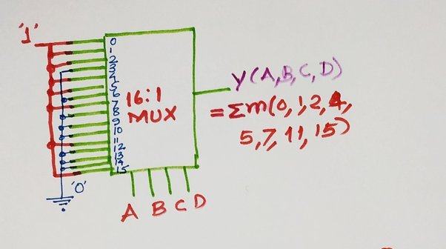
F=(A,B,C,D)=∑m(0,1,2,4,5,7,11,15)F=(A,B,C,D)=∑m(0,1,2,4,5,7,11,15)
Using 16:1 MUX:

Slide 21
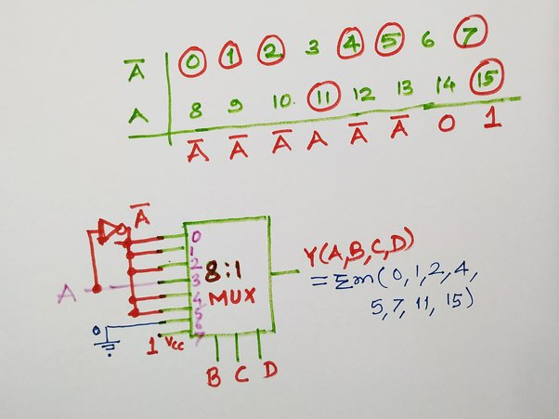
Using 8:1 MUX:

Slide 22
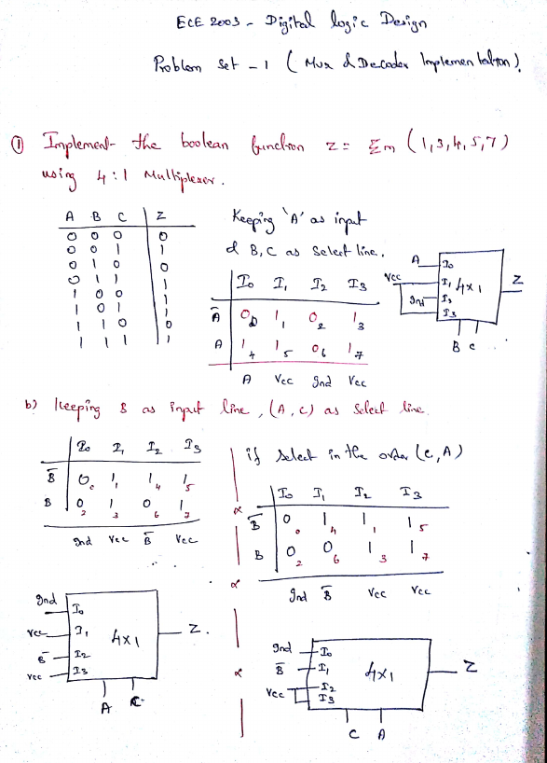

Slide 23
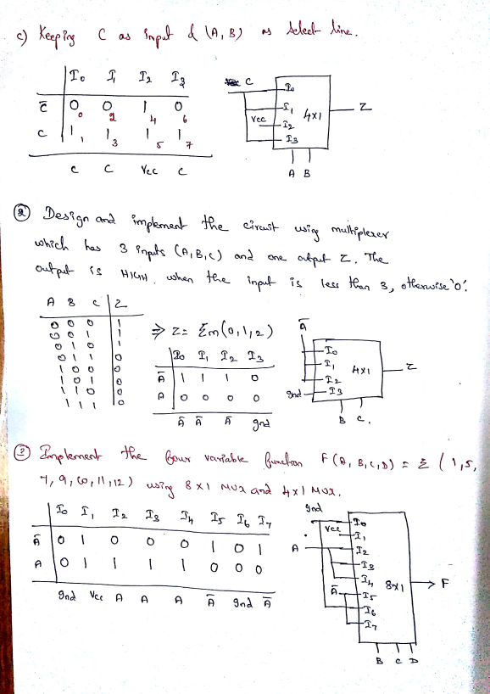

Slide 24
Implement the boolean expression F(A, B, C) = ∑ m(0, 2, 5, 6) using 4 : 1 multiplexer.

Slide 25
Implement F(A, B, C, D) = Σ m(0, 1, 5, 6, 8, 10, 12, 15) using 8 : 1 multiplexer.

