Slide 1

Analysis of Algorithms

Slide 2
Analysis of Algorithms
An algorithm is a finite set of precise instructions for performing a computation or for solving a problem.
What is the goal of analysis of algorithms?
  To compare algorithms mainly in terms of running time but also in terms of other factors (e.g., memory requirements, programmer's effort etc.)
What do we mean by running time analysis?
  Determine how running time increases as the size of the problem increases.

Slide 3
Input Size
Input size (number of elements in the input)
  size of an array
  polynomial degree
  # of elements in a matrix
  # of bits in the binary representation of the input
  vertices and edges in a graph

Slide 4
Types of Analysis
Worst case
  Provides an upper bound on running time
  An absolute guarantee that the algorithm would not run longer, no matter what the inputs are
Best case
  Provides a lower bound on running time
  Input is the one for which the algorithm runs the fastest
Average case
  Provides a prediction about the running time
  Assumes that the input is random

Slide 5
How do we compare algorithms?
We need to define a number of objective measures.
(1) Compare execution times?
Not good: times are specific to a particular computer !!
(2) Count the number of statements executed?
Not good: number of statements vary with the programming language as well as the style of the individual programmer.

Slide 6
Ideal Solution
Express running time as a function of the input size n (i.e., f(n)).
Compare different functions corresponding to running times.
Such an analysis is independent of machine time, programming style, etc.

Slide 7
Example
Associate a "cost" with each statement.
Find the "total cost“ by finding the total number of times each statement is executed.
Algorithm 1 Algorithm 2
Cost Cost
arr[0] = 0; c₁ for(i=0; i<N; i++) c₂
arr[1] = 0; c₁ arr[i] = 0; c₁
arr[2] = 0; c₁
... ...
arr[N-1] = 0; c₁
----------- -------------
c₁+c₁+...+c₁ = c₁ x N (N+1) x c₂ + N x c₁ =
(c₂ + c₁) x N + c₂

Slide 8
Another Example
Algorithm 3 Cost
sum = 0; c₁
for(i=0; i<N; i++) c₂
for(j=0; j<N; j++) c₂
sum += arr[i][j]; c₃
------------
c₁ + c₂ x (N+1) + c₂ x N x (N+1) + c₃ x N²

Slide 9
Asymptotic Analysis
To compare two algorithms with running times f(n) and g(n), we need a rough measure that characterizes how fast each function grows.
Hint: use rate of growth
Compare functions in the limit, that is, asymptotically!
  (i.e., for large values of n)

Slide 10
Rate of Growth
Consider the example of buying elephants and goldfish:
Cost: cost_of_elephants + cost_of_goldfish
Cost ~ cost_of_elephants (approximation)
The low order terms in a function are relatively insignificant for large n
n⁴ + 100n² + 10n + 50 ~ n⁴
i.e., we say that n⁴ + 100n² + 10n + 50 and n⁴ have the same rate of growth

Slide 11
Asymptotic Notation
O notation: asymptotic “less than”:
  f(n)=O(g(n)) implies: f(n) “≤” g(n)
Ω notation: asymptotic “greater than”:
  f(n)= Ω (g(n)) implies: f(n) “≥” g(n)
Θ notation: asymptotic “equality”:
  f(n)= Θ (g(n)) implies: f(n) “=” g(n)

Slide 12
Big-O Notation
We say f_{A}(n)=30n+8 is order n, or O (n)
It is, at most, roughly proportional to n.
f_{B}(n)=n²+1 is order n², or O(n²). It is, at most, roughly proportional to n².
In general, any O(n²) function is faster- growing than any O(n) function.

Slide 13
Visualizing Orders of Growth
On a graph, as
you go to the
right, a faster
growing
function
eventually
becomes
larger...
f_{A}(n)=30n+8
Value of function →
f_{B}(n)=n²+1
Increasing n →

Slide 14
More Examples …
n⁴ + 100n² + 10n + 50 is O(n⁴)
10n³ + 2n² is O(n³)
n³ - n² is O(n³)
constants
  10 is O(1)
  1273 is O(1)

Slide 15
Back to Our Example
Algorithm 1 Algorithm 2
Cost Cost
arr[0] = 0; c₁ for(i=0; i<N; i++) c₂
arr[1] = 0; c₁ arr[i] = 0; c₁
arr[2] = 0; c₁
...
arr[N-1] = 0; c₁
----------- -------------
c₁+c₁+...+c₁ = c₁ x N (N+1) x c₂ + N x c₁ =
(c₂ + c₁) x N + c₂
Both algorithms are of the same order: O(N)

Slide 16
Example (cont’d)
Algorithm 3 Cost
sum = 0; c₁
for(i=0; i<N; i++) c₂
for(j=0; j<N; j++) c₂
sum += arr[i][j]; c₃
------------
c₁ + c₂ x (N+1) + c₂ x N x (N+1) + c₃ x N² = O(N²)

Slide 17
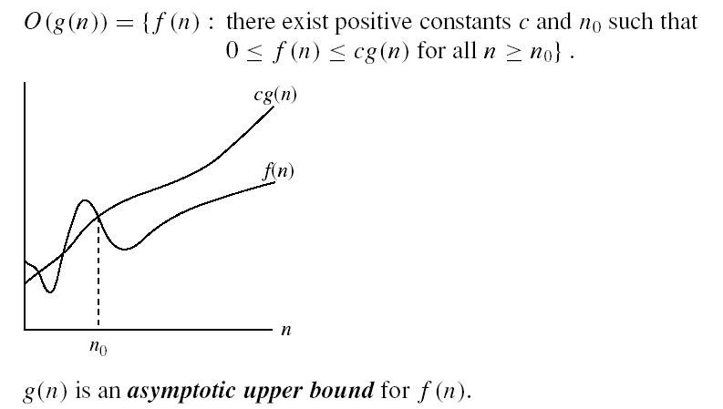
Asymptotic notations
O-notation

Slide 18
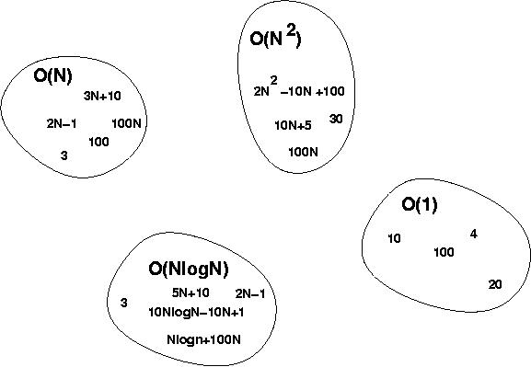
Big-O Visualization
O(g(n)) is the set of functions with smaller or same order of growth as g(n)

Slide 19
Examples
  2n² = O(n³):
  n² = O(n²):
  1000n²+1000n = O(n²):
  n = O(n²):
2n² ≤ cn³ ⇒ 2 ≤ cn ⇒ c = 1 and n₀= 2
n² ≤ cn² ⇒ c ≥ 1 ⇒ c = 1 and n₀= 1
1000n²+1000n ≤ 1000n²+ n² =1001n²⇒ c=1001 and n₀ = 1000
n ≤ cn² ⇒ cn ≥ 1 ⇒ c = 1 and n₀= 1

Slide 20
More Examples
Show that 30n+8 is O(n).
  Show ∃c,n₀: 30n+8 ≤ cn, ∀n>n₀ .
    Let c=31, n₀=8. Assume n>n₀=8. Then
    cn = 31n = 30n + n > 30n+8, so 30n+8 < cn.

Slide 21
Big-O example, graphically
Note 30n+8 isn’t
less than n
anywhere (n>0).
It isn’t even
less than 31n
everywhere.
But it is less than
31n everywhere to
the right of n=8.
cn =
31n
30n+8
30n+8
∈O(n)
Value of function →
n
n>n₀=8 →
Increasing n →

Slide 22
No Uniqueness
There is no unique set of values for n₀ and c in proving the asymptotic bounds
Prove that 100n + 5 = O(n²)
  100n + 5 ≤ 100n + n = 101n ≤ 101n²
  for all n ≥ 5
  n₀ = 5 and c = 101 is a solution
  100n + 5 ≤ 100n + 5n = 105n ≤ 105n²
  for all n ≥ 1
  n₀ = 1 and c = 105 is also a solution
  Must find SOME constants c and n₀ that satisfy the asymptotic notation relation

Slide 23
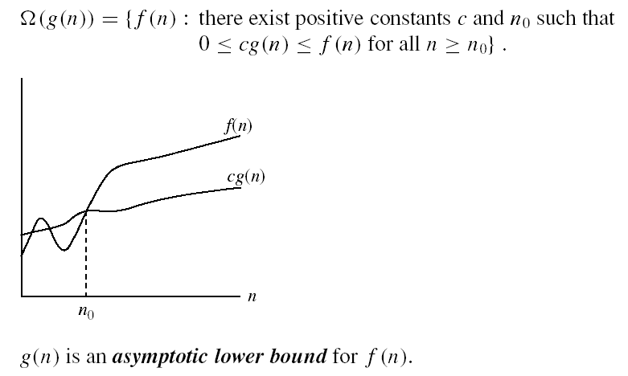
Asymptotic notations (cont.)
Ω - notation
Ω(g(n)) is the set of functions with larger or same order of growth as g(n)

Slide 24
Examples
  5n² = Ω(n)
  100n + 5 ≠ Ω(n²)
  n = Ω(2n), n³ = Ω(n²), n = Ω(logn)
  ∃ c, n₀ such that: 0 ≤ cn ≤ 5n²
⇒ cn ≤ 5n²
⇒ c = 1 and n₀ = 1
∃ c, n₀ such that: 0 ≤ cn² ≤ 100n + 5
100n + 5 ≤ 100n + 5n (∀ n ≥ 1) = 105n
cn² ≤ 105n
⇒ n(cn – 105) ≤ 0
Since n is positive ⇒ cn – 105 ≤ 0
⇒ n ≤ 105/c
⇒ contradiction: n cannot be smaller than a constant

Slide 25


Asymptotic notations (cont.)
Θ-notation
Θ(g(n)) is the set of functions with the same order of growth as g(n)

Slide 26
Examples
  n²/2 –n/2 = Θ(n²)
    ½ n² - ½ n ≤ ½ n² ∀n ≥ 0 ⇒ c₂= ½
    ½ n² - ½ n ≥ ½ n² - ½ n * ½ n ( ∀n ≥ 2 ) = ¼ n² ⇒ c₁= ¼
  n ≠ Θ(n²): c₁ n² ≤ n ≤ c₂ n²
  ⇒ only holds for: n ≤ 1/c₁

Slide 27
Examples
  6n³ ≠ Θ(n²): c₁ n² ≤ 6n³ ≤ c₂ n²
  ⇒ only holds for: n ≤ c₂ /6
  n ≠ Θ(logn): c₁ logn ≤ n ≤ c₂ logn
  ⇒ c₂ ≥ n/logn, ∀ n≥ n₀ – impossible

Slide 28
Relations Between Different Sets
Subset relations between order-of-growth sets.
R→R
O( f )
Ω( f )
• f
Θ( f )

Slide 29
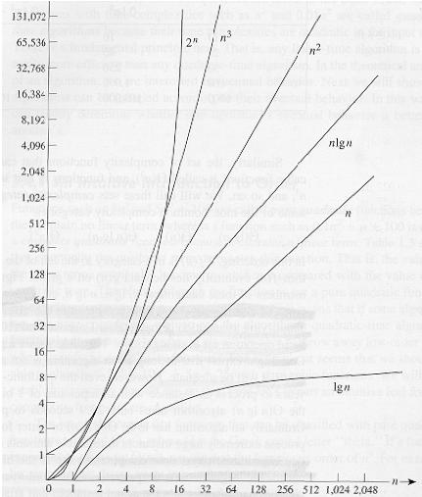
Common orders of magnitude

Slide 30
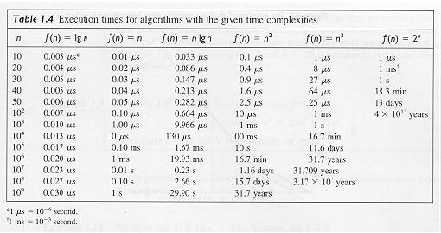
Common orders of magnitude

Slide 31
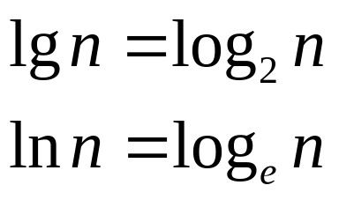
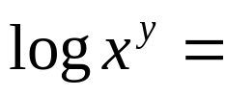



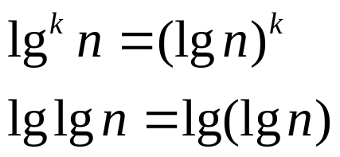
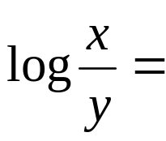




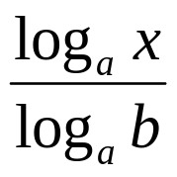
Logarithms and properties
In algorithm analysis we often use the notation “log n” without specifying the base
Binary logarithm
Natural logarithm

Slide 32
More Examples
For each of the following pairs of functions, either f(n) is O(g(n)), f(n) is Ω(g(n)), or f(n) = Θ(g(n)). Determine which relationship is correct.
  f(n) = log n²; g(n) = log n + 5
  f(n) = n; g(n) = log n²
  f(n) = log log n; g(n) = log n
  f(n) = n; g(n) = log² n
  f(n) = n log n + n; g(n) = log n
  f(n) = 10; g(n) = log 10
  f(n) = 2^{n}; g(n) = 10n²
  f(n) = 2^{n}; g(n) = 3^{n}
f(n) = Θ (g(n))
f(n) = Ω(g(n))
f(n) = O(g(n))
f(n) = Ω(g(n))
f(n) = Ω(g(n))
f(n) = Θ(g(n))
f(n) = Ω(g(n))
f(n) = O(g(n))

Slide 33
Properties
Theorem:
f(n) = Θ(g(n)) ⇔ f = O(g(n)) and f = Ω(g(n))
Transitivity:
  f(n) = Θ(g(n)) and g(n) = Θ(h(n)) ⇒ f(n) = Θ(h(n))
  Same for O and Ω
Reflexivity:
  f(n) = Θ(f(n))
  Same for O and Ω
Symmetry:
  f(n) = Θ(g(n)) if and only if g(n) = Θ(f(n))
Transpose symmetry:
  f(n) = O(g(n)) if and only if g(n) = Ω(f(n))

Slide 34
Asymptotic Notations in Equations
On the right-hand side
  Θ(n²) stands for some anonymous function in Θ(n²)
  2n² + 3n + 1 = 2n² + Θ(n) means:
  There exists a function f(n) ∈ Θ(n) such that
  2n² + 3n + 1 = 2n² + f(n)
On the left-hand side
  2n² + Θ(n) = Θ(n²)
  No matter how the anonymous function is chosen on the left-hand side, there is a way to choose the anonymous function on the right-hand side to make the equation valid.

Slide 35
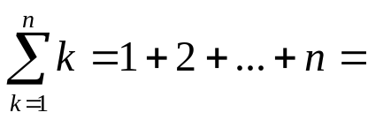
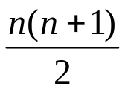
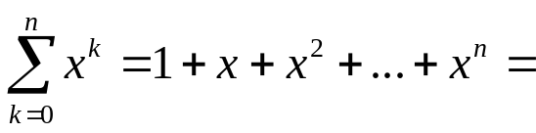
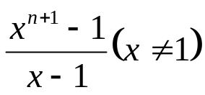
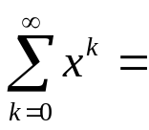
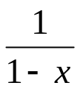
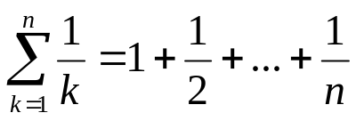

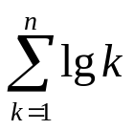

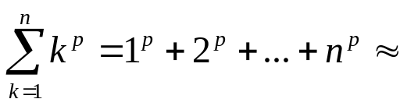
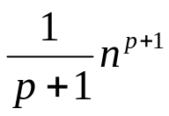
Common Summations
Arithmetic series:
Geometric series:
  Special case: |x| < 1:
Harmonic series:
Other important formulas:

Slide 36
Mathematical Induction
A powerful, rigorous technique for proving that a statement S(n) is true for every natural number n, no matter how large.
Proof:
  Basis step: prove that the statement is true for n = 1
  Inductive step: assume that S(n) is true and prove that S(n+1) is true for all n ≥ 1
Find case n “within” case n+1

Slide 37
Example
Prove that: 2n + 1 ≤ 2^{n} for all n ≥ 3
Basis step:
  n = 3: 2 ∗ 3 + 1 ≤ 2³ ⇔ 7 ≤ 8 TRUE
Inductive step:
  Assume inequality is true for n, and prove it for (n+1):
  2n + 1 ≤ 2^{n} must prove: 2(n + 1) + 1 ≤ 2^{n+1}
  2(n + 1) + 1 = (2n + 1 ) + 2 ≤ 2^{n} + 2 ≤
  ≤ 2^{n} + 2^{n} = 2^{n+1}, since 2 ≤ 2^{n} for n ≥ 1

