Slide 1
Sorting in linear time
Comparison sort:
  Lower bound: Ω(nlgn).
Non comparison sort:
  Bucket sort, counting sort, radix sort
  They are possible in linear time (under certain assumption).

Slide 2
Bucket Sort
Assumption: uniform distribution
  Input numbers are uniformly distributed in [0,1).
  Suppose input size is n.
Idea:
  Divide [0,1) into n equal-sized subintervals (buckets).
  Distribute n numbers into buckets
  Expect that each bucket contains few numbers.
  Sort numbers in each bucket (insertion sort as default).
  Then go through buckets in order, listing elements,

Slide 3
BUCKET-SORT(A)
n ←length[A]
for i ←1 to n
do insert A[i] into bucket B[⎣nA[i]⎦]
for i ←0 to n-1
do sort bucket B[i] using insertion sort
Concatenate bucket B[0],B[1],…,B[n-1]

Slide 4
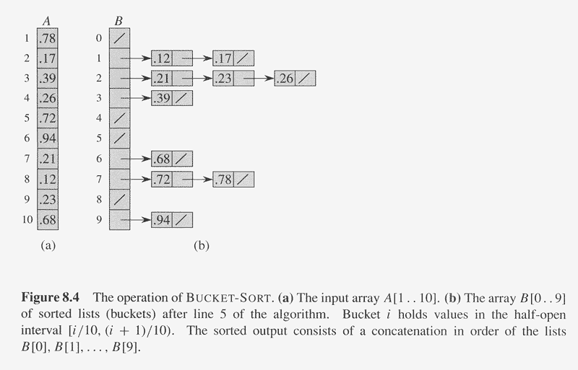
Example of BUCKET-SORT

Slide 5
Analysis of BUCKET-SORT(A)
n ←length[A] Ω(1)
for i ←1 to n O(n)
do insert A[i] into bucket B[⎣nA[i]⎦] Ω(1) (i.e. total O(n))
for i ←0 to n-1 O(n)
do sort bucket B[i] with insertion sort O(n_{i}²) (∑_{i=0}^{n-1} O(n_{i}²))
Concatenate bucket B[0],B[1],…,B[n-1] O(n)
Where n_{i} is the size of bucket B[i].
Thus T(n) = Θ(n) + ∑_{i=0}^{n-1} O(n_{i}²)
= Θ(n) + nO(2-1/n) = Θ(n). Beat Ω(nlg n)

Slide 6
Counting Sort
Assumption: n input numbers are integers in range [0,k], k=O(n).
Idea:
  Determine the number of elements less than x, for each input x.
  Place x directly in its position.

Slide 7
COUNTING-SORT(A,B,k)
for i←0 to k
do C[i] ←0
for j ←1 to length[A]
do C[A[j]] ←C[A[j]]+1
// C[i] contains number of elements equal to i.
for i ←1 to k
do C[i]=C[i]+C[i-1]
// C[i] contains number of elements ≤ i.
for j ←length[A] downto 1
do B[C[A[j]]] ←A[j]
C[A[j]] ←C[A[j]]-1

Slide 8
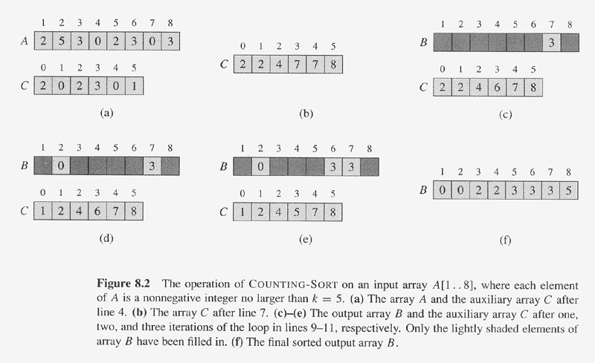
Example of Counting Sort

Slide 9
Analysis of COUNTING-SORT(A,B,k)
for i←0 to k Θ(k)
do C[i] ←0 Θ(1)
for j ←1 to length[A] Θ(n)
do C[A[j]] ←C[A[j]]+1 Θ(1) (Θ(1) Θ(n)= Θ(n))
// C[i] contains number of elements equal to i. Θ(0)
for i ←1 to k Θ(k)
do C[i]=C[i]+C[i-1] Θ(1) (Θ(1) Θ(n)= Θ(n))
// C[i] contains number of elements ≤ i. Θ(0)
for j ←length[A] downto 1 Θ(n)
do B[C[A[j]]] ←A[j] Θ(1) (Θ(1) Θ(n)= Θ(n))
C[A[j]] ←C[A[j]]-1 Θ(1) (Θ(1) Θ(n)= Θ(n))
Total cost is Θ(k+n), suppose k=O(n), then total cost is Θ(n). Beat Ω(nlg n).

Slide 10
Radix sort
Suppose a group of people, with last name, middle, and first name (each has one letter).
For example: (z, x, k), (z,j,y), (f,s,f), …
Sort it by the last name, then by middle, finally by the first name
Solution 1:
  sort by last name first as into (possible) 26 bins,
  Sort each bin by middle name into (possible) 26 more bins (26*26 =512)
  Sort each of 512 bins by the first name into 26 bins
So if many names, there may need possible 26*26*26 bins.
Suppose there are n names, there need possible n bins.
What is the efficient solution?

Slide 11
Radix sort
By first name, then middle, finally last name.
Then after every pass of sort, the bins can be combined as one file and proceed to the next sort.
Radix-sort(A,d)
  For i=1 to d do
    use a stable sort to sort array A on digit i.
Lemma 8.3: Given n d-digit numbers in which each digit can take on up to k possible values, Radix-sort correctly sorts these numbers in Θ(d(n+k)) time.
If d is constant and k=O(n), then time is Θ(n).

Slide 12
