Slide 1





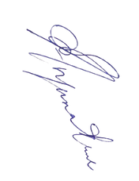
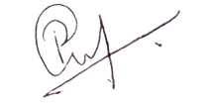
Certificate ID: LE01M008
CERTIFICATE OF PARTICIPATION
This is to certify that
<<NAME>>
has successfully participated in and completed the intensive AI workshop on "Neural Networks & AI Model Creation" as a part of HIVE Learnathon held on 12.07.2025, demonstrating dedication to learning and mastering cutting-edge artificial intelligence technologies.
ASME SRIT Coordinator
Member at Large
ASME TN Section

