Slide 1
Setup of Nextcloud using Kubernetes
20/21 Cloud Computing Seminar
Michael Zodel, Andrej Korinth, Francisco Seipel, Nils Krug

Slide 2
Agenda
Nextcloud
Kubernetes
Yaml files
Architecture
Live demo
Conclusion
Einleitung: Nils 1-2
Nextcloud Andrej
Kubernetes Andrej 4-5min
Yaml Michael
Architecture Michael 5min
Livedemo
4 Nodes, einer wird abgeschaltet: Francisco 5min
2 Nodes, Text/Voicechat: Nils 5min
Optional: Nextcloud/Cluster aufsetzen Michael
Conclusion: Andrej
Notes:
disease itself

Slide 3
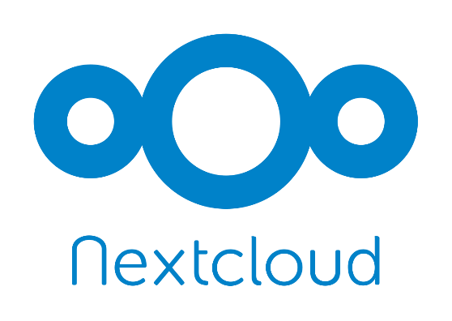
Cloud solution
Open source
Founded 2016
Main functionality sharing files
Other functionality added
Notes:
Nextcloud is an open source cloud solution. It was founded in 2016 as a fork of Owncloud. Its popularity grew steadily over the time. In 2019 some gouvernments made a contract with nextcloud as cloud solution including france and even germany. Nextcloud is also used in the UAS as the knowledge base foundation. The main functionality of nextcloud is to share files. With the time more functionalities, like the shared editing of documents and a video and text chat have been added.
On the next slide you can see a picture of the deployed application. This screen is shown after the login to the system. It shows the recomended files as well as the chats. On the top you can navigate through the different functionalities.
The application is deployed on kubernetes as the platform.

Slide 4
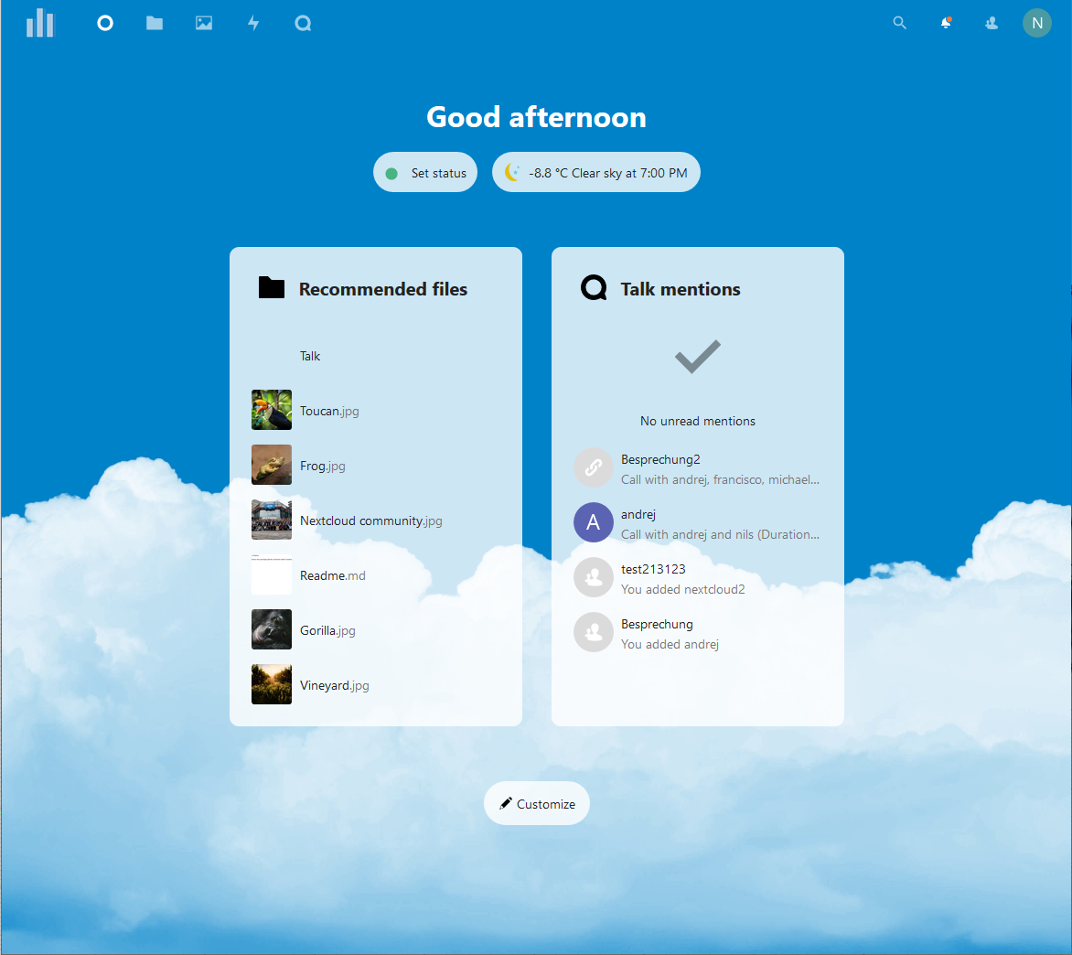
Notes:
On the next slide you can see a picture of the deployed application. This screen is shown after the login to the system. It shows the recomended files as well as the chats. On the top you can navigate through the different functionalities.
The application is deployed on kubernetes as the platform.

Slide 5
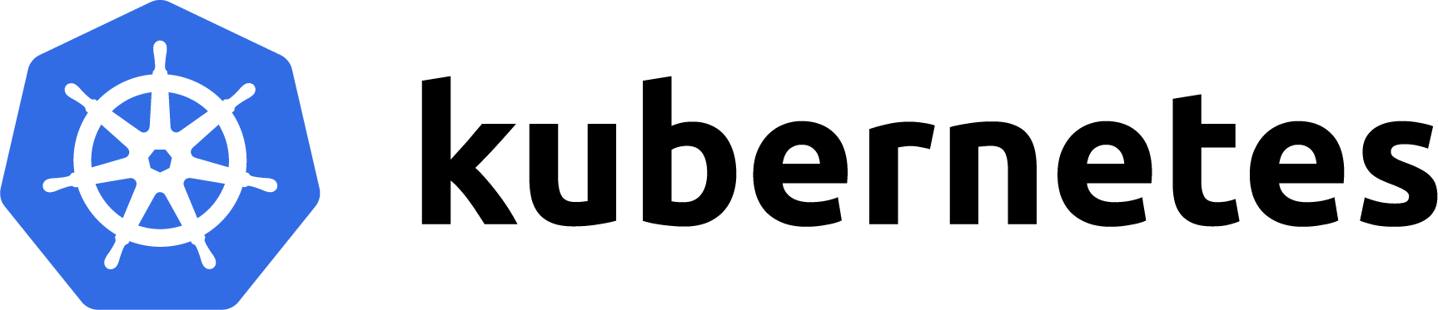
Open source platform
Founded 2014
First version published 2015
Aspects of IaaS and PaaS
Notes:
Kubernetes is an open source platform to manage container based applications and services. It is portable as well as scalable. 20114 it was founded by former Google employes. The first version had been published 2015. Nextcloud has aspects of infrastructure as a service as well as platform as a service. It eases up the configuration as well as the automation.
An exemplary architecture of kubernetes with its main components is shown on the next slide.
In the architecture we can see that kubernetes distinguishes between master and nodes. The master is used for managing the nodes, like time scheduling and reacts to actions like the shutdown of a node.

Slide 6
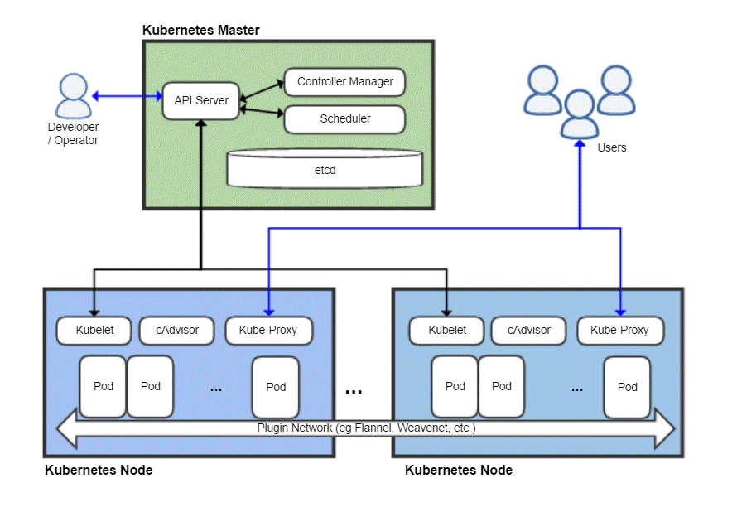
Notes:
An exemplary architecture of kubernetes with its main components is shown on the next slide.
In the architecture we can see that kubernetes distinguishes between master and nodes. The master is used for managing the nodes, like time scheduling and reacts to actions like the shutdown of a node.
Inside the nodes different pods are running. Pods are groups of one or more containers. The countainers can be deployments or services or similar things.
For example in our system on every node a pod is available, which includes the nextcloud deployment.
How to setup such a architecture Michael will now present to you.

Slide 7
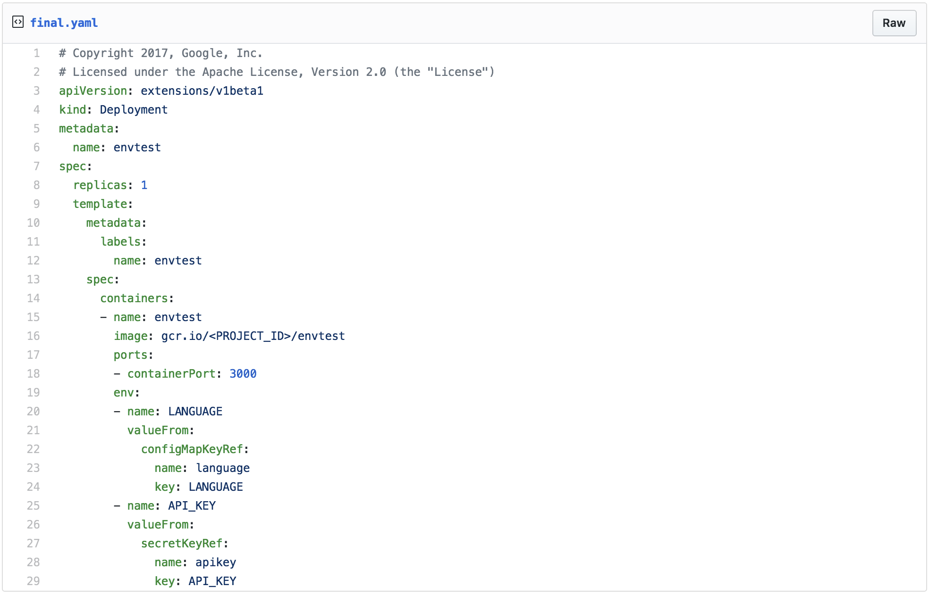
Yaml files
Base structure:
Apiversion
Kind
Metadata
Spec
Notes:
Kubernetes uses YAML configuration files to deploy different objects. They allow one to document the deployed pods and services and group them together. You can see an example YAML file on this slide. A YAML file has a base structure containing Apiversion, kind, metadata and spec.
Apiversion specifies the version of the kubernetes api used to create the object, in this example it is v1beta1
Kind describes the kind of object to be created. Deployment, as shown in the example is for the creation of pods.
Metadata is used to help uniquely identify an object. It often contains a name, like for example envtest as shown on the slide. It can also often contain unique identificators and namespaces.
Spec is then used to specify additional content depending on the type of object to be created. For example database deployments require a username and password as well as a service to connect to. In the shown example you can see a Port being specified.
Multiple YAML files were used, at least 1 per architecture component, which will be shown next.

Slide 8
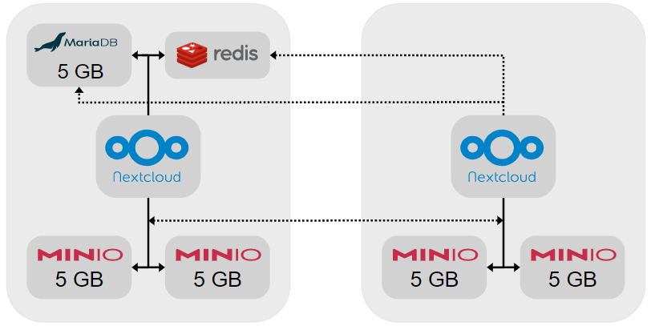
Architecture
Main objectives:
Scalability
Storage distribution
High availability
Notes:
For the architecture of our project, we focused on the main objectives of scalability, storage distribution and high availability.
As seen in the figure to the right, boxes containing nextcloud are the nodes. Every node has ist own nextcloud worker and part of the storage, as represented by MinIO. This diagram can be expanded horizontally as much as necessary, since the nextcloud workers are stateless and MinIO has no upper limit on servers.
Connected to the nodes you can see the node containing the database and cache, specifically MaraDB and Redis. This is the only factor limiting scalability, as every node has to access the database.
As for high availability, the only possible fail states are a failure of the node containing the database, as without a database connection the nextcloud nodes will not be able to function. The other possible point of failure is the MinIO object storage, however it has replication of data built in, therefore no data loss can occur.

Slide 9
Architecture ??
Used components:
MinIO
Redis
A database
MariaDB + MaxScale
Nextcloud
Cron

Slide 10
Live demonstration
-
Notes:
disease itself

Slide 11
Conclusion
Kubernetes
Powerful
Easy to setup
Nextcloud
Usefull application
Many different features
Expansion of pods
Adding of features
Notes:
disease itself

Slide 12
Thank you for your attention J

