Slide 1
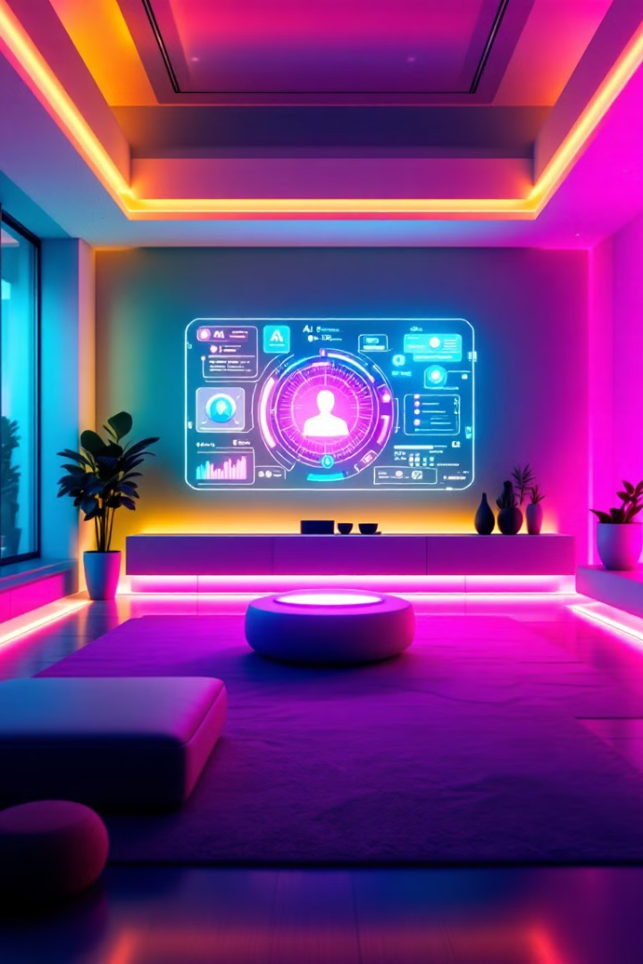

Lumi: AI-Powered Home Automation System
An Intelligent Assistant for Smart Home Control.
LO
by Landin Olandese

Slide 2

Agenda :
Problem statement
And Solution
Block Diagram and Demo
Initial Design & Current status
Under The Hood
Hands-free control
Future Plans
Advanced capabilities

Slide 3
Agenda :
Intro
About me, and this project
Problem statement
And Solution
Block Diagram and Demo
Initial Design & Current status
Under The Hood
Hands-free control
Future Plans
Advanced capabilities

Slide 4
Background:
My name is Landin, I studied Electrical Engineering at Oklahoma State University.
As a young kid, I was very curious about how the world worked. This manifested itself in my interest in taking things
apart - electronics mostly, and trying to build and automate things with them.
This presentation covers a project I've been excited about working on for the past few years, but just recently have been
able to allocate more time to.
The following showcases a home automation system I've implemented in my home, with AI governing and controlling it.

Slide 5
Agenda :
Intro
About me, and this project
Problem statement
And Solution
Block Diagram and Demo
Initial Design & Current status
Under The Hood
Hands-free control
Future Plans
Advanced capabilities

Slide 6
Problem Statement and Motives:
Privacy
Limited Interaction
Un-intuitive interactions
Smart home devices are always listening, sending your data elsewhere to be processed. I’d rather do that locally on my own terms.
Natural language control is often lacking. This limits accessibility. Telling your smart home your needs should feel natural, and conversational.
After OpenAI showcased ChatGPT, I was intrigued by doing some sort of engineering project with a local LLM.

Slide 7
Agenda :
Intro
About me, and this project
Problem statement
And Solution
Block Diagram and Demo
Initial Design & Current status
Under The Hood
Hands-free control
Future Plans
Advanced capabilities

Slide 8
I wanted to use
Fragmented Ecosystems
Unintuitive Interfaces
Limited Interaction
Smart home devices operate in silos. This makes unified control difficult.
Controlling devices requires multiple apps. This is not user-friendly.
Natural language control is often lacking. This limits accessibility.

Slide 9

Introducing Lumi: Your Conversational AI Assistant
1
Conversational AI
Lumi offers an intuitive way to manage your smart home.
2
Natural Language Processing
Control devices with simple voice commands.
3
Local Deployment
Privacy is paramount; processing occurs locally.
4
Seamless Integration
Works with your existing smart devices.

Slide 10




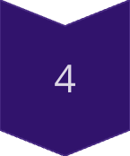
Technical Architecture: The Brains Behind Lumi
Ollama + Gemma 2
Powers natural language understanding.
Python Backend
Handles command processing.
ESP32 Microcontrollers
Enable device control.
WebSocket
Allows real-time communication.

Slide 11




Key Features: Simplifying Your Smart Home
Natural Language Control
Device Monitoring
Group Management
Control devices with voice or text.
Get real-time status updates.
Control devices in zones.

Slide 12

Implementation Details: How Lumi Works
Local LLM
1
Ensures privacy and reliability.
2
HTTP Server
Processes commands.
Context Management
3
Remembers past interactions.
4
State Polling
Tracks device status.

Slide 13

Lumi in Action: See the Magic
Example Interactions
Automation Scenarios
"Turn on the living room lights."
Automatically dim lights at sunset.
Web Interface
Simple and intuitive to use.

Slide 14



Challenges & Solutions: Overcoming Hurdles
Context Management
2
Conversation Tracking
Device Communication
1
Error Handling
Command Parsing
3
Structured AI

