Slide 1
Alpha Diversity ccl4

Slide 2
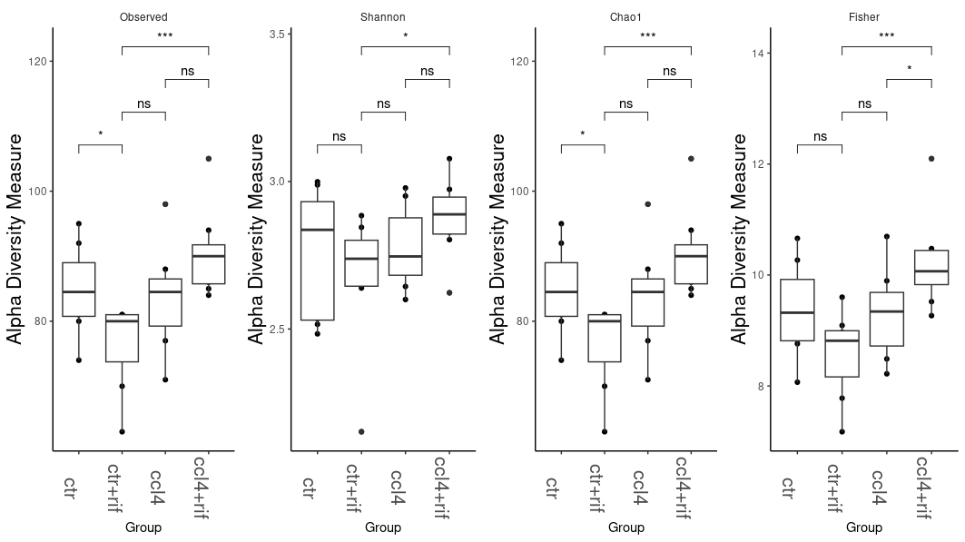
ps_2_genus

Slide 3
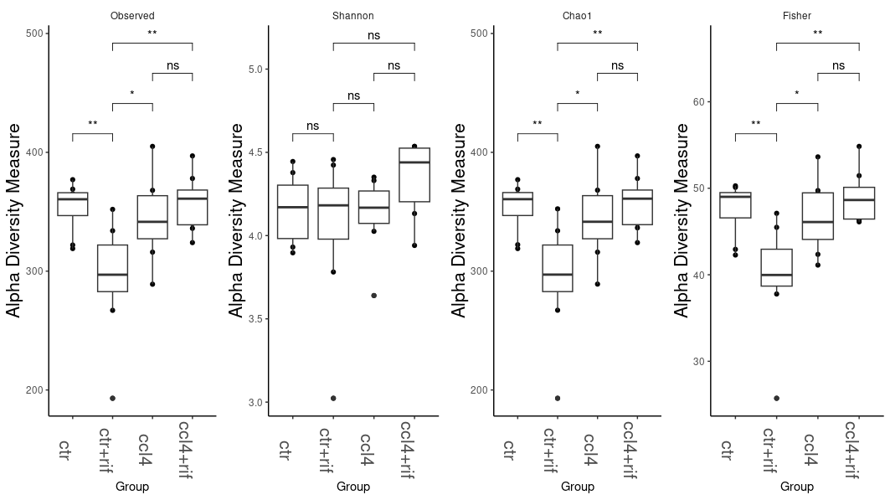
ps_2

Slide 4
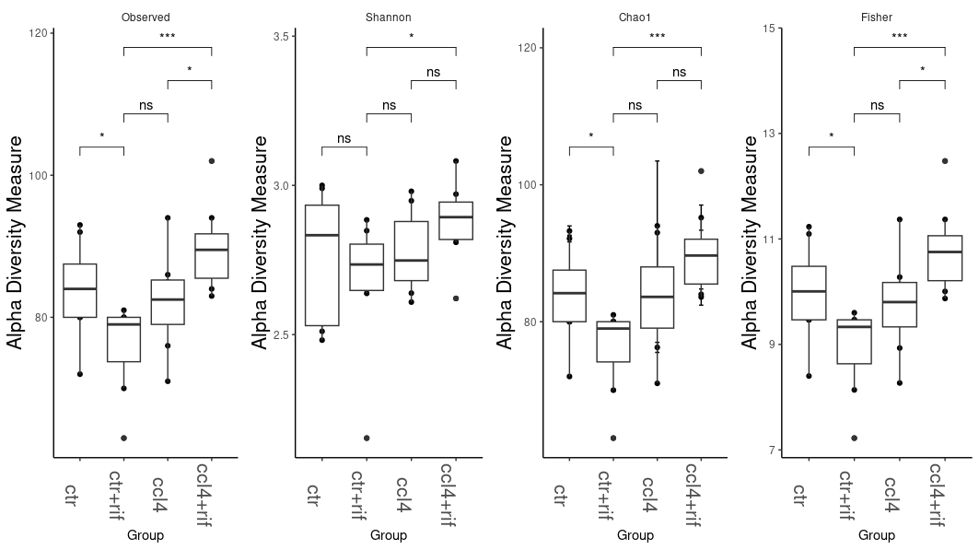
ps_raref_genus

Slide 5
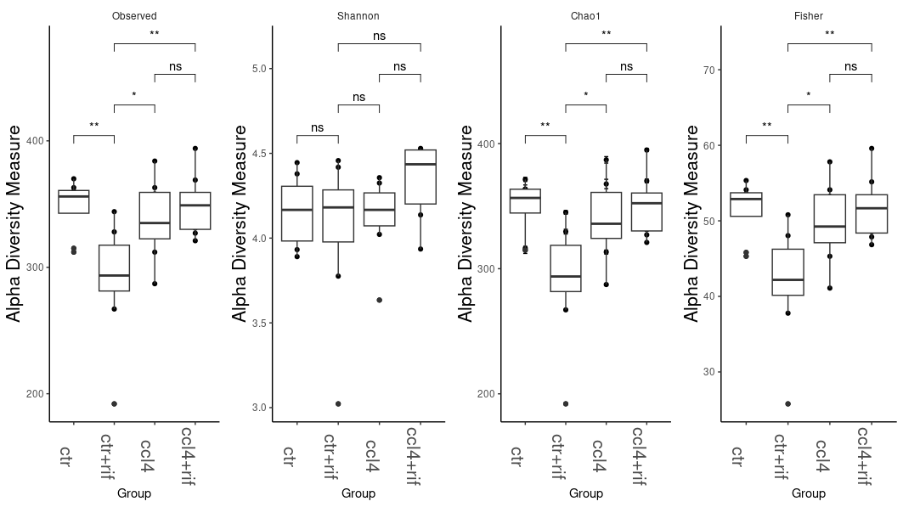
ps.rarefied.clean

Slide 6
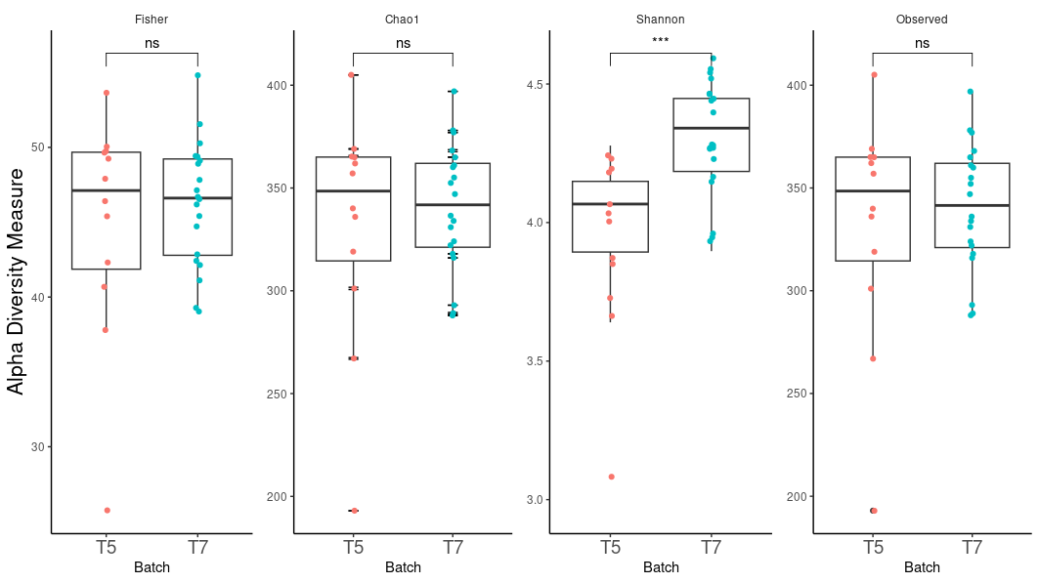
Ps_2 T5 vs T7

Slide 7
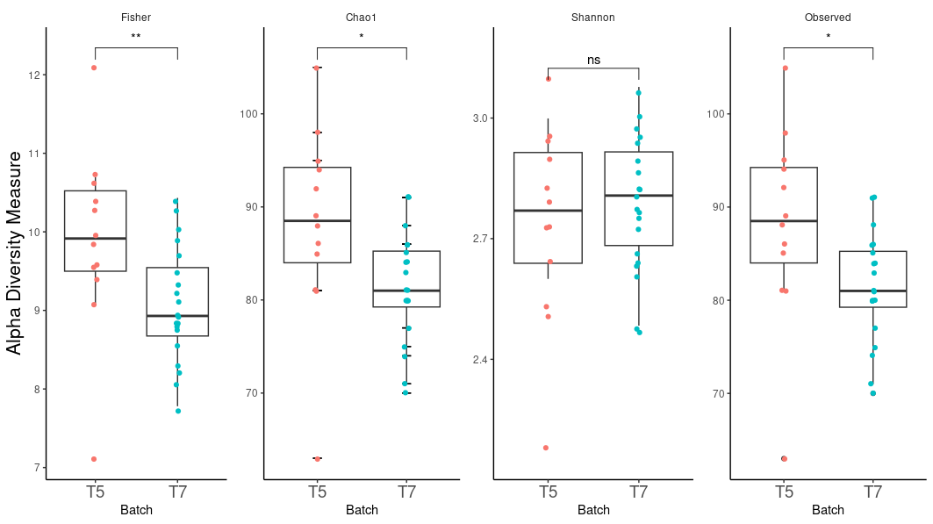
Ps_2_genus T5 vs T7

Slide 8
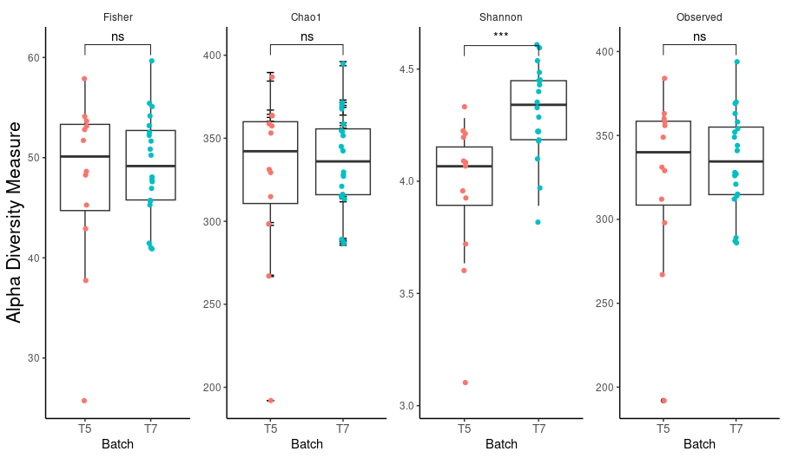
Ps.rarefied.clean T5 vs T7

Slide 9
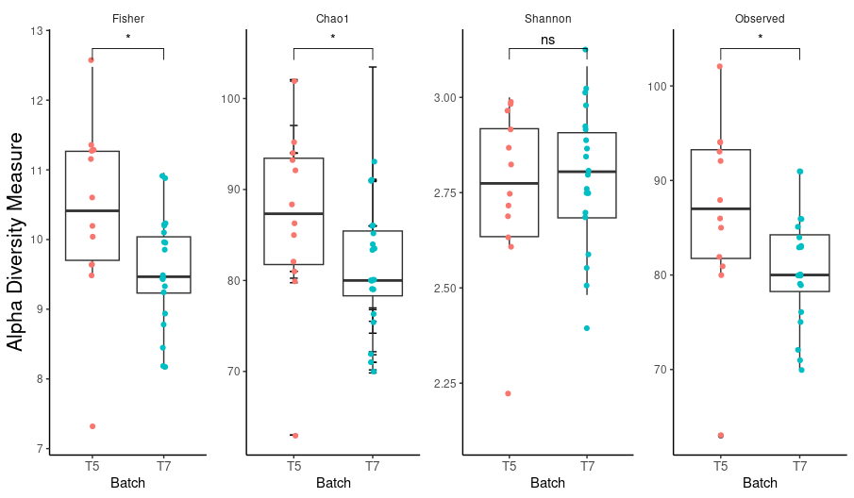
Ps_raref_genus T5 vs T7

Slide 10
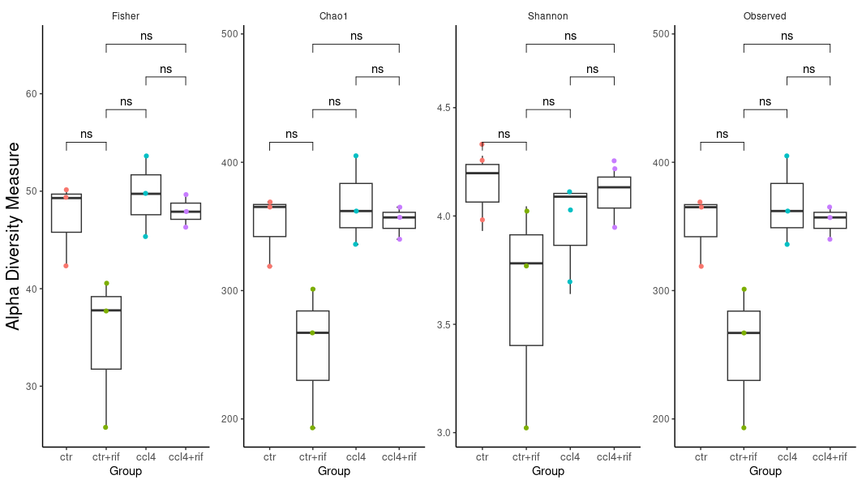
Only T5 ps_2

Slide 11
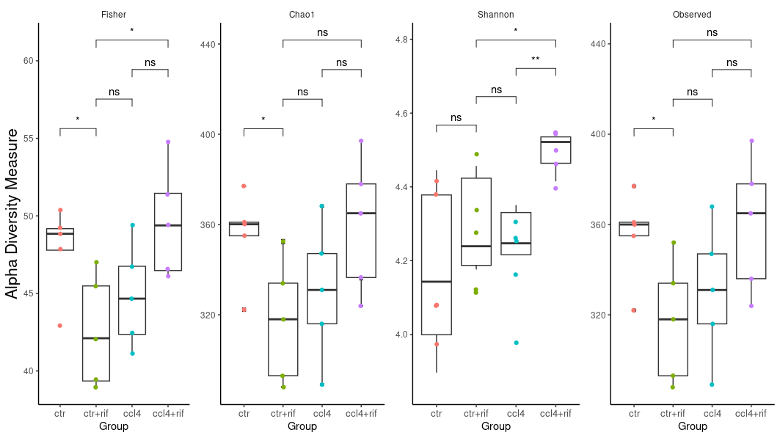
Only T7 ps_2

Slide 12
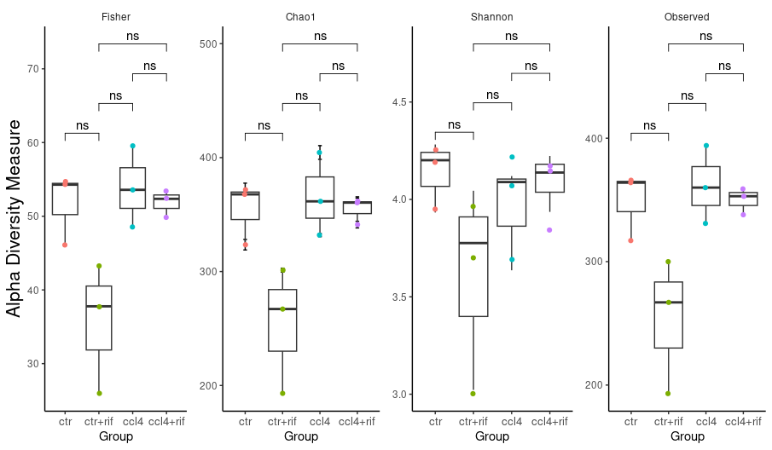
Only T5 ps.rarefied

Slide 13
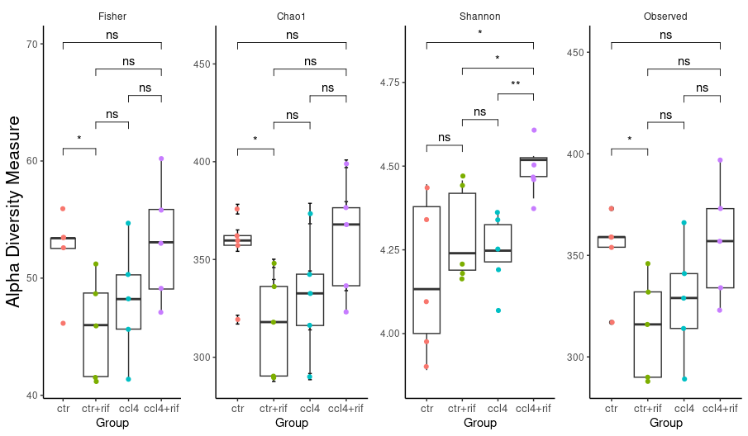
Only T7 ps.rarefied

