Slide 1
Alpha Diversity ccl4

Slide 2
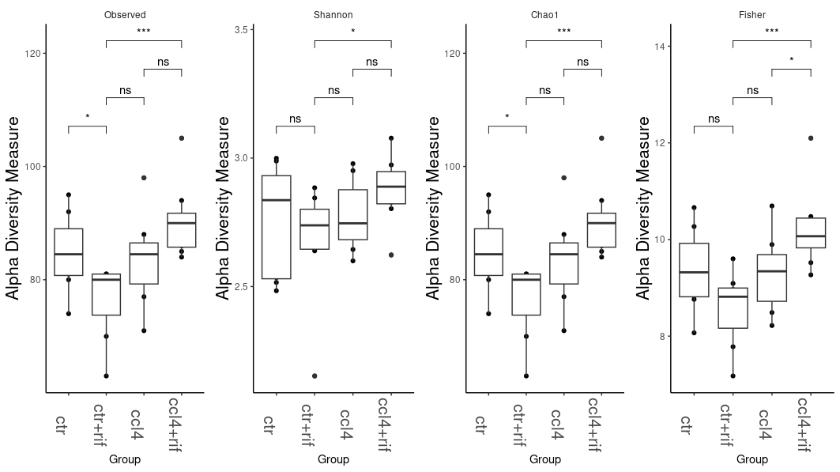
ps_2_genus

Slide 3
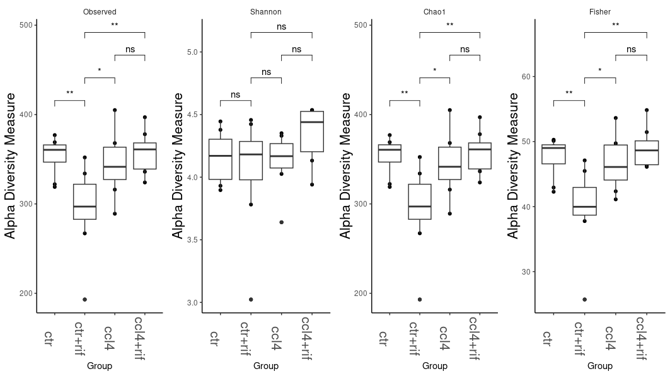
ps_2

Slide 4
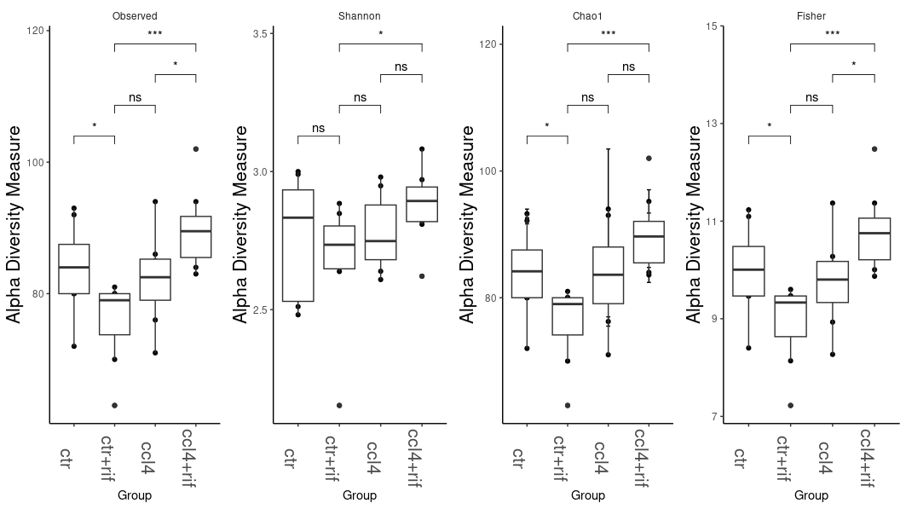
ps_raref_genus

Slide 5
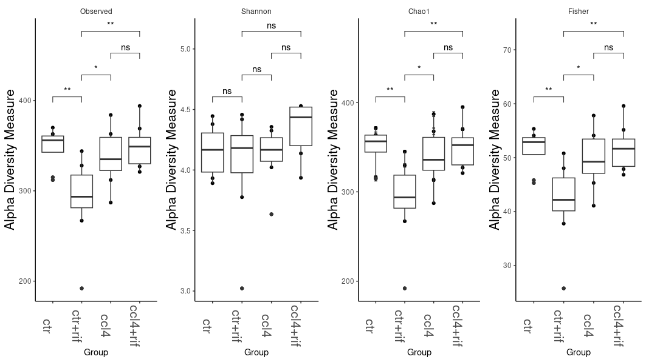
ps.rarefied.clean

Slide 6
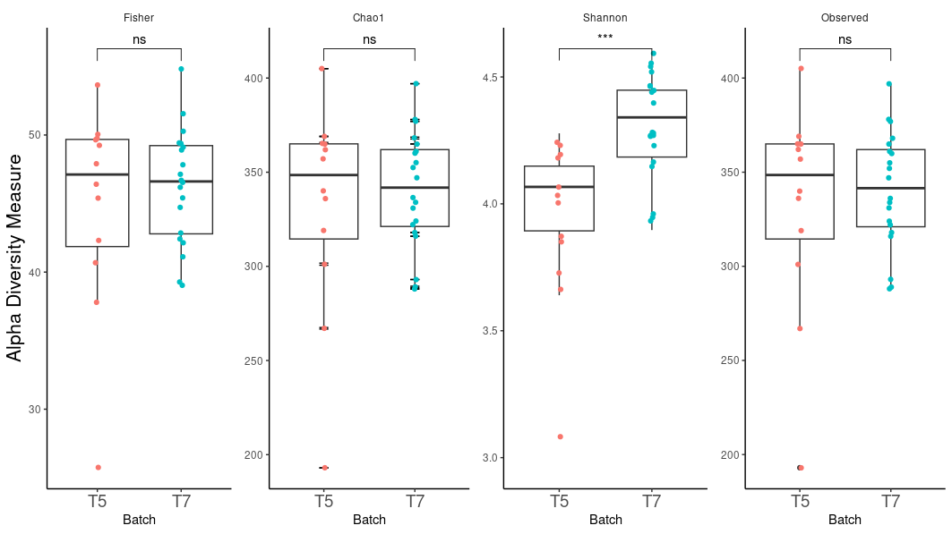
Ps_2 T5 vs T7

Slide 7
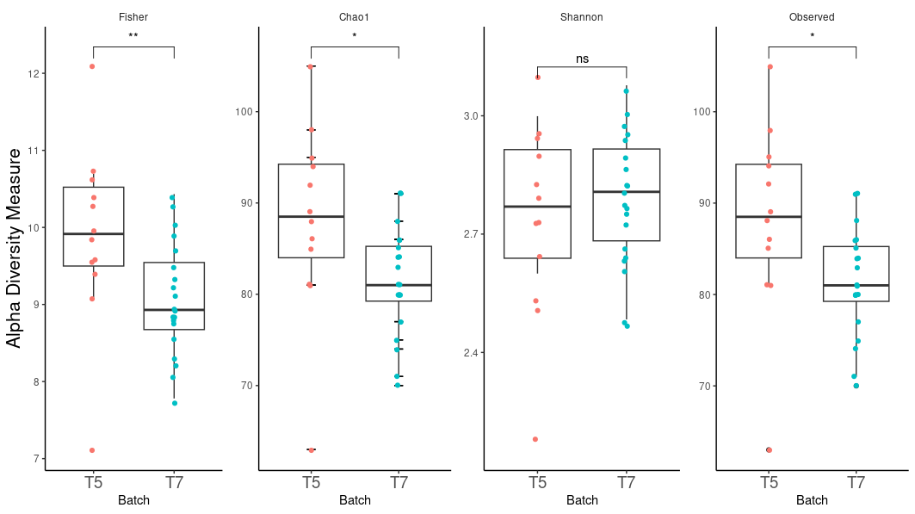
Ps_2_genus T5 vs T7

Slide 8
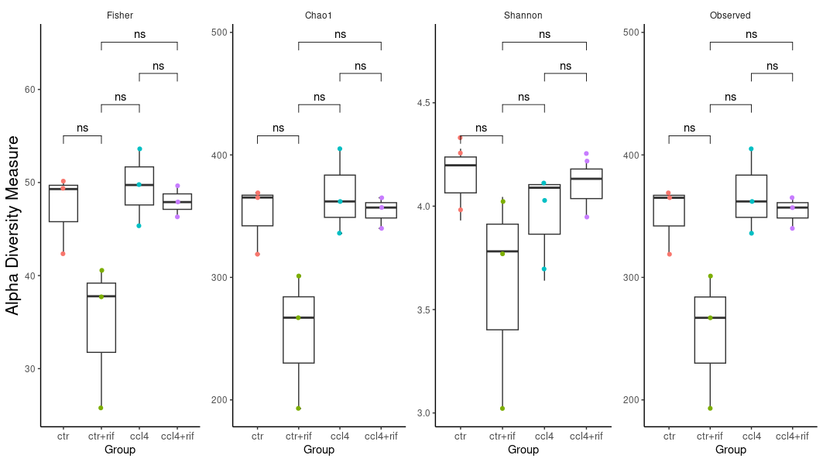
Only T5 ps_2

Slide 9
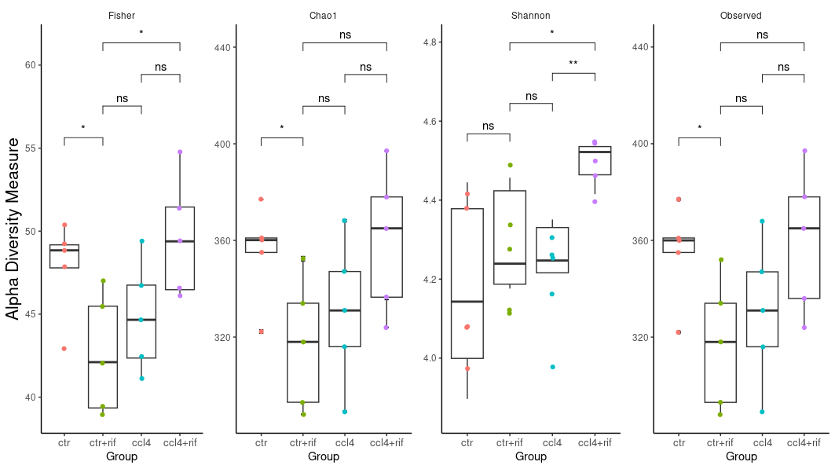
Only T7 ps_2

