Slide 1

eBay Don’t Get Kicked Classification Data Challenge
Meghan Ding
847.440.6922
menghanding2013@u.northwestern.edu

Slide 2
Problem Overview
Background: auto dealership purchase used cars at an auto auction is subjected to the risk of purchased vehicle having serious issues that prevent it from being sold to customers.
Goal: build a classifier to identify possibly defected used cars at auto auction that has no resale value.

Slide 3
Data
Data:
Training set: 72983 rows of historical auction record of car dealers for used cars, with 32 features in past purchasing history, car models and specs, and label of whether the car is a bad buy (kicked) or not.
Testing set: 72983 rows of historical auction record of car dealers for used cars, with 32 features in past purchasing history, car models and specs.
Missing data: 10 columns has missing data

Slide 4
Feature Engineering:
Impute/Transform Missing Values:
Transform ‘Trim’ to binary variable ‘Trim2’ indicating whether car has trim
Impute ‘Transmission’, ‘WheelType’, ‘Nationality’, ‘Size’, ‘TopThreeAmericanName’ with mode value
Impute price variables with median value
Impute ‘AUCGUART’ with ‘YELLOW’ neutral level
Recode/Extract New Features:
Extract new binary features '4D', '2D', 'SEDAN', 'SUV', 'SPORT', 'MINIVAN', 'WAGON', 'COUPE', 'PASSENGER', 'CAB', 'CONVERTIBLE','UTILITY’ from ‘Submodel’
Recode ‘Make’ into top 4 levels and other
Recode ‘Size’ into medium, large, and small
Recode State into top 5 States and other
Extracted premium and depreciation of car’s auction/retail price as percentage of purchase price
Consider extract binary variables from most frequent tokens of ‘Model’ column as a corpus
One hot encode all multi-level categorical variables
Normalize numeric variables

Slide 5
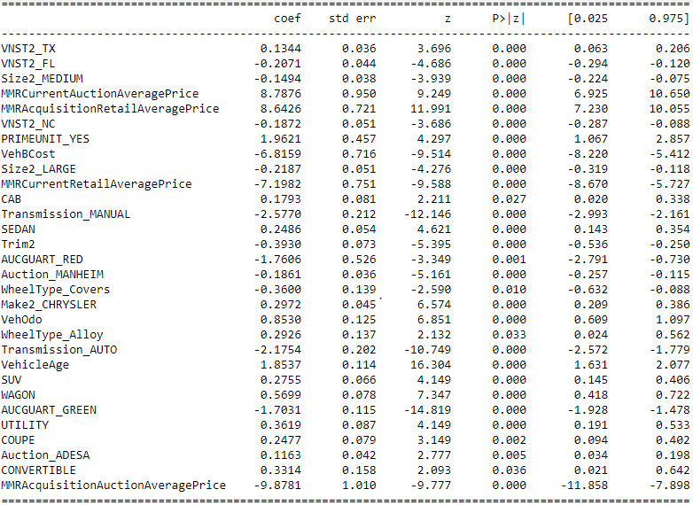
Methodology
Model: Logistic Regression
Final selected features: 29 features

Slide 6
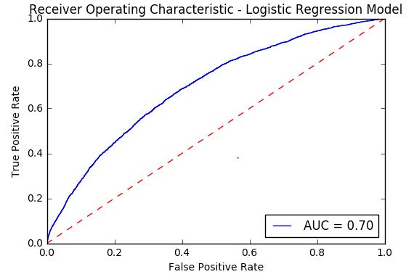
Model Validation
Accuracy Score: 88%
Recall: 99.9%
Specification: 0.03%
Precision: 88%
F1 score: 93.5%

Slide 7
Important Insights
Pricing factor: vehicle’s pricing has interesting impact on vehicle’s chance to be kicked. Specifically, the higher the current average auction price and the lower the current average retail price, the higher the chance that the car will be kicked back, since going back to auction other than retail for this car has a larger chance of recovering purchase value. The higher the historical purchase price and the lower the historical retail price, the higher the chance that the car will be kicked back, since the car is more likely to be over-valued and over-paid at time when initial purchase happened.
Vehicle condition at purchase: cars initially purchased at a higher price, will less likely be a kicked car, since the higher premium paid, the better quality the car is inspected to be at the time of purchase. However, the larger the mileages put on the car and older the car is at purchase, the higher the chance that the car will be kicked for issues happening in the future.
Car features: manual cars are less likely to be kicked back, as manual car are more of a niche car with inelastic demand that serve the choosers. Car at higher demand in the market than other cars on average will have higher chance to be kicked back, as the popularity factor may cause the car to be initially paid for at higher price (valued with lower risk of not being sold).

