Slide 1
EEL 6586: AUTOMATIC SPEECH PROCESSING
Speech Features Lecture
Mark D. Skowronski
Computational Neuro-Engineering Lab
University of Florida
February 20, 2006

Slide 2
What are speech features?
Speech features are:
  A linear/nonlinear projection of raw speech,
  A compressed representation,
  Salient and succinct characteristics (for a given application).

Slide 3
Why extract features?
Applications
  Communications
  Automatic speech recognition
  Speaker identification/verification
Feature extraction allows for the addition of expert information into the solution.

Slide 4
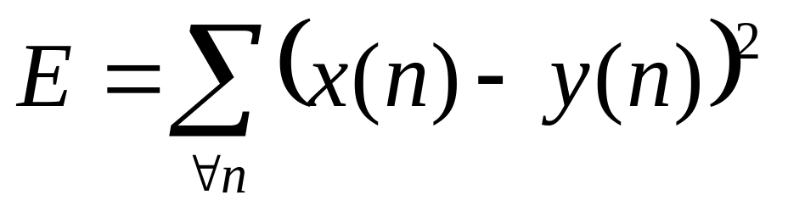
Application example
Automatic speech recognition between two speech utterances x(n) and y(n).
Naïve approach:
Problems w/ this approach?

Slide 5
Naïve approach limitations
x(n) = -1*y(n), yet E≠0
x(n) = α* y(n), yet E≠0
x(n) = y(n-m), yet E≠0
These variations can be removed by considering the normalized magnitude spectrum.

Slide 6
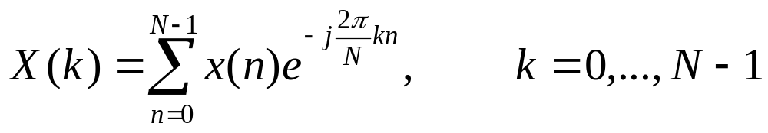
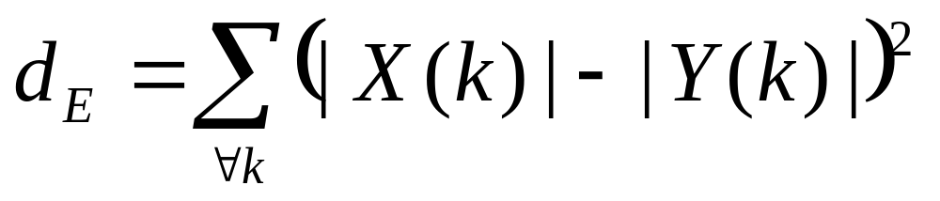
Frequency domain features
The Fourier transform:
Then consider the Euclidean distance between |X(k)| and |Y(k)|:
What about pitch?

Slide 7
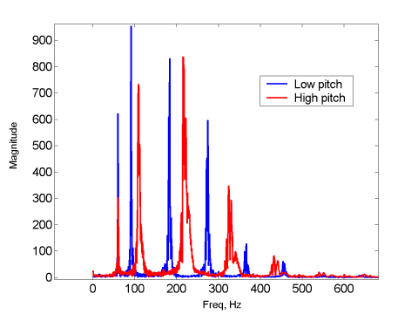
Pitch harmonics
Pitch harmonics reduce overlap between spectra.
Can we remove pitch? How?

Slide 8
Pitch-free speech features
Linear prediction (1967)
  Parametric estimator: all-pole filter for vocal tract model
  Hugs peaks of spectra
  Computationally inexpensive
  Transformable to more stable domains (cepstrum, reflection, pole pairs)

Slide 9
Pitch-free speech features
Linear prediction (1967)
  Parameters sensitive to noise, numeric precision
  Doesn’t model zeros in vocal tract transfer function (nasals, additive noise)
  Model order empirically determined:
    Too low: miss formants
    Too high: represent pitch information

Slide 10
Pitch-free speech features
Cepstrum (1962)
  Nonparametric estimator: homomorphic filtering transforms convolution to addition
  Pitch removed by low-time liftering in quefrency domain
  Orthogonal outputs
  Cepstral mean subtraction (removes stationary convolutive channel effects)

Slide 11
Pitch-free speech features
Cepstrum (1962)
  Doesn’t consider human auditory system characteristics (critical bands)
  Sensitive to outliers from log compression of noisy spectrum (“sum of the log” approach)

Slide 12
Modern improvements
Perceptual linear prediction (Hermansky,1990)
  Performs LP on the output of perceptually motivated filter banks
  Filter bank smoothes pitch (and noise)
  All the same benefits as LPC
Mel frequency cepstral coefficients (Davis & Mermelstein, 1980)
  Replace magnitude spectrum with mel-spaced filter bank energy
  Filter bank smoothes pitch (and noise)
  Orthogonal outputs (Gaussian modeling)

Slide 13
Modern improvements
Human factor cepstral coefficients (Skowronski & Harris, 2002)
  Decouples filter bandwidth from other filter spacing
  Sets bandwidth according to critical band expressions for the human auditory system
  Bandwidth may also be optimized to control trade-off between local SNR and spectral resolution

Slide 14
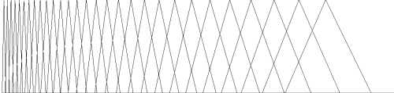
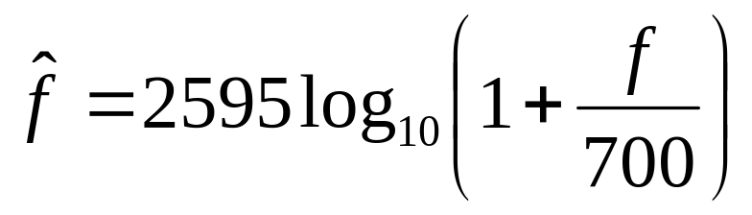
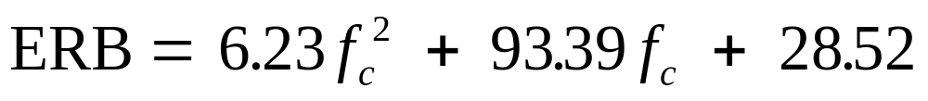
HFCC filter bank
Filters equally spaced in Fant’s mel frequency:
Uses Moore and Glasberg approximation of critical bandwidth, defined in Equivalent Rectangular Bandwidth (ERB):

Slide 15
Other features
Temporal features
  Static features (position)
  Δ: first derivative in time of each feature (velocity) (1981)
  ΔΔ: second derivative in time (acceleration) (1981)
Cepstral Mean Subtraction (1974)
  Convolution constant → Additive constant
  Removes static channel effects (microphone)

Slide 16
Typical feature matrix
Acceleration
Velocity
Position
Features
Time

Slide 17
References
Auditory Toolbox for Matlab
  Malcolm Slaney, MFCC code
  http://rvl4.ecn.purdue.edu/~malcolm/interval/1998-010/
HFCC and other Matlab tools
  HFCC.zip at http://www.cnel.ufl.edu/~markskow/

