Slide 1
CS 224S / LINGUIST 281
Speech Recognition, Synthesis, and Dialogue
Dan Jurafsky
Lecture 10: Acoustic Modeling
IP Notice:

Slide 2
Outline for Today
Speech Recognition Architectural Overview
Hidden Markov Models in general and for speech
  Forward
  Viterbi Decoding
How this fits into the ASR component of course
  Jan 27 HMMs, Forward, Viterbi,
  Jan 29 Baum-Welch (Forward-Backward)
  Feb 3: Feature Extraction, MFCCs, start of AM (VQ)
  Feb 5: Acoustic Modeling: GMMs
  Feb 10: N-grams and Language Modeling
  Feb 24: Search and Advanced Decoding
  Feb 26: Dealing with Variation
  Mar 3: Dealing with Disfluencies

Slide 3
Outline for Today
Acoustic Model
  Increasingly sophisticated models
  Acoustic Likelihood for each state:
    Gaussians
    Multivariate Gaussians
    Mixtures of Multivariate Gaussians
  Where a state is progressively:
    CI Subphone (3ish per phone)
    CD phone (=triphones)
    State-tying of CD phone
If Time: Evaluation
  Word Error Rate

Slide 4
Reminder: VQ
To compute p(o_{t}|q_{j})
  Compute distance between feature vector o_{t}
    and each codeword (prototype vector)
    in a preclustered codebook
    where distance is either
      Euclidean
      Mahalanobis
  Choose the vector that is the closest to o_{t}
    and take its codeword v_{k}
  And then look up the likelihood of v_{k} given HMM state j in the B matrix
B_{j}(o_{t})=b_{j}(v_{k}) s.t. v_{k} is codeword of closest vector to o_{t}
Using Baum-Welch as above

Slide 5
Computing b_{j}(v_{k})
Slide from John-Paul Hosum, OHSU/OGI
feature value 2
for state j
feature value 1 for state j
b_{j}(v_{k}) = number of vectors with codebook index k in state j
number of vectors in state j
14 1
= =
56 4

Slide 6
Summary: VQ
Training:
  Do VQ and then use Baum-Welch to assign probabilities to each symbol
Decoding:
  Do VQ and then use the symbol probabilities in decoding

Slide 7
Directly Modeling Continuous Observations
Gaussians
  Univariate Gaussians
    Baum-Welch for univariate Gaussians
  Multivariate Gaussians
    Baum-Welch for multivariate Gausians
  Gaussian Mixture Models (GMMs)
    Baum-Welch for GMMs

Slide 8
Better than VQ
VQ is insufficient for real ASR
Instead: Assume the possible values of the observation feature vector o_{t} are normally distributed.
Represent the observation likelihood function b_{j}(o_{t}) as a Gaussian with mean μ_{j} and variance σ_{j}²

Slide 9
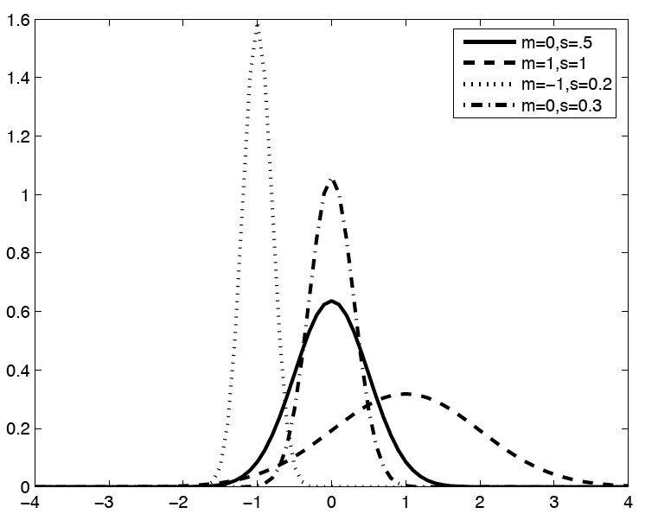
Gaussians are parameters by mean and variance

Slide 10
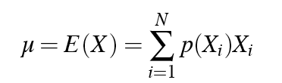

Reminder: means and variances
For a discrete random variable X
Mean is the expected value of X
  Weighted sum over the values of X
Variance is the squared average deviation from mean

Slide 11
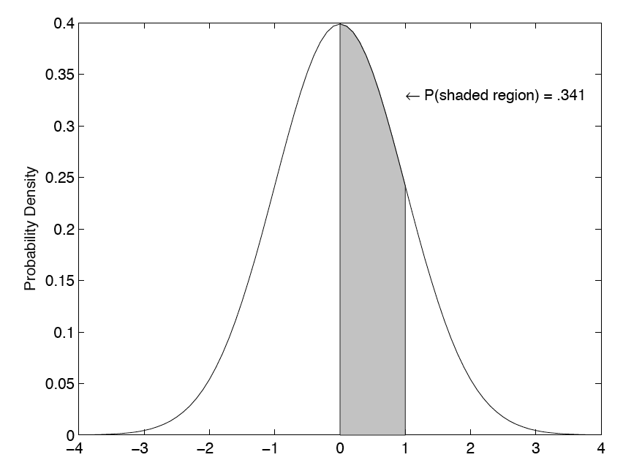
Gaussian as Probability Density Function

Slide 12
Gaussian PDFs
A Gaussian is a probability density function; probability is area under curve.
To make it a probability, we constrain area under curve = 1.
BUT…
  We will be using “point estimates”; value of Gaussian at point.
Technically these are not probabilities, since a pdf gives a probability over a interval, needs to be multiplied by dx
As we will see later, this is ok since the same value is omitted from all Gaussians, so argmax is still correct.

Slide 13
Gaussians for Acoustic Modeling
A Gaussian is parameterized by a mean and a variance:
Different means
P(o|q):
P(o|q) is highest here at mean
P(o|q)
P(o|q is low here, very far from mean)
o

Slide 14
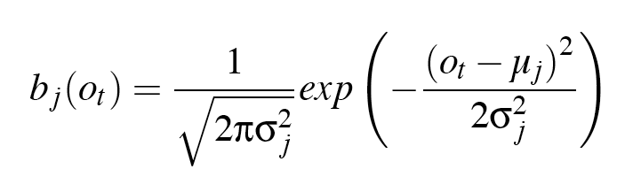
Using a (univariate Gaussian) as an acoustic likelihood estimator
Let’s suppose our observation was a single real-valued feature (instead of 39D vector)
Then if we had learned a Gaussian over the distribution of values of this feature
We could compute the likelihood of any given observation o_{t} as follows:

Slide 15
Training a Univariate Gaussian
A (single) Gaussian is characterized by a mean and a variance
Imagine that we had some training data in which each state was labeled
We could just compute the mean and variance from the data:

Slide 16
Training Univariate Gaussians
But we don’t know which observation was produced by which state!
What we want: to assign each observation vector o_{t} to every possible state i, prorated by the probability the the HMM was in state i at time t.
The probability of being in state i at time t is ξ_{t}(i)!!

Slide 17
Multivariate Gaussians
Instead of a single mean μ and variance σ:
Vector of observations x modeled by vector of means μ and covariance matrix Σ

Slide 18
Multivariate Gaussians
Defining μ and Σ
So the i-jth element of Σ is:

Slide 19
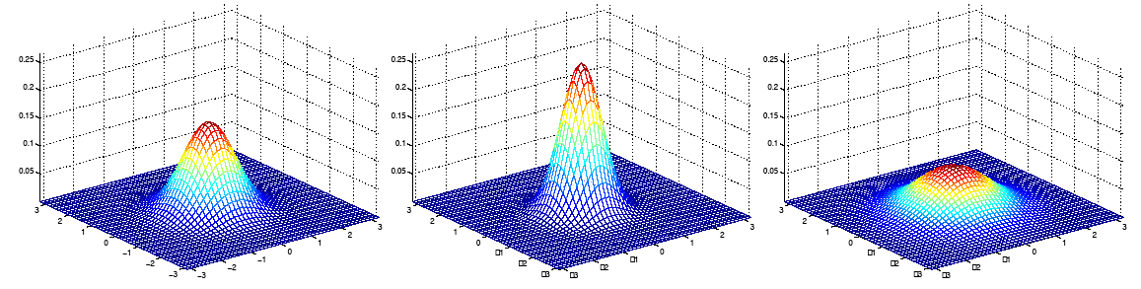
Gaussian Intuitions: Size of Σ
μ = [0 0] μ = [0 0] μ = [0 0]
Σ = I Σ = 0.6I Σ = 2I
As Σ becomes larger, Gaussian becomes more spread out; as Σ becomes smaller, Gaussian more compressed
Text and figures from Andrew Ng’s lecture notes for CS229

Slide 20
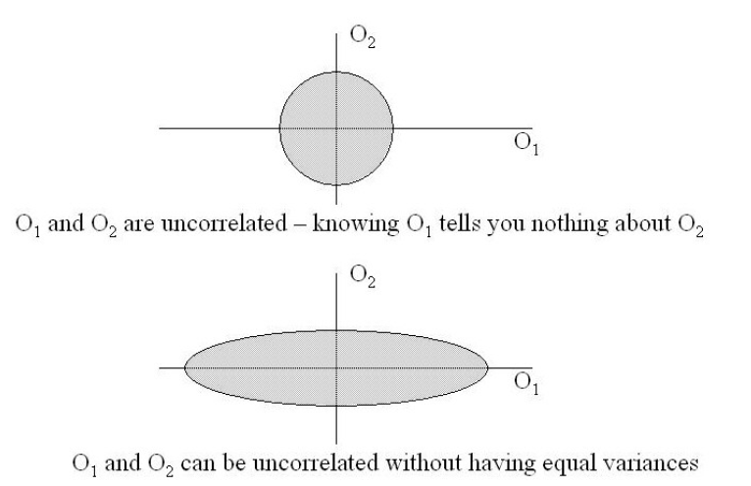
From Chen, Picheny et al lecture slides

Slide 21
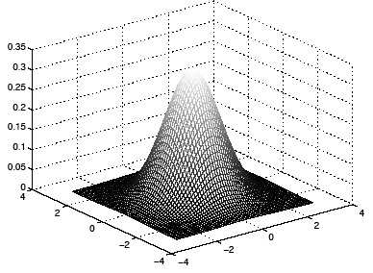
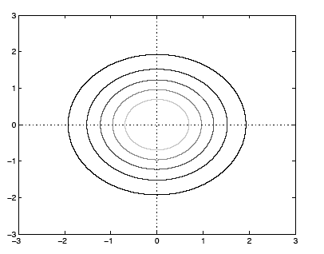
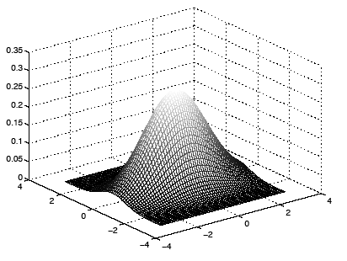
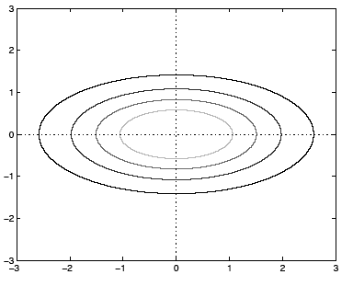
[1 0] [.6 0]
[0 1] [ 0 2]
Different variances in different dimensions

Slide 22
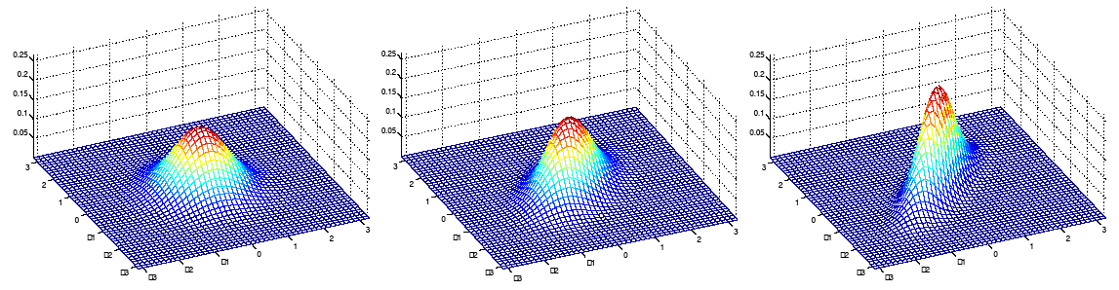
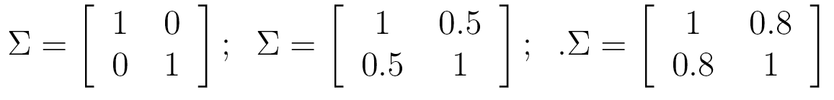
Gaussian Intuitions: Off-diagonal
As we increase the off-diagonal entries, more correlation between value of x and value of y
Text and figures from Andrew Ng’s lecture notes for CS229

Slide 23
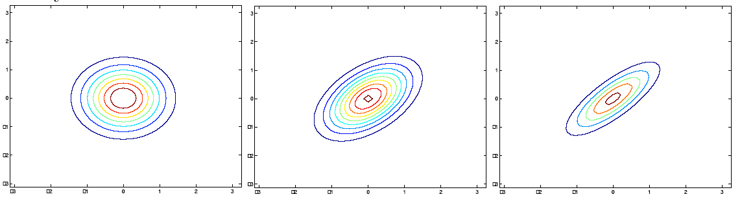
Gaussian Intuitions: off-diagonal
As we increase the off-diagonal entries, more correlation between value of x and value of y
Text and figures from Andrew Ng’s lecture notes for CS229

Slide 24
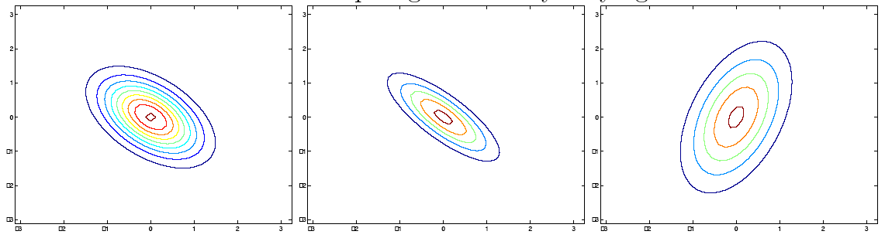
Gaussian Intuitions: off-diagonal and diagonal
Decreasing non-diagonal entries (#1-2)
Increasing variance of one dimension in diagonal (#3)
Text and figures from Andrew Ng’s lecture notes for CS229

Slide 25
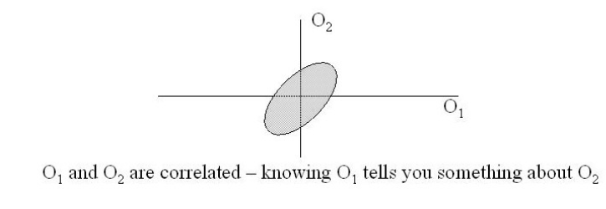
In two dimensions
From Chen, Picheny et al lecture slides

Slide 26
But: assume diagonal covariance
I.e., assume that the features in the feature vector are uncorrelated
This isn’t true for FFT features, but is true for MFCC features, as we saw las time
Computation and storage much cheaper if diagonal covariance.
I.e. only diagonal entries are non-zero
Diagonal contains the variance of each dimension σ_{ii}²
So this means we consider the variance of each acoustic feature (dimension) separately

Slide 27
Diagonal covariance
Diagonal contains the variance of each dimension σ_{ii}²
So this means we consider the variance of each acoustic feature (dimension) separately

Slide 28
Baum-Welch reestimation equations for multivariate Gaussians
Natural extension of univariate case, where now μ_{i} is mean vector for state i:

Slide 29
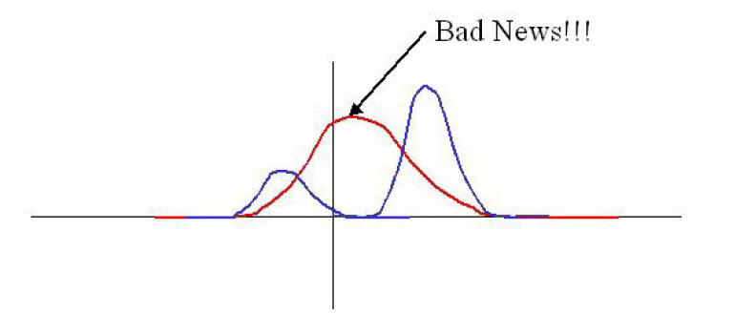
But we’re not there yet
Single Gaussian may do a bad job of modeling distribution in any dimension:
Solution: Mixtures of Gaussians
Figure from Chen, Picheney et al slides

Slide 30
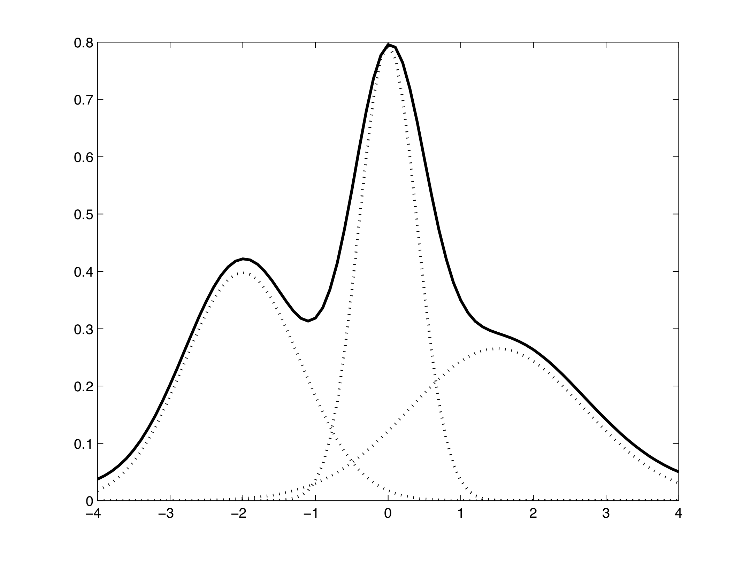
Mixture of Gaussians to model a function

Slide 31
Mixtures of Gaussians
M mixtures of Gaussians:
For diagonal covariance:

Slide 32
GMMs
Summary: each state has a likelihood function parameterized by:
  M Mixture weights
  M Mean Vectors of dimensionality D
  Either
    M Covariance Matrices of DxD
  Or more likely
    M Diagonal Covariance Matrices of DxD
    which is equivalent to
    M Variance Vectors of dimensionality D

Slide 33
Training a GMM
Problem: how do we train a GMM if we don’t know what component is accounting for aspects of any particular observation?
Intuition: we use Baum-Welch to find it for us, just as we did for finding hidden states that accounted for the observation

Slide 34
Baum-Welch for Mixture Models
By analogy with ξ earlier, let’s define the probability of being in state j at time t with the k^{th} mixture component accounting for o_{t}:
Now,

Slide 35
How to train mixtures?
Choose M (often 16; or can tune M dependent on amount of training observations)
Then can do various splitting or clustering algorithms
One simple method for “splitting”:
Compute global mean μ and global variance
Split into two Gaussians, with means μ±ε (sometimes ε is 0.2σ)
Run Forward-Backward to retrain
Go to 2 until we have 16 mixtures

Slide 36
Embedded Training
Components of a speech recognizer:
  Feature extraction: not statistical
  Language model: word transition probabilities, trained on some other corpus
  Acoustic model:
    Pronunciation lexicon: the HMM structure for each word, built by hand
    Observation likelihoods bj(ot)
    Transition probabilities aij
CS 224S Winter 2007

Slide 37
Embedded training of acoustic model
If we had hand-segmented and hand-labeled training data
With word and phone boundaries
We could just compute the
  B: means and variances of all our triphone gaussians
  A: transition probabilities
And we’d be done!
But we don’t have word and phone boundaries, nor phone labeling
CS 224S Winter 2007

Slide 38
Embedded training
Instead:
  We’ll train each phone HMM embedded in an entire sentence
  We’ll do word/phone segmentation and alignment automatically as part of training process
CS 224S Winter 2007

Slide 39
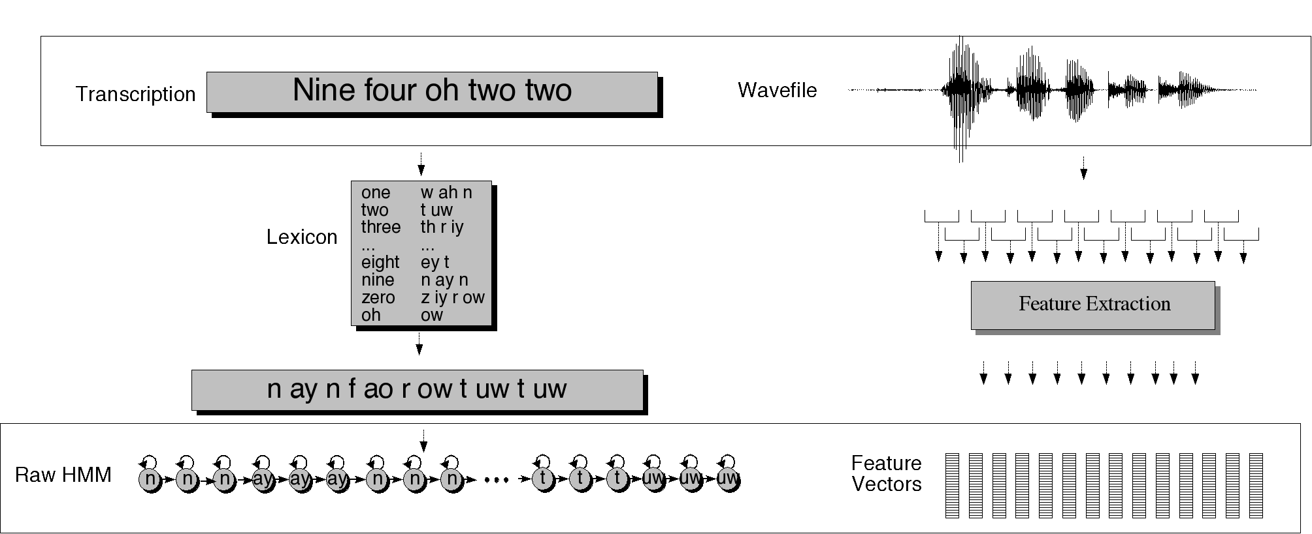
Embedded Training
CS 224S Winter 2007

Slide 40
Initialization: “Flat start”
Transition probabilities:
  set to zero any that you want to be “structurally zero”
    The γ probability computation includes previous value of a_{ij}, so if it’s zero it will never change
  Set the rest to identical values
Likelihoods:
  initialize μ and σ of each state to global mean and variance of all training data

Slide 41
Embedded Training
Given: phoneset, pron lexicon, transcribed wavefiles
  Build a whole sentence HMM for each sentence
  Initialize A probs to 0.5, or to zero
  Initialize B probs to global mean and variance
  Run multiple iteractions of Baum Welch
    During each iteration, we compute forward and backward probabilities
  Use them to re-estimate A and B
  Run Baum-Welch til converge

Slide 42
Viterbi training
Baum-Welch training says:
  We need to know what state we were in, to accumulate counts of a given output symbol o_{t}
  We’ll compute ξ_{I}(t), the probability of being in state i at time t, by using forward-backward to sum over all possible paths that might have been in state i and output o_{t}.
Viterbi training says:
  Instead of summing over all possible paths, just take the single most likely path
  Use the Viterbi algorithm to compute this “Viterbi” path
  Via “forced alignment”
CS 224S Winter 2007

Slide 43
Forced Alignment
Computing the “Viterbi path” over the training data is called “forced alignment”
Because we know which word string to assign to each observation sequence.
We just don’t know the state sequence.
So we use a_{ij} to constrain the path to go through the correct words
And otherwise do normal Viterbi
Result: state sequence!
CS 224S Winter 2007

Slide 44
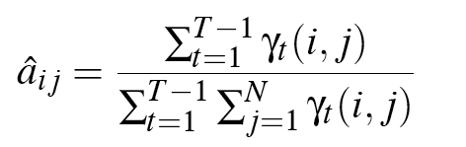
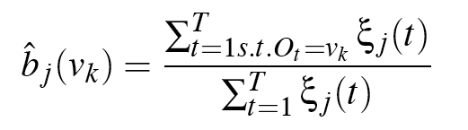
Viterbi training equations
Viterbi Baum-Welch
For all pairs of emitting states,
1 <= i, j <= N
Where n_{ij} is number of frames with transition from i to j in best path
And n_{j} is number of frames where state j is occupied
CS 224S Winter 2007

Slide 45
Viterbi Training
Much faster than Baum-Welch
But doesn’t work quite as well
But the tradeoff is often worth it.
CS 224S Winter 2007

Slide 46
Viterbi training (II)
Equations for non-mixture Gaussians
Viterbi training for mixture Gaussians is more complex, generally just assign each observation to 1 mixture
CS 224S Winter 2007

Slide 47
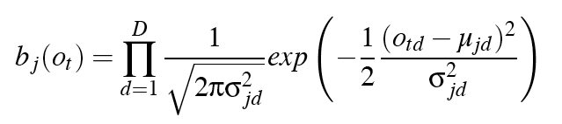
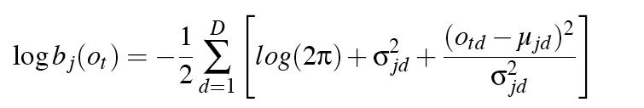
Log domain
In practice, do all computation in log domain
Avoids underflow
  Instead of multiplying lots of very small probabilities, we add numbers that are not so small.
Single multivariate Gaussian (diagonal Σ) compute:
In log space:
CS 224S Winter 2007

Slide 48
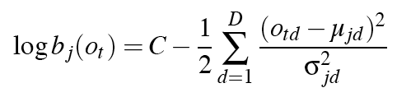
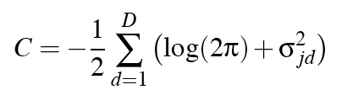
Log domain
Repeating:
With some rearrangement of terms
Where:
Note that this looks like a weighted Mahalanobis distance!!!
Also may justify why we these aren’t really probabilities (point estimates); these are really just distances.
CS 224S Winter 2007

Slide 49
Evaluation
How to evaluate the word string output by a speech recognizer?

Slide 50
Word Error Rate
Word Error Rate =
100 (Insertions+Substitutions + Deletions)
------------------------------
Total Word in Correct Transcript
Aligment example:
REF: portable **** PHONE UPSTAIRS last night so
HYP: portable FORM OF STORES last night so
Eval I S S
WER = 100 (1+2+0)/6 = 50%

Slide 51
NIST sctk-1.3 scoring softare:
Computing WER with sclite
http://www.nist.gov/speech/tools/
Sclite aligns a hypothesized text (HYP) (from the recognizer) with a correct or reference text (REF) (human transcribed)
id: (2347-b-013)
Scores: (#C #S #D #I) 9 3 1 2
REF: was an engineer SO I i was always with **** **** MEN UM and they
HYP: was an engineer ** AND i was always with THEM THEY ALL THAT and they
Eval: D S I I S S

Slide 52
Sclite output for error analysis
CONFUSION PAIRS Total (972)
With >= 1 occurances (972)
1: 6 -> (%hesitation) ==> on
2: 6 -> the ==> that
3: 5 -> but ==> that
4: 4 -> a ==> the
5: 4 -> four ==> for
6: 4 -> in ==> and
7: 4 -> there ==> that
8: 3 -> (%hesitation) ==> and
9: 3 -> (%hesitation) ==> the
10: 3 -> (a-) ==> i
11: 3 -> and ==> i
12: 3 -> and ==> in
13: 3 -> are ==> there
14: 3 -> as ==> is
15: 3 -> have ==> that
16: 3 -> is ==> this

Slide 53
Sclite output for error analysis
17: 3 -> it ==> that
18: 3 -> mouse ==> most
19: 3 -> was ==> is
20: 3 -> was ==> this
21: 3 -> you ==> we
22: 2 -> (%hesitation) ==> it
23: 2 -> (%hesitation) ==> that
24: 2 -> (%hesitation) ==> to
25: 2 -> (%hesitation) ==> yeah
26: 2 -> a ==> all
27: 2 -> a ==> know
28: 2 -> a ==> you
29: 2 -> along ==> well
30: 2 -> and ==> it
31: 2 -> and ==> we
32: 2 -> and ==> you
33: 2 -> are ==> i
34: 2 -> are ==> were

Slide 54
Better metrics than WER?
WER has been useful
But should we be more concerned with meaning (“semantic error rate”)?
  Good idea, but hard to agree on
  Has been applied in dialogue systems, where desired semantic output is more clear

Slide 55
Summary: ASR Architecture
Five easy pieces: ASR Noisy Channel architecture
  Feature Extraction:
    39 “MFCC” features
  Acoustic Model:
    Gaussians for computing p(o|q)
  Lexicon/Pronunciation Model
    HMM: what phones can follow each other
  Language Model
    N-grams for computing p(w_{i}|w_{i-1})
  Decoder
    Viterbi algorithm: dynamic programming for combining all these to get word sequence from speech!

Slide 56
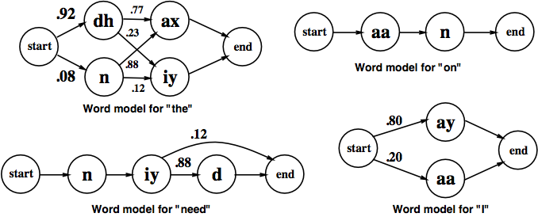
ASR Lexicon: Markov Models for pronunciation

Slide 57
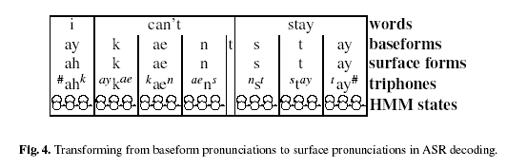
Pronunciation Modeling
Generating surface forms:
Eric Fosler-Lussier slide
Notes:
Transition to next slide: where did the middle layers come from?

Slide 58
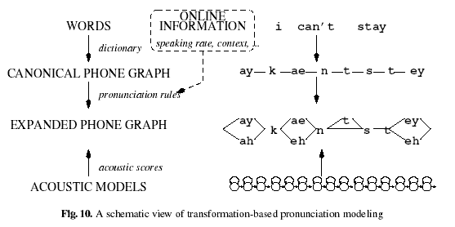
Dynamic Pronunciation Modeling
Slide from Eric Fosler-Lussier

Slide 59
Summary
Speech Recognition Architectural Overview
Hidden Markov Models in general
  Forward
  Viterbi Decoding
Hidden Markov models for Speech
Evaluation

