Slide 1
CS 124/LINGUIST 180: From Language to Information
Dan Jurafsky
Lecture 3: Intro to Probability, Language Modeling
IP notice: some slides for today from: Jim Martin, Sandiway Fong, Dan Klein

Slide 2
Outline
Probability
  Basic probability
  Conditional probability
Language Modeling (N-grams)
  N-gram Intro
  The Chain Rule
  The Shannon Visualization Method
  Evaluation:
    Perplexity
  Smoothing:
    Laplace (Add-1)
    Add-prior

Slide 3
Language Modeling
We want to compute
  P(w₁,w₂,w₃,w₄,w₅…w_{n}) = P(W)
  = the probability of a sequence
Alternatively we want to compute
  P(w₅|w₁,w₂,w₃,w₄)
  =the probability of a word given some previous words
The model that computes
  P(W) or
  P(w_{n}|w₁,w₂…w_{n-1})
  is called the language model.
A better term for this would be “The Grammar”
But “Language model” or LM is standard

Slide 4
Computing P(W)
How to compute this joint probability:
  P(“the”,”other”,”day”,”I”,”was”,”walking”,”along”,”and”,”saw”,”a”,”lizard”)
Intuition: let’s rely on the Chain Rule of Probability

Slide 5
The Chain Rule
Recall the definition of conditional probabilities
Rewriting:
More generally
P(A,B,C,D) = P(A)P(B|A)P(C|A,B)P(D|A,B,C)
In general
P(x₁,x₂,x₃,…x_{n}) = P(x₁)P(x₂|x₁)P(x₃|x₁,x₂)…P(x_{n}|x₁…x_{n-1})

Slide 6
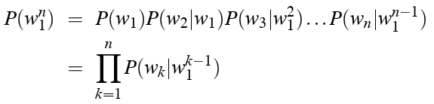
The Chain Rule applied to joint probability of words in sentence
P(“the big red dog was”)=
P(the) * P(big|the) * P(red|the big) * P(dog|the big red) * P(was|the big red dog)

Slide 7
Very easy estimate:
How to estimate?
  P(the | its water is so transparent that)
P(the | its water is so transparent that)
=
C(its water is so transparent that the)
___________________________________________________________________________________
C(its water is so transparent that)

Slide 8
Unfortunately
There are a lot of possible sentences
We’ll never be able to get enough data to compute the statistics for those long prefixes
P(lizard|the,other,day,I,was,walking,along,and,saw,a)
Or
P(the|its water is so transparent that)

Slide 9
Markov Assumption
Make the simplifying assumption
  P(lizard|the,other,day,I,was,walking,along,and,saw,a) = P(lizard|a)
Or maybe
  P(lizard|the,other,day,I,was,walking,along,and,saw,a) = P(lizard|saw,a)

Slide 10
Markov Assumption
So for each component in the product replace with the approximation (assuming a prefix of N)
Bigram version

Slide 11
Estimating bigram probabilities
The Maximum Likelihood Estimate

Slide 12


An example
<s> I am Sam </s>
<s> Sam I am </s>
<s> I do not like green eggs and ham </s>
This is the Maximum Likelihood Estimate, because it is the one which maximizes P(Training set|Model)

Slide 13
Maximum Likelihood Estimates
The maximum likelihood estimate of some parameter of a model M from a training set T
  Is the estimate
  that maximizes the likelihood of the training set T given the model M
Suppose the word Chinese occurs 400 times in a corpus of a million words (Brown corpus)
What is the probability that a random word from some other text will be “Chinese”
MLE estimate is 400/1000000 = .004
  This may be a bad estimate for some other corpus
But it is the estimate that makes it most likely that “Chinese” will occur 400 times in a million word corpus.

Slide 14
More examples: Berkeley Restaurant Project sentences
can you tell me about any good cantonese restaurants close by
mid priced thai food is what i’m looking for
tell me about chez panisse
can you give me a listing of the kinds of food that are available
i’m looking for a good place to eat breakfast
when is caffe venezia open during the day

Slide 15
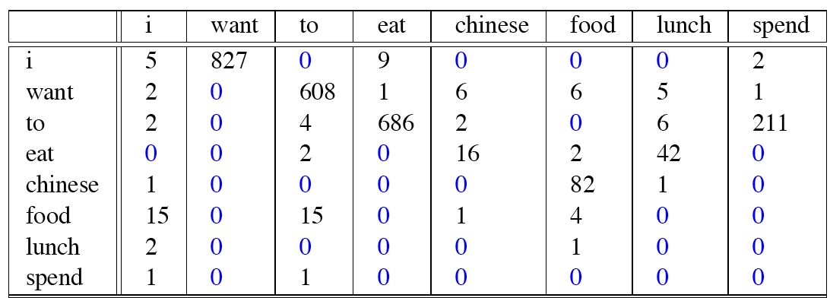
Raw bigram counts
Out of 9222 sentences
  Eg. “I want” occurred 827 times

Slide 16
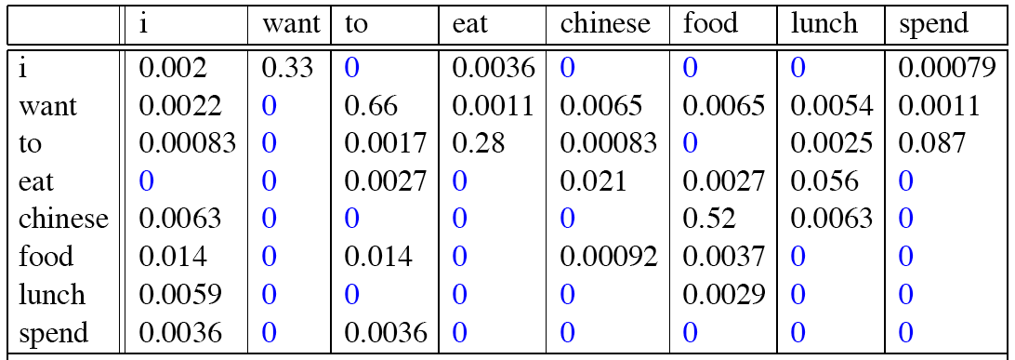
Raw bigram probabilities
Normalize by unigrams:
Result:

Slide 17
Bigram estimates of sentence probabilities
P(<s> I want english food </s>) =
P(i|<s>) x
P(want|I) x
P(english|want) x
P(food|english) x
P(</s>|food)
=.000031

Slide 18
What kinds of knowledge?
P(english|want) = .0011
P(chinese|want) = .0065
P(to|want) = .66
P(eat | to) = .28
P(food | to) = 0
P(want | spend) = 0
P (i | <s>) = .25

Slide 19
The Shannon Visualization Method
Generate random sentences:
Choose a random bigram <s>, w according to its probability
Now choose a random bigram (w, x) according to its probability
And so on until we choose </s>
Then string the words together
<s> I
I want
  want to
  to eat
  eat Chinese
  Chinese food
  food </s>

Slide 20
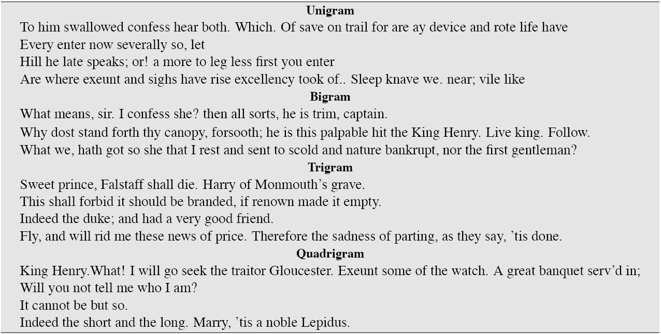
Approximating Shakespeare

Slide 21
Shakespeare as corpus
N=884,647 tokens, V=29,066
Shakespeare produced 300,000 bigram types out of V²= 844 million possible bigrams: so, 99.96% of the possible bigrams were never seen (have zero entries in the table)
Quadrigrams worse: What's coming out looks like Shakespeare because it is Shakespeare

Slide 22
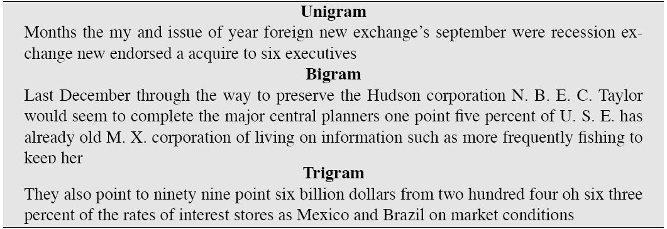
The wall street journal is not shakespeare (no offense)

Slide 23
Lesson 1: the perils of overfitting
N-grams only work well for word prediction if the test corpus looks like the training corpus
  In real life, it often doesn’t
  We need to train robust models, adapt to test set, etc

Slide 24
Lesson 2: zeros or not?
Some of those zeros are really zeros...
  Things that really aren’t ever going to happen
On the other hand, some of them are just rare events.
  If the training corpus had been a little bigger they would have had a count
    What would that count be in all likelihood?
Zipf’s Law (long tail phenomenon):
  A small number of events occur with high frequency
  A large number of events occur with low frequency
  You can quickly collect statistics on the high frequency events
  You might have to wait an arbitrarily long time to get valid statistics on low frequency events
Result:
  Our estimates are sparse! We have no counts at all for the vast bulk of things we want to estimate!
Answer:
  Estimate the likelihood of unseen (zero count) N-grams!
Slide adapted from Bonnie Dorr and Julia Hirschberg

Slide 25
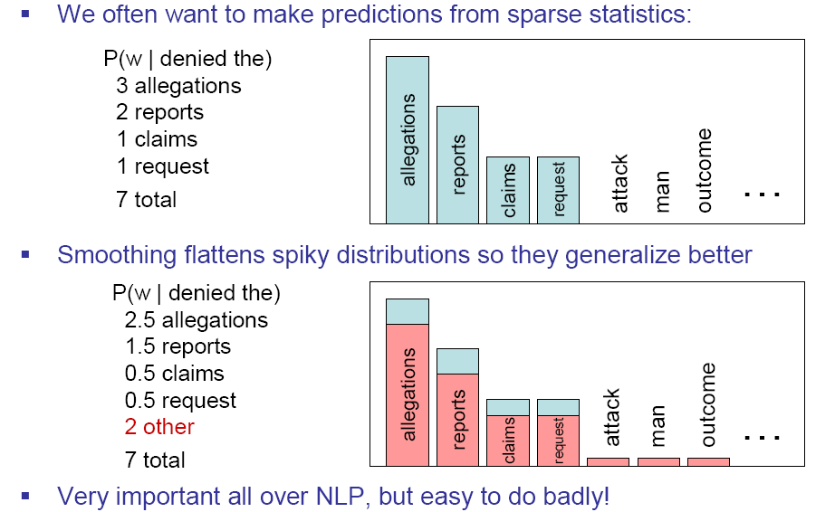
Smoothing is like Robin Hood:
Steal from the rich and give to the poor (in probability mass)
Slide from Dan Klein

Slide 26
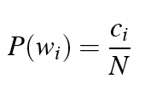

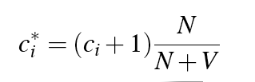
Laplace smoothing
Also called add-one smoothing
Just add one to all the counts!
Very simple
MLE estimate:
Laplace estimate:
Reconstructed counts:

Slide 27
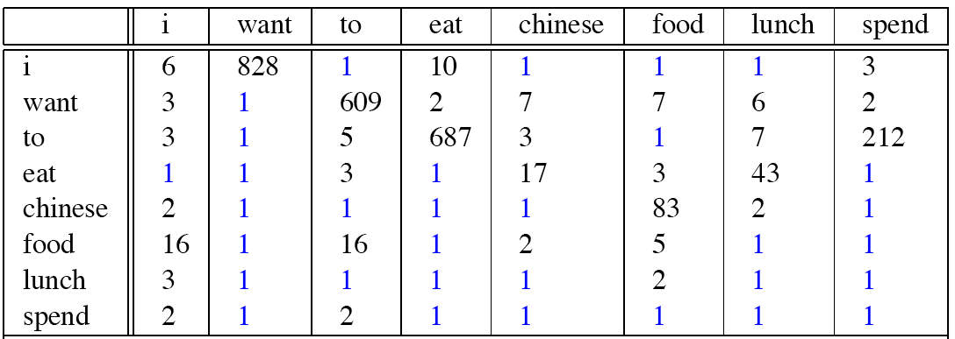
Laplace smoothed bigram counts

Slide 28

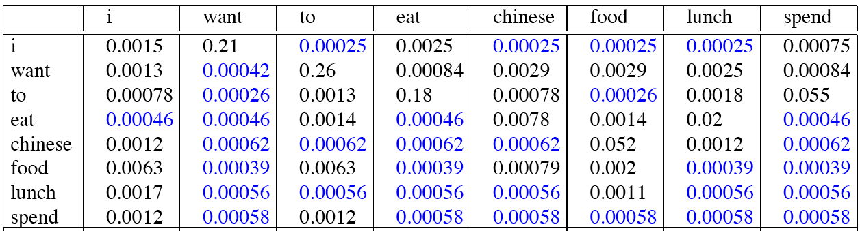
Laplace-smoothed bigrams

Slide 29
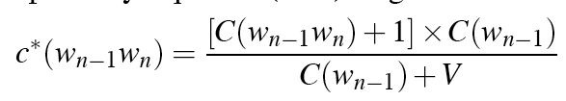
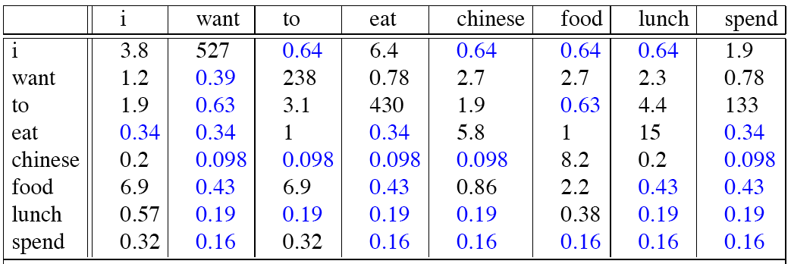
Reconstituted counts

Slide 30
Note big change to counts
C(count to) went from 608 to 238!
P(to|want) from .66 to .26!
Discount d= c*/c
  d for “chinese food” =.10!!! A 10x reduction
  So in general, Laplace is a blunt instrument
But Laplace smoothing not used for N-grams, as we have much better methods
Despite its flaws Laplace (add-k) is however still used to smooth other probabilistic models in NLP, especially
  For pilot studies
  in domains where the number of zeros isn’t so huge.

Slide 31
Add-k
Add a small fraction instead of 1

Slide 32
Bayesian unigram prior smoothing for bigrams
Maximum Likelihood Estimation
Laplace Smoothing
Bayesian prior Smoothing

Slide 33
Practical Issues
We do everything in log space
  Avoid underflow
  (also adding is faster than multiplying)

Slide 34
Language Modeling Toolkit
SRILM
  http://www.speech.sri.com/projects/srilm/

Slide 35
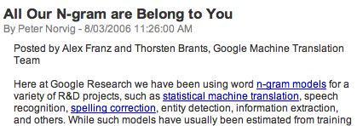

Google N-Gram Release

Slide 36
Google N-Gram Release
serve as the incoming 92
serve as the incubator 99
serve as the independent 794
serve as the index 223
serve as the indication 72
serve as the indicator 120
serve as the indicators 45
serve as the indispensable 111
serve as the indispensible 40
serve as the individual 234

Slide 37
Evaluating N-gram models
Best evaluation for an N-gram
  Put model A in a speech recognizer
  Run recognition, get word error rate (WER) for A
  Put model B in speech recognition, get word error rate for B
  Compare WER for A and B
  In-vivo evaluation

Slide 38
Difficulty of in-vivo evaluation of N-gram models
In-vivo evaluation
  This is really time-consuming
  Can take days to run an experiment
So
  As a temporary solution, in order to run experiments
  To evaluate N-grams we often use an approximation called perplexity
    But perplexity is a poor approximation unless the test data looks just like the training data
    So is generally only useful in pilot experiments (generally is not sufficient to publish)
    But is helpful to think about.

Slide 39
Unknown words: Open versus closed vocabulary tasks
If we know all the words in advanced
  Vocabulary V is fixed
  Closed vocabulary task
Often we don’t know this
  Out Of Vocabulary = OOV words
  Open vocabulary task
Instead: create an unknown word token <UNK>
  Training of <UNK> probabilities
    Create a fixed lexicon L of size V
    At text normalization phase, any training word not in L changed to <UNK>
    Now we train its probabilities like a normal word
  At decoding time
    If text input: Use UNK probabilities for any word not in training

Slide 40
Evaluating N-gram models
Best evaluation for an N-gram
  Put model A in a task (language identification, speech recognizer, machine translation system)
  Run the task, get an accuracy for A (how many lgs identified corrrectly, or Word Error Rate, or etc)
  Put model B in task, get accuracy for B
  Compare accuracy for A and B
  Extrinsic evaluation

Slide 41
Difficulty of extrinsic (in-vivo) evaluation of N-gram models
Extrinsic evaluation
  This is really time-consuming
  Can take days to run an experiment
So
  As a temporary solution, in order to run experiments
  To evaluate N-grams we often use an intrinsic evaluation, an approximation called perplexity
  But perplexity is a poor approximation unless the test data looks just like the training data
  So is generally only useful in pilot experiments (generally is not sufficient to publish)
  But is helpful to think about.

Slide 42
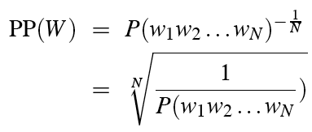
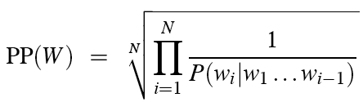
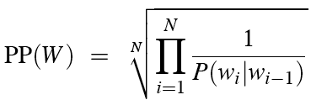
Perplexity
Perplexity is the probability of the test set (assigned by the language model), normalized by the number of words:
Chain rule:
For bigrams:
Minimizing perplexity is the same as maximizing probability
  The best language model is one that best predicts an unseen test set

Slide 43
A totally different perplexity Intuition
How hard is the task of recognizing digits ‘0,1,2,3,4,5,6,7,8,9,oh’: easy, perplexity 11 (or if we ignore ‘oh’, perplexity 10)
How hard is recognizing (30,000) names at Microsoft. Hard: perplexity = 30,000
If a system has to recognize
  Operator (1 in 4)
  Sales (1 in 4)
  Technical Support (1 in 4)
  30,000 names (1 in 120,000 each)
  Perplexity is 54
Perplexity is weighted equivalent branching factor
Slide from Josh Goodman

Slide 44
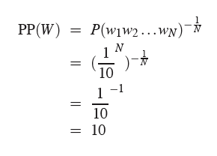
Perplexity as branching factor

Slide 45

Lower perplexity = better model
Training 38 million words, test 1.5 million words, WSJ

Slide 46
Advanced LM stuff
Current best smoothing algorithm
  Kneser-Ney smoothing
Other stuff
  Interpolation
  Backoff
  Variable-length n-grams
  Class-based n-grams
    Clustering
    Hand-built classes
  Cache LMs
  Topic-based LMs
  Sentence mixture models
  Skipping LMs
  Parser-based LMs

Slide 47
Better discounting algorithms
Intuition used by many smoothing algorithms
  Good-Turing
  Kneser-Ney
  Witten-Bell
Is to use the count of things we’ve seen once to help estimate the count of things we’ve never seen

Slide 48
Types, Tokens and Squirrels
Much of what’s coming up was first studied by field biologists who are often faced with 2 related problems
  Determining how many species occupy a particular area (types)
  And determining how many individuals of a given species are living in a given area (tokens)
Speech and Language Processing - Jurafsky and Martin

Slide 49
Good-Turing: Josh Goodman intuition
Imagine you are fishing
  There are 8 species: carp, perch, whitefish, trout, salmon, eel, catfish, bass
You have caught
  10 carp, 3 perch, 2 whitefish, 1 trout, 1 salmon, 1 eel = 18 fish
How likely is it that next fish caught will be an eel?
How likely is it that next fish caught will be a member of an unseen species (i.e. catfish or bass)
  3/18
Now how likely is it that next fish caught will be an eel?
  Must be less than 1/18
Slide adapted from Josh Goodman

Slide 50

Good-Turing Intuition
Notation: N_{x} is the frequency-of-frequency-x
  So N₁₀=1, N₁=3, etc
To estimate total number of unseen species
  Use number of species (words) we’ve seen once
  c₀* =c₁ p₀ = N₁/N
All other estimates are adjusted (down) to give probabilities for unseen
C*(eel) = c*(1) = (1+1) 1/ 3 = 2/3
Slide from Josh Goodman

Slide 51
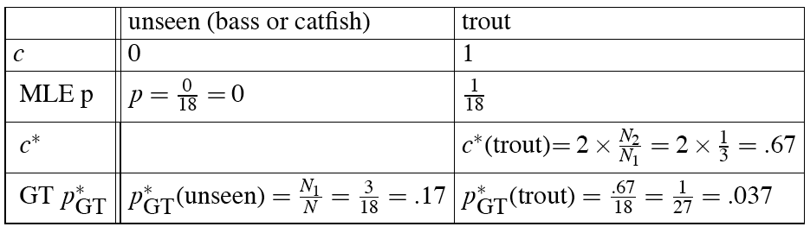

Slide 52
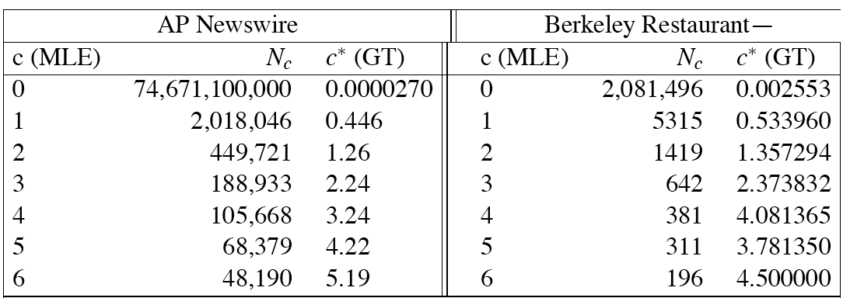
Bigram frequencies of frequencies and GT re-estimates

Slide 53
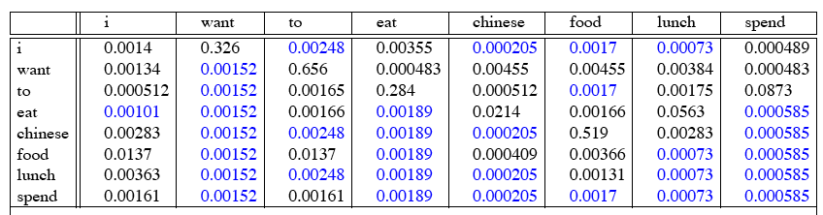
GT Smoothed Bigram
Probabilities
Speech and Language Processing - Jurafsky and Martin

Slide 54

Complications
In practice, assume large counts (c>k for some k) are reliable:
Also: we assume singleton counts c=1 are unreliable, so treat N-grams with count of 1 as if they were count=0
Also, need the Nk to be non-zero, so we need to smooth (interpolate) the Nk counts before computing c* from them

Slide 55
Backoff and Interpolation
Another really useful source of knowledge
If we are estimating:
  trigram p(z|xy)
  but c(xyz) is zero
Use info from:
  Bigram p(z|y)
Or even:
  Unigram p(z)
How to combine the trigram/bigram/unigram info?

Slide 56
Backoff versus interpolation
Backoff: use trigram if you have it, otherwise bigram, otherwise unigram
Interpolation: mix all three

Slide 57
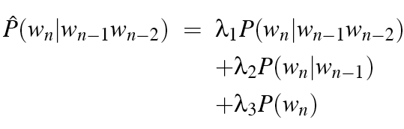

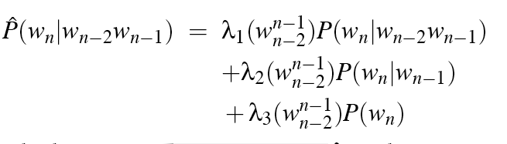
Interpolation
Simple interpolation
Lambdas conditional on context:

Slide 58
How to set the lambdas?
Use a held-out corpus
Choose lambdas which maximize the probability of some held-out data
  I.e. fix the N-gram probabilities
  Then search for lambda values
  That when plugged into previous equation
  Give largest probability for held-out set
  Can use EM to do this search

Slide 59
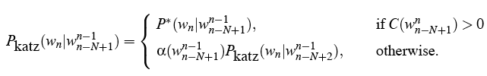
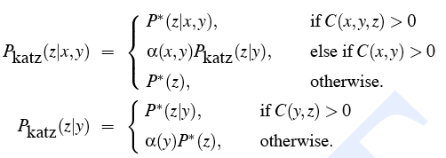
Katz Backoff

Slide 60


Why discounts P* and alpha?
MLE probabilities sum to 1
So if we used MLE probabilities but backed off to lower order model when MLE prob is zero
We would be adding extra probability mass
And total probability would be greater than 1

Slide 61
GT smoothed bigram probs

Slide 62
Intuition of backoff+discounting
How much probability to assign to all the zero trigrams?
  Use GT or other discounting algorithm to tell us
How to divide that probability mass among different contexts?
  Use the N-1 gram estimates to tell us
What do we do for the unigram words not seen in training?
  Out Of Vocabulary = OOV words

Slide 63
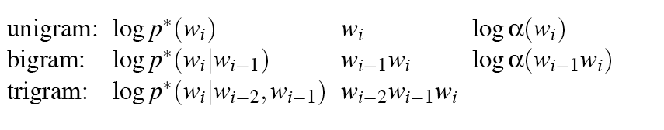
ARPA format

Slide 64
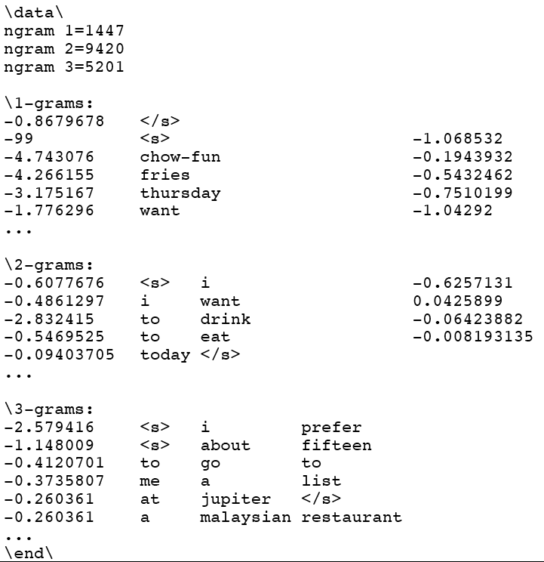

Slide 65
Summary
Language Modeling (N-grams)
  N-gram Intro
  The Shannon Visualization Method
  Evaluation:
    Perplexity
  Smoothing:
    Laplace (Add-1)
    Add-k
    Good-Turing
    Backoff
    Interpolation

