Slide 1
CS 224S/LING 281
Speech Recognition, Synthesis, and Dialogue
Dan Jurafsky
Lecture 12: Dialog Part I: Human conversation, frame-based dialogue systems, and VoiceXML

Slide 2
Outline
The Linguistics of Conversation
Basic Conversational Agents
  ASR
  NLU
  Generation
  Dialogue Manager
Dialogue Manager Design
  Finite State
  Frame-based
  Initiative: User, System, Mixed
VoiceXML

Slide 3
Conversational Agents
AKA:
  Spoken Language Systems
  Dialogue Systems
  Speech Dialogue Systems
Applications:
  Travel arrangements (Amtrak, United airlines)
  Telephone call routing
  Tutoring
  Communicating with robots
  Anything with limited screen/keyboard

Slide 4
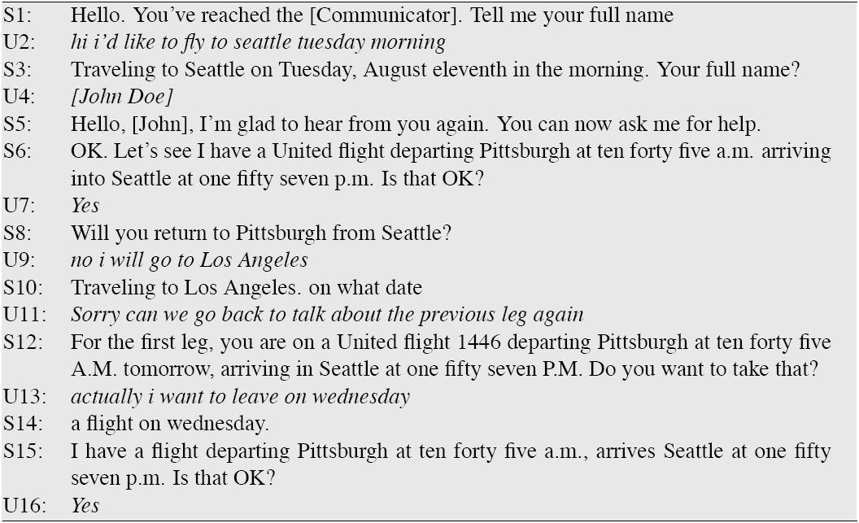
A travel dialog: Communicator
Xu and Rudnicky (2000)

Slide 5
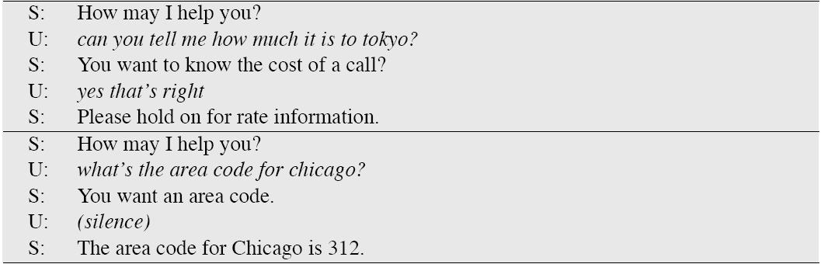
Call routing: ATT HMIHY
Goren et al. (1997)

Slide 6
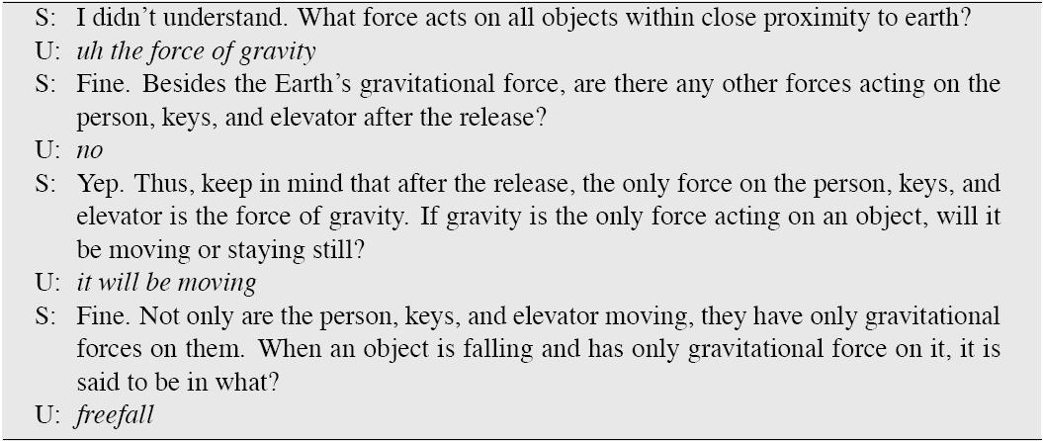
A tutorial dialogue: ITSPOKE
Litman and Silliman (2004)

Slide 7
Linguistics of Human Conversation
Turn-taking
Speech Acts
Grounding
Conversational Structure
Implicature

Slide 8
Turn-taking
Dialogue is characterized by turn-taking.
  A:
  B:
  A:
  B:
  …
Resource allocation problem:
How do speakers know when to take the floor?

Slide 9
Turn-taking rules
Sacks et al. (1974)
At each transition-relevance place of each turn:
  a. If during this turn the current speaker has selected B as the next speaker then B must speak next.
  b. If the current speaker does not select the next speaker, any other speaker may take the next turn.
  c. If no one else takes the next turn, the current speaker may take the next turn.

Slide 10
Implications of subrule a
For some utterances the current speaker selects the next speaker
  Adjacency pairs
    Question/answer
    Greeting/greeting
    Compliment/downplayer
    Request/grant
Silence between 2 parts of adjacency pair is different than silence after
  A: Is there something bothering you or not?
  (1.0)
  A: Yes or no?
  (1.5)
  A: Eh
  B: No.

Slide 11
Speech Acts
Austin (1962): An utterance is a kind of action
Clear case: performatives
  I name this ship the Titanic
  I second that motion
  I bet you five dollars it will snow tomorrow
Performative verbs (name, second)
Austin’s idea: not just these verbs

Slide 12
Each utterance is 3 acts
Locutionary act: the utterance of a sentence with a particular meaning
Illocutionary act: the act of asking, answering, promising, etc., in uttering a sentence.
Perlocutionary act: the (often intentional) production of certain effects upon the thoughts, feelings, or actions of addressee in uttering a sentence.

Slide 13
Locutionary and illocutionary
“You can’t do that!”
Illocutionary force:
  Protesting
Perlocutionary force:
  Effect of annoying addressee
  Effect of stopping addressee from doing something

Slide 14
The 3 levels of act revisited
 | Locutionary Force | Illocutionary Force | Perlocutionary Force
Can I have the rest of your sandwich? Or Are you going to finish that? | Question | Request | Effect: You give me sandwich (or you are amused by my quoting from “Diner”) (or etc)
I want the rest of your sandwich | Declarative | Request | Effect: as above
Give me your sandwich! | Imperative | Request | Effect: as above.

Slide 15
Illocutionary Acts
What are they?

Slide 16
5 classes of speech acts: Searle (1975)
Assertives: committing the speaker to something’s being the case
  (suggesting, putting forward, swearing, boasting, concluding)
Directives: attempts by the speaker to get the addressee to do something
  (asking, ordering, requesting, inviting, advising, begging)
Commissives: Committing the speaker to some future course of action
  (promising, planning, vowing, betting, opposing).
Expressives: expressing the psychological state of the speaker about a state of affairs
  (thanking, apologizing, welcoming, deploring).
Declarations: bringing about a different state of the world via the utterance
  (I resign; You’re fired)

Slide 17
Grounding
Why do elevator buttons light up?
Clark (1996) (after Norman 1988)
  Principle of closure. Agents performing an action require evidence, sufficient for current purposes, that they have succeeded in performing it
What is the linguistic correlate of this?

Slide 18
Grounding
Need to know whether an action succeeded or failed
Dialogue is also an action
  a collective action performed by speaker and hearer
  Common ground: set of things mutually believed by both speaker and hearer
Need to achieve common ground, so hearer must ground or acknowledge speakers utterance.

Slide 19
How do speakers ground?
Clark and Schaefer
Continued attention:
  B continues attending to A
Relevant next contribution:
  B starts in on next relevant contribution
Acknowledgement:
  B nods or says continuer like uh-huh, yeah, assessment (great!)
Demonstration:
  B demonstrates understanding A by paraphrasing or reformulating A’s contribution, or by collaboratively completing A’s utterance
Display:
  B displays verbatim all or part of A’s presentation

Slide 20
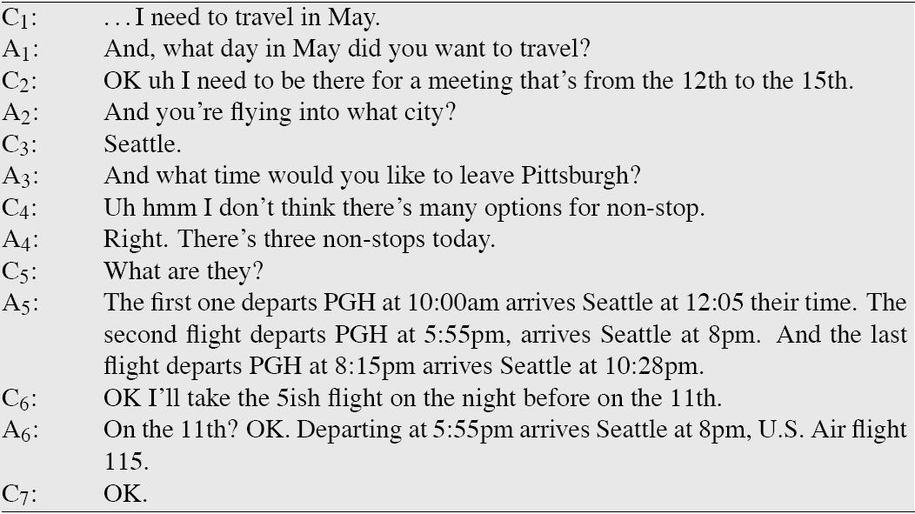
A human-human conversation

Slide 21
Grounding examples
Display:
  C: I need to travel in May
  A: And, what day in May did you want to travel?
Acknowledgement
  C: He wants to fly from Boston
  A: mm-hmm
  C: to Baltimore Washington International
  [Mm-hmm (usually transcribed “uh-huh”) is a backchannel, continuer, or acknowledgement token]

Slide 22
Grounding Examples (2)
Acknowledgement + next relevant contribution
  And, what day in May did you want to travel?
  And you’re flying into what city?
  And what time would you like to leave?
The and indicates to the client that agent has successfully understood answer to the last question.

Slide 23
Grounding negative responses
From Cohen et al. (2004)
System: Did you want to review some more of your personal profile?
Caller: No.
System: Okay, what’s next?
System: Did you want to review some more of your personal profile?
Caller: No.
System: What’s next?
Good!
Bad!

Slide 24
Grounding and Dialogue Systems
Grounding is not just a tidbit about humans
Is key to design of conversational agent
Why?
  HCI researchers find users of speech-based interfaces are confused when system doesn’t give them an explicit acknowledgement signal
  Stifelman et al. (1993), Yankelovich et al. (1995)

Slide 25
Why is this customer confused?
Customer: (rings)
Operator: Directory Enquiries, for which town please?
Customer: Could you give me the phone number of um: Mrs. um: Smithson?
Operator: Yes, which town is this at please?
Customer: Huddleston.
Operator: Yes. And the name again?
Customer: Mrs. Smithson

Slide 26
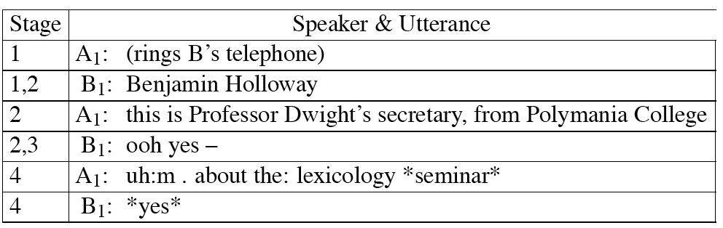
Conversational Structure
Telephone conversations
  Stage 1: Enter a conversation
  Stage 2: Identification
  Stage 3: Establish joint willingness to converse
  Stage 4: First topic is raised, usually by caller

Slide 27
Conversational Implicature
A: And, what day in May did you want to travel?
C: OK, uh, I need to be there for a meeting that’s from the 12th to the 15th.
Note that client did not answer question.
Meaning of client’s sentence:
  Meeting
    Start-of-meeting: 12th
    End-of-meeting: 15th
  Doesn’t say anything about flying!!!!!
What is it that licenses agent to infer that client is mentioning this meeting so as to inform the agent of the travel dates?

Slide 28
Conversational Implicature (2)
A: … there’s 3 non-stops today.
This would still be true if 7 non-stops today.
But no, the agent means: 3 and only 3.
How can client infer that agent means:
  only 3

Slide 29
Grice: conversational implicature
Implicature means a particular class of licensed inferences.
Grice (1975) proposed that what enables hearers to draw correct inferences is:
Cooperative Principle
  This is a tacit agreement by speakers and listeners to cooperate in communication

Slide 30
4 Gricean Maxims
Relevance: Be relevant
Quantity: Do not make your contribution more or less informative than required
Quality: try to make your contribution one that is true (don’t say things that are false or for which you lack adequate evidence)
Manner: Avoid ambiguity and obscurity; be brief and orderly

Slide 31
Relevance
A: Is Regina here?
B: Her car is outside.
Implication: yes
  Hearer thinks:
    Why mention the car?
    It must be relevant.
    How could it be relevant?
    It could since: if her car is here she is probably here.
Client: I need to be there for a meeting that’s from the 12th to the 15th
  Hearer thinks:
    Speaker is following maxims, would only have mentioned meeting if it was relevant. How could meeting be relevant?
      If client meant me to understand that he had to depart in time for the mtg.

Slide 32
Quantity
A: How much money do you have on you?
B: I have 5 dollars
  Implication: not 6 dollars
Similarly, 3 non stops can’t mean 7 non-stops
  Hearer thinks:
    If speaker meant 7 non-stops she would have said 7 non-stops
A: Did you do the reading for today’s class?
B: I intended to
  Implication: No
  B’s answer would be true if B intended to do the reading AND did the reading, but would then violate maxim

Slide 33
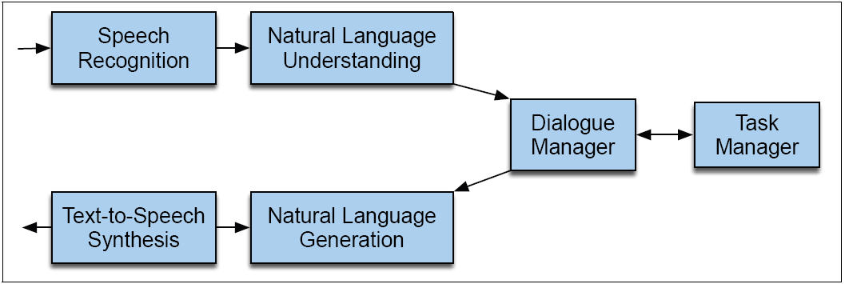
Dialogue System Architecture

Slide 34
Speech recognition
ASR issues in Dialogue Systems:
Language models are different
The speaker is talking to us for a while
It’s probably telephone speech

Slide 35
Language Model
Language models for dialogue are often based on hand-written Context-Free or finite-state grammars rather than N-grams
Why? Because of need for understanding; we need to constrain user to say things that we know what to do with.

Slide 36
Language Models for Dialogue (2)
We can have LM specific to a dialogue state
If system just asked “What city are you departing from?”
LM can be
  City names only
  FSA: (I want to (leave|depart)) (from) [CITYNAME]
  N-grams trained on answers to “Cityname” questions from labeled data
A LM that is constrained in this way is technically called a “restricted grammar” or “restricted LM”

Slide 37
Talking to the same human over the whole conversation.
Same speaker
So can adapt to speaker
  Acoustic Adaptation
    Vocal Tract Length Normalization (VTLN)
    Maximum Likelihood Linear Regression (MLLR)
  Language Model adaptation
  Pronunciation adaptation

Slide 38
Barge-in
Speakers barge-in
Need to deal properly with this via speech-detection, etc.

Slide 39
Natural Language Understanding
Or “NLU”
Or “Computational semantics”
There are many ways to represent the meaning of sentences
For speech dialogue systems, most common is “Frame and slot semantics”.

Slide 40
An example of a frame
Show me morning flights from Boston to SF on Tuesday.
SHOW:
FLIGHTS:
ORIGIN:
CITY: Boston
DATE: Tuesday
TIME: morning
DEST:
CITY: San Francisco

Slide 41
Generation and TTS
Generation component
  Chooses concepts to express to user
  Plans out how to express these concepts in words
  Assigns any necessary prosody to the words
TTS component
  What we’ve seen
In practice both often based on canned sentences

Slide 42
Dialogue Manager
Controls the architecture and structure of dialogue
  Takes input from ASR/NLU components
  Maintains some sort of state
  Interfaces with Task Manager
  Passes output to NLG/TTS modules

Slide 43
Four architectures for dialogue management
Finite State
Frame-based
Information State
  Markov Decision Processes
AI Planning

Slide 44
Finite-State Dialogue Mgmt
Consider a trivial airline travel system
  Ask the user for a departure city
  For a destination city
  For a time
  Whether the trip is round-trip or not

Slide 45
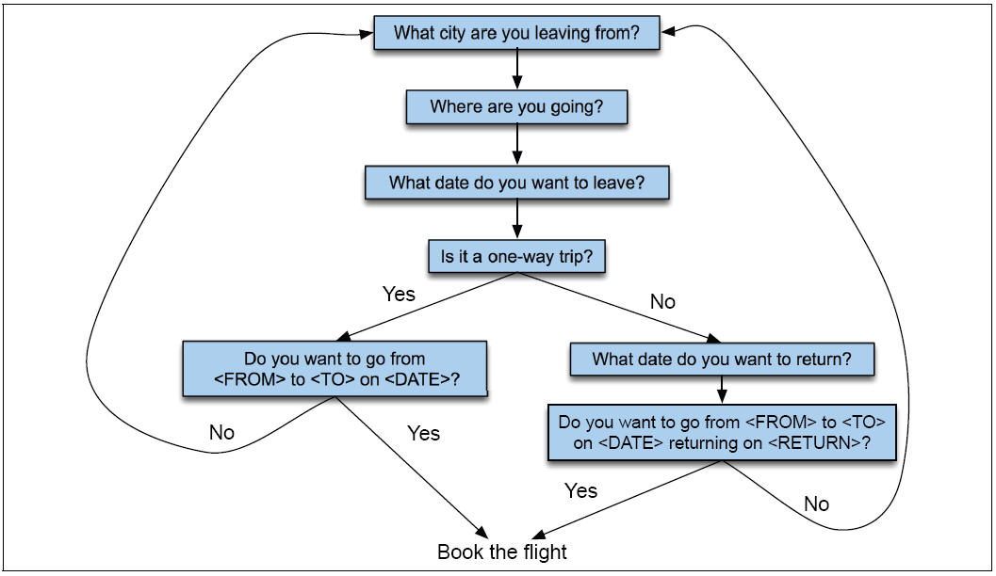
Finite State Dialogue Manager

Slide 46
Finite-state dialogue managers
System completely controls the conversation with the user.
It asks the user a series of questions
Ignoring (or misinterpreting) anything the user says that is not a direct answer to the system’s questions

Slide 47
Dialogue Initiative
Systems that control conversation like this are system initiative or single initiative.
“Initiative”: who has control of conversation
In normal human-human dialogue, initiative shifts back and forth between participants.

Slide 48
System Initiative
Systems which completely control the conversation at all times are called system initiative.
Advantages:
  Simple to build
  User always knows what they can say next
  System always knows what user can say next
    Known words: Better performance from ASR
    Known topic: Better performance from NLU
  Ok for VERY simple tasks (entering a credit card, or login name and password)
Disadvantage:
  Too limited

Slide 49
User Initiative
User directs the system
Generally, user asks a single question, system answers
System can’t ask questions back, engage in clarification dialogue, confirmation dialogue
Used for simple database queries
User asks question, system gives answer
Web search is user initiative dialogue.

Slide 50
Problems with System Initiative
Real dialogue involves give and take!
In travel planning, users might want to say something that is not the direct answer to the question.
For example answering more than one question in a sentence:
  Hi, I’d like to fly from Seattle Tuesday morning
  I want a flight from Milwaukee to Orlando one way leaving after 5 p.m. on Wednesday.

Slide 51
Single initiative + universals
We can give users a little more flexibility by adding universal commands
Universals: commands you can say anywhere
As if we augmented every state of FSA with these
  Help
  Start over
  Correct
This describes many implemented systems
But still doesn’t allow user to say what the want to say

Slide 52
Mixed Initiative
Conversational initiative can shift between system and user
Simplest kind of mixed initiative: use the structure of the frame itself to guide dialogue
  Slot Question
  ORIGIN What city are you leaving from?
  DEST Where are you going?
  DEPT DATE What day would you like to leave?
  DEPT TIME What time would you like to leave?
  AIRLINE What is your preferred airline?

Slide 53
Frames are mixed-initiative
User can answer multiple questions at once.
System asks questions of user, filling any slots that user specifies
When frame is filled, do database query
If user answers 3 questions at once, system has to fill slots and not ask these questions again!
Anyhow, we avoid the strict constraints on order of the finite-state architecture.

Slide 54
Multiple frames
flights, hotels, rental cars
Flight legs: Each flight can have multiple legs, which might need to be discussed separately
Presenting the flights (If there are multiple flights meeting users constraints)
  It has slots like 1ST_FLIGHT or 2ND_FLIGHT so user can ask “how much is the second one”
General route information:
  Which airlines fly from Boston to San Francisco
Airfare practices:
  Do I have to stay over Saturday to get a decent airfare?

Slide 55
Multiple Frames
Need to be able to switch from frame to frame
Based on what user says.
Disambiguate which slot of which frame an input is supposed to fill, then switch dialogue control to that frame.
Main implementation: production rules
  Different types of inputs cause different productions to fire
  Each of which can flexibly fill in different frames
  Can also switch control to different frame

Slide 56
VoiceXML
Voice eXtensible Markup Language
An XML-based dialogue design language
Makes use of ASR and TTS
Deals well with simple, frame-based mixed initiative dialogue.
Most common in commercial world (too limited for research systems)
But useful to get a handle on the concepts.

Slide 57
Voice XML
Each dialogue is a <form>. (Form is the VoiceXML word for frame)
Each <form> generally consists of a sequence of <field>s, with other commands

Slide 58
Sample vxml doc
<form>
<field name="transporttype">
<prompt>
Please choose airline, hotel, or rental car. </prompt>
<grammar type="application/x=nuance-gsl">
[airline hotel "rental car"]
</grammar>
</field>
<block>
<prompt>
You have chosen <value expr="transporttype">. </prompt>
</block>
</form>

Slide 59
VoiceXML interpreter
Walks through a VXML form in document order
Iteratively selecting each item
If multiple fields, visit each one in order.
Special commands for events

Slide 60
Another vxml doc (1)
<noinput>
I'm sorry, I didn't hear you. <reprompt/>
</noinput>
- “noinput” means silence exceeds a timeout threshold
<nomatch>
I'm sorry, I didn't understand that. <reprompt/>
</nomatch>
- “nomatch” means confidence value for utterance is too low
- notice “reprompt” command

Slide 61
Another vxml doc (2)
<form>
<block> Welcome to the air travel consultant. </block>
<field name="origin">
<prompt> Which city do you want to leave from? </prompt>
<grammar type="application/x=nuance-gsl">
[(san francisco) denver (new york) barcelona]
</grammar>
<filled>
<prompt> OK, from <value expr="origin"> </prompt>
</filled>
</field>
- “filled” tag is executed by interpreter as soon as field filled by user

Slide 62
Another vxml doc (3)
<field name="destination">
<prompt> And which city do you want to go to? </prompt>
<grammar type="application/x=nuance-gsl">
[(san francisco) denver (new york) barcelona]
</grammar>
<filled>
<prompt> OK, to <value expr="destination"> </prompt>
</filled>
</field>
<field name="departdate" type="date">
<prompt> And what date do you want to leave? </prompt>
<filled>
<prompt> OK, on <value expr="departdate"> </prompt>
</filled>
</field>

Slide 63
Another vxml doc (4)
<block>
<prompt> OK, I have you are departing from
<value expr="origin”> to <value expr="destination”> on <value expr="departdate">
</prompt>
send the info to book a flight...
</block>
</form>

Slide 64
Summary: VoiceXML
Voice eXtensible Markup Language
An XML-based dialogue design language
Makes use of ASR and TTS
Deals well with simple, frame-based mixed initiative dialogue.
Most common in commercial world (too limited for research systems)
But useful to get a handle on the concepts.

Slide 65
Summary
The Linguistics of Conversation
Basic Conversational Agents
  ASR
  NLU
  Generation
  Dialogue Manager
Dialogue Manager Design
  Finite State
  Frame-based
  Initiative: User, System, Mixed
VoiceXML

