Slide 1
CS 224S/LING 281
Speech Recognition, Synthesis, and Dialogue
Dan Jurafsky
Lecture 13: Dialogue: Information State Systems and Dialogue Act Interpretation

Slide 2
Outline
Natural Language Understanding
Natural Language Generation
Information-State Models
  Dialogue-Act Detection
  Dialogue-Act Generation

Slide 3
Summary
The Linguistics of Conversation
Basic Conversational Agents
  ASR
  NLU
  Generation
  Dialogue Manager
Dialogue Manager Design
  Finite State
  Frame-based
  Initiative: User, System, Mixed
VoiceXML
Advanced issues in NLU and Generation
Information-State
  Dialogue-Act Detection
  Dialogue-Act Generation
Evaluation
Utility-based conversational agents
  MDP, POMDP

Slide 4

Natural Language Understanding

Slide 5
Semantics for a sentence
LIST FLIGHTS ORIGIN
Show me flights from Boston
DESTINATION DEPARTDATE
to San Francisco on Tuesday
DEPARTTIME
morning

Slide 6
HMMs for semantics
Idea: use an HMM for semantics, just as we did for ASR (and part-of-speech tagging, etc)
Hidden units:
  Semantic slot names
    Origin
    Destination
    Departure time
Observations:
  Word sequences

Slide 7
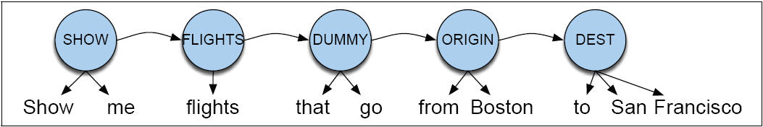
HMM model of semantics - Pieraccini et al (1991)

Slide 8
Semantic HMM
Goal of HMM model:
  to compute labeling of semantic roles C = c₁,c₂,…,c_{n} (C for ‘cases’ or ‘concepts’)
  that is most probable given words W

Slide 9
Semantic HMM
From previous slide:
Assume simplification:
Final form:

Slide 10
Semi-HMMs
Each hidden state
  Can generate multiple observations
By contrast, a traditional HMM
  One observation per hidden state
  Need to loop to have multiple observations with the same state label

Slide 11
Another way to do NLU: Semantic Grammars
CFG in which the LHS of rules is a semantic category:
  LIST -> show me | I want | can I see|…
  DEPARTTIME -> (after|around|before) HOUR | morning | afternoon | evening
  HOUR -> one|two|three…|twelve (am|pm)
  FLIGHTS -> (a) flight|flights
  ORIGIN -> from CITY
  DESTINATION -> to CITY
  CITY -> Boston | San Francisco | Denver | Washington

Slide 12
An example of a frame
Show me morning flights from Boston to SF on Tuesday.
SHOW:
FLIGHTS:
ORIGIN:
CITY: Boston
DATE: Tuesday
TIME: morning
DEST:
CITY: San Francisco

Slide 13
Generation Component
Content Planner
  Decides what content to express to user
    (ask a question, present an answer, etc)
  Often merged with dialogue manager
Language Generation
  Chooses syntactic structures and words to express meaning.
  Simplest method
    All words in sentence are prespecified!
    “Template-based generation”
    Can have variables:
      What time do you want to leave CITY-ORIG?
      Will you return to CITY-ORIG from CITY-DEST?

Slide 14
More sophisticated language generation component
Natural Language Generation
This is a field, like Parsing, or Natural Language Understanding, or Speech Synthesis, with its own (small) conference
Approach:
  Dialogue manager builds representation of meaning of utterance to be expressed
  Passes this to a “generator”
  Generators have three components
    Sentence planner
    Surface realizer
    Prosody assigner

Slide 15
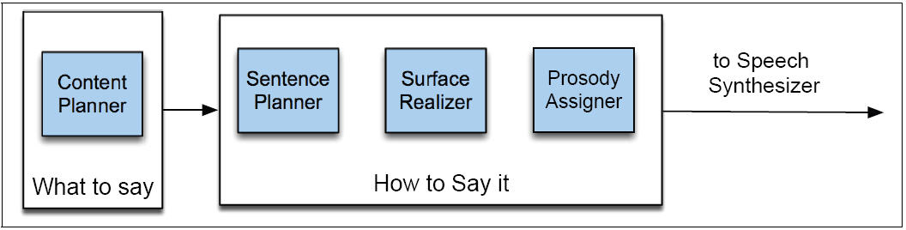
Architecture of a generator for a dialogue system
(after Walker and Rambow 2002)

Slide 16
HCI constraints on generation for dialogue: “Coherence”
Discourse markers and pronouns (“Coherence”):
(1) Please say the date.
…
Please say the start time.
…
Please say the duration…
…
Please say the subject…
(2) First, tell me the date.
…
Next, I’ll need the time it starts.
…
Thanks. <pause> Now, how long is it supposed to last?
…
Last of all, I just need a brief description
Bad!
Good!

Slide 17
HCI constraints on generation for dialogue: coherence (II): tapered prompts
Prompts which get incrementally shorter:
System: Now, what’s the first company to add to your watch list?
Caller: Cisco
System: What’s the next company name? (Or, you can say, “Finished”)
Caller: IBM
System: Tell me the next company name, or say, “Finished.”
Caller: Intel
System: Next one?
Caller: America Online.
System: Next?
Caller: …

Slide 18
How mixed initiative is usually defined
First we need to define two other factors
Open prompts vs. directive prompts
Restrictive versus non-restrictive grammar

Slide 19
Open vs. Directive Prompts
Open prompt
  System gives user very few constraints
  User can respond how they please:
  “How may I help you?” “How may I direct your call?”
Directive prompt
  Explicit instructs user how to respond
  “Say yes if you accept the call; otherwise, say no”

Slide 20
Restrictive vs. Non-restrictive grammars
Restrictive grammar
  Language model which strongly constrains the ASR system, based on dialogue state
Non-restrictive grammar
  Open language model which is not restricted to a particular dialogue state

Slide 21
Definition of Mixed Initiative
Grammar | Open Prompt | Directive Prompt
Restrictive | Doesn’t make sense | System Initiative
Non-restrictive | User Initiative | Mixed Initiative

Slide 22
Information-State and Dialogue Acts
If we want a dialogue system to be more than just form-filling
Needs to:
  Decide when the user has asked a question, made a proposal, rejected a suggestion
  Ground a user’s utterance, ask clarification questions, suggestion plans
Suggests:
  Conversational agent needs sophisticated models of interpretation and generation
    In terms of speech acts and grounding
    Needs more sophisticated representation of dialogue context than just a list of slots

Slide 23
Information-state architecture
Information state
Dialogue act interpreter
Dialogue act generator
Set of update rules
  Update dialogue state as acts are interpreted
  Generate dialogue acts
Control structure to select which update rules to apply

Slide 24
Information-state

Slide 25
Dialogue acts
Also called “conversational moves”
An act with (internal) structure related specifically to its dialogue function
Incorporates ideas of grounding
Incorporates other dialogue and conversational functions that Austin and Searle didn’t seem interested in

Slide 26
Verbmobil task
Two-party scheduling dialogues
Speakers were asked to plan a meeting at some future date
Data used to design conversational agents which would help with this task
(cross-language, translating, scheduling assistant)

Slide 27
Verbmobil Dialogue Acts
THANK thanks
GREET Hello Dan
INTRODUCE It’s me again
BYE Allright, bye
REQUEST-COMMENT How does that look?
SUGGEST June 13th through 17th
REJECT No, Friday I’m booked all day
ACCEPT Saturday sounds fine
REQUEST-SUGGEST What is a good day of the week for you?
INIT I wanted to make an appointment with you
GIVE_REASON Because I have meetings all afternoon
FEEDBACK Okay
DELIBERATE Let me check my calendar here
CONFIRM Okay, that would be wonderful
CLARIFY Okay, do you mean Tuesday the 23rd?

Slide 28
DAMSL: forward looking func.
STATEMENT a claim made by the speaker
INFO-REQUEST a question by the speaker
CHECK a question for confirming information
INFLUENCE-ON-ADDRESSEE (=Searle's directives)
OPEN-OPTION a weak suggestion or listing of options
ACTION-DIRECTIVE an actual command
INFLUENCE-ON-SPEAKER (=Austin's commissives)
OFFER speaker offers to do something
COMMIT speaker is committed to doing something
CONVENTIONAL other
OPENING greetings
CLOSING farewells
THANKING thanking and responding to thanks

Slide 29
DAMSL: backward looking func.
AGREEMENT speaker's response to previous proposal
ACCEPT accepting the proposal
ACCEPT-PART accepting some part of the proposal
MAYBE neither accepting nor rejecting the proposal
REJECT-PART rejecting some part of the proposal
REJECT rejecting the proposal
HOLD putting off response, usually via subdialogue
ANSWER answering a question
UNDERSTANDING whether speaker understood previous
SIGNAL-NON-UNDER. speaker didn't understand
SIGNAL-UNDER. speaker did understand
ACK demonstrated via continuer or assessment
REPEAT-REPHRASE demonstrated via repetition or reformulation
COMPLETION demonstrated via collaborative completion

Slide 30
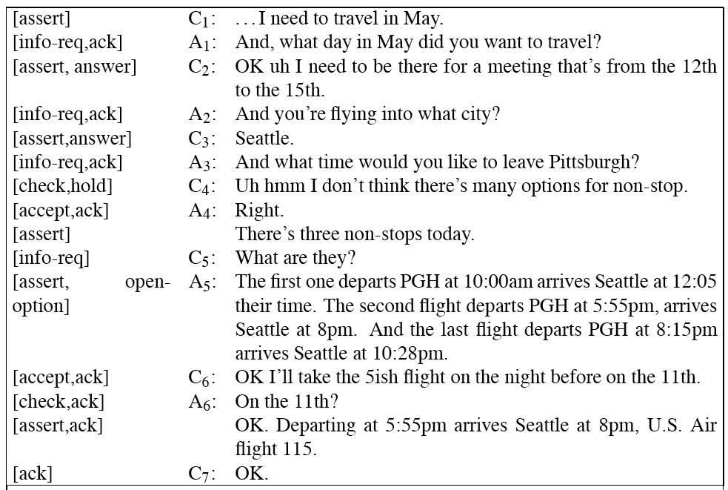
A DAMSL Labeling

Slide 31
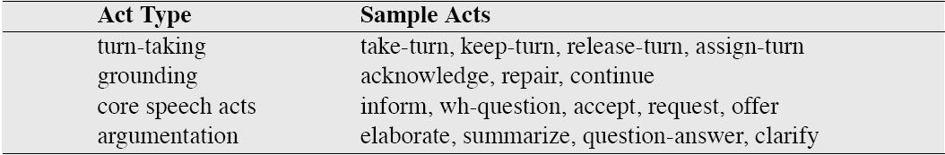
Conversation Acts
Traum and Hinkelman (1992)

Slide 32
Automatic Interpretation of Dialogue Acts
How do we automatically identify dialogue acts?
Given an utterance:
  Decide whether it is a QUESTION, STATEMENT, SUGGEST, or ACK
Recognizing illocutionary force will be crucial to building a dialogue agent
Perhaps we can just look at the form of the utterance to decide?

Slide 33
Can we just use the surface syntactic form?
YES-NO-Q’s have auxiliary-before-subject syntax:
  Will breakfast be served on USAir 1557?
STATEMENTs have declarative syntax:
  I don’t care about lunch
COMMAND’s have imperative syntax:
  Show me flights from Milwaukee to Orlando on Thursday night

Slide 34
Surface form != speech act type
 | Locutionary Force | Illocutionary Force
Can I have the rest of your sandwich? | Question | Request
I want the rest of your sandwich | Declarative | Request
Give me your sandwich! | Imperative | Request

Slide 35

Dialogue act disambiguation is hard! Who’s on First?
Abbott: Well, Costello, I'm going to New York with you. Bucky Harris the Yankee's manager gave me a job as coach for as long as you're on the team.
Costello: Look Abbott, if you're the coach, you must know all the players.
Abbott: I certainly do.
Costello: Well you know I've never met the guys. So you'll have to tell me their names, and then I'll know who's playing on the team.
Abbott: Oh, I'll tell you their names, but you know it seems to me they give these ball players now-a-days very peculiar names.
Costello: You mean funny names?
Abbott: Strange names, pet names...like Dizzy Dean...
Costello: His brother Daffy Abbott: Daffy Dean...
Costello: And their French cousin.
Abbott: French?
Costello: Goofe'
Abbott: Goofe' Dean. Well, let's see, we have on the bags, Who's on first, What's on second, I Don't Know is on third...
Costello: That's what I want to find out.
Abbott: I say Who's on first, What's on second, I Don't Know's on third.

Slide 36
Dialogue act ambiguity
Who’s on first?
  INFO-REQUEST
  or
  STATEMENT

Slide 37
Dialogue Act ambiguity
Can you give me a list of the flights from Atlanta to Boston?
  This looks like an INFO-REQUEST.
  If so, the answer is:
    YES.
  But really it’s a DIRECTIVE or REQUEST, a polite form of:
  Please give me a list of the flights…
What looks like a QUESTION can be a REQUEST

Slide 38
Dialogue Act ambiguity
Similarly, what looks like a STATEMENT can be a QUESTION:
Us | OPEN-OPTION | I was wanting to make some arrangements for a trip that I’m going to be taking uh to LA uh beginnning of the week after next
Ag | HOLD | OK uh let me pull up your profile and I’ll be right with you here. [pause]
Ag | CHECK | And you said you wanted to travel next week?
Us | ACCEPT | Uh yes.

Slide 39
Indirect speech acts
Utterances which use a surface statement to ask a question
Utterances which use a surface question to issue a request

Slide 40
DA interpretation as statistical classification
Lots of clues in each sentence that can tell us which DA it is:
Words and Collocations:
  Please or would you: good cue for REQUEST
  Are you: good cue for INFO-REQUEST
Prosody:
  Rising pitch is a good cue for INFO-REQUEST
  Loudness/stress can help distinguish yeah/AGREEMENT from yeah/BACKCHANNEL
Conversational Structure
  Yeah following a proposal is probably AGREEMENT; yeah following an INFORM probably a BACKCHANNEL

Slide 41
Statistical classifier model of dialogue act interpretation
Our goal is to decide for each sentence what dialogue act it is
This is a classification task (we are making a 1-of-N classification decision for each sentence)
With N classes (= number of dialog acts).
Three probabilistic models corresponding to the 3 kinds of cues from the input sentence.
  Conversational Structure: Probability of one dialogue act following another P(Answer|Question)
  Words and Syntax: Probability of a sequence of words given a dialogue act: P(“do you” | Question)
  Prosody: probability of prosodic features given a dialogue act : P(“rise at end of sentence” | Question)

Slide 42
An example of dialogue act detection: Correction Detection
Despite all these clever confirmation/rejection strategies, dialogue systems still make mistakes (Surprise!)
If system misrecognizes an utterance, and either
  Rejects
  Via confirmation, displays its misunderstanding
Then user has a chance to make a correction
  Repeat themselves
  Rephrasing
  Saying “no” to the confirmation question.

Slide 43

Corrections
Unfortunately, corrections are harder to recognize than normal sentences!
  Swerts et al (2000): corrections misrecognized twice as often (in terms of WER) as non-corrections!!!
  Why?
    Prosody seems to be largest factor: hyperarticulation
    English Example from Liz Shriberg
      “NO, I am DE-PAR-TING from Jacksonville)
    A German example from Bettina Braun from a talking elevator

Slide 44
Corrections
Unfortunately, corrections are harder to recognize than normal sentences!
  Swerts et al (2000): corrections misrecognized twice as often (in terms of WER) as non-corrections!!!
  Why?
    Prosody seems to be largest factor: hyperarticulation
    English Example from Liz Shriberg
      “NO, I am DE-PAR-TING from Jacksonville”
    A German example from Bettina Braun from a talking elevator
      “In den VIERTEN Stock”

Slide 45
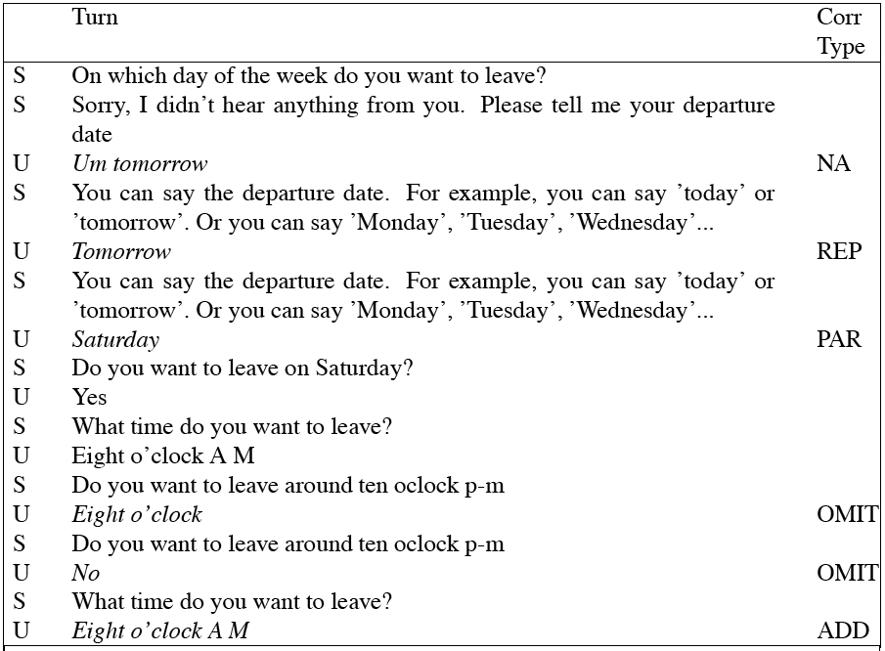
A Labeled dialogue (Swerts et al)

Slide 46
Machine learning to detect user corrections
Build classifiers using features like
  Lexical information (words “no”, “correction”, “I don’t”, swear words)
  Prosodic features (various increases in F0 range, pause duration, and word duration that correlation with hyperarticulation)
  Length
  ASR confidence
  LM probability
  Various dialogue features (repetition)

Slide 47
Prosodic Features
Shriberg et al. (1998)
Decision tree trained on simple acoustically-based prosodic features
  Slope of F0 at the end of the utterance
  Average energy at different places in utterance
  Various duration measures
  All normalized in various ways
These helped distinguish
  Statement (S)
  Yes-no-question (QY)
  Declarative question (QD) (“You’re going to the store?”)
  Wh-question (QW)

Slide 48
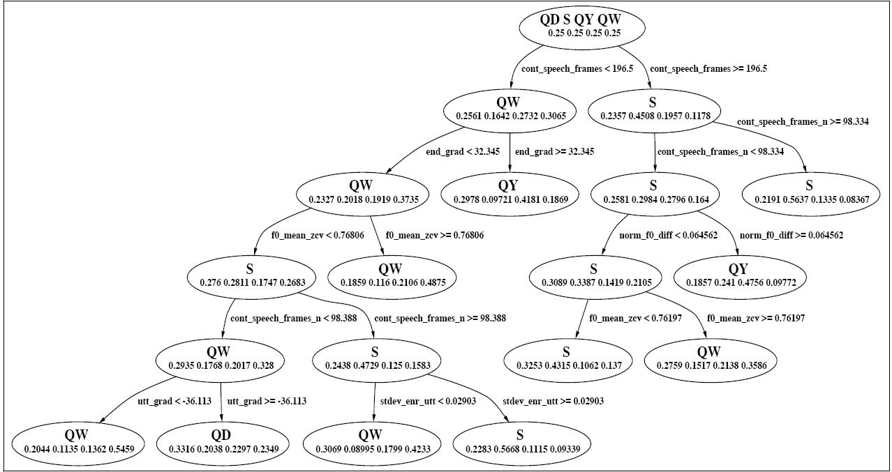
Prosodic Decision Tree for making S/QY/QW/QD decision

Slide 49
Generating Dialogue Acts
Confirmation
Rejection

Slide 50
Confirmation
Another reason for grounding
Errors: Speech is a pretty errorful channel
  Even for humans; so they use grounding to confirm that they heard correctly
ASR is way worse than humans!
So dialogue systems need to do even more grounding and confirmation than humans

Slide 51
Explicit confirmation
S: Which city do you want to leave from?
U: Baltimore
S: Do you want to leave from Baltimore?
U: Yes

Slide 52
Explicit confirmation
U: I’d like to fly from Denver Colorado to New York City on September 21st in the morning on United Airlines
S: Let’s see then. I have you going from Denver Colorado to New York on September 21st. Is that correct?
U: Yes

Slide 53
Implicit confirmation: display
U: I’d like to travel to Berlin
S: When do you want to travel to Berlin?
U: Hi I’d like to fly to Seattle Tuesday morning
S: Traveling to Seattle on Tuesday, August eleventh in the morning. Your name?

Slide 54
Implicit vs. Explicit
Complementary strengths
Explicit: easier for users to correct systems’s mistakes (can just say “no”)
But explicit is cumbersome and long
Implicit: much more natural, quicker, simpler (if system guesses right).

Slide 55
Implicit and Explicit
Early systems: all-implicit or all-explicit
Modern systems: adaptive
How to decide?
  ASR system can give confidence metric.
  This expresses how convinced system is of its transcription of the speech
  If high confidence, use implicit confirmation
  If low confidence, use explicit confirmation

Slide 56
Computing confidence
Simplest: use acoustic log-likelihood of user’s utterance
More features
  Prosodic: utterances with longer pauses, F0 excursions, longer durations
  Backoff: did we have to backoff in the LM?
  Cost of an error: Explicit confirmation before moving money or booking flights

Slide 57
Rejection
e.g., VoiceXML “nomatch”
“I’m sorry, I didn’t understand that.”
Reject when:
  ASR confidence is low
  Best interpretation is semantically ill-formed
Might have four-tiered level of confidence:
  Below confidence threshhold, reject
  Above threshold, explicit confirmation
  If even higher, implicit confirmation
  Even higher, no confirmation

Slide 58
Dialogue System Evaluation
Key point about SLP.
Whenever we design a new algorithm or build a new application, need to evaluate it
Two kinds of evaluation
  Extrinsic: embedded in some external task
  Intrinsic: some sort of more local evaluation.
How to evaluate a dialogue system?
What constitutes success or failure for a dialogue system?

Slide 59
Dialogue System Evaluation
It turns out we’ll need an evaluation metric for two reasons
  1) the normal reason: we need a metric to help us compare different implementations
    can’t improve it if we don’t know where it fails
    Can’t decide between two algorithms without a goodness metric
  2) a new reason: we will need a metric for “how good a dialogue went” as an input to reinforcement learning:
    automatically improve our conversational agent performance via learning

Slide 60
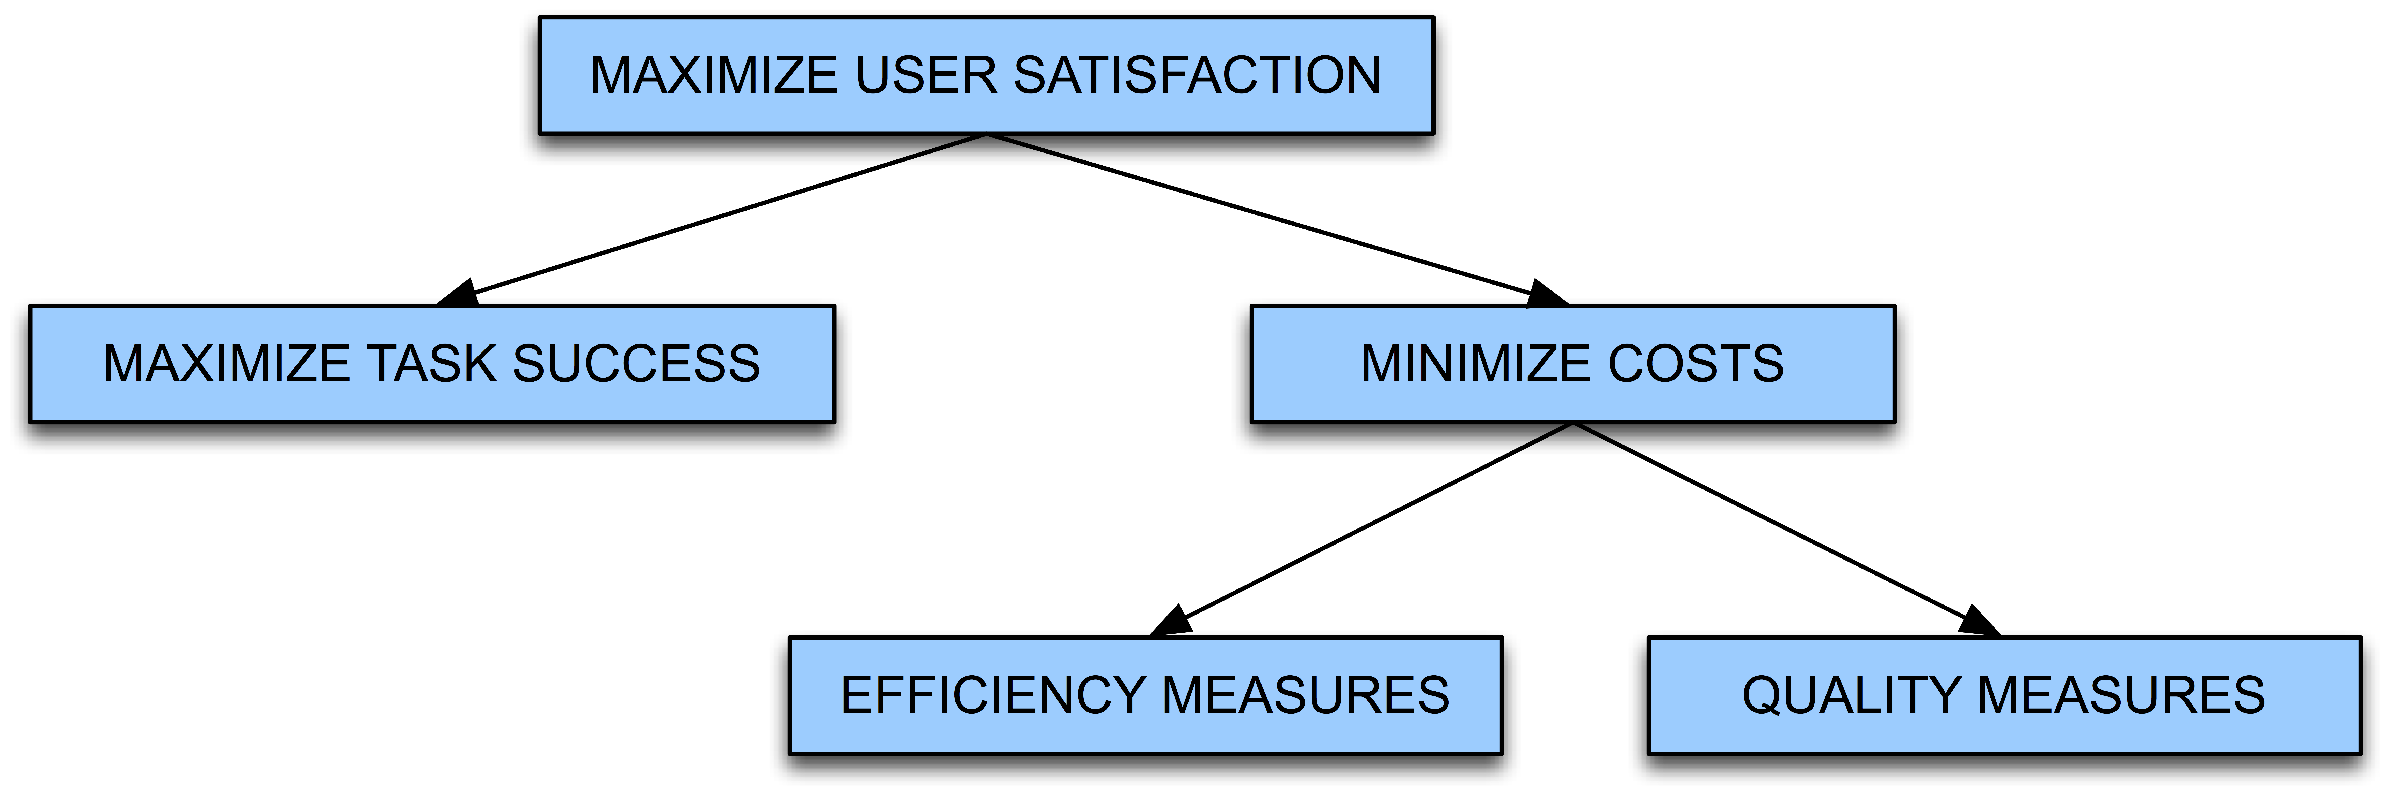
PARADISE evaluation
Maximize Task Success
Minimize Costs
  Efficiency Measures
  Quality Measures
PARADISE (PARAdigm for Dialogue System Evaluation) (Walker et al. 2000)

Slide 61
Task Success
% of subtasks completed
Correctness of each questions/answer/error msg
Correctness of total solution
  Attribute-Value matrix (AVM)
  Kappa coefficient
Users’ perception of whether task was completed

Slide 62
Task Success
    Task goals seen as Attribute-Value Matrix
        ELVIS e-mail retrieval task (Walker et al ‘97)
        “Find the time and place of your meeting with Kim.”
Attribute Value
Selection Criterion Kim or Meeting
Time 10:30 a.m.
Place 2D516
Task success can be defined by match between AVM values at end of task with “true” values for AVM
Slide from Julia Hirschberg

Slide 63
Efficiency Cost
Polifroni et al. (1992), Danieli and Gerbino (1995) Hirschman and Pao (1993)
Total elapsed time in seconds or turns
Number of queries
Turn correction ration: number of system or user turns used solely to correct errors, divided by total number of turns

Slide 64
Quality Cost
# of times ASR system failed to return any sentence
# of ASR rejection prompts
# of times user had to barge-in
# of time-out prompts
Inappropriateness (verbose, ambiguous) of system’s questions, answers, error messages

Slide 65
Another key quality cost
“Concept accuracy” or “Concept error rate”
% of semantic concepts that the NLU component returns correctly
I want to arrive in Austin at 5:00
  DESTCITY: Boston
  Time: 5:00
Concept accuracy = 50%
Average this across entire dialogue
“How many of the sentences did the system understand correctly”

Slide 66
PARADISE: Regress against user satisfaction

Slide 67
Regressing against user satisfaction
Questionnaire to assign each dialogue a “user satisfaction rating”: this is dependent measure
Set of cost and success factors are independent measures
Use regression to train weights for each factor

Slide 68
Experimental Procedures
Subjects given specified tasks
Spoken dialogues recorded
Cost factors, states, dialog acts automatically logged; ASR accuracy,barge-in hand-labeled
Users specify task solution via web page
Users complete User Satisfaction surveys
Use multiple linear regression to model User Satisfaction as a function of Task Success and Costs; test for significant predictive factors
Slide from Julia Hirschberg

Slide 69
User Satisfaction:
Sum of Many Measures
Was the system easy to understand? (TTS Performance)
Did the system understand what you said? (ASR Performance)
Was it easy to find the message/plane/train you wanted? (Task Ease)
Was the pace of interaction with the system appropriate? (Interaction Pace)
Did you know what you could say at each point of the dialog? (User Expertise)
How often was the system sluggish and slow to reply to you? (System Response)
Did the system work the way you expected it to in this conversation? (Expected Behavior)
Do you think you'd use the system regularly in the future? (Future Use)

Slide 70
Performance Functions from Three Systems
ELVIS User Sat.= .21* COMP + .47 * MRS - .15 * ET
TOOT User Sat.= .35* COMP + .45* MRS - .14*ET
ANNIE User Sat.= .33*COMP + .25* MRS +.33* Help
  COMP: User perception of task completion (task success)
  MRS: Mean (concept) recognition accuracy (cost)
  ET: Elapsed time (cost)
  Help: Help requests (cost)
Slide from Julia Hirschberg

Slide 71
Performance Model
Perceived task completion and mean recognition score (concept accuracy) are consistently significant predictors of User Satisfaction
Performance model useful for system development
  Making predictions about system modifications
  Distinguishing ‘good’ dialogues from ‘bad’ dialogues
  As part of a learning model

Slide 72
Now that we have a success metric
Could we use it to help drive learning?
In recent work we use this metric to help us learn an optimal policy or strategy for how the conversational agent should behave

Slide 73
New Idea: Modeling a dialogue system as a probabilistic agent
A conversational agent can be characterized by:
  The current knowledge of the system
    A set of states S the agent can be in
  a set of actions A the agent can take
  A goal G, which implies
    A success metric that tells us how well the agent achieved its goal
    A way of using this metric to create a strategy or policy π for what action to take in any particular state.

Slide 74
What do we mean by actions A and policies π?
Kinds of decisions a conversational agent needs to make:
  When should I ground/confirm/reject/ask for clarification on what the user just said?
  When should I ask a directive prompt, when an open prompt?
  When should I use user, system, or mixed initiative?

Slide 75
A threshold is a human-designed policy!
Could we learn what the right action is
  Rejection
  Explicit confirmation
  Implicit confirmation
  No confirmation
By learning a policy which,
  given various information about the current state,
  dynamically chooses the action which maximizes dialogue success

Slide 76
Another strategy decision
Open versus directive prompts
When to do mixed initiative
How we do this optimization?
Markov Decision Processes

Slide 77
Summary
The Linguistics of Conversation
Basic Conversational Agents
  ASR
  NLU
  Generation
  Dialogue Manager
Dialogue Manager Design
  Finite State
  Frame-based
  Initiative: User, System, Mixed
VoiceXML
Information-State
  Dialogue-Act Detection
  Dialogue-Act Generation
Evaluation
Utility-based conversational agents
  MDP, POMDP

