Slide 1
CS 224S/LING 281
Speech Recognition, Synthesis, and Dialogue
Dan Jurafsky
Lecture 14:
Dialogue: MDPs
and
Speaker Detection

Slide 2
Outline for today
MDP Dialogue Architectures
Speaker Recognition

Slide 3
Now that we have a success metric
Could we use it to help drive learning?
In recent work we use this metric to help us learn an optimal policy or strategy for how the conversational agent should behave

Slide 4
New Idea: Modeling a dialogue system as a probabilistic agent
A conversational agent can be characterized by:
  The current knowledge of the system
    A set of states S the agent can be in
  a set of actions A the agent can take
  A goal G, which implies
    A success metric that tells us how well the agent achieved its goal
    A way of using this metric to create a strategy or policy π for what action to take in any particular state.

Slide 5
What do we mean by actions A and policies π?
Kinds of decisions a conversational agent needs to make:
  When should I ground/confirm/reject/ask for clarification on what the user just said?
  When should I ask a directive prompt, when an open prompt?
  When should I use user, system, or mixed initiative?

Slide 6
A threshold is a human-designed policy!
Could we learn what the right action is
  Rejection
  Explicit confirmation
  Implicit confirmation
  No confirmation
By learning a policy which,
  given various information about the current state,
  dynamically chooses the action which maximizes dialogue success

Slide 7
Another strategy decision
Open versus directive prompts
When to do mixed initiative
How we do this optimization?
Markov Decision Processes

Slide 8
Review: Open vs. Directive Prompts
Open prompt
  System gives user very few constraints
  User can respond how they please:
  “How may I help you?” “How may I direct your call?”
Directive prompt
  Explicit instructs user how to respond
  “Say yes if you accept the call; otherwise, say no”

Slide 9
Review: Restrictive vs. Non-restrictive gramamrs
Restrictive grammar
  Language model which strongly constrains the ASR system, based on dialogue state
Non-restrictive grammar
  Open language model which is not restricted to a particular dialogue state

Slide 10
Kinds of Initiative
How do I decide which of these initiatives to use at each point in the dialogue?
Grammar | Open Prompt | Directive Prompt
Restrictive | Doesn’t make sense | System Initiative
Non-restrictive | User Initiative | Mixed Initiative

Slide 11
Modeling a dialogue system as a probabilistic agent
A conversational agent can be characterized by:
  The current knowledge of the system
    A set of states S the agent can be in
  a set of actions A the agent can take
  A goal G, which implies
    A success metric that tells us how well the agent achieved its goal
    A way of using this metric to create a strategy or policy π for what action to take in any particular state.

Slide 12
Goals are not enough
Goal: user satisfaction
OK, that’s all very well, but
  Many things influence user satisfaction
  We don’t know user satisfaction til after the dialogue is done
  How do we know, state by state and action by action, what the agent should do?
We need a more helpful metric that can apply to each state

Slide 13
Utility
A utility function
  maps a state or state sequence
  onto a real number
  describing the goodness of that state
  I.e. the resulting “happiness” of the agent
Principle of Maximum Expected Utility:
  A rational agent should choose an action that maximizes the agent’s expected utility

Slide 14
Maximum Expected Utility
Principle of Maximum Expected Utility:
  A rational agent should choose an action that maximizes the agent’s expected utility
Action A has possible outcome states Result_{i}(A)
E: agent’s evidence about current state of world
Before doing A, agent estimates prob of each outcome
  P(Result_{i}(A)|Do(A),E)
Thus can compute expected utility:

Slide 15
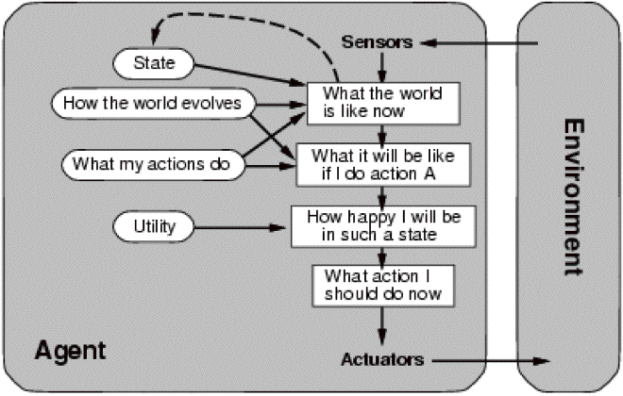
Utility (Russell and Norvig)

Slide 16
Markov Decision Processes
Or MDP
Characterized by:
  a set of states S an agent can be in
  a set of actions A the agent can take
  A reward r(a,s) that the agent receives for taking an action in a state
  (+ Some other things I’ll come back to (gamma, state transition probabilities))

Slide 17
A brief tutorial example
Levin et al (2000)
A Day-and-Month dialogue system
Goal: fill in a two-slot frame:
  Month: November
  Day: 12th
Via the shortest possible interaction with user

Slide 18
What is a state?
In principle, MDP state could include any possible information about dialogue
  Complete dialogue history so far
Usually use a much more limited set
  Values of slots in current frame
  Most recent question asked to user
  Users most recent answer
  ASR confidence
  etc

Slide 19
State in the Day-and-Month example
Values of the two slots day and month.
Total:
  2 special initial state s_{i} and s_{f}.
  365 states with a day and month
  1 state for leap year
  12 states with a month but no day
  31 states with a day but no month
  411 total states

Slide 20
Actions in MDP models of dialogue
Speech acts!
  Ask a question
  Explicit confirmation
  Rejection
  Give the user some database information
  Tell the user their choices
Do a database query

Slide 21
Actions in the Day-and-Month example
a_{d}: a question asking for the day
a_{m}: a question asking for the month
a_{dm}: a question asking for the day+month
a_{f}: a final action submitting the form and terminating the dialogue

Slide 22
A simple reward function
For this example, let’s use a cost function
A cost function for entire dialogue
Let
  N_{i}=number of interactions (duration of dialogue)
  N_{e}=number of errors in the obtained values (0-2)
  N_{f}=expected distance from goal
    (0 for complete date, 1 if either data or month are missing, 2 if both missing)
Then (weighted) cost is:
C = w_{i}×N_{i} + w_{e}×N_{e} + w_{f}×N_{f}

Slide 23
2 possible policies
P_{d}=probability of error in directive prompt
P_{o}=probability of error in open prompt

Slide 24
2 possible policies
Strategy 1 is better than strategy 2 when
improved error rate justifies longer interaction:

Slide 25
That was an easy optimization
Only two actions, only tiny # of policies
In general, number of actions, states, policies is quite large
So finding optimal policy π* is harder
We need reinforcement leraning
Back to MDPs:

Slide 26
MDP
We can think of a dialogue as a trajectory in state space
The best policy π* is the one with the greatest expected reward over all trajectories
How to compute a reward for a state sequence?

Slide 27
Reward for a state sequence
One common approach: discounted rewards
Cumulative reward Q of a sequence is discounted sum of utilities of individual states
Discount factor γ between 0 and 1
Makes agent care more about current than future rewards; the more future a reward, the more discounted its value

Slide 28
The Markov assumption
MDP assumes that state transitions are Markovian

Slide 29
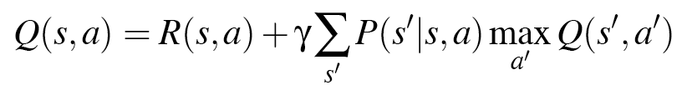
Expected reward for an action
Expected cumulative reward Q(s,a) for taking a particular action from a particular state can be computed by Bellman equation:
Expected cumulative reward for a given state/action pair is:
  immediate reward for current state
  + expected discounted utility of all possible next states s’
  Weighted by probability of moving to that state s’
  And assuming once there we take optimal action a’

Slide 30
What we need for Bellman equation
A model of p(s’|s,a)
Estimate of R(s,a)
How to get these?
If we had labeled training data
  P(s’|s,a) = C(s,s’,a)/C(s,a)
If we knew the final reward for whole dialogue R(s1,a1,s2,a2,…,sn)
Given these parameters, can use value iteration algorithm to learn Q values (pushing back reward values over state sequences) and hence best policy

Slide 31
Final reward
What is the final reward for whole dialogue R(s1,a1,s2,a2,…,sn)?
This is what our automatic evaluation metric PARADISE computes!
The general goodness of a whole dialogue!!!!!

Slide 32
How to estimate p(s’|s,a) without labeled data
Have random conversations with real people
  Carefully hand-tune small number of states and policies
  Then can build a dialogue system which explores state space by generating a few hundred random conversations with real humans
  Set probabilities from this corpus
Have random conversations with simulated people
  Now you can have millions of conversations with simulated people
  So you can have a slightly larger state space

Slide 33
An example
Singh, S., D. Litman, M. Kearns, and M. Walker. 2002. Optimizing Dialogue Management with Reinforcement Learning: Experiments with the NJFun System. Journal of AI Research.
NJFun system, people asked questions about recreational activities in New Jersey
Idea of paper: use reinforcement learning to make a small set of optimal policy decisions

Slide 34
Very small # of states and acts
States: specified by values of 8 features
  Which slot in frame is being worked on (1-4)
  ASR confidence value (0-5)
  How many times a current slot question had been asked
  Restrictive vs. non-restrictive grammar
  Result: 62 states
Actions: each state only 2 possible actions
  Asking questions: System versus user initiative
  Receiving answers: explicit versus no confirmation.

Slide 35
Ran system with real users
311 conversations
Simple binary reward function
  1 if competed task (finding museums, theater, winetasting in NJ area)
  0 if not
System learned good dialogue strategy: Roughly
  Start with user initiative
  Backoff to mixed or system initiative when re-asking for an attribute
  Confirm only a lower confidence values

Slide 36
State of the art
Only a few such systems
  From (former) ATT Laboratories researchers, now dispersed
  And Cambridge UK lab
Hot topics:
  Partially observable MDPs (POMDPs)
  We don’t REALLY know the user’s state (we only know what we THOUGHT the user said)
  So need to take actions based on our BELIEF , I.e. a probability distribution over states rather than the “true state”

Slide 37
Summary
Utility-based conversational agents
  Policy/strategy for:
    Confirmation
    Rejection
    Open/directive prompts
    Initiative
    +?????
  MDP
  POMDP

Slide 38
Summary
The Linguistics of Conversation
Basic Conversational Agents
  ASR
  NLU
  Generation
  Dialogue Manager
Dialogue Manager Design
  Finite State
  Frame-based
  Initiative: User, System, Mixed
VoiceXML
Information-State
  Dialogue-Act Detection
  Dialogue-Act Generation
Evaluation
Utility-based conversational agents
  MDP, POMDP

Slide 39

Part II: Speaker Recognition

Slide 40
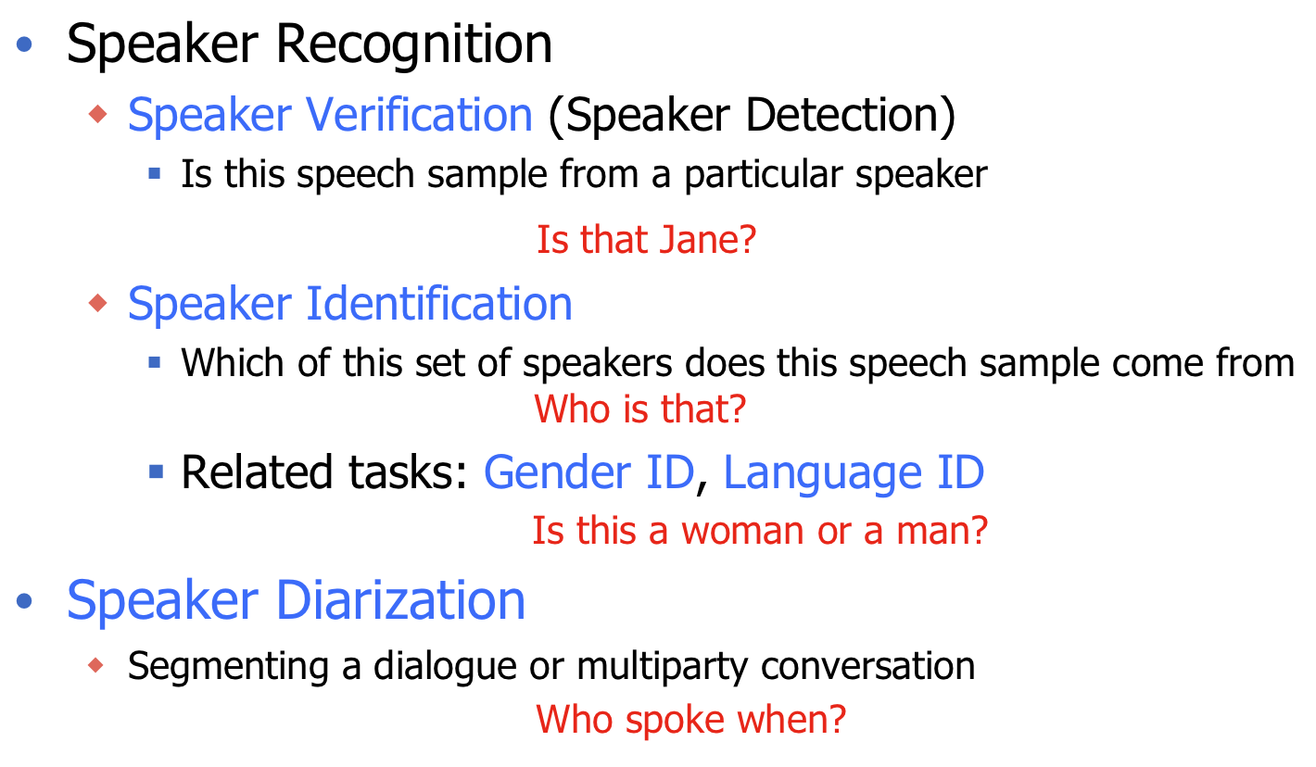
Speaker Recognition tasks

Slide 41
Speaker Recognition tasks
Two Modes of Speaker Verification
  Text-dependent (Text-constrained)
    There is some constraint on the type of utterance that users of the system can pronounce
  Text-independent
    Users can say whatever they want
Slide adapted from Chu, Bimbot, Bonastre, Fredouille, Gravier, Magrin-Chagnolleau, Meignier, Merlin, Ortega-Garcia, Petrovska-Delacretaz, Reynolds

Slide 42
Introduction (cont.)
Two Cases of Speaker Identification
  Closed Set
    A reference model for the unknown speaker may not exist
  Open Set
    An additional decision alternative, “the unknown does not match any of the models”, is required
Slide adapted from Chu, Bimbot, Bonastre, Fredouille, Gravier, Magrin-Chagnolleau, Meignier, Merlin, Ortega-Garcia, Petrovska-Delacretaz, Reynolds

Slide 43
Speaker Verification
Basic idea: likelihood ratio detection
  Assumption: A segment of speech Y contains speech from only one speaker
  Hypothesis test:
    H0: Y is from the hypothesized speaker S
    H1: Y is not from the hypothesized speaker S
  A likelihood ratio (LR) test given by
    p(Y|H0) > Θ, accept H0,
    p(Y|H1) < Θ, accept H1,
｛
______
Slide adapted from Chu, Bimbot, Bonastre, Fredouille, Gravier, Magrin-Chagnolleau, Meignier, Merlin, Ortega-Garcia, Petrovska-Delacretaz, Reynolds

Slide 44
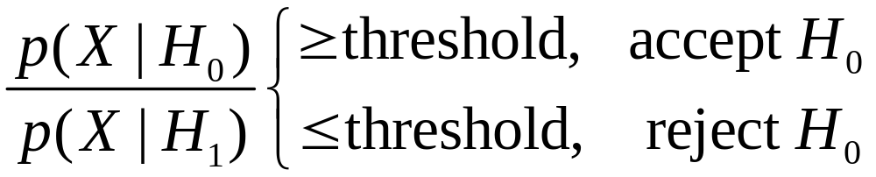
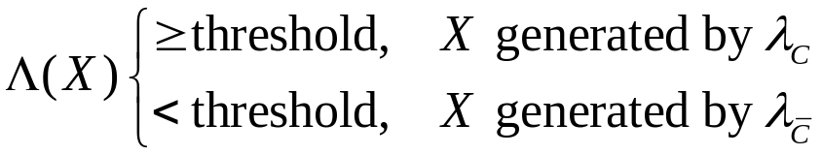
Speaker ID
Log-Likelihood Ratio Score
We determine which hypothesis is true using the ratio:
We use the log-likelihood ratio score to decide whether an observed speaker, language, or dialect is the target
Nicolas Malyska, Sanjeev Mohindra, Karen Lauro, Douglas Reynolds, and Jeremy Kepner
Notes:
We can write this test as a ratio. It is typical to take the logarithm of this ratio resulting in the log-likelihood ratio score.

Slide 45
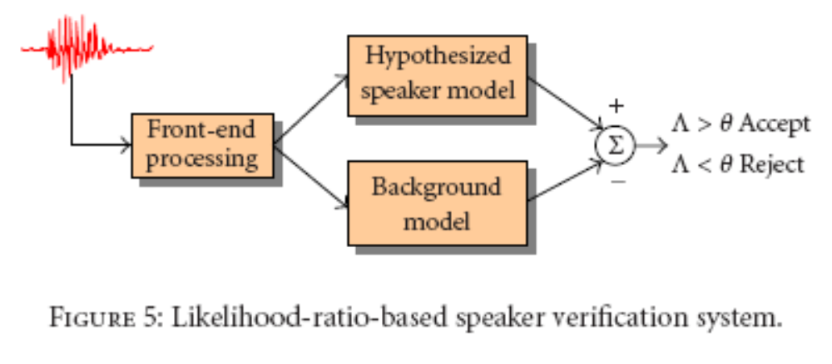
Statistical Modeling (cont.)
Slide adapted from Chu, Bimbot, Bonastre, Fredouille, Gravier, Magrin-Chagnolleau, Meignier, Merlin, Ortega-Garcia, Petrovska-Delacretaz, Reynolds

Slide 46
How do we get H1?
Pool speech from several speakers and train a single model:
  a universal background model (UBM)
Main advantage :
  a single speaker-independent model (λ_{bkg}) can be trained once for a particular task and then used for all hypothesized speakers in that task
Slide adapted from Chu, Bimbot, Bonastre, Fredouille, Gravier, Magrin-Chagnolleau, Meignier, Merlin, Ortega-Garcia, Petrovska-Delacretaz, Reynolds

Slide 47
How to compute P(H|X)?
For text-independent speaker recognition, the most successful likelihood function has been GMMs
Slide adapted from Chu, Bimbot, Bonastre, Fredouille, Gravier, Magrin-Chagnolleau, Meignier, Merlin, Ortega-Garcia, Petrovska-Delacretaz, Reynolds

Slide 48
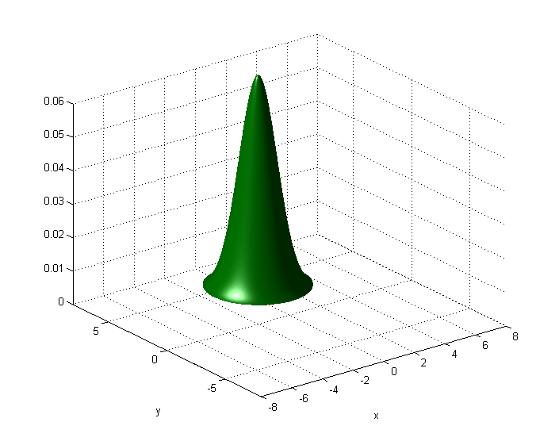
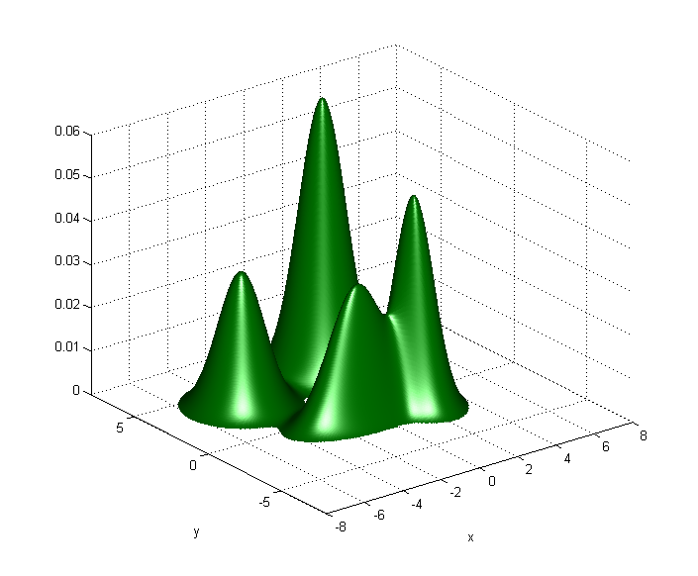





Recognition Systems
Gaussian Mixture Models
A Gaussian mixture model (GMM) represents features as the weighted sum of multiple Gaussian distributions
Each Gaussian state i has a
  Mean
  Covariance
  Weight
Dim 2
Dim 1
Nicolas Malyska, Sanjeev Mohindra, Karen Lauro, Douglas Reynolds, and Jeremy Kepner
Notes:
In modern recognition systems, it is typical to model the data as a weighted sum of multiple Gaussian distributions, each having a mean, covariance, and weight.

Slide 49

Recognition Systems
Gaussian Mixture Models
Parameters
Dim 2
Dim 1
Nicolas Malyska, Sanjeev Mohindra, Karen Lauro, Douglas Reynolds, and Jeremy Kepner
Notes:
Each Gaussian of the sum is represented by a parameter vector, as shown.

Slide 50
Recognition Systems
Gaussian Mixture Models
Parameters
Model Components
Dim 2
Dim 1
Nicolas Malyska, Sanjeev Mohindra, Karen Lauro, Douglas Reynolds, and Jeremy Kepner
Notes:
An entire GMM is represented by a matrix, having a parameter vector for each model state.

Slide 51
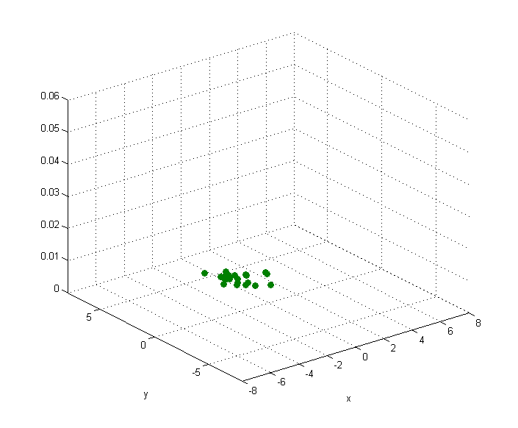


GMM training
Training Features
A recognition system makes decisions about observed data based on a knowledge of past data
During training, the system learns about the data it uses to make decisions
  A set of features are collected from a certain language, dialect, or speaker
  A model is generated to represent the data
Dim 2
Dim 1
Model
Dim 2
Dim 1
Nicolas Malyska, Sanjeev Mohindra, Karen Lauro, Douglas Reynolds, and Jeremy Kepner
Notes:
A model is then generated from these features. As an example, we can see here the data modeled with a single Gaussian distribution.

Slide 52
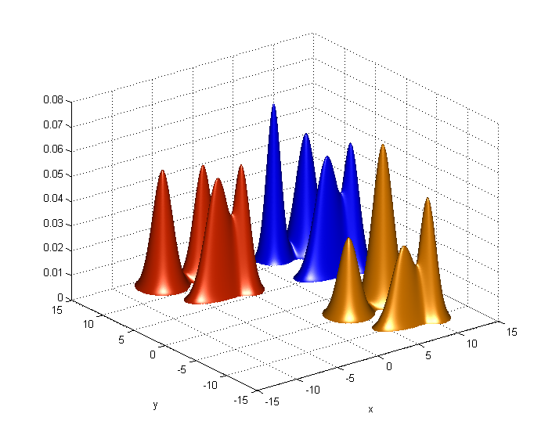





Recognition Systems
Language, Speaker, and Dialect Models
Languages,
Dialects,
or Speakers
Parameters
Model Components
In LID, DID, and SID,
we train a set of target models
for each dialect, language, or speaker
Dim 2
Dim 1
Nicolas Malyska, Sanjeev Mohindra, Karen Lauro, Douglas Reynolds, and Jeremy Kepner
Notes:
Using the GMMs that we have described, modern recognition systems store models for each language, dialect, or speaker of interest. These are called the target models.

Slide 53
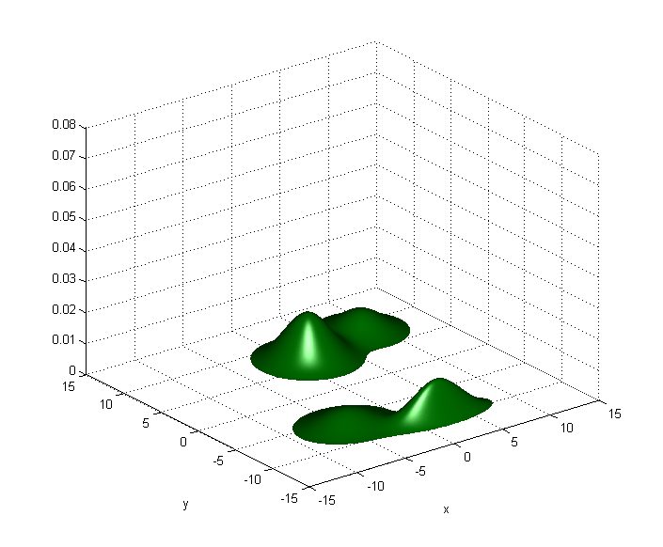



Recognition Systems
Universal Background Model
Parameters
Model Components
We also train a universal background
model representing all speech
Dim 2
Dim 1
Nicolas Malyska, Sanjeev Mohindra, Karen Lauro, Douglas Reynolds, and Jeremy Kepner
Notes:
It is also conventional to create a model called the universal background model, representing the universe of all speech. This model is typically trained on a wide variety of training data representing the scope of the languages, dialects, or speakers that are possible.

Slide 54
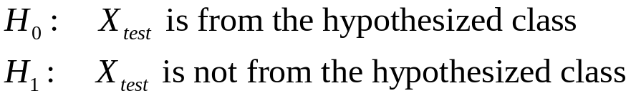

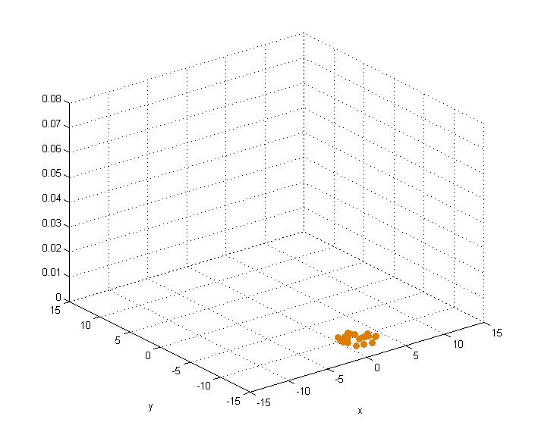
Recognition Systems
Hypothesis Test
Given a set of test observations, we perform a hypothesis test to determine whether a certain class produced it
Dim 2
Dim 1
Nicolas Malyska, Sanjeev Mohindra, Karen Lauro, Douglas Reynolds, and Jeremy Kepner
Notes:
Armed with the target and background models, the process of performing recognition become a hypothesis test. In this test, we ask whether a set of observed data more likely represents a hypothesized language, dialect, or speaker, or instead some other class.

Slide 55
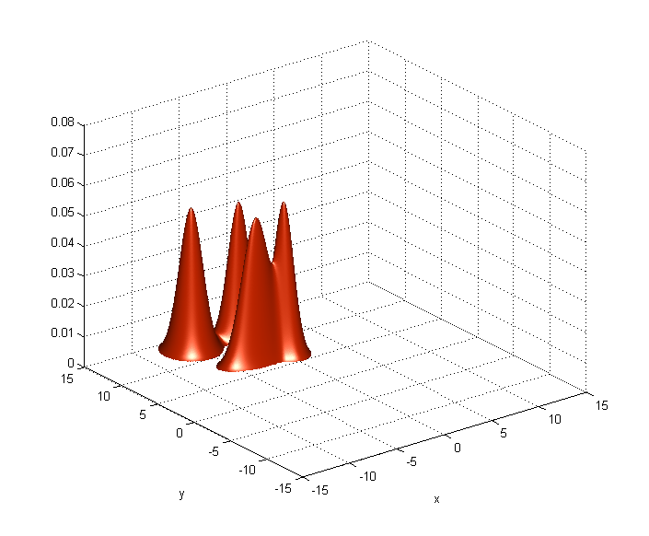




Recognition Systems
Hypothesis Test
Given a set of test observations, we perform a hypothesis test to determine whether a certain class produced it
Dim 2
Dim 1
Dim 2
Dim 1
Dim 2
Dim 1
Nicolas Malyska, Sanjeev Mohindra, Karen Lauro, Douglas Reynolds, and Jeremy Kepner
Notes:
As shown, this test is performed by considering the likelihood that a set of observed features was produced by a certain target model versus the probability that it comes for the universal background model.

Slide 56
Recognition Systems
Hypothesis Test
Given a set of test observations, we perform a hypothesis test to determine whether a certain class produced it
English?
Dim 2
Dim 1
Not English?
Dim 2
Dim 1
Dim 2
Dim 1
Nicolas Malyska, Sanjeev Mohindra, Karen Lauro, Douglas Reynolds, and Jeremy Kepner
Notes:
As shown, this test is performed by considering the likelihood that a set of observed features was produced by a certain target model versus the probability that it comes for the universal background model.

Slide 57



Recognition Systems
Log-Likelihood Computation
The observation log-likelihood given a model is:
Dim 2
Dim 1
Dim 2
Dim 1
Nicolas Malyska, Sanjeev Mohindra, Karen Lauro, Douglas Reynolds, and Jeremy Kepner
Notes:
To compute each log-likelihood, we perform the computational steps animated in this set of slides. The process involves taking a dot product and adding a constant value for each state, followed by a series of table lookups and a sum.

Slide 58

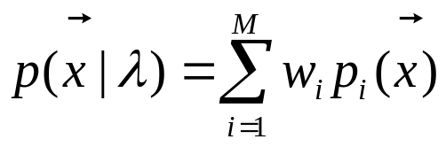
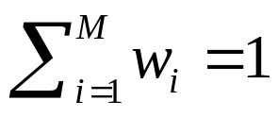
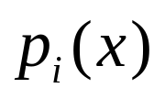

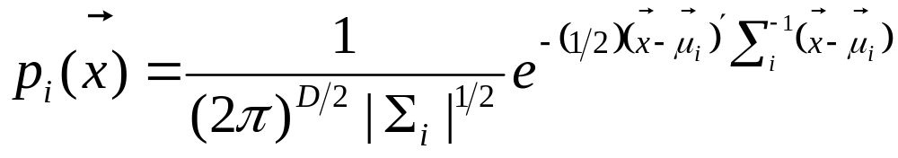

Gaussian mixture models
For a D-dimensional feature vector , the mixture density used for the likelihood function is defined as follows:
,
Gaussian densities , each parameterized by a D × 1 mean vector and a D × D covariance matrix Σi:
Collectively, the parameters of the density model are denoted as , i = (1, . . . ,M)
Slide adapted from Chu, Bimbot, Bonastre, Fredouille, Gravier, Magrin-Chagnolleau, Meignier, Merlin, Ortega-Garcia, Petrovska-Delacretaz, Reynolds

Slide 59

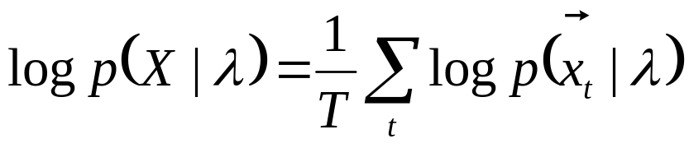
Gaussian mixture models
Under the assumption of independent feature vectors, the log-likelihood of a model λ for a sequence of feature vectors is computed as follows:
GMMs are comptuationally inexpensive
  For homework: single gaussian.
  Real systems:
    UBM background model: 512–2048 mixtures
    Speaker’s GMM: 64–256 mixtures
Recent work:
  Combining high-level information (such as speaker-dependent word usage or speaking style) with GMMs
Slide adapted from Chu, Bimbot, Bonastre, Fredouille, Gravier, Magrin-Chagnolleau, Meignier, Merlin, Ortega-Garcia, Petrovska-Delacretaz, Reynolds

Slide 60
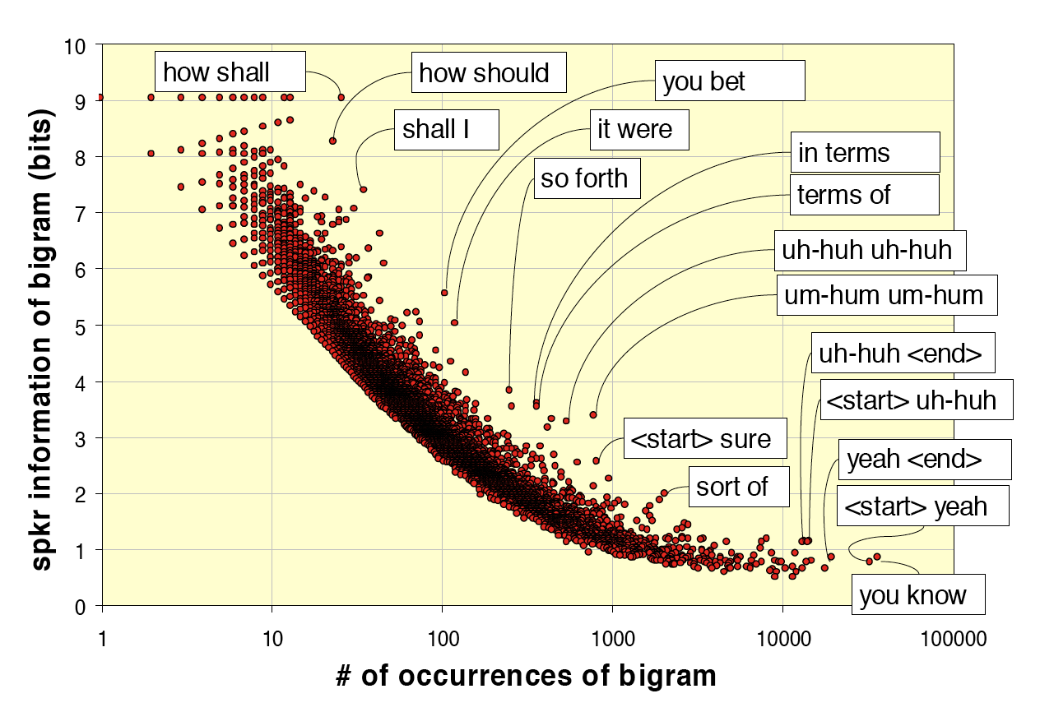
Doddington (2001)
Word bigrams can be very informative about speaker identity

Slide 61
Speaker diarization
Tasks
  Conversational telephone speech
    2 speakers
  Broadcast news
    Many speakers although often in dialogue (interviews) or in sequence (broadcast segments)
  Meeting recordings
    Many speakers, lots of overlap and disfluencies
General 2-step algorithm
  Segmentation into speakers
    Detection of speaker-change (insert boundaries)
  Clustering (MFCC)s of segments

Slide 62
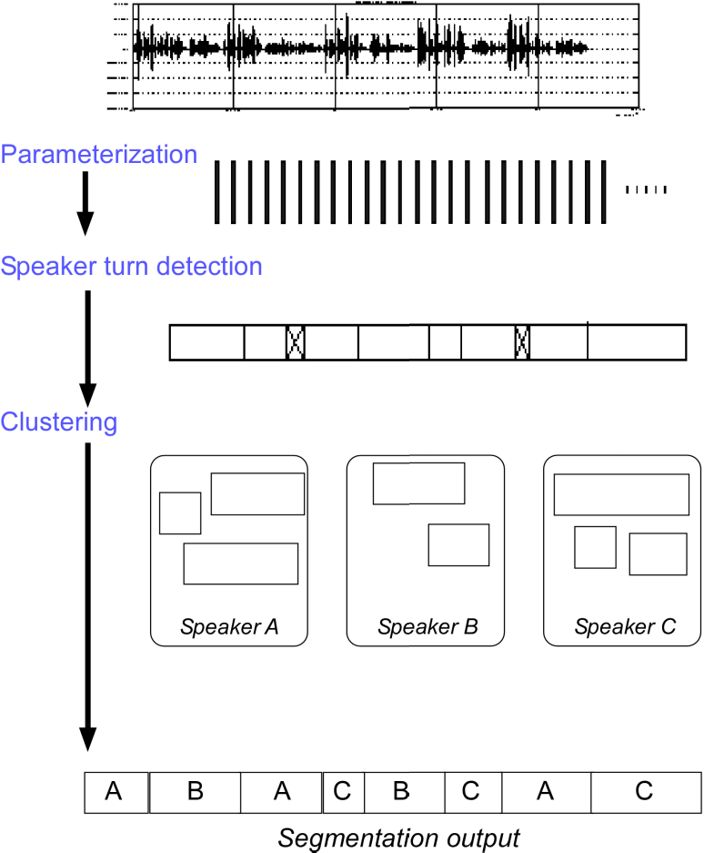
Speaker diarization
General 2-step algorithm
  Segmentation into speakers
    Detection of speaker-change (insert boundaries)
  Clustering (MFCC)s of segments
Picture from slide by Moraru, Besacier, Meignier, Fredouille, Bonastre

Slide 63
Outline for today
MDP Dialogue Architectures
Speaker Recognition

