Slide 1
CS 224S/LING 281
Speech Recognition, Synthesis, and Dialogue
Dan Jurafsky
Lecture 15:
ASR: Search (Lattices, N-best lists, A*, etc) and Scoring (sclite)

Slide 2
Evaluation
How to evaluate the word string output by a speech recognizer?

Slide 3
Word Error Rate
Word Error Rate =
100 (Insertions+Substitutions + Deletions)
------------------------------
Total Word in Correct Transcript
Aligment example:
REF: portable **** PHONE UPSTAIRS last night so
HYP: portable FORM OF STORES last night so
Eval I S S
WER = 100 (1+2+0)/6 = 50%

Slide 4
NIST sctk-1.3 scoring software:
Computing WER with sclite
http://www.nist.gov/speech/tools/
Sclite aligns a hypothesized text (HYP) (from the recognizer) with a correct or reference text (REF) (human transcribed)
id: (2347-b-013)
Scores: (#C #S #D #I) 9 3 1 2
REF: was an engineer SO I i was always with **** **** MEN UM and they
HYP: was an engineer ** AND i was always with THEM THEY ALL THAT and they
Eval: D S I I S S

Slide 5
Sclite output for error analysis
CONFUSION PAIRS Total (972)
With >= 1 occurances (972)
1: 6 -> (%hesitation) ==> on
2: 6 -> the ==> that
3: 5 -> but ==> that
4: 4 -> a ==> the
5: 4 -> four ==> for
6: 4 -> in ==> and
7: 4 -> there ==> that
8: 3 -> (%hesitation) ==> and
9: 3 -> (%hesitation) ==> the
10: 3 -> (a-) ==> i
11: 3 -> and ==> i
12: 3 -> and ==> in
13: 3 -> are ==> there
14: 3 -> as ==> is
15: 3 -> have ==> that
16: 3 -> is ==> this

Slide 6
Sclite output for error analysis
17: 3 -> it ==> that
18: 3 -> mouse ==> most
19: 3 -> was ==> is
20: 3 -> was ==> this
21: 3 -> you ==> we
22: 2 -> (%hesitation) ==> it
23: 2 -> (%hesitation) ==> that
24: 2 -> (%hesitation) ==> to
25: 2 -> (%hesitation) ==> yeah
26: 2 -> a ==> all
27: 2 -> a ==> know
28: 2 -> a ==> you
29: 2 -> along ==> well
30: 2 -> and ==> it
31: 2 -> and ==> we
32: 2 -> and ==> you
33: 2 -> are ==> i
34: 2 -> are ==> were

Slide 7
Better metrics than WER?
WER has been useful
But should we be more concerned with meaning (“semantic error rate”)?
  Good idea, but hard to agree on
  Has been applied in dialogue systems, where desired semantic output is more clear

Slide 8
Part II: Search (= “Decoding”)
Speeding things up: Viterbi beam decoding
Problems with Viterbi decoding
Multipass decoding
  N-best lists
  Lattices
  Word graphs
  Meshes/confusion networks
A* search

Slide 9
Speeding things up
Viterbi is O(N²T), where N is total number of HMM states, and T is length
This is too large for real-time search
A ton of work in ASR search is just to make search faster:
  Beam search (pruning)
  Fast match
  Tree-based lexicons

Slide 10
Beam search
Instead of retaining all candidates (cells) at every time frame
Use a threshold T to keep subset:
  At each time t
  Identify state with lowest cost D_{min}
  Each state with cost > D_{min}+ T is discarded (“pruned”) before moving on to time t+1
  Unpruned states are called the active states

Slide 11

Viterbi Beam Search
A:
π_{A}
b_{A}(1)
b_{A}(2)
b_{A}(3)
b_{A}(4)
B:
π _{B}
b_{B}(1)
b_{B}(2)
b_{B}(3)
b_{B}(4)
C:
π _{C}
b_{C}(1)
b_{C}(2)
b_{C}(3)
b_{C}(4)
t=0
t=1
t=2
t=3
t=4
Slide from John-Paul Hosom

Slide 12
Viterbi Beam search
Is the most common and powerful search algorithm for LVCSR
Note:
  What makes this possible is time-synchronous
  We are comparing paths of equal length
  For two different word sequences W₁ and W₂:
    We are comparing P(W₁|O₀^{t}) and P(W₂|O₀^{t})
    Based on same partial observation sequence O₀^{t}
    So denominator is same, can be ignored
  Time-asynchronous search (A*) is harder

Slide 13
Viterbi Beam Search
Empirically, beam size of 5-10% of search space
Thus 90-95% of HMM states don’t have to be considered at each time t
Vast savings in time.

Slide 14
On-line processing
Problem with Viterbi search
  Doesn’t return best sequence til final frame
This delay is unreasonable for many applications.
On-line processing
  usually smaller delay in determining answer
  at cost of always increased processing time.

Slide 15
On-line processing
At every time interval I (e.g. 1000 msec or 100 frames):
  At current time t_{curr}, for each active state q_{tcurr}, find best path P(q_{tcurr}) that goes from from t₀ to t_{curr} (using backtrace (ψ))
  Compare set of best paths P and find last time t_{match} at which all paths P have the same state value at that time
  If t_{match}exists {
    Output result from t₀ to t_{match}
    Reset/Remove ψ values until t_{match}
    Set t₀ to t_{match}+1
    }
Efficiency depends on interval I, beam threshold, and how well the observations match the HMM.
Slide from John-Paul Hosom

Slide 16
On-line processing
Example (Interval = 4 frames):
In this case, at time 4, all best paths for all states A, B, and C
have state B in common at time 2. So, t_{match} = 2.
Now output states BB for times 1 and 2, because no matter
what happens in the future, this will not change. Set t₀ to 3
best sequence
A:
δ₁(A)
δ₂(A)
δ₃(A)
δ₄(A)
BBAA
B:
δ₁(B)
δ₂(B)
δ₃(B)
δ₄(B)
BBBB
C:
δ₁(C)
δ₂(C)
δ₃(C)
δ₄(C)
BBBC
t=1
t=2
t=3
t=4
t₀=1
t_{curr}=4
Slide from John-Paul Hosom

Slide 17
On-line processing
Now t_{match} = 7, so output from t=3 to t=7: BBABB, then
set t₀ to 8.
If T=8, then output state with best δ₈, for example C.
Final result (obtained piece-by-piece) is then BBBBABBC
Interval=4
best sequence
A:
δ₃(A)
δ₄(A)
δ₅(A)
δ₆(A)
δ₇(A)
δ₈(A)
BBABBA
B:
δ₃(B)
δ₄(B)
δ₅(B)
δ₆(B)
δ₇(B)
δ₈(B)
BBABBB
C:
δ₃(C)
δ₄(C)
δ₅(C)
δ₆(C)
δ₇(C)
δ₈(C)
BBABBC
t=3
t=4
t=5
t=6
t=7
t=8
t₀=3
t_{curr}=8
Slide from John-Paul Hosom

Slide 18
Problems with Viterbi
It’s hard to integrate sophisticated knowledge sources
  Trigram grammars
  Parser-based LM
    long-distance dependencies that violate dynamic programming assumptions
  Knowledge that isn’t left-to-right
    Following words can help predict preceding words
Solutions
  Return multiple hypotheses and use smart knowledge to rescore them
  Use a different search algorithm, A* Decoding (=Stack decoding)

Slide 19
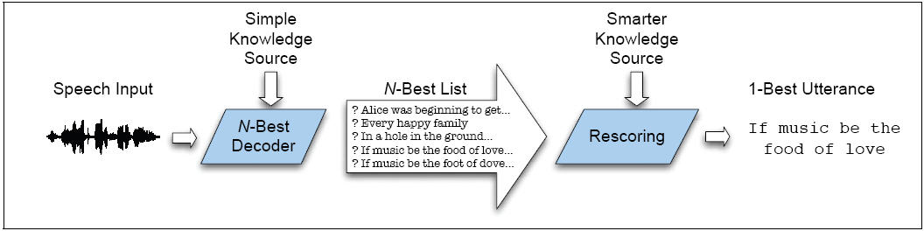
Multipass Search

Slide 20
Ways to represent multiple hypotheses
N-best list
  Instead of single best sentence (word string), return ordered list of N sentence hypotheses
Word lattice
  Compact representation of word hypotheses and their times and scores
Word graph
  FSA representation of lattice in which times are represented by topology

Slide 21


Another Problem with Viterbi
The forward probability of observation given word string
The Viterbi algorithm makes the “Viterbi Approximation”
Approximates probability of observation given word, with prob of observation given only best state sequence.

Slide 22
Solving the best-path-not-best-words problem
Viterbi returns best path (state sequence) not best word sequence
  Best path can be very different than best word string if words have many possible pronunciations
Two solutions
  Modify Viterbi to sum over different paths that share the same word string.
    Do this as part of N-best computation
      Compute N-best word strings, not N-best phone paths
  Use a different decoding algorithm (A*) that computes true Forward probability.

Slide 23
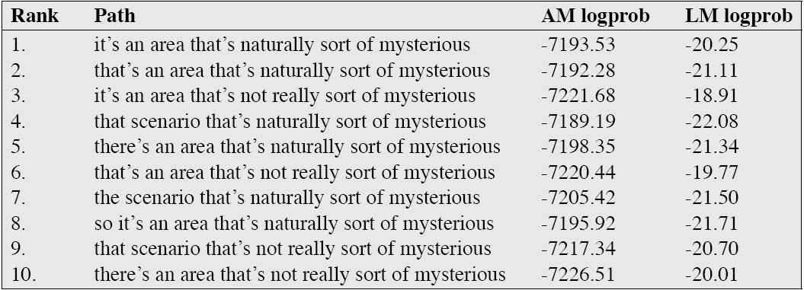
Sample N-best list

Slide 24
N-best lists
Again, we don’t want the N-best paths
That would be trivial
  Store N values in each state cell in Viterbi trellis instead of 1 value
But:
  Most of the N-best paths will have the same word string
    Useless!!!
  It turns out that a factor of N is too much to pay

Slide 25
Computing N-best lists
In the worst case, an admissible algorithm for finding the N most likely hypotheses is exponential in the length of the utterance.
  S. Young. 1984. “Generating Multiple Solutions from Connected Word DP Recognition Algorithms”. Proc. of the Institute of Acoustics, 6:4, 351-354.
For example, if AM and LM score were nearly identical for all word sequences, we must consider all permutations of word sequences for whole sentence (all with the same scores).
But of course if this is true, can’t do ASR at all!

Slide 26
Computing N-best lists
Instead, various non-admissible algorithms:
  (Viterbi) Exact N-best
  (Viterbi) Word Dependent N-best
And one admissible
  A* N-best

Slide 27
Exact N-best for time-synchronous Viterbi
Due to Schwartz and Chow; also called “sentence-dependent N-best”
Idea: each state stores multiple paths
Idea: maintain separate records for paths with distinct word histories
  History: whole word sequence up to current time t and word w
  When 2 or more paths come to the same state at the same time, merge paths w/same history and sum their probabilities.
    i.e. compute the forward probability within words
  Otherwise, retain only N-best paths for each state

Slide 28
Exact N-best for time-synchronous Viterbi
Efficiency:
  Typical HMM state has 2 or 3 predecessor states within word HMM
  So for each time frame and state, need to compare/merge 2 or 3 sets of N paths into N new paths.
  At end of search, N paths in final state of trellis give N-best word sequences
  Complexity is O(N)
    Still too slow for practical systems
      N is 100 to 1000
    More efficient versions: word-dependent N-best

Slide 29
Word-dependent (‘bigram’) N-best
Intuition:
  Instead of each state merging all paths from start of sentence
  We merge all paths that share the same previous word
Details:
  This will require us to do a more complex traceback at the end of sentence to generate the N-best list

Slide 30
Word-dependent (‘bigram’) N-best
At each state preserve total probability for each of k << N previous words
  K is 3 to 6; N is 100 to 1000
At end of each word, record score for each previous word hypothesis and name of previous word
  So each word ending we store “alternatives”
But, like normal Viterbi, pass on just the best hypothesis
At end of sentence, do a traceback
  Follow backpointers to get 1-best
  But as we follow pointers, put on a queue the alternate words ending at same point
  On next iteration, pop next best

Slide 31
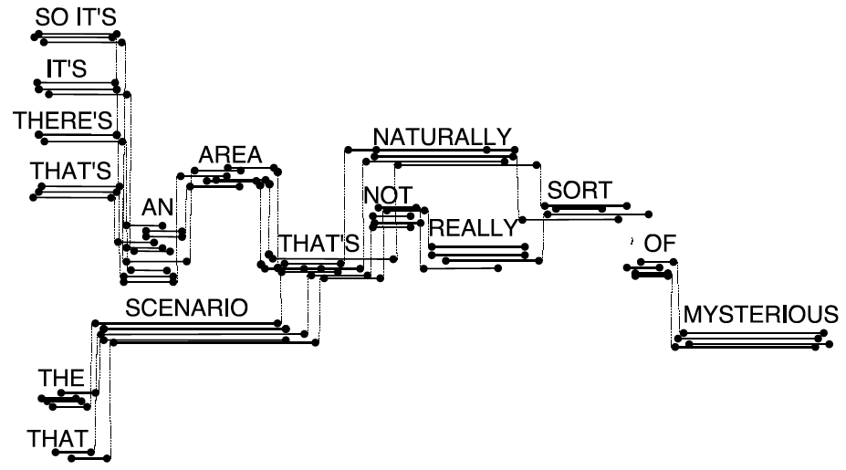
Word Lattice
Each arc annotated with AM and LM logprobs

Slide 32
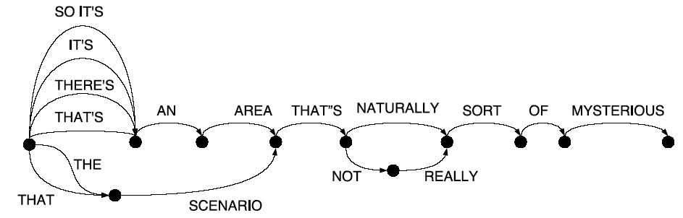
Word Graph
Timing information removed
Overlapping copies of words merged
AM information removed
Result is a WFST
Natural extension to N-gram language model

Slide 33
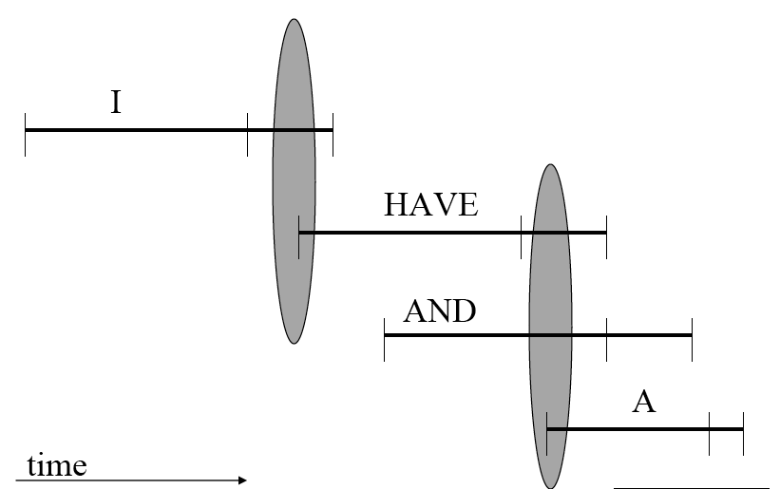
Converting word lattice to word graph
Word lattice can have range of possible end frames for word
Create an edge from (w_{i},t_{i}) to (w_{j},t_{j}) if t_{j-1} is one of the end-times of w_{i}
Bryan Pellom’s algorithm and figure, from his slides

Slide 34
Lattices
Some researchers are careful to distinguish between word graphs and word lattices
But we’ll follow convention in using “lattice” to mean both word graphs and word lattices.
Two facts about lattices:
  Density: the number of word hypotheses or word arcs per uttered word
  Lattice error rate (also called “lower bound error rate”): the lowest word error rate for any word sequence in lattice
    Lattice error rate is the “oracle” error rate, the best possible error rate you could get from rescoring the lattice.
    We can use this as an upper bound

Slide 35

Posterior lattices
We don’t actually compute posteriors:
Why do we want posteriors?
  Without a posterior, we can choose best hypothesis, but we can’t know how good it is!
  In order to compute posterior, need to
    Normalize over all different word hypothesis at a time
  Align all the hypotheses, sum over all paths passing through word

Slide 36
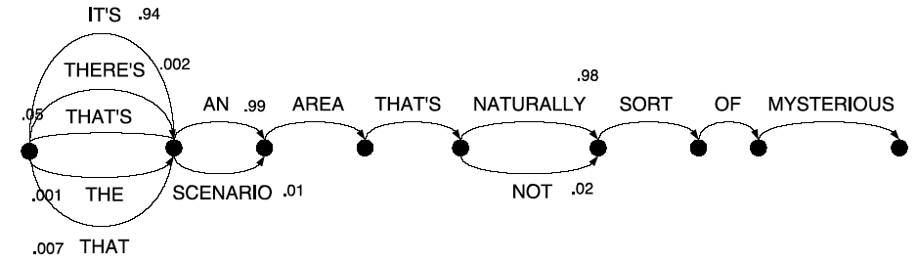
Mesh = Sausage = pinched lattice

Slide 37
One-pass vs. multipass
Potential problems with multipass
  Can’t use for real-time (need end of sentence)
    (But can keep successive passes really fast)
  Each pass can introduce inadmissible pruning
    (But one-pass does the same w/beam pruning and fastmatch)
Why multipass
  Very expensive KSs. (NL parsing,higher-order n-gram, etc)
  Spoken language understanding: N-best perfect interface
  Research: N-best list very powerful offline tools for algorithm development
  N-best lists needed for discriminant training (MMIE, MCE) to get rival hypotheses

Slide 38
A* Decoding = Stack decoding
Intuition:
  Viterbi wastes a lot of time on breadth-first search
    Computing lots of paths will never need
  If we had good heuristics for guiding decoding
  We could do depth-first (best-first) search and not waste all our time on computing all those paths at every time step as Viterbi does.
A* decoding, also called stack decoding, is an attempt to do that.
A* also does not make the Viterbi assumption
Uses the actual forward probability, rather than the Viterbi approximation

Slide 39
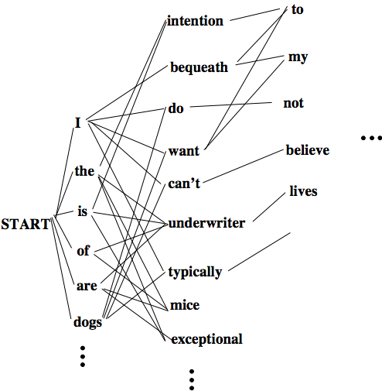
The search space for A* is the set of possible sentences

Slide 40
A* Search
“If music be the food of love”
(1) Start with NULL as root of sentence tree, set n to 0
(2) Determine every possible word starting at time t=1, adding
to the stack the words (now a partial sentence), their end times,
and scores (e.g. log probabilities, so closer to zero is better),
with a link to the NULL partial sentence.
If
(end=100,score=−33)
Alice
(end=280,score=−25)
NULL
(end=0, score= −INF)
Every
(end=310,score=−40)
In
(end=90,score=−250)
Slide from John-Paul Hosom

Slide 41
A* search
(3) Pop partial sentence with highest score, P, off the stack
(keeping the word, time, score, and link information for
future use)
(4) If P is a complete sentence (end time of last word in partial
sentence = T), then (a) output sentence by following links
to all previous words in sentence, (b) increment n.
(c) If n == N, then stop; otherwise, go to (3)
Determine every possible word starting at time t=(end time
of last word in P), adding to the stack the new words, their
end times, and scores, with a link to the last word in P.
Go to step (3)
Slide from John-Paul Hosom

Slide 42
A* Search
and the next step:
If
(end=100, score=−33)
was
(end=310, score=−35)
Alice
(end=280, score=−25)
wants
(end=360, score=−41)
NULL
(end=0, score=−INF)
Every
(end=310, score=−40)
walls
(end=370, score=−321)
In
(end=90, score=−250)
music
(end=290, score=-34)
muscle
(end=350, score=-36)
If
(end=100, score=-33)
messy
(end=360, score=-40)
Alice
(end=280, score=-25)
was
(end=310, score=-35)
NULL
(end=0, score=−INF)
Every
(end=310, score=-40)
wants
(end=360, score=-41)
In
(end=90, score=-250)
walls
(end=370, score=-321)
Slide from John-Paul Hosom

Slide 43
Reminder: A* search
A search algorithm is “admissible” if it can guarantee to find an optimal solution if one exists.
Heuristic search functions rank nodes in search space by f(N), the goodness of each node N in a search tree, computed as:
f(N) = g(N) + h(N)
where
  g(N) = The distance of the partial path already traveled from root S to node N
  h(N) = Heuristic estimate of the remaining distance from node N to goal node G.

Slide 44
Reminder: A* search
If the heuristic function h(N) of estimating the remaining distance from N to goal node G is an underestimate of the true distance, best-first search is admissible, and is called A* search.

Slide 45
A* search
A* search is “time-asynchronous” search
The score is an evaluation of how good a partial sentence is
Possible formula for score:
  score = p(o₁ o₂ … o_{t} | w₁ w₂ … w_{n}) · p(w₁ w₂ … w_{n})
  t is the end time of the partial sentence
  n is the number of words currently in the partial sentence.
How to compute this?
Forward Algorithm! But we can’t do this!!! Why not???
This results in lower scores for longer utterances.
Also, the score should reflect how good we think the final sentence will be when we get to the end.
Slide from John-Paul Hosom

Slide 46
A* search for speech
The forward algorithm can tell us the cost of the current path so far g(.)
We need an estimate of the cost from the current node to the end h(.)

Slide 47
Making A* work: h(.)
If h(.) is zero, breadth first search
Stupid estimates of h(.):
  Amount of time left in utterance
Slightly smarter:
  Estimate expected cost-per-frame for remaining path
  Multiply that by remaining time
  This can be computed from the training set (how much was the average acoustic cost for a frame in the training set)
Even better: two-pass decoding
  First pass, do Viterbi forward
  Now do A* backwards, using Viterbi best path as estimate h* for any hypothesis!

Slide 48
A* N-best
A* (stack-decoding) is best-first search
So we can just keep generating results until it finds N complete paths
This is the N-best list

Slide 49
A*: When to extend new words
Stack decoding is asynchronous
Need to detect when a phone/word ends, so search can extend to next phone/word
If we had a cost measure: how well input matches HMM state sequence so far
We could look for this cost measure slowly going down, and then sharply going up as we start to see the start of the next word.
Can’t use forward algorithm because can’t compare hypotheses of different lengths
Can do various length normalizations to get a normalized cost

Slide 50
Fast match
Efficiency: don’t want to expand to every single next word to see if it’s good.
Need a quick heuristic for deciding which sets of words are good expansions
“Fast match” is the name for this class of heuristics.
Can do some simple approximation to words whose initial phones seem to match the upcoming input

Slide 51
Summary
Search
  Defining the goal for ASR decoding
  Speeding things up: Viterbi beam decoding
  Problems with Viterbi decoding
  Multipass decoding
    N-best lists
    Lattices
    Word graphs
    Meshes/confusion networks
  A* search

