Slide 1
CS 224S/LING 281
Speech Recognition, Synthesis, and Dialogue
Dan Jurafsky
Lecture 17: Disfluencies

Slide 2
Outline
Disfluencies
Characteristics of disfluences
Detecting disfluencies
MDE bakeoff
Fragments

Slide 3
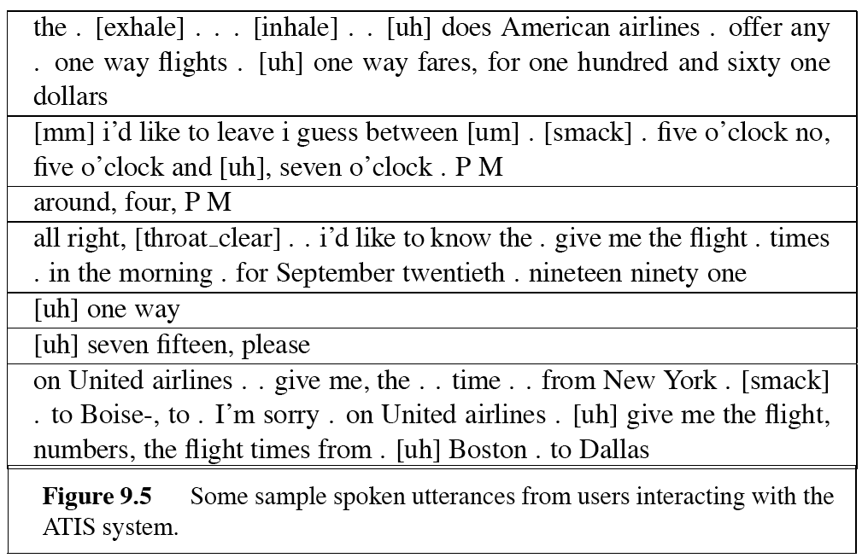
Disfluencies

Slide 4
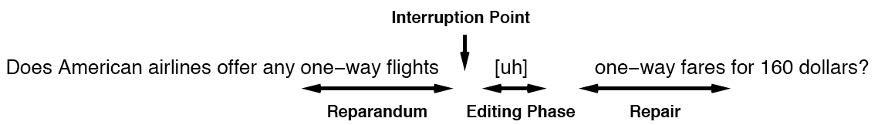
Disfluencies: standard terminology (Levelt)
Reparandum: thing repaired
Interruption point (IP): where speaker breaks off
Editing phase (edit terms): uh, I mean, you know
Repair: fluent continuation

Slide 5
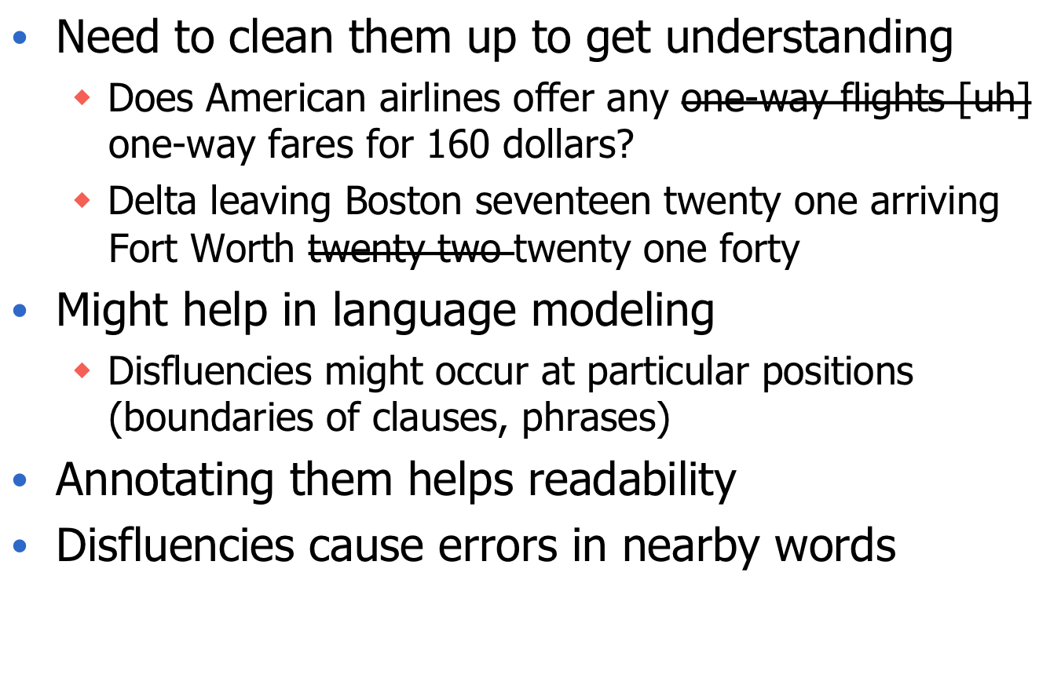
Why disfluencies?

Slide 6
Counts (from Shriberg, Heeman)
Sentence disfluency rate
  ATIS: 6% of sentences disfluent (10% long sentences)
  Levelt human dialogs: 34% of sentences disfluent
  Swbd: ~50% of multiword sentences disfluent
  TRAINS: 10% of words are in reparandum or editing phrase
Word disfluency rate
  SWBD: 6%
  ATIS: 0.4%
  AMEX 13%
    (human-human air travel)

Slide 7
Prosodic characteristics of disfluencies
Nakatani and Hirschberg 1994
Fragments are good cues to disfluencies
Prosody:
  Pause duration is shorter in disfluent silence than fluent silence
  F0 increases from end of reparandum to beginning of repair, but only minor change
  Repair interval offsets have minor prosodic phrase boundary, even in middle of NP:
    Show me all n- | round-trip flights | from Pittsburgh | to Atlanta

Slide 8
Syntactic Characteristics of Disfluencies
Hindle (1983)
The repair often has same structure as reparandum
Both are Noun Phrases (NPs) in this example:
So if could automatically find IP, could find and correct reparandum!

Slide 9
Disfluencies and LM
Clark and Fox Tree
Looked at “um” and “uh”
  “uh” includes “er” (“er” is just British non-rhotic dialect spelling for “uh”)
Different meanings
  Uh: used to announce minor delays
    Preceded and followed by shorter pauses
  Um: used to announce major delays
    Preceded and followed by longer pauses

Slide 10
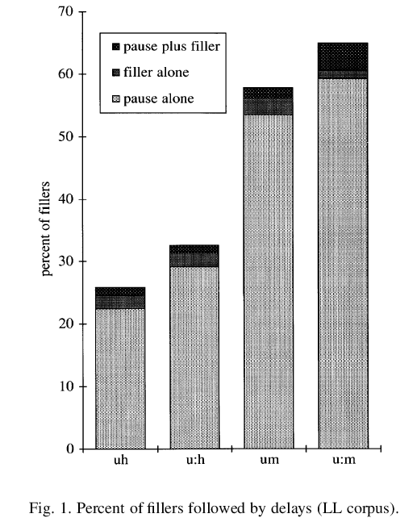
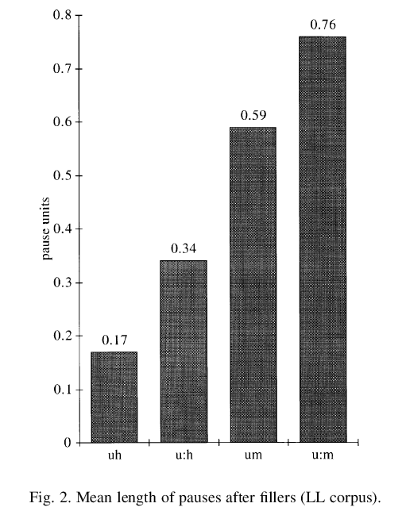
Um versus uh: delays
(Clark and Fox Tree)

Slide 11
Utterance Planning
The more difficulty speakers have in planning, the more delays
Consider 3 locations:
  I: before intonation phrase: hardest
  II: after first word of intonation phrase: easier
  III: later: easiest
And then uh somebody said, . [I] but um -- [II] don’t you think there’s evidence of this, in the twelfth - [III] and thirteenth centuries?

Slide 12
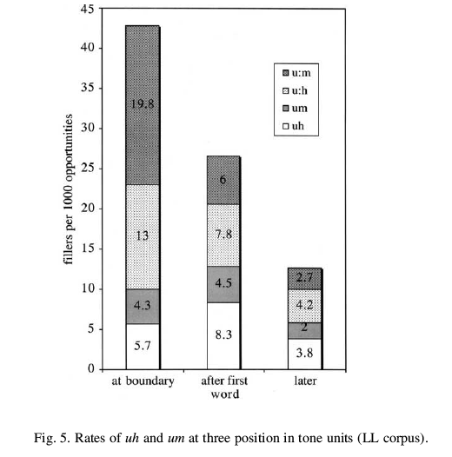
Delays at different points in phrase

Slide 13
Disfluencies in language modeling
Should we “clean up” disfluencies before training LM (i.e. skip over disfluencies?)
  Filled pauses
    Does United offer any [uh] one-way fares?
  Repetitions
    What what are the fares?
  Deletions
    Fly to Boston from Boston
  Fragments (we’ll come back to these)
    I want fl- flights to Boston.

Slide 14
Does deleting disfluencies improve LM perplexity?
Stolcke and Shriberg (1996)
Build two LMs
  Raw
  Removing disfluencies
See which has a higher perplexity on the data.
  Filled Pause
  Repetition
  Deletion

Slide 15

Change in Perplexity when Filled Pauses (FP) are removed
LM Perplexity goes up at following word:
Removing filled pauses makes LM worse!!
I.e., filled pauses seem to help to predict next word.
Why would that be?
Stolcke and Shriberg 1996

Slide 16
Filled pauses tend to occur at clause boundaries
Word before FP is end of previous clause; word after is start of new clause;
  Best not to delete FP
Some of the different things we’re doing [uh] there’s not time to do it all
“there’s” is very likely to start a sentence
So P(there’s|uh) is better estimate than P(there’s|doing)

Slide 17

Suppose we just delete medial FPs
Experiment 2:
  Parts of SWBD hand-annotated for clauses
  Build FP-model by deleting only medial FPs
  Now prediction of post-FP word (perplexity) improves greatly!
  Siu and Ostendorf found same with “you know”

Slide 18
What about REP and DEL
S+S built a model with “cleaned-up” REP and DEL
Slightly lower perplexity
But exact same word error rate (49.5%)
Why?
  Rare: only 2 words per 100
  Doesn’t help because adjacent words are misrecognized anyhow!

Slide 19
Stolcke and Shriberg conclusions wrt LM and disfluencies
Disfluency modeling purely in the LM probably won’t vastly improve WER
But
  Disfluencies should be considered jointly with sentence segmentation task
  Need to do better at recognizing disfluent words themselves
  Need acoustic and prosodic features

Slide 20
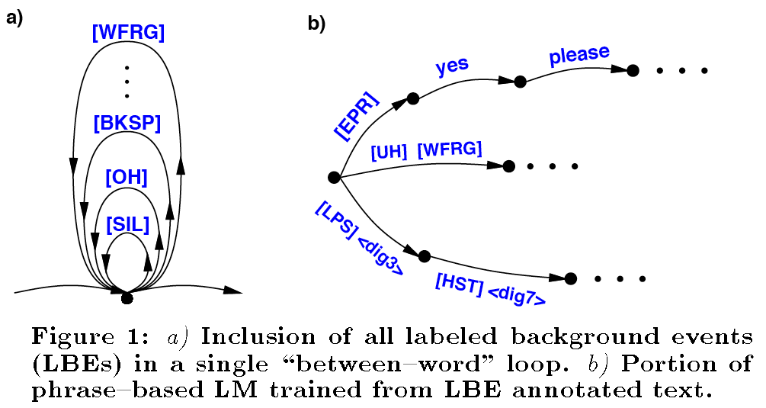
WER reductions from modeling disfluencies+background events
Rose and Riccardi (1999)

Slide 21
HMIHY Background events
Out of 16,159 utterances:
Filled Pauses | 7189
Word Fragments | 1265
Hesitations | 792
Laughter | 163
Lipsmack | 2171
Breath | 8048
Non-Speech Noise | 8834
Background Speech | 3585
Operater Utt. | 5112
Echoed Prompt | 5353

Slide 22
Phrase-based LM
“I would like to make a collect call”
“a [wfrag]”
<dig3> [brth] <dig3>
“[brth] and I”

Slide 23
Rose and Riccardi (1999)
Modeling “LBEs” does help in WER
ASR Word Accuracy
System Configuration |  | Test Corpora
HMM | LM | Greeting (HMIHY) | Card Number
Baseline | Baseline | 58.7 | 87.7
LBE | Baseline | 60.8 | 88.1
LBE | LBE | 60.8 | 89.8

Slide 24
More on location of FPs
Peters: Medical dictation task
  Monologue rather than dialogue
  In this data, FPs occurred INSIDE clauses
  Trigram PP after FP: 367
  Trigram PP after word: 51
Stolcke and Shriberg (1996b)
  w_{k} FP w_{k+1}: looked at P(w_{k+1}|w_{k})
  Transition probabilities lower for these transitions than normal ones
Conclusion:
  People use FPs when they are planning difficult things, so following words likely to be unexpected/rare/difficult

Slide 25
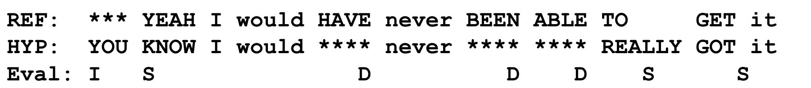
Goldwater study
Study error rate in two recognizers
  SRI/ICSI/UW RT-04 CTS system (Stolcke et al., 2006)
  CU-HTK RT-04 CTS system (Evermann 2004a, 2005)
On NIST RT-03 development set.
  36 telephone conversations, 72 speakers, 38477 reference words.
  Metric: Individual Word Error Rate:

Slide 26
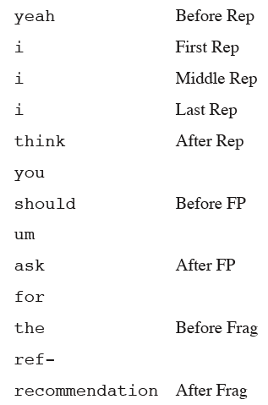
Coding disfluencies

Slide 27
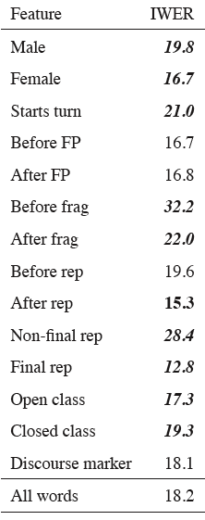
Other factors and (independent) results
Word class
  Open
  Function
  Discourse marker
Turn-initial
Male
Female
Word length in phones
LM unigram, trigram
Prosodic features

Slide 28
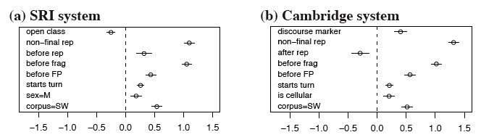
Coefficient values in joint regression
Left of dotted line -> reduces error
Right of dotted line -> increases error

Slide 29
Detection of disfluencies
Nakatani and Hirschberg
Decision tree at w_{i}-w_{j} boundary
  pause duration
  Word fragments
  Filled pause
  Energy peak within w_{i}
  Amplitude difference between w_{i} and w_{j}
  F0 of w_{i}
  F0 differences
  Whether wi accented
Results:
  78% recall/89.2% precision

Slide 30
Detection/Correction
Bear, Dowding, Shriberg (1992)
System 1:
Hand-written pattern matching rules to find repairs
    Look for identical sequences of words
    Look for syntactic anomalies (“a the”, “to from”)
    62% precision, 76% recall
    Rate of accurately correcting: 57%

Slide 31
Using Natural Language Constraints
Gemini natural language system
Based on Core Language Engine
Full syntax and semantics for ATIS
Coverage of whole corpus:
  70% syntax
  50% semantics

Slide 32
Using Natural Language Constraints
Gemini natural language system
Run pattern matcher
For each sentence it returned
  Remove fragment sentences
  Leaving 179 repairs, 176 false positives
  Parse each sentence
    If succeed: mark as false positive
    If fail:
      run pattern matcher, make corrections
      Parse again
      If succeeds, mark as repair
      If fails, mark no opinion

Slide 33
NL Constraints
Syntax Only
  Precision: 96%
Syntax and Semantics
  Correction: 70%

Slide 34
Recent work: EARS Metadata Evaluation (MDE)
A recent multiyear DARPA bakeoff
Sentence-like Unit (SU) detection:
  find end points of SU
  Detect subtype (question, statement, backchannel)
Edit word detection:
  Find all words in reparandum (words that will be removed)
Filler word detection
  Filled pauses (uh, um)
  Discourse markers (you know, like, so)
  Editing terms (I mean)
Interruption point detection
Liu et al 2003

Slide 35
Kinds of disfluencies
Repetitions
  I * I like it
Revisions
  We * I like it
Restarts (false starts)
  It’s also * I like it

Slide 36
MDE transcription
Conventions:
  ./ for statement SU boundaries,
  <> for fillers,
  [] for edit words,
  * for IP (interruption point) inside edits
And <uh> <you know> wash your clothes wherever you are ./ and [ you ] * you really get used to the outdoors ./

Slide 37
MDE Labeled Corpora
 | CTS | BN
Training set (words) | 484K | 182K
Test set (words) | 35K | 45K
STT WER (%) | 14.9 | 11.7
SU % | 13.6 | 8.1
Edit word % | 7.4 | 1.8
Filler word % | 6.8 | 1.8

Slide 38
MDE Algorithms
Use both text and prosodic features
At each interword boundary
  Extract Prosodic features (pause length, durations, pitch contours, energy contours)
  Use N-gram Language model
  Combine via HMM, Maxent, CRF, or other classifier

Slide 39
State of the art: SU detection
2 stage
  Decision tree plus N-gram LM to decide boundary
  Second maxent classifier to decide subtype
Current error rates:
  Finding boundaries
    40-60% using ASR
    26-47% using transcripts

Slide 40
State of the art: Edit word detection
Multi-stage model
    HMM combining LM and decision tree finds IP
    Heuristics rules find onset of reparandum
    Separate repetition detector for repeated words
One-stage model
  CRF jointly finds edit region and IP
  BIO tagging (each word has tag whether is beginning of edit, inside edit, outside edit)
Error rates:
  43-50% using transcripts
  80-90% using ASR

Slide 41
Using only lexical cues
3-way classification for each word
  Edit, filler, fluent
Using TBL
  Templates: Change
    Word X from L1 to L2
    Word sequence X Y to L1
    Left side of simple repeat to L1
    Word with POS X from L1 to L2 if followed by word with POS Y

Slide 42
Rules learned
Label all fluent filled pauses as fillers
Label the left side of a simple repeat as an edit
Label “you know” as fillers
Label fluent well’s as filler
Label fluent fragments as edits
Label “I mean” as a filler

Slide 43
Error rates using only lexical cues
CTS, using transcripts
  Edits: 68%
  Fillers: 18.1%
Broadcast News, using transcripts
  Edits 45%
  Fillers 6.5%
Using speech:
  Broadcast news filler detection from 6.5% error to 57.2%
Other systems (using prosody) better on CTS, not on Broadcast News

Slide 44
Conclusions: Lexical Cues Only
Can do pretty well with only words
  (As long as the words are correct)
Much harder to do fillers and fragments from ASR output, since recognition of these is bad

Slide 45

Fragments
Incomplete or cut-off words:
  Leaving at seven fif- eight thirty
  uh, I, I d-, don't feel comfortable
  You know the fam-, well, the families
  I need to know, uh, how- how do you feel…
  Uh yeah, yeah, well, it- it- that’s right. And it-
SWBD: around 0.7% of words are fragments (Liu 2003)
ATIS: 60.2% of repairs contain fragments (6% of corpus sentences had a least 1 repair) Bear et al (1992)
Another ATIS corpus: 74% of all reparanda end in word fragments (Nakatani and Hirschberg 1994)

Slide 46
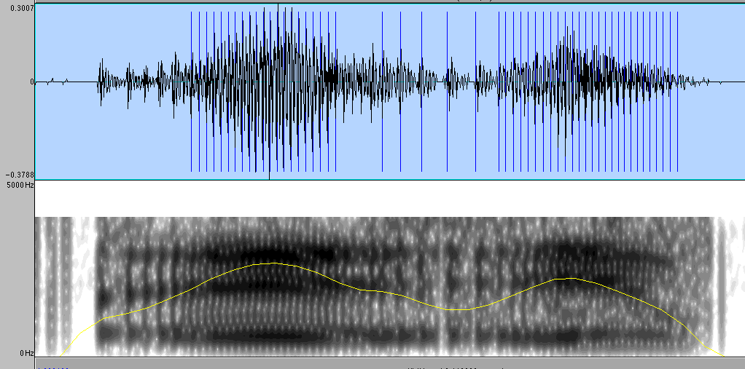
Fragment glottalization
  Uh yeah, yeah, well, it- it- that’s right. And it-

Slide 47
Why fragments are important
Frequent enough to be a problem:
  Only 1% of words/3% of sentences
  But if miss fragment, tend to get surrounding words wrong (word segmentation error).
  Goldwater et al.:
    14% absolute increase in word error rate (from 18% to 32%) for words before fragments!!
Useful for finding other repairs
  In 40% of SRI-ATIS sentences containing fragments, fragment occurred at right edge of long repair
  74% of ATT-ATIS reparanda ended in fragments
Sometimes are the only cue to repair
  “leaving at <seven> <fif-> eight thirty”

Slide 48
How fragments are dealt with in current ASR systems
In training, throw out any sentences with fragments
In test, get them wrong
Probably get neighboring words wrong too!
!!!!!

Slide 49
Cues for fragment detection
49/50 cases examined ended in silence >60msec; average 282ms (Bear et al)
24 of 25 vowel-final fragments glottalized (Bear et al)
  Glottalization: increased time between glottal pulses
75% don’t even finish the vowel in first syllable (i.e., speaker stopped after first consonant) (O’Shaughnessy)

Slide 50
Cues for fragment detection
Nakatani and Hirschberg (1994)
Word fragments tend to be content words:
Lexical Class | Token | Percent
Content | 121 | 42%
Function | 12 | 4%
Untranscribed | 155 | 54%

Slide 51
Cues for fragment detection
Nakatani and Hirschberg (1994)
91% are one syllable or less
Syllables | Tokens | Percent
0 | 113 | 39%
1 | 149 | 52%
2 | 25 | 9%
3 | 1 | 0.3%

Slide 52
Cues for fragment detection
Nakatani and Hirschberg (1994)
Fricative-initial common; not vowel-initial
Class | % words | % frags | % 1-C frags
Stop | 23% | 23% | 11%
Vowel | 25% | 13% | 0%
Fric | 33% | 45% | 73%

Slide 53
Liu (2003): Acoustic-Prosodic detection of fragments
Prosodic features
  Duration (from alignments)
    Of word, pause, last-rhyme-in word
    Normalized in various ways
  F0 (from pitch tracker)
    Modified to compute stylized speaker-specific contours
  Energy
    Frame-level, modified in various ways

Slide 54
Liu (2003): Acoustic-Prosodic detection of fragments
Voice Quality Features
  Jitter
    A measure of perturbation in pitch period
      Praat computes this
  Spectral tilt
    Overall slope of spectrum
    Speakers modify this when they stress a word
  Open Quotient
    Ratio of times in which vocal folds are open to total length of glottal cycle
    Can be estimated from first and second harmonics
    Creaky voice (laryngealization) vocal folds held together, so short open quotient

Slide 55
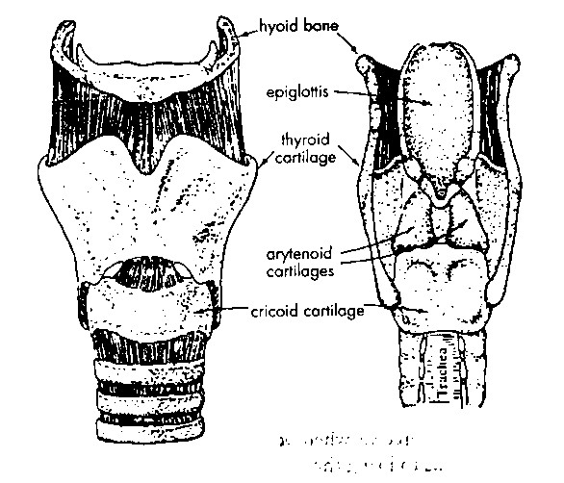
The larynx
main
function
of vocal
folds:
block
objects
from
falling
into
trachea
Slide from Ulrike Gut

Slide 56
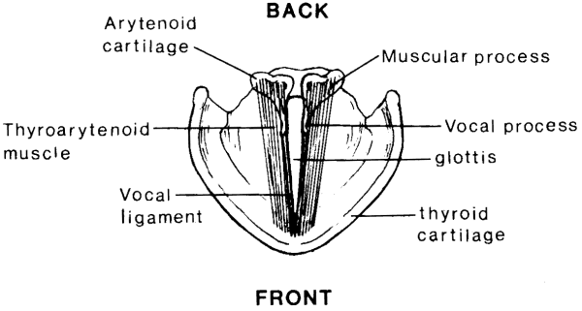
Inside the larynx
Slide from Ulrike Gut

Slide 57
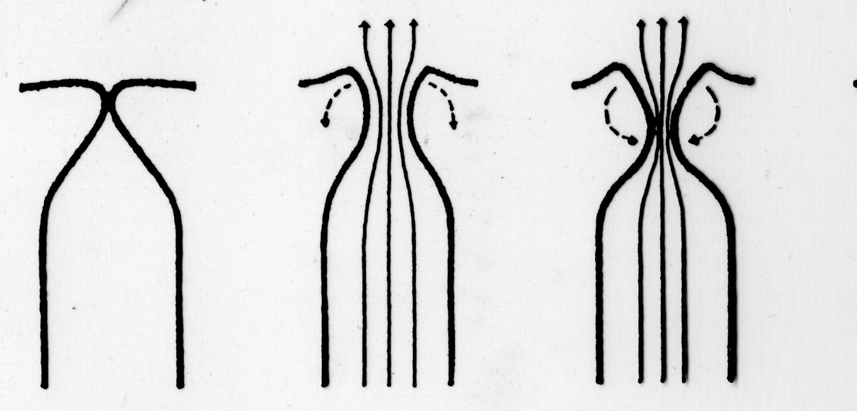
Phonation
phonation: vibration (=opening and closing) of the vocal folds
  vocal folds closed - air from the lungs pushes them apart – sucked back together (Bernoulli effect)
Slide from Ulrike Gut

Slide 58
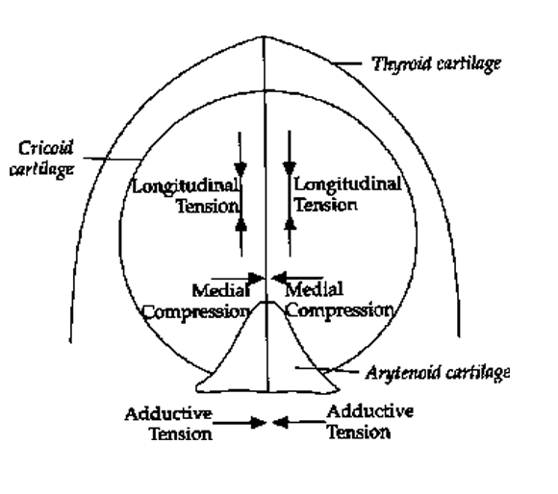
Voice Quality and the Larynx
Adductive tension
(interarytenoid muscles adduct the arytenoid muscles)
Medial compression
(adductive force on vocal processes- adjustment of ligamental glottis)
Longitudinal pressure
(tension of vocal folds)
Slide from K. Marasek, J. Wilcox

Slide 59
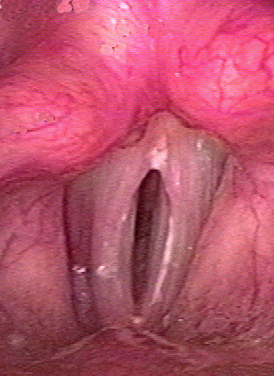
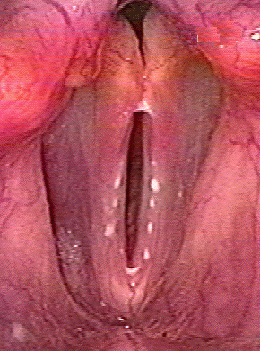
Modulation of vocal fold vibration
vocal folds are moved (adducted) by muscles
can be tensed – the shorter the vocal folds the faster they vibrate
200 times/sec
120 times/sec
Slide from Ulrike Gut

Slide 60
Modes of phonation
voicelessness = no vocal fold vibration
modal (normal) voicing
whisper
breathy voice
voice
creaky voice
Slide from Ulrike Gut

Slide 61
Modal voice
neutral mode
muscular adjustments are moderate
vibration of the vocal folds is periodic with full closing of glottis, so no audible friction noises are produced when air flows through the glottis.
frequency of vibration and loudness are in the lowto mid range for conversational speech
Slide from K. Marasek, J. Wilcox

Slide 62
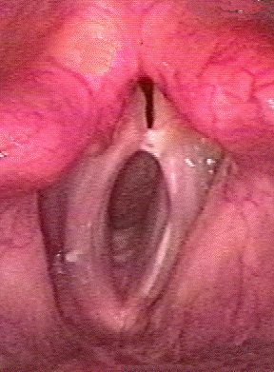
Breathy voice
arytenoid cartilages
remain slightly apart
continuous airflow
during vocal fold
vibration
Slide from Ulrike Gut

Slide 63

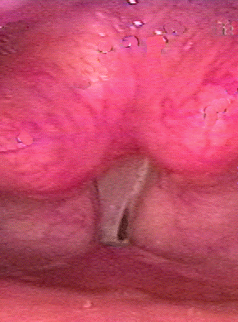

Creaky voice
arytenoid cartilages tightly together so that vocal folds can only vibrate at the other end
normal
creaky voice
Slide from Ulrike Gut

Slide 64
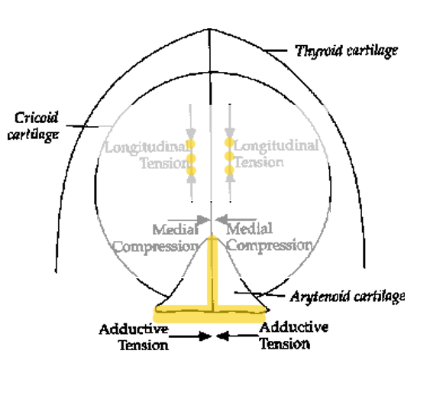
Creaky voice – voiced phonation
vocal folds vibrate at a very low frequency – vibration is somewhat irregular, vibrating mass is “heavier” because of low tension (only the ligamental part of glottis vibrates)
The vocal folds are strongly adducted
longitudinal tension is weak
Moderately high medial compression
Vocal folds “thicken” and create an unusually thick and slack structure.
Slide from K. Marasek, J. Wilcox

Slide 65
Whisper
in whisper there is no true vibration of the vocal folds; adduction of vocal folds while maintaining an opening between the arytenoid cartilages
Slide from Ulrike Gut

Slide 66
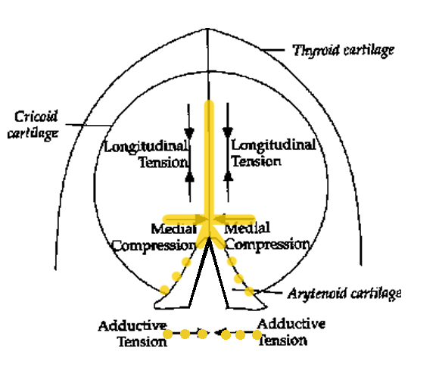
Whispery voice – voiceless phonation
Very low adductive tension
Medial compression moderately high
Longitudinal tension moderately high
Little or no vocal fold vibration
( produced through turbulences generated by the friction of the air in and above the larynx, which produces frication)
Slide from K. Marasek, J. Wilcox

Slide 67
Liu (2003)
Use Switchboard 80%/20%
Downsampled to 50% frags, 50% words
Generated forced alignments with gold transcripts
Extract prosodic and voice quality features
Train decision tree

Slide 68
Liu (2003) results
Precision 74.3%, Recall 70.1%
 |  | hypothesis
 |  | complete | fragment
reference | complete | 109 | 35
 | fragment | 43 | 101

Slide 69
Liu (2003) features
Features most queried by DT
Feature | %
jitter | .272
Energy slope difference between current and following word | .241
Ratio between F0 before and after boundary | .238
Average OQ | .147
Position of current turn | 0.084
Pause duration | 0.018

Slide 70
Liu (2003) conclusion
Very preliminary work
Fragment detection is good problem that is understudied!

Slide 71
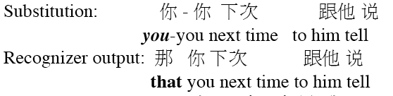
Fragments in other languages
Mandarin (Chu, Sung, Zhao, Jurafsky 2006)
Fragments cause similar errors as in English:
但我﹣我問的是
I- I was asking…
他是﹣卻很﹣活的很好
He very- lived very well

Slide 72
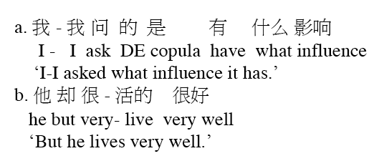
Fragments in Mandarin
Mandarin fragments unlike English; no glottalization.
Instead: Mostly (unglottalized) repetitions
So: best features are lexical, rather than voice quality

Slide 73
Summary
Disfluencies
Characteristics of disfluences
Detecting disfluencies
MDE bakeoff
Fragments

