Slide 1
CS 224S / LINGUIST 281
Speech Recognition and Synthesis
Dan Jurafsky
Lecture 2: Acoustic Phonetics
1/5/07

Slide 2
Outline for today
Acoustic Phonetics
  Waves, sound waves, and spectra
    (Informally! We’ll see it with more math when we do feature extraction)
  Speech waveforms
  F0, pitch, intensity
  Spectra
    Spectrograms
    Formants
    Reading spectrograms
  Deriving schwa: why are formants where they are
  PRAAT
  Resources: dictionaries and phonetically-labeled corpora

Slide 3
Acoustic Phonetics
Sound Waves
  http://www.kettering.edu/~drussell/Demos/waves-intro/waves-intro.html
1/5/07

Slide 4
Simple Period Waves (sine waves)
Characterized by:
  period: T
  amplitude A
  phase φ
Fundamental frequency
in cycles per second, or Hz
  F₀=1/T
1 cycle
1/5/07

Slide 5
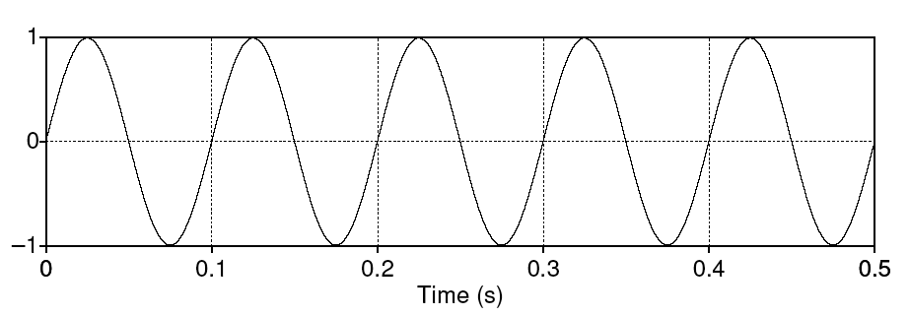
Simple periodic waves
Computing the frequency of a wave:
  5 cycles in .5 seconds = 10 cycles/second = 10 Hz
Amplitude:
  1
Equation:
  Y = A sin(2πft)
1/5/07

Slide 6
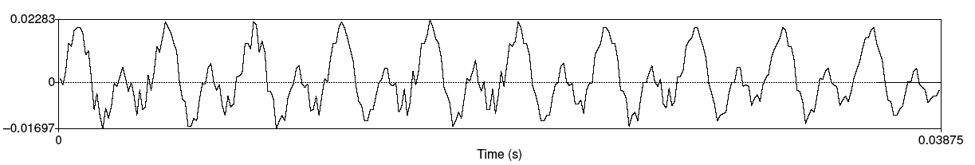
Speech sound waves
A little piece from the waveform of the vowel [iy]
Y axis:
  Amplitude = amount of air pressure at that time point
    Positive is compression
    Zero is normal air pressure,
    negative is rarefaction
X axis: time.
1/5/07

Slide 7
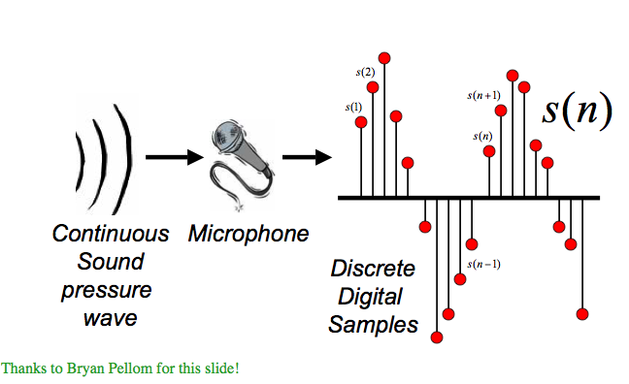
Digitizing Speech
1/5/07

Slide 8
Digitizing Speech
Analog-to-digital conversion
Or A-D conversion.
Two steps
  Sampling
  Quantization
1/5/07

Slide 9
Sampling
Measuring amplitude of a signal at time t
The sample rate needs to have at least two samples for each cycle
  One for the positiive, and one for the negative half of each cycle
  More than two samples per cycle is ok
  Less than two samples will cause frequencies to be missed
So the maximum frequency that can be measured is one that is half the sampling rate.
The maximum frequency for a given sampling rate called Nyquist frequency
1/5/07

Slide 10
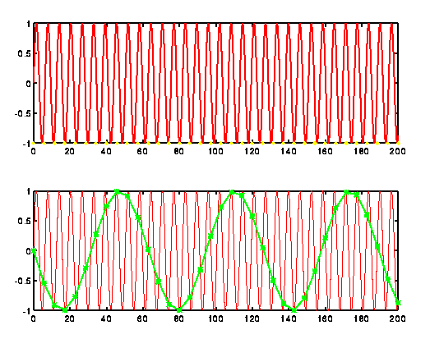
Sampling
Original signal in red:
If measure at green dots, will see a lower frequency wave and miss the correct higher frequency one!
1/5/07

Slide 11
Sampling
In practice we use the following sample rates
  16,000 Hz (samples/sec), for microphones, “wideband”
  8,000 Hz (samples/sec) Telephone
Why?
  Need at least 2 samples per cycle
  Max measurable frequency is half the sampling rate
  Human speech < 10KHz, so need max 20K
  Telephone is filtered at 4K, so 8K is enough.
1/5/07

Slide 12
Quantization
Quantization
  Representing real value of each amplitude as integer
  8-bit (-128 to 127) or 16-bit (-32768 to 32767)
Formats:
  16 bit PCM
  8 bit mu-law; log compression
Byte order
  LSB (Intel) vs. MSB (Sun, Apple)
Headers:
  Raw (no header)
  Microsoft wav
  Sun .au
40 byte
header
1/5/07

Slide 13
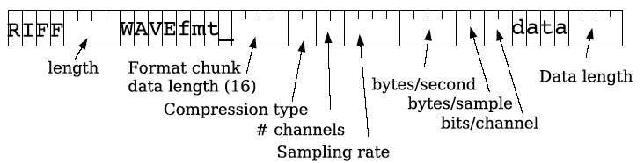
WAV format
1/5/07

Slide 14
Fundamental frequency
Waveform of the vowel [iy]
Frequency: repetitions/second of a wave
Above vowel has 10 reps in .03875 secs
So freq is 10/.03875 = 258 Hz
This is speed that vocal folds move, hence voicing
Each peak corresponds to an opening of the vocal folds
The frequency of the complex wave is called the fundamental frequency of the wave or F0

Slide 15

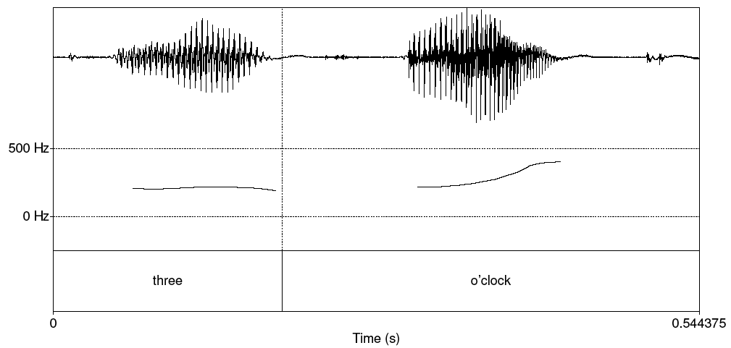
Pitch track

Slide 16
Amplitude
We need a way to talk about the amplitude of a region of a signal over tune
We can’t just average all the values.
Why not?
So we often talk about RMS amplitude

Slide 17
Power and Intensity
Power: related to square of amplitude
Intensity in air: power normalized to auditory threshold, given in dB. P0 is auditory threshold pressure = 2x10⁻⁵ pa

Slide 18
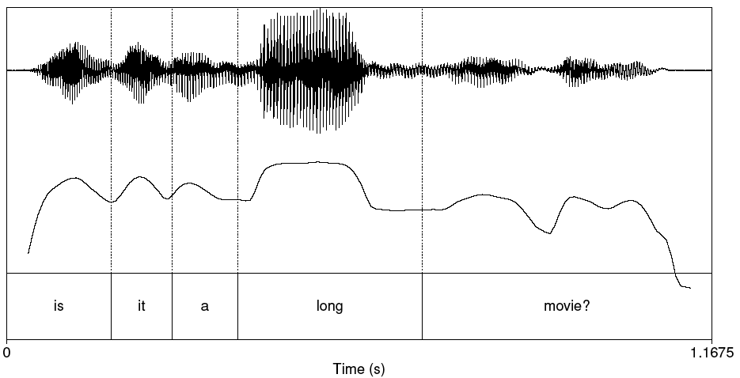
Plot of Intensity

Slide 19
Pitch and Loudness
Pitch is the mental sensation or perceptual correlated of F0
Relationship between pitch and F0 is not linear;
  human pitch perception is most accurate between 100Hz and 1000Hz.
    Linear in this range
    Logarithmic above 1000Hz
Mel scale is one model of this F0-pitch mapping
  A mel is a unit of pitch defined so that pairs of sounds which are perceptually equidistant in pitch are separated by an equal number of mels
  Frequency in mels = 1127 ln (1 + f/700)

Slide 20
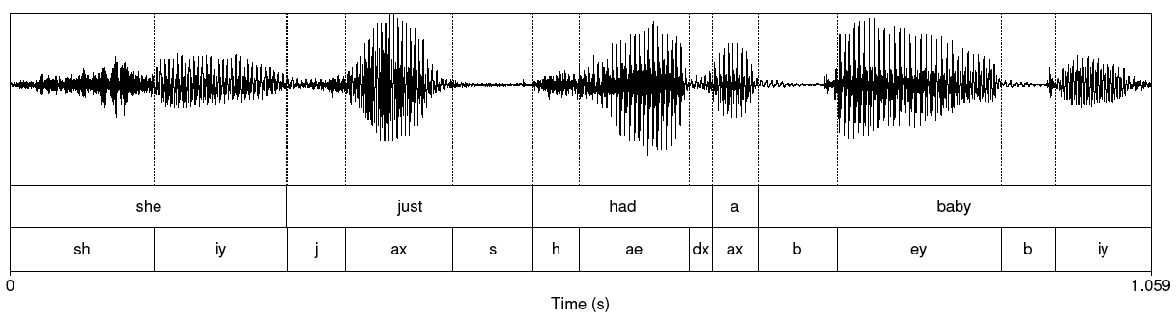
She just had a baby
Note that vowels all have regular amplitude peaks
Stop consonant
  Closure followed by release
  Notice the silence followed by slight bursts of emphasis: very clear for [b] of “baby”
Fricative: noisy. [sh] of “she” at beginning

Slide 21
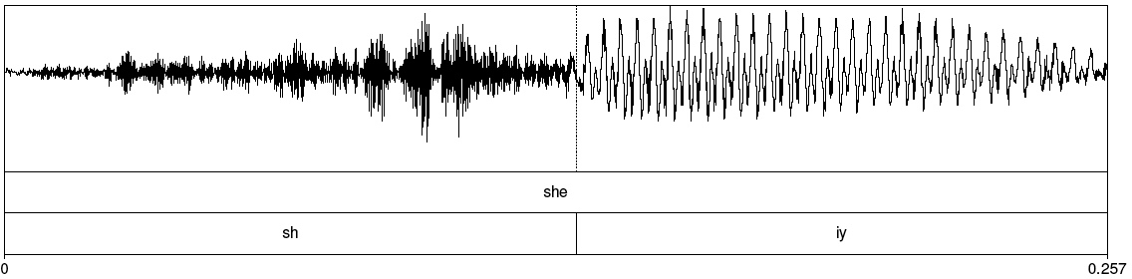
Fricative
1/5/07

Slide 22
Waves have different frequencies
100 Hz
1000 Hz
1/5/07

Slide 23
Complex waves: Adding a 100 Hz and 1000 Hz wave together
1/5/07

Slide 24
Spectrum
Frequency components (100 and 1000 Hz) on x-axis
Amplitude
100
Frequency in Hz
1000
1/5/07

Slide 25
Spectra continued
Fourier analysis: any wave can be represented as the (infinite) sum of sine waves of different frequencies (amplitude, phase)
1/5/07

Slide 26
Spectrum of one instant in an actual soundwave: many components across frequency range
1/5/07

Slide 27
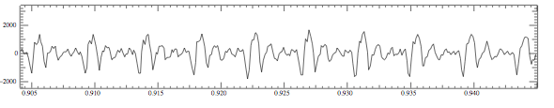
Part of [ae] waveform from “had”
Note complex wave repeating nine times in figure
Plus smaller waves which repeats 4 times for every large pattern
Large wave has frequency of 250 Hz (9 times in .036 seconds)
Small wave roughly 4 times this, or roughly 1000 Hz
Two little tiny waves on top of peak of 1000 Hz waves
1/5/07

Slide 28
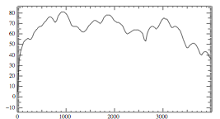
Back to spectrum
Spectrum represents these freq components
Computed by Fourier transform, algorithm which separates out each frequency component of wave.
x-axis shows frequency, y-axis shows magnitude (in decibels, a log measure of amplitude)
Peaks at 930 Hz, 1860 Hz, and 3020 Hz.
1/5/07

Slide 29
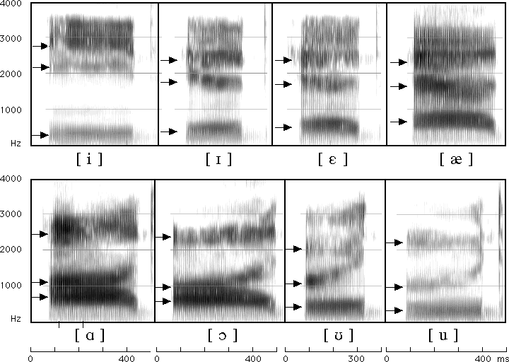
Seeing formants: the spectrogram
1/5/07

Slide 30
Formants
Vowels largely distinguished by 2 characteristic pitches.
One of them (the higher of the two) goes downward throughout the series iy ih eh ae aa ao ou u
The other goes up for the first four vowels and then down for the next four.
These are called "formants" of the vowels, lower is 1st formant, higher is 2nd formant.
1/5/07

Slide 31
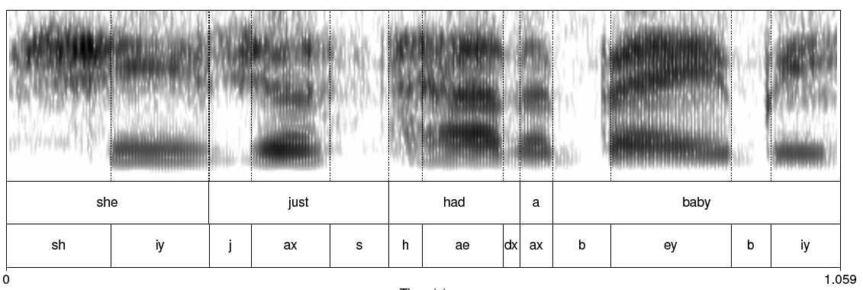
Spectrogram: spectrum + time dimension
1/5/07

Slide 32
Different vowels have different formants
Vocal tract as "amplifier"; amplifies different frequencies
Formants are result of different shapes of vocal tract.
Any body of air will vibrate in a way that depends on its size and shape.
Air in vocal tract is set in vibration by action of vocal cords.
Every time the vocal cords open and close, pulse of air from the lungs, acting like sharp taps on air in vocal tract,
Setting resonating cavities into vibration so produce a number of different frequencies.
1/5/07

Slide 33
Again: why is a speech sound wave composed of these peaks?
Articulatory facts:
  The vocal cord vibrations create harmonics
  The mouth is an amplifier
  Depending on shape of mouth, some harmonics are amplified more than others
1/5/07

Slide 34
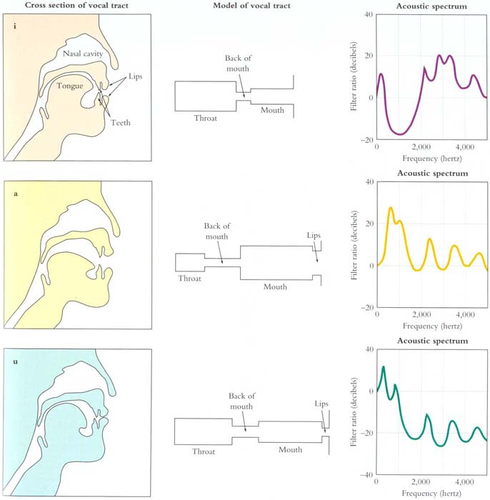
From
Mark
Liberman’s
Web site
1/5/07

Slide 35
How formants are produced
Q: Why do different vowels have different pitches if the vocal cords are vibrating at the same rate?
A: This is a confusion of frequencies of SOURCE and frequencies of FILTER!
1/5/07

Slide 36
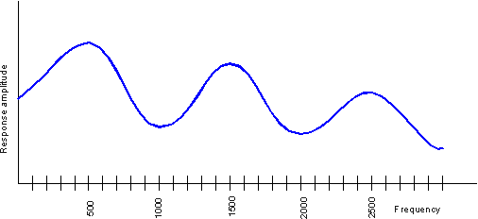
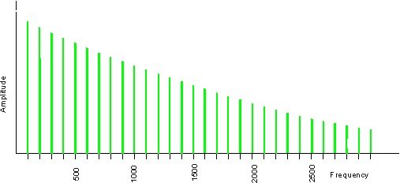
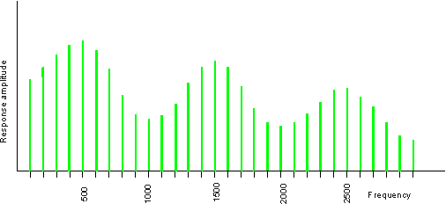
Source-filter model of speech production
Input
Filter
Output
Glottal spectrum
Vocal tract frequency
response function
Source and filter are independent, so:
Different vowels can have same pitch
The same vowel can have different pitch
Figures and text from Ratree Wayland slide from his website
1/5/07

Slide 37
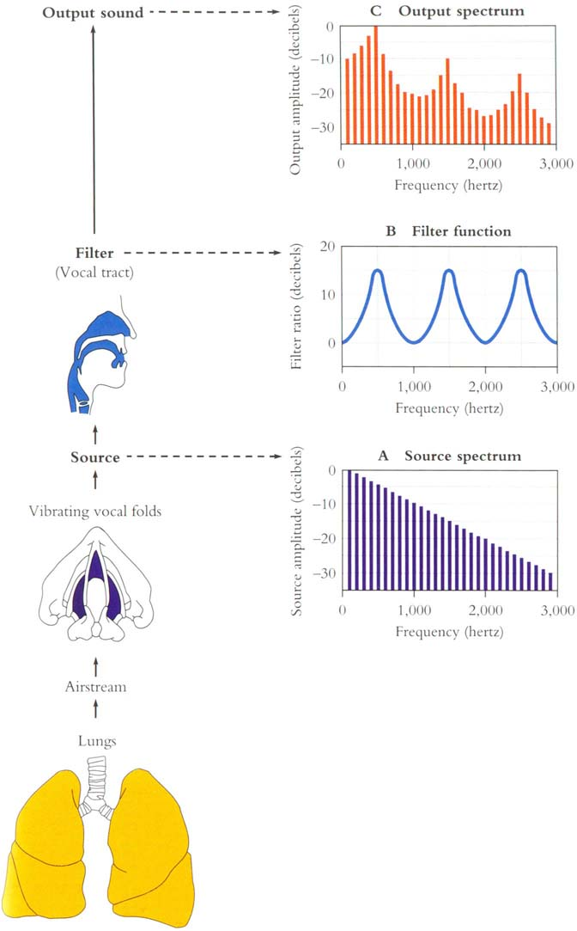
1/5/07

Slide 38
Deriving schwa: how shape of mouth (filter function) creates peaks!
Reminder of basic facts about sound waves
f = c/λ
c = speed of sound (approx 35,000 cm/sec)
A sound with λ=10 meters has low frequency f = 35 Hz (35,000/1000)
A sound with λ=2 centimeters has high frequency f = 17,500 Hz (35,000/2)
1/5/07

Slide 39
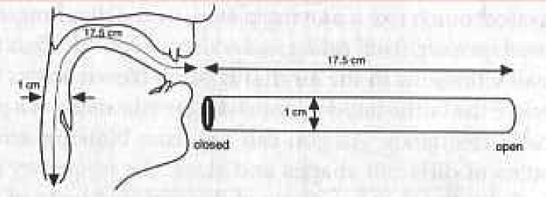
Resonances of the vocal tract
The human vocal tract as an open tube
Air in a tube of a given length will tend to vibrate at resonance frequency of tube.
Closed end
Open end
Length 17.5 cm.
Figure from Ladefoged(1996) p 117
1/5/07

Slide 40
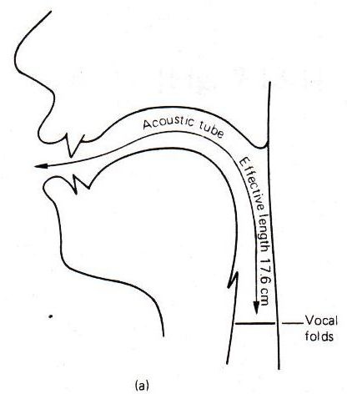
Resonances of the vocal tract
The human vocal tract as an open tube
Air in a tube of a given length will tend to vibrate at resonance frequency of tube.
Closed end
Open end
Length 17.5 cm.
Figure from W. Barry Speech Science slides
1/5/07

Slide 41
Resonances of the vocal tract
If vocal tract is cylindrical tube open at one end
Standing waves form in tubes
Waves will resonate if their wavelength corresponds to dimensions of tube
Constraint: Pressure differential should be maximal at (closed) glottal end and minimal at (open) lip end.
Next slide shows what kind of length of waves can fit into a tube with this contraint
1/5/07

Slide 42
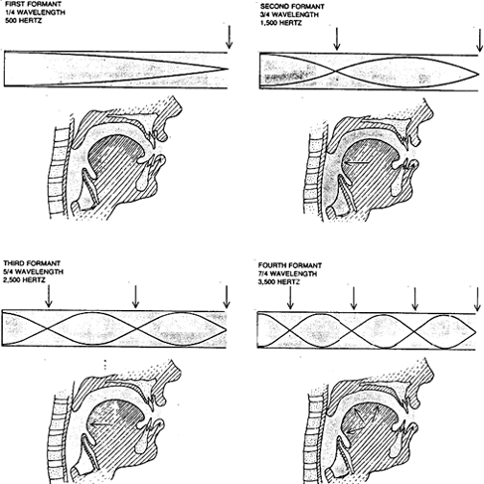
From Sundberg
1/5/07

Slide 43
Computing the 3 formants of schwa
Let the length of the tube be L
F₁ = c/λ₁ = c/(4L) = 35,000/4*17.5 = 500Hz
F₂ = c/λ₂ = c/(4/3L) = 3c/4L = 3*35,000/4*17.5 = 1500Hz
F₁ = c/λ₂ = c/(4/5L) = 5c/4L = 5*35,000/4*17.5 = 2500Hz
So we expect a neutral vowel to have 3 resonances at 500, 1500, and 2500 Hz
These vowel resonances are called formants
1/5/07

Slide 44
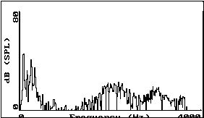
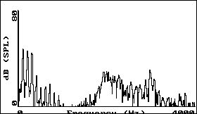
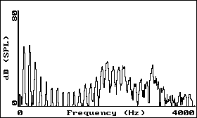
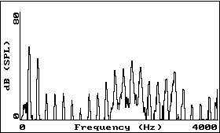
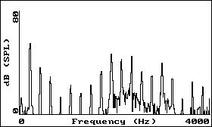
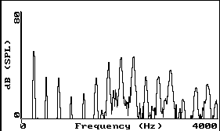
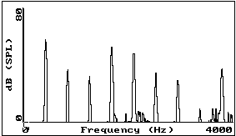
Vowel [i] sung at successively higher pitch.
1
2
3
4
5
6
7
1/5/07
Figures from Ratree Wayland slides from his website

Slide 45
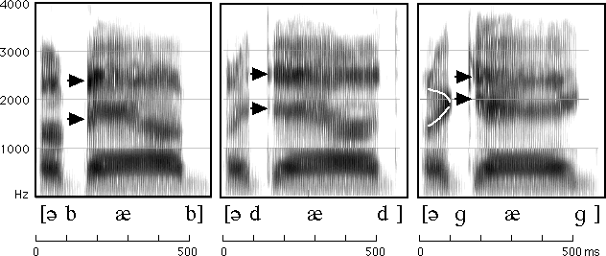
How to read spectrograms
bab: closure of lips lowers all formants: so rapid increase in all formants at beginning of "bab”
dad: first formant increases, but F2 and F3 slight fall
gag: F2 and F3 come together: this is a characteristic of velars. Formant transitions take longer in velars than in alveolars or labials
From Ladefoged “A Course in Phonetics”
1/5/07

Slide 46
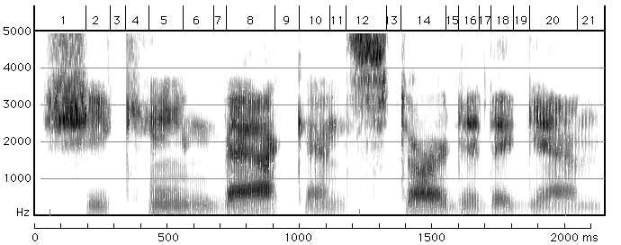
She came back and started again
1. lots of high-freq energy
3. closure for k
4. burst of aspiration for k
5. ey vowel;faint 1100 Hz formant is nasalization
6. bilabial nasal
7. short b closure, voicing barely visible.
8. ae; note upward transitions after bilabial stop at beginning
9. note F2 and F3 coming together for "k”
From Ladefoged “A Course in Phonetics”
1/5/07

Slide 47
Homework 1
http://www.stanford.edu/class/cs224s/hw1.html
You’ll need to download PRAAT; details are in the homework.
1/5/07

Slide 48
Phonetic Resources
Phonetic dictionaries
  CMU dict
  CELEX
Phonetically transcribed corpora
  TIMIT
  Switchboard
1/5/07

Slide 49
TIMIT
Read speech corpus, time aligned
1/5/07

Slide 50
Switchboard
Spontaneous speech corpus
Telephone conversations between strangers
“They’re kind of in between right now”
Time alignments
1/5/07

Slide 51
Summary
Acoustic Phonetics
  Waves, sound waves, and spectra
  Speech waveforms
  F0, pitch, intensity
  Spectra
    Spectrograms
    Formants
    Reading spectrograms
  Deriving schwa: why are formants where they are
  PRAAT
  Resources: dictionaries and phonetically-labeled corpora.
1/5/07

Slide 52
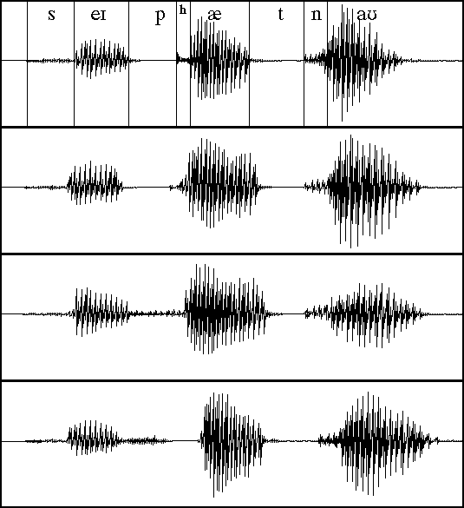
Examples from Ladefoged
pad
bad
spat
1/5/07

