Slide 1
CS 224S / LINGUIST 281
Speech Recognition, Synthesis, and Dialogue
Dan Jurafsky
Lecture 2: TTS: Brief History, Text Normalization and Part-of-Speech Tagging
IP Notice: lots of info, text, and diagrams on these slides comes (thanks!) from Alan Black’s excellent lecture notes and from Richard Sproat’s slides.

Slide 2
Outline
History of Speech Synthesis
State of the Art Demos
Brief Architectural Overview
Text Processing
  Text Normalization
    Tokenization
    End of sentence detection
      Methodology: decision trees
  Homograph disambiguation
  Part-of-speech tagging
    Methodology: Hidden Markov Models

Slide 3
Dave Barry on TTS
“And computers are getting smarter all the time; scientists tell us that soon they will be able to talk with us.
(By "they", I mean computers; I doubt scientists will ever be able to talk to us.)

Slide 4
History of TTS
Pictures and some text from Hartmut Traunmüller’s web site:
  http://www.ling.su.se/staff/hartmut/kemplne.htm
Von Kempeln 1780 b. Bratislava 1734 d. Vienna 1804
Leather resonator manipulated by the operator to try and copy vocal tract configuration during sonorants (vowels, glides, nasals)
Bellows provided air stream, counterweight provided inhalation
Vibrating reed produced periodic pressure wave

Slide 5
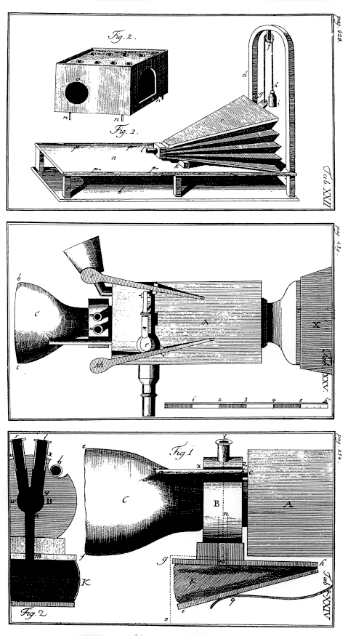
Von Kempelen:
Small whistles controlled consonants
Rubber mouth and nose; nose had to be covered with two fingers for non-nasals
Unvoiced sounds: mouth covered, auxiliary bellows driven by string provides puff of air
From Traunmüller’s web site

Slide 6
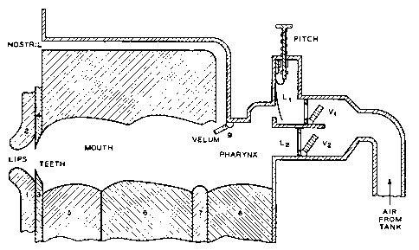
Closer to a natural vocal tract: Riesz 1937

Slide 7
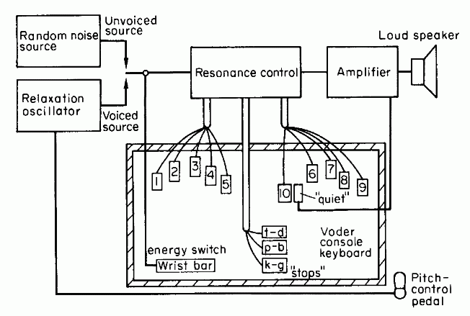
Homer Dudley 1939 VODER
Synthesizing speech by electrical means
1939 World’s Fair

Slide 8
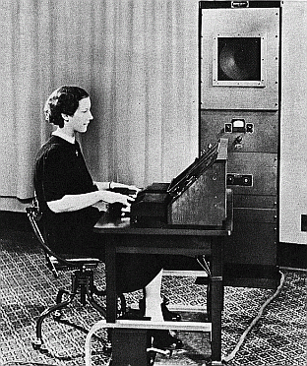

Homer Dudley’s VODER
Manually controlled through complex keyboard
Operator training was a problem

Slide 9
An aside on demos
That last slide
Exhibited Rule 1 of playing a speech synthesis demo:
Always have a human say what the words are right before you have the system say them

Slide 10
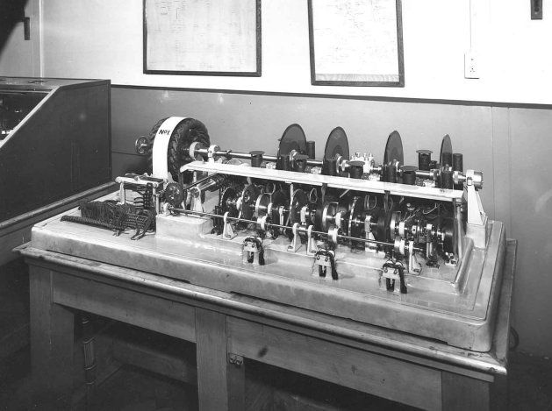
The 1936 UK Speaking Clock
From http://web.ukonline.co.uk/freshwater/clocks/spkgclock.htm

Slide 11
The UK Speaking Clock
July 24, 1936
Photographic storage on 4 glass disks
2 disks for minutes, 1 for hour, one for seconds.
Other words in sentence distributed across 4 disks, so all 4 used at once.
Voice of “Miss J. Cain”

Slide 12
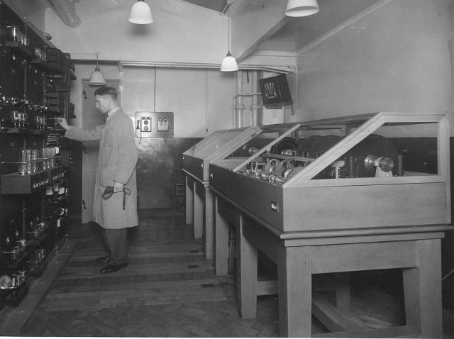
A technician adjusts the amplifiers of the first speaking clock
From http://web.ukonline.co.uk/freshwater/clocks/spkgclock.htm

Slide 13
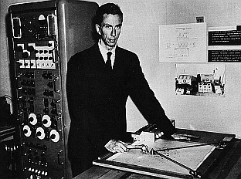
Gunnar Fant’s OVE synthesizer
Of the Royal Institute of Technology, Stockholm
Formant Synthesizer for vowels
F1 and F2 could be controlled
From Traunmüller’s web site

Slide 14
Cooper’s Pattern Playback
Haskins Labs for investigating speech perception
Works like an inverse of a spectrograph
Light from a lamp goes through a rotating disk then through spectrogram into photovoltaic cells
Thus amount of light that gets transmitted at each frequency band corresponds to amount of acoustic energy at that band

Slide 15
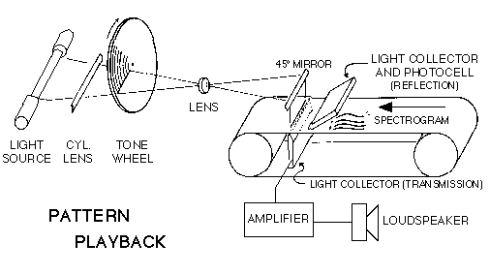
Cooper’s Pattern Playback

Slide 16
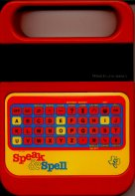
Modern TTS systems
1960’s first full TTS: Umeda et al (1968)
1970’s
  Joe Olive 1977 concatenation of linear-prediction diphones
  Texas Instruments Speak and Spell,
    June 1978
    Paul Breedlove
1980’s
  1979 MIT MITalk (Allen, Hunnicut, Klatt)
1990’s-present
  Diphone synthesis
  Unit selection synthesis
  HMM synthesis

Slide 17
TTS Demos (Unit-Selection)
ATT:
  http://www.naturalvoices.att.com/demos/
Festival
  http://www-2.cs.cmu.edu/~awb/festival_demos/index.html
Cepstral
  http://www.cepstral.com/cgi-bin/demos/general
IBM
  http://www-306.ibm.com/software/pervasive/tech/demos/tts.shtml

Slide 18
Two steps
PG&E will file schedules on April 20.
TEXT ANALYSIS: Text into intermediate representation:
WAVEFORM SYNTHESIS: From the intermediate representation into waveform

Slide 19
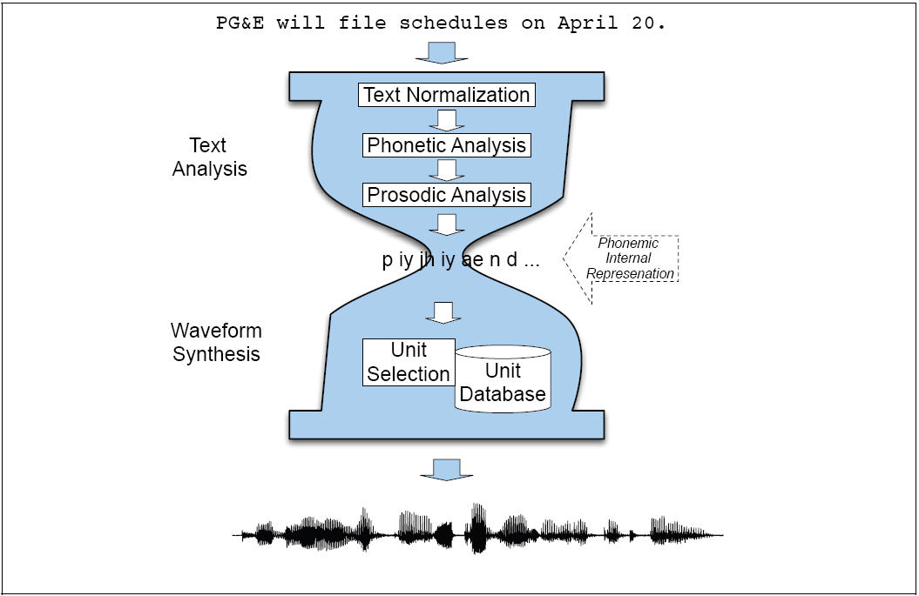
Architecture

Slide 20
Types of Waveform Synthesis
Articulatory Synthesis:
  Model movements of articulators and acoustics of vocal tract
Formant Synthesis:
  Start with acoustics, create rules/filters to create each formant
Concatenative Synthesis:
  Use databases of stored speech to assemble new utterances.
    Diphone
    Unit Selection
Statistical (HMM) Synthesis
  Trains parameters on databases of speech
Text modified from Richard Sproat slides

Slide 21
Formant Synthesis
Were the most common commercial systems when computers were slow and had little memory.
1979 MIT MITalk (Allen, Hunnicut, Klatt)
1983 DECtalk system
  “Perfect Paul” (The voice of Stephen Hawking)
  “Beautiful Betty”

Slide 22
2nd Generation Synthesis
Diphone Synthesis
  Units are diphones; middle of one phone to middle of next.
  Why? Middle of phone is steady state.
  Record 1 speaker saying each diphone
  ~1400 recordings
  Paste them together and modify prosody.

Slide 23
3rd GenerationSynthesis
All current commercial systems.
Unit Selection Synthesis
  Larger units of variable length
  Record one speaker speaking 10 hours or more,
    Have multiple copies of each unit
  Use search to find best sequence of units
Hidden Markov Model Synthesis
  Train a statistical model on large amounts of data.

Slide 24
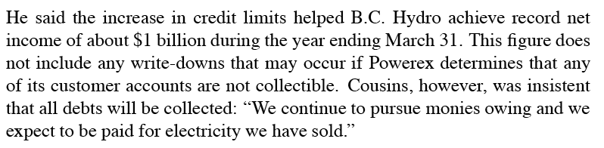
1. Text Normalization
Analysis of raw text into pronounceable words:
Sentence Tokenization
Text Normalization
  Identify tokens in text
  Chunk tokens into reasonably sized sections
  Map tokens to words
  Identify types for words

Slide 25
I. Text Processing
He stole $100 million from the bank
It’s 13 St. Andrews St.
The home page is http://www.stanford.edu
Yes, see you the following tues, that’s 11/12/01
IV: four, fourth, I.V.
IRA: I.R.A. or Ira
1750: seventeen fifty (date, address) or one thousand seven… (dollars)

Slide 26
I.1 Text Normalization Steps
Identify tokens in text
Chunk tokens
Identify types of tokens
Convert tokens to words

Slide 27
Step 1: identify tokens and chunk
Whitespace can be viewed as separators
Punctuation can be separated from the raw tokens
Festival converts text into
  ordered list of tokens
  each with features:
    its own preceding whitespace
    its own succeeding punctuation

Slide 28
Important issue in tokenization: end-of-utterance detection
Relatively simple if utterance ends in ?!
But what about ambiguity of “.”
Ambiguous between end-of-utterance and end-of-abbreviation
  My place on Winfield St. is around the corner.
  I live at 151 Winfield St.
  (Not “I live at 151 Winfield St..”)
How to solve this period-disambiguation task?

Slide 29
How about rules for end-of-utterance detection?
A dot with one or two letters is an abbrev
A dot with 3 cap letters is an abbrev.
An abbrev followed by 2 spaces and a capital letter is an end-of-utterance
Non-abbrevs followed by capitalized word are breaks

Slide 30
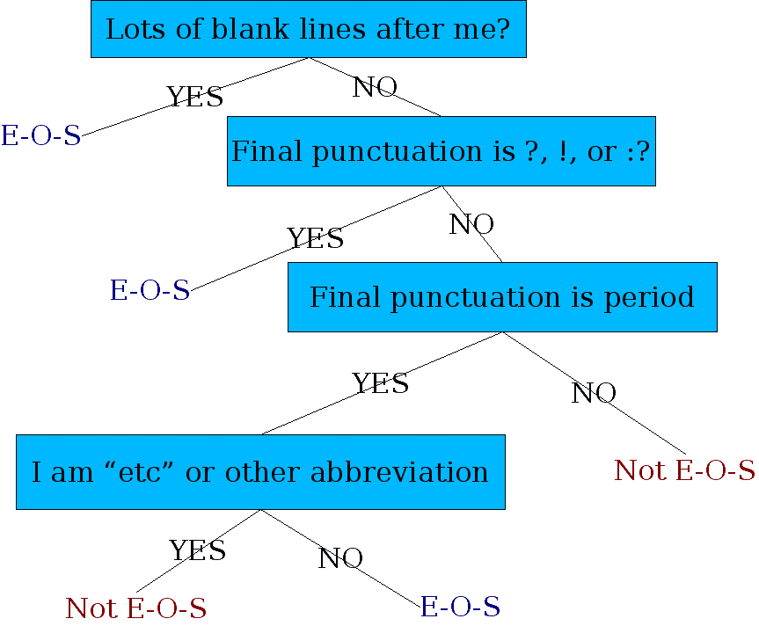
Determining if a word is end-of-utterance: a Decision Tree

Slide 31
CART
Breiman, Friedman, Olshen, Stone. 1984. Classification and Regression Trees. Chapman & Hall, New York.
Description/Use:
  Binary tree of decisions, terminal nodes determine prediction (“20 questions”)
  If dependent variable is categorial, “classification tree”,
  If continuous, “regression tree”
Text from Richard Sproat

Slide 32
Determining end-of-utterance
The Festival hand-built decision tree
((n.whitespace matches ".*\n.*\n[ \n]*") ;; A significant break in text
((1))
((punc in ("?" ":" "!"))
((1))
((punc is ".")
;; This is to distinguish abbreviations vs periods
;; These are heuristics
((name matches "\\(.*\\..*\\|[A-Z][A-Za-z]?[A-Za-z]?\\|etc\\)")
((n.whitespace is " ")
((0)) ;; if abbrev, single space enough for break
((n.name matches "[A-Z].*")
((1))
((0))))
((n.whitespace is " ") ;; if it doesn't look like an abbreviation
((n.name matches "[A-Z].*") ;; single sp. + non-cap is no break
((1))
((0)))
((1))))
((0)))))

Slide 33
The previous decision tree
Fails for
  Cog. Sci. Newsletter
  Lots of cases at end of line.
  Badly spaced/capitalized sentences

Slide 34
More sophisticated decision tree features
Prob(word with “.” occurs at end-of-s)
Prob(word after “.” occurs at begin-of-s)
Length of word with “.”
Length of word after “.”
Case of word with “.”: Upper, Lower, Cap, Number
Case of word after “.”: Upper, Lower, Cap, Number
Punctuation after “.” (if any)
Abbreviation class of word with “.” (month name, unit-of-measure, title, address name, etc)
From Richard Sproat slides

Slide 35
Learning DTs
DTs are rarely built by hand
Hand-building only possible for very simple features, domains
Lots of algorithms for DT induction
Covered in detail in Machine Learning or AI classes
  Russell and Norvig AI text.
I’ll give quick intuition here

Slide 36
CART Estimation
Creating a binary decision tree for classification or regression involves 3 steps:
  Splitting Rules: Which split to take at a node?
  Stopping Rules: When to declare a node terminal?
  Node Assignment: Which class/value to assign to a terminal node?
From Richard Sproat slides

Slide 37
Splitting Rules
Which split to take a node?
Candidate splits considered:
  Binary cuts: for continuous (-inf < x < inf) consider splits of form:
    X <= k vs. x > k ∀K
  Binary partitions: For categorical x ∈ {1,2,…} = X consider splits of form:
  x ∈ A vs. x ∈ X-A, ∀A ∈ X
From Richard Sproat slides

Slide 38
Splitting Rules
Choosing best candidate split.
  Method 1: Choose k (continuous) or A (categorical) that minimizes estimated classification (regression) error after split
  Method 2 (for classification): Choose k or A that minimizes estimated entropy after that split.
From Richard Sproat slides

Slide 39
Decision Tree Stopping
When to declare a node terminal?
Strategy (Cost-Complexity pruning):
  Grow over-large tree
  Form sequence of subtrees, T0…Tn ranging from full tree to just the root node.
  Estimate “honest” error rate for each subtree.
  Choose tree size with minimum “honest” error rate.
To estimate “honest” error rate, test on data different from training data (i.e. grow tree on 9/10 of data, test on 1/10, repeating 10 times and averaging (cross-validation).
From Richard Sproat

Slide 40
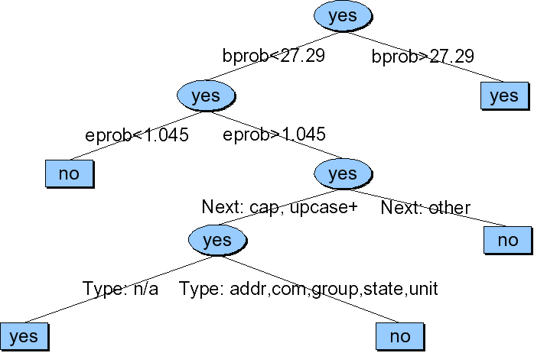
Sproat EOS tree
From Richard Sproat slides

Slide 41
Summary on end-of-sentence detection
Best references:
  David Palmer and Marti Hearst. 1997. Adaptive Multilingual Sentence Boundary Disambiguation. Computational Linguistics 23, 2. 241-267.
  David Palmer. 2000. Tokenisation and Sentence Segmentation. In “Handbook of Natural Language Processing”, edited by Dale, Moisl, Somers.

Slide 42
Steps 3+4: Identify Types of Tokens, and Convert Tokens to Words
Pronunciation of numbers often depends on type. 3 ways to pronounce 1776:
  1776 date: seventeen seventy six.
  1776 phone number: one seven seven six
  1776 quantifier: one thousand seven hundred (and) seventy six
  Also:
    25 day: twenty-fifth

Slide 43
Festival rule for dealing with “$1.2 million”
(define (token_to_words utt token name)
(cond
((and (string-matches name "\\$[0-9,]+\\(\\.[0-9]+\\)?")
(string-matches (utt.streamitem.feat utt token "n.name")
".*illion.?"))
(append
(builtin_english_token_to_words utt token (string-after name "$"))
(list
(utt.streamitem.feat utt token "n.name"))))
((and (string-matches (utt.streamitem.feat utt token "p.name")
"\\$[0-9,]+\\(\\.[0-9]+\\)?")
(string-matches name ".*illion.?"))
(list "dollars"))
(t
(builtin_english_token_to_words utt token name))))

Slide 44
Rule-based versus machine learning
As always, we can do things either way, or more often by a combination
Rule-based:
  Simple
  Quick
  Can be more robust
Machine Learning
  Works for complex problems where rules hard to write
  Higher accuracy in general
  But worse generalization to very different test sets
Real TTS and NLP systems
  Often use aspects of both.

Slide 45
Machine learning method for Text Normalization
From 1999 Hopkins summer workshop “Normalization of Non-Standard Words”
  Sproat, R., Black, A., Chen, S., Kumar, S., Ostendorf, M., and Richards, C. 2001. Normalization of Non-standard Words, Computer Speech and Language, 15(3):287-333
NSW examples:
  Numbers:
    123, 12 March 1994
  Abrreviations, contractions, acronyms:
    approx., mph. ctrl-C, US, pp, lb
  Punctuation conventions:
    3-4, +/-, and/or
  Dates, times, urls, etc

Slide 46
How common are NSWs?
Varies over text type
Word not in lexicon, or with non-alphabetic characters:
Text Type | % NSW
novels | 1.5%
press wire | 4.9%
e-mail | 10.7%
recipes | 13.7%
classified | 17.9%
From Alan Black slides

Slide 47
How hard are NSWs?
Identification:
  Some homographs “Wed”, “PA”
  False positives: OOV
Realization:
  Simple rule: money, $2.34
  Type identification+rules: numbers
  Text type specific knowledge (in classified ads, BR for bedroom)
Ambiguity (acceptable multiple answers)
  “D.C.” as letters or full words
  “MB” as “meg” or “megabyte”
  250

Slide 48
Step 1: Splitter
Letter/number conjunctions (WinNT, SunOS, PC110)
Hand-written rules in two parts:
  Part I: group things not to be split (numbers, etc; including commas in numbers, slashes in dates)
  Part II: apply rules:
    At transitions from lower to upper case
    After penultimate upper-case char in transitions from upper to lower
    At transitions from digits to alpha
    At punctuation
From Alan Black Slides

Slide 49
Step 2: Classify token into 1 of 20 types
EXPN: abbrev, contractions (adv, N.Y., mph, gov’t)
LSEQ: letter sequence (CIA, D.C., CDs)
ASWD: read as word, e.g. CAT, proper names
MSPL: misspelling
NUM: number (cardinal) (12,45,1/2, 0.6)
NORD: number (ordinal) e.g. May 7, 3rd, Bill Gates II
NTEL: telephone (or part) e.g. 212-555-4523
NDIG: number as digits e.g. Room 101
NIDE: identifier, e.g. 747, 386, I5, PC110
NADDR: number as stresst address, e.g. 5000 Pennsylvania
NZIP, NTIME, NDATE, NYER, MONEY, BMONY, PRCT,URL,etc
SLNT: not spoken (KENT*REALTY)

Slide 50
More about the types
4 categories for alphabetic sequences:
  EXPN: expand to full word or word seq (fplc for fireplace, NY for New York)
  LSEQ: say as letter sequence (IBM)
  ASWD: say as standard word (either OOV or acronyms)
5 main ways to read numbers:
  Cardinal (quantities)
  Ordinal (dates)
  String of digits (phone numbers)
  Pair of digits (years)
  Trailing unit: serial until last non-zero digit: 8765000 is “eight seven six five thousand” (some phone numbers, long addresses)
  But still exceptions: (947-3030, 830-7056)

Slide 51
Type identification algorithm
Create large hand-labeled training set and build a DT to predict type
Example of features in tree for subclassifier for alphabetic tokens:
  P(t|o) = p(o|t)p(t)/p(o)
  P(o|t), for t in ASWD, LSWQ, EXPN (from trigram letter model)
  P(t) from counts of each tag in text
  P(o) normalization factor

Slide 52
Type identification algorithm
Hand-written context-dependent rules:
  List of lexical items (Act, Advantage, amendment) after which Roman numbers read as cardinals not ordinals
Classifier accuracy:
  98.1% in news data,
  91.8% in email

Slide 53
Step 3: expanding NSW Tokens
Type-specific heuristics
  ASWD expands to itself
  LSEQ expands to list of words, one for each letter
  NUM expands to string of words representing cardinal
  NYER expand to 2 pairs of NUM digits…
  NTEL: string of digits with silence for puncutation
  Abbreviation:
    use abbrev lexicon if it’s one we’ve seen
    Else use training set to know how to expand
    Cute idea: if “eat in kit” occurs in text, “eat-in kitchen” will also occur somewhere.

Slide 54
What about unseen abbreviations?
Problem: given a previously unseen abbreviation, how do you use corpus-internal evidence to find the expansion into a standard word?
Example:
  Cus wnt info on services and chrgs
Elsewhere in corpus:
  …customer wants…
  …wants info on vmail…
From Richard Sproat

Slide 55
4 steps to Sproat et al. algorithm
Splitter (on whitespace or also within word (“AltaVista”)
Type identifier: for each split token identify type
Token expander: for each typed token, expand to words
  Deterministic for number, date, money, letter sequence
  Only hard (nondeterministic) for abbreviations
Language Model: to select between alternative pronunciations
From Alan Black slides

Slide 56
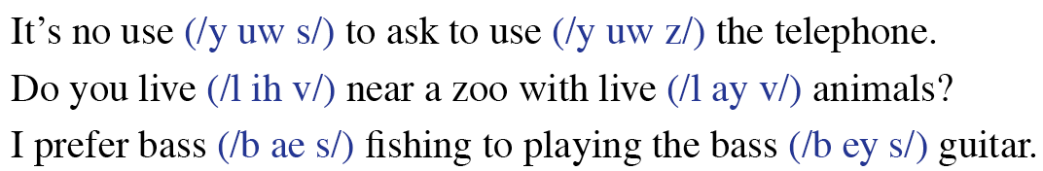
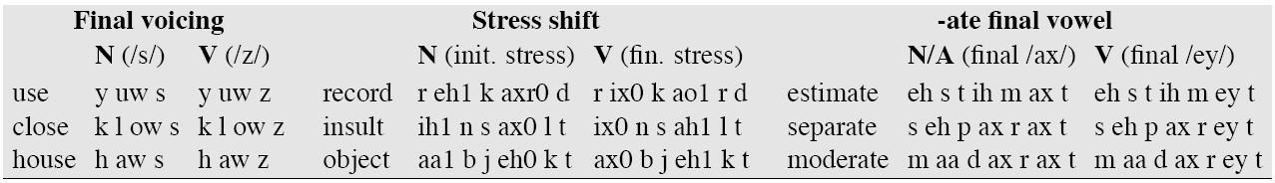
I.2 Homograph disambiguation

Slide 57
I.2 Homograph disambiguation
19 most frequent homographs, from Liberman and Church
  use 319
  increase 230
  close 215
  record 195
  house 150
  contract 143
  lead 131
  live 130
  lives 105
  protest 94
  survey 91
  project 90
  separate 87
  present 80
  read 72
  subject 68
  rebel 48
  finance 46
  estimate 46
Not a huge problem, but still important

Slide 58
POS Tagging for homograph disambiguation
Many homographs can be distinguished by POS
  use y uw s y uw z
  close k l ow s k l ow z
  house h aw s h aw z
  live l ay v l ih v
  REcord reCORD
  INsult inSULT
  OBject obJECT
  OVERflow overFLOW
  DIScount disCOUNT
  CONtent conTENT
POS tagging also useful for CONTENT/FUNCTION distinction, which is useful for phrasing

Slide 59
Part of speech tagging
8 (ish) traditional parts of speech
  Noun, verb, adjective, preposition, adverb, article, interjection, pronoun, conjunction, etc
  This idea has been around for over 2000 years (Dionysius Thrax of Alexandria, c. 100 B.C.)
  Called: parts-of-speech, lexical category, word classes, morphological classes, lexical tags, POS
  We’ll use POS most frequently
  I’ll assume that you all know what these are

Slide 60
POS examples
N noun chair, bandwidth, pacing
V verb study, debate, munch
ADJ adj purple, tall, ridiculous
ADV adverb unfortunately, slowly,
P preposition of, by, to
PRO pronoun I, me, mine
DET determiner the, a, that, those

Slide 61
POS Tagging: Definition
The process of assigning a part-of-speech or lexical class marker to each word in a corpus:
WORDS
TAGS
the
koala
put
the
keys
on
the
table
N
V
P
DET

Slide 62
POS Tagging example
WORD tag
the DET
koala N
put V
the DET
keys N
on P
the DET
table N

Slide 63
POS tagging: Choosing a tagset
There are so many parts of speech, potential distinctions we can draw
To do POS tagging, need to choose a standard set of tags to work with
Could pick very coarse tagets
  N, V, Adj, Adv.
More commonly used set is finer grained, the “UPenn TreeBank tagset”, 45 tags
  PRP$, WRB, WP$, VBG
Even more fine-grained tagsets exist

Slide 64
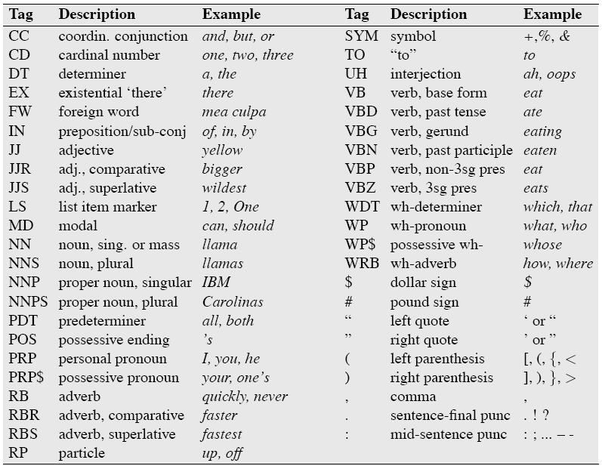
Penn TreeBank POS Tag set

Slide 65
Using the UPenn tagset
The/DT grand/JJ jury/NN commmented/VBD on/IN a/DT number/NN of/IN other/JJ topics/NNS ./.
Prepositions and subordinating conjunctions marked IN (“although/IN I/PRP..”)
Except the preposition/complementizer “to” is just marked “to”.

Slide 66
POS Tagging
Words often have more than one POS: back
  The back door = JJ
  On my back = NN
  Win the voters back = RB
  Promised to back the bill = VB
The POS tagging problem is to determine the POS tag for a particular instance of a word.
These examples from Dekang Lin

Slide 67
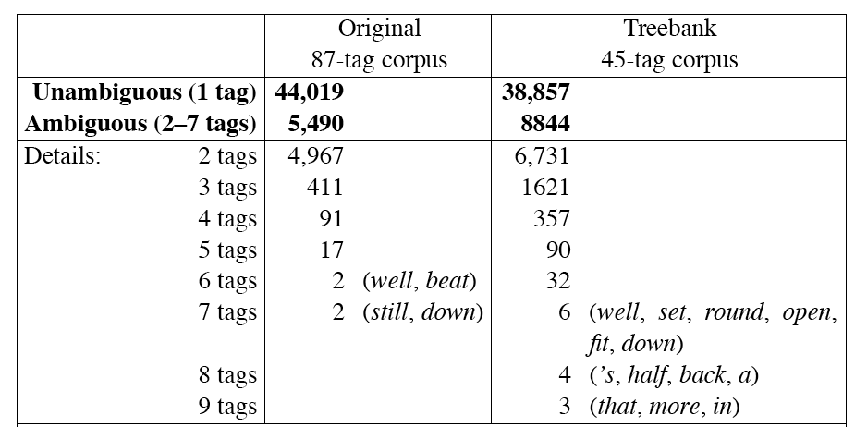
How hard is POS tagging? Measuring ambiguity

Slide 68
3 methods for POS tagging
Rule-based tagging
  (ENGTWOL)
Stochastic (=Probabilistic) tagging
  HMM (Hidden Markov Model) tagging
Transformation-based tagging
  Brill tagger

Slide 69
Hidden Markov Model Tagging
Using an HMM to do POS tagging
Is a special case of Bayesian inference
  Foundational work in computational linguistics
  Bledsoe 1959: OCR
  Mosteller and Wallace 1964: authorship identification
It is also related to the “noisy channel” model that we’ll do when we do ASR (speech recognition)

Slide 70
POS tagging as a sequence classification task
We are given a sentence (an “observation” or “sequence of observations”)
  Secretariat is expected to race tomorrow
What is the best sequence of tags which corresponds to this sequence of observations?
Probabilistic view:
  Consider all possible sequences of tags
  Out of this universe of sequences, choose the tag sequence which is most probable given the observation sequence of n words w1…wn.

Slide 71

Getting to HMM
We want, out of all sequences of n tags t₁…t_{n} the single tag sequence such that P(t₁…t_{n}|w₁…w_{n}) is highest.
Hat ^ means “our estimate of the best one”
Argmax_{x} f(x) means “the x such that f(x) is maximized”

Slide 72
Getting to HMM
This equation is guaranteed to give us the best tag sequence
But how to make it operational? How to compute this value?
Intuition of Bayesian classification:
  Use Bayes rule to transform into a set of other probabilities that are easier to compute

Slide 73
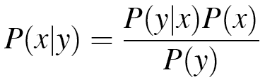
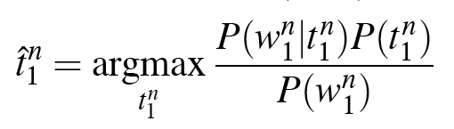
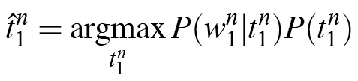
Using Bayes Rule

Slide 74
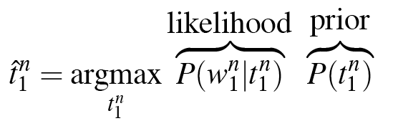
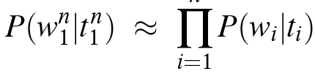
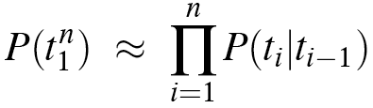
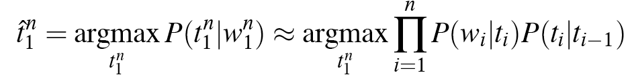
Likelihood and prior
n

Slide 75
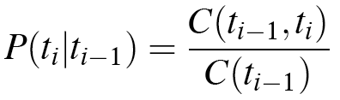
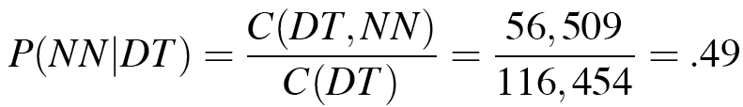
Two kinds of probabilities (1)
Tag transition probabilities p(t_{i}|t_{i-1})
  Determiners likely to precede adjs and nouns
    That/DT flight/NN
    The/DT yellow/JJ hat/NN
    So we expect P(NN|DT) and P(JJ|DT) to be high
    But P(DT|JJ) to be:
  Compute P(NN|DT) by counting in a labeled corpus:

Slide 76
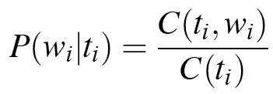
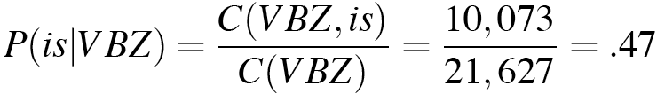
Two kinds of probabilities (2)
Word likelihood probabilities p(w_{i}|t_{i})
  VBZ (3sg Pres verb) likely to be “is”
  Compute P(is|VBZ) by counting in a labeled corpus:

Slide 77
An Example: the verb “race”
Secretariat/NNP is/VBZ expected/VBN to/TO race/VB tomorrow/NR
People/NNS continue/VB to/TO inquire/VB the/DT reason/NN for/IN the/DT race/NN for/IN outer/JJ space/NN
How do we pick the right tag?

Slide 78
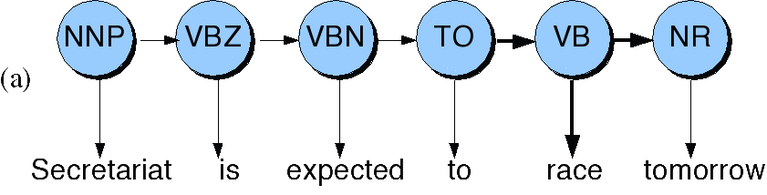
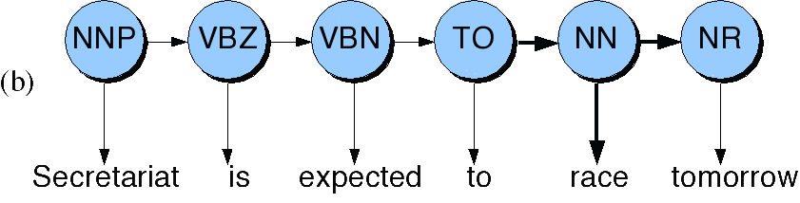
Disambiguating “race”

Slide 79
P(NN|TO) = .00047
P(VB|TO) = .83
P(race|NN) = .00057
P(race|VB) = .00012
P(NR|VB) = .0027
P(NR|NN) = .0012
P(VB|TO)P(NR|VB)P(race|VB) = .00000027
P(NN|TO)P(NR|NN)P(race|NN)=.00000000032
So we (correctly) choose the verb reading

Slide 80
Hidden Markov Models
What we’ve described with these two kinds of probabilities is a Hidden Markov Model
A Hidden Markov Model is a particular probabilistic kind of automaton
Let’s just spend a bit of time tying this into the model
We’ll return to this in much more detail in 3 weeks when we do ASR

Slide 81
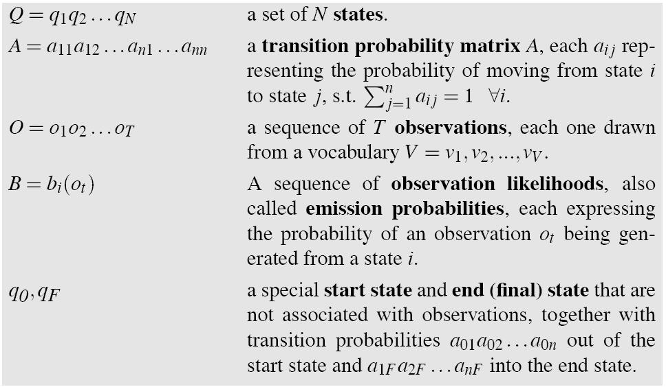
Hidden Markov Model

Slide 82
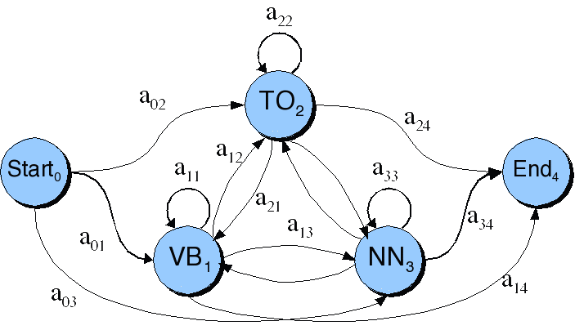
Transitions between the hidden states of HMM, showing A probs

Slide 83
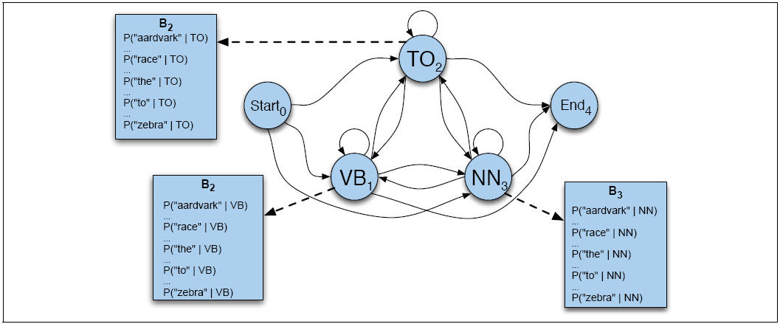
B observation likelihoods for POS HMM

Slide 84
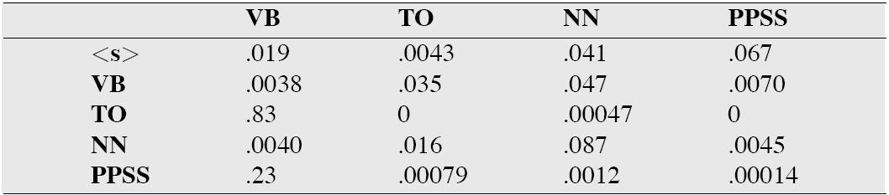
The A matrix for the POS HMM

Slide 85
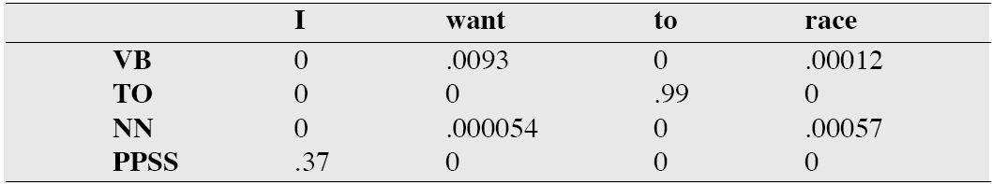
The B matrix for the POS HMM

Slide 86
Viterbi intuition: we are looking for the best ‘path’
S₁
S₂
S₃
S₄
S₅
Slide from Dekang Lin

Slide 87
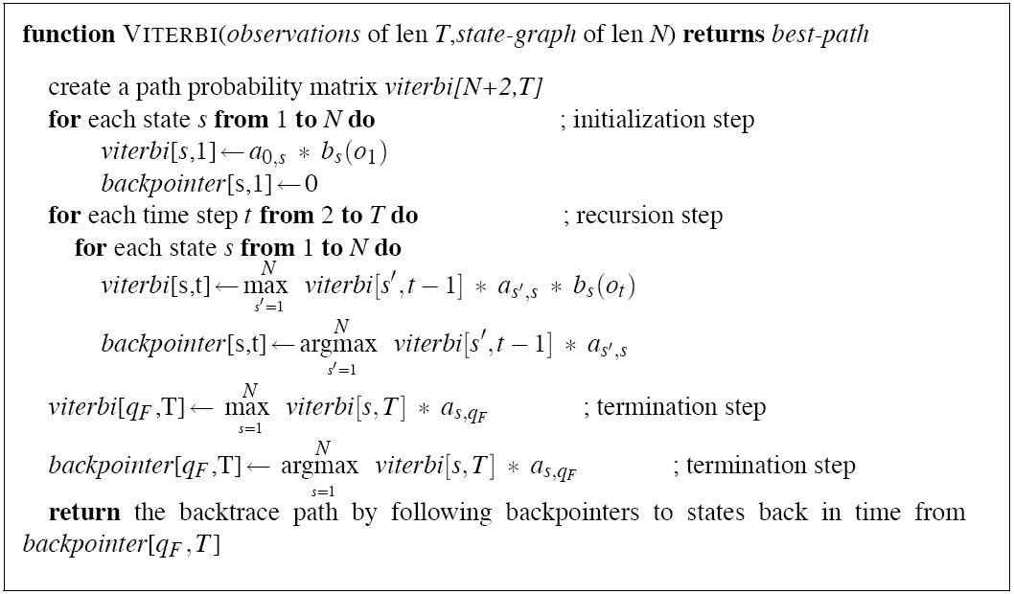
The Viterbi Algorithm

Slide 88

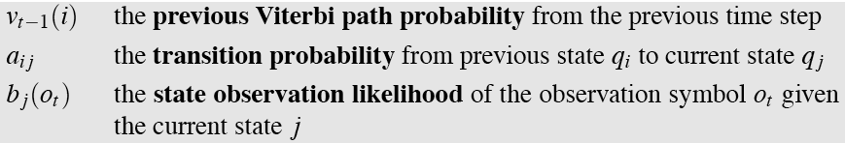
Intuition
The value in each cell is computed by taking the MAX over all paths that lead to this cell.
An extension of a path from state i at time t-1 is computed by multiplying:

Slide 89
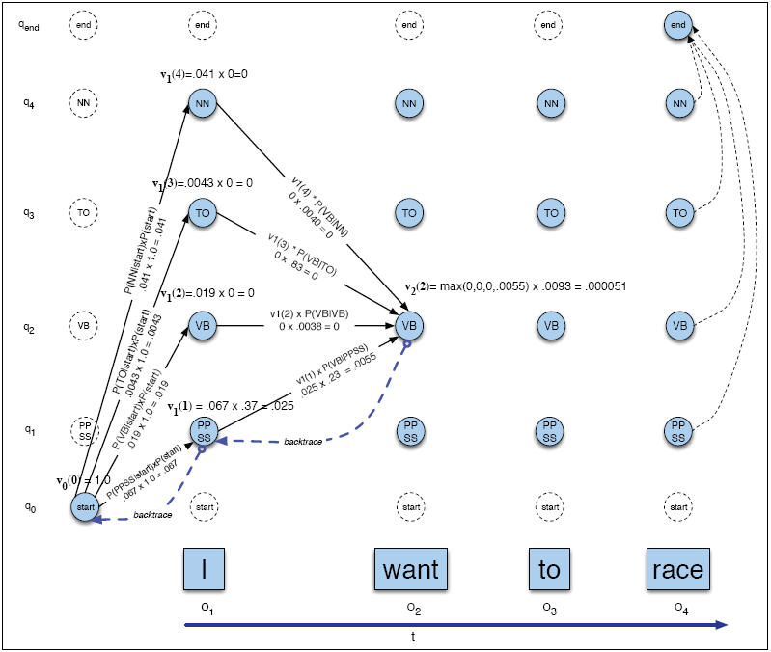
Viterbi example

Slide 90
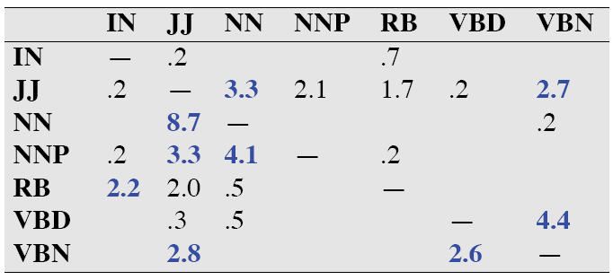
Error Analysis: ESSENTIAL!!!
Look at a confusion matrix
See what errors are causing problems
  Noun (NN) vs ProperNoun (NN) vs Adj (JJ)
  Adverb (RB) vs Particle (RP) vs Prep (IN)
  Preterite (VBD) vs Participle (VBN) vs Adjective (JJ)

Slide 91
Evaluation
The result is compared with a manually coded “Gold Standard”
  Typically accuracy reaches 96-97%
  This may be compared with result for a baseline tagger (one that uses no context).
Important: 100% is impossible even for human annotators.

Slide 92
Summary
Part of speech tagging plays important role in TTS
Most algorithms get 96-97% tag accuracy
Not a lot of studies on whether remaining error tends to cause problems in TTS
  For example POS taggers don’t do well in reading headlines

Slide 93
Summary
Text Processing
  Text Normalization
    Tokenization
    End of sentence detection
      Methodology: decision trees
  Homograph disambiguation
  Part-of-speech tagging
    Methodology: Hidden Markov Models

