Slide 1
CS 224S / LINGUIST 281
Speech Recognition, Synthesis, and Dialogue
Dan Jurafsky
Lecture 4: Intro to Festival; rest of Text Normalization; Letter-to-Sound
IP Notice: lots of info, text, and diagrams on these slides comes (thanks!) from Alan Black’s excellent lecture notes and from Richard Sproat’s great new slides.
1/5/07

Slide 2
Outline
Overview of Festival
  Where it lives, its components
  Its scripting language: Scheme
Finishing up Part of Speech Tagging
Phonetic Analysis
  Dictionaries
  Names
  Letter-to-Sound Rules
    (or “Grapheme-to-Phoneme Conversion”)
1/5/07

Slide 3
Festival
Open source speech synthesis system
Designed for development and runtime use
  Use in many commercial and academic systems
  Distributed with RedHat 9.x, etc
  Hundreds of thousands of users
  Multilingual
    No built-in language
    Designed to allow addition of new languages
  Additional tools for rapid voice development
    Statistical learning tools
    Scripts for building models
Text from Richard Sproat
1/5/07

Slide 4
Festival as software
http://festvox.org/festival/
General system for multi-lingual TTS
C/C++ code with Scheme scripting language
General replaceable modules:
  Lexicons, LTS, duration, intonation, phrasing, POS tagging, tokenizing, diphone/unit selection, signal processing
General tools
  Intonation analysis (f0, Tilt), signal processing, CART building, N-gram, SCFG, WFST
Text from Richard Sproat
1/5/07

Slide 5
Festival as software
http://festvox.org/festival/
No fixed theories
New languages without new C++ code
Multiplatform (Unix/Windows)
Full sources in distribution
Free software
Text from Richard Sproat
1/5/07

Slide 6
CMU FestVox project
Festival is an engine, how do you make voices?
Festvox: building synthetic voices:
  Tools, scripts, documentation
  Discussion and examples for building voices
  Example voice databases
  Step by step walkthroughs of processes
Support for English and other languages
Support for different waveform synthesis methods
  Diphone
  Unit selection
  Limited domain
Text from Richard Sproat
1/5/07

Slide 7
Synthesis tools
I want my computer to talk
  Festival Speech Synthesis
I want my computer to talk in my voice
  FestVox Project
I want it to be fast and efficient
  Flite
Text from Richard Sproat
1/5/07

Slide 8
Using Festival
How to get Festival to talk
Scheme (Festival’s scripting language)
Basic Festival commands
Text from Richard Sproat
1/5/07

Slide 9
Getting it to talk
Say a file
  festival --tts file.txt
From Emacs
  say region, say buffer
Command line interpreter
  festival> (SayText “hello”)
Text from Richard Sproat
1/5/07

Slide 10
Scheme: the scripting lg
Advantages of a scripting lg
  Convenient, easy to add functionality
Why Scheme?
  Holdover from the LISP days of AI.
  Many people like it.
  It’s very simple
Text adapted from Richard Sproat
1/5/07

Slide 11
Quick Intro to Scheme
Scheme is a dialect of LISP
expressions are
  atoms or
  lists
    a bcd “hello world” 12.3
    (a b c)
    (a (1 2) seven)
Interpreter evaluates expressions
  Atoms evaluate as variables
  Lists evaluate as functional calls
    bxx
    3.14
    (+ 2 3)
Text from Richard Sproat
1/5/07

Slide 12
Quick Intro to Scheme
Setting variables
  (set! a 3.14)
Defining functions
  (define (timestwo n) (* 2 n))
  (timestwo a)
  6.28
Text from Richard Sproat
1/5/07

Slide 13
Lists in Scheme
festival> (set! alist '(apples pears bananas))
(apples pears bananas)
festival> (car alist)
apples
festival> (cdr alist)
(pears bananas)
festival> (set! blist (cons 'oranges alist))
(oranges apples pears bananas)
festival> append alist blist
#<SUBR(6) append>
(apples pears bananas)
(oranges apples pears bananas)
festival> (append alist blist)
(apples pears bananas oranges apples pears bananas)
festival> (length alist)
3
festival> (length (append alist blist))
7
Text from Richard Sproat
1/5/07

Slide 14
Scheme: speech
Make an utterance of type text
  festival> (set! utt1 (Utterance Text “hello”))
  #<Utterance 0xf6855718>
Synthesize an utterance
  festival> (utt.synth utt1)
  #<Utterance 0xf6855718>
Play waveform
  festival> (utt.play utt1)
  #<Utterance 0xf6855718>
Do all together
  festival> (SayText “This is an example”)
  #<Utterance 0xf6961618>
Text from Richard Sproat
1/5/07

Slide 15
Scheme: speech
In a file
  (define (SpeechPlus a b)
  (SayText
  (format nil
  “%d plus %d equals %d”
  a b (+ a b))))
Loading files
  festival> (load “file.scm”)
  t
Do all together
  festival> (SpeechPlus 2 4)
  #<Utterance 0xf6961618>
Text from Richard Sproat
1/5/07

Slide 16
Scheme: speech
(define (sp_time hour minute)
  (cond
  (( < hour 12)
  (SayText
  (format nil
  “It is %d %d in the morning”
  hour minute )))
  (( < hour 18)
  (SayText
  (format nil
  “It is %d %d in the afternoon”
  (- hour 12) minute )))
  (t
  (SayText
  (format nil
  “It is %d %d in the evening”
  (- hour 12) minute )))))
Text from Richard Sproat
1/5/07

Slide 17
Getting help
Online manual
  http://festvox.org/docs/manual-1.4.3
Alt-h (or esc-h) on current symbol short help
Alt-s (or esc-s) to speak help
Alt-m goto man page
Use TAB key for completion
1/5/07

Slide 18
Festival Structure
Utterance structure in Festival
http://www.festvox.org/docs/manual-1.4.2/festival_14.html
Features in festival
http://www.festvox.org/docs/manual-1.4.2/festival_32.html
1/5/07

Slide 19
Hidden Markov Model Tagging
Using an HMM to do POS tagging
Is a special case of Bayesian inference
  Foundational work in computational linguistics
  Bledsoe 1959: OCR
  Mosteller and Wallace 1964: authorship identification
It is also related to the “noisy channel” model that we’ll do when we do ASR (speech recognition)

Slide 20
POS tagging as a sequence classification task
We are given a sentence (an “observation” or “sequence of observations”)
  Secretariat is expected to race tomorrow
What is the best sequence of tags which corresponds to this sequence of observations?
Probabilistic view:
  Consider all possible sequences of tags
  Out of this universe of sequences, choose the tag sequence which is most probable given the observation sequence of n words w1…wn.

Slide 21

Getting to HMM
We want, out of all sequences of n tags t₁…t_{n} the single tag sequence such that P(t₁…t_{n}|w₁…w_{n}) is highest.
Hat ^ means “our estimate of the best one”
Argmax_{x} f(x) means “the x such that f(x) is maximized”

Slide 22
Getting to HMM
This equation is guaranteed to give us the best tag sequence
But how to make it operational? How to compute this value?
Intuition of Bayesian classification:
  Use Bayes rule to transform into a set of other probabilities that are easier to compute

Slide 23

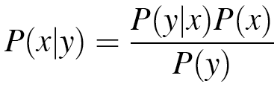
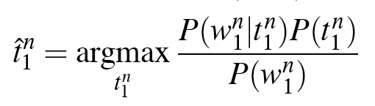
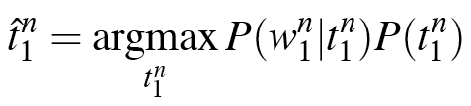
Using Bayes Rule

Slide 24
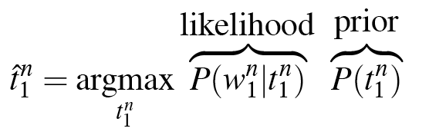
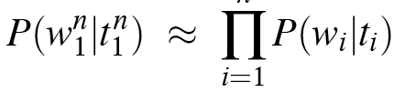
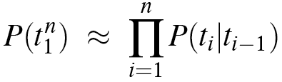
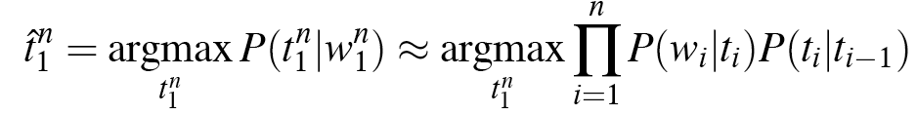
Likelihood and prior
n

Slide 25
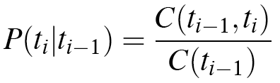
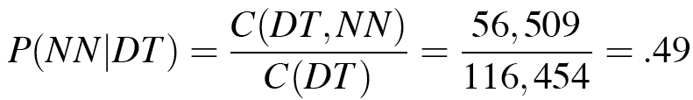
Two kinds of probabilities (1)
Tag transition probabilities p(t_{i}|t_{i-1})
  Determiners likely to precede adjs and nouns
    That/DT flight/NN
    The/DT yellow/JJ hat/NN
    So we expect P(NN|DT) and P(JJ|DT) to be high
    But P(DT|JJ) to be:
  Compute P(NN|DT) by counting in a labeled corpus:

Slide 26
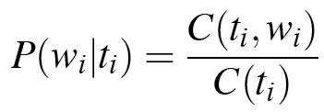
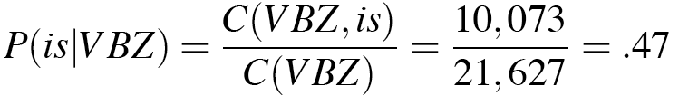
Two kinds of probabilities (2)
Word likelihood probabilities p(w_{i}|t_{i})
  VBZ (3sg Pres verb) likely to be “is”
  Compute P(is|VBZ) by counting in a labeled corpus:

Slide 27
POS tagging: likelihood and prior
n
1/5/07

Slide 28
An Example: the verb “race”
Secretariat/NNP is/VBZ expected/VBN to/TO race/VB tomorrow/NR
People/NNS continue/VB to/TO inquire/VB the/DT reason/NN for/IN the/DT race/NN for/IN outer/JJ space/NN
How do we pick the right tag?
1/5/07

Slide 29
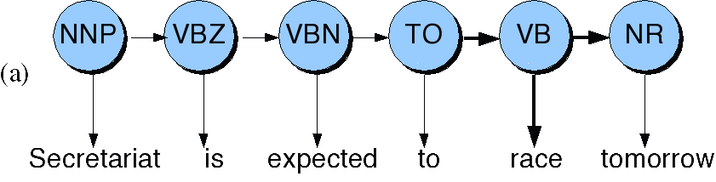
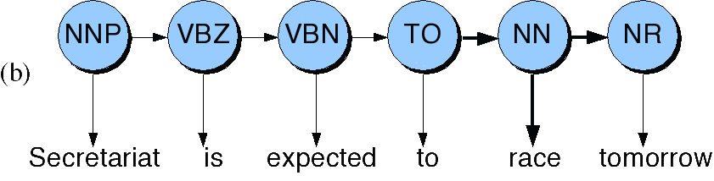
Disambiguating “race”
1/5/07

Slide 30
P(NN|TO) = .00047
P(VB|TO) = .83
P(race|NN) = .00057
P(race|VB) = .00012
P(NR|VB) = .0027
P(NR|NN) = .0012
P(VB|TO)P(NR|VB)P(race|VB) = .00000027
P(NN|TO)P(NR|NN)P(race|NN)=.00000000032
So we (correctly) choose the verb reading
1/5/07

Slide 31
Hidden Markov Models
What we’ve described with these two kinds of probabilities is a Hidden Markov Model
A Hidden Markov Model is a particular probabilistic kind of automaton
Let’s just spend a bit of time tying this into the model
We’ll return to this in much more detail in 2 weeks when we do ASR
1/5/07

Slide 32
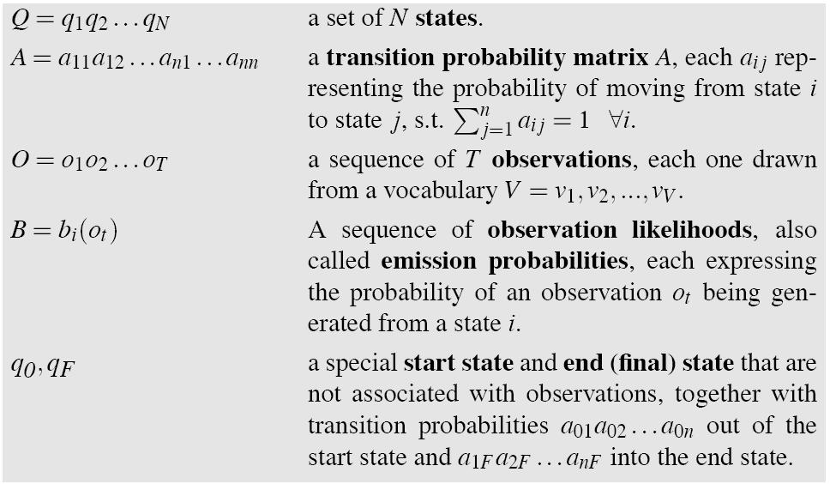
Hidden Markov Model
1/5/07

Slide 33
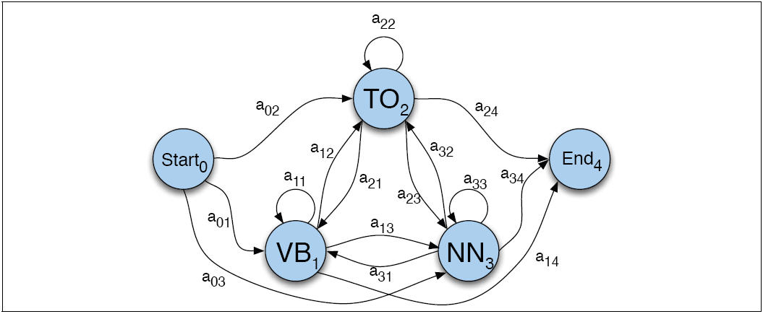
Transitions between the hidden states of HMM, showing A probs
1/5/07

Slide 34
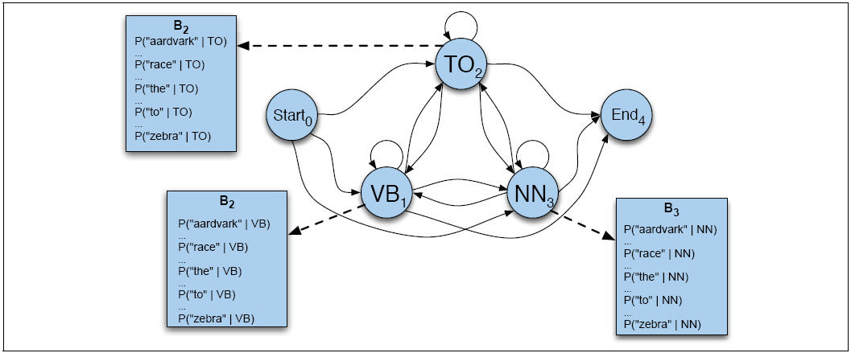
B observation likelihoods for POS HMM
1/5/07

Slide 35
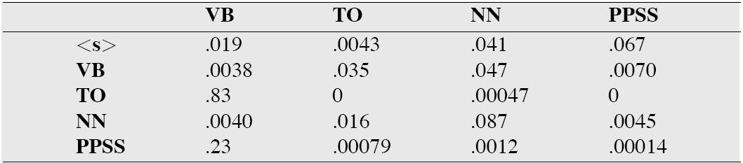
The A matrix for the POS HMM
1/5/07

Slide 36
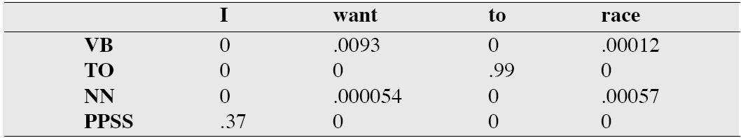
The B matrix for the POS HMM
1/5/07

Slide 37
Viterbi intuition: we are looking for the best ‘path’
S₁
S₂
S₃
S₄
S₅
Slide from Dekang Lin
1/5/07

Slide 38
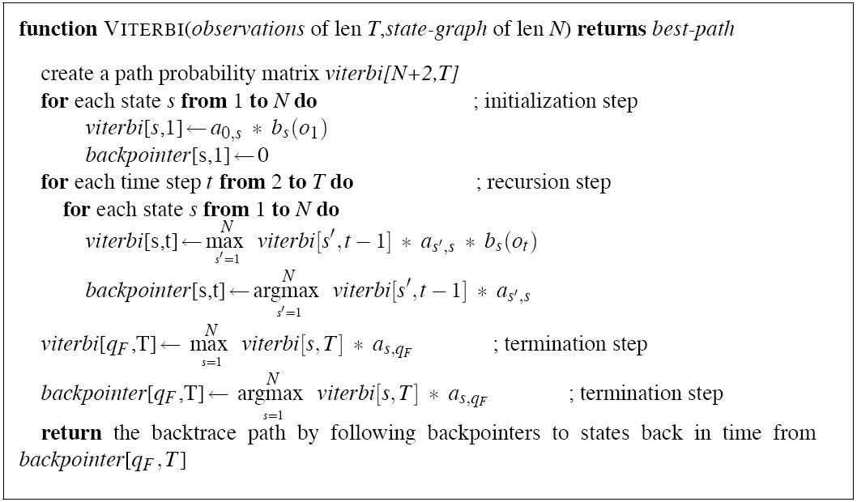
The Viterbi Algorithm
1/5/07

Slide 39

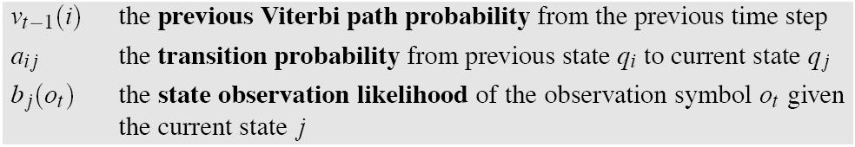
Intuition
The value in each cell is computed by taking the MAX over all paths that lead to this cell.
An extension of a path from state i at time t-1 is computed by multiplying:
1/5/07

Slide 40
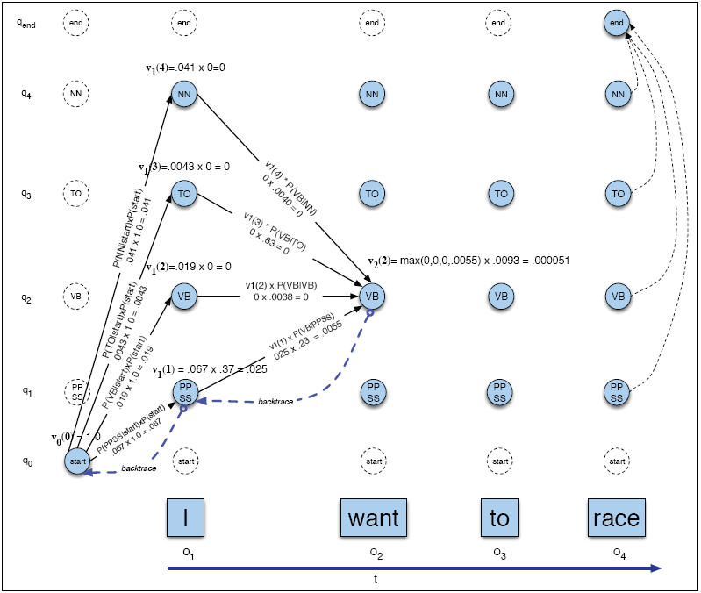
Viterbi example
1/5/07

Slide 41
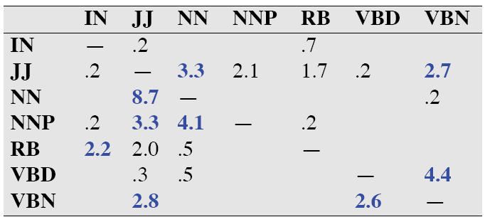
Error Analysis: ESSENTIAL!!!
Look at a confusion matrix
See what errors are causing problems
  Noun (NN) vs ProperNoun (NN) vs Adj (JJ)
  Adverb (RB) vs Particle (RP) vs Prep (IN)
  Preterite (VBD) vs Participle (VBN) vs Adjective (JJ)
1/5/07

Slide 42
Evaluation
The result is compared with a manually coded “Gold Standard”
  Typically accuracy reaches 96-97%
  This may be compared with result for a baseline tagger (one that uses no context).
Important: 100% is impossible even for human annotators.
1/5/07

Slide 43
Baseline
Most frequent class baseline
1/5/07

Slide 44
Summary
Part of speech tagging plays important role in TTS
Most algorithms get 96-97% tag accuracy
Not a lot of studies on whether remaining error tends to cause problems in TTS
1/5/07

Slide 45
Summary
Text Processing
  Text Normalization
    Tokenization
    End of sentence detection
      Methodology: decision trees
  Homograph disambiguation
  Part-of-speech tagging
    Methodology: Hidden Markov Models
1/5/07

Slide 46
II. Phonetic Analysis
1/5/07

Slide 47
Converting from words to phones
Most important: dictionary
1/5/07

Slide 48
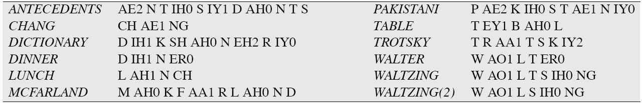
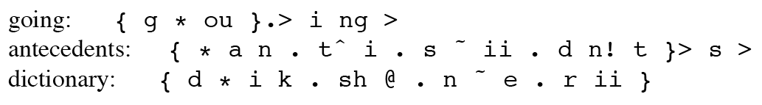
Dictionaries
CMU dictionary: 127K words
  http://www.speech.cs.cmu.edu/cgi-bin/cmudict
Unisyn dictionary
1/5/07

Slide 49
Lexicons and Lexical Entries
In Festival you can explicitly give pronunciations for words
  Each lg/dialect has its own lexicon
  You can lookup words with
    (lex.lookup WORD)
  You can add entries to the current lexicon
    (lex.add.entry NEWENTRY)
  Entry: (WORD POS (SYL0 SYL1…))
  Syllable: ((PHONE0 PHONE1 …) STRESS )
  Example:
    ‘(“cepstra” n ((k eh p) 1) ((s t r aa) 0))))
1/5/07

Slide 50
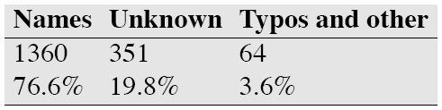
Dictionaries aren’t always sufficient
Unknown words
  Seem to be linear with number of words in unseen text
  Mostly person, company, product names
  But also foreign words, etc.
  From a Black et al analysis
    Of 39K tokens in part of the Wall Street Journal
    1775 (4.6%) were not in the OALD dictionary:
So commercial systems have 3-part system:
  Big dictionary
  Special code for handling names
  Machine learned LTS system for other unknown words
1/5/07

Slide 51
Names
Big problem area is names
Names are common
  20% of tokens in typical newswire text will be names
  Spiegel (2003) estimate of US names:
    2 million surnames
    100,000 first names
  Personal names: McArthur, D’Angelo, Jiminez, Rajan, Raghavan, Sondhi, Xu, Hsu, Zhang, Chang, Nguyen
  Company/Brand names: Infinit, Kmart, Cytyc, Medamicus, Inforte, Aaon, Idexx Labs, Bebe
1/5/07

Slide 52
Names
Methods:
  Can do morphology (Walters -> Walter, Lucasville)
  Can write stress-shifting rules (Jordan -> Jordanian)
  Rhyme analogy: Plotsky by analogy with Trostsky (replace tr with pl)
  Liberman and Church: for 250K most common names, got 212K (85%) from these modified-dictionary methods, used LTS for rest.
  Can do automatic country detection (from letter trigrams) and then do country-specific rules
1/5/07

Slide 53
Letter-to-Sound Rules
Festival LTS rules:
(LEFTCONTEXT [ ITEMS] RIGHTCONTEXT = NEWITEMS )
Example:
  ( # [ c h ] C = k )
  ( # [ c h ] = ch )
# denotes beginning of word
C means all consonants
Rules apply in order
  “christmas” pronounced with [k]
  But word with ch followed by non-consonant pronounced [ch]
    E.g., “choice”
1/5/07

Slide 54
What about stress: practice
Generally
Pronounced
Exception
Dictionary
Significant
Prefix
Exhale
Exhalation
Sally
1/5/07

Slide 55
Stress rules in LTS
English famously evil: one from Allen et al 1987
V -> [1-stress] / X_C* {Vshort C C?|V} {[Vshort C*|V}
Where X must contain all prefixes:
Assign 1-stress to the vowel in a syllable preceding a weak syllable followed by a morpheme-final syllable containing a short vowel and 0 or more consonants (e.g. difficult)
Assign 1-stress to the vowel in a syllable preceding a weak syllable followed by a morpheme-final vowel (e.g. oregano)
etc
1/5/07

Slide 56
Modern method: Learning LTS rules automatically
Induce LTS from a dictionary of the language
Black et al. 1998
Applied to English, German, French
Two steps: alignment and (CART-based) rule-induction
1/5/07

Slide 57
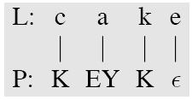

Alignment
Letters: c h e c k e d
Phones: ch _ eh _ k _ t
Black et al Method 1:
  First scatter epsilons in all possible ways to cause letters and phones to align
  Then collect stats for P(phone|letter) and select best to generate new stats
  This iterated a number of times until settles (5-6)
  This is EM (expectation maximization) alg
1/5/07

Slide 58

Alignment
Black et al method 2
Hand specify which letters can be rendered as which phones
  C goes to k/ch/s/sh
  W goes to w/v/f, etc
  An actual list:
Once mapping table is created, find all valid alignments, find p(letter|phone), score all alignments, take best
1/5/07

Slide 59
Alignment
Some alignments will turn out to be really bad.
These are just the cases where pronunciation doesn’t match letters:
  Dept d ih p aa r t m ah n t
  CMU s iy eh m y uw
  Lieutenant l eh f t eh n ax n t (British)
Also foreign words
These can just be removed from alignment training
1/5/07

Slide 60
Building CART trees
Build a CART tree for each letter in alphabet (26 plus accented) using context of +-3 letters
# # # c h e c -> ch
c h e c k e d -> _
This produces 92-96% correct LETTER accuracy (58-75 word acc) for English
1/5/07

Slide 61
Improvements
Take names out of the training data
And acronyms
Detect both of these separately
And build special-purpose tools to do LTS for names and acronyms
1/5/07

Slide 62
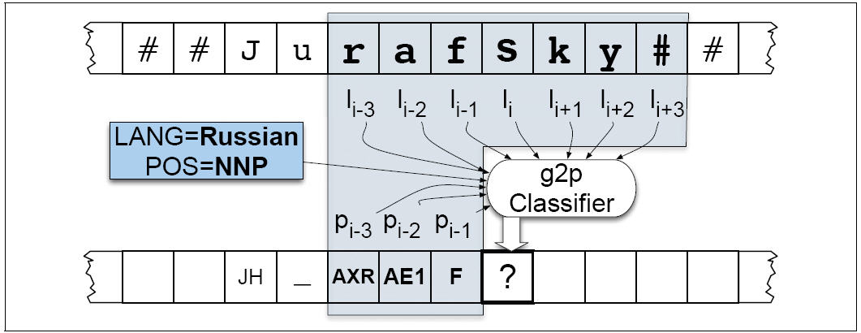
Add more features
1/5/07

Slide 63
Summary
Overview of Festival
  Where it lives, its components
  Its scripting language: Scheme
Finishing up Part of Speech Tagging
Phonetic Analysis
  Dictionaries
  Names
  Letter-to-Sound Rules
    (or “Grapheme-to-Phoneme Conversion”)
1/5/07

