Slide 1
CS 224S / LINGUIST 281
Speech Recognition, Synthesis, and Dialogue
Dan Jurafsky
Lecture 5: Prosodic Processing for TTS
IP Notice: many of the slides in the first half come from two lectures of Jennifer Venditti on intonation (thanks!); lots of other info in these slides comes from Alan Black’s and Richard Sproat’s lecture notes

Slide 2
Outline
Linguistic Background
  What is Prosody?
  Thinking about F0
  Intonational Prominence: Pitch Accents
  Intonational Boundaries/Phrasing
  Intonational Tunes
Producing Intonation in TTS
  Predicting Accents
  Predicting Boundaries
  Predicting Duration
  Generating F0
Advanced: The TOBI Prosodic Transcription Theory

Slide 3

Part I: Linguistic Background

Slide 4
I.1 Defining Intonation
Ladd (1996) “Intonational phonology”
“The use of suprasegmental phonetic features
  Suprasegmental = above and beyond the segment/phone
  F0
  Intensity (energy)
  Duration
to convey sentence-level pragmatic meanings”
  I.e. meanings that apply to phrases or utterances as a whole, not lexical stress, not lexical tone.

Slide 5
Three aspects of prosody
Prominence: some syllables/words are more prominent than others
Structure/boundaries: sentences have prosodic structure
  Some words group naturally together
  Others have a noticeable break or disjuncture between them
Tune: the intonational melody of an utterance.
From Ladd (1996)

Slide 6

Prosodic Prominence: Pitch Accents
A: What types of foods are a good source of vitamins?
B1: Legumes are a good source of VITAMINS.
B2: LEGUMES are a good source of vitamins.
Prominent syllables are:
  Louder
  Longer
  Have higher F0 and/or sharper changes in F0 (higher F0 velocity)
Slide from Jennifer Venditti

Slide 7
Prosodic Boundaries
I met Mary and Elena’s mother at the mall yesterday.
I met Mary and Elena’s mother at the mall yesterday.
French [bread and cheese]
[French bread] and [cheese]
Slide from Jennifer Venditti

Slide 8
Prosodic Tunes
Legumes are a good source of vitamins.
Are legumes a good source of vitamins?
Slide from Jennifer Venditti

Slide 9
Part I.2
Thinking about F0

Slide 10
Graphic representation of F0
F0 (in Hertz)
legumes are a good source of VITAMINS
time
Slide from Jennifer Venditti

Slide 11
The ‘ripples’
[ s ]
[ s ]
[ t ]
legumes are a good source of VITAMINS
F0 is not defined for consonants without vocal
fold vibration.
Slide from Jennifer Venditti

Slide 12
The ‘ripples’
[ g ]
[ z ]
[ g ]
[ v ]
legumes are a good source of VITAMINS
... and F0 can be perturbed by consonants with
an extreme constriction in the vocal tract.
Slide from Jennifer Venditti

Slide 13
Abstraction of the F0 contour
legumes are a good source of VITAMINS
Our perception of the intonation contour abstracts
away from these perturbations.
Slide from Jennifer Venditti

Slide 14
The ‘waves’ and the ‘swells’
‘wave’ = accent
‘swell’ = phrase
legumes are a good source of VITAMINS
Slide from Jennifer Venditti

Slide 15
Part I.3
Prominence:
Placement of Pitch Accents

Slide 16
Stress vs. accent
Stress is a structural property of a word
  it marks a potential (arbitrary) location for an accent to occur, if there is one.
Accent is a property of a word in context
  it is a way to mark intonational prominence in order to ‘highlight’ important words in the discourse.
(x) |  |  |  |  |  | (x) |  |  | (accented syll)
x |  |  |  |  |  | x |  |  | stressed syll
x |  |  |  | x |  | x |  |  | full vowels
x | x | x |  | x | x | x | x |  | syllables
vi | ta | mins |  | Ca | li | for | nia
Slide from Jennifer Venditti

Slide 17
Stress vs. accent (2)
The speaker decides to make the word vitamin more prominent by accenting it.
Lexical stress tell us that this prominence will appear on the first syllable, hence VItamin.
So we will have to look at both the lexicon and the context to predict the details of prominence
I’m a little surPRISED to hear it CHARacterized as upBEAT

Slide 18
Which word receives an accent?
It depends on the context.
  The ‘new’ information in the answer to a question is often accented
    while the ‘old’ information is usually not.
  Q1: What types of foods are a good source of vitamins?
  A1: LEGUMES are a good source of vitamins.
  Q2: Are legumes a source of vitamins?
  A2: Legumes are a GOOD source of vitamins.
  Q3: I’ve heard that legumes are healthy, but what are they a good source of ?
  A3: Legumes are a good source of VITAMINS.
Slide from Jennifer Venditti

Slide 19
Same ‘tune’, different alignment
LEGUMES are a good source of vitamins
The main rise-fall accent (= “I assert this”) shifts locations.
Slide from Jennifer Venditti

Slide 20
Same ‘tune’, different alignment
Legumes are a GOOD source of vitamins
The main rise-fall accent (= “I assert this”) shifts locations.
Slide from Jennifer Venditti

Slide 21
Same ‘tune’, different alignment
legumes are a good source of VITAMINS
The main rise-fall accent (= “I assert this”) shifts locations.
Slide from Jennifer Venditti

Slide 22
Levels of prominence
Most phrases have more than one accent
The last accent in a phrase is perceived as more prominent
  Called the Nuclear Accent
Emphatic accents like nuclear accent often used for semantic purposes, such as indicating that a word is contrastive, or the semantic focus.
  The kind of thing you uses ***s in IM, or capitalized letters
  ‘_x0005_I know SOMETHING interesting is sure to happen,’ she said to herself.
Can also have words that are less prominent than usual
  Reduced words, especially function words.
Often use 4 classes of prominence:
  Emphatic accent, pitch accent, unaccented, reduced

Slide 23
Part I.4
Intonational phrasing/boundaries

Slide 24
A single intonation phrase
legumes are a good source of vitamins
Broad focus statement consisting of one intonation phrase
(that is, one intonation tune spans the whole unit).
Slide from Jennifer Venditti

Slide 25
Multiple phrases
legumes are a good source of vitamins
Utterances can be ‘chunked’ up into smaller phrases
in order to signal the importance of information in each unit.
Slide from Jennifer Venditti

Slide 26
I wanted to go to London, but could only get tickets for France

Slide 27
Phrasing sometimes helps disambiguate
Global ambiguity:
    The old men and women stayed home.
    Sally saw the man with the binoculars.
    John doesn’t drink because he’s unhappy.
Slide from Jennifer Venditti

Slide 28
Phrasing can disambiguate
Global ambiguity:
    The old men and women stayed home.
    The old men % and women % stayed home.
    Sally saw % the man with the binoculars.
    Sally saw the man % with the binoculars.
    John doesn’t drink because he’s unhappy.
    John doesn’t drink % because he’s unhappy.
Slide from Jennifer Venditti

Slide 29
Phrasing sometimes helps disambiguate
Temporary ambiguity:
    When Madonna sings the song ...
Slide from Jennifer Venditti

Slide 30
Phrasing sometimes helps disambiguate
Temporary ambiguity:
    When Madonna sings the song is a hit.
Slide from Jennifer Venditti

Slide 31
Phrasing sometimes helps disambiguate
Temporary ambiguity:
    When Madonna sings % the song is a hit.
    When Madonna sings the song % it’s a hit.
    [from Speer & Kjelgaard (1992)]
Slide from Jennifer Venditti

Slide 32
Phrasing sometimes helps disambiguate
Mary & Elena’s mother
mall
I met Mary and Elena’s mother at the mall yesterday
One intonation phrase with relatively flat overall pitch range.
Slide from Jennifer Venditti

Slide 33
Phrasing sometimes helps disambiguate
Elena’s mother
mall
Mary
I met Mary and Elena’s mother at the mall yesterday
Separate phrases, with expanded pitch movements.
Slide from Jennifer Venditti

Slide 34
Part I.4 Intonational tunes

Slide 35
Yes-No question tune
are LEGUMES a good source of vitamins
Rise from the main accent to the end of the sentence.
Slide from Jennifer Venditti

Slide 36
Yes-No question tune
are legumes a GOOD source of vitamins
Rise from the main accent to the end of the sentence.
Slide from Jennifer Venditti

Slide 37
Yes-No question tune
are legumes a good source of VITAMINS
Rise from the main accent to the end of the sentence.
Slide from Jennifer Venditti

Slide 38
WH-questions
[I know that many natural foods are healthy, but ...]
WHAT are a good source of vitamins
WH-questions typically have falling contours, like statements.
Slide from Jennifer Venditti

Slide 39
Broad focus
“Tell me something about the world.”
legumes are a good source of vitamins
In the absence of narrow focus, English tends to mark the first
and last ‘content’ words with perceptually prominent accents.
Slide from Jennifer Venditti

Slide 40
Rising statements
“Tell me something I didn’t already know.”
legumes are a good source of vitamins
[... does this statement qualify?]
High-rising statements can signal that the speaker
is seeking approval.
Slide from Jennifer Venditti

Slide 41
Yes-No question
are legumes a good source of VITAMINS
Rise from the main accent to the end of the sentence.
Slide from Jennifer Venditti

Slide 42
‘Surprise-redundancy’ tune
[How many times do I have to tell you ...]
legumes are a good source of vitamins
Low beginning followed by a gradual rise to a high at the end.
Slide from Jennifer Venditti

Slide 43
‘Contradiction’ tune
“I’ve heard that linguini is a good source of vitamins.”
linguini isn’t a good source of vitamins
[... how could you think that?]
Sharp fall at the beginning, flat and low, then rising at the end.
Slide from Jennifer Venditti

Slide 44
Part 2: Using Intonation in TTS
Prominence/Accent: Decide which words are accented, which syllable has accent, what sort of accent
Boundaries: Decide where intonational boundaries are
Duration: Specify length of each segment
F0: Generate F0 contour from these

Slide 45
TOPIC II.1
Predicting pitch accent

Slide 46
Factors in accent prediction
Part of speech:
  Content words are usually accented
  Function words are rarely accented
    Of, for, in on, that, the, a, an, no, to, and but or will may would can her is their its our there is am are was were, etc

Slide 47
Simplest possible algorithm for pitch accent assignment
(set! simple_accent_cart_tree
‘
(
(R:SylStructure.parent.gpos is content)
( (stress is 1)
((Accented))
((NONE))
)
)
)

Slide 48
But not just function/content:
A Broadcast News example from Hirschberg (1993)
SUN MICROSYSTEMS INC, the UPSTART COMPANY that HELPED LAUNCH the DESKTOP COMPUTER industry TREND TOWARD HIGH powered WORKSTATIONS, was UNVEILING an ENTIRE OVERHAUL of its PRODUCT LINE TODAY. SOME of the new MACHINES, PRICED from FIVE THOUSAND NINE hundred NINETY five DOLLARS to seventy THREE thousand nine HUNDRED dollars, BOAST SOPHISTICATED new graphics and DIGITAL SOUND TECHNOLOGIES, HIGHER SPEEDS AND a CIRCUIT board that allows FULL motion VIDEO on a COMPUTER SCREEN.

Slide 49
Factors in accent prediction
Contrast
  Legumes are poor source of VITAMINS
  No, legumes are a GOOD source of vitamins
  I think JOHN or MARY should go
  No, I think JOHN AND MARY should go

Slide 50
List intonation
I went and saw ANNA, LENNY, MARY, and NORA.

Slide 51
Word order
Preposed items are accented more frequently
TODAY we will BEGIN to LOOK at FROG anatomy.
We will BEGIN to LOOK at FROG anatomy today.

Slide 52
Information Status
New versus old information.
Old information is deaccented
There are LAWYERS, and there are GOOD lawyers
EACH NATION DEFINES its OWN national INTERST.
I LIKE GOLDEN RETRIEVERS, but MOST dogs LEAVE me COLD.

Slide 53
Complex Noun Phrase Structure
Sproat, R. 1994. English noun-phrase accent prediction for text-to-speech. Computer Speech and Language 8:79-94.
Proper Names, stress on right-most word
  New York CITY; Paris, FRANCE
Adjective-Noun combinations, stress on noun
  Large HOUSE, red PEN, new NOTEBOOK
Noun-Noun compounds: stress left noun
  HOTdog (food) versus HOT DOG (overheated animal)
  WHITE house (place) versus WHITE HOUSE (made of stucco)
examples:
  MEDICAL Building, APPLE cake, cherry PIE.
  What about: Madison avenue, park street ??
Some Rules
  Furniture+Room -> RIGHT (e.g., kitchen TABLE)
  Proper-name + Street -> LEFT (e.g. PARK street)

Slide 54
Other features
POS
POS of previous word
POS of next word
Stress of current, previous, next syllable
Unigram probability of word
Bigram probability of word
Position of word in sentence

Slide 55

Advanced features
Accent is often deflected away from a word due to focus on a neighboring word.
Could use syntactic parallelism to detect this kind of contrastive focus:
  ……driving [FIFTY miles] an hour in a [THIRTY mile] zone
  [WELD] [APPLAUDS] mandatory recycling. [SILBER] [DISMISSES] recycling goals as meaningless.
  …but while Weld may be [LONG] on people skills, he may be [SHORT] on money

Slide 56
State of the art
Hand-label large training sets
Use CART, SVM, CRF, etc to predict accent
Lots of rich features from context
Classic lit:
  Hirschberg, Julia. 1993. Pitch Accent in context: predicting intonational prominence from text. Artificial Intelligence 63, 305-340

Slide 57
TOPIC II.2
Predicting boundaries

Slide 58
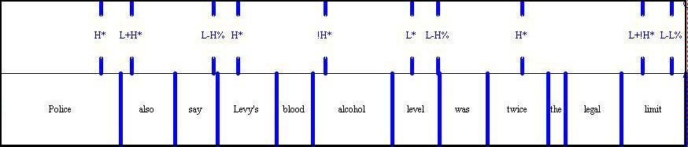
Predicting Boundaries
Intonation phrase boundaries
  Intermediate phrase boundaries
  Full intonation phrase boundaries
⬇
⬇
⬇

Slide 59
More examples
Ostendorf and Veilleux. 1994 “Hierarchical Stochastic model for Automatic Prediction of Prosodic Boundary Location”, Computational Linguistics 20:1
Computer phone calls, || which do everything | from selling magazine subscriptions || to reminding people about meetings || have become the telephone equivalent | of junk mail. ||
Doctor Norman Rosenblatt, || dean of the college | of criminal justice at Northeastern University, || agrees.||
For WBUR, || I’m Margo Melnicove.

Slide 60
Simplest CART
(set! simple_phrase_cart_tree
'
((lisp_token_end_punc in ("?" "." ":"))
((BB))
((lisp_token_end_punc in ("'" "\"" "," ";"))
((B))
((n.name is 0) ;; end of utterance
((BB))
((NB))))))

Slide 61
More complex features
Ostendorf and Veilleux
English: boundaries are more likely between content words and function words
Syntactic structure (parse trees)
  Largest syntactic category dominating preceding word but not succeeding word
  How many syntactic units begin/end between words
Type of function word to right
Capitalized names
# of content words since previous function word

Slide 62
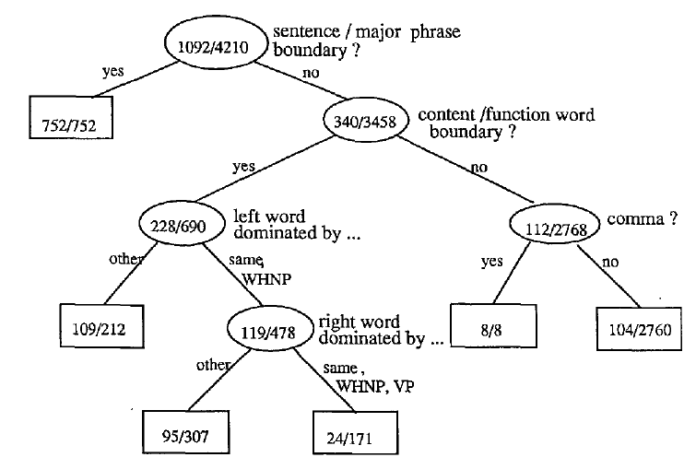
Ostendorf and Veilleux CART

Slide 63
TOPIC II.3
Predicting duration

Slide 64
Duration
Simplest: fixed size for all phones (100 ms)
Next simplest: average duration for that phone (from training data). Samples from SWBD in ms:
  aa 118 b 68
  ax 59 d 68
  ay 138 dh 44
  eh 87 f 90
  ih 77 g 66
Next Next Simplest: add in phrase-final and initial lengthening plus stress

Slide 65
Klatt duration rules
Models how context-neutral duration of a phone lengthened/shortened by context
  While staying above a min duration d_{min}
Prepausal lengthening:
  The vowel or syllabic consonant in the syllable before a pause is lengthened by 1.4
Non-phrase-final shortening
  Segments which are not phrase-final are shortened by 0.6. Phrase-final postvocalic liquids and nasals are lengthened by 1.4
Unstressed shortening
  Unstressed segments are more compressible, so their minimum duration d_{min} is halved, and are shortened by .7 for most phone types.
Lengthening for accent
  A vowel which bears accent is lengthened by 1.4
Shortening in clusters
  A consonant followed by a consonant is shortened by 0.5
Pre-voiceless shortening
  Vowels are shortened before a voiceless plosive by 0.7

Slide 66
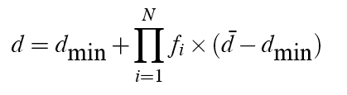
Klatt duration rules
Klatt formula for phone durations:
Festival: 2 options
  Klatt rules
  Use labeled training set with Klatt features to train CART
    Identity of the left and right context phone
    Lexical stress and accent values of current phone
    Position in syllable, word, phrase
    Following pause

Slide 67
Duration: state of the art
Lots of fancy models of duration prediction:
  Using Z-scores and other clever normalizations
  Sum-of-products model
  New features like word predictability
    Words with higher bigram probability are shorter

Slide 68
Duration in Festival
(set! spanish_dur_tree
'
((R:SylStructure.parent.R:Syllable.p.syl_break > 1 ) ;; clause initial
((R:SylStructure.parent.stress is 1)
((1.5))
((1.2)))
((R:SylStructure.parent.syl_break > 1) ;; clause final
((R:SylStructure.parent.stress is 1)
((2.0))
((1.5)))
((R:SylStructure.parent.stress is 1)
((1.2))
((1.0))))))

Slide 69
TOPIC II.4
F0 Generation

Slide 70
F0 Generation
Generation in Festival
  F0 Generation by rule
  F0 Generation by linear regression
Some constraints
  F0 is constrained by accents and boundaries
  F0 declines gradually over an utterance (“declination”)

Slide 71
F0 Generation by rule
Generate a list of target F0 points for each syllable
Here’s a rule to generate a simple H* “hat” accent (with fixed = speaker-specific F0 values):
(define (targ_func1 utt syl)
"(targ_func1 UTT STREAMITEM)
Returns a list of targets for the given syllable."
(let ((start (item.feat syl 'syllable_start))
(end (item.feat syl 'syllable_end)))
(if (equal? (item.feat syl "R:Intonation.daughter1.name") "Accented")
(list
(list start 110)
(list (/ (+ start end) 2.0) 140)
(list end 100)))))

Slide 72
F0 generation by regression
Supervised machine learning again
We predict: value of F0 at 3 places in each syllable
Predictor features:
  Accent of current word, next word, previous
  Boundaries
  Syllable type, phonetic information
  Stress information
Need training sets with pitch accents labeled
F0 is generally defined relative to pitch range
  A speaker’s pitch range is the range between
    Baseline frequency: lowest freq in a particular utterence
    Topline frequency: highest freq in a particular utterance

Slide 73
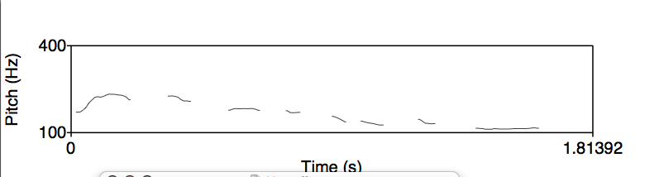
Declination
F0 tends to decline throughout a sentence

Slide 74
Advanced:
Intonational
Transcription Theories:
ToBI and Tilt

Slide 75
ToBI: Tones and Break Indices
Pitch accent tones
  H* “peak accent”
  L* “low accent”
  L+H* “rising peak accent” (contrastive)
  L*+H ‘scooped accent’
  H+!H* downstepped high
Boundary tones
  L-L% (final low; Am Eng. Declarative contour)
  L-H% (continuation rise)
  H-H% (yes-no queston)
Break indices
  0: clitics, 1, word boundaries, 2 short pause
  3 intermediate intonation phrase
  4 full intonation phrase/final boundary.

Slide 76
Examples of the TOBI system
I don’t eat beef.
L* L* L*L-L%
Marianna made the marmalade.
H* L-L%
L* H-H%
“I” means insert.
H* H* H*L-L%
1
H*L- H*L-L%
3
Slide from Lavoie and Podesva

Slide 77
ToBI
http://www.ling.ohio-state.edu/~tobi/
TOBI for American English
  http://www.ling.ohio-state.edu/~tobi/ame_tobi/
Silverman, K., Beckman, M., Pitrelli, J., Ostendorf, M., Wightman, C., Price, P., Pierrehumbert, J., and Hirschberg, J. (1992). ToBI: a standard for labelling English prosody. In Proceedings of ICSLP92, volume 2, pages 867-870
Pitrelli, J. F., Beckman, M. E., and Hirschberg, J. (1994). Evaluation of prosodic transcription labeling reliability in the ToBI framework. In ICSLP94, volume 1, pages 123-126
Pierrehumbert, J., and J. Hirschberg (1990) The meaning of intonation contours in the interpretation of discourse. In P. R. Cohen, J.Morgan, and M. E. Pollack, eds., Plans and Intentions inCommunication and Discourse, 271-311. MIT Press.
Beckman and Elam. Guidelines for ToBI Labelling. Web.

Slide 78
Tilt
Taylor (2000)
Like ToBI,
  has sequences of intonational events
  Accents and boundary tones
Unlike ToBI,
  not based on discrete classes
  Continuous parameters representing F0 shape

Slide 79


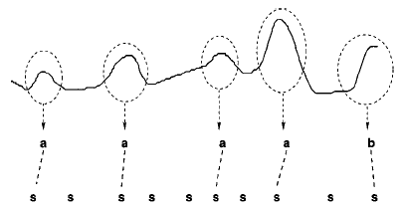
Tilt
Each accent in tilt has a (possibly zero) rise followed by a (possibly zero) fall
Tilt values:
  0 equal rise and fall
  1.0 rise
  -1.0 fall
  -0.5 rise w/larger fall

Slide 80
Summary
Linguistics of Prosody
  Prominence
  Boundaries
  Tune
Producing Intonation in TTS
  Predicting Accents
  Predicting Boundaries
  Predicting Duration
  Generating F0

Slide 81
Jennifer Venditti’s References
Jennifer’s list of introductory readings on intonational form and function:
Bolinger, D. (1972) Intonation [introduction and chapter 1]. Penguin Books, Ltd.
Ladd, D.R. (1996) Intonational Phonology. Cambridge Univ. Press.
Kadmon, N. (2001) Formal Pragmatics [chapter 12]. Blackwell Publ.
Beckman, M. & J. Pierrehumbert (1986) Intonational structure in Japanese and English. Phonology Yearbook 3: 255-309.
Pierrehumbert, J. & Hirschberg (1990) The meaning of intonational contours in interpretation of discourse. In Cohen, et al. (eds.) Intentions in Communication. MIT Press.
.

