Slide 1
CS 224S / LINGUIST 281
Speech Recognition, Synthesis, and Dialogue
Dan Jurafsky
Lecture 6: Waveform Synthesis
(in Concatenative TTS)
IP Notice: many of these slides come directly from Richard Sproat’s slides, and others (and some of Richard’s) come from Alan Black’s excellent TTS lecture notes. A couple also from Paul Taylor

Slide 2
Goal of Today’s Lecture
Given:
  String of phones
  Prosody
    Desired F0 for entire utterance
    Duration for each phone
    Stress value for each phone, possibly accent value
Generate:
  Waveforms

Slide 3
Outline: Waveform Synthesis in Concatenative TTS
Diphone Synthesis
Break: Final Projects
Unit Selection Synthesis
  Target cost
  Unit cost
Joining
  Dumb
  PSOLA

Slide 4

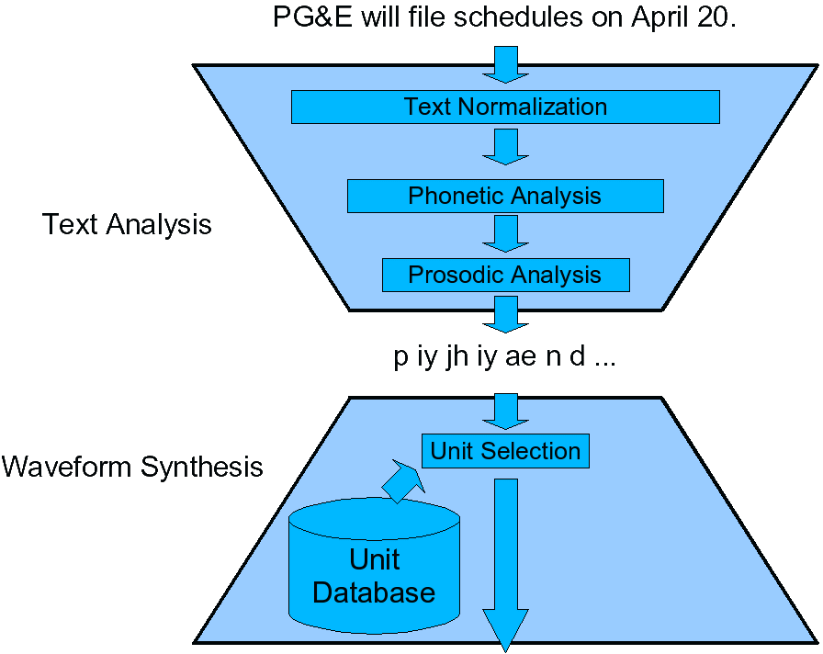
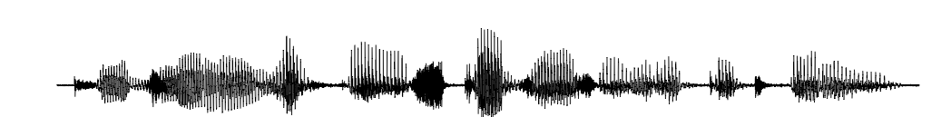
The hourglass architecture

Slide 5
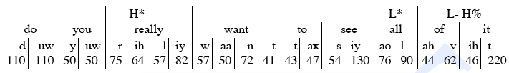
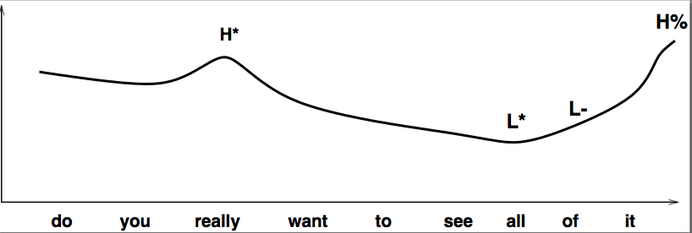
Internal Representation:
Input to Waveform Wynthesis

Slide 6
Diphone TTS architecture
Training:
  Choose units (kinds of diphones)
  Record 1 speaker saying 1 example of each diphone
  Mark the boundaries of each diphones,
    cut each diphone out and create a diphone database
Synthesizing an utterance,
  grab relevant sequence of diphones from database
  Concatenate the diphones, doing slight signal processing at boundaries
  use signal processing to change the prosody (F0, energy, duration) of selected sequence of diphones

Slide 7
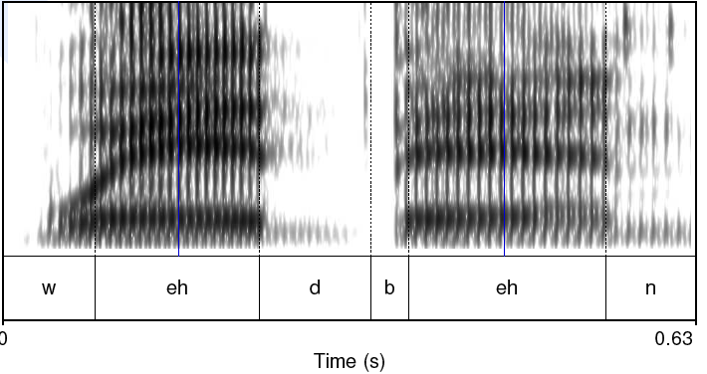
Diphones
Mid-phone is more stable than edge:

Slide 8
Diphones
mid-phone is more stable than edge
Need O(phone²) number of units
  Some combinations don’t exist (hopefully)
  ATT (Olive et al. 1998) system had 43 phones
    1849 possible diphones
    Phonotactics ([h] only occurs before vowels), don’t need to keep diphones across silence
    Only 1172 actual diphones
  May include stress, consonant clusters
    So could have more
  Lots of phonetic knowledge in design
Database relatively small (by today’s standards)
  Around 8 megabytes for English (16 KHz 16 bit)
Slide from Richard Sproat

Slide 9
Voice
Speaker
  Called a voice talent
Diphone database
  Called a voice

Slide 10
Designing a diphone inventory:
Nonsense words
Build set of carrier words:
  pau t aa b aa b aa pau
  pau t aa m aa m aa pau
  pau t aa m iy m aa pau
  pau t aa m iy m aa pau
  pau t aa m ih m aa pau
Advantages:
  Easy to get all diphones
  Likely to be pronounced consistently
    No lexical interference
Disadvantages:
  (possibly) bigger database
  Speaker becomes bored
Slide from Richard Sproat

Slide 11
Designing a diphone inventory:
Natural words
Greedily select sentences/words:
  Quebecois arguments
  Brouhaha abstractions
  Arkansas arranging
Advantages:
  Will be pronounced naturally
  Easier for speaker to pronounce
  Smaller database? (505 pairs vs. 1345 words)
Disadvantages:
  May not be pronounced correctly
Slide from Richard Sproat

Slide 12
Making recordings consistent:
Diiphone should come from mid-word
  Help ensure full articulation
Performed consistently
  Constant pitch (monotone), power, duration
Use (synthesized) prompts:
  Helps avoid pronunciation problems
  Keeps speaker consistent
  Used for alignment in labeling
Slide from Richard Sproat

Slide 13
Building diphone schemata
Find list of phones in language:
  Plus interesting allophones
  Stress, tons, clusters, onset/coda, etc
  Foreign (rare) phones.
Build carriers for:
  Consonant-vowel, vowel-consonant
  Vowel-vowel, consonant-consonant
  Silence-phone, phone-silence
  Other special cases
Check the output:
  List all diphones and justify missing ones
  Every diphone list has mistakes
Slide from Richard Sproat

Slide 14
Recording conditions
Ideal:
  Anechoic chamber
  Studio quality recording
  EGG signal
More likely:
  Quiet room
  Cheap microphone/sound blaster
  No EGG
  Headmounted microphone
What we can do:
  Repeatable conditions
  Careful setting on audio levels
Slide from Richard Sproat

Slide 15
Labeling Diphones
Run a speech recognizer in forced alignment mode
  Forced alignment:
    A trained ASR system
    A wavefile
    A word transcription of the wavefile
    Returns an alignment of the phones in the words to the wavefile.
Much easier than phonetic labeling:
  The words are defined
  The phone sequence is generally defined
  They are clearly articulated
  But sometimes speaker still pronounces wrong, so need to check.
Phone boundaries less important
  +- 10 ms is okay
Midphone boundaries important
  Where is the stable part
  Can it be automatically found?
Slide from Richard Sproat

Slide 16
Diphone auto-alignment
Given
  synthesized prompts
  Human speech of same prompts
Do a dynamic time warping alignment of the two
  Using Euclidean distance
Works very well 95%+
  Errors are typically large (easy to fix)
  Maybe even automatically detected
Malfrere and Dutoit (1997)
Slide from Richard Sproat

Slide 17
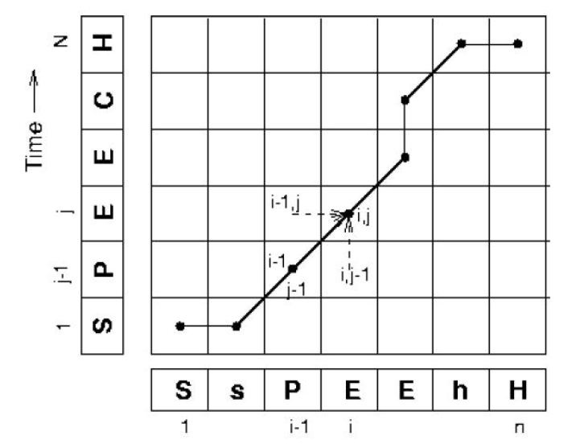
Dynamic Time Warping
Slide from Richard Sproat

Slide 18
Finding diphone boundaries
Stable part in phones
  For stops: one third in
  For phone-silence: one quarter in
  For other diphones: 50% in
In time alignment case:
  Given explicit known diphone boundaries in prompt in the label file
  Use dynamic time warping to find same stable point in new speech
Optimal coupling
  Taylor and Isard 1991, Conkie and Isard 1996
  Instead of precutting the diphones
    Wait until we are about to concatenate the diphones together
    Then take the 2 complete (uncut diphones)
    Find optimal join points by measuring cepstral distance at potential join points, pick best
Slide modified from Richard Sproat

Slide 19
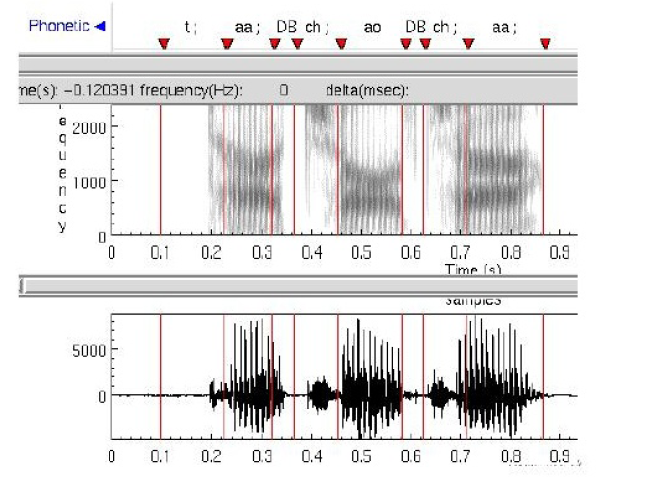
Diphone boundaries in stops
Slide from Richard Sproat

Slide 20
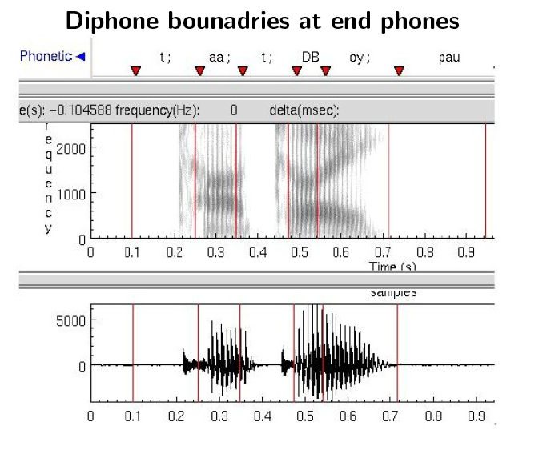
Diphone boundaries in end phones
Slide from Richard Sproat

Slide 21
Concatenating diphones: junctures
If waveforms are very different, will perceive a click at the junctures
  So need to window them
Also if both diphones are voiced
  Need to join them pitch-synchronously
That means we need to know where each pitch period begins, so we can paste at the same place in each pitch period.
  Pitch marking or epoch detection: mark where each pitch pulse or epoch occurs
    Finding the Instant of Glottal Closure (IGC)
  (note difference from pitch tracking)

Slide 22
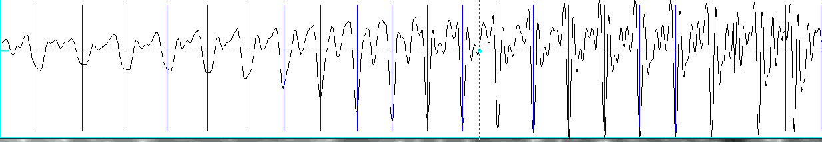
Epoch-labeling
An example of epoch-labeling useing “SHOW PULSES” in Praat:

Slide 23
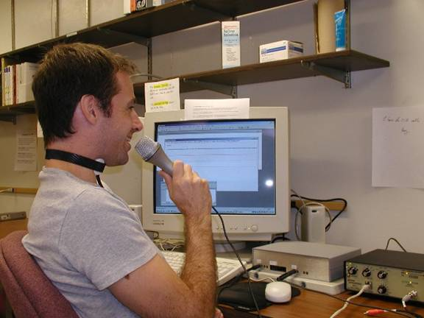
Epoch-labeling: Electroglottograph (EGG)
Also called laryngograph or Lx
  Device that straps on speaker’s neck near the larynx
  Sends small high frequency current through adam’s apple
  Human tissue conducts well; air not as well
  Transducer detects how open the glottis is (I.e. amount of air between folds) by measuring impedence.
Picture from UCLA Phonetics Lab

Slide 24
Less invasive way to do epoch-labeling
Signal processing
  E.g.:
  BROOKES, D. M., AND LOKE, H. P. 1999. Modelling energy flow in the vocal tract with applications to glottal closure and opening detection. In ICASSP 1999.

Slide 25
Prosodic Modification
Modifying pitch and duration independently
Changing sample rate modifies both:
  Chipmunk speech
Duration: duplicate/remove parts of the signal
Pitch: resample to change pitch
Text from Alan Black

Slide 26
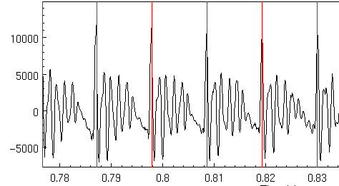
Speech as Short Term signals
Alan Black

Slide 27
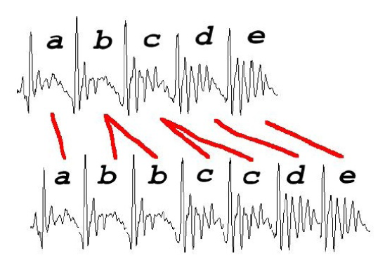
Duration modification
Duplicate/remove short term signals
Slide from Richard Sproat

Slide 28
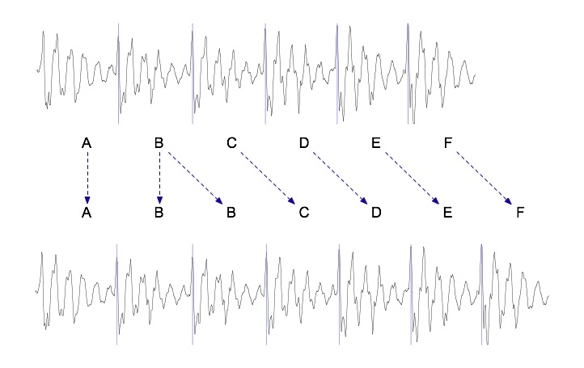
Duration modification
Duplicate/remove short term signals

Slide 29
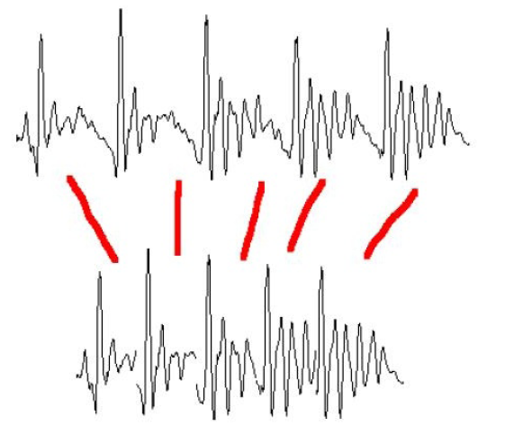
Pitch Modification
Move short-term signals closer together/further apart
Slide from Richard Sproat

Slide 30
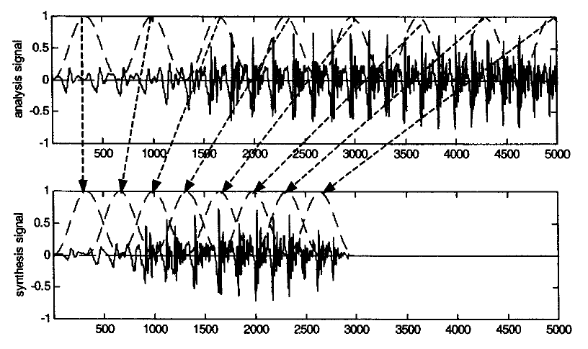
Overlap-and-add (OLA)
Huang, Acero and Hon

Slide 31
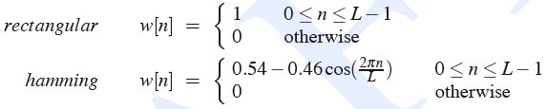
Windowing
Multiply value of signal at sample number n by the value of a windowing function
y[n] = w[n]s[n]

Slide 32
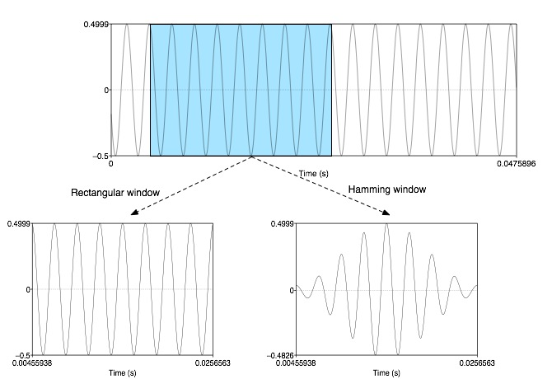
Windowing
y[n] = w[n]s[n]

Slide 33
Overlap and Add (OLA)
Hanning windows of length 2N used to multiply the analysis signal
Resulting windowed signals are added
Analysis windows, spaced 2N
Synthesis windows, spaced N
Time compression is uniform with factor of 2
Pitch periodicity somewhat lost around 4th window
Huang, Acero, and Hon

Slide 34
TD-PSOLA ™
Time-Domain Pitch Synchronous Overlap and Add
Patented by France Telecom (CNET)
Very efficient
  No FFT (or inverse FFT) required
Can modify Hz up to two times or by half
Slide from Richard Sproat

Slide 35
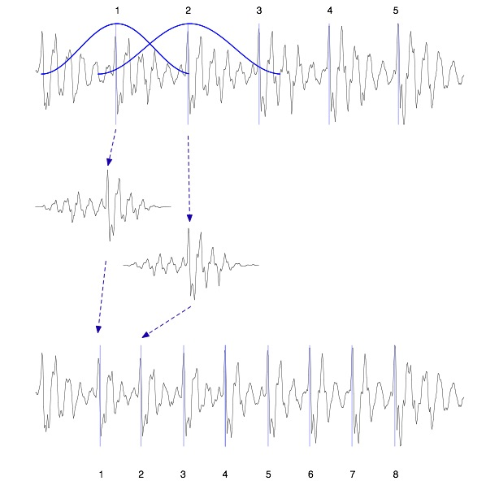
TD-PSOLA ™
Windowed
Pitch-synchronous
Overlap-
-and-add

Slide 36
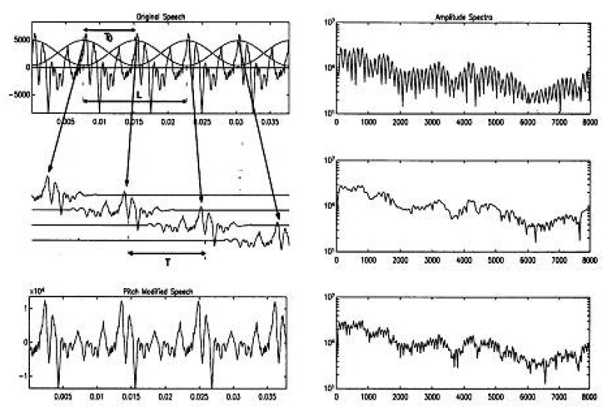
TD-PSOLA ™
Thierry Dutoit

Slide 37
Summary: Diphone Synthesis
Well-understood, mature technology
Augmentations
  Stress
  Onset/coda
  Demi-syllables
Problems:
  Signal processing still necessary for modifying durations
  Source data is still not natural
  Units are just not large enough; can’t handle word-specific effects, etc

Slide 38
Problems with diphone synthesis
Signal processing methods like TD-PSOLA leave artifacts, making the speech sound unnatural
Diphone synthesis only captures local effects
  But there are many more global effects (syllable structure, stress pattern, word-level effects)

Slide 39
Unit Selection Synthesis
Generalization of the diphone intuition
  Larger units
    From diphones to sentences
  Many many copies of each unit
    10 hours of speech instead of 1500 diphones (a few minutes of speech)
  Little or no signal processing applied to each unit
    Unlike diphones

Slide 40
Why Unit Selection Synthesis
Natural data solves problems with diphones
  Diphone databases are carefully designed but:
    Speaker makes errors
    Speaker doesn’t speak intended dialect
    Require database design to be right
  If it’s automatic
    Labeled with what the speaker actually said
    Coarticulation, schwas, flaps are natural
“There’s no data like more data”
  Lots of copies of each unit mean you can choose just the right one for the context
  Larger units mean you can capture wider effects

Slide 41
Unit Selection Intuition
Given a big database
For each segment (diphone) that we want to synthesize
  Find the unit in the database that is the best to synthesize this target segment
What does “best” mean?
  “Target cost”: Closest match to the target description, in terms of
    Phonetic context
    F0, stress, phrase position
  “Join cost”: Best join with neighboring units
    Matching formants + other spectral characteristics
    Matching energy
    Matching F0

Slide 42
Targets and Target Costs
A measure of how well a particular unit in the database matches the internal representation produced by the prior stages
Features, costs, and weights
Examples:
  /ih-t/ from stressed syllable, phrase internal, high F0, content word
  /n-t/ from unstressed syllable, phrase final, low F0, content word
  /dh-ax/ from unstressed syllable, phrase initial, high F0, from function word “the”
Slide from Paul Taylor

Slide 43
Target Costs
Comprised of k subcosts
  Stress
  Phrase position
  F0
  Phone duration
  Lexical identity
Target cost for a unit:
Slide from Paul Taylor

Slide 44
How to set target cost weights (1)
What you REALLY want as a target cost is the perceivable acoustic difference between two units
But we can’t use this, since the target is NOT ACOUSTIC yet, we haven’t synthesized it!
We have to use features that we get from the TTS upper levels (phones, prosody)
But we DO have lots of acoustic units in the database.
We could use the acoustic distance between these to help set the WEIGHTS on the acoustic features.

Slide 45
How to set target cost weights (2)
Clever Hunt and Black (1996) idea:
Hold out some utterances from the database
Now synthesize one of these utterances
  Compute all the phonetic, prosodic, duration features
  Now for a given unit in the output
  For each possible unit that we COULD have used in its place
  We can compute its acoustic distance from the TRUE ACTUAL HUMAN utterance.
  This acoustic distance can tell us how to weight the phonetic/prosodic/duration features

Slide 46
How to set target cost weights (3)
Hunt and Black (1996)
Database and target units labeled with:
  phone context, prosodic context, etc.
Need an acoustic similarity between units too
Acoustic similarity based on perceptual features
  MFCC (spectral features) (to be defined next week)
  F0 (normalized)
  Duration penalty
Richard Sproat slide

Slide 47
How to set target cost weights (4)
Collect phones in classes of acceptable size
  E.g., stops, nasals, vowel classes, etc
Find AC between all of same phone type
Find C^{t} between all of same phone type
Estimate w_{1-j} using linear regression

Slide 48
How to set target cost weights (5)
Target distance is
For examples in the database, we can measure
Therefore, estimate weights w from all examples of
Use linear regression
Richard Sproat slide

Slide 49
Join (Concatenation) Cost
Measure of smoothness of join
Measured between two database units (target is irrelevant)
Features, costs, and weights
Comprised of k subcosts:
  Spectral features
  F0
  Energy
Join cost:
Slide from Paul Taylor

Slide 50
Join costs
Hunt and Black 1996
If u_{i-1}==prev(u_{i}) C^{c}=0
Used
  MFCC (mel cepstral features)
  Local F0
  Local absolute power
  Hand tuned weights

Slide 51
Join costs
The join cost can be used for more than just part of search
Can use the join cost for optimal coupling (Isard and Taylor 1991, Conkie 1996), i.e., finding the best place to join the two units.
  Vary edges within a small amount to find best place for join
  This allows different joins with different units
  Thus labeling of database (or diphones) need not be so accurate

Slide 52
Total Costs
Hunt and Black 1996
We now have weights (per phone type) for features set between target and database units
Find best path of units through database that minimize:
Standard problem solvable with Viterbi search with beam width constraint for pruning
Slide from Paul Taylor

Slide 53
Improvements
Taylor and Black 1999: Phonological Structure Matching
Label whole database as trees:
  Words/phrases, syllables, phones
For target utterance:
  Label it as tree
  Top-down, find subtrees that cover target
  Recurse if no subtree found
Produces list of target subtrees:
  Explicitly longer units than other techniques
Selects on:
  Phonetic/metrical structure
  Only indirectly on prosody
  No acoustic cost
Slide from Richard Sproat

Slide 54
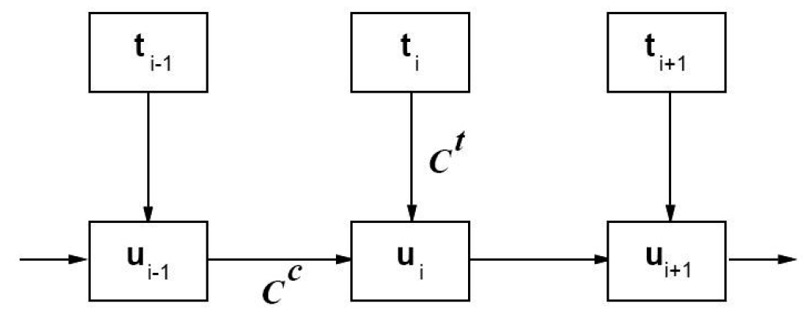
Unit Selection Search
Slide from Richard Sproat

Slide 55
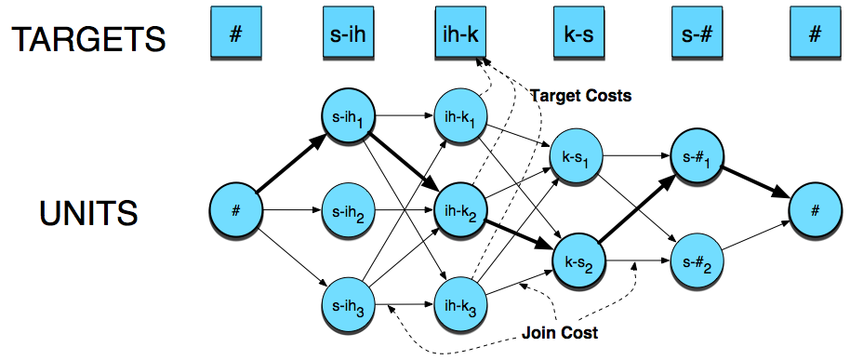

Slide 56
Database creation (1)
Good speaker
  Professional speakers are always better:
    Consistent style and articulation
    Although these databases are carefully labeled
  Ideally (according to AT&T experiments):
    Record 20 professional speakers (small amounts of data)
    Build simple synthesis examples
    Get many (200?) people to listen and score them
    Take best voices
  Correlates for human preferences:
    High power in unvoiced speech
    High power in higher frequencies
    Larger pitch range
Text from Paul Taylor and Richard Sproat

Slide 57
Database creation (2)
Good recording conditions
Good script
  Application dependent helps
    Good word coverage
    News data synthesizes as news data
    News data is bad for dialog.
  Good phonetic coverage, especially wrt context
  Low ambiguity
  Easy to read
Annotate at phone level, with stress, word information, phrase breaks
Text from Paul Taylor and Richard Sproat

Slide 58
Creating database
Unliked diphones, prosodic variation is a good thing
Accurate annotation is crucial
Pitch annotation needs to be very very accurate
Phone alignments can be done automatically, as described for diphones

Slide 59
Practical System Issues
Size of typical system (Rhetorical rVoice):
  ~300M
Speed:
  For each diphone, average of 1000 units to choose from, so:
  1000 target costs
  1000x1000 join costs
  Each join cost, say 30x30 float point calculations
  10-15 diphones per second
  10 billion floating point calculations per second
But commercial systems must run ~50x faster than real time
Heavy pruning essential: 1000 units -> 25 units
Slide from Paul Taylor

Slide 60
Unit Selection Summary
Advantages
  Quality is far superior to diphones
  Natural prosody selection sounds better
Disadvantages:
  Quality can be very bad in places
    HCI problem: mix of very good and very bad is quite annoying
  Synthesis is computationally expensive
  Can’t synthesize everything you want:
    Diphone technique can move emphasis
    Unit selection gives good (but possibly incorrect) result
Slide from Richard Sproat

Slide 61
Recap: Joining Units (+F0 + duration)
unit selection, just like diphone, need to join the units
  Pitch-synchronously
For diphone synthesis, need to modify F0 and duration
  For unit selection, in principle also need to modify F0 and duration of selection units
  But in practice, if unit-selection database is big enough (commercial systems)
    no prosodic modifications (selected targets may already be close to desired prosody)
Alan Black

Slide 62
Joining Units (just like diphones)
Dumb:
  just join
  Better: at zero crossings
TD-PSOLA
  Time-domain pitch-synchronous overlap-and-add
  Join at pitch periods (with windowing)
Alan Black

Slide 63
Evaluation of TTS
Intelligibility Tests
  Diagnostic Rhyme Test (DRT)
    Humans do listening identification choice between two words differing by a single phonetic feature
      Voicing, nasality, sustenation, sibilation
    96 rhyming pairs
    Veal/feel, meat/beat, vee/bee, zee/thee, etc
      Subject hears “veal”, chooses either “veal or “feel”
      Subject also hears “feel”, chooses either “veal” or “feel”
    % of right answers is intelligibility score.
Overall Quality Tests
  Have listeners rate space on a scale from 1 (bad) to 5 (excellent) (Mean Opinion Score)
AB Tests (prefer A, prefer B) (preference tests)
Huang, Acero, Hon

Slide 64
Recent stuff
Problems with Unit Selection Synthesis
  Can’t modify signal
  (mixing modified and unmodified sounds bad)
  But database often doesn’t have exactly what you want
Solution: HMM (Hidden Markov Model) Synthesis
  Won recent TTS bakeoffs.
  Sounds unnatural to researchers
  But naïve subjects preferred it
  Has the potential to improve on both diphone and unit selection.
  Is the future of TTS

Slide 65

HMM Synthesis, ~2007
Unit selection (Roger)
HMM (Roger)
Unit selection (Nina)
HMM (Nina)

Slide 66
Summary
Diphone Synthesis
Unit Selection Synthesis
  Target cost
  Unit cost
HMM Synthesis

