Slide 1
CS 224S / LINGUIST 281
Speech Recognition, Synthesis, and Dialogue
Dan Jurafsky
Lecture 6: Forward-Backward (Baum-Welch) and Word Error Rate
IP Notice:

Slide 2
Outline for Today
Speech Recognition Architectural Overview
Hidden Markov Models in general and for speech
  Forward
  Viterbi Decoding
How this fits into the ASR component of course
  July 27 (today): HMMs, Forward, Viterbi,
  Jan 29 Baum-Welch (Forward-Backward)
  Feb 3: Feature Extraction, MFCCs
  Feb 5: Acoustic Modeling and GMMs
  Feb 10: N-grams and Language Modeling
  Feb 24: Search and Advanced Decoding
  Feb 26: Dealing with Variation
  Mar 3: Dealing with Disfluencies

Slide 3
LVCSR
Large Vocabulary Continuous Speech Recognition
~20,000-64,000 words
Speaker independent (vs. speaker-dependent)
Continuous speech (vs isolated-word)

Slide 4
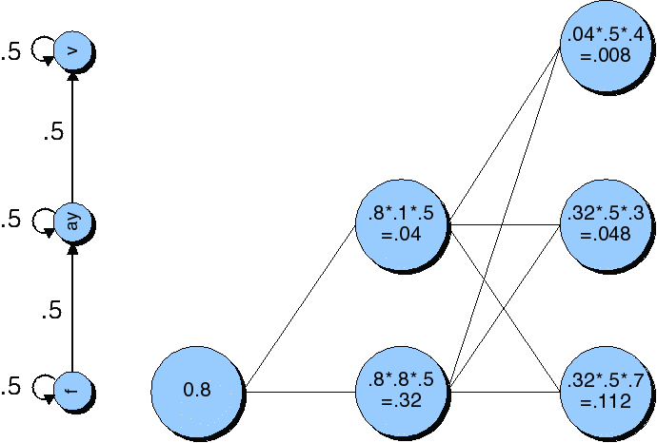
Viterbi trellis for “five”

Slide 5
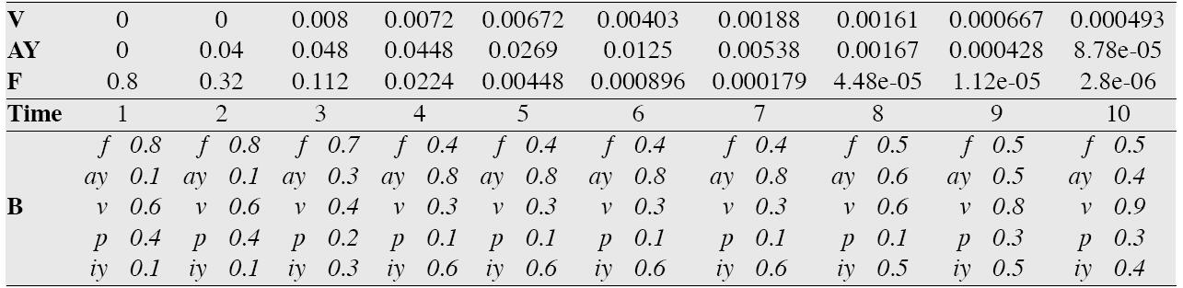
Viterbi trellis for “five”

Slide 6
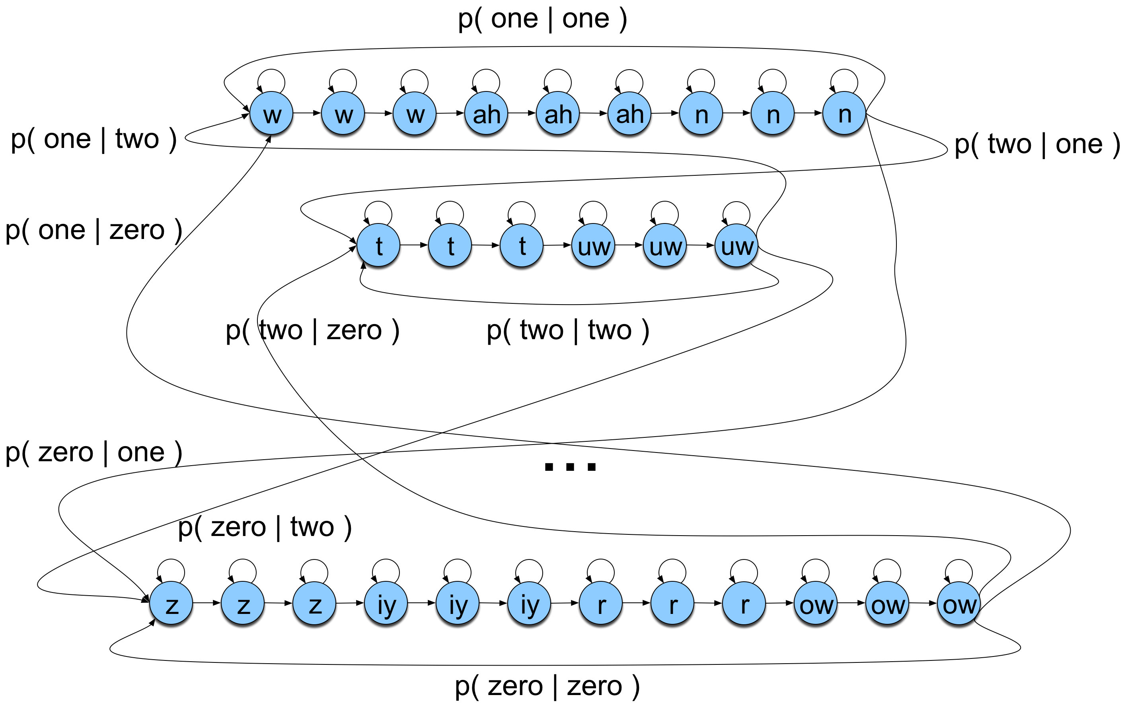
Search space with bigrams

Slide 7
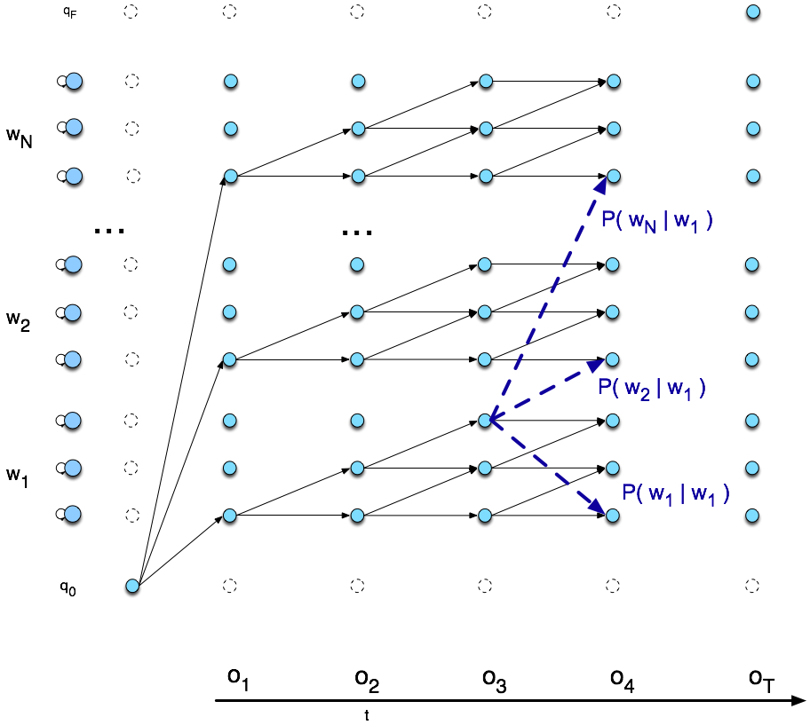
Viterbi trellis

Slide 8
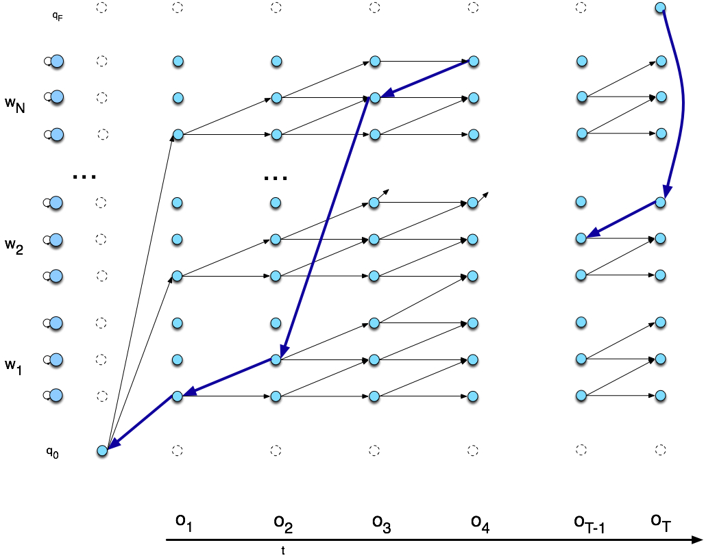
Viterbi backtrace

Slide 9
The Learning Problem
Baum-Welch = Forward-Backward Algorithm (Baum 1972)
Is a special case of the EM or Expectation-Maximization algorithm (Dempster, Laird, Rubin)
The algorithm will let us train the transition probabilities A= {a_{ij}} and the emission probabilities B={b_{i}(o_{t})} of the HMM

Slide 10
Input to Baum-Welch
O unlabeled sequence of observations
Q vocabulary of hidden states
For ice-cream task
  O = {1,3,2.,,,.}
  Q = {H,C}

Slide 11
Starting out with Observable Markov Models
How to train?
Run the model on observation sequence O.
Since it’s not hidden, we know which states we went through, hence which transitions and observations were used.
Given that information, training:
  B = {b_{k}(o_{t})}: Since every state can only generate one observation symbol, observation likelihoods B are all 1.0
  A = {a_{ij}}:

Slide 12
Extending Intuition to HMMs
For HMM, cannot compute these counts directly from observed sequences
Baum-Welch intuitions:
  Iteratively estimate the counts.
    Start with an estimate for a_{ij} and b_{k}, iteratively improve the estimates
  Get estimated probabilities by:
    computing the forward probability for an observation
    dividing that probability mass among all the different paths that contributed to this forward probability

Slide 13
The Backward algorithm
We define the backward probability as follows:
This is the probability of generating partial observations O_{t+1}^{T} from time t+1 to the end, given that the HMM is in state i at time t and of course given Φ.

Slide 14
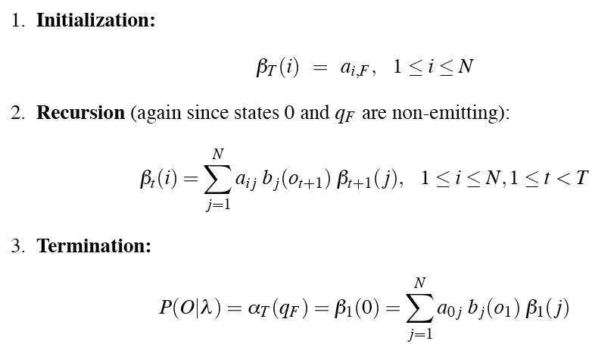
The Backward algorithm
We compute backward prob by induction:

Slide 15
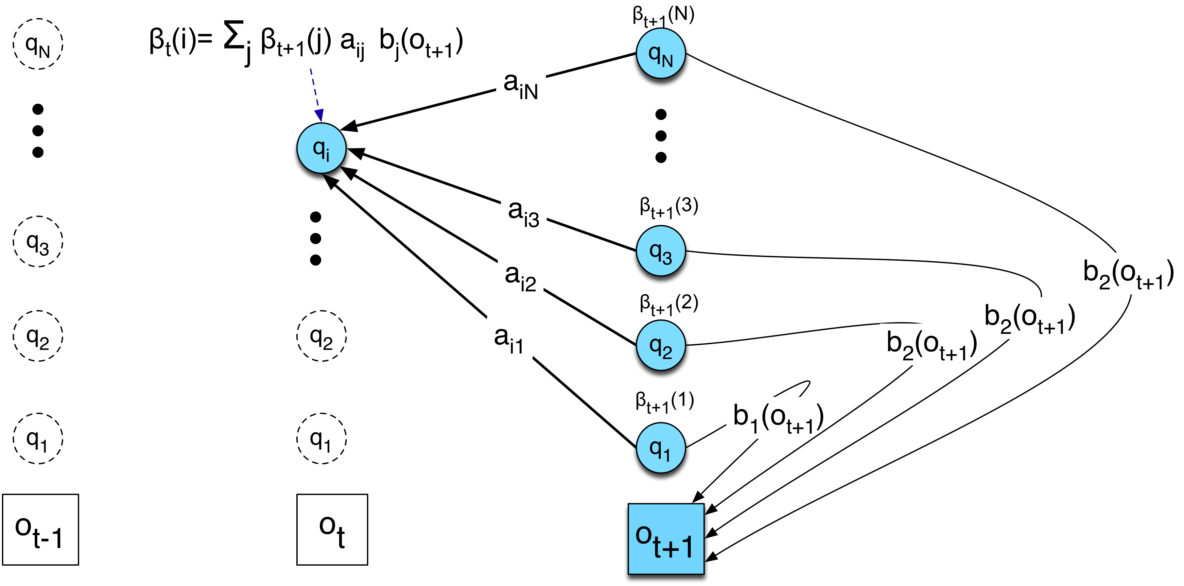
Inductive step of the backward algorithm
(figure inspired by Rabiner and Juang)
Computation of β_{t}(i) by weighted sum of all successive values β_{t+1}

Slide 16
Intuition for re-estimation of a_{ij}
We will estimate â_{ij} via this intuition:
Numerator intuition:
  Assume we had some estimate of probability that a given transition i➔j was taken at time t in observation sequence.
  If we knew this probability for each time t, we could sum over all t to get expected value (count) for i➔j.

Slide 17
Re-estimation of a_{ij}
Let ξ_{t} be the probability of being in state i at time t and state j at time t+1, given O_{1..T} and model Φ:
We can compute ξ from not-quite-ξ, which is:

Slide 18
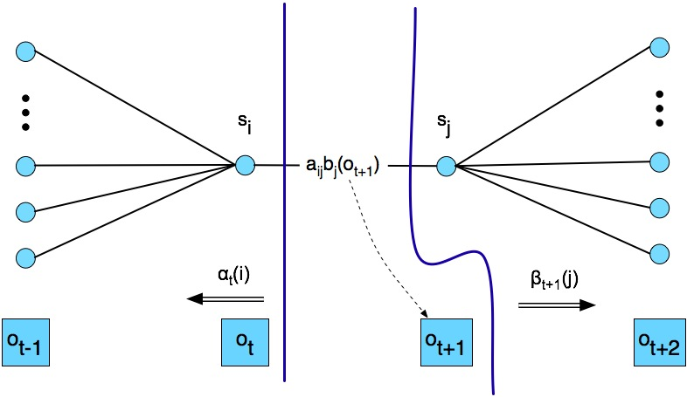
Computing not-quite-ξ

Slide 19
From not-quite-ξ to ξ
We want:
We’ve got:
Which we compute as follows:

Slide 20

From not-quite-ξ to ξ
We want:
We’ve got:
Since:
We need:

Slide 21
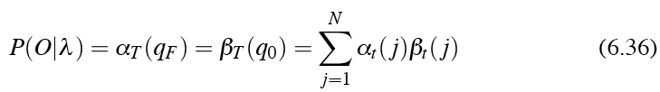

From not-quite-ξ to ξ

Slide 22

From ξ to a_{ij}
The expected number of transitions from state i to state j is the sum over all t of ξ
The total expected number of transitions out of state i is the sum over all transitions out of state i
Final formula for reestimated a_{ij}

Slide 23
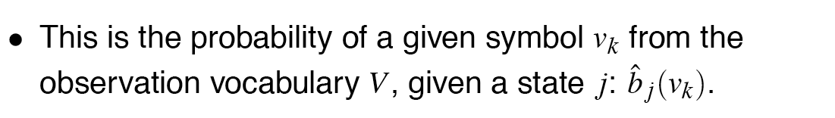




Re-estimating the observation likelihood b
We’ll need to know the probability of being in state j at time t:

Slide 24
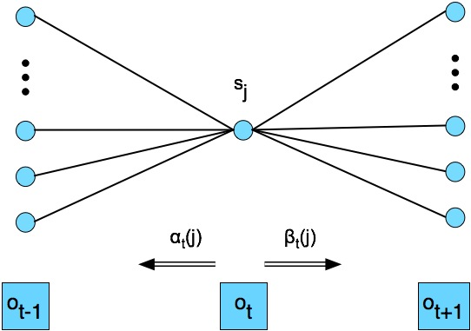
Computing γ (gamma)

Slide 25
Summary
The ratio between the expected number of transitions from state i to j and the expected number of all transitions from state i
The ratio between the expected number of times the observation data emitted from state j is v_{k}, and the expected number of times any observation is emitted from state j

Slide 26
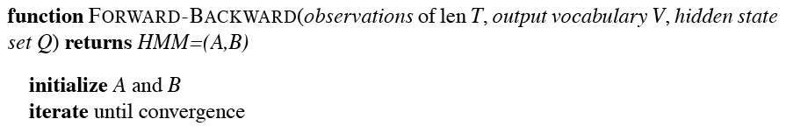
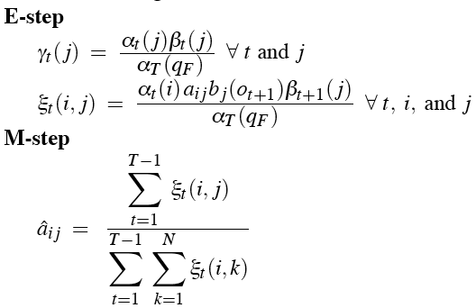
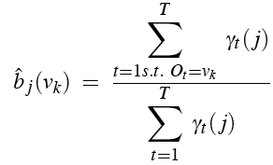

The Forward-Backward Alg

Slide 27
Summary: Forward-Backward Algorithm
Intialize Φ=(A,B)
Compute α, β, ξ
Estimate new Φ’=(A,B)
Replace Φ with Φ’
If not converged go to 2

Slide 28
Applying FB to speech: Caveats
Network structure of HMM is always created by hand
  no algorithm for double-induction of optimal structure and probabilities has been able to beat simple hand-built structures.
  Always Bakis network = links go forward in time
  Subcase of Bakis net: beads-on-string net:
Baum-Welch only guaranteed to return local max, rather than global optimum

Slide 29
Complete Embedded Training
Setting all the parameters in an ASR system
Given:
  training set: wavefiles & word transcripts for each sentence
  Hand-built HMM lexicon
Uses:
  Baum-Welch algorithm
We’ll return to this after we’ve introduced GMMs

Slide 30
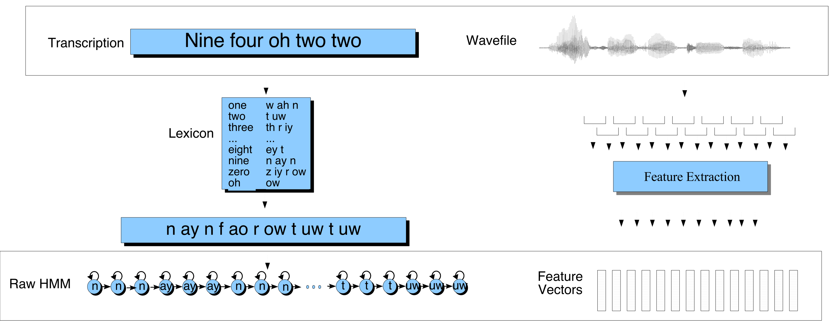
Embedded Training

Slide 31
What we are searching for
Given Acoustic Model (AM) and Language Model (LM):
AM (likelihood)
LM (prior)
(1)

Slide 32
Combining Acoustic and Language Models
We don’t actually use equation (1)
  AM underestimates acoustic probability
    Why? Bad independence assumptions
    Intuition: we compute (independent) AM probability estimates; but if we could look at context, we would assign a much higher probability. So we are underestimating
    We do this every 10 ms, but LM only every word.
    Besides: AM (as we’ve seen) isn’t a true probability
  AM and LM have vastly different dynamic ranges

Slide 33
Language Model Scaling Factor
Solution: add a language model weight (also called language weight LW or language model scaling factor LMSF
Value determined empirically, is positive (why?)
Often in the range 10 +- 5.

Slide 34
Word Insertion Penalty
But LM prob P(W) also functions as penalty for inserting words
  Intuition: when a uniform language model (every word has an equal probability) is used, LM prob is a 1/V penalty multiplier taken for each word
  Each sentence of N words has penalty N/V
  If penalty is large (smaller LM prob), decoder will prefer fewer longer words
  If penalty is small (larger LM prob), decoder will prefer more shorter words
When tuning LM for balancing AM, side effect of modifying penalty
So we add a separate word insertion penalty to offset

Slide 35
Log domain
We do everything in log domain
So final equation:

Slide 36
Language Model Scaling Factor
As LMSF is increased:
  More deletion errors (since increase penalty for transitioning between words)
  Fewer insertion errors
  Need wider search beam (since path scores larger)
  Less influence of acoustic model observation probabilities
Text from Bryan Pellom’s slides

Slide 37
Word Insertion Penalty
Controls trade-off between insertion and deletion errors
  As penalty becomes larger (more negative)
  More deletion errors
  Fewer insertion errors
Acts as a model of effect of length on probability
  But probably not a good model (geometric assumption probably bad for short sentences)
Text augmented from Bryan Pellom’s slides

Slide 38
Summary
Speech Recognition Architectural Overview
Hidden Markov Models in general
  Forward
  Viterbi Decoding
Hidden Markov models for Speech
Evaluation

