Slide 1
CS 224S / LINGUIST 281
Speech Recognition, Synthesis, and Dialogue
Dan Jurafsky
Lecture 9: Feature Extraction and start of Acoustic Modeling (VQ)
IP Notice:

Slide 2
Outline for Today
Speech Recognition Architectural Overview
Hidden Markov Models in general and for speech
  Forward
  Viterbi Decoding
How this fits into the ASR component of course
  Jan 27 HMMs, Forward, Viterbi,
  Jan 29 Baum-Welch (Forward-Backward)
  Feb 3: Feature Extraction, MFCCs, start of AM
  Feb 5: Acoustic Modeling and GMMs
  Feb 10: N-grams and Language Modeling
  Feb 24: Search and Advanced Decoding
  Feb 26: Dealing with Variation
  Mar 3: Dealing with Disfluencies

Slide 3
Outline for Today
Feature Extraction
  Mel-Frequency Cepstral Coefficients
Acoustic Model
  Increasingly sophisticated models
  Acoustic Likelihood for each state:
    Gaussians
    Multivariate Gaussians
    Mixtures of Multivariate Gaussians
  Where a state is progressively:
    CI Subphone (3ish per phone)
    CD phone (=triphones)
    State-tying of CD phone
Evaluation
  Word Error Rate

Slide 4
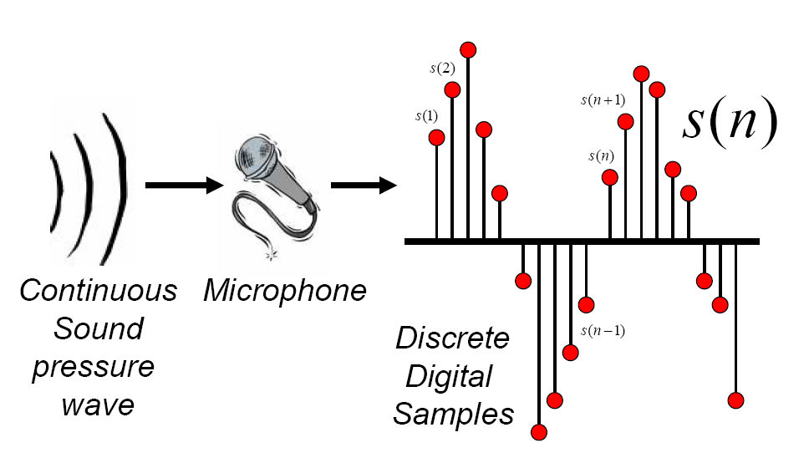
Discrete Representation of Signal
Represent continuous signal into discrete form.
Thanks to Bryan Pellom for this slide

Slide 5
Digitizing The Signal (A-D)
Sampling:
  measuring amplitude of signal at time t
  16,000 Hz (samples/sec) Microphone (“Wideband”):
  8,000 Hz (samples/sec) Telephone
  Why?
    Need at least 2 samples per cycle
    max measurable frequency is half sampling rate
    Human speech < 10,000 Hz, so need max 20K
    Telephone filtered at 4K, so 8K is enough

Slide 6
Digitizing Speech (II)
Quantization
  Representing real value of each amplitude as integer
  8-bit (-128 to 127) or 16-bit (-32768 to 32767)
Formats:
  16 bit PCM
  8 bit mu-law; log compression
LSB (Intel) vs. MSB (Sun, Apple)
Headers:
  Raw (no header)
  Microsoft wav
  Sun .au
40 byte
header

Slide 7
Discrete Representation of Signal
Byte swapping
  Little-endian vs. Big-endian
Some audio formats have headers
  Headers contain meta-information such as sampling rates, recording condition
  Raw file refers to 'no header'
  Example: Microsoft wav, Nist sphere
Nice sound manipulation tool: sox.
  change sampling rate
  convert speech formats

Slide 8
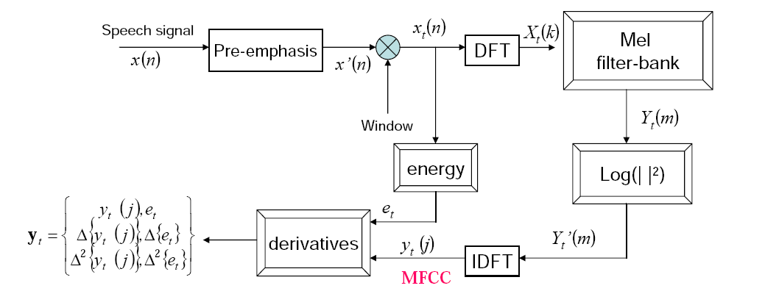
MFCC
Mel-Frequency Cepstral Coefficient (MFCC)
  Most widely used spectral representation in ASR

Slide 9
Pre-Emphasis
Pre-emphasis: boosting the energy in the high frequencies
Q: Why do this?
A: The spectrum for voiced segments has more energy at lower frequencies than higher frequencies.
  This is called spectral tilt
  Spectral tilt is caused by the nature of the glottal pulse
Boosting high-frequency energy gives more info to Acoustic Model
  Improves phone recognition performance

Slide 10
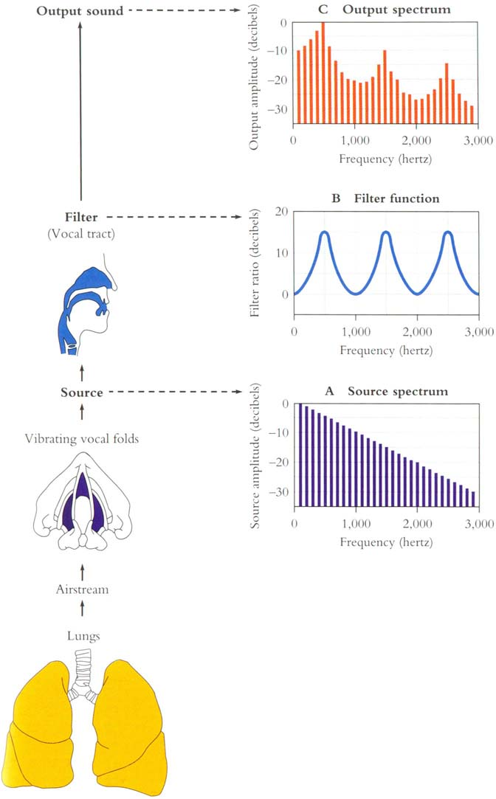
George Miller figure

Slide 11
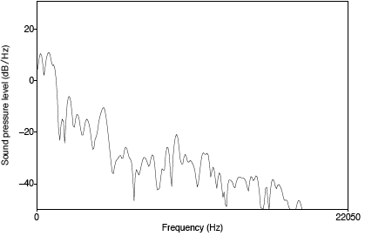
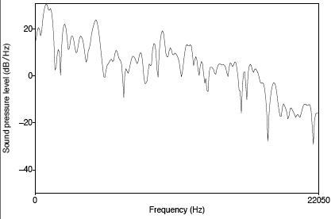
Example of pre-emphasis
Before and after pre-emphasis
  Spectral slice from the vowel [aa]

Slide 12
MFCC

Slide 13
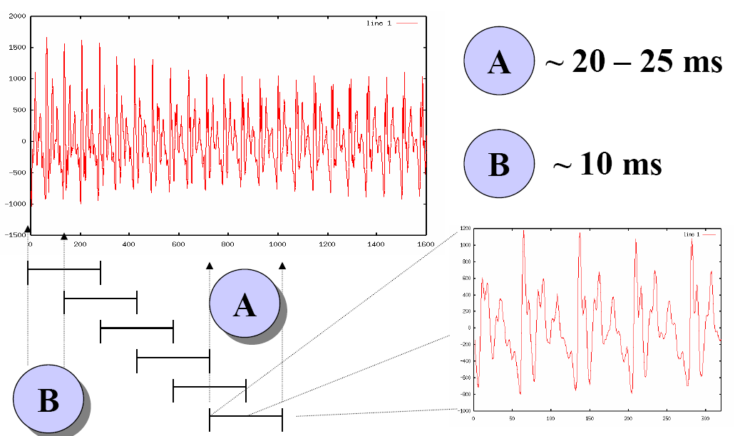
Windowing
Slide from Bryan Pellom

Slide 14
Windowing
Why divide speech signal into successive overlapping frames?
  Speech is not a stationary signal; we want information about a small enough region that the spectral information is a useful cue.
Frames
  Frame size: typically, 10-25ms
  Frame shift: the length of time between successive frames, typically, 5-10ms

Slide 15


Common window shapes
Rectangular window:
Hamming window

Slide 16
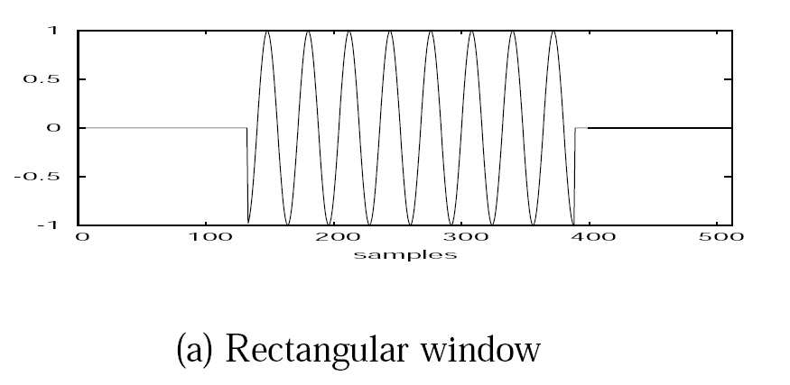
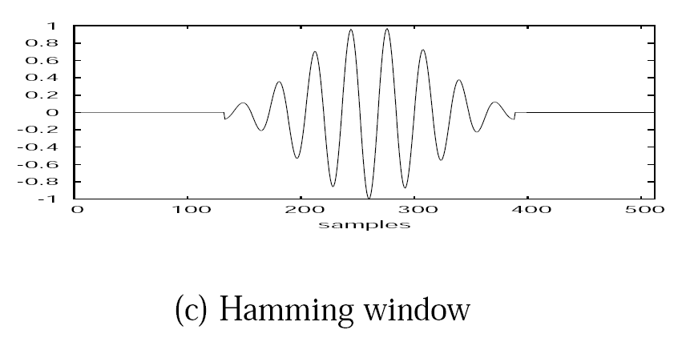
Window in time domain

Slide 17
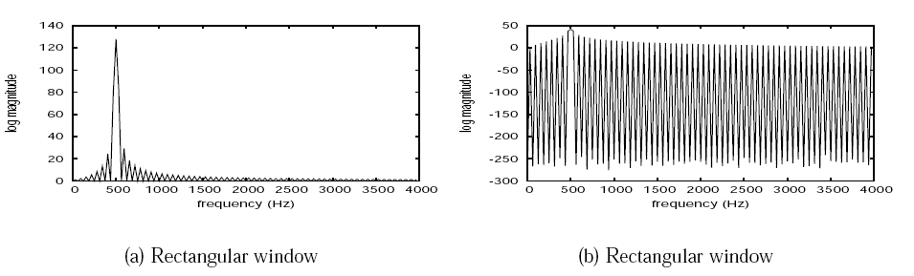
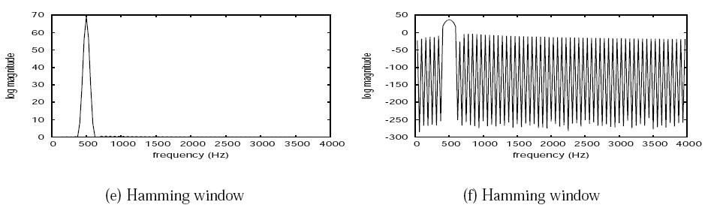
Window in the frequency domain

Slide 18
MFCC

Slide 19

Discrete Fourier Transform
Input:
  Windowed signal x[n]…x[m]
Output:
  For each of N discrete frequency bands
  A complex number X[k] representing magnidue and phase of that frequency component in the original signal
Discrete Fourier Transform (DFT)
Standard algorithm for computing DFT:
  Fast Fourier Transform (FFT) with complexity N*log(N)
  In general, choose N=512 or 1024

Slide 20
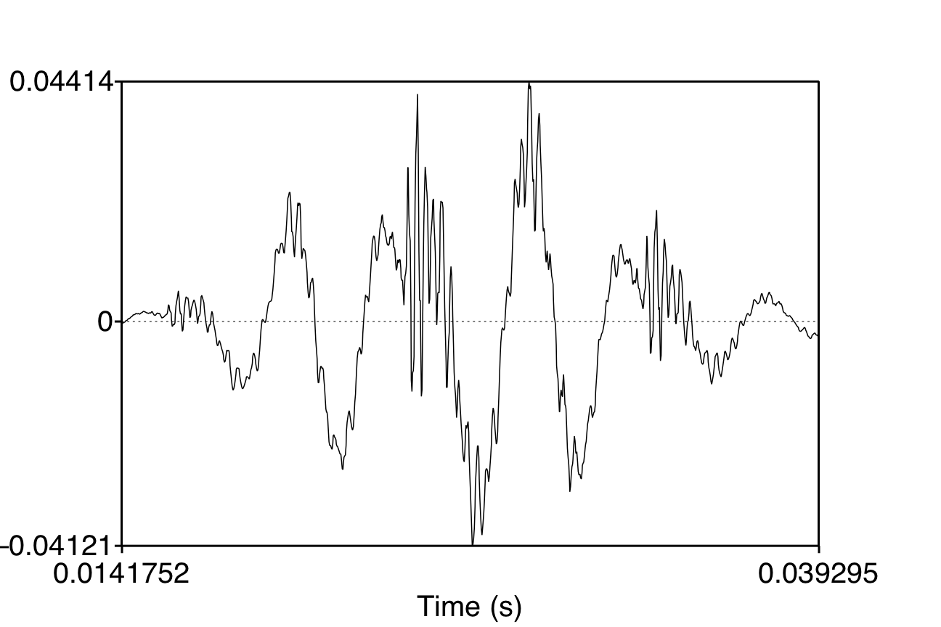
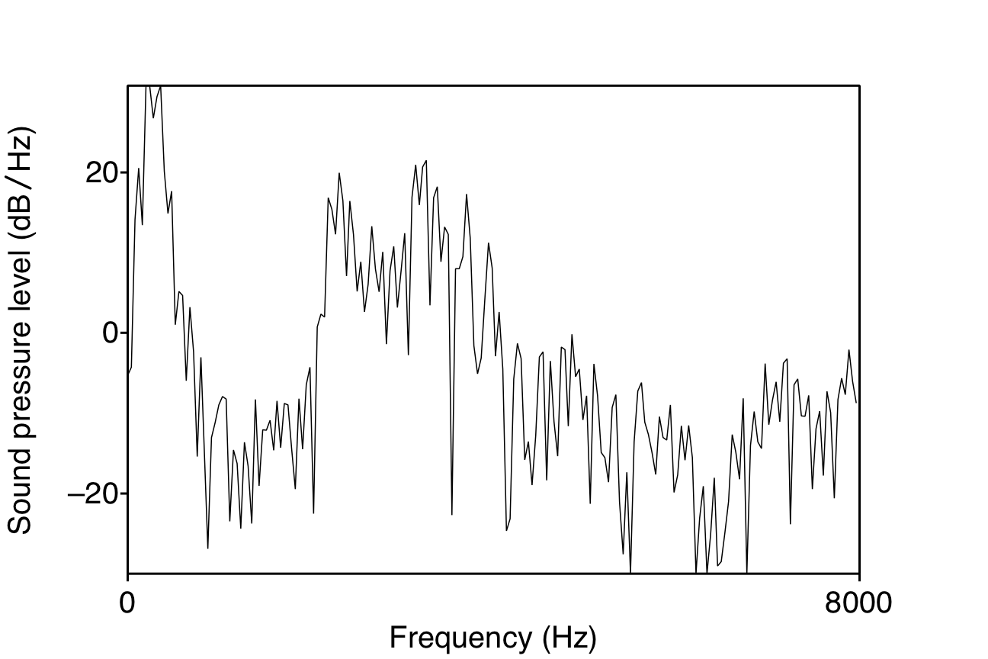
Discrete Fourier Transform computing a spectrum
A 25 ms Hamming-windowed signal from [iy]
  And its spectrum as computed by DFT (plus other smoothing)

Slide 21
MFCC

Slide 22
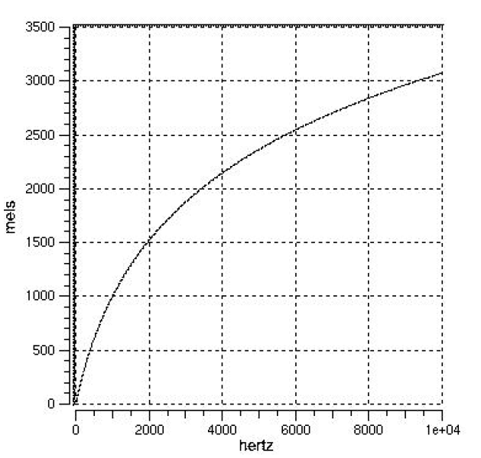
Mel-scale
Human hearing is not equally sensitive to all frequency bands
Less sensitive at higher frequencies, roughly > 1000 Hz
I.e. human perception of frequency is non-linear:

Slide 23

Mel-scale
A mel is a unit of pitch
  Definition:
    Pairs of sounds perceptually equidistant in pitch
    Are separated by an equal number of mels:
Mel-scale is approximately linear below 1 kHz and logarithmic above 1 kHz
Definition:

Slide 24
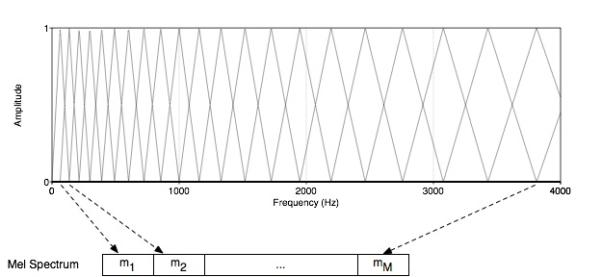
Mel Filter Bank Processing
Mel Filter bank
  Uniformly spaced before 1 kHz
  logarithmic scale after 1 kHz

Slide 25
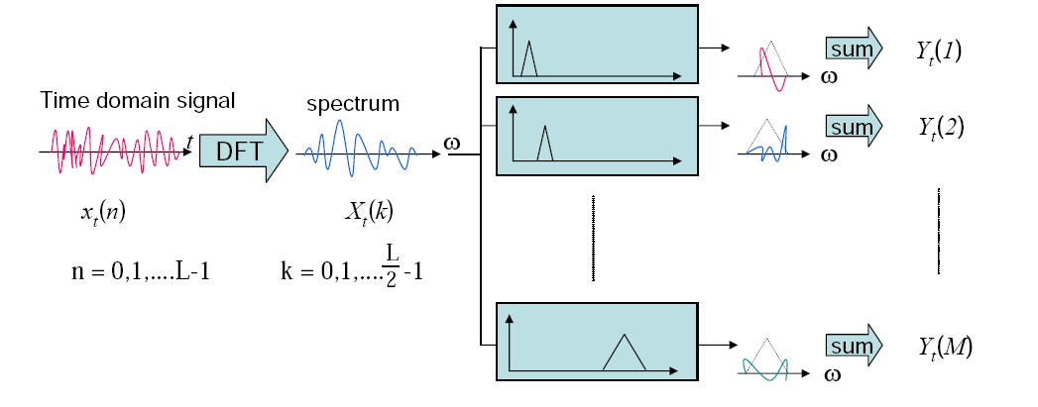
Mel-filter Bank Processing
Apply the bank of filters according Mel scale to the spectrum
Each filter output is the sum of its filtered spectral components

Slide 26
MFCC

Slide 27
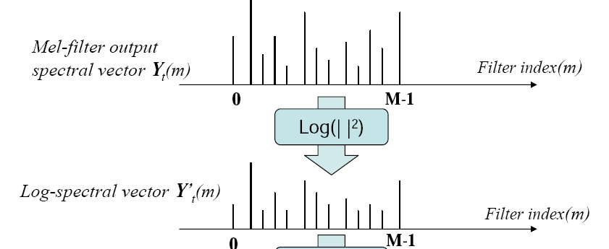
Log energy computation
Compute the logarithm of the square magnitude of the output of Mel-filter bank

Slide 28
Log energy computation
Why log energy?
Logarithm compresses dynamic range of values
  Human response to signal level is logarithmic
  humans less sensitive to slight differences in amplitude at high amplitudes than low amplitudes
Makes frequency estimates less sensitive to slight variations in input (power variation due to speaker’s mouth moving closer to mike)
Phase information not helpful in speech

Slide 29
MFCC

Slide 30
The Cepstrum
One way to think about this
  Separating the source and filter
  Speech waveform is created by
    A glottal source waveform
    Passes through a vocal tract which because of its shape has a particular filtering characteristic
Articulatory facts:
  The vocal cord vibrations create harmonics
  The mouth is an amplifier
  Depending on shape of oral cavity, some harmonics are amplified more than others

Slide 31
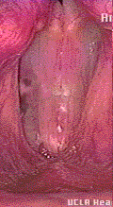
Vocal Fold Vibration
UCLA Phonetics Lab Demo

Slide 32
George Miller figure

Slide 33
We care about the filter not the source
Most characteristics of the source
  F0
  Details of glottal pulse
Don’t matter for phone detection
What we care about is the filter
  The exact position of the articulators in the oral tract
So we want a way to separate these
  And use only the filter function

Slide 34
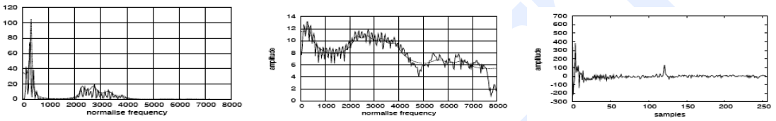
The Cepstrum
The spectrum of the log of the spectrum
Spectrum
Log spectrum
Spectrum of log spectrum

Slide 35
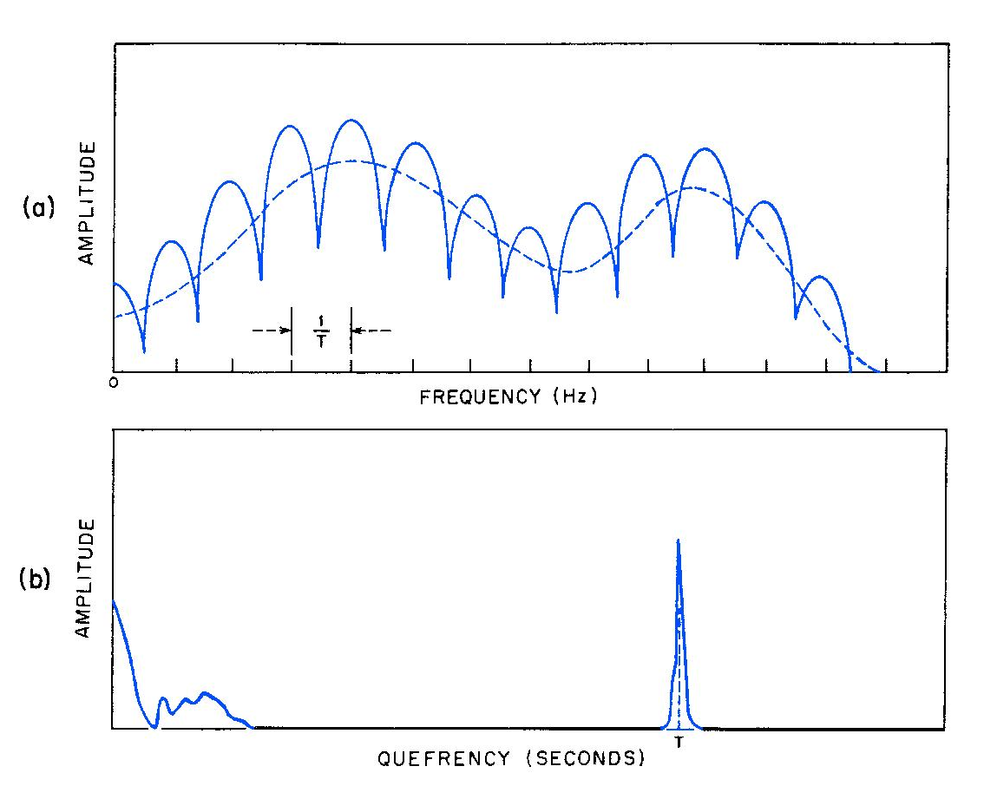
Thinking about the Cepstrum

Slide 36

Mel Frequency cepstrum
The cepstrum requires Fourier analysis
But we’re going from frequency space back to time
So we actually apply inverse DFT
Details for signal processing gurus: Since the log power spectrum is real and symmetric, inverse DFT reduces to a Discrete Cosine Transform (DCT)

Slide 37
Another advantage of the Cepstrum
DCT produces highly uncorrelated features
We’ll see when we get to acoustic modeling that these will be much easier to model than the spectrum
  Simply modelled by linear combinations of Gaussian density functions with diagonal covariance matrices
In general we’ll just use the first 12 cepstral coefficients (we don’t want the later ones which have e.g. the F0 spike)

Slide 38
MFCC

Slide 39

Dynamic Cepstral Coefficient
The cepstral coefficients do not capture energy
So we add an energy feature
Also, we know that speech signal is not constant (slope of formants, change from stop burst to release).
So we want to add the changes in features (the slopes).
We call these delta features
We also add double-delta acceleration features

Slide 40

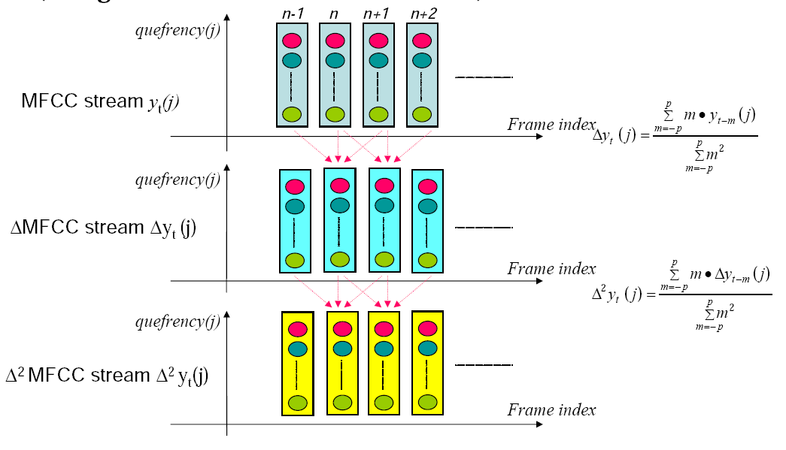
Delta and double-delta
Derivative: in order to obtain temporal information

Slide 41
Typical MFCC features
Window size: 25ms
Window shift: 10ms
Pre-emphasis coefficient: 0.97
MFCC:
  12 MFCC (mel frequency cepstral coefficients)
  1 energy feature
  12 delta MFCC features
  12 double-delta MFCC features
  1 delta energy feature
  1 double-delta energy feature
Total 39-dimensional features

Slide 42
Why is MFCC so popular?
Efficient to compute
Incorporates a perceptual Mel frequency scale
Separates the source and filter
IDFT(DCT) decorrelates the features
  Improves diagonal assumption in HMM modeling
Alternative
  PLP

Slide 43
Now on to Acoustic Modeling

Slide 44
Problem: how to apply HMM model to continuous observations?
We have assumed that the output alphabet V has a finite number of symbols
But spectral feature vectors are real-valued!
How to deal with real-valued features?
  Decoding: Given o_{t}, how to compute P(o_{t}|q)
  Learning: How to modify EM to deal with real-valued features

Slide 45
Vector Quantization
Create a training set of feature vectors
Cluster them into a small number of classes
Represent each class by a discrete symbol
For each class v_{k}, we can compute the probability that it is generated by a given HMM state using Baum-Welch as above

Slide 46
VQ
We’ll define a
  Codebook, which lists for each symbol
  A prototype vector, or codeword
If we had 256 classes (‘8-bit VQ’),
  A codebook with 256 prototype vectors
  Given an incoming feature vector, we compare it to each of the 256 prototype vectors
  We pick whichever one is closest (by some ‘distance metric’)
  And replace the input vector by the index of this prototype vector

Slide 47
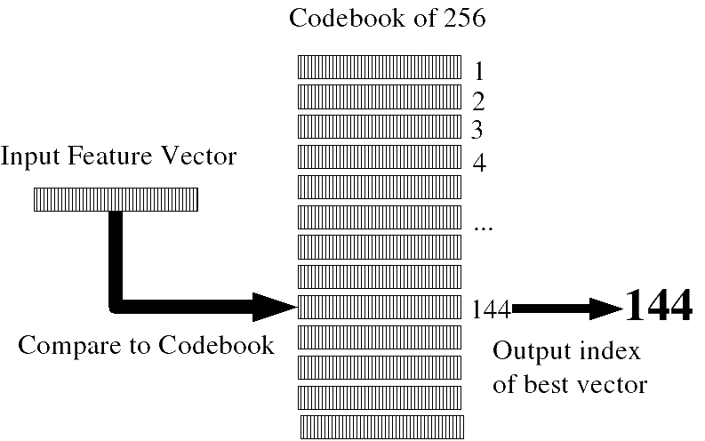
VQ

Slide 48
VQ requirements
A distance metric or distortion metric
  Specifies how similar two vectors are
  Used:
    to build clusters
    To find prototype vector for cluster
    And to compare incoming vector to prototypes
A clustering algorithm
  K-means, etc.

Slide 49
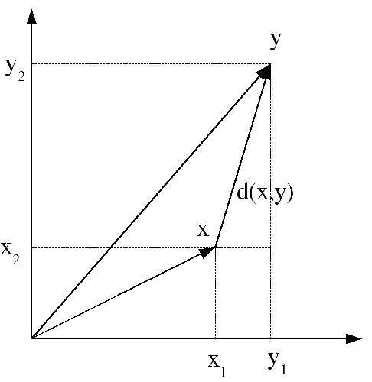
Distance metrics
Simplest:
  (square of) Euclidean distance
  Also called ‘sum-squared error’

Slide 50
Distance metrics
More sophisticated:
  (square of) Mahalanobis distance
  Assume that each dimension of feature vector has variance σ²
  Equation above assumes diagonal covariance matrix; more on this later

Slide 51
Training a VQ system (generating codebook): K-means clustering
1. Initialization
choose M vectors from L training vectors (typically M=2^{B})
as initial code words… random or max. distance.
2. Search:
for each training vector, find the closest code word,
assign this training vector to that cell
3. Centroid Update:
for each cell, compute centroid of that cell. The
new code word is the centroid.
4. Repeat (2)-(3) until average distance falls below threshold (or no change)
Slide from John-Paul Hosum, OHSU/OGI

Slide 52
Vector Quantization
Slide thanks to John-Paul Hosum, OHSU/OGI
Example
Given data points, split into 4 codebook vectors with initial
values at (2,2), (4,6), (6,5), and (8,8)
9
9
8
8
7
7
6
6
5
5
4
4
3
3
2
2
1
1
0
0
0
1
2
3
4
5
6
7
8
9
0
1
2
3
4
5
6
7
8
9

Slide 53
Vector Quantization
Slide from John-Paul Hosum, OHSU/OGI
Example
compute centroids of each codebook, re-compute nearest
neighbor, re-compute centroids...
9
9
8
8
7
7
6
6
5
5
4
4
3
3
2
2
1
1
0
0
0
1
2
3
4
5
6
7
8
9
0
1
2
3
4
5
6
7
8
9

Slide 54
Vector Quantization
Slide from John-Paul Hosum, OHSU/OGI
Example
Once there’s no more change, the feature space will be
partitioned into 4 regions. Any input feature can be classified
as belonging to one of the 4 regions. The entire codebook
can be specified by the 4 centroid points.
9
8
7
6
5
4
3
2
1
0
0
1
2
3
4
5
6
7
8
9

Slide 55
Summary: VQ
To compute p(o_{t}|q_{j})
  Compute distance between feature vector o_{t}
    and each codeword (prototype vector)
    in a preclustered codebook
    where distance is either
      Euclidean
      Mahalanobis
  Choose the vector that is the closest to o_{t}
    and take its codeword v_{k}
  And then look up the likelihood of v_{k} given HMM state j in the B matrix
B_{j}(o_{t})=b_{j}(v_{k}) s.t. v_{k} is codeword of closest vector to o_{t}
Using Baum-Welch as above

Slide 56
Computing b_{j}(v_{k})
Slide from John-Paul Hosum, OHSU/OGI
feature value 2
for state j
feature value 1 for state j
b_{j}(v_{k}) = number of vectors with codebook index k in state j
number of vectors in state j
14 1
= =
56 4

Slide 57
Summary: VQ
Training:
  Do VQ and then use Baum-Welch to assign probabilities to each symbol
Decoding:
  Do VQ and then use the symbol probabilities in decoding

Slide 58
Next Time: Directly Modeling Continuous Observations
Gaussians
  Univariate Gaussians
    Baum-Welch for univariate Gaussians
  Multivariate Gaussians
    Baum-Welch for multivariate Gausians
  Gaussian Mixture Models (GMMs)
    Baum-Welch for GMMs

Slide 59
Summary
Feature Extraction
Beginning of Acoustic Modeling
  Vector Quantization (VQ)

