Slide 1
CS 552/652
Hidden Markov Models for Speech Recognition
Spring, 2006
Oregon Health & Science University
OGI School of Science & Engineering
John-Paul Hosom
April 3
Course Overview, Background on Speech

Slide 2
Course Overview
Hidden Markov Models for speech recognition
- concepts, terminology, theory
- develop ability to create simple HMMs from scratch
Three programming projects (each counts 15%, 20%, 25%)
Midterm (in-class) (20%)
Final exam (take-home) (20%)
Readings from book to supplement lecture notes
Class web site http://www.cse.ogi.edu/class/cse552/
updated on regular basis with lecture notes, project
data, etc.

Slide 3
Course Overview
Books: Fundamentals of Speech Recognition
Lawrence Rabiner & Biing-hwang Juang
Prentice Hall, New Jersey (1994)
      Statistical Methods for Speech Recognition
      Frederick Jelinek
      The MIT Press, Cambridge, MA (1999)
Other Recommended Readings/Source Material:
Large Vocabulary Continuous Speech Recognition
(Steve Young, 1996)
Survey of the State of the Art in Human Language Tech.
(Cole et al., 1996) http://cslu.cse.ogi.edu/HLTsurvey/
Probability & Statistics for Engineering and the Sciences
(Jay L. Devore, 1982)
e-mail: ‘hosom’ at cslu.ogi.edu

Slide 4
Course Overview
Introduction to Speech & Automatic Speech Recognition (ASR)
Dynamic Time Warping (DTW)
The Hidden Markov Model (HMM) framework
Speech Features and Gaussian Mixture Models (GMMs)
Searching an Existing HMM: the Viterbi Search
Obtaining Initial Estimates of HMM Parameters
Improving Parameter Estimates: Forward-Backward Algorithm
Modifications to Viterbi Search
HMM Modifications for Speech Recognition
Language Modeling
Alternatives to HMMs
Evaluating Systems & Review State-of-the-Art

Slide 5
Introduction: Why is Speech Recognition Difficult?
Speech is:
  Time-varying signal,
  Well-structured communication process,
  Depends on known physical movements,
  Composed of known, distinct units (phonemes),
  Modified when speaking to improve SNR (Lombard).
⇒ should be easy.

Slide 6
Introduction: Why is Speech Recognition Difficult?
However, speech:
  Is different for every speaker,
  May be fast, slow, or varying in speed,
  May have high pitch, low pitch, or be whispered,
  Has widely-varying types of environmental noise,
  Can occur over any number of channels,
  Changes depending on sequence of phonemes,
  May not have distinct boundaries between units (phonemes),
  Boundaries may be more or less distinct depending on
  speaker style and types of phonemes,
  Changes depending on the semantics of the utterance,
  Has an unlimited number of words,
  Has phonemes that can be modified, inserted, or deleted

Slide 7
Introduction: Why is Speech Recognition Difficult?
To solve a problem requires in-depth understanding of the
problem.
A data-driven approach requires (a) knowing what data is
relevant and what data is not relevant, and (b) that the problem
is easily addressed by machine-learning techniques.
Nobody has sufficient understanding of human speech
recognition to either build a working model or even
know how to effectively integrate all relevant information.
First class: present some of what is known about speech;
motivate use of HMMs for Automatic Speech Recognition
(ASR).

Slide 8
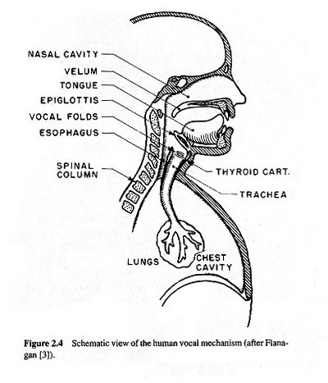
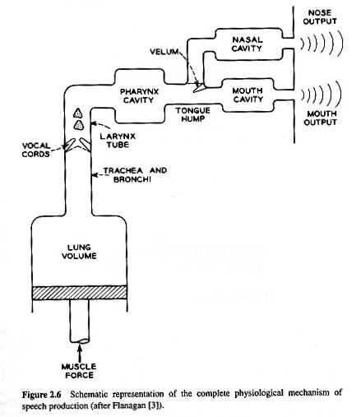
Background: Speech Production
The Speech Production Process (from Rabiner and Juang, pp.16,17)

Slide 9
Background: Speech Production
Sources of Sound:
  Vocal cord vibration
    voiced speech (/aa/, /iy/, /m/, /oy/)
  Narrow constriction in mouth
    fricatives (/s/, /f/)
  Airflow with no vocal-cord vibration, no constriction
    aspiration (/h/)
  Release of built-up pressure
    plosives (/p/, /t/, /k/)
  Combination of sources
    voiced fricatives (/z/, /v/), affricates (/ch/, /jh/)

Slide 10
Background: Speech Production
Vocal tract creates resonances:
Resonant energy based on shape of mouth cavity and location
of constriction
Frequency location of resonances determines identity of phoneme
This implies that a key component of ASR is to create a mapping
from observed resonances to phonemes. However, this is only
one issue in ASR; another important issue is that ASR must
solve both phoneme identity and phoneme duration simultaneously.
Anti-resonances (zeros) also possible in nasals, fricatives
bandwidth
power (dB)
frequency
frequency (Hz)

Slide 11

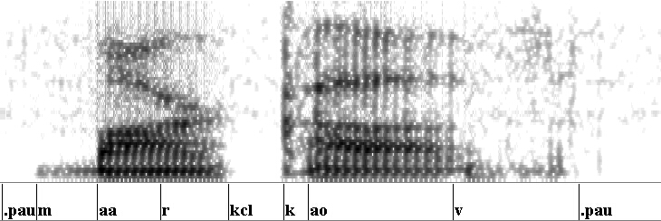
Background: Representations of Speech
Time domain (waveform):
Frequency domain (spectrogram):

Slide 12



Background: Representations of Speech
Spectrogram Displays:
frame=0.5
win. = 7
frame=.5
win. = 34
frame=10
win. = 16

Slide 13



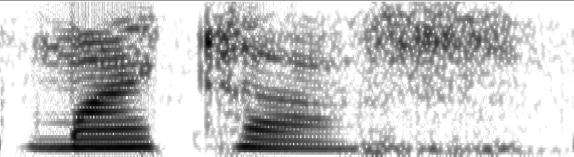
Background: Representations of Speech
Time domain (waveform):
Frequency domain (spectrogram):
“Markov”: male speaker
“Markov”: female speaker

Slide 14
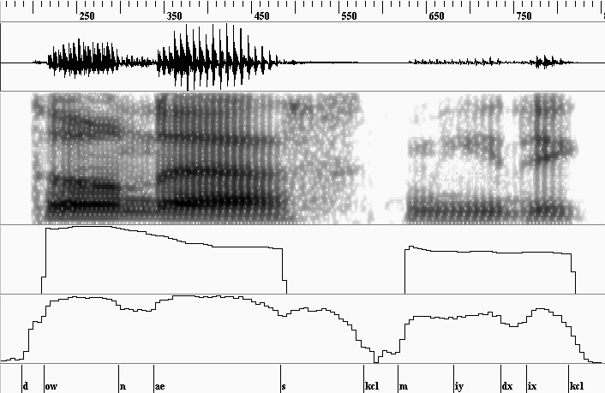
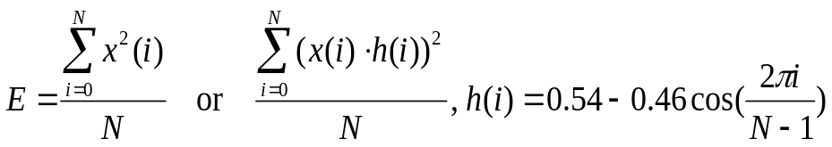
Background: Representations of Speech: Pitch & Energy
F0
100 Hz
energy
80 dB
F0 or Pitch:
rate of vibration
of vocal cords
Energy:

Slide 15
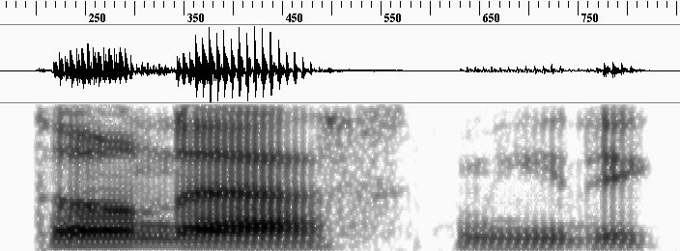

Background: Representations of Speech: Cepstral Features
Cepstral domain (PLP, MFCC):

Slide 16
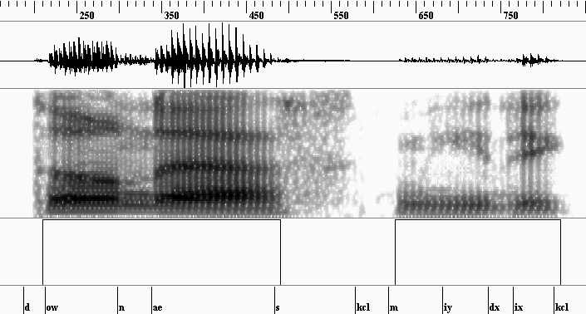
Background: Representations of Speech: Formants & Voicing
voicing (binary)

Slide 17
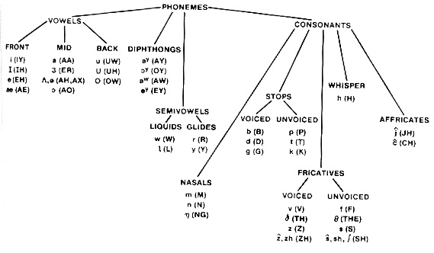
Background: Types of Phonemes
Phoneme Tree: categorization of phonemes (from Rabiner and Juang, p.25)

Slide 18
Background: Types of Phonemes: Vowels & Diphthongs
Vowels:
  /aa/, /uw/, /eh/, etc.
  Voiced speech
  Average duration: 70 msec
  Spectral slope: higher frequencies have lower energy (usually)
  Resonant frequencies (formants) at well-defined locations
  Formant frequencies determine the type of vowel
Diphthongs:
  /ay/, /oy/, etc.
  Combination of two vowels
  Average duration: about 140 msec
  Slow change in resonant frequencies from beginning to end

Slide 19
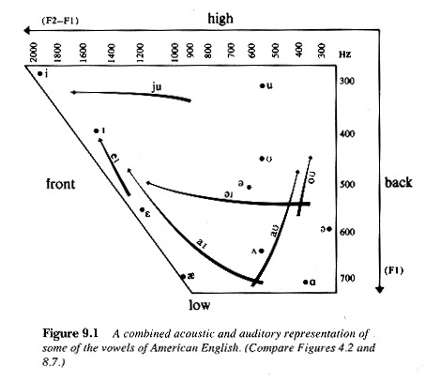
Background: Types of Phonemes: Vowels & Diphthongs
Vowel qualities:
  front, mid, back
  high, low
  open, closed
  (un)rounded
  tense, lax
Vowel Chart (from Ladefoged, p. 218)

Slide 20
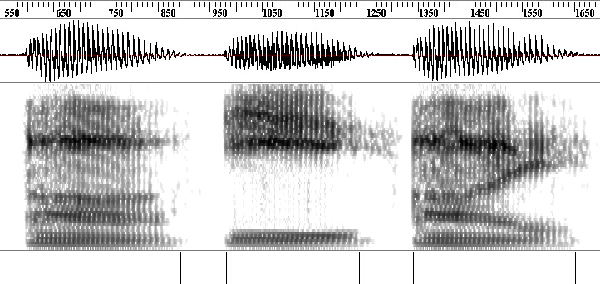
Background: Types of Phonemes: Vowels & Diphthongs
/ah/: low, back
/iy/: high, front
/ay/: diphthong

Slide 21
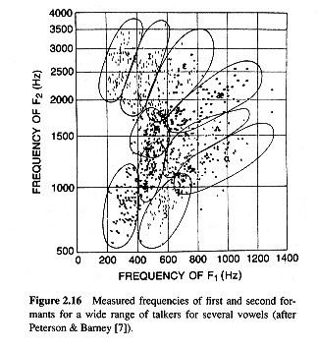
Background: Types of Phonemes: Vowels
Vowel Space (from Rabiner and Juang, p. 27)

Slide 22
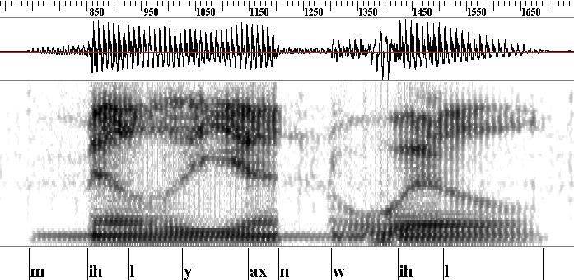
Background: Types of Phonemes: Nasals
Nasals:
  /m/, /n/, /ng/
  Voiced speech
  Spectral slope: higher frequencies have lower energy (usually)
  Resonant frequencies often close together
  Spectral anti-resonances (zeros)

Slide 23
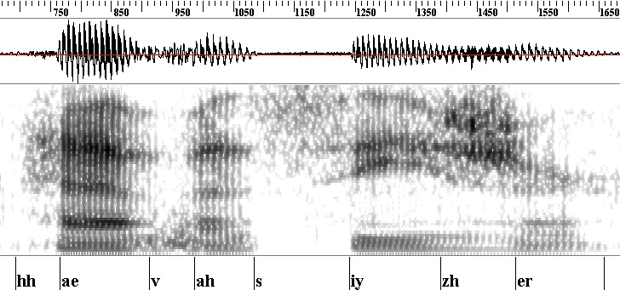
Background: Types of Phonemes: Fricatives
Fricatives:
  /s/, /z/, /f/, /v/, etc.
  Voiced and unvoiced speech (/z/ vs. /s/)
  Resonant frequencies not as well modeled as with vowels

Slide 24
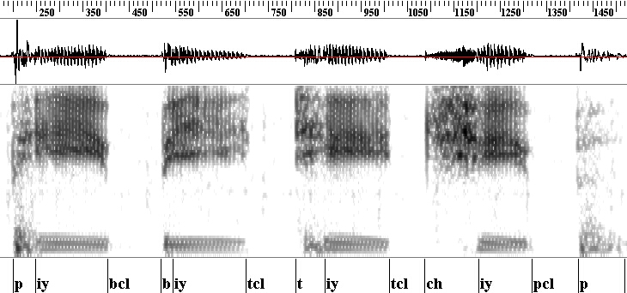
Background: Types of Phonemes: Plosives (stops) & Affricates
Plosives:
  /p/, /t/, /k/, /b/, /d/, /g/
  Sequence of events: silence, burst, frication, aspiration
  Average duration: about 40 msec (5 to 120 msec)
Affricates:
  /ch/, /jh/
  Plosive followed immediately by fricative

Slide 25
Background: Time-Domain Aspects of Speech
Coarticulation
  Tongue moves gradually from one location to the next
  Formant frequencies change smoothly over time
  No distinct boundary between phonemes, especially vowels
/aa/
/iy/
/ay/
frequency
frequency
+
=
frequency
time
time
time

Slide 26
Background: Time-Domain Aspects of Speech
Duration modeling
  Rate of speech varies according to speaker, mood, etc.
  Some phonetic distinctions based on duration (/s/, /z/)
  Duration of each phoneme depends on rate of speech, intrinsic
  duration of that phoneme, identities of surrounding phonemes,
  syllabic stress, word emphasis, position in word, position in
  phrase, etc.
(Gamma distribution)
number of instances
duration (msec)

Slide 27
Background: Models of Human Speech Recognition
The Motor Theory (Liberman et al.)
  Speech is perceived in terms of intended physical gestures
  Special module in brain required to understand speech
  Decoding module may work using “Analysis by Synthesis”
  Decoding is “inherently complex”
Criticisms of the Motor Theory
  People able to read spectrograms
  Complex non-speech sounds can also be recognized
  Acoustically-similar sounds may have different gestures

Slide 28
Background: Models of Human Speech Recognition
The Multiple-Cue Model (Cole and Scott)
  Speech is perceived in terms of
  (a) context-independent invariant cues &
  (b) context-dependent phonetic transition cues
  Invariant cues sufficient for some phonemes (/s/, /ch/, etc)
  Other phonemes require invariant and context-dependent cues
  Computationally more practical than Motor Theory
Criticism of the Multiple-Cue Model
  Reliable extraction of cues not always possible

Slide 29
Background: Models of Human Speech Recognition
The Fletcher-Allen Model
  Frequency bands processed independently
  Classification results from each band “fused” to classify
  phonemes
  Phonetic classification results used to classify syllables,
  syllable results used to classify words
  Little feedback from higher levels to lower levels
  p(CVC) = p(c₁) p(V) p(c₂); implies phonemes perceived
  individually
Criticism of the Fletcher-Allen Model
  How to do frequency-band recognition? How to fuse results?

Slide 30
Background: Models of Human Speech Recognition
Summary:
  Motor Theory has many criticisms; is inherently difficult
  to implement.
  Multiple-Cue model requires accurate feature extraction.
  Fletcher-Allen model provides good high-level description,
  but little detail for actual implementation.
  No model provides both a good fit to all data AND a well-
  defined method of implementation.

Slide 31
Why is Speech Recognition Difficult?
Nobody has sufficient understanding of human speech
recognition to either build a working model or even
know how to effectively integrate all relevant information.
Lack of knowledge of human processing leads to the use of
“whatever works” and data-driven approaches
Current solution:
Data-driven training of phoneme-specific models
Simultaneously solve for duration and phoneme identity
Models are connected according to vocabulary constraints
⇒ Hidden Markov Model framework
No relationship between theories of human speech processing
(Motor Theory, Cue-Based, Fletcher-Allen) and HMMs.
No proof that HMMs are the “best” solution to automatic speech recognition problem, but HMMs provide best performance so far. One goal for this course is to understand both advantages and disadvantages of HMMs.

Slide 32
Reading
Rabiner & Juang
Chapter 2, sections 2.1 to 2.4
do NOT read Section 2.5… outdated!!
Next class: Dynamic Time Warping for speech recognition;
assign first programming project.

