Slide 1
CSE 552/652
Hidden Markov Models for Speech Recognition
Spring, 2006
Oregon Health & Science University
OGI School of Science & Engineering
John-Paul Hosom
April 5
Issues in ASR, Induction, and DTW

Slide 2
Issues in Developing ASR Systems
There are a number of issues that impact the performance of an automatic speech recognition (ASR) system:
Type of Channel
  Microphone signal different from telephone signal,
  “land-line” telephone signal different from cellular signal.
  Channel characteristics:
  pick-up pattern (omni-directional, unidirectional, etc.)
  frequency response, sensitivity, noise, etc.
  Typical channels:
  desktop boom mic: unidirectional, 100 to 16000 Hz
  hand-held mic: super-cardioid, 60 to 20000 Hz
  telephone: unidirectional, 300 to 8000 Hz
  Training on data from one type of channel automatically
  “learns” that channel’s characteristics; switching
  channels degrades performance.

Slide 3
Issues in Developing ASR Systems
Speaker Characteristics
  Because of differences in vocal tract length, male, female,
  and children’s speech are different.
  Regional accents are expressed as differences in resonant
  frequencies, durations, and pitch.
  Individuals have resonant frequency patterns and duration
  patterns that are unique (allowing us to identify speaker).
  Training on data from one type of speaker automatically
  “learns” that group or person’s characteristics, makes
  recognition of other speaker types much worse.
  Training on data from all types of speakers results in lower
  performance than could be obtained with speaker-specific
  models.

Slide 4
Issues in Developing ASR Systems
Speaking Rate
  Even the same speaker may vary the rate of speech.
  Most ASR systems require a fixed window of input speech.
  Formant dynamics change with different speaking rates.
  ASR performance is best when tested on same rate of speech
  as training data.
  Training on a wide variation in speaking rate results in
  lower performance than could be obtained with duration-
  specific models.

Slide 5
Issues in Developing ASR Systems
Noise
  Two types of noise:
  additive, convolutional
  Additive: e.g. white noise (random values added to waveform)
  Convolutional: filter (additive values in log spectrum)
  Techniques for removing noise: RASTA, Cepstral
  Mean Subtraction (CMS)
  (Nearly) impossible to remove all noise while preserving
  all speech (nearly impossible to separate speech from noise)
  Stochastic training “learns” noise as well as speech; if
  noise changes, performance degrades.

Slide 6
Issues in Developing ASR Systems
Vocabulary
  Vocabulary must be specified in advance
  (can’t recognize new words)
  Pronunciation of each word must be specified exactly
  (phonetic substitutions may degrade performance)
  Grammar: either
  very simple but with likelihoods of word sequences, or
  highly structured
  Reasons for pre-specified vocabulary, grammar constraints:
    phonetic recognition so poor that confidence
    in each recognized phoneme usually very low.
    humans often speak ungrammatically or disfluently.

Slide 7
Issues in Developing ASR Systems
Comparing Human and Computer Performance
Human performance:
  Large-vocabulary corpus (1995 CSR Hub-3) consisting of
North American business news recorded with 3 microphones.
  Average word error rate of 2.2%, best word error rate of 0.9%,
  “committee” error rate of 0.8%
  Typical errors: “emigrate” vs. “immigrate”,
  most errors due to inattention.
Computer performance:
  Similar large-vocabulary corpus (1998 Broadcast News Hub-4)
  Best performance of 13.5% word error rate,
  (for < 10x real time, best performance of 16.1%),
  a “committee” error rate of 10.6%
  More recent focus on natural speech… best error rates of ≈25%
This is consistent with results from other tasks: a general
order-of-magnitude difference between human and computer
performance; computer doesn’t generalize to new conditions.

Slide 8
Induction
Induction (from Floyd & Beigel, The Language of Machines, pp. 39-66)
Technique for proving theorems, used in Hidden Markov Models
Understand induction by doing example proofs…
Suppose P(n) is statement about number n, and we want to
prove P(n) is true for all n ≥ 0.
Inductive proof:
Show both of the following:
Base case: P(0) is true
Induction: (∀n ≥ 0) [P(n) ⇒ P(n+1)]
In the inductive case, we want to show that if (assuming) P is true for n, then it must be true for n+1. We never prove P is true for any specific value of n other than 0.
If both cases are shown, then P(n) is true for all n ≥ 0.

Slide 9
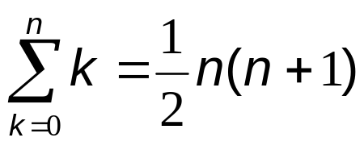
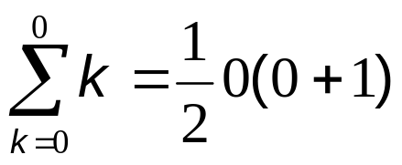

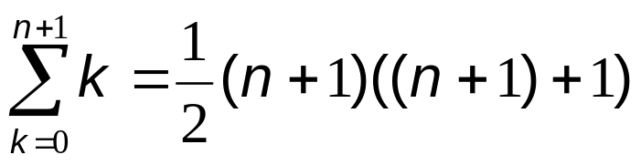
Induction
Example:
Prove that
Step 1: Prove base case:
Step 2: Prove the inductive case (if true for n, true for n+1):
show if then
Step 2a: assume that is true for some
fixed value of n.
for n ≥ 0
(In other words, show that if true for n, then true for n+1)

Slide 10
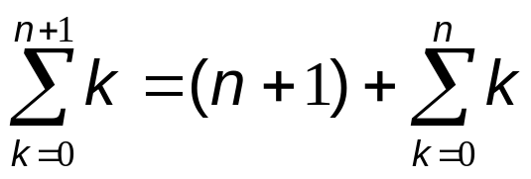
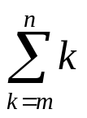
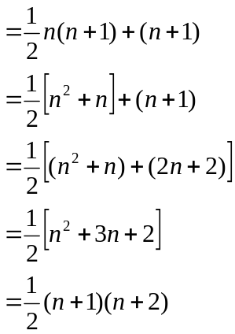
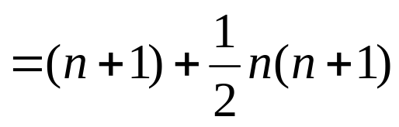
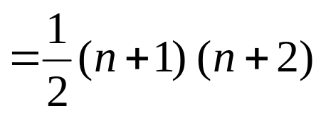
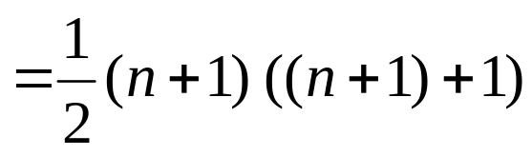
Induction
Step 2b: extend equation to next value for n:
(from definition of )
(from 2a)
(algebra)
we have now showed
what we wanted to show
at beginning of Step 2.
We proved case for (n+1), assuming that case for n is true.
If we look at base case (n=0), we can show truth for n=0.
Given that case for n=0 is true, then case for n=1 is true.
Given that case for n=1 is true, then case for n=2 is true. (etc.)
By proving base case and inductive step, we prove ∀ n≥0.

Slide 11
Induction
Inductive (“Dynamic Programming”) technique:
To find value X at step t in a process (X(t)), where X(t) can be computed from X(t-1):
1. Compute X(1)
2. For m = 2 to t:
Use value from previous iteration (X(m-1)) to determine X(m)
3. X(t) is last result from Step (2).
For speech, X(t) will be the “best” value at time t, either in
terms of “least distortion” or “highest probability”.
By showing that the best value at time t depends only on the previous values at time t-1, the best value for an entire utterance
(the end of the signal, time T) can be comptued. This is not a Greedy Algorithm!

Slide 12
Induction
“Greedy Algorithm”:
  Make a locally-optimum choice going forward at each step, hoping (but not guaranteeing) that the globally-optimum will be found at the last step.
Example:
Travelling Salesman Problem:
  Given a number of cities, what is the shortest route that visits each city exactly once and then returns to the starting city?
Vancouver
21
Gresham
26
Hillsboro
35
146
183
167
Bend
53
55
58
132
Salem

Slide 13

Induction
Exhaustive solution: compute distance of all possible routes, and select the shortest. Time required is O(n!) where n is the number of cities. With even moderate values of n, solution is impractical.
Greedy Algorithm solution: At each city, the next city to visit is the unvisited city nearest to the current city. This process does not guarantee that the globally-optimum solution will be found, but is a fast solution O(n²).
Dynamic-Programming solution: Does guarantee that the globally-optimum solution will be found, because it relies on
induction. For Travelling Salesman problem, the solution¹ is
O(n²2^{(n-1)}). For speech problems, the dynamic-programming solution is O(n²T) where n is the number of states (not used in DTW but used in HMMs) and T is the number of time frames.
¹Bellman, R. “Dynamic Programming Treatment of the Travelling Salesman Problem,” in Journal of the ACM (JACM), vol. 9, no. 1, January 1962, pp. 61 – 63.

Slide 14






Dynamic Time Warping (DTW)
Goal: Given two utterances, find “best” alignment between pairs of frames from each utterance.
(A)
(B)
The path through this matrix
shows the best pairing of
frames from utterance A with
utterance B:
This path can be considered
the best “warping” between
A and B.
time (frame) of (B)
time (frame) of (A)

Slide 15
Dynamic Time Warping (DTW)
Dynamic Time Warping
  Requires measure of “distance” between 2 frames of speech,
  one frame from utterance A and one from utterance B.
  Requires heuristics about allowable transitions from one
  frame in A to another frame in A (and likewise for B).
  Uses inductive algorithm to find best warping.
  Can get total “distortion score” for best warped path.
Distance:
  Measure of dissimilarity of two frames of speech
Heuristics:
  Constrain begin and end times to be (1,1) and (T,T)
  Allow only monotonically increasing time
  Don’t allow too many frames to be skipped
  Can express in terms of “paths” with “slope weights”

Slide 16
Dynamic Time Warping (DTW)
Does not require that both patterns have the same length
We may refer to one speech pattern as the “input” and the
other speech pattern as the “template”, and compare input
with template.
For speech, we divide speech signal into equally-spaced frames
(e.g. 10 msec) and compute one set of features per frame.
The local distance measure is the distance between features at
a pair of frames (one from A, one from B).
Local distance between frames called d. Global distortion from
beginning of utterance until current pair of frames called D.
DTW can also be applied to related speech problems, such as
matching up two similar sequences of phonemes.
Algorithm:
  Similar in some respects to Viterbi search, which will be
  covered later

Slide 17
Dynamic Time Warping (DTW)
Heuristics:
½
P₁
½
1
P₁
½
P1=(1,1)(1,0)
P2=(1,1)
P3=(1,1)(0,1)
P₂
P1=(1,0)
P2=(1,1)
P3=(1,2)
P₂
½
P₃
P₃
Heuristic 1
Heuristic 2
Path P and slope weight m determined heuristically
Paths considered backward from target frame
Larger weight values for less preferable paths
Paths always go up, right (monotonically increasing in time)
Only evaluate P if all frames have meaningful values (e.g.
don’t evaluate a path if one frame is at time −1, because there
is no data for time −1).

Slide 18
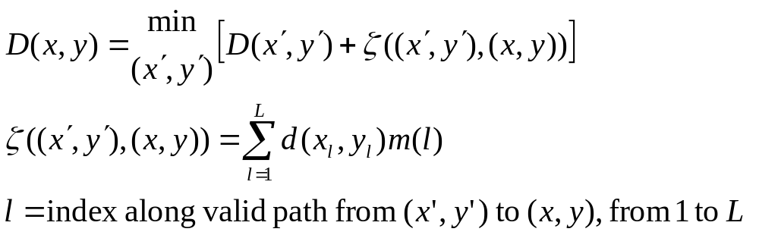
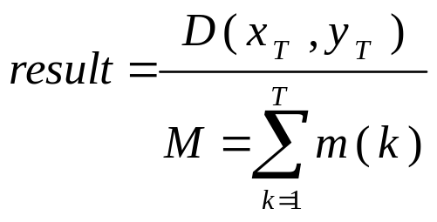
Dynamic Time Warping (DTW)
Algorithm:
1. Initialization (time 1 is first time frame)
D(1,1) = d(1,1)
2. Recursion
(ζ=zeta)
3. Termination
M sometimes defined as T_{x}, or T_{x}+T_{y},
or (T_{x} ²+ T_{y} ²)^{½}

Slide 19
Dynamic Time Warping (DTW)
Example:
3
2
3
2
2
2
heuristic paths:
3
2
3
1
1
1
1
1
P1=(1,0)
P2=(1,1)
P3=(1,2)
2
2
2
1
2
2
2
1
2
2
1
3
1
1
1
1
1
2
3
1
1
3
3
3
3
begin at (1,1), end at (6,6)
6
6
7
D(1,1) = D(2,1) = D(3,1) = D(4,1) =
D(1,2) = D(2,2) = D(3,2) = D(4,2) =
D(2,3) = D(3,3) = D(4,3) = D(5,3) =
D(3,4) = D(4,4) = D(5,4) = D(6,4) =
D(3,5) = D(4,5) = D(5,5) = D(6,5) =
D(3,6) = D(4,6) = D(5,6) = D(6,6) =
5
5
5
6
4
4
6
7
2
4
5
5
8
2
3
4
6
9
1
2
5
8
11
14
normalized distortion = 7/6 = 1.16

Slide 20
Dynamic Time Warping (DTW)
Can we do local look-ahead to speed up process?
For example, at (1,1) we know that there are 3 possible
points to go to ((2,1), (2,2), (2,3)). Can we compute the
cumulative distortion for those 3 points, select the minimum,
(e.g. (2,2)), and proceed only from that best point?
No, because (global) end-point constraint (end at (6,6)) may
alter the path. We can’t make local decisions with a global
constraint.
In addition, we can’t do this because often there are many ways
to end up at a single point, and we don’t know all the ways
of getting to a point until we visit it and compute it’s cumulative
distortion.
This look-ahead transforms DTW from dynamic-programming
to greedy algorithm.

Slide 21
Dynamic Time Warping (DTW)
Example:
3
2
3
2
2
2
heuristic paths:
3
2
3
1
1
1
1
1
1
P1=(1,0)
P2=(1,1)
P3=(0,1)
2
2
2
1
2
2
2
8
9
2
1
3
2
1
8
1
2
3
1
2
3
3
3
3
begin at (1,1), end at (6,6)
13
11
12
12
12
13
D(1,1) = 1 D(2,1) = 3 D(3,1) = 6 D(4,1) = 9 …
D(1,2) = 3 D(2,2) = 2 D(3,2) = 10 D(4,2) = 7 …
D(1,3) = 5 D(2,3) = 10 D(3,3) = 11 D(4,3) = 9 …
D(1,4) = 7 D(2,4) = 7 D(3,4) = 9 D(4,4) = 10 …
D(1,5) = 10 D(2,5) = 9 D(3,5) = 10 D(4,5) = 10 …
D(1,6) = 13 D(2,6) = 11 D(3,6) = 12 D(4,6) = 12 …
normalized distortion = 13/6 = 2.17
10
9
10
10
11
11
7
7
9
10
10
10
5
10
11
9
8
11
3
2
10
7
9
12
1
3
6
9
12
15

Slide 22
Dynamic Time Warping (DTW)
Example:
3
2
3
2
2
2
heuristic paths:
3
2
3
1
1
1
½
½
1
P1=(1,1)(1,0)
P2=(1,1)
P3=(1,1)(0,1)
2
2
2
1
2
2
½
2
1
2
2
1
3
½
1
1
1
1
2
3
1
1
3
3
3
3
begin at (1,1), end at (6,6)
D(1,1) = D(2,1) = D(3,1) = D(4,1) =
D(1,2) = D(2,2) = D(3,2) = D(4,2) =
D(2,3) = D(3,3) = D(4,3) = D(5,3) =
D(3,4) = D(4,4) = D(5,4) = D(6,4) =
D(3,5) = D(4,5) = D(5,5) = D(6,5) =
D(3,6) = D(4,6) = D(5,6) = D(6,6) =

Slide 23
Dynamic Time Warping (DTW)
Distance Measures
Need to compare two frames of speech and measure how
similar or dissimilar they are
A distance measure should have the following properties:
0 ≤ d(x,y) ≤ ∞
0 = d(x,y) iff x = y
d(x,y) = d(y,x) (symmetry)
d(x,y) ≤ d(x,z) + d(z,y) (triangle inequality)
A distance measure should also, for speech, correlate well
with perceived distance. Spectral domain is better than time
domain for this; a perceptually-warped spectral domain is
even better.
(positive definiteness)

Slide 24
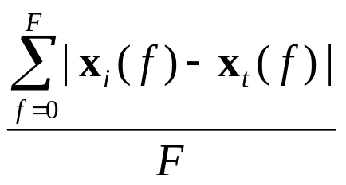
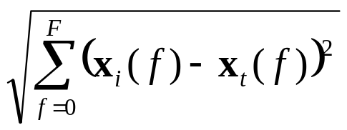
Dynamic Time Warping (DTW)
Distance Measures
Simple solution: log-spectral distance between two sets of signals
represented by features x_{i} and x_{t}.
where x_{i}(f) is the log power
spectrum of signal i at frequency f
with maximum frequency F
also the Euclidean distance:
here f is a feature index, which may
or may not correspond to a frequency
band. Feature index from 0… F, e.g.
13 cepstral features c₀ through c₁₂.
other distance measures:
Itakura-Saito distance (also called Itakura-Saito distortion),
COSH distance, likelihood ratio distance, etc…

Slide 25
Dynamic Time Warping (DTW)
Termination Step
The termination step is taking the value at the endpoint (the
score of the least distortion over the entire utterance) and dividing
by a normalizing factor.
The normalizing factor is only necessary in order to compare
the DTW result for this template with DTW from other templates.
So, one method of normalizing is to divide by the number of
frames in the template. This is quick, easy, and effective for
speech recognition and comparing results of templates.
Another method is to divide by the length of the path taken,
adjusting the length by the slope weights at each transition.
This requires going back and summing the slope values, so
it’s slower. But, sometimes it’s more appropriate.

Slide 26
Dynamic Time Warping (DTW)
DTW can be used to perform ASR by comparing input
speech with a number of templates; the template with
the lowest normalized distortion is most similar to the
input and is selected as the recognized word.
DTW provides both a historical and a logical basis for
studying Hidden Markov Models… Hidden Markov Models
(HMMs) can be seen as an advancement over DTW technology.
“Sneak preview”:
  DTW compares input speech against fixed template (local distortion measure); HMMs compare input speech against “probabilistic template.”
  The search algorithm used in HMMs is also similar, but instead of a fixed set of possible paths, there are probabilities of all possible paths.

Slide 27
Dynamic Time Warping (DTW) Project
First project: Implement DTW algorithm, perform automatic
speech recognition
“Template” code is available to read in features, provide
some context and a starting point.
The features will be given are “real,” in that they are
spectrogram values (energy levels at different frequencies) from
utterances of “yes” and “no” sampled every 10 msec.
For a local distance measure for each frame, use the Euclidean
distance.
Use the following heuristic paths:
Give thought to the representation of paths in your code…
make your code easily changed to specify new paths AND
be able to use slope weights
1
1
1
P₁
1
P1=(1,1)(1,0)
P2=(1,1)
P3=(1,1)(0,1)
P₂
1
P₃

Slide 28
Dynamic Time Warping (DTW) Project
Align pair of files, and print out normalized distortion score:
yes_template.txt input1.txt
no_template.txt input1.txt
yes_template.txt input2.txt
no_template.txt input2.txt
yes_template.txt input3.txt
no_template.txt input3.txt
Then, use results to perform rudimentary ASR…
(1) is input1.txt more likely to be “yes” or “no”?
(2) is input2.txt more likely to be “yes” or “no”?
(3) is input3.txt more likely to be “yes” or “no”?
You may have trouble along the way… good code doesn’t
always produce an answer. Can you add to or modify the
paths to produce an answer for all three inputs?

Slide 29
Dynamic Time Warping (DTW) Project
List 3 reasons why you wouldn’t want to rely on DTW
for all of your ASR needs…
Due on April 24 (Monday, 2½ weeks from now); send
  your source code
  recognition results (minimum normalized distortion
  scores for each comparison, as well as the best time
  warping between the two inputs) using the specified paths
  3 reasons why wouldn’t want to rely on DTW…
  results using specifications given here, and results using
  any necessary modifications to provide answer for all
  three inputs.
to ‘hosom’ at cslu.ogi.edu; late responses generally not accepted.

Slide 30
Reading
Rabiner & Juang
Chapter 4, especially Section 4.7
Sections 4.1 through 4.6 may be interesting; we’ll
cover this material from a different perspective later
in the course.

