Slide 1
CSE 552/652
Hidden Markov Models for Speech Recognition
Spring, 2006
Oregon Health & Science University
OGI School of Science & Engineering
John-Paul Hosom
Lecture Notes for April 10
Review of Probability & Statistics; Markov Models

Slide 2
Review of Probability and Statistics
Random Variables
  “variable” because different values are possible
  “random” because observed value depends on outcome of
  some experiment
  discrete random variables:
  set of possible values is a discrete set
  continuous random variables:
  set of possible values is an interval of numbers
  usually a capital letter is used to denote a random variable.

Slide 3
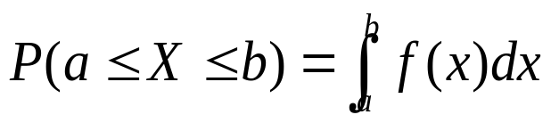
Review of Probability and Statistics
Probability Density Functions
  If X is a continuous random variable, then the p.d.f. of X is
  a function f(x) such that
  so that the probability that X has a value between a and
  b is the area of the density function from a to b.
  Note: f(x) ≥ 0 for all x
  area under entire graph = 1
  Example 1:
f(x)
a
b
x

Slide 4
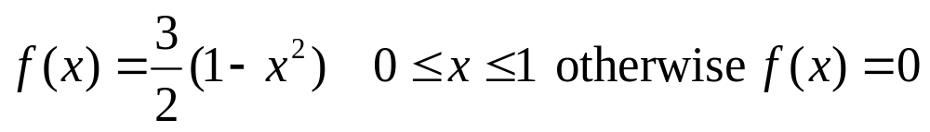
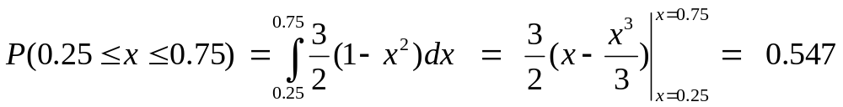
Review of Probability and Statistics
Probability Density Functions
  Example 2:
from Devore, p. 134
f(x)
a=0.25
b=0.75
x
Probability that x is between 0.25 and 0.75 is

Slide 5
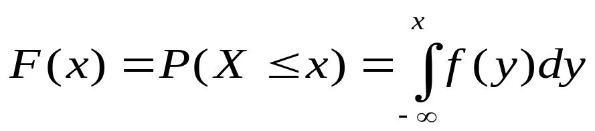
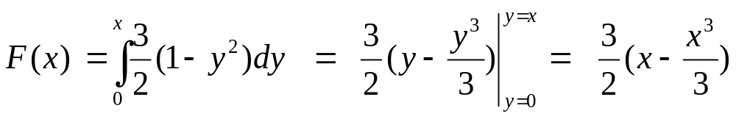
Review of Probability and Statistics
Cumulative Distribution Functions
  cumulative distribution function (c.d.f.) F(x) for c.r.v. X is:
  example:
f(x)
b=0.75
x
C.D.F. of f(x) is

Slide 6
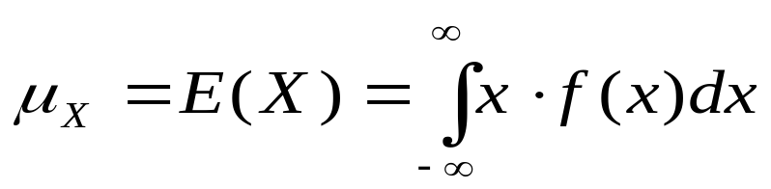
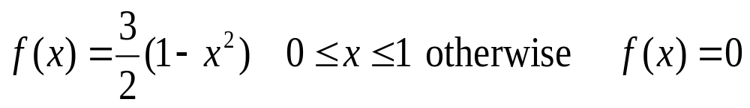
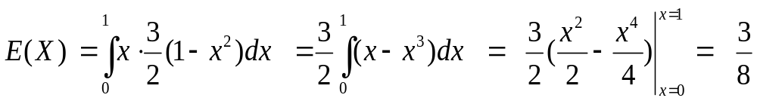
Review of Probability and Statistics
Expected Values
  expected (mean) value of c.r.v. X with p.d.f. f(x) is:
  example 1 (discrete):
  example 2 (continuous):
0.25
0.20
E(X) = 2·0.05+3·0.10+ … +9·0.05 = 5.35
0.15
0.15
0.10
0.05
0.05
0.05
1.0
2.0
3.0
4.0
5.0
6.0
7.0
8.0
9.0

Slide 7
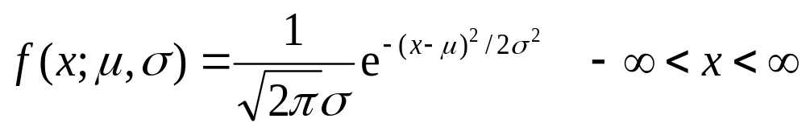
Review of Probability and Statistics
The Normal (Gaussian) Distribution
  the p.d.f. of a Normal distribution is
where μ is the mean and σ is the standard deviation
σ
μ
σ² is called the variance.

Slide 8
Review of Probability and Statistics
The Normal Distribution
  any arbitrary p.d.f. can be constructed by summing
  N weighted Gaussians (mixtures of Gaussians)
w₁
w₂
w₃
w₄
w₅
w₆

Slide 9
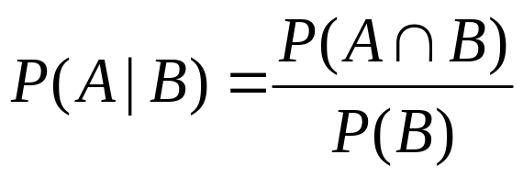

Review of Probability and Statistics
Conditional Probability
  event space
  the conditional probability of event A given that event B
  has occurred:
A
B
  the multiplication rule:

Slide 10
Review of Probability and Statistics
Conditional Probability: Example (from Devore, p.52)
  3 equally-popular airlines (1,2,3) fly from LA to NYC.
  Probability of 1 being delayed: 40%
  Probability of 2 being delayed: 50%
  Probability of 3 being delayed: 70%
  probability of selecting an airline=A, probability of delay=B
P(B|A₁) = 4/10
P(A₁∩B) = 1/3 × 4/10 = 4/30
Late = B
P(A₁ ) = 1/3
P(B’|A₁) = 6/10
A₁ = Airline 1
Not Late = B’
P(A₂ ) = 1/3
P(B|A₂) = 5/10
P(A₂∩B) = 1/3 × 5/10 = 5/30
A₂ = Airline 2
Late = B
P(B’|A₂) = 5/10
P(A₃ ) = 1/3
Not Late = B’
A₃ = Airline 3
P(B|A₃) = 7/10
Late = B
P(A₃∩B) = 1/3 × 7/10 = 7/30
P(B’|A₃) = 3/10
Not Late = B’

Slide 11
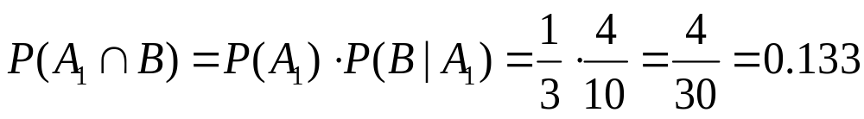
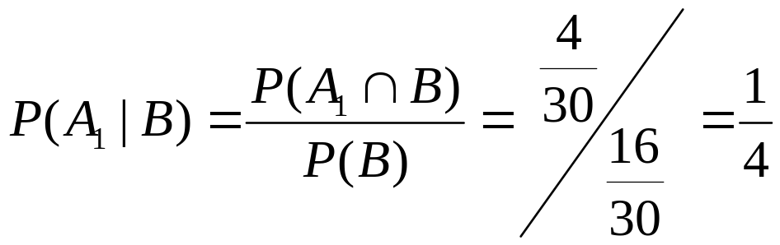
Review of Probability and Statistics
Conditional Probability: Example (from Devore, p.52)
  What is probability of choosing airline 1 and being delayed
  on that airline?
  What is probability of being delayed?
  Given that the flight was delayed, what is probability that
  the airline is 1?

Slide 12
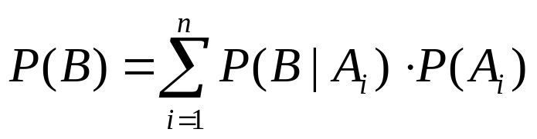
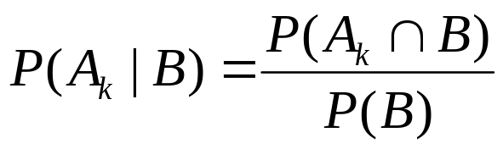
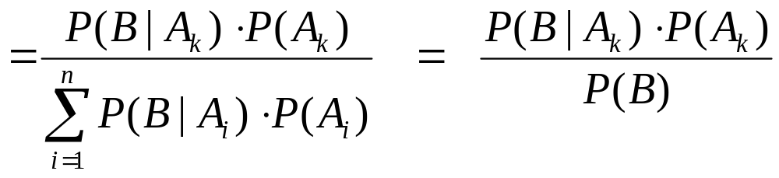
Review of Probability and Statistics
Law of Total Probability
  for independent events A₁, A₂, … A_{n} and any other event B:
Bayes’ Rule
  for independent events A₁, A₂, … A_{n} and any other event B,
  with P(A_{i}) > 0 and P(B) > 0:

Slide 13

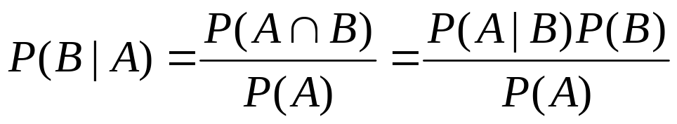

Review of Probability and Statistics
Independence
  events A and B are independent iff
  from multiplication rule or from Bayes’ rule,
  from multiplication rule and definition of independence, events A and B are independent iff

Slide 14
What is a Markov Model?
A Markov Model (Markov Chain) is:
similar to a finite-state automata, with probabilities of
transitioning from one state to another:
0.5
0.1
1.0
S₁
S₂
S₃
S₄
S₅
0.5
0.3
0.9
0.8
0.7
0.2
transition from state to state at discrete time intervals
can only be in 1 state at any given time

Slide 15
What is a Markov Model?
Elements of a Markov Model (Chain):
clock
t = {1, 2, 3, … T}
N states
Q = {1, 2, 3, … N}
N events
E = {e₁, e₂, e₃, …, e_{N}}
initial probabilities
π_{j} = P[q₁ = j] 1 ≤ j ≤ N
transition probabilities
a_{ij} = P[q_{t} = j | q_{t-1} = i] 1 ≤ i, j ≤ N

Slide 16
What is a Markov Model?
Elements of a Markov Model (chain):
the (potentially) occupied state at time t is called q_{t}
the occupied state referred to by its index: q_{t} = j
1 event corresponds to 1 state:
At each time t, the occupied state outputs (“emits”)
its corresponding event.
Markov model is generator of events.
each event is discrete, has single output.
in typical finite-state machine, actions occur at transitions,
but in most Markov Models, actions occur at each state.

Slide 17
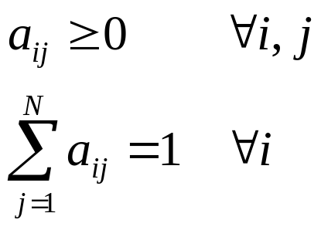
What is a Markov Model?
Transition Probabilities:
no assumptions (full probabilistic description of system):
P[q_{t} = j | q_{t-1}= i, q_{t-2}= k, … , q₁=m]
usually use first-order Markov Model:
P[q_{t} = j | q_{t-1}= i] = a_{ij}
first-order assumption:
  transition probabilities depend only on previous state
a_{ij} obeys usual rules:
sum of probabilities leaving a state = 1
(must leave a state)

Slide 18
What is a Markov Model?
Transition Probabilities:
example:
0.5
S₁
S₂
S₃
0.5
0.3
1.0
0.7
a₁₁ = 0.0 a₁₂ = 0.5 a₁₃ = 0.5 a_{1Exit}=0.0 Σ=1.0
a₂₁ = 0.0 a₂₂ = 0.7 a₂₃ = 0.3 a_{2Exit}=0.0 Σ=1.0
a₃₁ = 0.0 a₃₂ = 0.0 a₃₃ = 0.0 a_{3Exit}=1.0 Σ=1.0

Slide 19
What is a Markov Model?
Transition Probabilities:
probability distribution function:
S₁
S₂
S₃
0.6
0.4
p(remain in state S₂ exactly 1 time) = 0.4 ·0.6 = 0.240
p(remain in state S₂ exactly 2 times) = 0.4 ·0.4 ·0.6 = 0.096
p(remain in state S₂ exactly 3 times) = 0.4 ·0.4 ·0.4 ·0.6 = 0.038
= exponential decay (characteristic of Markov Models)

Slide 20
What is a Markov Model?
Transition Probabilities:
S₁
S₂
S₃
0.1
0.9
p(remain in state S₂ exactly 1 time) = 0.9 ·0.1 = 0.090
p(remain in state S₂ exactly 2 times) = 0.9 ·0.9 ·0.1 = 0.081
p(remain in state S₂ exactly 5 times) = 0.9 ·0.9 · ... ·0.1 = 0.059
a₂₂=0.9
(note:
in graph, no
multiplication
by a₂₃)
prob. of being in state
a₂₂=0.7
a₂₂=0.5
length of time in same state

Slide 21
What is a Markov Model?
Transition Probabilities:
can construct second-order Markov Model:
P[q_{t} = j | q_{t-1}= i, q_{t-2}= k]
q_{t-2}=S₂: 0.15
q_{t-2}=S₃: 0.25
S₁
S₂
q_{t-2}=S₁:0.10
q_{t-2}=S₃:0.30
q_{t-2}=S₁:0.2
q_{t-2}=S₁:0.3
q_{t-2}=S₂:0.2
q_{t-2}=S₂:0.3
q_{t-2}=S₂:0.1
q_{t-2}=S₁:0.25
q_{t-2}=S₃:0.2
q_{t-2}=S₃:0.35
S₃

Slide 22
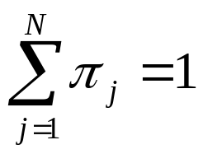
What is a Markov Model?
Initial Probabilities:
probabilities of starting in each state at time 1
denoted by π_{j}
π_{j} = P[q₁ = j] 1 ≤ j ≤ N

Slide 23
What is a Markov Model?
Example 1: Single Fair Coin
0.5
0.5
0.5
S₁
S₂
0.5
S₁ corresponds to e₁ = Heads a₁₁ = 0.5 a₁₂ = 0.5
S₂ corresponds to e₂ = Tails a₂₁ = 0.5 a₂₂ = 0.5
Generate events:
H T H H T H T T T H H
corresponds to state sequence
S₁ S₂ S₁ S₁ S₂ S₁ S₂ S₂ S₂ S₁ S₁

Slide 24
What is a Markov Model?
Example 2: Single Biased Coin (outcome depends on previous result)
0.7
0.6
0.3
S₁
S₂
0.4
S₁ corresponds to e₁ = Heads a₁₁ = 0.7 a₁₂ = 0.3
S₂ corresponds to e₂ = Tails a₂₁ = 0.4 a₂₂ = 0.6
Generate events:
H H H T T T H H H T T H
corresponds to state sequence
S₁ S₁ S₁ S₂ S₂ S₂ S₁ S₁ S₁ S₂ S₂ S₁

Slide 25
What is a Markov Model?
Example 3: Portland Winter Weather
0.7
0.5
0.25
S₁
S₂
0.4
0.2
0.7
0.05
0.1
S₃
0.1

Slide 26
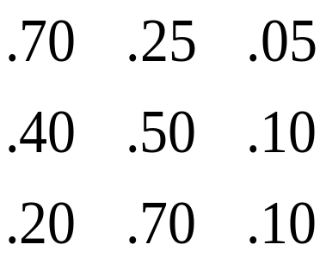
What is a Markov Model?
Example 3: Portland Winter Weather (con’t)
S₁ = event₁ = rain
S₂ = event₂ = clouds A = {a_{ij}} =
S₃ = event₃ = sun
what is probability of {rain, rain, rain, clouds, sun, clouds, rain}?
Obs. = {r, r, r, c, s, c, r}
S = {S₁, S₁, S₁, S₂, S₃, S₂, S₁}
time = {1, 2, 3, 4, 5, 6, 7} (days)
= P[S₁] P[S₁|S₁] P[S₁|S₁] P[S₂|S₁] P[S₃|S₂] P[S₂|S₃] P[S₁|S₂]
= 0.5 · 0.7 · 0.7 · 0.25 · 0.1 · 0.7 · 0.4
= 0.001715
π₁ = 0.5
π₂ = 0.4
π₃ = 0.1

Slide 27
What is a Markov Model?
Example 3: Portland Winter Weather (con’t)
S₁ = event₁ = rain
S₂ = event₂ = clouds A = {a_{ij}} =
S₃ = event₃ = sunny
what is probability of {sun, sun, sun, rain, clouds, sun, sun}?
Obs. = {s, s, s, r, c, s, s}
S = {S₃, S₃, S₃, S₁, S₂, S₃, S₃}
time = {1, 2, 3, 4, 5, 6, 7} (days)
= P[S₃] P[S₃|S₃] P[S₃|S₃] P[S₁|S₃] P[S₂|S₁] P[S₃|S₂] P[S₃|S₃]
= 0.1 · 0.1 · 0.1 · 0.2 · 0.25 · 0.1 · 0.1
= 5.0x10⁻⁷
π₁ = 0.5
π₂ = 0.4
π₃ = 0.1

Slide 28
What is a Markov Model?
Example 4: Marbles in Jars (lazy person)
(assume unlimited number of marbles)
Jar 1
Jar 2
Jar 3
0.6
0.6
0.3
S₁
S₂
0.2
0.1
0.3
0.1
0.2
S₃
0.6

Slide 29
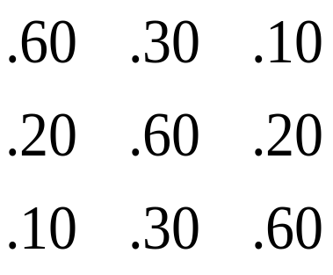
What is a Markov Model?
Example 4: Marbles in Jars (con’t)
S₁ = event₁ = black
S₂ = event₂ = white A = {a_{ij}} =
S₃ = event₃ = grey
what is probability of {grey, white, white, black, black, grey}?
Obs. = {g, w, w, b, b, g}
S = {S₃, S₂, S₂, S₁, S₁, S₃}
time = {1, 2, 3, 4, 5, 6}
= P[S₃] P[S₂|S₃] P[S₂|S₂] P[S₁|S₂] P[S₁|S₁] P[S₃|S₁]
= 0.33 · 0.3 · 0.6 · 0.2 · 0.6 · 0.1
= 0.0007128
π₁ = 0.33
π₂ = 0.33
π₃ = 0.33

Slide 30
What is a Markov Model?
Example 4A: Marbles in Jars
Jar 1
Jar 2
Jar 3
0.6
0.6
0.33
0.33
0.3
0.33
S₁
S₂
S₁
0.33
S₂
0.2
0.1
0.3
0.33
0.33
0.1
0.2
0.33
0.33
S₃
S₃
“lazy”
“random”
0.6
0.33
Same data, two different models...

Slide 31
What is a Markov Model?
Example 4A: Marbles in Jars
What is probability of:
{w, g, b, b, w}
given each model (“lazy” and “random”)?
S = {S₂, S₃, S₁, S₁, S₂}
time = {1, 2, 3, 4, 5}
“lazy” “random”
= P[S₂] P[S₃|S₂] P[S₁|S₃] P[S₁|S₁] P[S₂|S₁] = P[S₂] P[S₃|S₂] P[S₁|S₃] P[S₁|S₁] P[S₂|S₁]
= 0.33 · 0.2 · 0.1 · 0.6 · 0.3 = 0.33 · 0.33 · 0.33 · 0.33 · 0.33
= 0.001188 = 0.003913
{w, g, b, b, w} has greater probability if generated by “random.”
⇒“random” model more likely to generate {w, g, b, b, w}.

Slide 32
What is a Markov Model?
Notes:
Independence is assumed between events that are separated by
more than one time frame, when computing probability of sequence
of events (for first-order model).
Given list of observations, I can determine exact state sequence.
⇒ state sequence not hidden.
Each state associated with only one event (output).
Computing probability of a given observation and model is
straightforward.
Given multiple Markov Models and an observation sequence,
it’s easy to determine the M.M. most likely to have generated
the data.

