Slide 1
CSE 552/652
Hidden Markov Models for Speech Recognition
Spring, 2006
Oregon Health & Science University
OGI School of Science & Engineering
John-Paul Hosom
Lecture Notes for April 12
Hidden Markov Models, Vector Quantization

Slide 2
Review: Markov Models
Example 4: Marbles in Jars (lazy person)
(assume unlimited number of marbles)
Jar 1
Jar 2
Jar 3
0.6
0.6
0.3
S₁
S₂
0.2
0.1
0.3
0.1
0.2
S₃
0.6

Slide 3
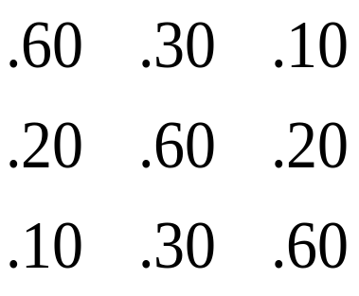
Review: Markov Models
Example 4: Marbles in Jars (con’t)
S₁ = event₁ = black
S₂ = event₂ = white A = {a_{ij}} =
S₃ = event₃ = grey
what is probability of {grey, white, white, black, black, grey}?
Obs. = {g, w, w, b, b, g}
S = {S₃, S₂, S₂, S₁, S₁, S₃}
time = {1, 2, 3, 4, 5, 6}
= P[S₃] P[S₂|S₃] P[S₂|S₂] P[S₁|S₂] P[S₁|S₁] P[S₃|S₁]
= 0.33 · 0.3 · 0.6 · 0.2 · 0.6 · 0.1
= 0.0007128
π₁ = 0.33
π₂ = 0.33
π₃ = 0.33

Slide 4
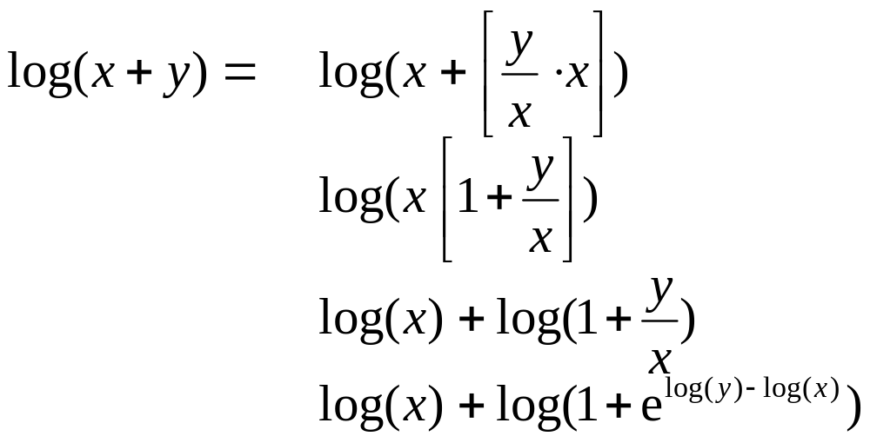
Log-Domain Mathematics
When multiplying many numbers together, we run the risk of
underflow errors… one solution is to transform everything into
the log domain:
linear domain log domain
x^{y} e^{y} · x
x·y x+y
x+y logAdd(x,y)
logAdd(x,y) computes sum of x and y when both x and y are
already in log domain.

Slide 5
Log-Domain Mathematics
log-domain mathematics avoids underflow, allows (expensive)
multiplications to be transformed to (cheap) additions.
Typically used in HMMs, because there are a large number of
multiplications… O(F) where F is the number of frames. If
F is moderately large (e.g. 5 seconds of speech = 500 frames),
even large probabilities (e.g. 0.9) yield small results:
0.9⁵⁰⁰ = 1.3×10⁻²³
0.65⁵⁰⁰ = 2.8×10⁻⁹⁴
.5¹⁰⁰ = 7.9×10⁻³¹
.12¹⁰⁰ = 8.3×10⁻⁹³
For the examples in class, we’ll stick with linear domain,
but in class projects, you’ll want to use log domain math.
Major point: logAdd(x,y) is NOT same as log(x×y) = log(x)+log(y)

Slide 6
What is a Hidden Markov Model?
Hidden Markov Model:
more than 1 event associated with each state.
all events have some probability of emitting at each state.
given a sequence of outputs, we can’t determine exactly
the state sequence.
We can compute the probabilities of different state sequences
given an output sequence.
Doubly stochastic (probabilities of both emitting events and
transitioning between states); exact state sequence is “hidden.”

Slide 7
What is a Hidden Markov Model?
Elements of a Hidden Markov Model:
clock t = {1, 2, 3, … T}
N states Q = {1, 2, 3, … N}
M events E = {e₁, e₂, e₃, …, e_{M}}
initial probabilities π_{j} = P[q₁ = j] 1 ≤ j ≤ N
transition probabilities a_{ij} = P[q_{t} = j | q_{t-1} = i] 1 ≤ i, j ≤ N
observation probabilities b_{j}(k)=P[o_{t} = e_{k} | q_{t} = j] 1 ≤ k ≤ M
b_{j}(o_{t})=P[o_{t} = e_{k} | q_{t} = j] 1 ≤ k ≤ M
A = matrix of a_{ij} values, B = set of observation probabilities,
π = vector of π_{j} values.
Entire Model: λ = (A,B,π)

Slide 8
What is a Hidden Markov Model?
Notes:
an HMM still generates observations,
each state is still discrete,
observations can still come from a finite set (discrete HMMs).
the number of items in the set of events does not have to
be the same as the number of states.
when in state S,
there’s p(e₁) of generating event 1,
there’s p(e₂) of generating event 2, etc.
S₁
S₂
0.5
0.1
p_{S1}(black) = 0.3
p_{S1}(white) = 0.7
p_{S2}(black) = 0.6
p_{S2}(white) = 0.4
0.5
0.9

Slide 9
What is a Hidden Markov Model?
Example 1: Marbles in Jars (lazy person)
(assume unlimited number of marbles)
0.6
0.6
State 1
State 2
State 3
0.3
S₁
S₂
0.2
Jar 1
Jar 2
Jar 3
0.1
0.3
p(b) =0.8
p(w)=0.1
p(g) =0.1
p(b) =0.2
p(w)=0.5
p(g) =0.3
p(b) =0.1
p(w)=0.2
p(g) =0.7
0.1
0.2
S₃
π₁=0.33
π₂=0.33
π₃=0.33
0.6

Slide 10
What is a Hidden Markov Model?
Example 1: Marbles in Jars (lazy person)
(assume unlimited number of marbles)
With the following observation:
What is probability of this observation, given state sequence
{S₃ S₂ S₂ S₁ S₁ S₃} and the model??
= b₃(g) b₂(w) b₂(w) b₁(b) b₁(b) b₃(g)
= 0.7 ·0.5 · 0.5 · 0.8 · 0.8 · 0.7
= 0.0784
g w w b b g

Slide 11
What is a Hidden Markov Model?
Example 1: Marbles in Jars (lazy person)
(assume unlimited number of marbles)
With the same observation:
What is probability of this observation, given state sequence
{S₁ S₁ S₃ S₂ S₃ S₁} and the model??
= b₁(g) b₁(w) b₃(w) b₂(b) b₃(b) b₁(g)
= 0.1 ·0.1 · 0.2 · 0.2 · 0.1 · 0.1
= 4.0x10⁻⁶
g w w b b g

Slide 12
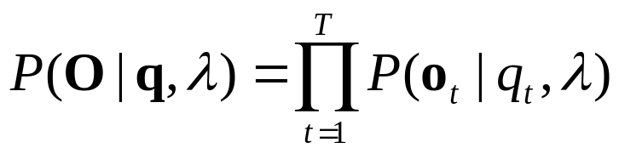
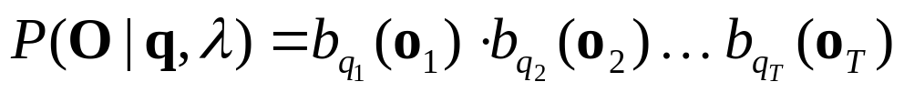
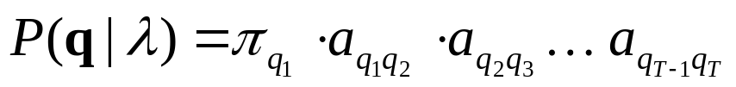
What is a Hidden Markov Model?
Some math…
With an observation sequence O=(o₁ o₂ … o_{T}), state sequence
q=(q₁ q₂ … q_{T}), and model λ:
Probability of O, given state sequence q and model λ, is:
assuming independence between observations. This expands:
The probability of the state sequence q can be written:

Slide 13

What is a Hidden Markov Model?
The probability of both O and q occurring simultaneously is:
which can be expanded to:
Independence between a_{ij} and b_{j}(o_{t}) is NOT assumed:
this is just multiplication rule: P(A∩B) = P(A | B) P(B)

Slide 14
What is a Hidden Markov Model?
Example 2: Weather and Atmospheric Pressure
0.6
0.2
0.3
P( )=0.1
P( )=0.2
P( )=0.8
P( )=0.3
P( )=0.4
P( )=0.3
H
M
0.3
0.1
0.6
0.1
0.5
π_{H} = 0.4
π_{M} = 0.2
π_{L} = 0.4
L
P( )=0.6
P( )=0.3
P( )=0.1
0.3

Slide 15
What is a Hidden Markov Model?
Example 2: Weather and Atmospheric Pressure
If weather observation O={sun, sun, cloud, rain, cloud, sun}
what is probability of O, given the model and the sequence
{H, M, M, L, L, M}?
= b_{H}(sun) b_{M}(sun) b_{M}(cloud) b_{L}(rain) b_{L}(cloud) b_{M}(sun)
= 0.8 ·0.3 · 0.4 · 0.6 · 0.3 · 0.3
= 5.2x10⁻³

Slide 16
What is a Hidden Markov Model?
Example 2: Weather and Atmospheric Pressure
What is probability of O={sun, sun, cloud, rain, cloud, sun}
and the sequence {H, M, M, L, L, M}, given the model?
= π_{H}·b_{H}(s) ·a_{HM}·b_{M}(s) ·a_{MM}·b_{M}(c) ·a_{ML}·b_{L}(r) ·a_{LL}·b_{L}(c) ·a_{LM}·b_{M}(s)
= 0.4 · 0.8 · 0.3 · 0.3 · 0.2 · 0.4 · 0.5 · 0.6 · 0.3 · 0.3 · 0.6 · 0.3
= 1.12x10⁻⁵
What is probability of O={sun, sun, cloud, rain, cloud, sun}
and the sequence {H, H, M, L, M, H}, given the model?
= π_{H}·b_{H}(s) ·a_{HH}·b_{H}(s) ·a_{HM}·b_{M}(c) ·a_{ML}·b_{L}(r) ·a_{LM}·b_{M}(c) ·a_{MH}·b_{H}(s)
= 0.4 · 0.8 · 0.6 · 0.8 · 0.3 · 0.4 · 0.5 · 0.6 · 0.6 · 0.4 · 0.3 · 0.6
= 2.39x10⁻⁴

Slide 17
What is a Hidden Markov Model?
Notes about HMMs:
must know all possible states in advance
must know possible state connections in advance
cannot recognize things outside of model
must have some estimate of state emission probabilities
and state transition probabilities
make several assumptions (usually so math is easier)
if we can find best state sequence through an HMM for
a given observation, we can compare multiple HMMs
for recognition. (next week)

Slide 18
What is a Hidden Markov Model?
questions??

Slide 19
HMM Topologies
There are a number of common topologies for HMMs:
Ergodic (fully-connected)
Bakis (left-to-right)
0.6
0.2
0.3
S₁
0.3
S₂
π₁ = 0.4
π₂ = 0.2
π₃ = 0.4
0.1
0.6
0.1
0.5
S₃
0.3
0.6
0.4
0.1
1.0
π₁ = 1.0
π₂ = 0.0
π₃ = 0.0
π₄ = 0.0
0.3
0.4
0.9
S₁
S₂
S₃
S₄
0.1
0.2

Slide 20
HMM Topologies
Many varieties are possible:
Topology defined by the state transition matrix (If an
element of this matrix is zero, there is no transition between
those two states).
0.4
0.6
0.7
0.3
1.0
π₁ = 0.5
π₂ = 0.0
π₃ = 0.0
π₄ = 0.5
π₅ = 0.0
π₆ = 0.0
0.3
S₂
S₄
0.3
0.4
S₁
0.2
0.5
0.2
S₆
0.8
0.3
S₃
S₅
a₁₁ a₁₂ a₁₃ 0
0.0 a₂₂ a₂₃ a₂₄
0.0 0.0 a₃₃ a₃₄
0.0 0.0 0.0 a₄₄
A =

Slide 21
HMM Topologies
The topology must be specified in advance by the system
designer
Common use in speech is to have one HMM per phoneme,
and three states per phoneme. Then, the phoneme-level
HMMs can be connected to form word-level HMMs
0.6
0.3
0.5
π₁ = 1.0
π₂ = 0.0
π₃ = 0.0
0.4
0.7
0.5
A₁
A₂
A₃
0.5
0.2
0.3
0.6
0.3
0.5
0.6
0.2
4.0
0.5
0.8
0.7
0.4
0.7
0.5
0.4
0.8
0.6
B₁
B₂
B₃
A₁
A₂
A₃
T₁
T₂
T₃

Slide 22
Vector Quantization
Vector Quantization (VQ) is a method of automatically partitioning a feature space into different clusters based on training data.
Given a test point (vector) from the feature space, we can determine the cluster that this point should be associated with.
A “codebook” lists central locations of each cluster, and gives each cluster a name (usually a numerical index).
This can be used for data reduction (mapping a large number
of feature points to a much smaller number of clusters), or for probability estimation.
Requires data to train on, a distance measure, and test data.

Slide 23
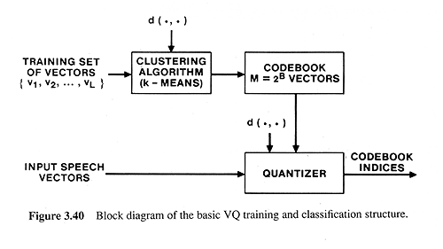
Vector Quantization
Required distance measure:
d(v_{i},v_{j}) = d_{ij}
= 0 if v_{i} = v_{j}
> 0 otherwise
Should also have symmetry and triangle inequality properites.
Often use Euclidean spectral/cepstral distance.
Vector Quantization for pattern classification:

Slide 24
Vector Quantization
How to “train” a VQ system (generate a codebook)?
K-means clustering
  1. Initialization:
  choose M data points (vectors) from L training vectors
  (typically M=2^{B}) as initial code words… random or
  maximum distance.
  2. Search:
  for each training vector, find the closest code word,
  assign this training vector to that code word’s cluster.
  3. Centroid Update:
  for each code word cluster (group of data points associated
  with a code word), compute centroid. The new code word
  is the centroid.
  4. Repeat Steps (2)-(3) until average distance falls below
  threshold (or no change). Final codebook contains identity
  and location of each code word.

Slide 25
Vector Quantization
Example
Given the following data points, create codebook of 4 clusters,
with initial code word values at (2,2), (4,6), (6,5), and (8,8)
9
9
8
8
7
7
6
6
5
5
4
4
3
3
2
2
1
1
0
0
0
1
2
3
4
5
6
7
8
9
0
1
2
3
4
5
6
7
8
9

Slide 26
Vector Quantization
Example
compute centroids of each code word, re-compute nearest
neighbor, re-compute centroids...
9
9
8
8
7
7
6
6
5
5
4
4
3
3
2
2
1
1
0
0
0
1
2
3
4
5
6
7
8
9
0
1
2
3
4
5
6
7
8
9

Slide 27
Vector Quantization
Example
Once there’s no more change, the feature space will be
partitioned into 4 regions. Any input feature can be classified
as belonging to one of the 4 regions. The entire codebook is specified by the 4 centroid points.
9
8
Voronoi cell
7
6
5
4
3
2
1
0
0
1
2
3
4
5
6
7
8
9

Slide 28
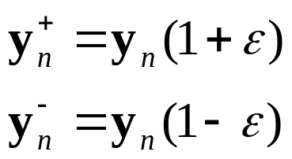
Vector Quantization
How to Increase Number of Clusters?
Binary Split Algorithm
  1. Design 1-vector codebook (no iteration)
  2. Double codebook size by splitting each code word y_{n}
  according to the rule:
  where 1≤n≤M, and ε is a splitting parameter (0.01≤ ε ≤0.05)
  3. Use K-means algorithm to get best set of centroids
  4. Repeat (2)-(3) until desired codebook size is obtained.

Slide 29
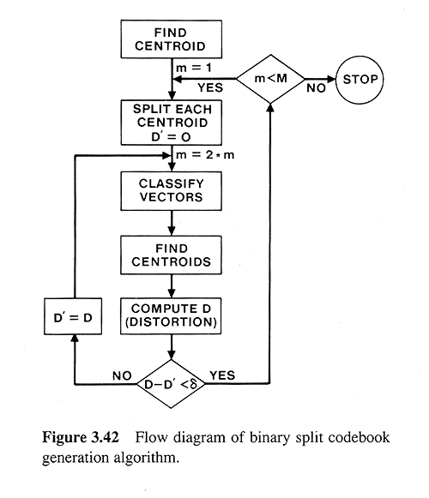
Vector Quantization

Slide 30
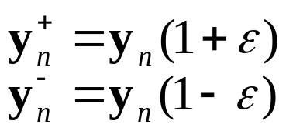
Vector Quantization
Given a set of data points, create a codebook with 2 code words:
1.
create codebook with
one code word, y_{n}
create 2 code words from
the original code word:
2.
3.
use K-means to assign all data
points to new code words
4.
and compute new centroids,
repeat (3) and (4) until stable

Slide 31
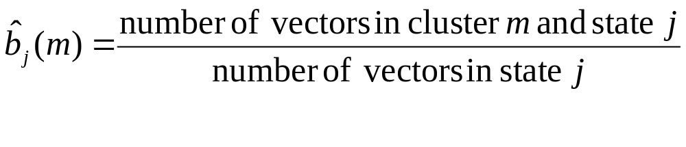
Vector Quantization
Notes:
If we keep training data information (number of data points per
code word), VQ can be used to construct “discrete” HMM
observation probabilities:
Classification and probability estimation using VQ is fast…
just table lookup
No assumptions are made about Normal or other probability
distribution of training data
Quantization error may occur if samples near codebook boundary

Slide 32
Vector Quantization
Vector quantization used in “discrete” HMM
Given input vector, determine discrete centroid with best match
Probability depends on relative number of training samples
in that region
feature value 2
for state j
feature value 1 for state j
b_{j}(k) = number of vectors with codebook index k in state j
number of vectors in state j
14 1
= =
56 4

Slide 33
Vector Quantization
Other states have their own data, and their own VQ partition
Important that all states have same number of code words
For HMMs, compute the probability that observation o_{t} is generated
by each state j. Here, there are two states, red and blue:
b_{blue}(o_{t}) = 14/56 = 1/4 = 0.25
b_{red}(o_{t}) = 8/56 = 1/7 = 0.14

Slide 34

Vector Quantization
A number of issues need to be addressed in practice:
what happens if a single cluster gets a small number of points,
but other clusters could still be reliably split?
how are initial points selected?
how is determined?
other clustering techniques (pairwise nearest neighbor,
Lloyd algorithm, etc)
splitting a tree using “balanced growing” (all nodes split at
same time) or “unbalanced growing” (split one node at a time)
tree pruning algorithms…
different splitting algorithms…

