Slide 1
CSE 552/652
Hidden Markov Models for Speech Recognition
Spring, 2006
Oregon Health & Science University
OGI School of Science & Engineering
John-Paul Hosom
Lecture Notes for April 17:
Vector Quantization review;
Computing Probabilities from PDFs;
Gaussian Mixture Models;
Features

Slide 2

Review: HMMs
Elements of a Hidden Markov Model:
clock t = {1, 2, 3, … T}
N states Q = {q₁, q₂, q₃, …, q_{N}}
M events E = {e₁, e₂, e₃, …, e_{M}}
initial probabilities π_{j} = P[q₁ = j] 1 ≤ j ≤ N
transition probabilities a_{ij} = P[q_{t} = j | q_{t-1} = i] 1 ≤ i, j ≤ N
observation probabilities b_{j}(k)=P[o_{t} = e_{k} | q_{t} = j] 1 ≤ k ≤ M
b_{j}(o_{t})=P[o_{t} = e_{k} | q_{t} = j] 1 ≤ k ≤ M
Entire Model: λ = (A,B,π)
The probability of both O and q occurring simultaneously is:
which can be expanded to:

Slide 3
Review: HMMs
Example: Weather and Atmospheric Pressure
0.6
0.2
0.3
P( )=0.1
P( )=0.2
P( )=0.8
P( )=0.3
P( )=0.4
P( )=0.3
H
M
0.4
0.1
0.7
0.1
0.5
π_{H} = 0.4
π_{M} = 0.2
π_{L} = 0.4
L
P( )=0.6
P( )=0.3
P( )=0.1
0.4

Slide 4
Review: HMMs
Example: Weather and Atmospheric Pressure
What is probability of O={sun, sun, cloud, rain, cloud, sun}
and the sequence {H, M, M, L, L, M}, given the model?
= π_{H}·b_{H}(s) ·a_{HM}·b_{M}(s) ·a_{MM}·b_{M}(c) ·a_{ML}·b_{L}(r) ·a_{LL}·b_{L}(c) ·a_{LM}·b_{M}(s)
= 0.4 · 0.8 · 0.3 · 0.3 · 0.2 · 0.4 · 0.5 · 0.6 · 0.4 · 0.3 · 0.7 · 0.3
= 1.74x10⁻⁵
What is probability of O={sun, sun, cloud, rain, cloud, sun}
and the sequence {H, H, M, L, M, H}, given the model?
= π_{H}·b_{H}(s) ·a_{HH}·b_{H}(s) ·a_{HM}·b_{M}(c) ·a_{ML}·b_{L}(r) ·a_{LM}·b_{M}(c) ·a_{MH}·b_{H}(s)
= 0.4 · 0.8 · 0.6 · 0.8 · 0.3 · 0.4 · 0.5 · 0.6 · 0.7 · 0.4 · 0.4 · 0.8
= 4.95x10⁻⁴

Slide 5
Review: Vector Quantization
Vector Quantization (VQ) is a method of automatically partitioning a feature space into different clusters based on training data.
Given a test point (vector) from the feature space, we can determine the cluster that this point should be associated with.
A “codebook” lists central locations of each cluster, and gives each cluster a name (usually a numerical index).
This can be used for data reduction (mapping a large number
of feature points to a much smaller number of clusters), or for probability estimation.

Slide 6
Review: Vector Quantization
How to “train” a VQ system (generate a codebook)?
K-means clustering
  1. Initialization:
  choose M data points (vectors) from L training vectors
  (typically M=2^{B}) as initial code words… random or
  maximum distance.
  2. Search:
  for each training vector, find the closest code word,
  assign this training vector to that code word’s cluster.
  3. Centroid Update:
  for each code word cluster (group of data points associated
  with a code word), compute centroid. The new code word
  is the centroid.
  4. Repeat Steps (2)-(3) until average distance falls below
  threshold (or no change). Final codebook contains identity
  and location of each code word.

Slide 7
Review: Vector Quantization
Vector quantization used in “discrete” HMM
Given input vector, determine discrete centroid with best match
Probability depends on relative number of training samples
in that region
feature value 2
for state j
feature value 1 for state j
b_{j}(k) = number of vectors with codebook index k in state j
number of vectors in state j
14 1
= =
56 4

Slide 8
Review: Vector Quantization
Other states have their own data, and their own VQ partition
Important that all states have same number of code words
For HMMs, compute the probability that observation o_{t} is generated
by each state j. Here, there are two states, red and blue:
b_{blue}(o_{t}) = 14/56 = 1/4 = 0.25
b_{red}(o_{t}) = 8/56 = 1/7 = 0.14

Slide 9
Vector Quantization
Features ⇔ observations, probability of feature = b_{j}(o_{t})
However, quantization error can arise when modeling a
continuous signal (feature space) with discrete units (clusters)
What happens to p(x) if feature space moves back and forth
between bins 3 and 4? What about between bins 5 and 6?
In addition, initialization can influence the location and
histogram counts of the final clusters… want more robustness
p(x)
1
2
3
4
5
6
7
8
9
10
11
12
13
x

Slide 10
Continuous Probability Distribution
What we want is a smooth, robust estimate of p(x) (and b_{j}(o_{t}))!!
How about this:
Now, small movement along x axis has smooth, gradual effect
on p(x).
Still a question about initialization… we’ll address that later.
p(x)
x

Slide 11
Continuous Probability Distribution
One way of creating such a smooth model is to use a mixture
of Gaussian probability density functions (p.d.f.s).
The detail of the model is related to the number of Gaussian
components
This Gaussian Mixture Model (GMM) is characterized by
(a) the number of components,
(b) the mean and standard deviation of each component,
(c) the weight (height) of each component
One remaining question: how to compute probabilities from p.d.f.
at one point (a single x value)
p(x)
x

Slide 12
Computing Probabilities From Probability Density Functions
The probability of an event is computed as the integral of the p.d.f. over a range of values. Therefore, a p.d.f. is a plot of the change in probability at each x (time) point. The units on the vertical axis are probability-per-x-unit.
Example 1:
I am waiting for an earthquake. All I know is that it could happen at any time, but it will definitely happen within the next 100 years. My time scale is in years. What is the p.d.f.
of an earthquake?
The y axis is in units of probability-of-earthquake-per-year. The probability of an earthquake within 100 years is 1.0.
The probability of an earthquake within the next 40 years is 0.4
0.01
0
100

Slide 13
Computing Probabilities From Probability Density Functions
Example 2:
I am waiting for an earthquake. All I know is that it could happen at any time, but it will definitely happen within the next 100 years. My time scale is in days. What is the p.d.f.
of an earthquake? (Assume 1 year = 365 days)
The y axis is in units of probability-of-earthquake-per-day.
The probability of an earthquake within the next 100 years (36,500) days is 1.0, because it’s the area under the “curve” from 0 to 100, and the area of the rectangle is 36,500 × 2.74×10⁻⁵= 1.0. The probability of an earthquake within the next 40 years is 14,600 days × 2.74×10⁻⁵ = 0.4
2.74×10⁻⁵
0
36500

Slide 14
Computing Probabilities From Probability Density Functions
Example 3:
I am waiting for an earthquake. All I know is that it could happen at any time, but it will definitely happen within the next 100 years. My time scale is in millennia. What is the p.d.f.
of an earthquake? (Define 1 millenium = 1000 years)
The y axis is in units of probability-of-earthquake-per-millenium. The probability of an earthquake within the next 100 years (0.1 millennia) days is 1.0, because it’s the area under the “curve” from 0 to 0.1, and the area of the rectangle is 0.1 × 10 = 1.0. The probability of an earthquake within the next 40 years is 0.04 × 10 = 0.4
10
0
0.1
…
1

Slide 15
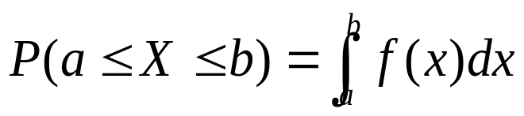
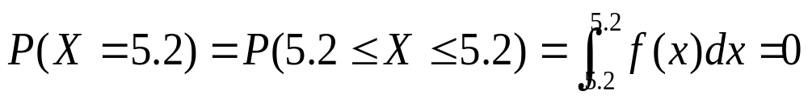
Computing Probabilities From Probability Density Functions
For speech recognition, we are given a data point for one frame of speech, and we want to know the probability of observing this data point (or vector of data points).
The probability of observing any single value along a continuous scale is 0.0, because
and so
The probability of a specific data point (or vector) is then zero.
But this will not allow us to perform speech recognition, if the
probability of any and all observations is zero.
In order to obtain useful data, we compute the probability of a specific data point a over a range from a–ε to a+ε, and let ε approach the limit of zero. Furthermore, we multiply the p.d.f. by a scaling function that increases as ε approaches zero.

Slide 16
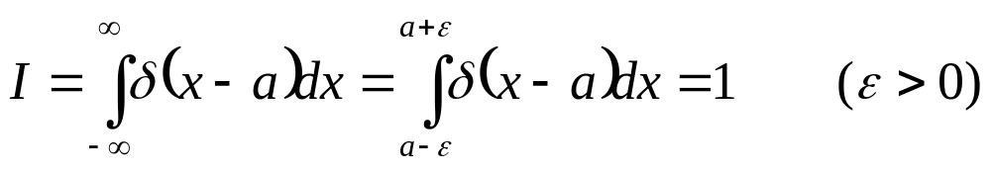
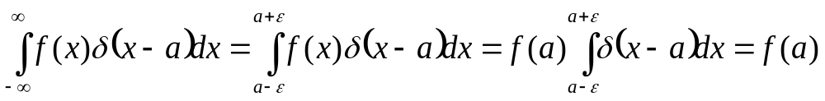
Computing Probabilities From Probability Density Functions
Define Dirac delta function: (not really a true function, but close enough)
The value is zero for all values less than a-ε and for all values greater than a+ε. The integral over this range is one. Also, ε approaches zero.
If we multiply this delta function by an arbitrary p.d.f. and integrate, the result is the value of the p.d.f. at point a, as ε approaches zero:
As ε approaches zero, the function f(x) approaches the constant value f(a). Constants can be moved outside the integration.

Slide 17
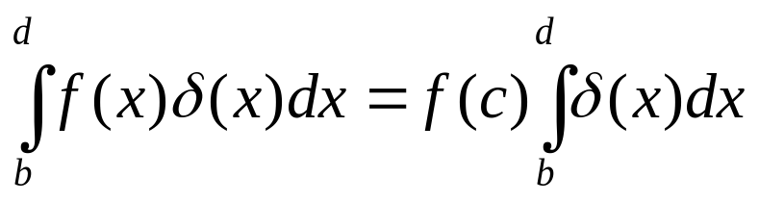
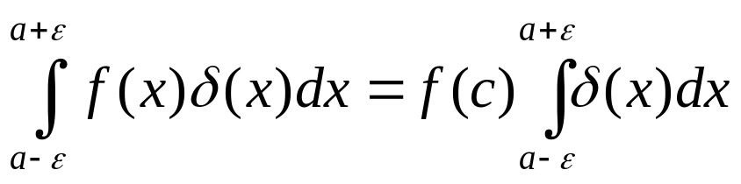
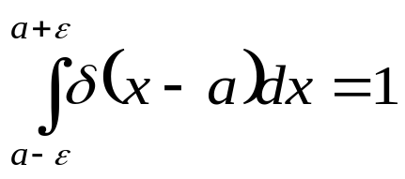
Computing Probabilities From Probability Density Functions
Why does f(x) approach f(a) as ε approaches zero?
(Generalized) Mean-Value Theorem for Integration:
If f(x) is continuous on [b,d], and δ(x) is an integrable positive function, then there is at least one number c in range (b,d) for which
If b=a-ε and d=a+ε, then
and as ε approaches zero, c approaches a, because a-ε < c <a+ε
From the definition of the delta function, so:
1

Slide 18
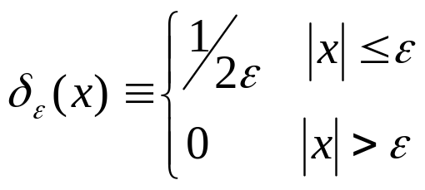
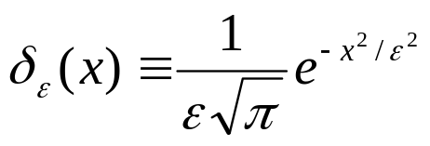
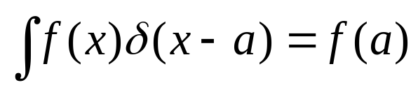
Computing Probabilities From Probability Density Functions
Example delta functions:
Example of ε approaching the limit of zero for an arbitrary p.d.f., f(x), using impulse function:
(Gaussian)
ε₃=0.25, δ(x)=1/8
ε₂=0.5, δ(x)=1/4
f(x),
δ(x)
ε₁=1, δ(x)=1/2
ε₁
a
ε₁
As ε decreases, area remains 1, probability of a approaches

Slide 19
Computing Probabilities From Probability Density Functions
So, the probability of an interval approaches zero as the limit approaches zero, but the scaling factor (delta function between a-ε and a+ε) approaces infinity. When we integrate the p.d.f. multiplied by the scaling factor, the result is a useful number, namely the value of the p.d.f. at point a.
As long as the p.d.f.s are comparable (have the same y-axis units), we can compare “scaled” probability values of different points. However, if the y-axis units change, then the results need to be normalized in order to be comparable.
The y-axis units change when the x-axis units change, so the normalizing factor will be different when x-axis dimensions are different.
This normalizing factor will be seen later when we combine observation probabilities with language-model probabilities.

Slide 20
Computing Probabilities From Probability Density Functions
For example, the probability of an earthquake at any particular instant should be the same (and non-zero), regardless of whether the scale used to construct the p.d.f. is measured in days, years, or millennia. The same small but non-zero value of ε, however, represents a distance that is 1000 times larger when the x-axis scale is millennia than when the scale is in years. So we can only compare probabilities after we have normalized by the difference in x-axis units.
If pdf_{x=millennia}(0.05) = 10 and
pdf_{x=years}(50) = 0.01
but we want p(50_{years}= 0.05_{millennia}) to have the same non-zero probability value at the same time instant, then we can compare or combine p.d.f. “probabilities” only if we normalize, e.g.
pdf_{x=millennia}(0.05)/1000 = pdf_{x=years}(50)
where the normalizing factor is the difference in x-axis scale. When the x-axis scales have different meanings (e.g. quefrency vs. frequency), the (linear) normalizing factor is not obvious.

Slide 21
Computing Probabilities From Probability Density Functions
In short, we will use p.d.f. values evaluated at a single point (or vector) as the probability of that point (or vector).
These values are not true probabilities, but they do maintain the relative relationship and scale of probabilities that are properly computed over (infinitely) small x-axis regions.
As a result:
  Combining or comparing “probabilities” from different p.d.f.s may require a (unknown) scaling factor if the dimensions of the p.d.f. axes are different.
  “Probability” values obtained from a p.d.f may be greater than 1.0. (Only the integral must be one; any individual point on the p.d.f. (which represents change in probability per x-axis unit) may have any positive value.)

Slide 22
Gaussian Mixture Models
Typical HMMs for speech are continuous-density HMMs
Use Gaussian Mixture Models (GMMs) to estimate probability
of “emitting” each observation given the speech category (state).
probability
feature value
Features ⇔ observations, probability of feature = b_{j}(o_{t})

Slide 23
Gaussian Mixture Models
The GMM has the same dimension as the feature space
(13 PLP coefficients = 13-dimensional GMM;
2 formant frequencies = 2-dimensional GMM)
For visualization purposes, here are 2-dimensional GMMs:
likelihood
feature1
feature2
feature2
feature1

Slide 24
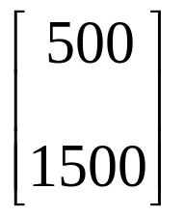
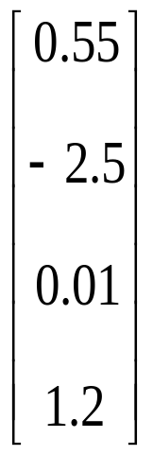
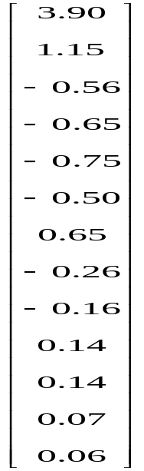
Gaussian Mixture Models
The GMM has the same dimension as the feature space
(13 “PLP” coefficients = 13-dimensional GMM;
2 formant frequencies = 2-dimensional GMM)
We’ll write observations as vectors in the feature space,
with the dimension of the feature space the length of the
vector:
2 dimensions 4 dimensions 13 dimensions

Slide 25
Gaussian Mixture Models
Use of multiple Gaussian components does not assume
speech data are Normally distributed (if use enough mixtures)
Use of GMMs is not discriminatory:
probability
feature value
state 1
state 2

Slide 26
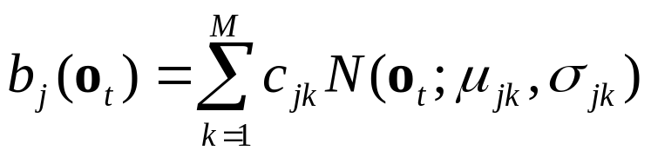
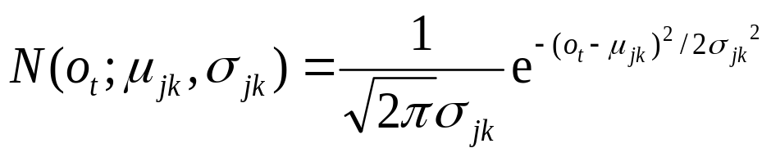
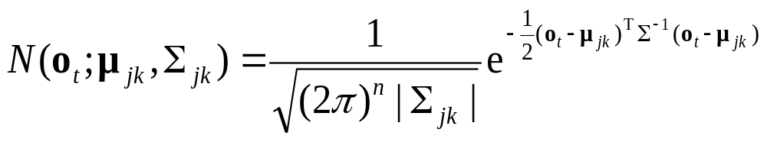
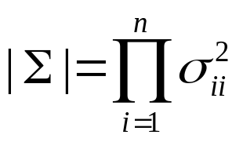
Gaussian Mixture Models
number of mixture components;
different from number of events
Equations for GMMs:
(a) single-dimensional case:
mixture weights
(b) multi-dimensional case: n is dimension of feature vector
μ becomes vector μ,
σ becomes covariance matrix Σ.
T=transpose,
not end time
assume Σ is diagonal matrix:
1
0
0
σ²₁₁
1
Σ⁻¹ =
0
0
σ²₂₂
1
0
0
σ²₃₃

Slide 27
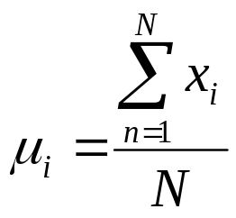
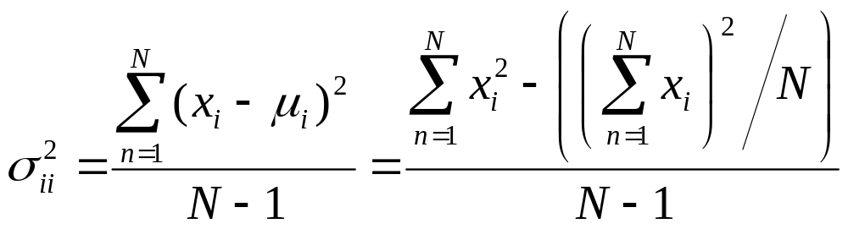
Gaussian Mixture Models
To simplify calculations, assume diagonal matrix for Σ
This assumes lack of correlation among the features
Not true for speech!! (but makes the math easier.)
One reason for using cepstral features = mostly uncorrelated
Some labs (MIT) use full covariance matrix
Mean of the i^{th} dimension in multi-dimensional feature array:
Covariance of the i^{th} dimension in multi-dimensional feature array:
using N will
underestimate σ²
for small
population sizes

Slide 28
Gaussian Mixture Models
Comparing continuous (GMM) and discrete (VQ) HMMs:
Continuous HMMs:
□ assume independence of features for diagonal matrix
□ require large number of components to represent arbitrary
function
□ large number of parameters = slow, can’t always
train well
□ small number of components may not represent speech well
Discrete HMMs:
□ quantization errors at boundaries
□ relies on how well VQ partitions the space
□ sometimes problems estimating probabilities when
unusual input vector not seen in training

Slide 29


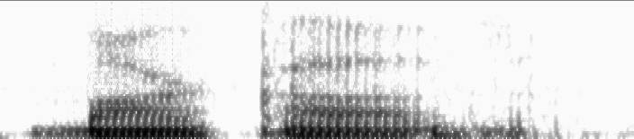
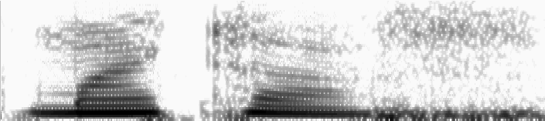
Features: How to Represent the Speech Signal
Features must (a) provide good representation of phonemes
(b) be robust to non-phonetic changes in signal
Time domain (waveform):
Frequency domain (spectrogram):
“Markov”: male speaker
“Markov”: female speaker

Slide 30
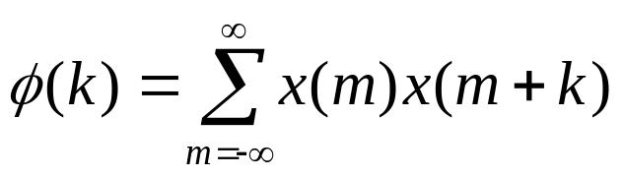
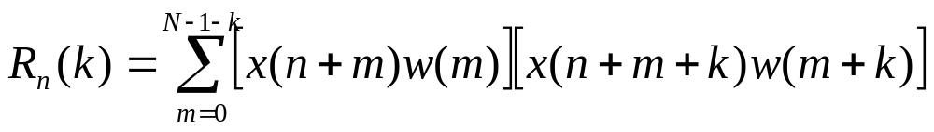
Features: Autocorrelation
Autocorrelation:
measure of periodicity in signal

Slide 31
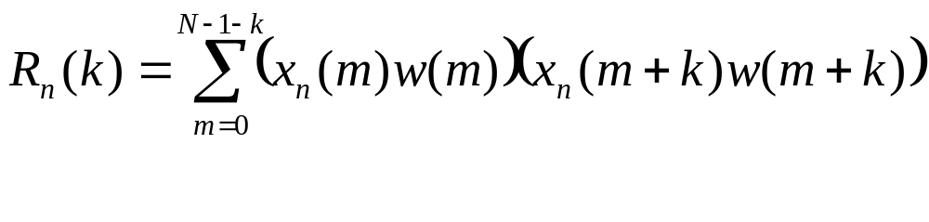
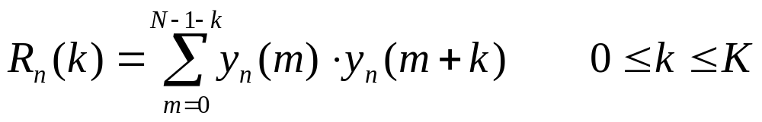
Features: Autocorrelation
Autocorrelation: measure of periodicity in signal
If we change x(n) to x_{n} (signal x starting at sample n), then
the equation becomes:
and if we set y_{n}(m) = x_{n}(m) w(m), so that y is the windowed
signal of x where the window is zero for m<0 and m>N-1, then:
where K is the maximum autocorrelation index desired.
Note that R_{n}(k) = R_{n}(-k), because when we sum over all
values of m that have a non-zero y value (or just change the
limits in the summation to m=k to N-1), then
the shift is the same in both cases

Slide 32
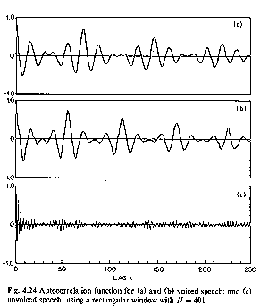
Features: Autocorrelation
Autocorrelation of speech signals: (from Rabiner & Schafer, p. 143)

Slide 33
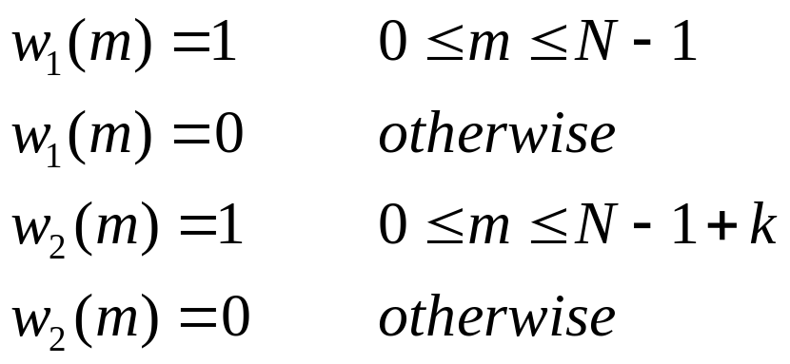
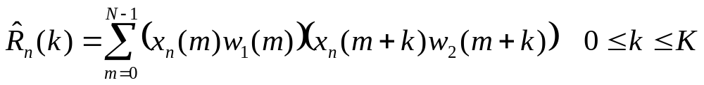
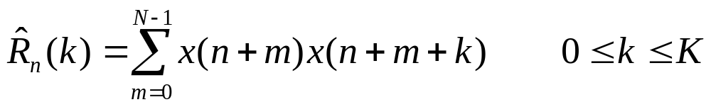
Features: Autocorrelation
Eliminate “fall-off” by including samples in w₂ not in w₁.
= modified autocorrelation function
= cross-correlation function
Note: requires k ·N multiplications; can be slow

Slide 34
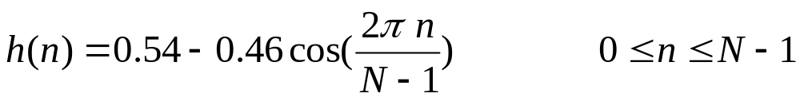
Features: Windowing
In many cases, our math assumes that the signal is periodic.
However, when we take a rectangular window, we have
discontinuities in the signal at the ends. So we can
window the signal with other shapes, making the signal closer
to zero at the ends.
Hamming window:
1.0
0.0
N-1

Slide 35
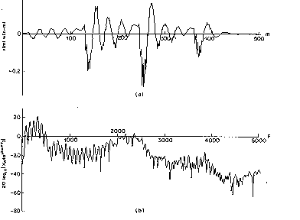
Features: Spectrum and Cepstrum
(log power) spectrum:
1. Hamming window
2. Fast Fourier Transform (FFT)
3. Compute 10 log₁₀(r²+i²)
where r is the real component, i is the imaginary component

Slide 36
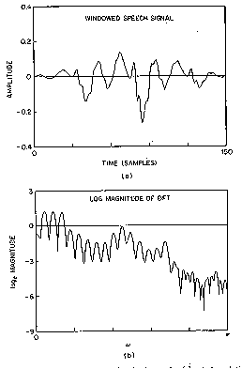
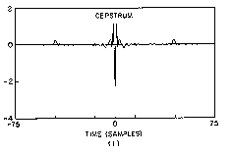
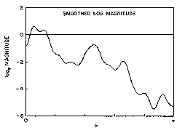
Features: Spectrum and Cepstrum
cepstrum:
treat spectrum as signal subject to frequency analysis…
1. Compute log power spectrum
2. Compute FFT of log power spectrum

