Slide 1
CSE 552/652
Hidden Markov Models for Speech Recognition
Spring, 2006
Oregon Health & Science University
OGI School of Science & Engineering
John-Paul Hosom
Lecture Notes for April 19:
Features of the Speech Signal

Slide 2


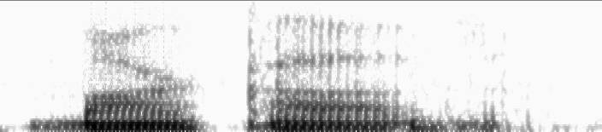

Features: How to Represent the Speech Signal
Features must (a) provide good representation of phonemes
(b) be robust to non-phonetic changes in signal
Time domain (waveform):
Frequency domain (spectrogram):
“Markov”: male speaker
“Markov”: female speaker

Slide 3
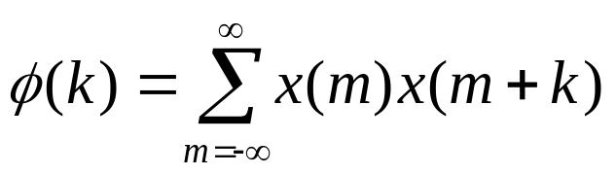
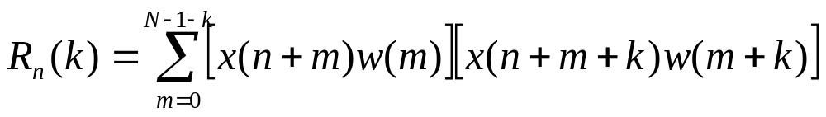
Features: Autocorrelation
Autocorrelation:
measure of periodicity in signal
amplitude
time

Slide 4
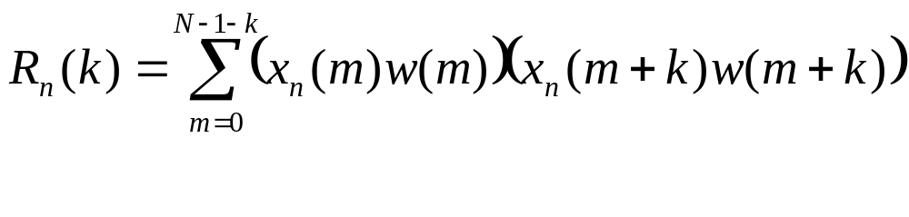
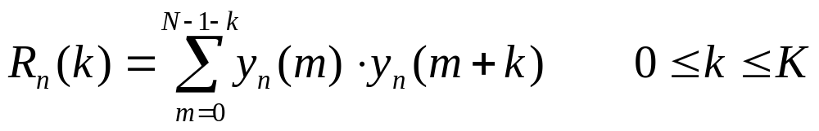
Features: Autocorrelation
Autocorrelation: measure of periodicity in signal
If we change x(n) to x_{n} (signal x starting at sample n), then
the equation becomes:
and if we set y_{n}(m) = x_{n}(m) w(m), so that y is the windowed
signal of x where the window is zero for m<0 and m>N-1, then:
where K is the maximum autocorrelation index desired.
Note that R_{n}(k) = R_{n}(-k), because when we sum over all
values of m that have a non-zero y value (or just change the
limits in the summation to m=k to N-1), then
the shift is the same in both cases

Slide 5
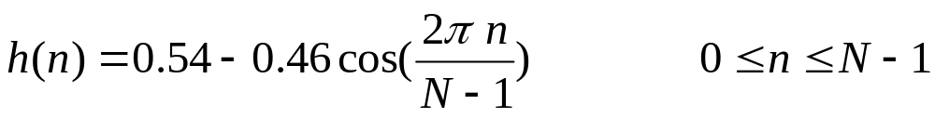
Features: Windowing
In many cases, our math assumes that the signal is periodic.
However, when we take a rectangular window, we have
discontinuities in the signal at the ends. So we can
window the signal with other shapes, making the signal closer
to zero at the ends.
Hamming window:
1.0
amplitude
0.0
time
N-1

Slide 6
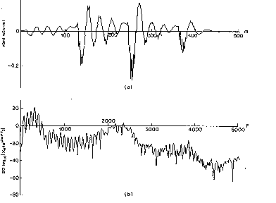
Features: Spectrum and Cepstrum
(log power) spectrum:
1. Hamming window
2. Fast Fourier Transform (FFT)
3. Compute 10 log₁₀(r²+i²)
where r is the real component, i is the imaginary component
amplitude
time
energy (dB)
frequency

Slide 7
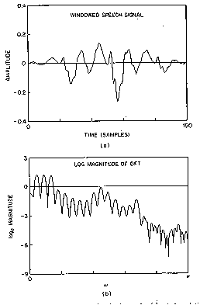
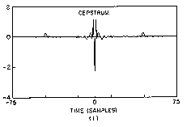
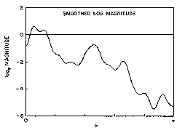
Features: Spectrum and Cepstrum
cepstrum:
treat spectrum as signal subject to frequency analysis…
1. Compute log power spectrum
2. Compute FFT of log power spectrum
amplitude
amplitude
time
quefrency
energy (dB)
energy (dB)
frequency
frequency

Slide 8
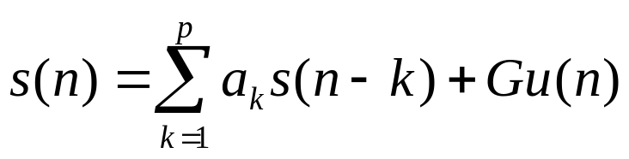
Features: LPC
Linear Predictive Coding (LPC) provides
  low-dimension representation of speech signal at one frame
  representation of spectral envelope, not harmonics
  “analytically tractable” method
  some ability to identify formants
LPC models the speech signal at time point n as an approximate
linear combination of previous p samples:
where a₁, a₂, … a_{p} are constant for each frame of speech.
We can make the approximation exact by including a
“difference” or “residual” term, which is the excitation of the
signal if the LPC coefficients are a filter:
(1)
(2)

Slide 9
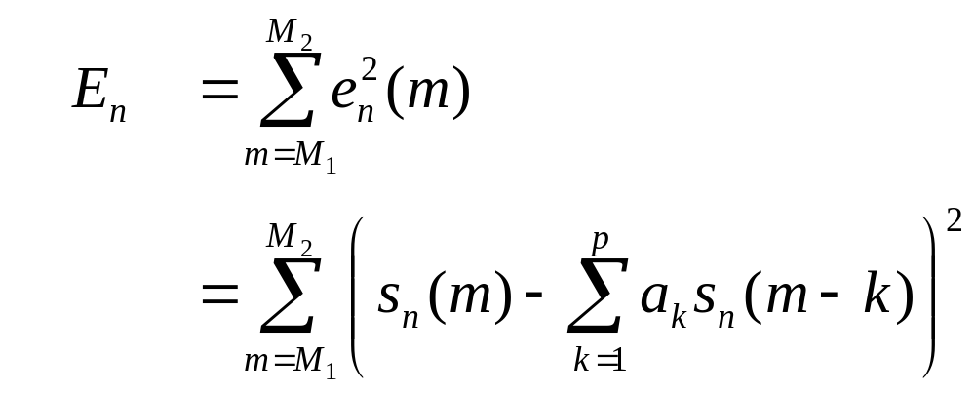

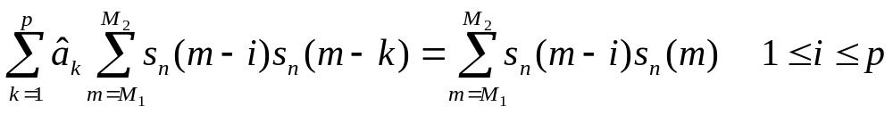
Features: LPC
If the error over a segment of speech is defined as
(3)
(4)
where (s_{n} = signal starting at time n)
then we can find a_{k} by setting ∂E_{n}/∂a_{k} = 0 for k = 1,2,…p,
obtaining p equations and p unknowns:
(5)
(as shown on next slide…)
Error is minimum (not maximum) when derivative is zero, because
as any a_{k} changes away from optimum value, error will increase.

Slide 10
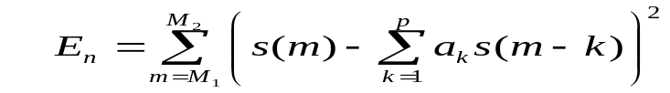
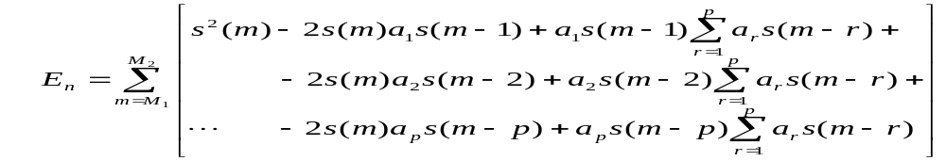
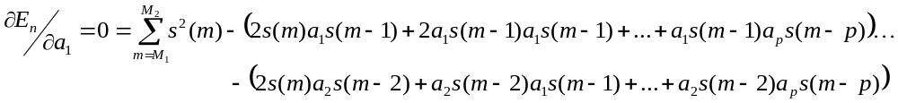
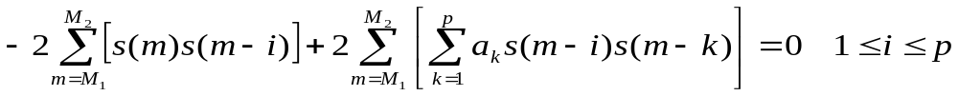

Features: LPC
(5-1)
(5-2)
(5-3)
(5-4)
(5-5)
(5-6)
repeat (5-4) to (5-6) for a₂, a₃, … a_{p}
(5-7)
(5-8)
(5-9)

Slide 11
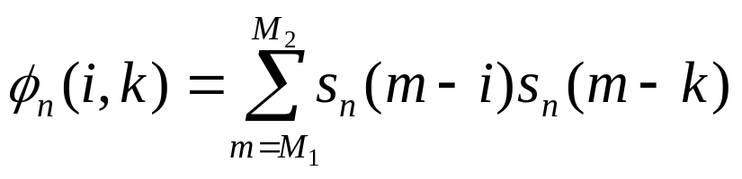
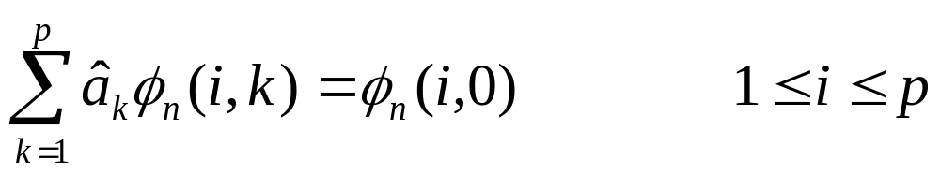

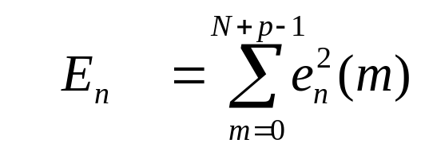
Features: LPC Autocorrelation Method
Then, defining
we can re-write equation (5) as:
(6)
(7)
We can solve for a_{k} using several methods. The most common
method in speech processing is the “autocorrelation” method:
Force the signal to be zero outside of interval 0 ≤ m ≤ N-1:
where w(m) is a finite-length window (e.g. Hamming) of length N
that is zero when less than 0 and greater than N-1. ŝ is the
windowed signal. As a result,
(8)
(9)

Slide 12
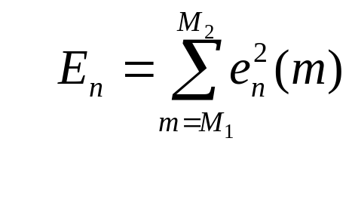
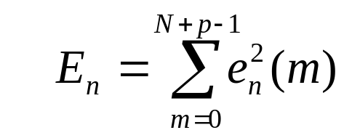
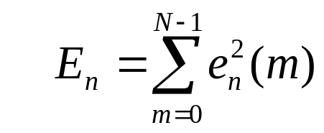
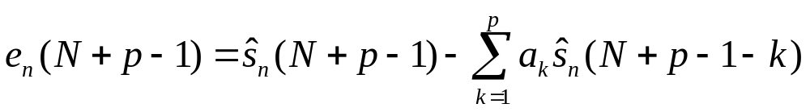
Features: LPC Autocorrelation Method
How did we get from
to
(equation (3))
(equation (9))
with window from 0 to N-1? Why not
??
Because value for e_{n}(m) may not be zero when m > N-1…
for example, when m = N+p-1, then
0
0
ŝ_{n}(N-1) is not zero!

Slide 13
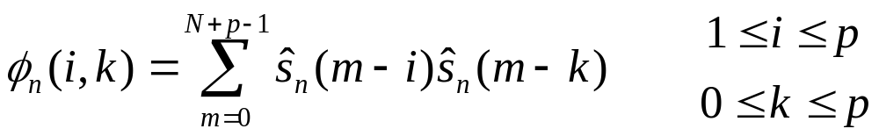
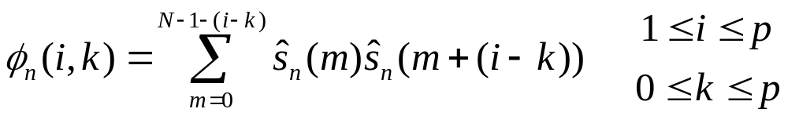
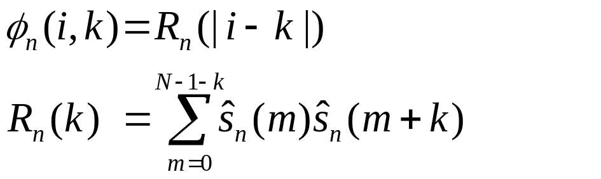
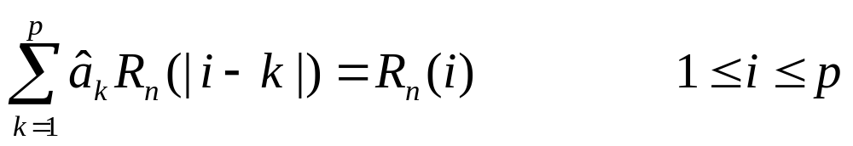
Features: LPC Autocorrelation Method
because of setting the signal to zero outside the window, eqn (6):
and this can be expressed as
and this is identical to the autocorrelation function for |i-k| because
the autocorrelation function is symmetric, R_{n}(-x) = R_{n}(x) :
so the set of equations for a_{k} (eqn (7)) can be combo of (7) and (12):
(10)
(11)
(12)
where
(13)
(14)

Slide 14
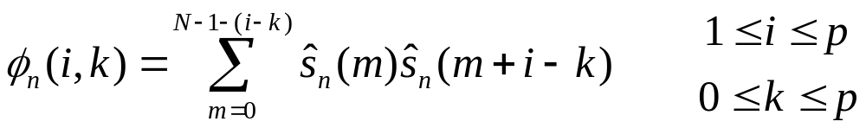
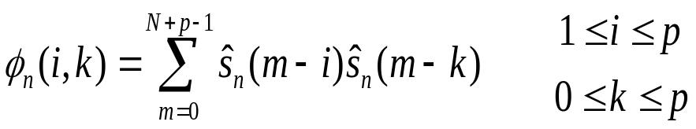
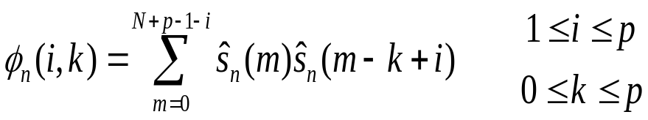
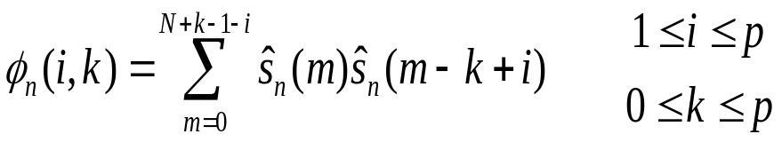
Features: LPC Autocorrelation Method
Why can equation (10):
be expressed as (11): ???
original equation
add i to s_{n}() offset and subtract i from summation limits. If m < 0, s_{n}(m) is zero so still start sum at 0.
replace p in sum limit by k, because
when m > N+k-1-i, s(m+i-k)=0

Slide 15
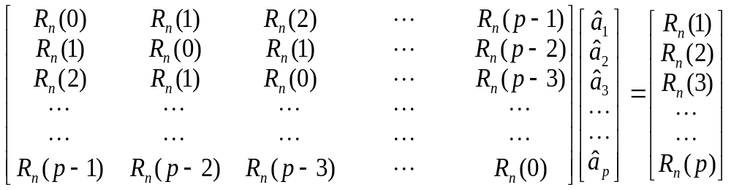
Features: LPC Autocorrelation Method
In matrix form, equation (14) looks like this:
There is a recursive algorithm to solve this: Durbin’s solution

Slide 16
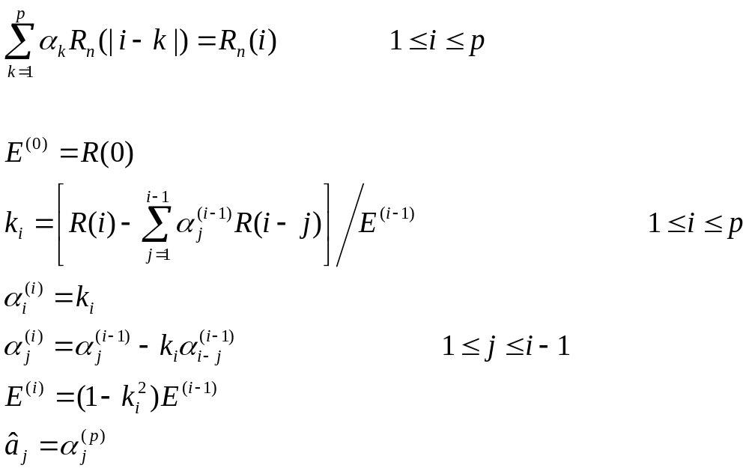
Features: LPC Durbin’s Solution
Solve a Toeplitz (symmetric, diagonal elements equal) matrix
for values of a:

Slide 17
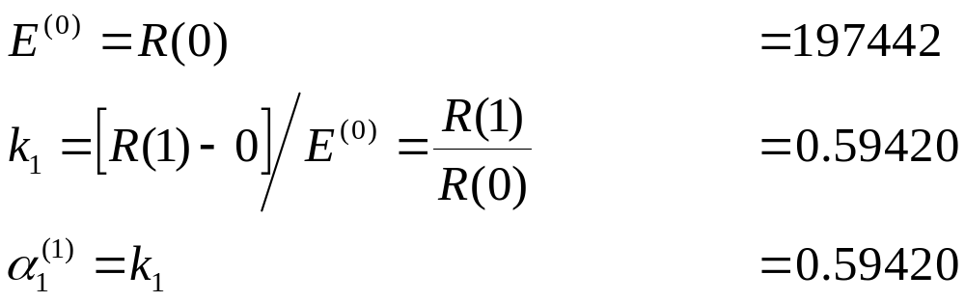
Features: LPC Example
For 2nd-order LPC, with waveform samples
{462 16 -294 -374 -178 98 40 -82}
If we apply a Hamming window (because we assume signal is zero
outside of window; if rectangular window, large prediction error
at edges of window), which is
{0.080 0.253 0.642 0.954 0.954 0.642 0.253 0.080}
then we get
{36.96 4.05 -188.85 -356.96 -169.89 62.95 10.13 -6.56}
and so
R(0) = 197442 R(1)=117319 R(2)=-946

Slide 18
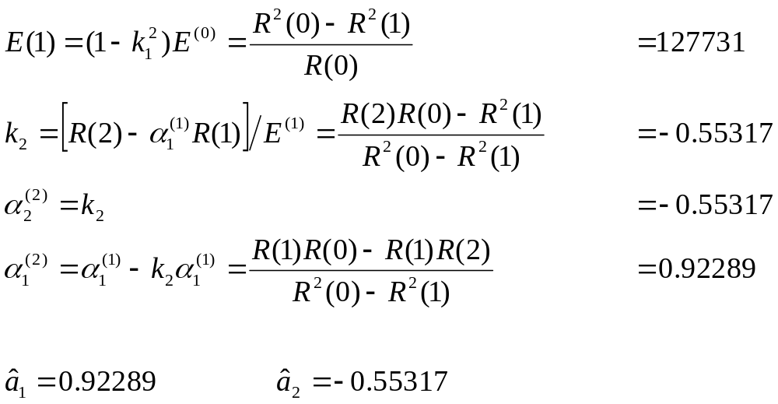
Features: LPC Example
Note: if divide all R(·) values by R(0), solution is unchanged,
but error E^{(i)} is now “normalized error”.
Also: -1 ≤ k_{r} ≤1 for r = 1,2,…,p

Slide 19
Features: LPC Example
We can go back and check our results by using these
coefficients to “predict” the windowed waveform:
{36.96 4.05 -188.85 -356.96 -169.89 62.95 10.13 -6.56}
and compute the error from time 0 to N+p-1 (Eqn (9))
0 ×0.92542 + 0 × -0.5554 = 0 vs. 36.96, diff = 36.96 0
36.96 ×0.92542 + 0 × -0.5554 = 34.1 vs. 4.05, diff = -30.05 1
4.05 ×0.92542 + 36.96 × -0.5554 = -16.7 vs. –188.85, diff = -172.15 2
-188.9×0.92542 + 4.05 × -0.5554 = -176.5 vs. –356.96, diff = -180.43 3
-357.0×0.92542 + -188.9×-0.5554 = -225.0 vs. –169.89, diff = 55.07 4
-169.9×0.92542 + -357.0×-0.5554 = 40.7 vs. 62.95, diff = 22.28 5
62.95×0.92542 + -169.89×-0.5554 = 152.1 vs. 10.13, diff = -141.95 6
10.13×0.92542 + 62.95×-0.5554 = -25.5 vs. –6.56, diff = 18.92 7
-6.56×0.92542 + 10.13×-0.5554 = -11.6 vs. 0, diff = 11.65 8
0×0.92542 + -6.56×-0.5554 = 3.63 vs. 0, diff = -3.63 9
A total squared error of 88645, or error normalized by R(0) of
0.449
(If p=0, then predict nothing, and total error equals R(0), so we can
normalize all error values by dividing by R(0).)
time

Slide 20
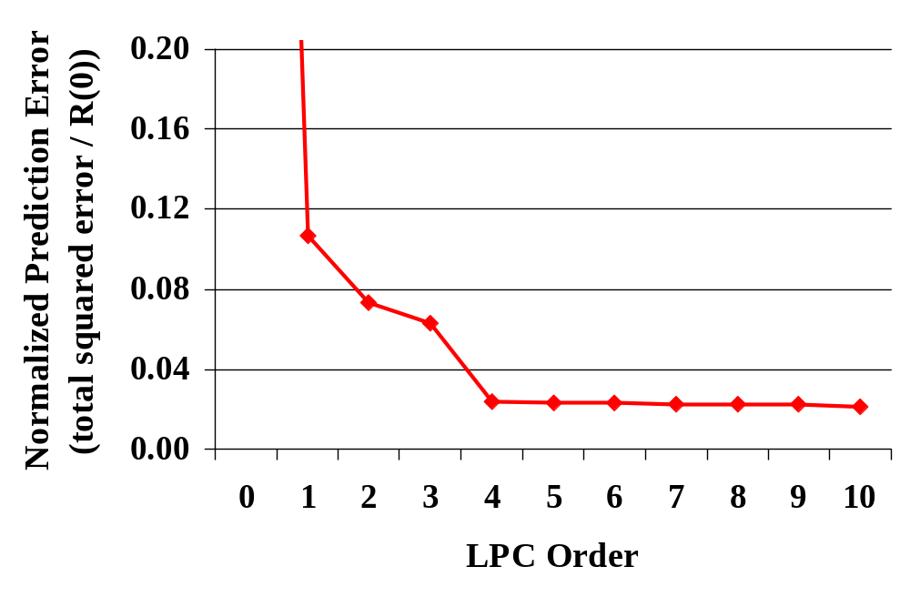
Features: LPC Example
If we look at a longer speech sample of the vowel /iy/, do
pre-emphasis of 0.97 (see following slides), and perform LPC
of various orders, we get:
which implies that order 4 captures most of the important
information in the signal (probably corresponding to 2 formants)

Slide 21
Features: LPC and Linear Regression
LPC models the speech at time n as a linear combination of the previous p samples. The term “linear” does not imply that the result involves a straight line, e.g. s = ax + b.
Speech is then modeled as a linear but time-varying system (piecewise linear).
LPC is a form of linear regression, called multiple linear regression, in which there is more than one parameter. In other words, instead of an equation with one parameter of the form s = a₁x + a₂x², an equation of the form s = a₁x + a₂y + …
In addition, the speech samples from previous time points are combined linearly (as in ‘straight line’) to predict the current value. (e.g. the form is s = a₁x + a₂y + … , not s = a₁x + a₂x² + a₃y + a₄y² + …)
Because the function is linear in its parameters, the solution reduces to a system of linear equations, and other techniques for linear regression (e.g. gradient descent) are not necessary.

Slide 22
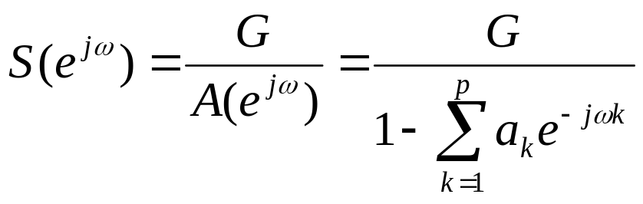

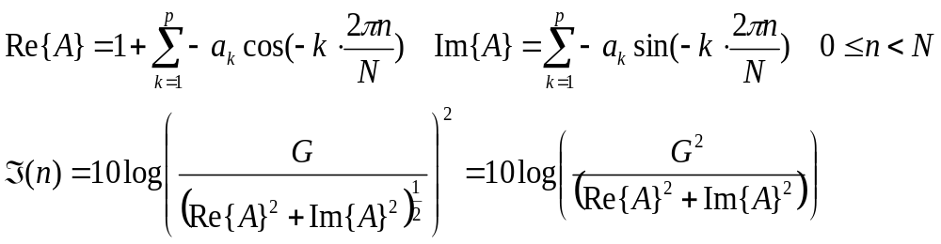
Features: LPC Spectrum
We can compute spectral envelope magnitude from LPC parameters
by evaluating the transfer function S(z) for z=e^{jω}:
because the log power spectrum ℑ is:
Each resonance (complex pole) in spectrum requires two
LPC coefficients; each spectral slope factor (frequency=0 or
Nyquist frequency) requires one LPC coefficient.
For 8 kHz speech, 4 formants ⇒ LPC order of 9 or 10

Slide 23
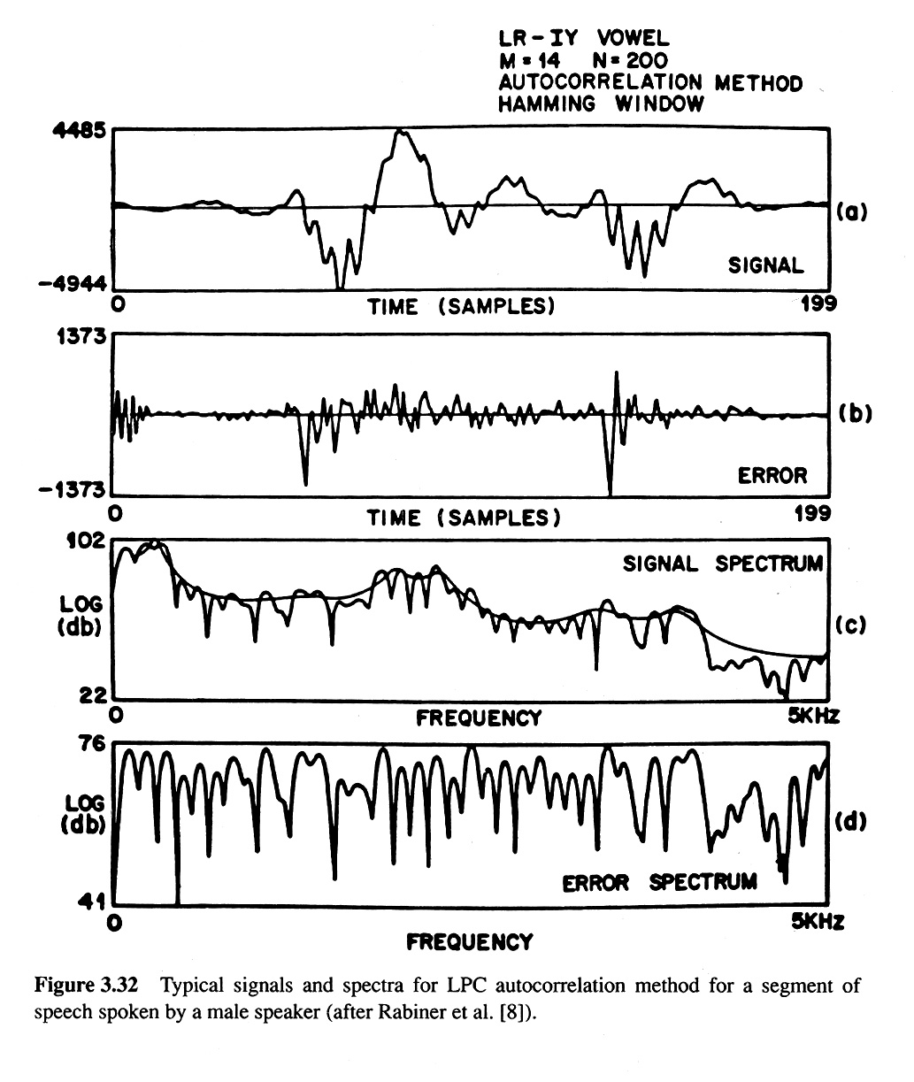
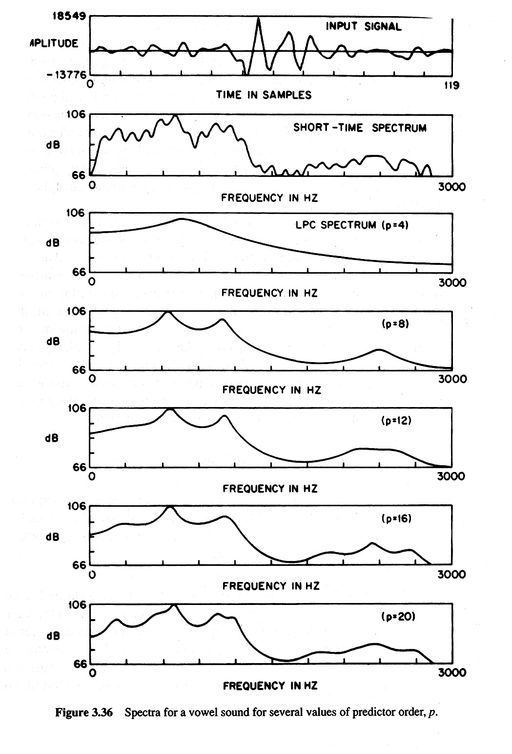
Features: LPC Representations

Slide 24
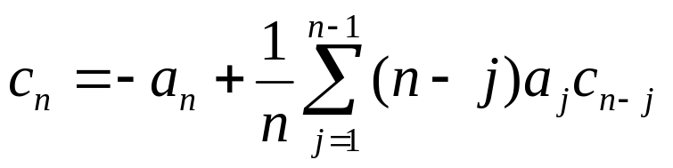
Features: LPC Cepstral Features
The LPC values are more correlated than cepstral coefficients.
But, for GMM with diagonal covariance matrix, we want values
to be uncorrelated.
So, we can convert the LPC coefficients into cepstral values:

Slide 25
Features: Pre-emphasis
The source signal for voiced sounds has slope of -6 dB/octave:
We want to model only the resonant energies, not the source.
But LPC will model both source and resonances.
If we pre-emphasize the signal for voiced sounds, we flatten it
in the spectral domain, and source of speech more closely
approximates impulses. LPC can then model only resonances
(important information) rather than resonances + source.
Pre-emphasis:
energy (dB)
0
1k
2k
3k
4k
frequency

Slide 26
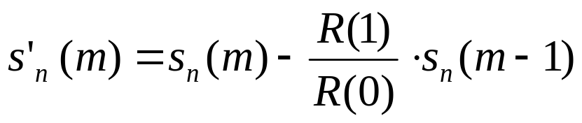
Features: Pre-emphasis
Adaptive pre-emphasis:
a better way to flatten the speech signal
1. LPC of order 1
= value of spectral slope in dB/octave
= R(1)/R(0)
= first value of normalized autocorrelation
2. Result = pre-emphasis factor

Slide 27
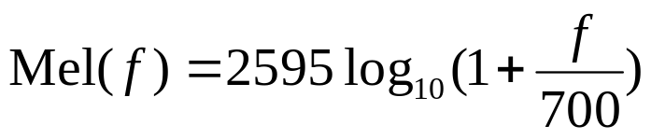
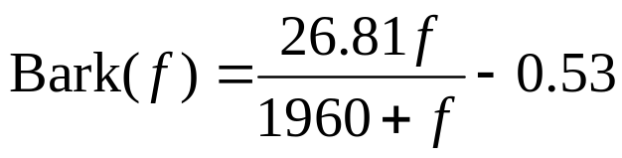
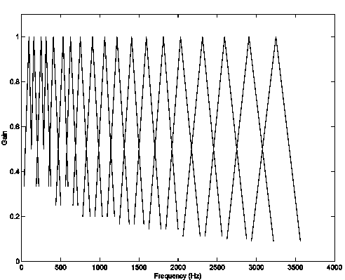
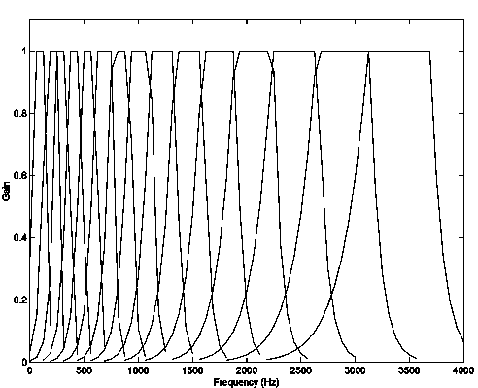
Features: Frequency Scales
The human ear has different responses at different frequencies.
Two scales are common:
Mel scale: Bark scale (from Traunmüller 1990):
energy (dB)
frequency
frequency

Slide 28
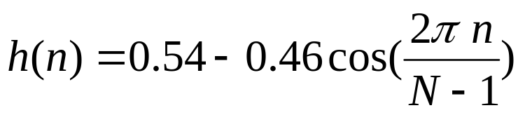
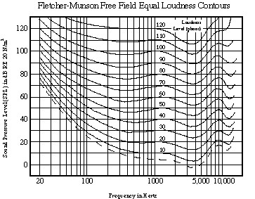
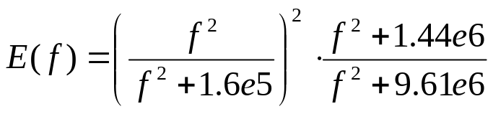
Features: Perceptual Linear Prediction (PLP)
Perceptual Linear Prediction (PLP) is composed of the
following steps:
1. Hamming window
2. power spectrum (not dB scale) (frequency analysis)
S=(X_{r}²+X_{i}²)
3. Bark scale filter banks (trapezoidal filters) (freq. resolution)
4. equal-loudness weighting (frequency sensitivity)

Slide 29




Features: PLP
PLP is composed of the following steps:
5. cubic compression (relationship between intensity and loudness)
6. LPC analysis (compute autocorrelation from freq. domain)
7. compute cepstral coefficients
8. weight cepstral coefficients

Slide 30

Features: Mel-Frequency Cepstral Coefficients (MFCC)
Mel-Frequency Cepstral Coefficients (MFCC) is composed of
the following steps:
1. pre-emphasis
2. Hamming window
3. power spectrum (not dB scale)
S=(X_{r}²+X_{i}²)
4. Mel scale filter banks (triangular filters)

Slide 31

Features: MFCC
MFCC is composed of the following steps:
5. compute log spectrum from filter banks
10 log₁₀(S)
6. convert log energies from filter banks to cepstral coefficients
7. weight cepstral coefficients

Slide 32


Features: Delta Values
The PLP and MFCC features, as presented, analyze speech
signal at one time frame. However, speech changes over time.
To capture dynamics of speech, use “delta” features.
Using this formula for delta of n^{th} cepstral coefficient c, at time t:
too noisy!
Use this formula (Furui, 1986, IEEE Trans ASSP, 34, pp 52-59):
The “acceleration” or “delta-delta” coefficients may also be used,
and computed by applying the same formula to the delta features.
Θ = window size = 2 frames
(50 msec window)

Slide 33

Features: Delta Values
Derivation of delta formula:
linear regression formula
for slope of n points (x_{i},y_{i})
x_{i} = frame index from –Θ to Θ
y_{i} = c_{n,t+i}
remove factors that cancel out
change limits on sum from
(–Θ … Θ) to (1 … Θ)

Slide 34
Removing Noise: CMS
Convolutional noise (from type of channel) is
  convolutional in the time domain
  multiplicative in the spectral domain
  additive in the log-spectral domain
So, we can remove constant convolutional effects by removing
constant values from the log spectrum, which is called spectral
mean subtraction
Cepstral Mean Subtraction (CMS)
  removes mean value from cepstral parameters to reduce
  convolutional noise, in the cepstral domain
CMS assumes that there is enough of a signal that the mean is
not significantly influenced by the speech component of the signal.

Slide 35

Removing Noise: RASTA
2 types of noise:
additive: noise values added to time-domain signal
convolutional: noise values added to log-domain spectrum
In RASTA, the time trajectory of the log power spectrum (or
cepstral coefficients) is filtered with a band-pass filter:
The high-pass portion of the filter alleviates channel characteristics,
the low-pass portion smooths small frame-to-frame changes.
If, instead of log compression, a linear-log compression is
done (linear for small spectral values), both additive and
convolutional noise can be suppressed.

Slide 36
Features: Summary
Typical features represent the speech signal using a small
analysis window (e.g. 16 msec) with a medium-size frame
rate (e.g. 10 msec).
Dynamics of speech, removing channel noise are addressed,
but current solutions may not be optimal solutions.
PLP and MFCC features are advantageous because they mimic
some of the human processing of the signal, emphasizing
the perceptually-important aspects.
The use of a small number of cepstral coefficients approximates
the spectral envelope, removing (unwanted) information about
pitch.
Usually one set of generic features is used; features not “targeted”
to any specific phonemes.

