Slide 1
CSE 552/652
Hidden Markov Models for Speech Recognition
Spring, 2006
Oregon Health & Science University
OGI School of Science & Engineering
John-Paul Hosom
Lecture Notes for April 24:
HMMs for speech;
review anatomy/framework of HMM;
start Viterbi search

Slide 2
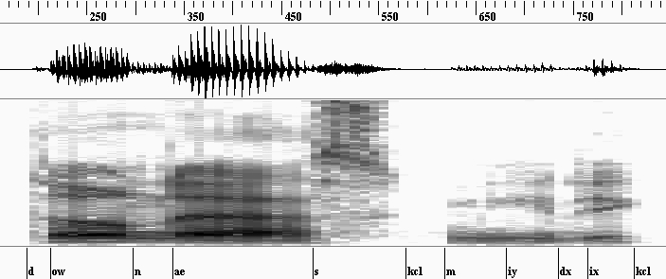
HMMs for Speech
Speech is the output of an HMM; problem is to find most likely
state sequence for a given observation of speech.
Speech is divided into sequence of 10-msec frames, one frame
per state transition (faster processing). Assume speech can
be recognized using 10-msec chunks.
time

Slide 3
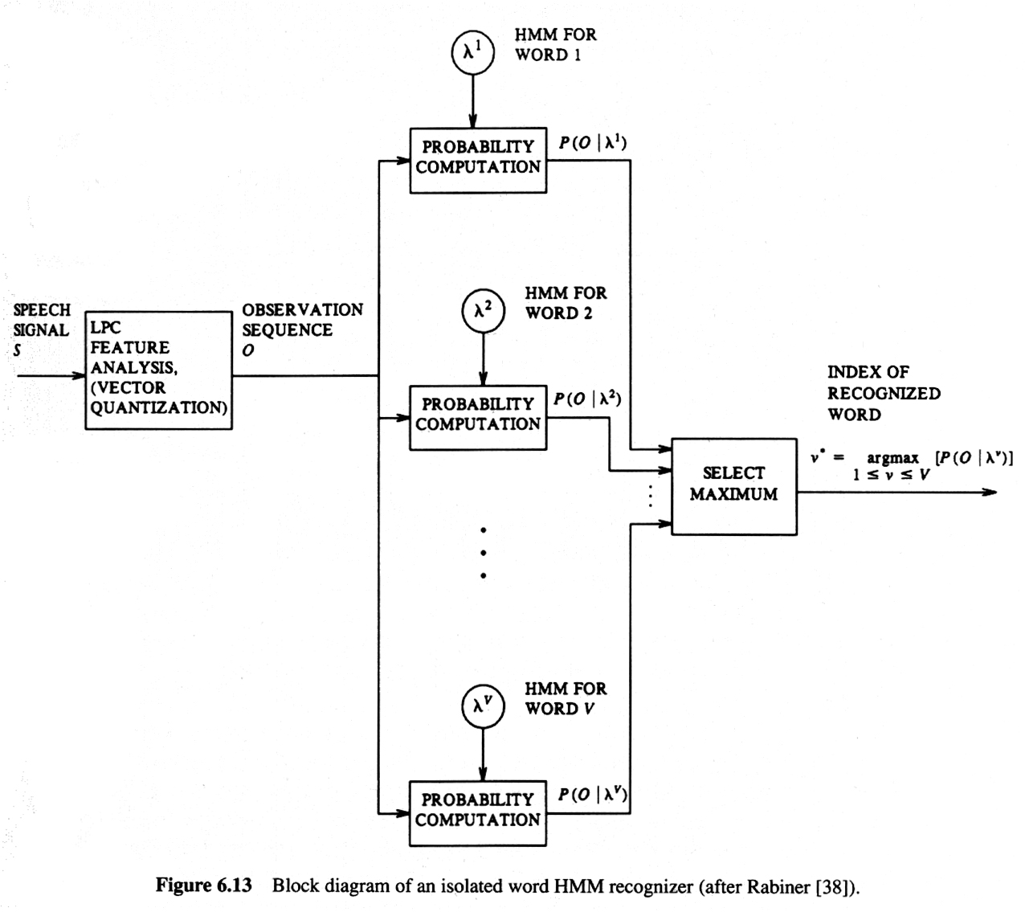
HMMs for Speech

Slide 4
HMMs for Speech
Each state can be associated with
□ sub-phoneme
□ phoneme
□ sub-word
Usually, sub-phonemes or sub-words are used, to account
for coarticulation (spectral dynamics).
One HMM corresponds to one phoneme or word
For each HMM, determine the most likely state sequence that
results in the observed speech.
Choose HMM with best match to observed speech.
Given most likely HMM and state sequence, determine the
corresponding phoneme and word sequence (simple).

Slide 5
HMMs for Speech
Example of states for word model:
0.5
0.9
0.3
3-state word model
for “cat”
k
ae
t
0.5
0.1
0.7
0.5
0.9
0.3
5-state word model for
“cat” with null states
<null>
k
ae
t
<null>
1.0
0.5
0.1
0.7
1.0

Slide 6
HMMs for Speech
Example of states for word model:
0.5
0.7
0.7
0.1
0.2
<null>
k
ae₁
ae₂
tcl
t
0.7
<null>
1.0
1.0
0.5
0.3
0.3
0.9
7-state word model for “cat” with null states
Null states do not emit observations, and are entered and
exited at the same time t. Theoretically, they are unnecessary.
Practically, they can make implementation easier.
States don’t have to correspond directly to phonemes

Slide 7
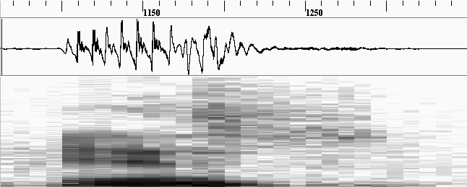
HMMs for Speech
Example of using HMM for word “yes” on an utterance:
o₁
o₂
o₃
o₄
o₅
o₆
o₇
o₈
o₂₉
0.6
0.3
0.5
0.8
1.0
sil
0.4
y
0.7
eh
0.5
s
0.2
sil
b_{sil}(o₁)·0.6·b_{sil}(o₂)·0.6·b_{sil}(o₃)·0.6·b_{sil}(o₄)·0.4·b_{y}(o₅)·0.3·b_{y}(o₆)·0.3·b_{y}(o₇)·0.7 ...
observation
state

Slide 8
HMMs for Speech
Example of using HMM for word “no” on same utterance:
o₁
o₂
o₃
o₄
o₅
o₆
o₇
o₈
o₂₉
0.6
0.2
0.9
1.0
sil
0.4
n
0.8
ow
0.1
sil
b_{sil}(o₁)·0.6·b_{sil}(o₂)·0.6·b_{sil}(o₃)·0.4·b_{n}(o₄)·0.8·b_{ow}(o₅)·0.9·b_{ow}(o₆)·0.9 ...

Slide 9
HMMs for Speech
Because of coarticulation, states are sometimes made dependent
on preceding and/or following phonemes (context dependent).
    ae (monophone model)
    k-ae+t (triphone model)
    k-ae (diphone model)
    ae+t (diphone model)
Constructing words requires matching the contexts:
  “cat”:
  sil-k+ae k-ae+t ae-t+sil

Slide 10
HMMs for Speech
This permits several different models for each phoneme,
depending on surrounding phonemes (context sensitive)
    k-ae+t
    p-ae+t
    k-ae+p
Probability of “illegal” state sequence is zero (never used)
sil-k+ae p-ae+t
Much larger number of states to train on… (50 vs. 125,000)
0.0

Slide 11
HMMs for Speech
Example of 3-state, triphone HMM (expand from previous):
0.3
0.5
0.4
y
0.7
eh
0.5
0.2
0.3
0.2
0.3
0.4
0.3
0.5
0.8
0.7
0.8
0.7
0.3
0.7
sil-y+eh
sil-y+eh
sil-y+eh
y-eh+s
y-eh+s
y-eh+s

Slide 12
HMMs for Speech
1-state monophone (context independent)
3-state monophone (context independent)
1-state triphone (context dependent)
3-state triphone (context dependent)
0.3
0.4
y
0.7
0.2
0.3
0.2
0.5
y₁
0.8
y₂
0.7
y₃
0.8
0.3
0.4
sil-y+eh
0.7
0.2
0.3
0.2
0.5
sil-y+eh
0.8
sil-y+eh
0.7
sil-y+eh
0.8
what about a context-independent triphone??

Slide 13
HMMs for Speech
Typically, one HMM = one word or phoneme
Join HMMs to form sequence of phonemes = word
Join words to form sentences
Use <null> states at ends of HMM to simplify implementation
0.5
0.9
0.3
k
ae
t
(instantaneous transition)
null
1.0
0.1
0.7
null
0.5
0.8
0.9
0.3
null
s
ae
t
null
(i.t.)
0.2
0.1
0.7
1.0

Slide 14
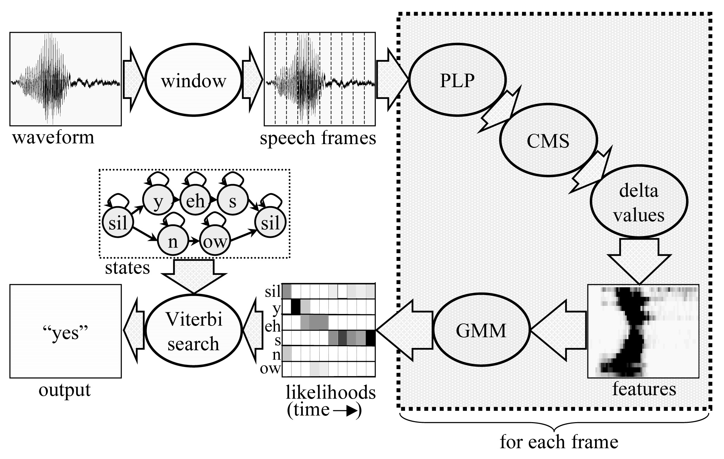
HMMs for Speech
Reminder of big picture:

Slide 15
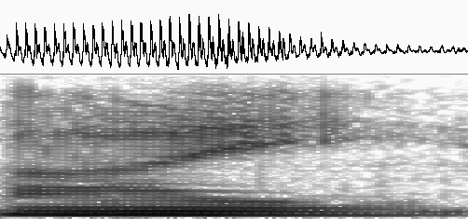
HMMs for Speech
Notes:
Assume that speech observation is stationary for 1 frame
If frame is small enough, and enough states are used, we
can approximate dynamics of speech:
The use of context-dependent states accounts (somewhat)
for context-dependent nature of speech.
/ay/
(frame size=
4 msec)
s₁
s₂
s₃
s₄
s₅

Slide 16
HMMs for Speech
Prior segmentation of speech into categories not required
before performing classification.
This provides robustness over other methods that first segment
and then classify, because any attempt to do prior segmentation
will yield errors.
As we move through an HMM to determine most likely
sequence, we get segmentation.
First-order and independence assumptions correct for some
phenomena, but not for speech. But math is easier.

Slide 17
HMMs for Word Recognition
Different Topologies are Possible:
“standard”
“short phoneme”
“left-to-right”
0.3
0.4
0.3
0.8
A₁
0.7
A₂
0.3
A₃
0.7
0.3
0.4
0.3
0.8
A₁
0.5
A₂
0.3
A₃
0.7
0.2
0.3
0.4
0.3
0.4
0.3
0.8
A₁
0.7
A₂
0.3
A₃
0.7
A₄
0.3
A₅
0.7

Slide 18
Anatomy of an HMM
HMMs for speech:
first-order HMM
one HMM per phoneme or word
3 states per phoneme-level HMM, more for word-level HMM
sequential series of states, each with self-loop
link HMMs together to form words and sentences
GMM: many Gaussian components per state (16)
context-dependent HMMs: HMMs can be linked together
only if their contexts correspond

Slide 19
Anatomy of an HMM
HMMs for speech:
speech signal divided into 10-msec quanta
1 HMM state per 10-msec quantum (frame)
use self-loop for speech units that require more than N states
trace through an HMM to determine likelihood of utterance
and state sequence.

Slide 20
Anatomy of an HMM
Diagram of one HMM
/y/ in context of preceding silence, followed by /eh/
0.2
0.3
0.2
0.5
0.8
0.7
0.8
sil-y+eh
sil-y+eh
sil-y+eh
vector:
μ₁₁
Σ₁₁
c₁₁
μ₁₂
Σ₁₂
c₁₂
μ₁₃
Σ₁₃
c₁₃
μ₂₁
Σ₂₁
c₂₁
μ₂₂
Σ₂₂
c₂₂
μ₂₃
Σ₂₃
c₂₃
μ₃₁
Σ₃₁
c₃₁
μ₃₂
Σ₃₂
c₃₂
μ₃₃
Σ₃₃
c₃₃
matrix:
scalar:

Slide 21
Framework for HMMs
N = number of states
3 per phoneme, >3 per word
S = states {S₁, S₂, S₃, … , S_{N}}
even though any state can output (any) observation,
associate most likely output with state name. Often use
context-dependent phonetic states (triphones):
{sil-y+eh y-eh+s eh-s+sil …}
T = final time of output
t = {1, 2, … T}
O = observations {o₁ o₂ … o_{T}}
actual output generated by HMM;
features (LPC, MFCC, PLP, etc) of a speech signal

Slide 22
Framework for HMMs
M = number of observation symbols per state
= number of codewords for discrete HMM
= “infinite” for continuous HMM
v = symbols {v₁ v₂ … v_{M}}
“codebook indices” generated by discrete (VQ) HMM;
for speech, indices point to locations in feature space.
No direct correspondence for continuous HMM; output
of continuous HMM is sequence of observations
{speech vector 1, speech vector 2, …}
output can be any point in continuous n-dimensional space.
A = matrix of transition probabilities {a_{ij}}
a_{ij} = P(q_{t}=j | q_{t-1}=i)
ergodic HMM: all a_{ij} > 0
B = set of parameters for determining probabilities b_{j}(o_{t})
b_{j}(o_{t}) = P(o_{t} = v_{k} | q_{t} = j) (discrete: codebook)
= P(o_{t} | q_{t} = j) (continuous: GMM)

Slide 23
Framework for HMMs
π = initial state distribution {π_{i}}
π_{i} = P(q₁ = i)
λ = entire model
λ = (A, B, π)

Slide 24
Framework for HMMs
Example: “hi”
0.3
0.4
1.0
0.7
0.6
sil-h+ay
h-ay+sil
1.0
1.0
0.0
0.0
0.0
1.0
0.0
1.0
observed features: o₁ = {0.8}
o₂ = {0.8}
o₃ = {0.2}
what is probability of O and the state sequence:
{sil-h+ay h-ay+sil h-ay+sil}
{1 2 2}

Slide 25
Framework for HMMs
Example: “hi”
P = π₁ b₁(o₁) a₁₂ b₂(o₂) a₂₂ b₂(o₃)
P = 1.0 · 0.76 · 0.7 · 0.27 · 0.4 · 0.82
P = 0.0471
1.0
q₁
q₂
q₂
0.0
o₁=0.8
o₂=0.8
o₃=0.2

Slide 26
Framework for HMMs
What is probability of an observation sequence and state sequence,
given the model?
  P(O, q | λ) = P(O | q, λ) P(q | λ)
What is the “best” valid observation sequence from time
1 to time T, given the model?
At every time t, can connect to up to N states
⇒ There are up to N^{T} possible state sequences
(for one second of speech with 3 states, N^{T} = 10⁴⁷ sequences)
infeasible!!

Slide 27
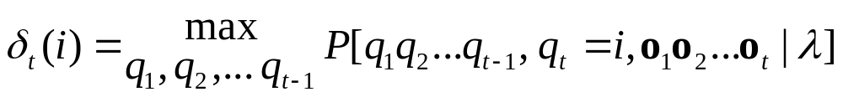




Viterbi Search: Formula
Question 1: What is best score along a single path, up to time t,
ending in state i?
Use inductive procedure
Best sequence defined as:
First iteration (t=1):

Slide 28
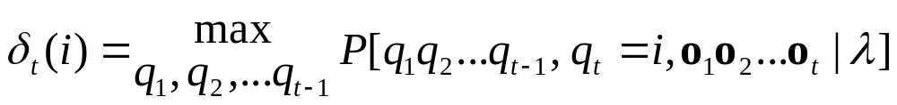
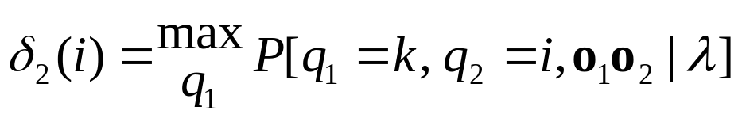
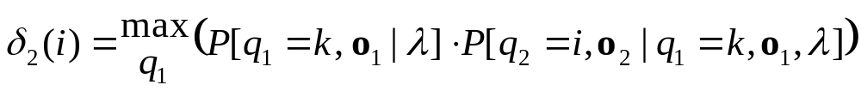
Viterbi Search: Formula
Second iteration (t=2)

Slide 29
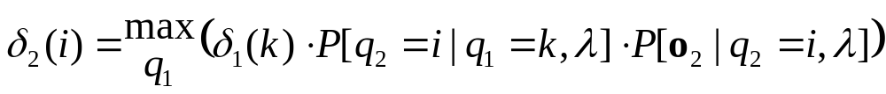
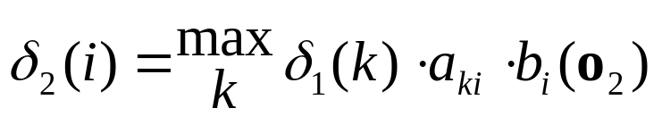
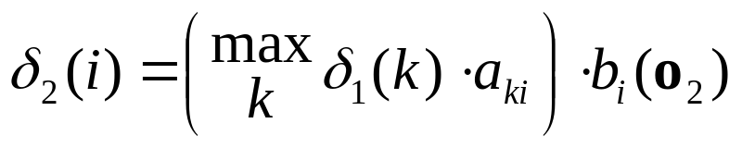
Viterbi Search: Formula
Second iteration (t=2) (continued…)
P(o₂) independent of o₁ and q_{1;}
P(q₂) independent of o₁

Slide 30
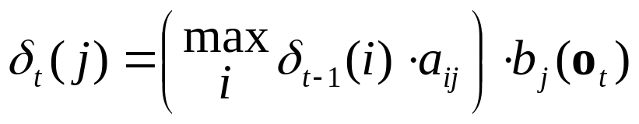
Viterbi Search: Formula
In general, for any value of t:
Best path from {1, 2, … t} is not dependent on future times
{t+1, t+2, … T} (from definition)
Best path from {1, 2, … t} is not necessarily the same as
the best path from {1, 2, … (t-1)} concatenated with the
best path {(t-1) t}

Slide 31
Viterbi Search: Formula
Keep in memory only δ_{t-1}(i) for all i.
For each time t and state j, need
(N multiply and compare) + (1 multiply)
For each time t, need
N * ((N multiply and compare) + (1 multiply))
To find best path, need
O( N²T )
operations.
This is much better than N^{T} possible paths, especially for
large T!

