Slide 1
CSE 552/652
Hidden Markov Models for Speech Recognition
Spring, 2006
Oregon Health & Science University
OGI School of Science & Engineering
John-Paul Hosom
Lecture Notes for April 26
The Viterbi Search Algorithm

Slide 2
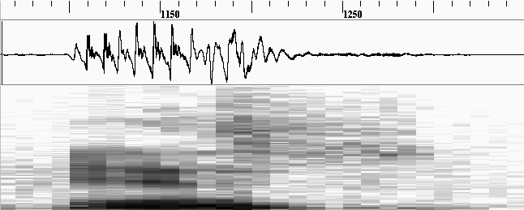
Review: HMMs for Speech
example of using HMM for word “yes” on an utterance:
o₁
o₂
o₃
o₄
o₅
o₆
o₇
o₈
o₂₉
0.6
0.3
0.5
0.8
1.0
sil
0.4
y
0.7
eh
0.5
s
0.2
sil
b_{sil}(o₁)·0.6·b_{sil}(o₂)·0.6·b_{sil}(o₃)·0.6·b_{sil}(o₄)·0.4·b_{y}(o₅)·0.3·b_{y}(o₆)·0.3·b_{y}(o₇)·0.7 ...
observation
state

Slide 3
Review: HMMs for Speech
Example: “hi”
0.3
0.4
1.0
0.7
0.6
sil-h+ay
h-ay+sil
1.0
1.0
0.0
0.0
0.0
1.0
0.0
1.0
observed features: o₁ = {0.8}
o₂ = {0.8}
o₃ = {0.2}
what is probability of O and state sequence:
{sil-h+ay h-ay+sil h-ay+sil}
{1 2 2}

Slide 4
Framework for HMMs
What is likelihood of an observation sequence and state sequence,
given the model?
  P(O , q | λ) = P(O | q, λ) P(q | λ)
What is the “best” valid observation sequence from time
1 to time T, given the model?
At every time t, can connect to up to N states
⇒ There are up to N^{T} possible state sequences
(for one second of speech with 3 states, N^{T} = 10⁴⁷ sequences)
infeasible!!

Slide 5
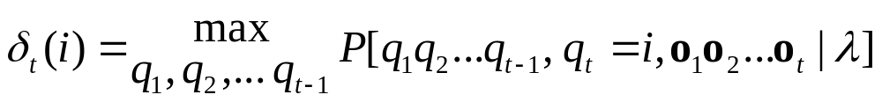




Viterbi Search: Formula
Question 1: What is best score along a single path, up to time t,
ending in state i?
Use inductive procedure
Best sequence defined as:
First iteration (t=1):

Slide 6
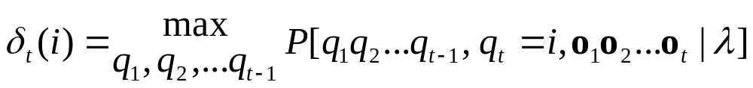
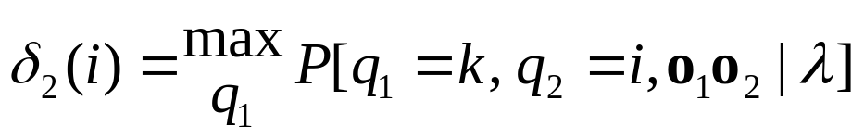
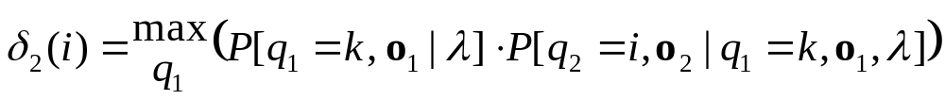
Viterbi Search: Formula
Second iteration (t=2)

Slide 7
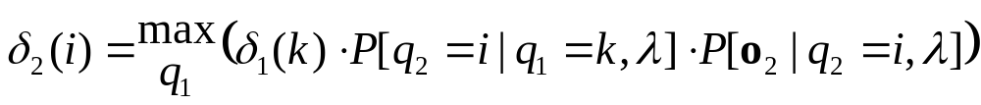
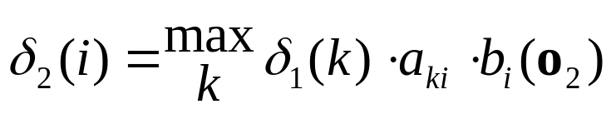
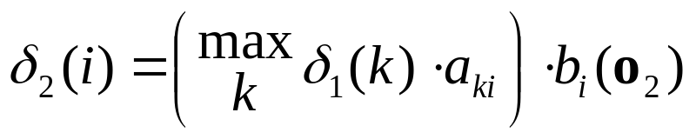
Viterbi Search: Formula
Second iteration (t=2) (continued…)
P(o₂) independent of o₁ and q_{1;}
P(q₂) independent of o₁

Slide 8
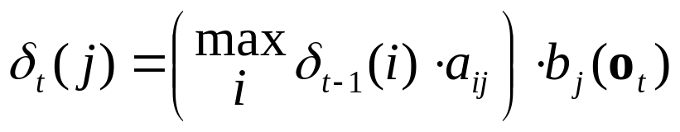
Viterbi Search: Formula
In general, for any value of t:
Best path from {1, 2, … t} is not dependent on future times
{t+1, t+2, … T} (from definition)
Best path from {1, 2, … t} is not necessarily the same as
the best path from {1, 2, … (t-1)} concatenated with the
best path {(t-1) t}

Slide 9
Viterbi Search: Formula
Keep in memory only δ_{t-1}(i) for all i.
For each time t and state j, need
(N multiply and compare) + (1 multiply)
For each time t, need
N * ((N multiply and compare) + (1 multiply))
To find best path, need
O( N²T )
operations.
This is much better than N^{T} possible paths, especially for
large T!
Viterbi, A. J. “Error bounds for convolutional codes and an asymptotically
optimum decoding algorithm.” IEEE Transactions on Information Theory
13 (2), Apr. 1967, pp. 260–269.
Forney, G. D. “The Viterbi algorithm.” Proc. IEEE. 61 (3), Mar. 1973,
pp.268–278.

Slide 10
Viterbi Search: Formula Example
Given the following model of the weather:
(states indicate
barometer pressure)
0.7
H
0.2
0.1
0.1
0.3
0.3
L
M
0.4
0.6
0.3
state M state H state L
P(sun) 0.5 0.75 0.25
P(rain) 0.5 0.25 0.75
π_{M} = 0.50
π_{H} = 0.20
π_{L} = 0.30

Slide 11
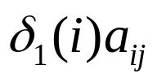
Viterbi Search: Formula Example
If the observation sequence is: s s r s r (s=sun,r=rain)
What is the best score (maximum probability) at time t=2 for
state M?
Step 1: what are δ₁(j) for all j?
  δ₁(M) = 0.50 · 0.50 = 0.25
  δ₁(H) = 0.20 · 0.75 = 0.15
  δ₁(L) = 0.30 · 0.25 = 0.075
Step 2: what is max( ) ending in state j=M?
  M₁,M₂= 0.25 · 0.4 = 0.10
  H₁,M₂ = 0.15 · 0.2 = 0.03
  L₁,M₂ = 0.075 · 0.3 = 0.0225
max_{M}=0.10

Slide 12
Viterbi Search: Formula Example
Step 3: what is δ₂(M)?
  δ₂(M) = 0.10 · 0.50 = 0.05
Answer: best score at time 2, ending in state M, is 0.05
Next question: what’s the best score at time t=2 for all states?
Answer: compute best scores for all states at time t,
take max score.

Slide 13
Viterbi Search: Formula Example
If the observation sequence is: s s r s r (s=sun,r=rain),
what is the best score at time t=2 over all states?
Step 1: what are δ₁(j) for all j?
  δ₁(M) = 0.50 · 0.50 = 0.25
  δ₁(H) = 0.20 · 0.75 = 0.15
  δ₁(L) = 0.30 · 0.25 = 0.075
Step 2: what are max( )?
  M₁,M₂= 0.10 M₁,H₂= 0.075 M₁,L₂= 0.075
  H₁,M₂ = 0.03 H₁,H₂ = 0.105 H₁,L₂ = 0.015
  L₁,M₂ = 0.0225 L₁,H₂ = 0.0075 L₁,L₂ = 0.045
max_{M}=0.10
max_{H}=0.105
max_{L}=0.075

Slide 14
Viterbi Search: Formula Example
Step 3: what is δ₂(j) for all j?
  δ₂(M) = 0.10 · 0.50 = 0.05
  δ₂(H) = 0.105 · 0.75 = 0.07875
  δ₂(L) = 0.075 · 0.25 = 0.01875
Step 4: take maximum score at time 2:
max(δ₂(i)) = 0.07875
Answer: best score at time 2 is 0.07875, in state H

Slide 15
Viterbi Search: Algorithm
Question 2: What is best state sequence along a single path,
up to time t?
Need to keep track of (best path up to time t) for each time & state
ψ_{t}(j) = best state prior to state j at time t. (ψ=psi)
Can use ψ_{t}(j) to trace back, from time = T to 1, the best path.

Slide 16
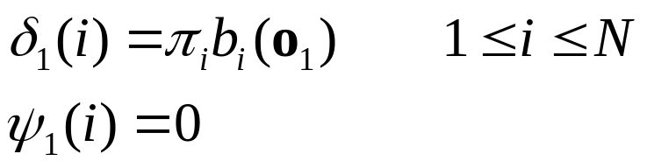
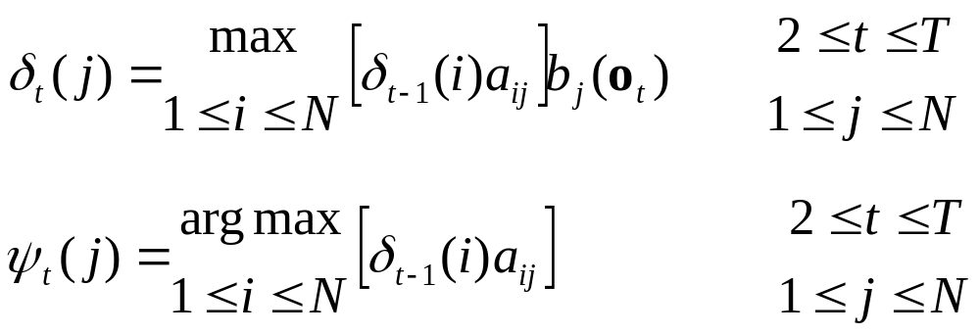
Viterbi Search: Algorithm
(1) Initialization:
(2) Recursion:

Slide 17
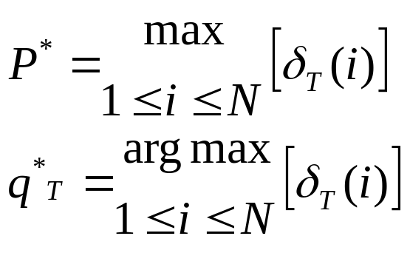
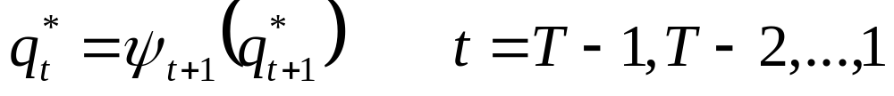
Viterbi Search: Algorithm
(3) Termination:
(4) Backtracking:
Note 1: Usually this algorithm is done in log domain, to avoid
underflow errors.
Note 2: This assumes that any state is a valid end-of-utterance state.
If only some states are valid end-of-utterance states, then
maximization occurs over only those states.

Slide 18

Viterbi Search: Algorithm Example
If the observation sequence is: s s r s r (s=sun,r=rain),
what is the best state sequence at time t=2 over all states?
Step 1: what are δ₁(j), ψ₁(j) for all j?
  δ₁(M) = 0.50 · 0.50 = 0.25 ψ₁(M) = 0
  δ₁(H) = 0.20 · 0.75 = 0.15 ψ₁(H) = 0
  δ₁(L) = 0.30 · 0.25 = 0.075 ψ₁(L) = 0
Step 2: what are
  M₁,M₂= 0.05 M₁,H₂= 0.05625 M₁,L₂= 0.01875
  H₁,M₂ = 0.015 H₁,H₂ = 0.07875 H₁,L₂ = 0.00375
  L₁,M₂ = 0.011 L₁,H₂ = 0.005625 L₁,L₂ = 0.01125
δ₂(M)=0.05
δ₂(H)=0.07875
δ₂(L)=0.01875
ψ₂(M) =M
ψ₂(H) =H
ψ₂(L) =M
(can take maximum before multiplying by b_{j}(o_{t}) to save time)

Slide 19
Viterbi Search: Algorithm Example
Step 3: what are P* and q*_{T}?
P* = 0.07875
q*₂ = H
Step 4: backtracking:
q*₁ = ψ₂(q*₂)
q*₁ = ψ₂(H)
q*₁ = H
Answer: best state sequence is H H

Slide 20
Viterbi Search: Algorithm Example
NOTE:
best state sequence up to t=2 is H H
best state sequence at t=1, up to t=2, is H
best state sequence at t=1, up to t=1, is M
same time, different “best” sequences!
“best” state sequence can change as t increases
(that’s why we need to backtrack)
δ_{t}(j) is the same for all times greater than t,
but a_{ij} may change the result of “max” operation
if a_{ij} is same for all states, best state sequence does not
require backtracking!

Slide 21
Viterbi Search: Algorithm Example
Given the following model of the weather:
(states indicate
barometer pressure)
0.33
H
0.33
0.33
0.33
0.33
0.33
L
M
0.33
0.33
0.33
state M state H state L
P(sun) 0.5 0.75 0.25
P(rain) 0.5 0.25 0.75
π_{M} = 0.33
π_{H} = 0.33
π_{L} = 0.33

Slide 22
Viterbi Search: Algorithm Example
If the observation sequence is: s s r s r (s=sun,r=rain),
what is best state sequence?
Omit initial, transition probabilities, since they’re all same
δ₁(M)=0.5 δ₁(H)=0.75 δ₁(L)=0.25 (s)
δ₂(M)=0.75·0.5 δ₂(H)=0.75·0.75 δ₂(L)=0.75·0.25 (s)
δ₃(M)=0.75²·0.5 δ₃(H)=0.75²·0.25 δ₃(L)=0.75²·0.75 (r)
δ₄(M)=0.75³·0.5 δ₄(H)=0.75³·0.75 δ₄(L)=0.75³·0.25 (s)
δ₅(M)=0.75³·0.5 δ₅(H)=0.75³·0.25 δ₅(L)=0.75³·0.75 (r)
State M
State H
State L
1
2
3
4
5

Slide 23
Viterbi Search: Algorithm Example
Given the following model of the weather:
(states indicate
barometer pressure)
0.7
H
0.2
0.1
0.1
0.3
0.3
L
M
0.4
0.6
0.3
state M state H state L
P(sun) 0.5 0.75 0.25
P(rain) 0.5 0.25 0.75
π_{M} = 0.50
π_{H} = 0.20
π_{L} = 0.30

Slide 24
Viterbi Search: Algorithm Example
If the observation sequence is: s s r s r (s=sun,r=rain),
what is best state sequence?
Can’t omit initial, transition probabilities...
δ₁(M)=0.5·0.5 δ₁(H)=0.2·0.75 δ₁(L)=0.3·0.25
δ₂(M)=0.25·0.4·0.5 δ₂(H)=0.15·0.7·0.75 δ₂(L)=0.25·0.3·0.25
δ₃(M)=0.05·0.4·0.5 δ₃(H)=0.08·0.7·0.25 δ₃(L)=0.05·0.3·0.75
δ₄(M)=0.010·0.4·0.5 δ₄(H)=0.014·0.7·0.75 δ₄(L)=0.011·0.6·0.25
δ₅(M)=0.0014·0.4·0.5 δ₅(H)=0.007·0.7·0.25 δ₅(L)=0.0016·0.6·0.75
State M
State H
State L
1
2
3
4
5

Slide 25
Viterbi Search: Algorithm Example
The backtrace for δ₅(L) is also interesting...
δ₁(M)=0.5·0.5 δ₁(H)=0.2·0.75 δ₁(L)=0.3·0.25
δ₂(M)=0.25·0.4·0.5 δ₂(H)=0.15·0.7·0.75 δ₂(L)=0.25·0.3·0.25
δ₃(M)=0.05·0.4·0.5 δ₃(H)=0.08·0.7·0.25 δ₃(L)=0.05·0.3·0.75
δ₄(M)=0.010·0.4·0.5 δ₄(H)=0.014·0.7·0.75 δ₄(L)=0.011·0.6·0.25
δ₅(M)=0.0014·0.4·0.5 δ₅(H)=0.007·0.7·0.025 δ₅(L)=0.0016·0.6·0.75
State M
State H
State L
1
2
3
4
5

Slide 26
Viterbi Search: Speech Example
Example: “hi”
0.3
1.0
1.0
0.7
sil-h+ay
h-ay+sil
A
B
1.0
1.0
0.0
0.0
0.0
1.0
0.0
1.0
observed features: O = {0.8 0.6 0.5}
what is best state sequence for O, given λ ?

Slide 27
Viterbi Search: Speech Example
1. initialization:
δ₁(A)=1.0·0.76 δ₁(B)=0.0·0.28
δ₁(A)=0.76 δ₁(B)=0.0
ψ₁(A)=0 ψ₁(B)=0
2. recursion at time = 2:
δ₂(A)=0.76·0.3·0.45 δ₂(B)=0.76·0.7·0.38
δ₂(A)=0.1026 δ₂(B)=0.20216
ψ₂(A)=A ψ₂(B)=A
3. recursion at time = 3:
δ₃(A)=0.10·0.3·0.51 δ₃(B)=0.20·1.0·0.51
δ₃(A)=0.0157 δ₃(B)=0.1031
ψ₃(A)=A ψ₃(B)=B

Slide 28
Viterbi Search: Speech Example
4. termination:
P* = max[δ₃(j)] = 0.1031
q*_{T} = argmax[δ₃(j)] = B
5. path backtracking:
q*₂ = ψ₃(q*₃) = ψ₃(B) = B
q*₁ = ψ₂(q*₂) = ψ₂(B) = A
Answer: best state sequence is
A B B

Slide 29
Viterbi Search: Yet Another Example (part 1)
0.4
0.2
0.6
1
2
π₂=0.5
π₁=0.5
P(A)=0.7
P(B)=0.3
0.8
P(A)=0.1
P(B)=0.9
A
A
B
A
0.5*0.7
0.35*0.4*0.7
0.098*0.4*0.3
0.012*0.4*0.7
1
0.50
0.35
0.098
0.012
0.030
0.35*0.6*0.1
0.098*0.6*0.9
0.012*0.6*0.1
0.05*0.8*0.7
0.021*0.8*0.3
0.053*0.8*0.7
2
0.50
0.05
0.021
0.053
0.001
0.5*0.1
0.05*0.2*0.1
0.021*0.2*0.9
0.053*0.2*0.1
t=0
t=1
t=2
t=3
t=4
best state sequence = 1 1 2 1

Slide 30
Viterbi Search: Yet Another Example (part 2)
0.9
0.2
0.1
1
2
π₂=0.5
π₁=0.5
P(A)=0.7
P(B)=0.3
0.8
P(A)=0.1
P(B)=0.9
obs. =
A
A
B
A
0.5*0.7
0.35*0.9*0.7
0.220*0.9*0.3
0.059*0.9*0.7
1
0.50
0.35
0.220
0.059
0.037
0.35*0.1*0.1
0.220*0.1*0.9
0.059*0.1*0.1
0.05*0.8*0.7
0.004*0.8*0.3
0.020*0.8*0.7
2
0.50
0.05
0.0035
0.020
0.0006
0.5*0.1
0.05*0.2*0.1
0.0035*0.2*0.9
0.020*0.2*0.1
t=0
t=1
t=2
t=3
t=4
best state sequence = 1 1 1 1

Slide 31
Viterbi Search: Minor Theoretical Problem
The Viterbi search determines the sequence of states that
is most probable given the input. However, the best word
sequence may not, in theory, be best state sequence.
0.5
ax
0.5
0.25
0.25
0.5
dh
0.25
0.5
iy
0.25
0.5
0.5
ih
0.5
ah
0.5
P(the) = p(dh|dh)·p(ax|dh) ·p(ax|ax) < P(a) = p(ah|ah) ·p(ah|ah) ·p(ah|ah)

