Slide 1
CSE 552/652
Hidden Markov Models for Speech Recognition
Spring, 2006
Oregon Health & Science University
OGI School of Science & Engineering
John-Paul Hosom
Lecture Notes for May 1
Alternative Duration Modeling,
Initializing an HMM

Slide 2
Pi, Beginning of Utterance, and End of Utterance
The π_{j} values represent the probability of a transition into the first state j at time 1. This can also be considered a transition from a special “beginning-of-utterance” state at time 0 to the first state at time 1. Can we also define a probability of transitioning from the final state at time T to a special “end-of-utterance” state?
First, consider beginning of utterance and transition probabilities:
Transition probabilities are computed for the transition from the “previous” state to the “current” state. At time 1 there is no “previous” state other than a possible “beginning of utterance” special state that emits a “beginning of utterance” symbol with probability 1 at time 0 and with probability 0 at all other times. So, either use π_{j} values or (equivalently) a_{ij} values that go from this “beginning of utterance” state (subscript i in a_{ij}) to all possible initial states (subscript j in a_{ij}). Then, the probability of starting in this “beginning of utterance” state at time 0 is 1 (π_{beg_utt}=1). The a_{ij} values in other states do not change.

Slide 3
Pi, Beginning of Utterance, and End of Utterance
Now, consider the end of utterance and transition probabilities:
Transition probabilities are computed for the transition from the “previous” state to the “current” state. At time T there is a “previous” state and a “current” state, so normal a_{ij} values are used.
However, we still could have a special “end of utterance” state that emits a special “end of utterance” symbol with probability 1 at time T+1 and with probability 0 at all other times. What makes this state special is that, unlike our definition of a normal state (which must transition either to itself or to another state according to the transition probabilities a_{ij}, and Σa_{ij} = 1 (Lecture 3 Slide 17)), this state transitions to no other state, and Σa_{ij} = 0.
So, we need to extend our definition of HMMs to include this new, special “end of utterance” state.

Slide 4
Pi, Beginning of Utterance, and End of Utterance
We can then have a_{ij} values that go from all possible “normal” states (subscript i in a_{ij}) to this special “end of utterance” state (subscript j in a_{ij}). These would be comparable to the π_{j} values at the beginning of an utterance, but would be specific to the end of an utterance.
The probability of transitioning into this “end of utterance” state is 0 when t ≤ T, and 1 when t = T+1. To show this, consider the following: If we transition into this special state when t ≤ T, then the HMM has generated fewer events than there are observed events, and so this HMM is capable of doing the impossible (generating N events and having N+M events be observed.)
So, for all states in the HMM, the transition probabilities become time-dependent, a_{ij}(t)

Slide 5
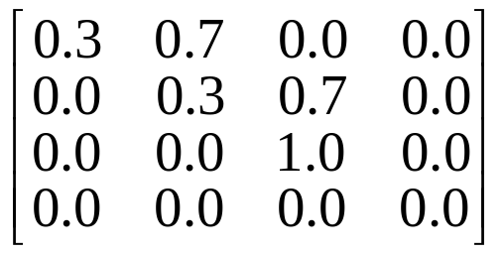
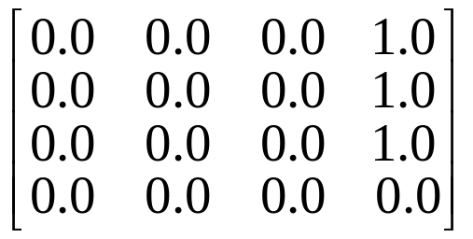
Pi, Beginning of Utterance, and End of Utterance
We specify a probability of transitioning from a state at time T to a special “end-of-utterance” state at time T+1, and this probability is always 1 if the state can be an utterance-final state.
The time-dependent transition probabilities can be defined as:
if t ≤ T+1, then a_{ij} are “standard” and there are no
transitions from i into the “end of utterance” state j
if t = T+1, then a_{ij} are probability of transition from i
into “end of utterance” state j, and this probability is 1
for utterance-final states and 0 for other states.
e.g.
when t ≤ T+1: A =
when t = T+1: A=
X Y Z
EoU

Slide 6
Pi, Beginning of Utterance, and End of Utterance
This can be mapped directly to the “recursive” step of the Viterbi search for the case of t ≤ T, and to the “termination” step of the Viterbi search for the case of t = T+1. (Lecture 8, Slides 16 and 17).
So, having this special “end of utterance” state is equivalent to having the “termination” step in Viterbi search.
t ≤ T
t = T+1
1.0
.33
1.0
1.0
.34
0.6
.33
1.0
0.4

Slide 7
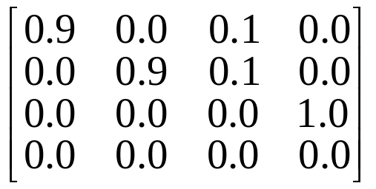
Pi, Beginning of Utterance, and End of Utterance
We can also define one or more “final output” states that emit one observation at the final time T; these states are defined just like any other state, but they transition to the special end-of-utterance state with probability 1 at time T+1:
.90
.60
.10
1.0
.40
.90
.10
“final output” state that emits one “final output” symbol at time T
This 1.0 is unnecessary; we enter this state
at time T with some probability. Then at T+1 we always transition to the special state, according to the time-dependent transition probabilities for a_{ij}(T+1).

Slide 8
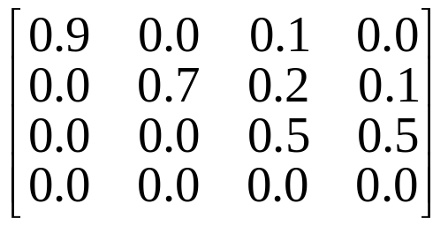
Pi, Beginning of Utterance, and End of Utterance
We can have different probabilities of transitioning into the
“end of utterance” state, but only if T is not known:
.90
0.5
.60
.10
0.5
.40
.70
.20
.10
At time t, after generating an output, this state has probability of 0.7 of generating another output from this state with t < T, probability of 0.2 of going to another state with t < T, and probability of 0.1 of emitting no more outputs from this state with time t = T. T is unknown when the model is created, and during the generation of observations. For speech recognition, T is known during recognition, and so such a model won’t be created. (Also, training process doesn’t use “end-of-utt” state.)

Slide 9
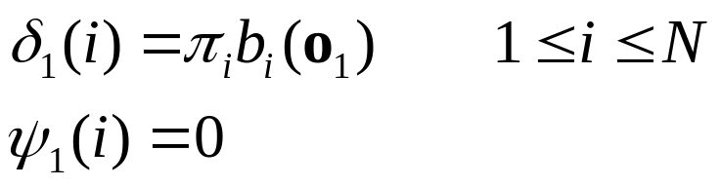
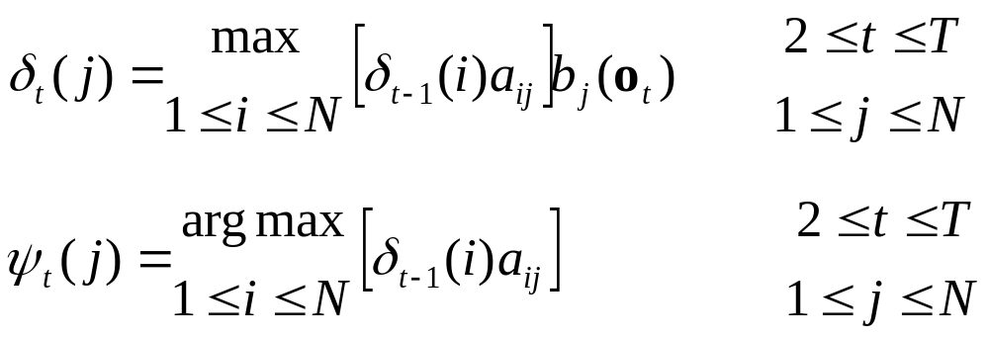
Review: Viterbi Search
(1) Initialization:
(2) Recursion:

Slide 10
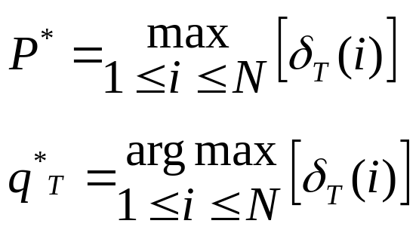
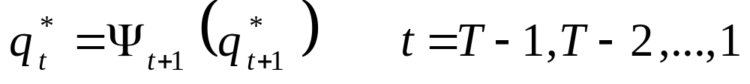
Review: Viterbi Search
(3) Termination:
(4) Backtracking:
Note 1: Usually this algorithm is done in log domain, to avoid
underflow errors.
Note 2: This assumes that any state is a valid end-of-utterance state.
If only some states are valid end-of-utterance states, then
maximization occurs over only those states.

Slide 11
Duration Modeling: Rabiner 6.9
Exponential distribution implicit in transition probabilities:
a₂₂=0.9
prob. of being in state 2
a₂₂=0.7
a₂₂=0.5
However, a phoneme tends to have, on average, a Gamma
distribution:
prob. of being in phn

Slide 12
Duration Modeling: the Semi-Markov Model
One method of correction is a “semi−Markov model”
(also called Continuously Variable Duration Hidden Markov Models or
Explicit State-Duration Density HMMs):
a₁₁
a₂₂
a₁₂
S1
S2
standard HMM
o_{t}
a₂₁
o_{t}
p_{S1}(d)
a₁₂
p_{S2}(d)
S1
S2
semi-Markov model
o_{t}o_{t+1}…o_{t+d1-1}
a₂₁
o_{t}o_{t+1}…o_{t+d2-1}
Note: self-loop not allowed in SMM
In SMM, one state generates multiple (d) observation vectors;
the probability of generating exactly d vectors is determined
from the function p_{j}(d). This function may be continuous (e.g. Gamma) or discrete.

Slide 13
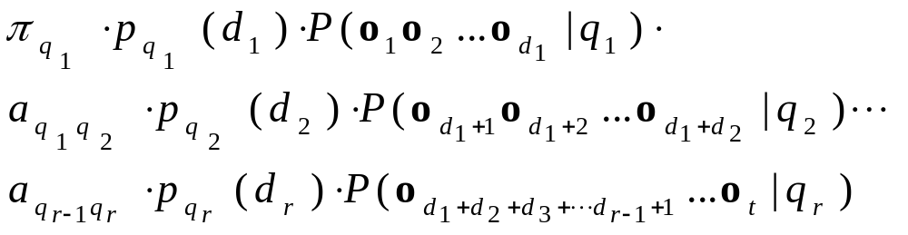
Duration Modeling: the Semi-Markov Model
Assuming that r states have been visited during t observations,
with states Q={q₁, q₂, … q_{r}} having durations {d₁, d₂, … d_{r}}
such that d₁+ d₂+ … d_{r} = t, then the probability of being in state i
at time t and observing Q is:
where p_{q}(d) describes probability of being in state q exactly d
times:

Slide 14
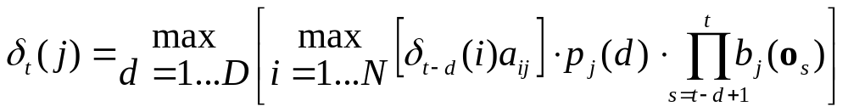
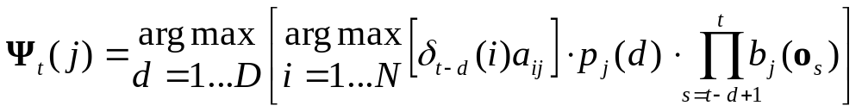
Duration Modeling: the Semi-Markov Model
which makes the Viterbi search look like:
where D is the maximum duration for any p_{j}(d)
Ψ_{t}(j) now is a vector, with the maximum of both duration and
state information. Ψ contains the information of both “what state is the best state going into current state j which ends at time t” and “what is the best duration of the current state j which ends at time t”.

Slide 15
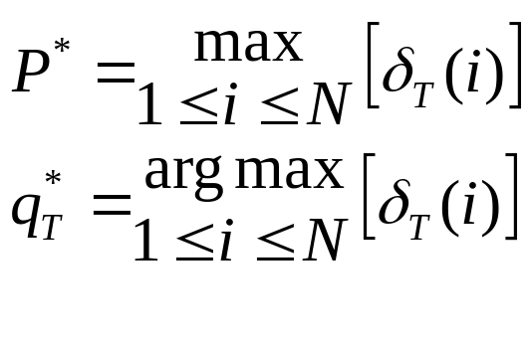

Duration Modeling: the Semi-Markov Model
The Termination step becomes:
The Backtracking step becomes more difficult to express as an
equation, but in algorithm form (C code) is:
bestState = ;
bestDur = psi[T][bestState][1];
printf(“state ending at time %d is %d, duration=%d\n”,
T, bestState, bestDur);
for (t = T-bestDur; t >= 0; ) {
q = psi[t+bestDur][bestState][0];
bestDur = psi[t][q][1];
bestState = q;
printf(“state ending at time %d is %d, duration=%d\n”,
t, bestState, bestDur);
t -= bestDur;
}

Slide 16
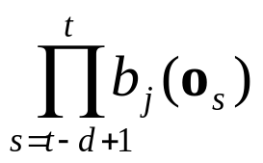
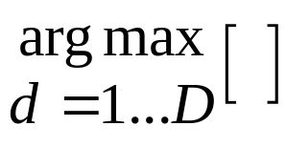
Duration Modeling: the Semi-Markov Model
Advantages of SMM:
better modeling of phonetic durations
Disadvantages of SMM:
• O(D) to O(D²) increase in computation time, depending
on method of implementation… namely whether or not
the full multiplication
is repeated for all cases of
• fewer data with which to estimate a_{ij}. (However, the
number of state transitions is the same, so arguably the
data that remain are the useful data.)
• more parameters (p_{j}(d)) to compute. (However, the
data not used to compute a_{ij} can be used to compute
p_{j}(d)).

Slide 17
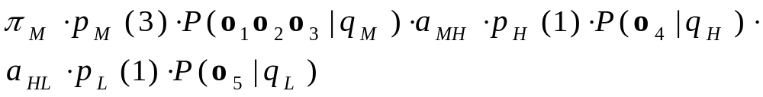
Duration Modeling: the Semi-Markov Model
Example:
state M state H state L
P(sun) 0.4 0.75 0.25
P(rain) 0.6 0.25 0.75
0.1
H
0.7
0.3
0.5
0.9
π_{M} = 0.50
π_{H} = 0.20
π_{L} = 0.30
0.3
L
M
p_{j}(d)
0.2
0.2
0.1
0.1
0.1
0.5
∀j
what is the probability of the observation sequence:
s s r s r (s=sun,r=rain) and the state sequence M_{d=3} H_{d=1} L_{d=1} ??
= 0.5 · 0.3 · (0.4 · 0.4 · 0.6) · 0.5 · 0.1 · 0.75 · 0.3 · 0.1 · 0.75

Slide 18
Duration Modeling: Duration Penalties
Duration Penalties assume uniform transition probabilities:
p_{j}(d)
∀j
but then apply penalties if, during the search, the hypothesized
duration is shorter or longer than specified limits:
p_{j}(d) = penalty_{long} ^{(dj – maxdurj)} if d_{j} > maxdur_{j}, else
penalty_{short} ^{(mindurj – dj)} if d_{j} < mindur_{j}, else
1.0
where penalty_{long}, penalty_{short} are values less than 1.0, d_{j} is the
hypothesized duration of state j, mindur_{j} and maxdur_{j} are duration
limits specific to state j.
No longer guaranteed to find the best state sequence, but usually do.

Slide 19


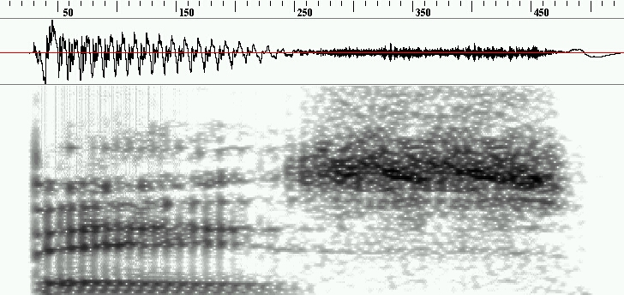
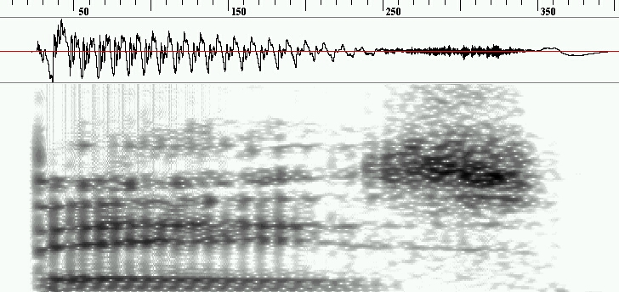
Duration Modeling
Does duration modeling matter?
No: no matter which type of duration model you use, you get
similar ASR performance.
Yes: relative duration can be critical to phonemic distinction;
all HMM (and SMM, etc.) systems lack the ability to
model this

Slide 20
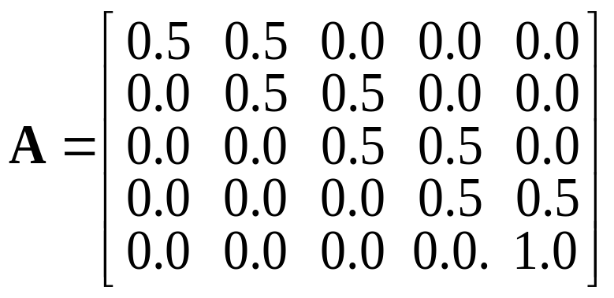
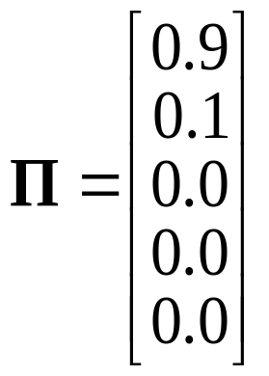
How To Start Training an HMM??
Q1: How to compute initial π_{i}, a_{ij} values?
Assign random, equally-likely, or other values.
(works fine for π_{i} or a_{ij} but not b_{j}(o_{t}))
pau
y
E
s
pau

Slide 21
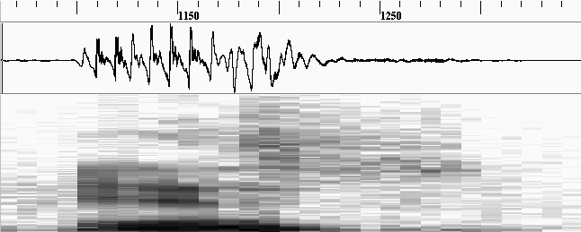
How To Start Training an HMM??
Q2: How to create initial b_{j}(o_{t}) values?
Initializing b_{j}(o_{t}) requires segmentation of training data
(2a) Don’t worry about content of training data, divide it into
equal-length segments, compute b_{j}(o_{t}) for each segment.
= “flat start”.
pau
y
E
s
pau

Slide 22
How To Start Training an HMM??
Initializing b_{j}(o_{t}) requires segmentation of training data
(2b) Better solution:
Use manually-aligned data, if available. Split each phoneme
into X equal parts to create X states per phoneme.
pau
y
E₁
E₂
s
pau

Slide 23
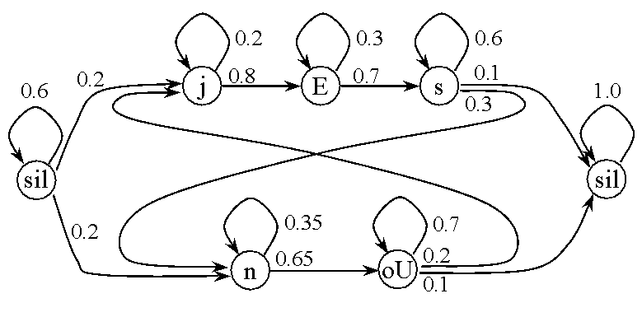
How To Start Training an HMM??
Initializing b_{j}(o_{t}) requires segmentation of training data
(2c) Intermediate solution:
Use “force-aligned data.” We know phoneme sequence, so
use Viterbi on existing HMM to determine best alignment.

Slide 24
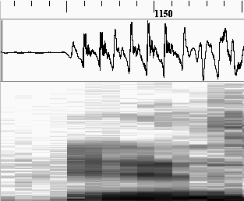
How To Start Training an HMM??
Given a segmentation corresponding to one state,
split that segment (state) into mixture components
using VQ:
clusters may be independent of time!
for 2-dimensional feature:
cluster into 3 groups:
7
12

Slide 25
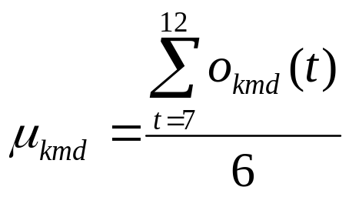
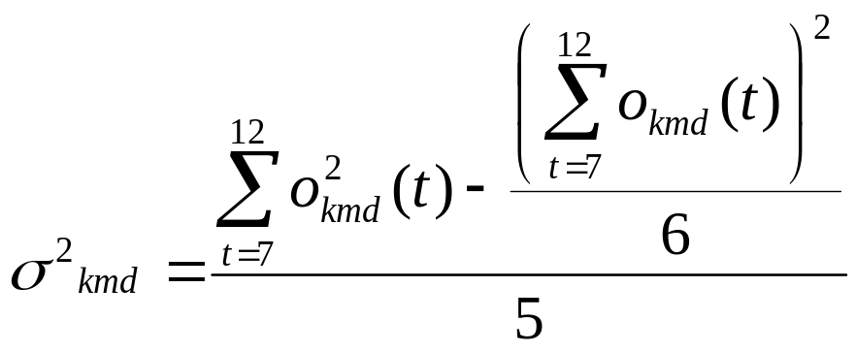
How To Start Training an HMM??
For each mixture component in each segment, compute means
and diagonals of covariance matrices:
o_{kmd}(t) = d^{th} dimension
of observation o(t)
corresponding to m^{th}
mixture component
in k^{th} state
y
Cov(X,Y) = E[(X–μ_{x})(Y–μ_{y})]
= E(XY)–μ_{x}μ_{y}
Cov(X,X) = E(X²)-μ²_{x}
= (ΣX²)/N - (ΣX/N)²
= σ²(X)
7
12
num
points
num
points-1

Slide 26
How To Start Training an HMM??
Q3: How to improve initial a_{ij}, b_{j}(o_{t}) estimates?
Viterbi Segmentation (k-means segmentation)
1. Assume training data, initial model.
2. Use Viterbi to determine best state sequence through data.
3. For each state (segment):
□ for each observation,
assign o(t) to most likely mixture component
using b_{j}(o_{t})
□ update c_{jm}, μ_{jm}, Σ_{jm}, a_{ij}
4. If new model very different from current model,
set current model to “new” model and then
go to (2).

Slide 27
How To Start Training an HMM??
How does assignment and updating work?
1. VQ to create clusters;
cluster weight = ratio of
points in cluster to total
points in state
2. Estimate b_{j}(•) by computing
means, covariances
3. Perform Viterbi search to get
best state alignment
these points are
within one state
these white points go to neighboring state

Slide 28
How To Start Training an HMM??
How does assignment and updating work?
4. Assign each observation to the
mixture component that yields
the greatest probability of that
observation.
5. Update means, covariances,
mixture weights, transition
probabilities (a_{ij} measured from
data)
6. Repeat from (3) until converge; convergence to a locally
“best” model is guaranteed (Juang, B. H. and L. R. Rabiner.
1990. The segmental k-means algorithm for estimating parameters of
hidden Markov models. IEEE Trans. Acoust. Sp. Sig. Proc. 38:1639–1641.)

Slide 29
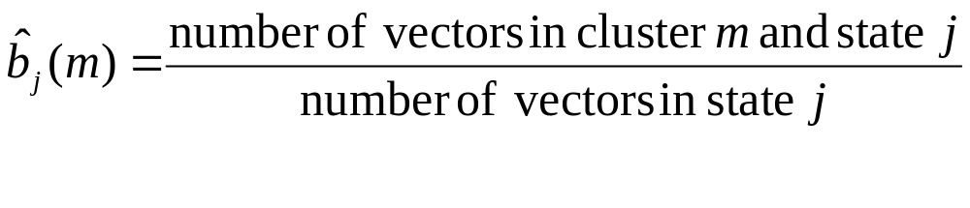
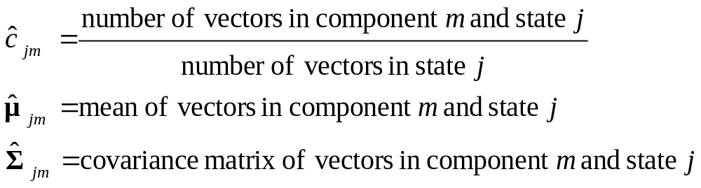
How To Start Training an HMM??
How is updating done?
Discrete HMM (VQ):
Continuous HMM (GMM):

Slide 30
How To Start Training an HMM??
Example for Speech:
2-state HMM, each state
has 2 mixture components:
y
E
each observation has
2 dimensions; use flat
start to select initial
states
use VQ to cluster
into initial 4 groups:

Slide 31
How To Start Training an HMM??
Example for Speech:
compute a_{ij}, b_{j}():
Use Viterbi to segment
utterance
Re-cluster points according
to highest probability

Slide 32
How To Start Training an HMM??
Example for Speech:
re-compute a_{ij}, b_{j}(),
re-segment
re-compute a_{ij}, b_{j}(),
re-segment
Eventually...

Slide 33
How To Start Training an HMM??
Viterbi segmentation can be used to boot-strap another
method, EM, for locally maximizing the likelihood of P(O|λ).
We’ll talk later about implementing EM using the forward-
backward (also known as Baum-Welch) procedure.
Then embedded training will relax one of the constraints
for further improvement.
All methods provide locally-optimal solution; there is no
known globally-optimal (closed) solution for HMM parameter
estimation. The better the initial estimates of λ (in
particular b_{j}(o_{t})), the better the final result.

Slide 34
Viterbi Search Project
Second project: Given an existing HMM, implement a
Viterbi search to find likelihood of utterance and best
state sequence.
“Template” code is available to read in features, read in
HMM values, provide some context and a starting point.
The features will be given to you are “real,” in that they are
7 PLP coefficients plus 7 delta values from utterances of “yes”
and “no” sampled every 10 msec.
Also given to you is the logAdd() function, but you must
implement the multi-dimensional GMM code (see formula
from Lecture 5, slides 26-27). Assume diagonal covariance
matrix.
All necessary files (template, HMM, speech data files) located
on the class web site.

Slide 35
Viterbi Search Project
“Search” files with HMMs for “yes” and “no”, and print out final
likelihood scores and most likely state sequences:
input1.txt hmm_yes.10
input1.txt hmm_no.10
input2.txt hmm_yes.10
input2.txt hmm_no.10
input3.txt hmm_yes.10
input3.txt hmm_no.10
Then, use results to perform ASR…
(1) is input1.txt more likely to be “yes” or “no”?
(2) is input2.txt more likely to be “yes” or “no”?
(3) is input3.txt more likely to be “yes” or “no”?
Due on May 15; send your source code and results
(including final scores and most likely state sequences)
to hosom at cslu. ogi. edu; late responses generally not accepted.

Slide 36
Viterbi Search Project
Assume that any state can follow any other state; this will
greatly simplify the implementation.
Also assume that this is a whole-word recognizer, and that
each word is recognized with a separate execution of the
program. This will greatly simplify the implementation
Print out both the score for the utterance and the most likely
state sequence from t=1 to T

