Slide 1
CSE 552/652
Hidden Markov Models for Speech Recognition
Spring, 2006
Oregon Health & Science University
OGI School of Science & Engineering
John-Paul Hosom
Lecture Notes for May 3
Alpha and Beta

Slide 2
Outline of Lecture
Ask questions like
“what is probability of an observation sequence
given model?”
“what is probability of being in state j at time t?”
Then ask big question:
“How do we improve our initial estimates of the
HMM parameters?”

Slide 3
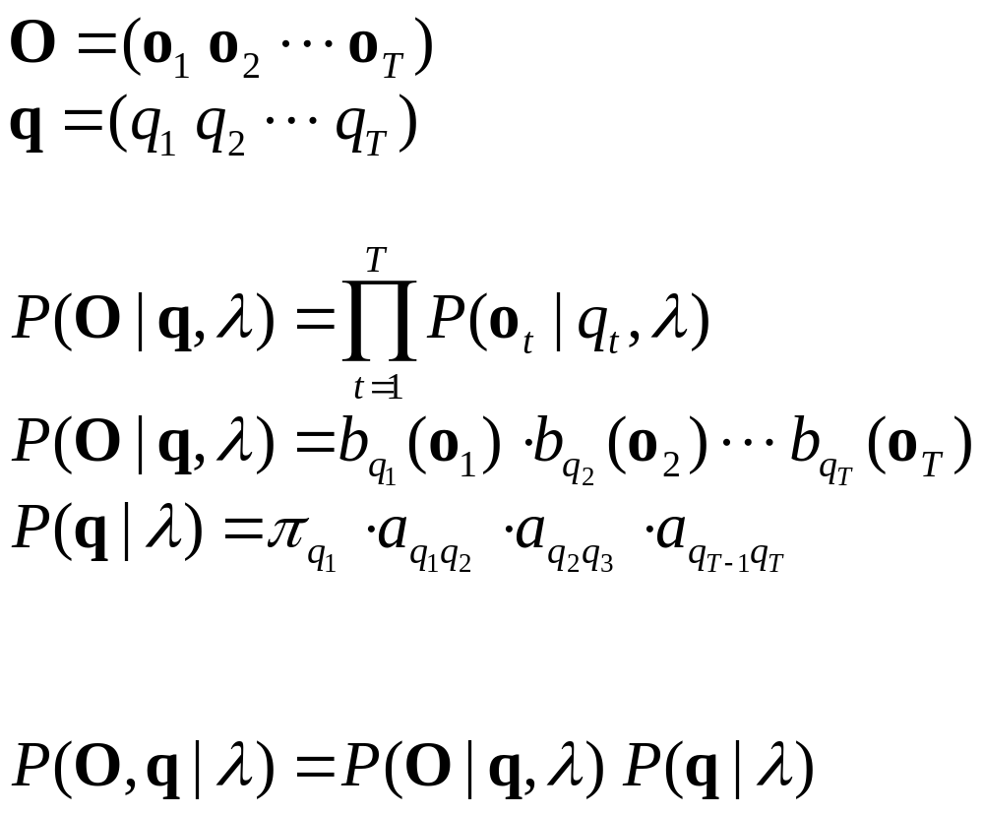
Probability Evaluation
What is probability of a set of observations and a specific
state sequence, given an HMM? (review)
(assume independence of observations)
The joint probability of O and q simultaneously is

Slide 4
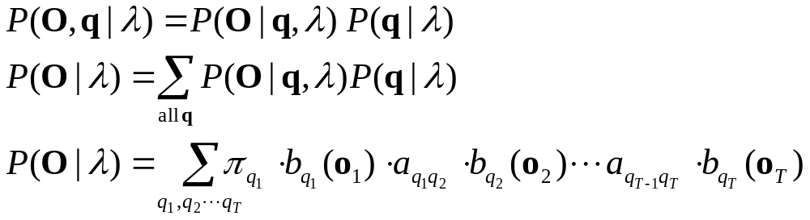
Probability Evaluation
What is probability of a set of observations, given an
HMM?
This requires O(2T·N^{T}) calculations!
Impractical for large values of T (long utterances)
Solution: use an inductive procedure (similar to Viterbi search)
called the Forward Procedure

Slide 5

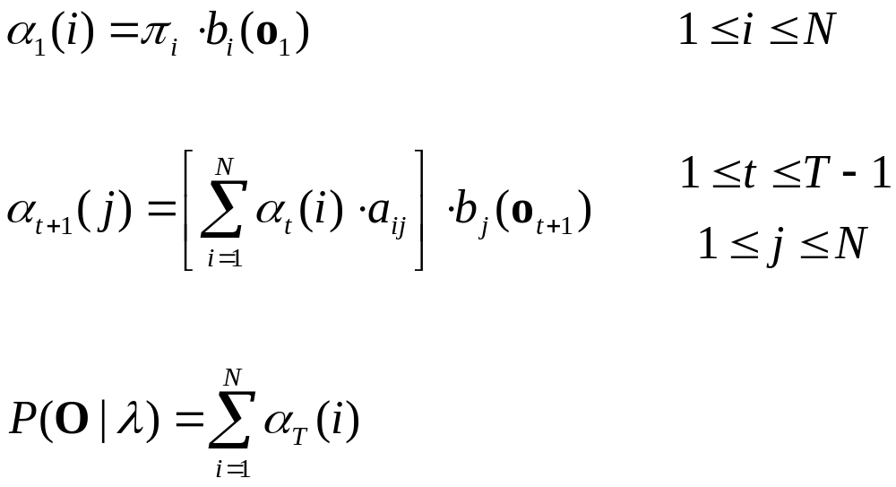
Forward Probability: α
Define variable α which has meaning of
“the probability of observations o₁ through o_{t} and
being in state i at time t, given our HMM”
Compute α and P(O|λ) with the following procedure:
Induction:
Termination:

Slide 6
Forward Procedure: Algorithm Example #1
Given the following model of the weather:
(states indicate
barometer pressure)
0.5
H
0.4
0.1
0.1
0.4
0.4
L
M
0.3
0.5
0.3
state M state H state L
P(sun) 0.50 0.75 0.25
P(rain) 0.50 0.25 0.75
π_{M} = 0.50
π_{H} = 0.20
π_{L} = 0.30

Slide 7
Forward Procedure: Algorithm Example #1
What is the probability of the observation sequence:
s r r s r (s=sun,r=rain)?
Compute value of Σα at time 5...
α₁(M)=0.5·0.5 α₁(H)=0.2·0.75 α₁(L)=0.3·0.25
α₁(M)=0.25 α₁(H)=0.15 α₁(L)=0.075
α₂(M) = [0.25·0.3 + 0.15·0.4 + 0.075·0.4] · 0.5 = 0.0825
α₂(H) = [0.25·0.4 + 0.15·0.5 + 0.075·0.1] · 0.25 = 0.0456
α₂(L) = [0.25·0.3 + 0.15·0.1 + 0.075·0.5] · 0.75 = 0.0956
α₃(M) = [0.0825·0.3 + 0.0456·0.4 + 0.0956·0.4] · 0.5 = 0.0406
α₃(H) = [0.0825·0.4 + 0.0456·0.5 + 0.0956·0.1] · 0.25 = 0.0163
α₃(L) = [0.0825·0.3 + 0.0456·0.1 + 0.0956·0.5] · 0.75 = 0.0578

Slide 8
Forward Procedure: Algorithm Example #1
α₄(M) = [0.0406·0.3 + 0.0163·0.4 + 0.0578·0.4] · 0.5 = 0.0209
α₄(H) = [0.0406·0.4 + 0.0163·0.5 + 0.0578·0.1] · 0.75 = 0.0226
α₄(L) = [0.0406·0.3 + 0.0163·0.1 + 0.0578·0.5] · 0.25 = 0.0107
α₅(M) = [0.0209·0.3 + 0.0226·0.4 + 0.0107·0.4] · 0.5 = 0.0098
α₅(H) = [0.0209·0.4 + 0.0226·0.5 + 0.0107·0.1] · 0.25 = 0.0052
α₅(L) = [0.0209·0.3 + 0.0226·0.1 + 0.0107·0.5] · 0.75 = 0.0104
0.0254
State M
State H
State L
1
2
3
4
5

Slide 9
Forward Procedure: Compare with Viterbi
So what about Viterbi? Why do we need Viterbi?
Same observations: s r r s r
Compute Viterbi path up to time 5...
δ₁(M)=0.5·0.5 δ₁(H)=0.2·0.75 δ₁(L)=0.3·0.25
δ₁(M)=0.25 δ₁(H)=0.15 δ₁(L)=0.075
δ₂(M) = max[0.25·0.3, 0.15·0.4, 0.075·0.4] · 0.5 = 0.0375
δ₂(H) = max[0.25·0.4, 0.15·0.5, 0.075·0.1] · 0.25 = 0.0250
δ₂(L) = max[0.25·0.3, 0.15·0.1, 0.075·0.5] · 0.75 = 0.0563
δ₃(M) = max[0.0375·0.3, 0.0250·0.4, 0.0563·0.4] · 0.5 = 0.0113
δ₃(H) = max[0.0375·0.4, 0.0250·0.5, 0.0563·0.1] · 0.25 = 0.0038
δ₃(L) = max[0.0375·0.3, 0.0250·0.1, 0.0563·0.5] · 0.75 = 0.0211

Slide 10
Forward Procedure: Compare with Viterbi
δ₄(M) = max[0.0113·0.3 + 0.0038·0.4 + 0.0211·0.4] · 0.5 = 0.0042
δ₄(H) = max[0.0113·0.4 + 0.0038·0.5 + 0.0211·0.1] · 0.75 = 0.0034
δ₄(L) = max[0.0113·0.3 + 0.0038·0.1 + 0.0211·0.5] · 0.25 = 0.0026
δ₅(M) = max[0.0042·0.3 + 0.0034·0.4 + 0.0026·0.4] · 0.5 = 0.0007
δ₅(H) = max[0.0042·0.4 + 0.0034·0.5 + 0.0026·0.1] · 0.25 = 0.0004
δ₅(L) = max[0.0042·0.3 + 0.0034·0.1 + 0.0026·0.5] · 0.75 = 0.0010
Maximum state score at time 5 = 0.0010 in state L
State M
State H
State L
1
2
3
4
5

Slide 11
Forward Procedure: Notes
Forward and Viterbi yield different results because Forward
is computing total probability of being in a state, regardless
of any state sequence used to get to that state.
Viterbi gives best state sequence until time t, but not overall
probability of being in a given state.
The only difference between Forward and Viterbi is
sum vs. max operation.

Slide 12
Comparing Forward Procedure with Viterbi Search
both Viterbi and Forward produce answer in N²T calculations
for Viterbi search, we want most likely state sequence,
and we can only be in one state at any time t. So we
take the “max” to determine which state.
for the Forward procedure, we want the total probability,
so we sum the probabilities over all possible paths to any
given state.
The “Viterbi approximation” means to use Viterbi search
to find the best HMM for an utterance because it’s (a little bit)
faster to take a max than a sum, and recognition results end up
being nearly the same, plus you get the state (word) location
information from Viterbi.

Slide 13
Forward Procedure: Algorithm Example #2
Given the following model of the weather:
(states indicate
barometer pressure)
0.6
H
0.4
0.5
L
0.4
M
0.6
0.5
state M state H state L
P(sun) 0.50 0.75 0.25
P(rain) 0.50 0.25 0.75
π_{M} = 0.33
π_{H} = 0.33
π_{L} = 0.33
What is the overall probability of the observation sequence:
s r r s r (s=sun,r=rain)?

Slide 14
Forward Procedure: Algorithm Example #2
α₁(M)=0.1667 α₁(H)=0.2500 α₁(L)=0.0833
α₂(M) = [ 0.2500·0.4 + 0.0833·0.4 ] · 0.5 = 0.0667
α₂(H) = [0.1667·0.5 + 0.2500·0.6 ] · 0.25 = 0.0583
α₂(L) = [0.1667·0.5 + 0.0833·0.6] · 0.75 = 0.1000
α₃(M) = [ 0.0583·0.4 + 0.1000·0.4] · 0.5 = 0.0317
α₃(H) = [0.0667·0.5 + 0.0583·0.6 + ] · 0.25 = 0.0171
α₃(L) = [0.0667·0.5 + 0.1000·0.6] · 0.75 = 0.0700
α₄(M) = [ 0.0171·0.4 + 0.0700·0.4] · 0.5 = 0.0174
α₄(H) = [0.0317·0.5 + 0.0171·0.6 + ] · 0.75 = 0.0196
α₄(L) = [0.0317·0.5 + 0.0700·0.6] · 0.25 = 0.0144
α₅(M) = [ 0.0196·0.4 + 0.0144·0.4] · 0.5 = 0.0068
α₅(H) = [0.0174·0.5 + 0.0196·0.6 + ] · 0.25 = 0.0051
α₅(L) = [0.0174·0.5 + 0.0144·0.6] · 0.75 = 0.0130
0.0249

Slide 15
Forward Procedure: Algorithm Example #3
0.3
0.4
Example: “hi”
1.0
h
0.7
ay
0.6
1.0
1.0
0.55
0.65
0.20
0.15
0.0
0.0
0.0
1.0
0.0
1.0
observed features: o₁ = {0.8} o₂ = {0.8} o₃ = {0.2}
What are all α values?
What is probability of {o₁} and being in state /h/ at time 1?
What is prob. of {o₁ o₂} and being in state /ay/ at time 2?
α₁(h)=0.55 α₁(ay)=0.0
α₂(h) = [0.55·0.3 + 0.0·0.0] · 0.55 = 0.09075
α₂(ay) = [0.55·0.7 + 0.0·0.4] · 0.15 = 0.05775

Slide 16
Forward Procedure: Algorithm Example #3
What are all α values? (con’t)
What is probability of {o₁} and being in state /h/ at time 1?
0.55
What is probability of {o₁ o₂} and being in state /ay/ at time 2?
0.05775
α₃(h) = [0.09075·0.3 + 0.05775·0.0] · 0.20 = 0.0054
α₃(ay) = [0.09075·0.7 + 0.05775·0.4] · 0.65 = 0.0563
0.0617

Slide 17

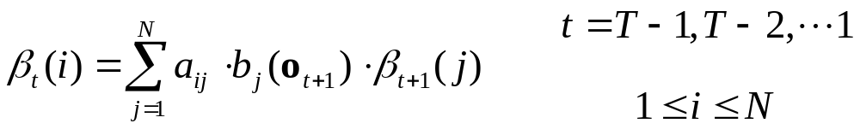
Backward Procedure: β
In the same way that we defined α, we can define β
Define variable β which has meaning of
“the probability of observations o_{T} through o_{t+1}, given
that we’re in state i at time t, and given our HMM”
Compute β with the following procedure:
Where a value of 1 for T is chosen “arbitrarily” (value won’t affect results). One reasoning for a value of 1 is that, given that the model is in state i at time T, the probability of emitting an “end-of-sequence” observation at time T+1 is 1.0. (By definition, at time T+1 we have finished processing the input sequence, no matter what state we’re in, and we can emit a special symbol.)

Slide 18
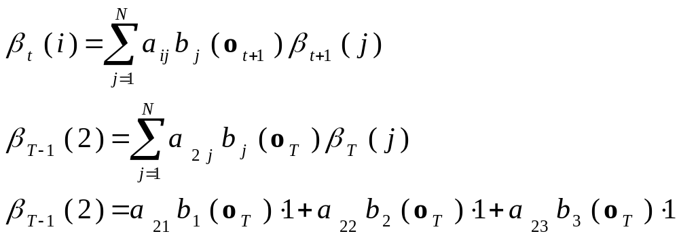
Backward Procedure: Illustration
For other times other than T, illustrated as follows:
b₁(o_{T})
a₂₁
State 1
a₂₂
b₂(o_{T})
β_{T-1}(2)
State 2
a₂₃
b₃(o_{T})
State 3

Slide 19
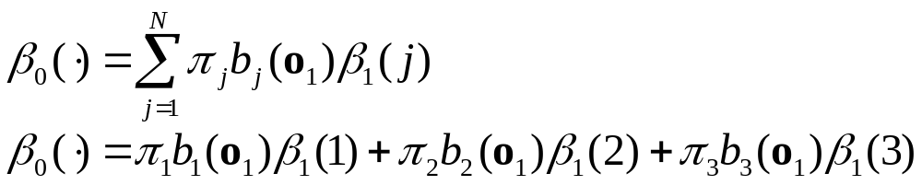
Backward Procedure: Illustration
Finally, we can compute β₀(·), going to a special “beginning of
utterance” state that emits the π values in the transition to the
first “real” states, from time 0 to time 1.
b₁(o₁)
π₂₁
State 1
π₂₂
b₂(o₁)
β₀(·)
State 2
π₂₃
b₃(o₁)
State 3

Slide 20
Backward Procedure: Example #1
What is the probability of the observation sequence:
s r r s r (s=sun,r=rain)?
given the model from Example #1
Compute value of β at from time 5 to time 0:
β₅(M)=1.0 β₅(H)=1.0 β₅(L)=1.0
β₄(M) = [0.3·0.50·1.0 + 0.4·0.25·1.0 + 0.3·0.75·1.0] = 0.4750
β₄(H) = [0.4·0.50·1.0 + 0.5·0.25·1.0 + 0.1·0.75·1.0] = 0.4000
β₄(L) = [0.4·0.50·1.0 + 0.1·0.25·1.0 + 0.5·0.75·1.0] = 0.6000
β₃(M) = [0.3·0.50·0.475 + 0.4·0.75·0.400 + 0.3·0.25·0.600] = 0.2363
β₃(H) = [0.4·0.50·0.475 + 0.5·0.75·0.400 + 0.1·0.25·0.600] = 0.2600
β₃(L) = [0.4·0.50·0.475 + 0.1·0.75·0.400 + 0.5·0.25·0.600] = 0.2000

Slide 21
Backward Procedure: Example #1
β₂(M) = [0.3·0.50·0.236 + 0.4·0.25·0.260 + 0.3·0.75·0.200] = 0.1064
β₂(H) = [0.4·0.50·0.236 + 0.5·0.25·0.260 + 0.1·0.75·0.200] = 0.0947
β₂(L) = [0.4·0.50·0.236 + 0.1·0.25·0.260 + 0.5·0.75·0.200] = 0.1287
β₁(M) = [0.3·0.50·0.106 + 0.4·0.25·0.095 + 0.3·0.75·0.129] = 0.0544
β₁(H) = [0.4·0.50·0.106 + 0.5·0.25·0.095 + 0.1·0.75·0.129] = 0.0428
β₁(L) = [0.4·0.50·0.106 + 0.1·0.25·0.095 + 0.5·0.75·0.129] = 0.0720
β₀(·) = [0.5·0.50·0.054 + 0.2·0.75·0.043 + 0.3·0.25·0.072] = 0.0254
Note that β₀(·) = Σα_{T}(i); this value is the total probability of the
observation sequence.

Slide 22
Backward Procedure: Example #2
What is the probability of the observation sequence:
s r r s r (s=sun,r=rain)?
given the model from Example #2
Compute value of β at time 0...
β₅(M)=1.0 β₅(H)=1.0 β₅(L)=1.0
β₄(M) = [ 0.5·0.25·1.0 + 0.5·0.75·1.0] = 0.5000
β₄(H) = [0.4·0.50·1.0 + 0.6·0.25·1.0 ] = 0.3500
β₄(L) = [0.4·0.50·1.0 + 0.6·0.75·1.0] = 0.6500
β₃(M) = [ 0.5·0.75·0.350 + 0.5·0.25·0.650] = 0.2125
β₃(H) = [0.4·0.50·0.500 + 0.6·0.75·0.350 ] = 0.2575
β₃(L) = [0.4·0.50·0.500 + 0.6·0.25·0.650] = 0.1975

Slide 23
Backward Procedure: Example #2
β₂(M) = [ 0.5·0.25·0.258 + 0.5·0.75·0.198] = 0.1065
β₂(H) = [0.4·0.50·0.213 + 0.6·0.25·0.258 ] = 0.0813
β₂(L) = [0.4·0.50·0.213 + 0.6·0.75·0.198] = 0.1317
β₁(M) = [ 0.5·0.25·0.081 + 0.5·0.75·0.132] = 0.0596
β₁(H) = [0.4·0.50·0.106 + 0.6·0.25·0.081 ] = 0.0333
β₁(L) = [0.4·0.50·0.106 + 0.6·0.75·0.132] = 0.0806
β₀(·) = [0.33·0.50·0.060 + 0.33·0.75·0.033 + 0.33·0.25·0.081] = 0.0248
Note that β₀(·) = α_{T}(·); this value is the total probability of the
observation sequence.

Slide 24
Backward Procedure: Example #3
0.3
0.4
Example: “hi”
1.0
h
0.7
ay
0.6
1.0
1.0
0.55
0.65
0.20
0.15
0.0
0.0
0.0
1.0
0.0
1.0
observed features: o₁ = {0.8} o₂ = {0.8} o₃ = {0.2}
What are all β values?
What is prob. of {o₂, o₃} given that we’re in state /h/ at time 1?
What is prob. of {o₃} given that we’re in state /ay/ at time 2?
β₃(h)=1.0 β₃(ay)=1.0
β₂(h) = [0.3·0.20·1.0 + 0.7·0.65·1.0] = 0.515
β₂(ay) = [0.0·0.20·1.0 + 0.4·0.65·1.0] = 0.260

Slide 25
Backward Procedure: Example #3
What are all β values? (con’t)
What is prob. of {o₂, o₃} given that we’re in state /h/ at time 1?
  0.1123
What is prob. of {o₃} given that we’re in state /ay/ at time 2?
0.260
β₁(h) = [0.3·0.55·0.515 + 0.7·0.15·0.260] = 0.1123
β₁(ay) = [0.0·0.55·0.515 + 0.4·0.15·0.260] = 0.0156
β₀(·) = [1.0·0.55·0.1123 + 0.0·0.15·0.0156] = 0.0618

Slide 26

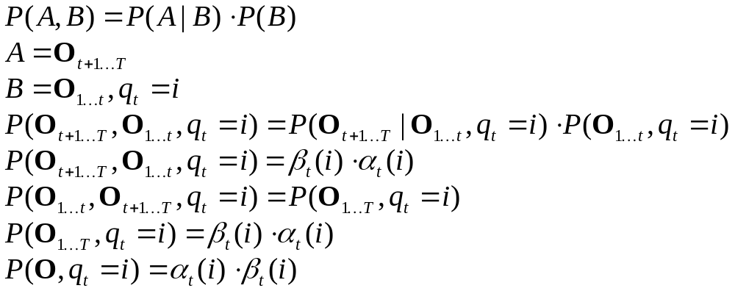
Forward-Backward Fun
Since
then
Derivation:

Slide 27
Forward-Backward Fun
So, what’s the probability of the observation sequence and
being in state /ay/ at time 2?
0.05775 · 0.260 = 0.015
What’s the probability of the observation sequence and
being in state /h/ at time 1?
0.55 · 0.1123 = 0.0618
= probability of total observation O
Why??

