Slide 1
CSE 552/652
Hidden Markov Models for Speech Recognition
Spring, 2006
Oregon Health & Science University
OGI School of Science & Engineering
John-Paul Hosom
Lecture Notes for May 10
Gamma, Xi, and the Forward-Backward Algorithm

Slide 2

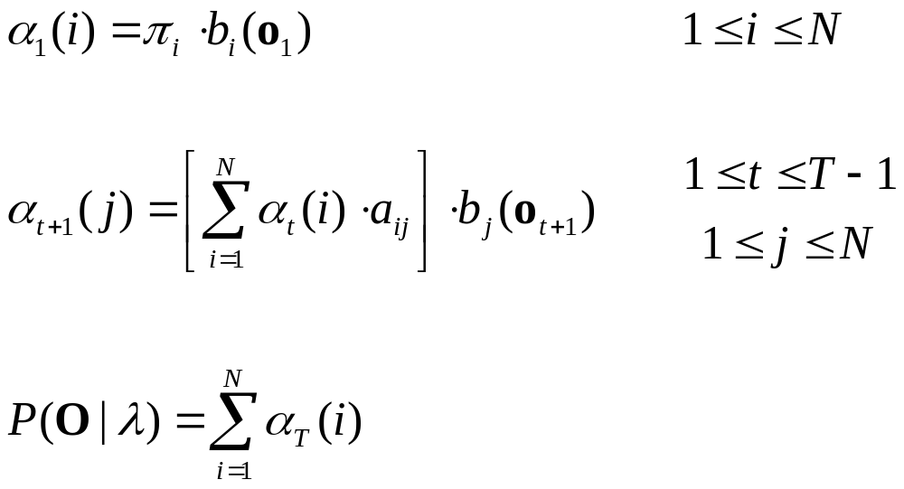
Review: α and β
Define variable α which has meaning of
“the probability of observations o₁ through o_{t} and
being in state i at time t, given our HMM”
Compute α and P(O | λ) with the following procedure:
Initialization:
Induction:
Termination:

Slide 3

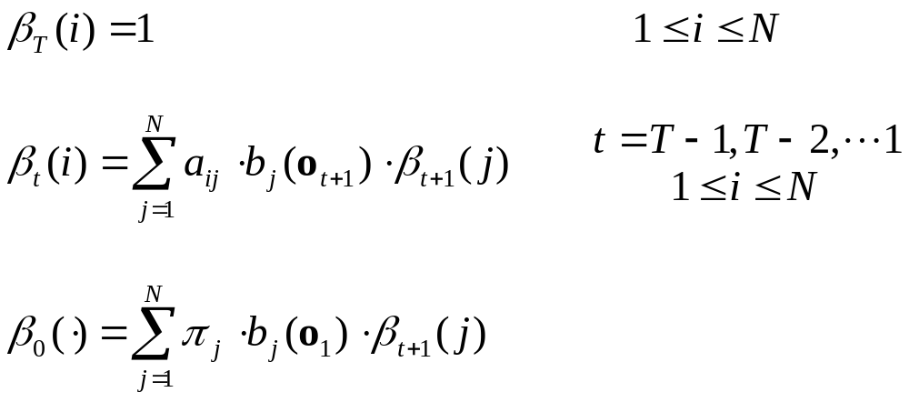
Review: α and β
In the same way that we defined α, we can define β:
Define variable β which has meaning of
“the probability of observations o_{t+1} through o_{T}, given
that we’re in state i at time t, and given our HMM”
Compute β with the following procedure:
Initialization:
Induction:
Termination:

Slide 4
Forward Procedure: Algorithm Example
0.3
0.4
Example: “hi”
1.0
h
0.7
ay
0.6
1.0
1.0
0.55
0.65
0.20
0.15
0.0
0.0
0.0
1.0
0.0
1.0
observed features: o₁ = {0.8} o₂ = {0.8} o₃ = {0.2}
α₁(h)=0.55 α₁(ay)=0.0
α₂(h) = [0.55·0.3 + 0.0·0.0] · 0.55 = 0.09075
α₂(ay) = [0.55·0.7 + 0.0·0.4] · 0.15 = 0.05775
α₃(h) = [0.09075·0.3 + 0.05775·0.0] · 0.20 = 0.0054
α₃(ay) = [0.09075·0.7 + 0.05775·0.4] · 0.65 = 0.0563
Σα₃(i) = 0.0617

Slide 5
Backward Procedure: Algorithm Example
What are all β values?
β₃(h)=1.0 β₃(ay)=1.0
β₂(h) = [0.3·0.20·1.0 + 0.7·0.65·1.0] = 0.515
β₂(ay) = [0.0·0.20·1.0 + 0.4·0.65·1.0] = 0.260
β₁(h) = [0.3·0.55·0.515 + 0.7·0.15·0.260] = 0.1123
β₁(ay) = [0.0·0.55·0.515 + 0.4·0.15·0.260] = 0.0156
β₀(·) = [1.0·0.55·0.1123 + 0.0·0.15·0.0156] = 0.0618
β₀(·) = Σ α₃(i) = P(O|λ)

Slide 6
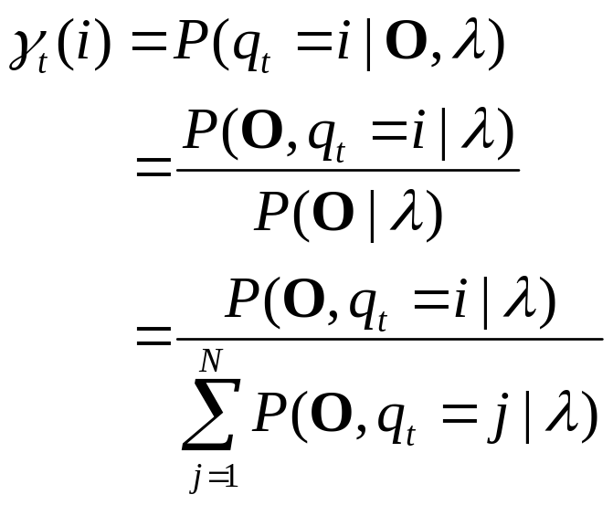

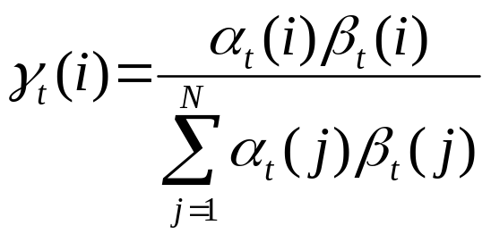
Probability of Gamma
Now we can define γ, the probability of being in state i at time t
given an observation sequence and HMM.
(multiplication rule)
Note: We’re writing the
denominator this way
only to show that it’s
equivalent to P(O|λ).
We won’t further modify
this term, or actually use
the denominator in this
form in implementation.
also , so

Slide 7
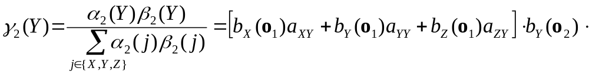
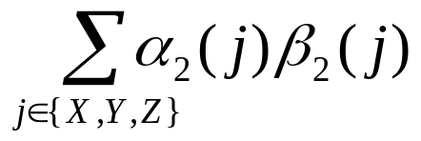
Probability of Gamma: Illustration
Illustration: what is probability of being in state Y at time 2?
b_{X}(o₁)
b_{X}(o₂)
b_{X}(o₃)
a_{XY}
a_{YX}
State X
b_{Y}(o₁)
a_{YY}
b_{Y}(o₂)
a_{YY}
b_{Y}(o₃)
a_{ZY}
a_{YZ}
State Y
b_{Z}(o₁)
b_{Z}(o₂)
b_{Z}(o₃)
State Z

Slide 8
Gamma: Example
Given this 3-state HMM and set of 4 observations, what is
probability of being in state A at time 2?
0.2
0.3
1.0
1.0
0.8
0.7
sil-y+eh
sil-y+eh
sil-y+eh
A
B
C
1.0
0.0
0.0
1.0
O = {0.2 0.3 0.4 0.5}

Slide 9
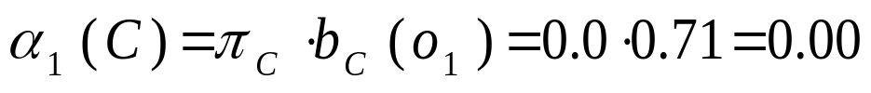
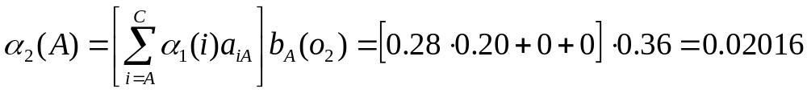
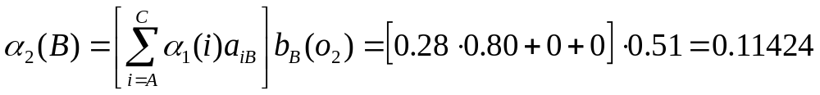
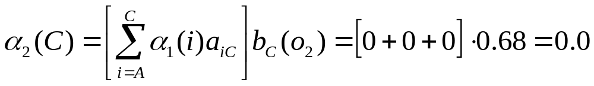
Gamma: Example
1. Compute forward probabilities up to time 2

Slide 10
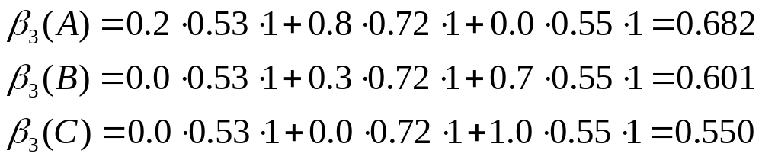
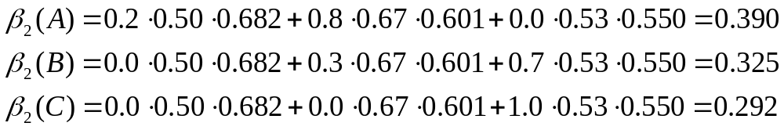
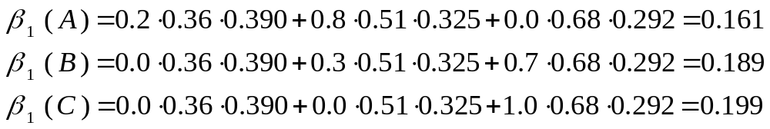
Gamma: Example
2. Compute backward probabilities for times 4, 3, 2

Slide 11
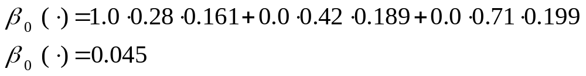
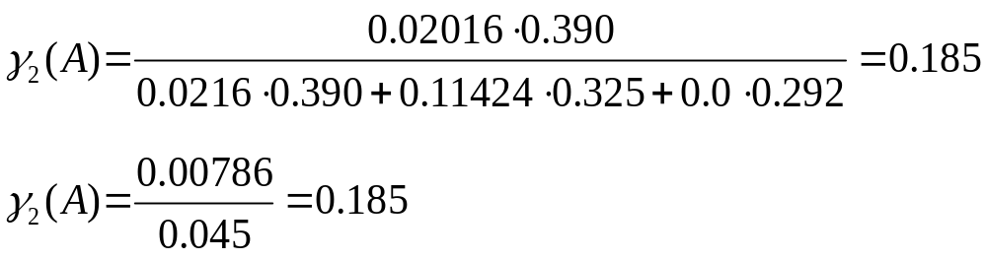
Gamma: Example
3. Compute γ

Slide 12

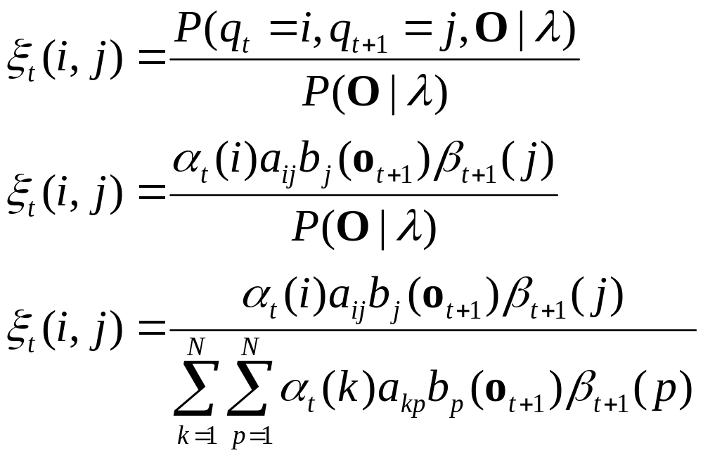
Xi
We can define one more variable:
ξ is the probability of being in state i at time t, and
in state j at time t+1, given the observations and HMM
We can specify ξ as follows:
Note: We’re writing the
denominator this way
only to show that it’s
equivalent to P(O|λ).
We won’t further modify
this term, or actually use
the denominator in this
form in implementation.

Slide 13
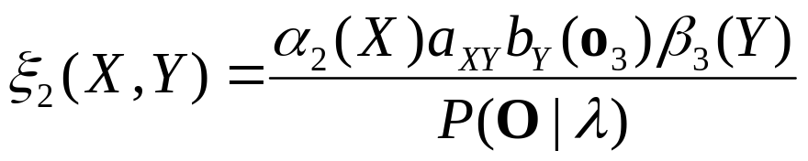
Xi: Diagram
This diagram illustrates ξ
b_{X}(o₁)
a_{XX}
b_{X}(o₂)
b_{X}(o₃)
b_{X}(o₄)
a_{YX}
a_{YX}
State X
b_{Y}(o₁)
b_{Y}(o₂)
b_{Y}(o₃)
b_{Y}(o₄)
a_{YY}
a_{ZX}
State Y
a_{YZ}
b_{Z}(o₁)
b_{Z}(o₂)
b_{Z}(o₃)
b_{Z}(o₄)
State Z
a_{AB}b_{B}(o₃)
t-1
t
t+1
t+2
α₂(X)
β₃(Y)

Slide 14
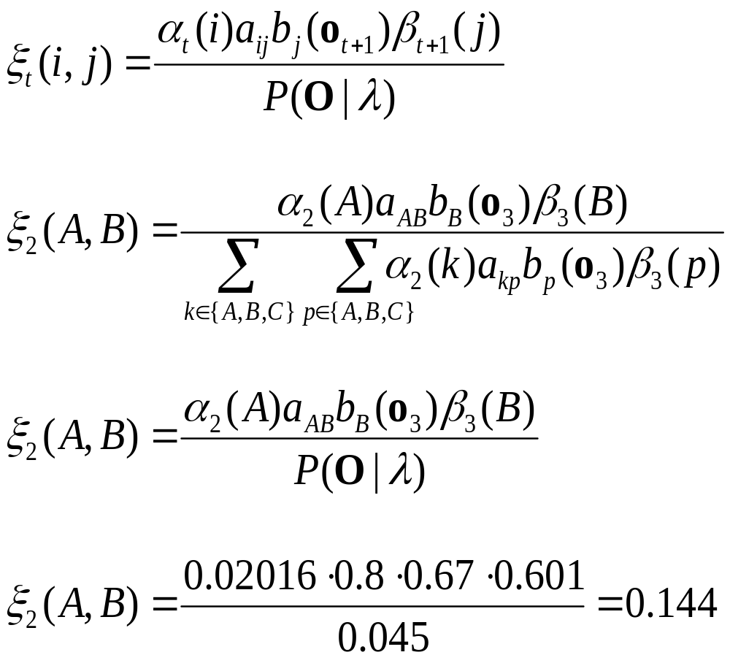
Xi: Example #1
Given the same HMM and observations as in the Example for
Gamma, what is ξ₂(A,B)?

Slide 15
Xi: Example #2
Given this 3-state HMM and set of 4 observations, what is
the expected number of transitions from B to C?
0.2
0.3
1.0
1.0
0.8
0.7
sil-y+eh
sil-y+eh
sil-y+eh
A
B
C
1.0
0.0
0.0
1.0
O = {0.2 0.3 0.4 0.5}

Slide 16
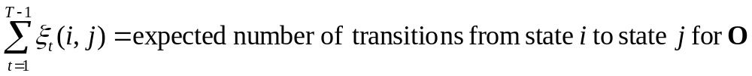
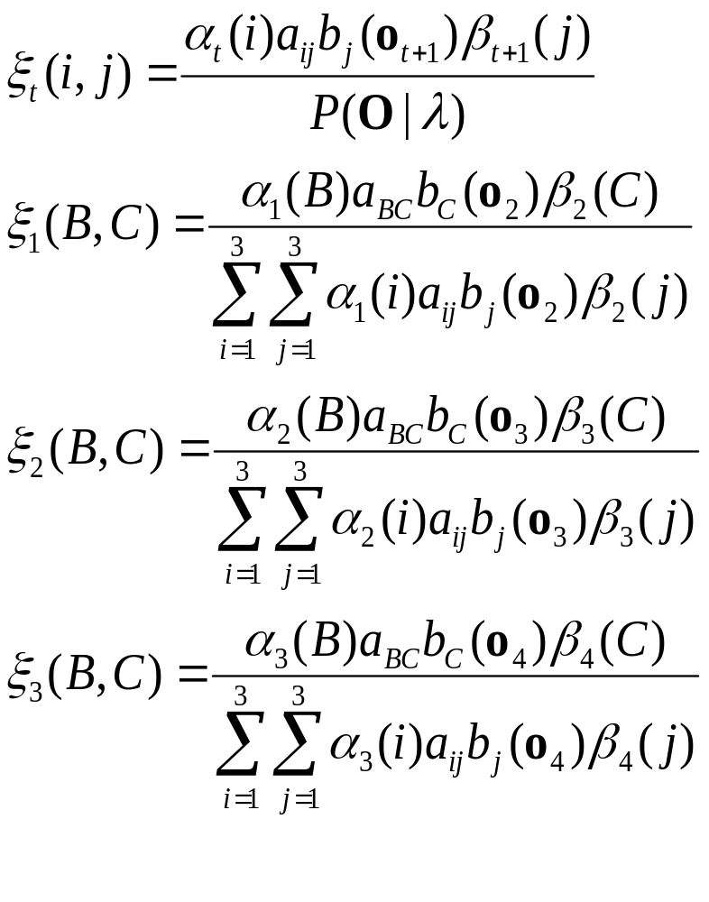
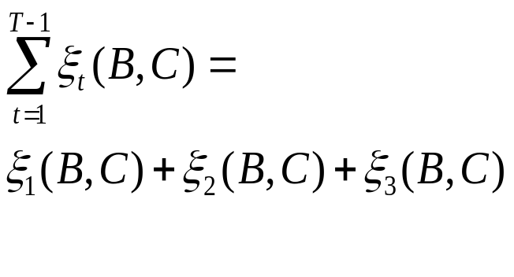
Xi: Example #2

Slide 17
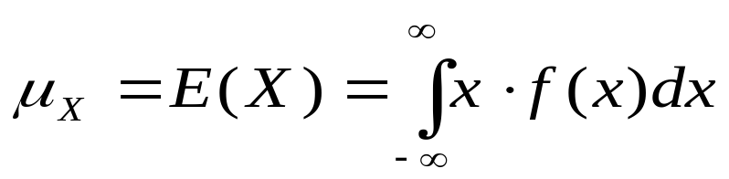
“Expected Values”
The “expected number of transitions from state i to j for O” does
not have to be an integer, even if the actual number of
transitions for any single O is always an integer.
These expected values have the same meaning as the expected
value of a variable x for a function f(x), which is the mean
value of x. This mean value does not have to be an integer value,
even if x only takes on integer values.
From Lecture 3, slide 6:
  expected (mean) value of c.r.v. X with p.d.f. f(x) is:
  example 1 (discrete):
0.25
0.20
E(X) = 2·0.05+3·0.10+ … +9·0.05 = 5.35
0.15
0.15
0.10
0.05
0.05
0.05
1.0
2.0
3.0
4.0
5.0
6.0
7.0
8.0
9.0

Slide 18
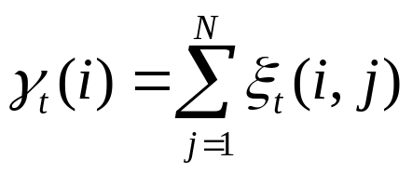
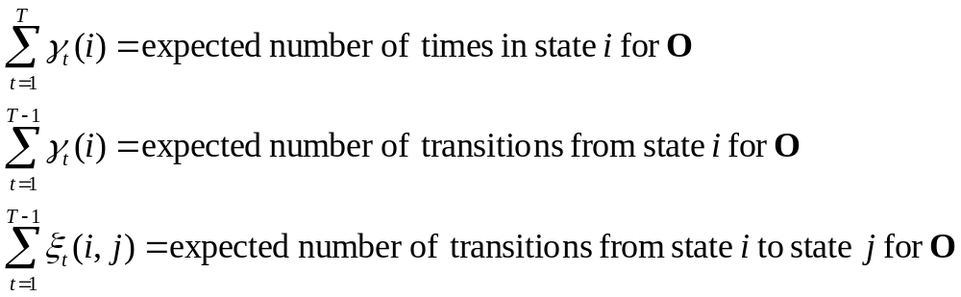
Xi
We can also specify γ in terms of ξ (up to t=T-1):
and finally, using the original definition of γ (slide 6):
But why do we care??

Slide 19
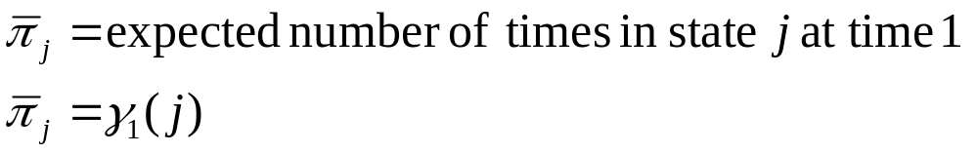
How Do We Improve Estimates of HMM Parameters?
We can improve estimates of HMM parameters using one
case of the Expectation-Maximization procedure, known as
the Baum-Welch method or forward-backward algorithm.
In this algorithm, we use existing estimates of HMM parameters
to compute new estimates of HMM parameters. The new
parameters are guaranteed to be the same or “better” than old ones.
The process of iterative improvement is repeated until the model
doesn’t change.
We can use the following re-estimation formulae:
Formula for updating initial state probabilities:

Slide 20
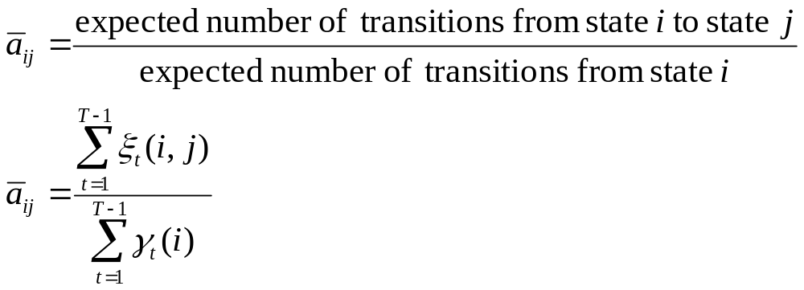
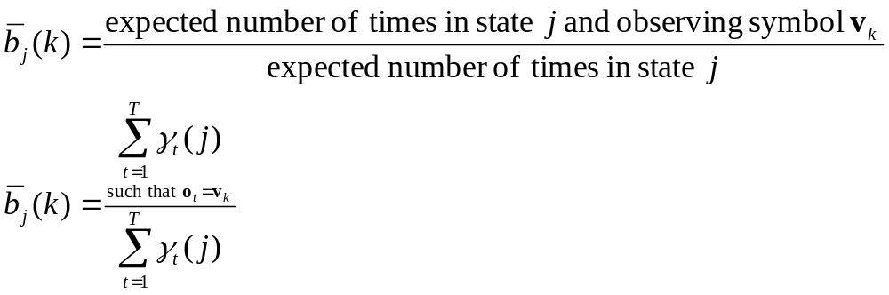
How Do We Improve Estimates of HMM Parameters?
Formula for updating transition probabilities:
Formula for observation probabilities, for discrete HMMs:

Slide 21
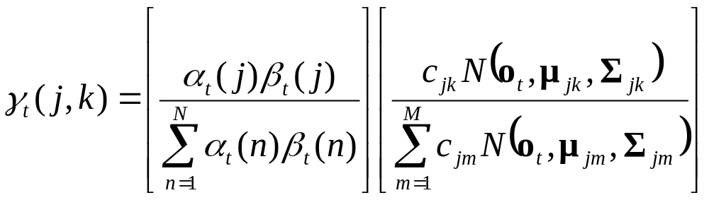
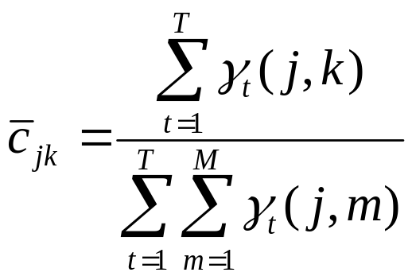
How Do We Improve Estimates of HMM Parameters?
Formula for observation probabilities, for continuous HMMs:
j=state,
k=mixture
component!!
= p(being in state j from component k)
= p(being in state j)
(c is the mixture weight (Lecture 5, slide 26))

Slide 22
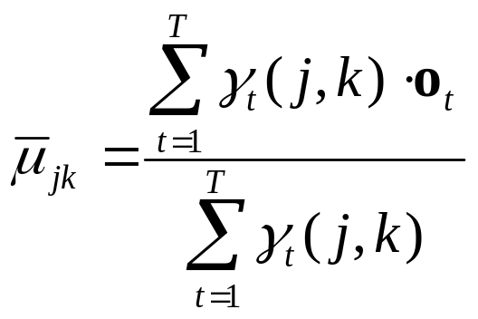
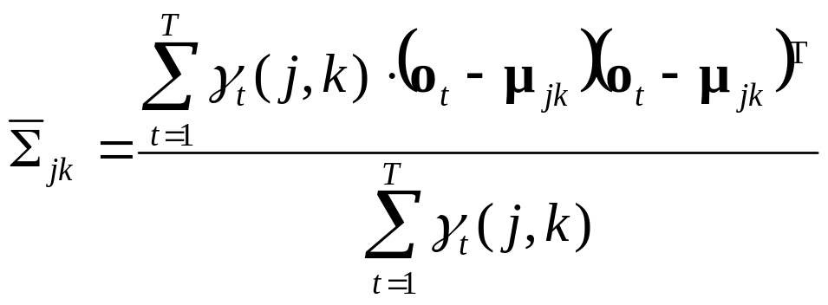
How Do We Improve Estimates of HMM Parameters?
For continuous HMMs:
= expected value of o_{t} based on existing λ
T=transpose,
not end time
= expected value of diagonal of covariance
matrix based on existing λ

Slide 23
How Do We Improve Estimates of HMM Parameters?
After computing new model parameters, we “maximize”
by substituting the new parameter values in place of the
old parameter values and repeat until the model parameters
stabilize.
This process is guaranteed to converge monotonically to
a maximum-likelihood estimate.
The next lecture will try to explain why the process converges
to a better estimate with each iteration using these formulae.
There may be many local “best” estimates (local maxima in
the parameter space); we can’t guarantee that the EM
process will reach the globally best result.
This is different from Viterbi segmentation because it utilizes
probabilities over entire sequence, not just most likely events.

Slide 24

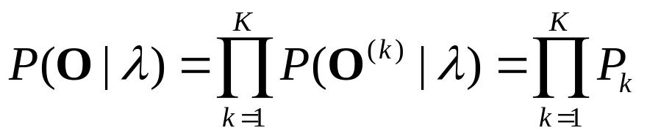
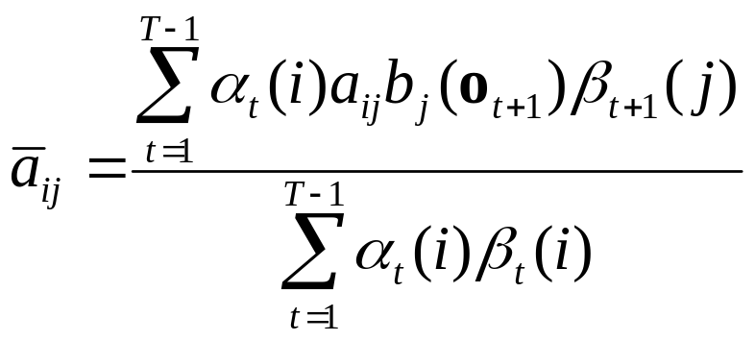
Forward-Backward Training: Multiple Observation Sequences
Usually, training is performed on a large number of separate
observation sequences, e.g. multiple examples of the word “yes.”
If we denote individual observation sequences with a superscript,
where O^{(i)} is the i^{th} observation sequence, then we can consider
the set of all K observation sequences used in training:
We want to maximize
The re-estimation formulas are based on frequencies of
events for a single observation sequence O={o₁,o₂,…,o_{T}}, e.g.
[1]
[2]
[3]

Slide 25
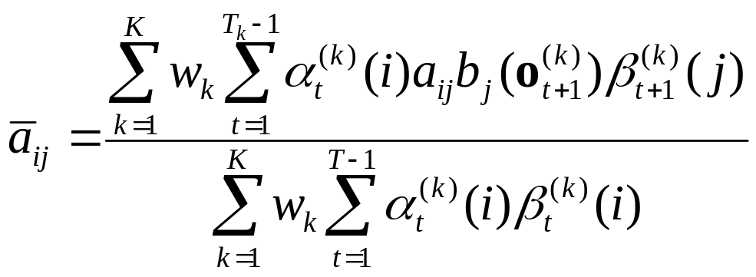
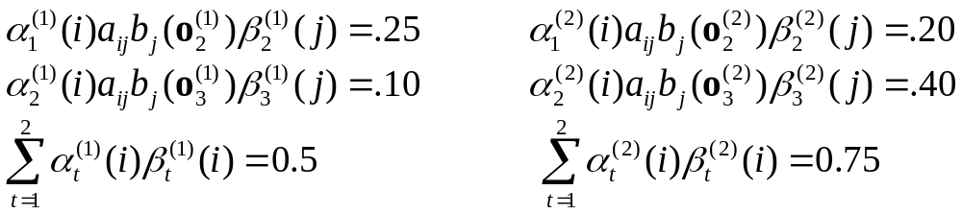
Forward-Backward Training: Multiple Observation Sequences
If we have multiple observation sequences,
then we can re-write the re-estimation formulas for specific
sequences, e.g.
For example, let’s say we have two observation sequences,
each of length 3, and furthermore, let’s pretend that the following
are reasonable numbers:
[4]

Slide 26
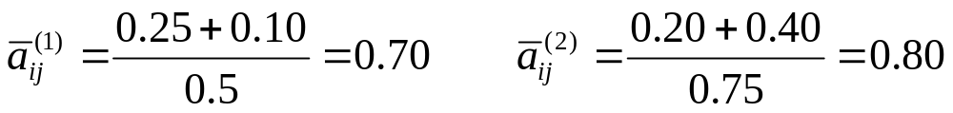
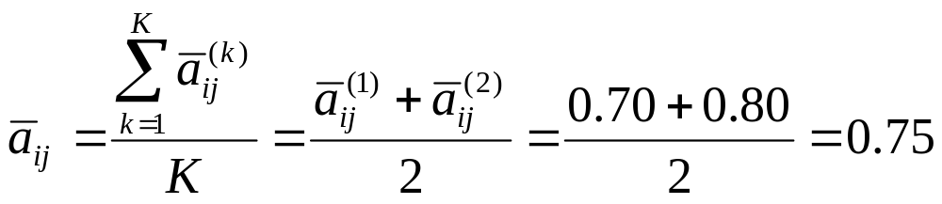
Forward-Backward Training: Multiple Observation Sequences
If we look at the transition probabilities computed separately
for each sequence O⁽¹⁾ and O⁽²⁾, then
One way of computing the re-estimation formula for a_{ij} is to set
the weight w_{k} to 1.0 and then
Another way of re-estimating is to give each individual estimate
equal weight by computing the mean, e.g.
[5]

Slide 27
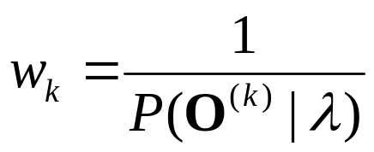
Forward-Backward Training: Multiple Observation Sequences
Rabiner proposes using a weight inversely proportional to the
probability of the observation sequence, given the model:
This weighting gives greater weight in the re-estimation to those
utterances that don’t fit the model well.
This is reasonable if one assumes that in training the model and
data should always have a good fit.
However, we assume that from the (known) words in the training
set we can obtain the correct phoneme sequences in the training set.
But, this assumption is in many cases not valid. Therefore, it can
be safer to use a weight of w_{k} = 1.0.
Also, when dealing with very small values of P(O | λ), small
changes in P(O | λ) can yield large changes in the weights.
[6]

Slide 28
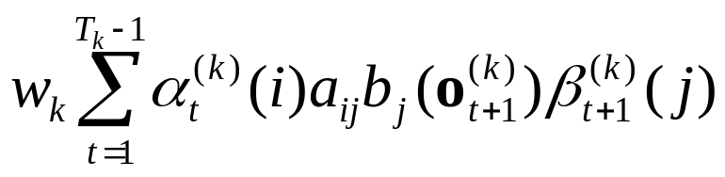
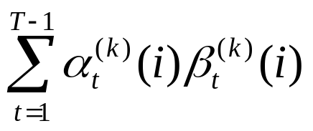
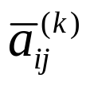
Forward-Backward Training: Multiple Observation Sequences
For the third project, you may implement either equations [4] or
[5] (above) when dealing with multiple observation sequences
(multiple recordings of the same word, in this case).
As noted on the next slides, implementation of either
solution involves use of “accumulators”… the idea is to
add values in the accumulator for each file, and then when
all files have been processed, compute the new model
parameters. For example, for equation [4], the numerator
of the accumulator contains the sum (over each file) of
and the denominator contains the sum (over each file) of
For equation [5], the accumulator contains the sum of individual
values of , and this sum is then divided by K.

Slide 29
Forward-Backward Training: Multiple Observation Sequences
Initialize an HMM:
  for each file:
    compute initial state boundaries (e.g. flat start)
    add information to “accumulator” (sum, sum squared, count)
  compute mean, variance for each GMM
set initial estimates of state parameters from mean, variance
File 1:
.pau y eh s .pau
File 2:
.pau y eh s .pau
File 3:
.pau y eh s .pau

Slide 30
Forward-Backward Training: Multiple Observation Sequences
Iteratively Improve an HMM:
  for each iteration:
reset accumulators
for each file:
get state parameter info. from previous iteration
add new state information to accumulators
compute mean, variance for each GMM
update estimates of state parameters

