Slide 1
CSE 552/652
Hidden Markov Models for Speech Recognition
Spring, 2006
Oregon Health & Science University
OGI School of Science & Engineering
John-Paul Hosom
Lecture Notes for May 15
Expectation Maximization,
Embedded Training

Slide 2
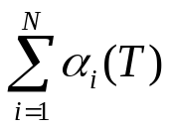
Expectation-Maximization*
We want to compute “good” parameters for an HMM so that
when we evaluate it on different utterances, recognition results
are accurate.
How do we define or measure “good”?
Important variables are the HMM model λ, observations O
where O = {o₁, o₂, … o_{T}}, and state sequence S (instead of Q).
The probability density function p(o_{t} | λ) is used to compute the
probability of an observation given the entire model (NOT same
as b_{j}(o_{t})); p(O | λ) is the probability of an observation sequence
given the model ( ).
We assume a 1:1 correspondence between p.d.f. and probabilites
*These lecture notes are based on:
Bilmes, J. A., “A Gentle Tutorial of the EM Algorithm and Its Application to Parameter Estimation for Gaussian Mixture and Hidden Markov Models”, ICSI Tech. Report TR-97-021, 1998.
Zhai, C. X., “A Note on the Expectation-Maximization (EM) Algorithm,” CS397-CXZ Introduction to Text Information Systems, University of Illinois at Urbana-Champaign, 2003

Slide 3
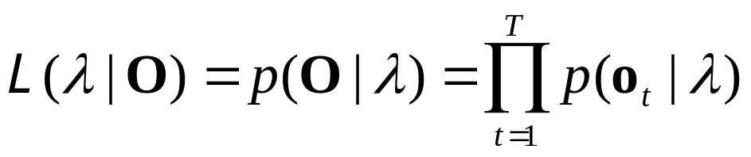
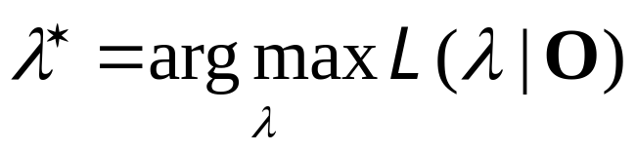
Expectation-Maximization: Likelihood Functions, “Best” Model
Let’s assume, as usual, that the data vectors o_{t} are independent.
Define the likelihood of a model λ given a set of observations O:
L(λ | O) is the likelihood function. It is a function of the
model λ, given a fixed set of data O. If, for two models λ₁ and
λ₂, the probability p(O | λ₁) is larger than probability p(O | λ₂),
then λ₁ provides a better fit to the data than λ₂. In this case,
we consider λ₁ to be a “better” model than λ₂ for the data O.
In this case, also, L(λ₁ | O) > L(λ₂ | O), and so we can measure
the relative goodness of a model by computing its likelihood.
So, to find the “best” model parameters, we want to find the
λ that maximizes the likelihood function:
[1]
[2]

Slide 4
Expectation-Maximization: Maximizing the Likelihood
This is the “maximum likelihood” approach to obtaining
parameters of a model (training).
It is sometimes easier to maximize the log likelihood,
log(L(λ | O)). This will be true in our case.
In some cases (e.g. where the data have the distribution of a
single Gaussian), a solution can be obtained directly.
In our case, p(o_{t} | λ) is a complicated distribution (depending on
several mixtures of Gaussians and an unknown state sequence),
and a more complicated solution is used… namely the iterative
approach of the Expectation-Maximization (EM) algorithm.
EM is more of a (general) process than a (specific) algorithm;
the Baum Welch algorithm (also called the forward-backward
algorithm) is a specific implementation of EM.

Slide 5
Expectation-Maximization: Incorporating Hidden Data
Before talking about EM in more detail, we should specifically
mention the “hidden” data…
Instead of just O, the observed data, and a model λ, we also
have “hidden” data, the state sequence S. S is “hidden” because
we can never know the “true” state sequence that generated
a set of observations, we can only compute the most probable
state sequence (using Viterbi).
Let’s call the set of complete data (both the observations and
the state sequence) Z, where Z = (O, S).
The state sequence S is unknown, but can be expressed as a
random variable dependent on the observed data and the model.
Again, we can compute the most probable S (using Viterbi),
but the true S is unknown… we can think of different possible
state sequences having different probabilities, given the
observed data and model.

Slide 6
Expectation-Maximization: Incorporating Hidden Data
Specify a joint-density function
(the last term comes from the multiplication rule)
The complete-data likelihood function is then
Our goal is then to maximize the expected value of the
log-likelihood of this complete likelihood function, and
determine the model that yields this maximum likelihood:
We compute the expected value, because the true value
can never be known, because S is hidden. We only know
probabilities of different state sequences.
[3]
[4]
[5]

Slide 7
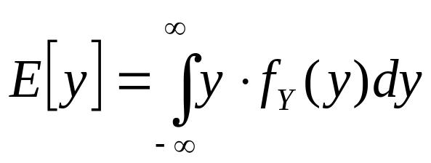
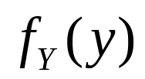
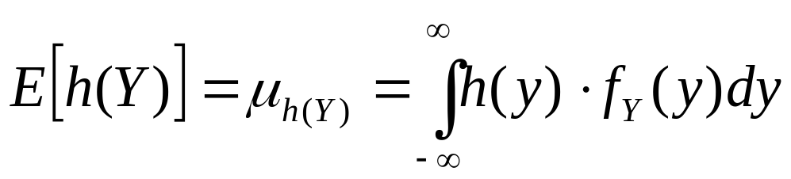
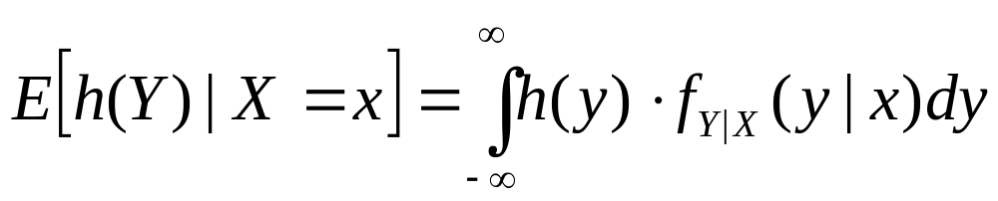
Expectation-Maximization: Incorporating Hidden Data
What is the expected value of a function when the p.d.f. of
the random variable depends on some other variable(s)?
Expected value of a random variable Y:
where is p.d.f. of Y
(as specified on slide 6 of Lecture 3)
Expected value of a function h(Y) of the random variable Y:
If the probability density function of Y, f_{Y}(y), depends on some
random variable X, then:
[6]
[7]
[8]

Slide 8
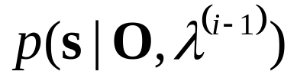
Expectation-Maximization: Overview of EM
First step in EM:
Compute the expected value of the complete-data log-likelihood,
log(L(λ | O, S))=log p(O, S | λ), with respect to the hidden data S (so we’ll integrate over the space of state sequences S), given the observed data O and previous best model λ^{(i-1)}.
Let’s review the meaning of all these variables:
  λ is some model which we want to evaluate the likelihood of.
  O is the observed data (O is known and constant)
  i is the index of the current iteration, i = 1, 2, 3, …
  λ^{(i-1)} is a set of parameters of a model from a previous
  iteration i-1. (for i = 1, λ^{(i-1)} is the set of initial model values)
  (λ^{(i-1)} is known and constant)
  S is a random variable dependent on O and λ^{(i-1)} with pdf

Slide 9
Expectation-Maximization: Overview of EM
First step in EM:
Compute the expected value of the complete-data log-likelihood,
log(L(λ | O, S))=log p(O, S | λ), with respect to the hidden data S (so we’ll integrate over the space of state sequences S), given the observed data O and previous best model λ^{(i-1)}.
The function of this expected value is called Q(λ, λ^{(i-1)}):
[9]
O and λ^{(i-1)} are constant, but we can compute E[p(O, S | λ)]
for any λ. (Can’t compute exact prob., because S is unknown).
Q(λ, λ^{(i-1)})
E[p(O,S | λ)]
model λ parameters

Slide 10
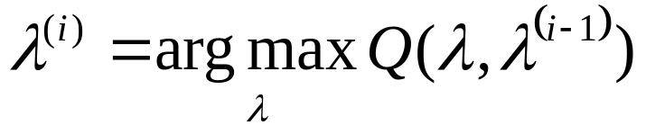
Expectation-Maximization: Overview of EM
Second step in EM:
Find the parameters λ that maximize the value of Q(λ, λ^{(i-1)}).
These parameters become the i^{th} value of λ, to be used in the next iteration
In practice, the expectation and maximization steps are
performed simultaneously.
Repeat this expectation-maximization, increasing the value of i at each iteration, until Q(λ, λ^{(i-1)}) doesn’t change (or change is
below some threshold).
It is guaranteed that with each iteration, the likelihood of λ will
increase or stay the same. (The reasoning for this will follow later in this lecture).
[10]

Slide 11
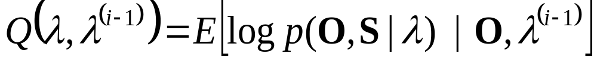
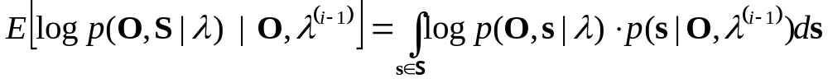
Expectation-Maximization: EM Step 1
So, for first step, we want to compute
which we can combine with equation 8
to get the expected value with respect to the unknown data S
where S is the space of values (state sequences) that s can have.
[11]
[8]
[12]

Slide 12
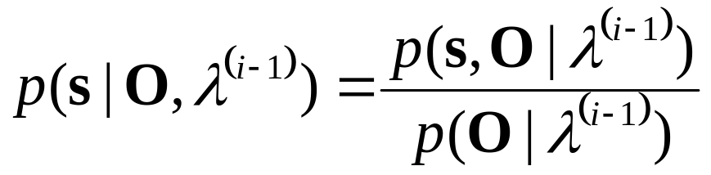
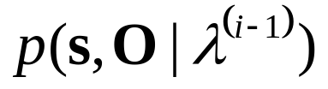
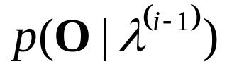
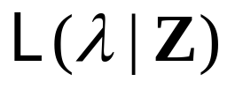
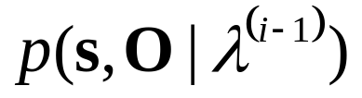
Expectation-Maximization: EM Step 1
Problem:
We don’t easily know
But, from the multiplication rule,
We do know how to compute
is constant for a given λ^{(i-1)}, and so this term
has no effect on maximizing the expected value of
So, we can replace with
and not affect results.
[13]

Slide 13
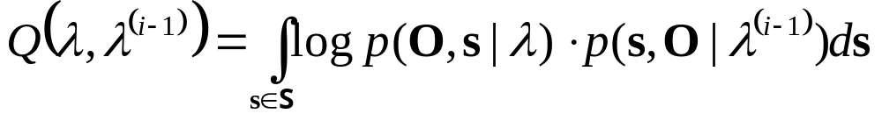
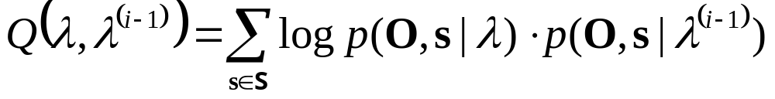
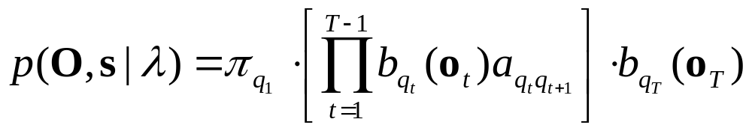
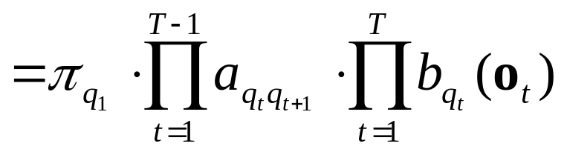
Expectation-Maximization: EM Step 1
The Q function will therefore be implemented as
Since the state sequence is discrete, not continuous, this can
be represented as
Given a specific state sequence s = {q₁,q₂,…q_{T}},
[14]
[15]
[16]
[17]

Slide 14

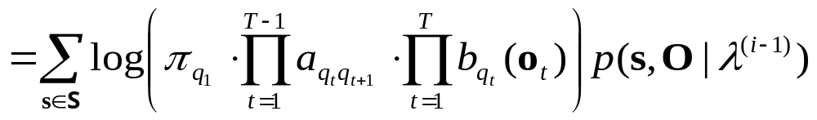
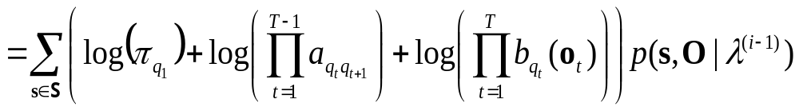
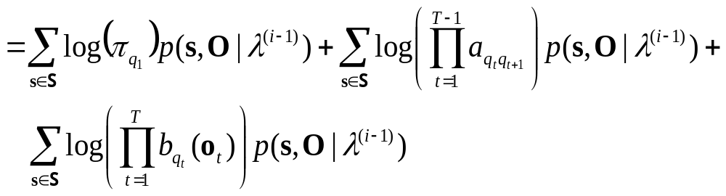
Expectation-Maximization: EM Step 1
Then the Q function is represented as:
[18=15]
[19]
[20]
[21]

Slide 15
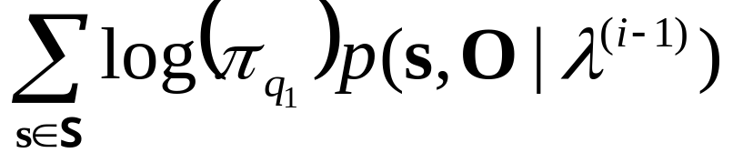
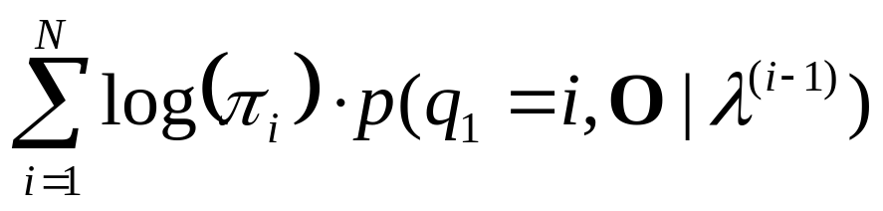
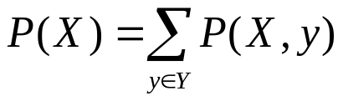
Expectation-Maximization: EM Step 2
If we optimize by finding the parameters at which the derivative of the Q function is zero, we don’t have to actually search over all possible λ to compute
We can optimize each part independently, since the three
parameters to be optimized are in three separate terms.
We will consider each term separately.
First term to optimize:
because states other than q₁ have a constant effect and so can
be omitted (e.g. )
[22]
=
[23]

Slide 16
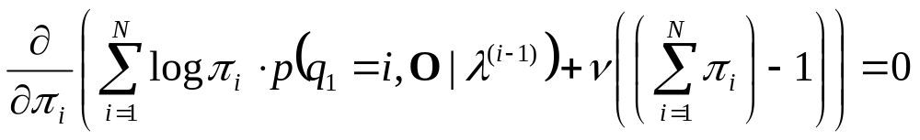
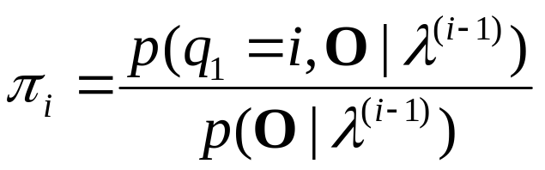
Expectation-Maximization: EM Step 2
We have the additional constraint that all π values sum to 1.0, so we use a Lagrange multiplier ν (the usual symbol for the Lagrange multiplier, λ, is taken), then find the maximum by setting the derivative to 0:
Solution (lots of math left out):
Which equals γ₁(i)
Which is the same update formula for π we saw earlier
(Lecture 11, slide 19)
[24]
[25]

Slide 17
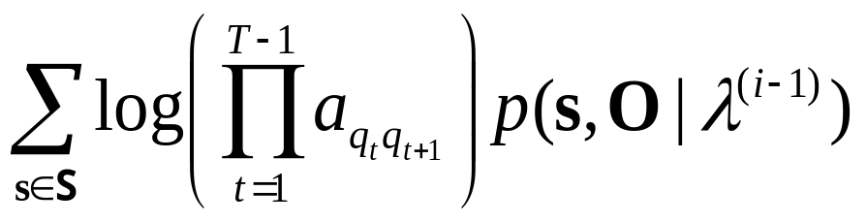
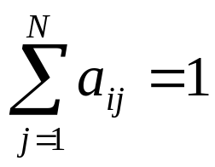
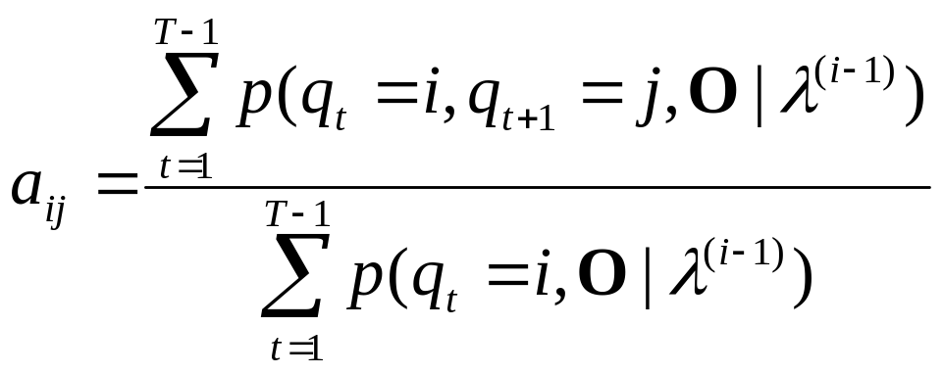
Expectation-Maximization: EM Step 2
Second term to optimize:
We (again) have an additional constraint, namely
so we use the Lagrange multiplier ν, then find the maximum by setting the derivative to 0.
Solution (lots of math left out):
Which is equivalent to the update formula Lecture 11, slide 20.
[26]
[27]

Slide 18
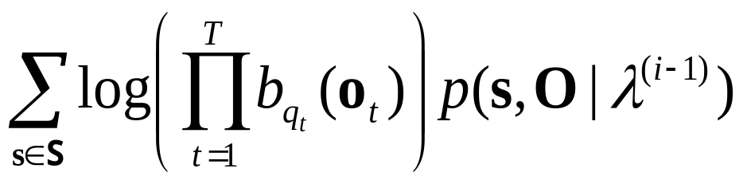
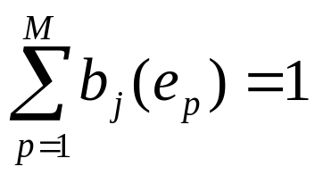
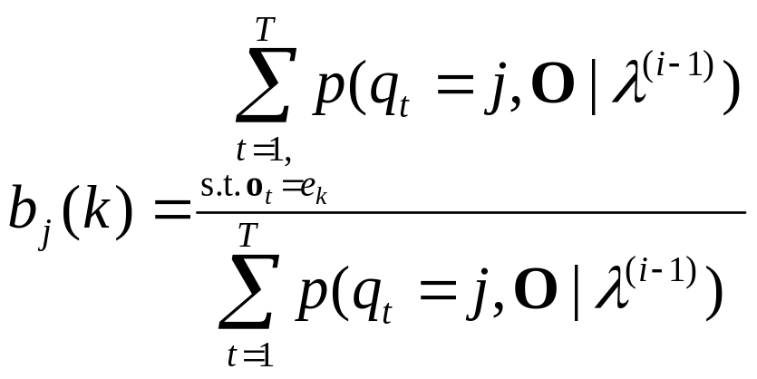
Expectation-Maximization: EM Step 2
Third term to optimize:
Which has the constraint, in the discrete-HMM case, of
After lots of math, the result is:
Which is equivalent to the update formula Lecture 11, slide 20.
[28]
there are M discrete events
e₁… e_{M} generated by the HMM
[29]

Slide 19
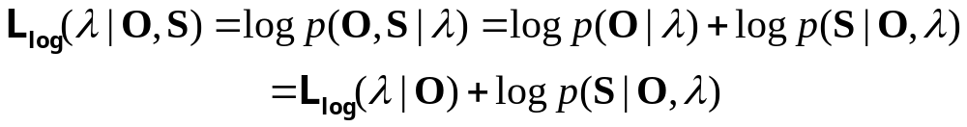
Expectation-Maximization: Increasing Likelihood?
By solving for the point at which the derivative is zero, these solutions find the point at which the Q function (expected
log-likelihood of the model λ) is at a local maximum, based
on a prior model λ^{(i-1)}.
We are maximizing the Q function for each iteration.
Is that the same as maximizing the likelihood of the model λ?
Consider the log-likelihood of a model based on a complete
data set, L_{log}(λ | O, S), vs. the log-likelihood based on only the observed data O, L_{log} (λ | O): (L_{log} = log(L))
[30]
[31]

Slide 20
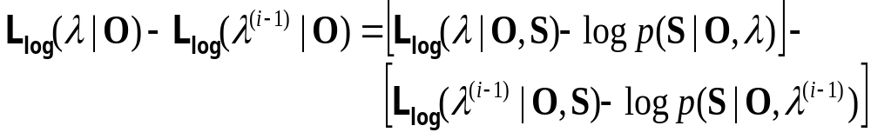
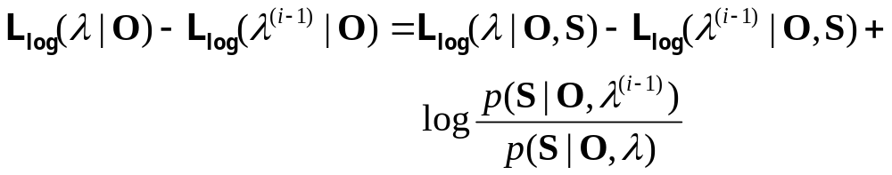
Expectation-Maximization: Increasing Likelihood?
Now consider the difference between a new and an old likelihood of the observed data, as a function of the complete data:
If we take the expectation of this difference in log-likelihood
with respect to the hidden state sequence S given the observations
O and the model λ^{(i-1)} then we get… (next slide)
[32]
[33]

Slide 21
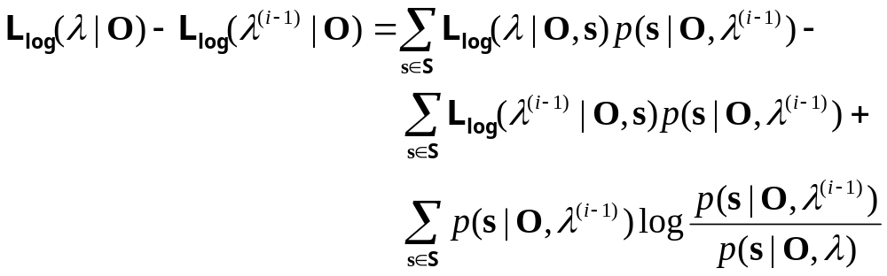
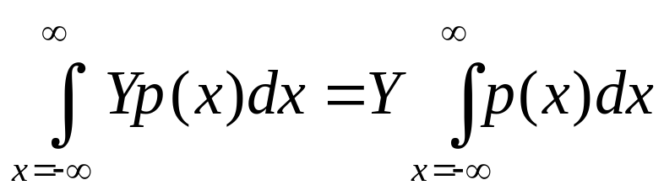
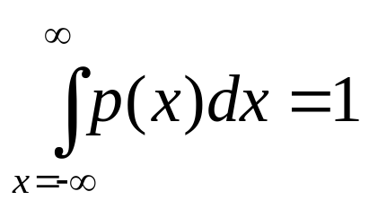
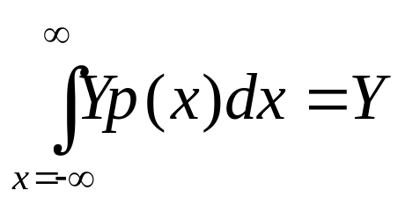
Expectation-Maximization: Increasing Likelihood?
Left hand side doesn’t change because it’s not a function of S:
if p(x) is a probability density function, then
so
[34]
[35]
[36]

Slide 22
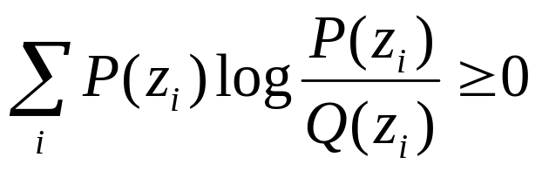
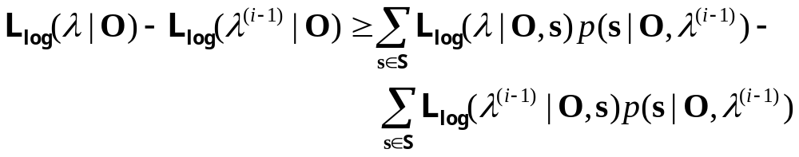
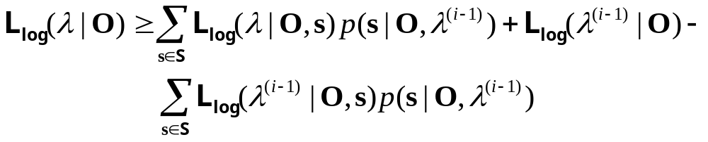
Expectation-Maximization: Increasing Likelihood?
The third term is the Kullback-Leibler Distance:
(proof involves inequality log(x) ≤ x –1)
So, we have
which is the same as
P(z_{i}), Q(z_{i}) are probability
density functions
[37]
[38]
[39]

Slide 23
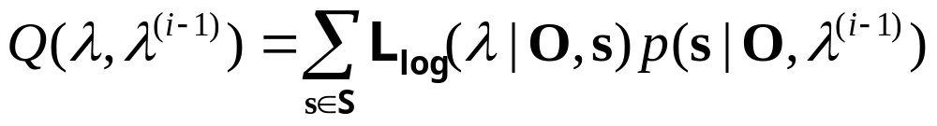
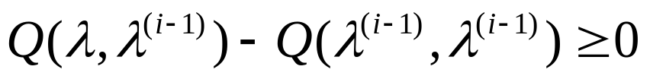
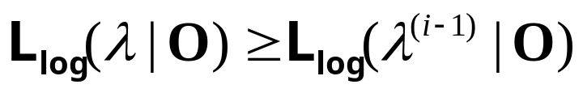
Expectation-Maximization: Increasing Likelihood?
The right-hand side of this equation [39] is the lower bound on the likelihood function L_{log}(λ | O)
By combining [12], [4], and [15] we can write Q as
So, we can re-write L_{log}(λ | O) as
Since we have maximized the Q function for model λ,
And therefore
[40]
[41]
maximum
[42]
not greater than
maximum
[43]

Slide 24
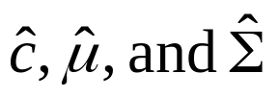
Expectation-Maximization: Increasing Likelihood?
Therefore, by maximizing the Q function, the log-likelihood of the model λ given the observations O does increase (or stay the same) with each iteration.
More work is needed to show the solutions for the re-estimation formulae for in the case where b_{j}(o_{t}) is computed from a Gaussian Mixture Model.

Slide 25
Expectation-Maximization: Forward-Backward Algorithm
Because we directly compute the model parameters that maximize the Q function directly, we don’t need to iterate in the
Maximization step, and so we can perform both Expectation and Maximization for one model λ^{(i)} simultaneously.
The algorithm is then as follows:
  (1) get initial model λ⁽⁰⁾
  (2) for i = 1 to R:
  (2a) use re-estimation formulae to compute parameters
  of λ^{(i)} (based on model λ^{(i-1)})
  (2b) if λ^{(i)} = λ^{(i-1)} then stop
where R is the maximum number of iterations
This is called the forward-backward algorithm because the
re-estimation formulae use the variables α (which computes
probabilities going forward in time) and β (which computes
probabilities going backward in time).

Slide 26

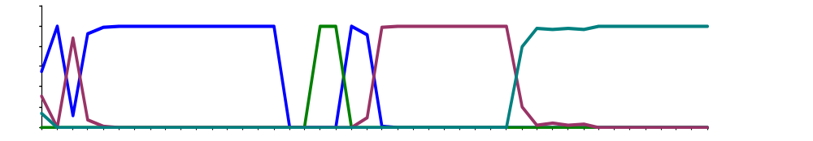
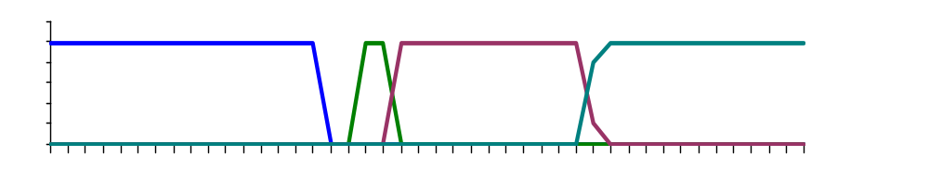
Expectation-Maximization: Forward-Backward Illustration
Forward-Backward Algorithm, Iteration 1:
μ_{j}, Σ_{j}
0.5
0.5
0.5
0.5
0.5
a_{ij}
0.5
0.5
0.5
0.5
0.5
b_{j}(o_{t})
μ
σ²
o_{t}
α, β
a_{ij}
P(q_{t}=j|O,λ)
μ_{j}, Σ_{j}
=α_{t}(j)

Slide 27


Expectation-Maximization: Forward-Backward Illustration
Forward-Backward Algorithm, Iteration 2:
0.94
0.5
0.5
0.91
0.92
a_{ij}
0.06
0.5
0.5
0.09
0.08
b_{j}(o_{t})
μ
σ²
o_{t}
α, β
a_{ij}
P(q_{t}=j|O,λ)
μ_{j}, Σ_{j}
=α_{t}(j)

Slide 28


Expectation-Maximization: Forward-Backward Illustration
Forward-Backward Algorithm, Iteration 3:
0.93
0.53
0.75
0.88
0.93
a_{ij}
0.07
0.47
0.25
0.12
0.07
b_{j}(o_{t})
μ
σ²
o_{t}
α, β
a_{ij}
P(q_{t}=j|O,λ)
μ_{j}, Σ_{j}
=α_{t}(j)

Slide 29


Expectation-Maximization: Forward-Backward Illustration
Forward-Backward Algorithm, Iteration 4:
0.91
0.58
0.88
0.85
0.93
a_{ij}
0.08
0.42
0.12
0.15
0.07
b_{j}(o_{t})
μ
σ²
o_{t}
α, β
a_{ij}
P(q_{t}=j|O,λ)
μ_{j}, Σ_{j}
=α_{t}(j)

Slide 30


Expectation-Maximization: Forward-Backward Illustration
Forward-Backward Algorithm, Iteration 10:
0.89
0.85
0.87
0.78
0.94
a_{ij}
0.11
0.15
0.13
0.22
0.06
b_{j}(o_{t})
μ
σ²
o_{t}
α, β
a_{ij}
P(q_{t}=j|O,λ)
μ_{j}, Σ_{j}
=α_{t}(j)

Slide 31


Expectation-Maximization: Forward-Backward Illustration
Forward-Backward Algorithm, Iteration 20:
0.89
0.84
0.87
0.73
0.94
a_{ij}
0.11
0.16
0.13
0.27
0.06
b_{j}(o_{t})
μ
σ²
o_{t}
α, β
a_{ij}
P(q_{t}=j|O,λ)
μ_{j}, Σ_{j}
=α_{t}(j)

Slide 32
Embedded Training
Typically, when training a medium- to large-vocabulary system, each phoneme has its own HMM; these phoneme-level HMMs are then concatenated into a word-level HMM to form the words in the vocabulary.
Typically, forward-backward training is for training the phoneme-level HMMs, and uses a database in which the phonemes have been time-aligned (e.g. TIMIT) so that each phoneme can be trained separately.
The phoneme-level HMMs have been trained to maximize the likelihood of these phoneme models, and so the word-level HMMs created from these phoneme-level HMMs can then be used to then recognize words.
In addition, we can train on sentences (word sequences) in our training corpus using a method called embedded training.

Slide 33
Embedded Training
Initial forward-backward procedure trains on each phoneme individually:
Embedded training concatenates all phonemes in a sentence into one sentence-level HMM, then performs forward-backward training on the entire sentence:
y₁
y₂
y₃
s₁
s₂
s₃
E₁
E₂
E₃
y₁
y₂
y₃
E₁
E₂
E₃
s₁
s₂
s₃

Slide 34
Embedded Training
Example: Perform embedded training on a sentence from the Resource-Management (RM) corpus:
    “Show all alerts.”
First, generate phoneme-level pronunciations for each word
Second, take existing phoneme-level HMMs and concatenate them into one sentence-level HMM.
Third, perform forward-backward training on this sentence-level HMM.
SHOW
ALL
ALERTS
SH
OW
AA
L
AX
L
ER
TS
SH
SH
SH
OW
OW
OW
AA
AA
AA
L
L
L
AX
AX
AX
L
L
L
ER
ER
ER
TS
TS
TS

Slide 35
Embedded Training
Why do embedded training?
Better learning of acoustic characteristics of specific words.
(the acoustics of /r/ in “true” and “not rue” are somewhat different, even though the phonetic context is the same)
Given initial phoneme-level HMMs trained using forward-backward, can perform embedded training on much
larger corpus of target speech using only the word-level
transcription and a pronunciation dictionary. Resulting HMMs are then (a) trained on more data and (b) tuned to specific words in the target corpus.
Caution: Words spoken in sentences can have pronunciation that is different from the pronunciation obtained from a dictionary. (Word pronunciation can be context-dependent or speaker- dependent).

