Slide 1
CSE 552/652
Hidden Markov Models for Speech Recognition
Spring, 2006
Oregon Health & Science University
OGI School of Science & Engineering
John-Paul Hosom
Lecture Notes for May 17
Two-Level, Level Building, One-Pass

Slide 2
Project 3: Forward-Backward Algorithm
Given existing data files of speech, implement the forward-
backward (EM, Baum-Welch) algorithm to train HMMs.
“Template” code is available to read in features, write out HMM
values to an output file, provide some context and a starting point.
The features in the speech files are “real,” in that they are 7
cepstral coefficients plus 7 delta values from utterances of “yes”
and “no” sampled every 10 msec.
All necessary files (data files and list of files to train on) are in
the project3.zip file on the class web site.
Train an HMM on the word “no” using the list “nolist.txt,”
which contains the filenames “no_1.txt” “no_2.txt” and “no_3.txt”
Train for 10 iterations.

Slide 3
Project 3: Forward-Backward Algorithm
The HMM should have 7 states, the first and last of which are
"NULL" states.
You can use the first NULL state to store information about π,
and you can start off assuming that the π value for the first "real"
(non-null) state is 1.0 and all other states π is zero.
You can use any method to get initial HMM parameters; the “flat
start” method is easiest.
You can use only one mixture component in training, and you
can assume a diagonal covariance matrix.
Updating of the parameters using the accumulators is currently
set up for accumulating numerators and denominators separately
for a_{ij}, means, and covariances. If you want to do the updating
differently (using only one accumulator each for a_{ij}, means,
and covariances), feel free to do so.

Slide 4
Project 3: Forward-Backward Algorithm
Sanity check: There are two kinds of sanity checks you can do.
First, your output should be close to the HMM file for the word
“no” that you used in the Viterbi project. (Results may not be
exactly the same, depending on different assumptions made.)
Second, you can compare alpha and beta values, as discussed in
class, to make sure that they are equal in certain cases.
Submit your results for the 10th iteration of training on the
words “yes” and “no”.
Send your source code and results (the file “hmm_no.10”
that you created) to hosom at cslu .ogi .edu; late responses
generally not accepted.

Slide 5
Connected Word Recognition: 2-Level, Level Building, One Pass
So far, we’ve been doing isolated word recognition, by computing
P(O | λ) for all word models λ, and selecting the λ that yields the
maximum probability.
For connected word recognition, we can view the problem as
computing P(O | Λ_{W}), where Λ_{W} is a model of a word (or word and state) sequence W, and selecting the Λ_{W} from all possible word-sequence models that yields the maximum probability.
So, Λ_{W} is composed of a sequence of word models, (λ_{w(1)}, λ_{w(2)}, … λ_{w(L)}) where L is the number of words in the hypothesized sequence, and the sequence contains words w(1) through w(L). For HMM-based speech recognition, λ_{w(n)} is the HMM for a single word; for DTW-based recognition, λ_{w(n)} is the template for a single word.
We can refer to Λ_{W} as the “sequence model.” Then we can define
the set of all possible sequence models, Λ^{S}={Λ_{W1}, Λ_{W2}, …}, and
call this the “super model.”¹
¹The term “super model” is not found elsewhere in the literature. Rabiner uses the term “super-reference pattern”, but “super model” is a more general term that can be used to describe both DTW- and HMM-based recognition.

Slide 6
Connected Word Recognition: 2-Level, Level Building, One Pass
Notation:
V = the set of vocabulary words, equals {w_{A}, w_{B}, …, w_{M}}
w = a single word from V
w(n) = the n^{th} word in a word sequence
L = the length of a particular word sequence
W = a sequence of words, equals (w(1), w(2), … , w(L))
L_{min} = the minimum number of words in a sequence
L_{max} = the maximum number of words in a sequence
X = the number of possible word sequences W
λ_{w(n)} = a model of the word w(n)
Λ_{W} = a model of a word sequence W, equals (λ_{w(1)}, λ_{w(2)}, … λ_{w(L)})
Λ^{S} = the set of all Λ_{W}, equals {Λ_{W1}, Λ_{W2}, …, Λ_{WX}}
T = the final time frame
O = observation sequence, equals (o₁,o₂, … o_{T})
q_{t} = a state at time t
q = a sequence of states
s = a frame at which a word is hypothesized to start
e = a frame at which a word is hypothesized to end

Slide 7
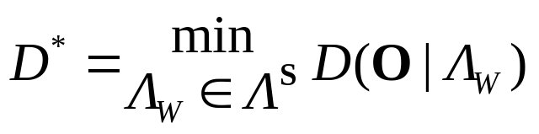
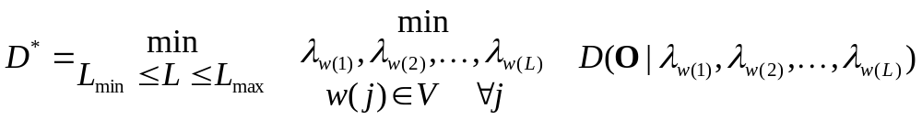
Connected Word Recognition: 2-Level, Level Building, One Pass
We will look at three ways of solving for P(O | Λ_{W}). Two approaches are commonly used with DTW, and the third approach is used by DTW and HMMs. In order to have a consistent notation for both DTW and HMMs, we will change the problem to minimize the
distortion D, instead of maximizing the probability P:
We will define distortion as the negative log probability, as needed.
The “brute-force” method searches over all possible sequences of length L and searches over all sequence lengths from L_{min} to L_{max}:
where V is the set of vocabulary words.
The three algorithms that find the best Λ_{W} faster than the brute-force method are: 2-Level, Level Building, and One Pass

Slide 8
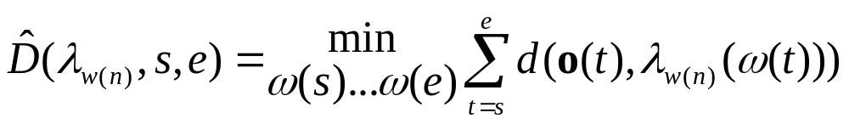
Connected Word Recognition: 2-Level, Level Building, One Pass
First, we’ll define the cost for word w(n) from frame s to frame e:
where ω(t) is a warping from one frame of the observation at time t
to another frame (or state) in the model λ_{w(n)}.
For DTW, the local distortion d() is typically the Euclidean distance between the frame of the observation and the frame of the template, assuming heuristic weights of 1, and the set of possible warpings, ω(s)…ω(e), is limited by the path heuristics. The word model λ_{w(n)}
is a template (sequence of features of the word w(n)).
This cost does not take into account the cost of transitioning into word w(n) at frame s, and so it is a locally-optimal cost.

Slide 9
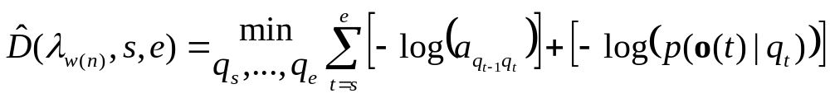
Connected Word Recognition: 2-Level, Level Building, One Pass
For HMMs, if word w(n) is modeled by HMM λ_{w(n)}, then
allows a Viterbi-based solution, assuming a_{ij} = π_{j} when t=0.
When t > 0, then there are two ways of defining q_{s-1}:
1. If we know the best cost for each state at time s-1 and the transition cost, then q_{s-1} is the state with the minimum cost at time s-1 plus transition cost into state q_{s}. This will yield the globally-optimal cost for w(n) beginning at s and ending at e, but we need to know costs for all states at time s-1.
2. If we don’t know the best cost for each state at time s-1 (in other words, if we’re not applying a dynamic-programming solution when finding costs), then the cost for word w(n) from s to e is reasonable, but not guaranteed to be the globally-optimal cost.

Slide 10

Connected Word Recognition: 2-Level, Level Building, One Pass
Note that in the DTW case or case (2) of HMMs, we will be trying to compute a globally-minimum cost D* from a combination of locally-minimum costs .
The 2-Level and Level-Building solutions assume that there is a direct connection from (only) the last frame of word λ_{w(n-1)} to (only) the first frame of word λ_{w(n)}. In other words, for DTW, a single path from end frame e of word λ_{w(n-1)} to start frame s of word λ_{w(n)} with a path weight of 1. For HMMs, a transition probability of 1 from the final state of λ_{w(n-1)} at frame e to the initial state of λ_{w(n)} at frame s.
Under that assumption, they return the best solution. However, this is slightly different from, e.g. a global DTW of a single reference sequence Λ_{W}=(λ_{w(1)},λ_{w(2)},…,λ_{w(L)}), because in the latter case the between-word path heuristic (or transition probability) is the same as the within-word path heuristic (or transition probability).

Slide 11
Connected Word Recognition: 2-Level, Level Building, One Pass
λ₅
global DTW that
yields global best
warping
local DTWs that
yield local best
warping
λ₄
Λ_{W}=(λ_{w(1)},λ_{w(2)},…λ_{w(L)})
λ₃
best path
selected
from all
available
paths
λ₂
only 1-step
diagonal
transition
allowed
λ₁
O=(o₁,o₂, … o_{T})
O=(o₁,o₂, … o_{T})
Global DTW, single
reference Λ_{W}
2-Level and LB build Λ_{W} from
sequence of connected λ_{w(n)}
As long as the number of words L is not too large, the number of
between-word transitions is small relative to the number of within-word transitions, and so results are nearly the same.

Slide 12
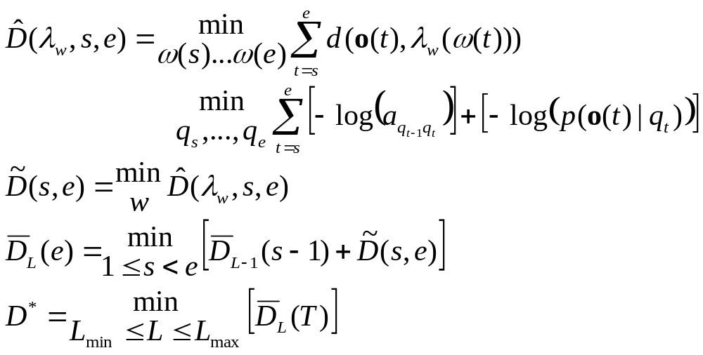
The 2-Level Dynamic Programming Algorithm
In the 2-Level Algorithm, we will compute
by using a (familiar) dynamic-programming algorithm. There are a lot of D’s involved:
best distortion for word model λ_{w} from frame s to frame e
or
best distortion over all words,
from frame s to frame e
best distortion of an L-word
sequence, over all words, from
frame 1 to frame e
best distortion over all possible L-word
sequences, ending at observation end-time T.

Slide 13

The 2-Level Dynamic Programming Algorithm
Warning!! the name should be “3-Step Dynamic Programming;”
it actually has three steps, not 2 levels. The word “level” will be
used with a different meaning later, so don’t let this name confuse
you.
Step 1: match every possible word model, λ_{w}, with every possible
range of frames of the observation O. For each range of
frames from O, save only the best word w (and score ).
Step 2: use dynamic programming to select word-model sequence
(a) that covers entire range of observation O, and
(b) has best overall score for a given number of words, L
Step 3: choose word sequence with best score over all possible
word-sequence lengths from L_{min} to L_{max}.

Slide 14
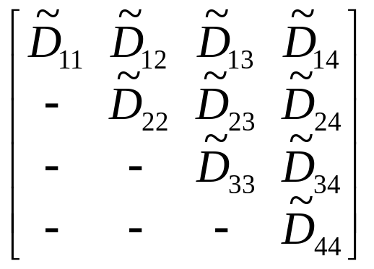

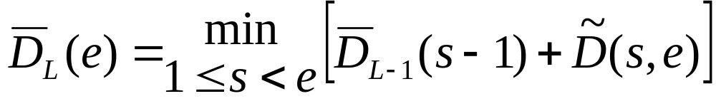
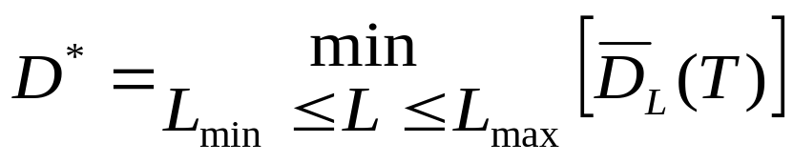
The 2-Level Dynamic Programming Algorithm
Here is the same procedure, said differently:
Step 1: compute for all pairs of frames
distance of best word
beginning at frame 3 and
ending at frame 4
Step 2: compute for all end frames e and word-sequence lengths L
Step 3: compute D*

Slide 15
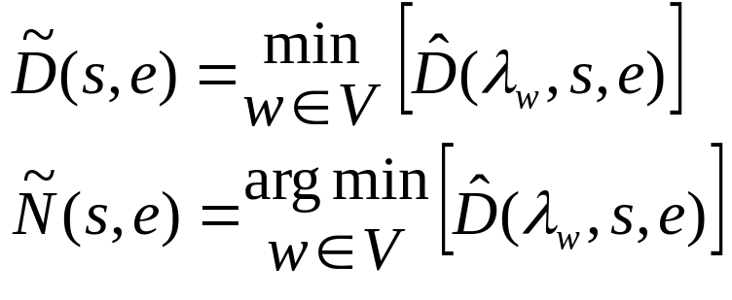
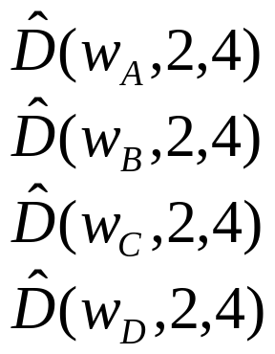
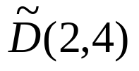
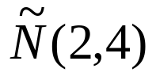
The 2-Level Dynamic Programming Algorithm
Step 1: compute distances (where V is set of vocabulary words)
= best score from s to e
= best word from s to e
V={w_{A},w_{B},w_{C},w_{D}}
choose min
begin frame
6 5 4 3 2 1
= score of best word from 2 to 4
= best word from 2 to 4
1 2 3 4 5 6
end frame
Viterbi or DTW score for word
w_{D} beginning at time 2, ending
at time 4

Slide 16
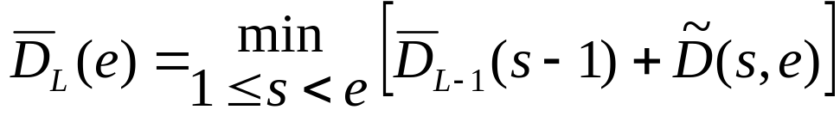
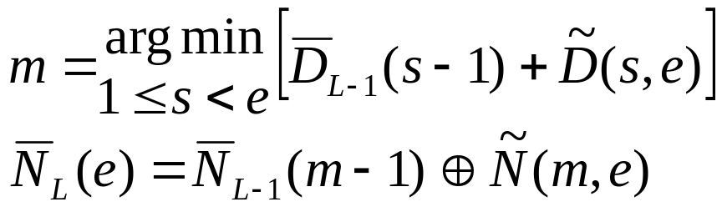

The 2-Level Dynamic Programming Algorithm
Step 2: determine best sequence of best-word utterances
accumulated cost of L-1word
sequence ending at time s-1
cost of best word from s to e
word sequence obtained from word pointers created in Step 2:
evaluate at time e=T to determine best L words in observation O.
Step 3: choose minimum value of over all values of L if
exact number of words is not known in advance.

Slide 17
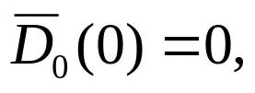
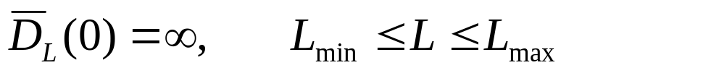
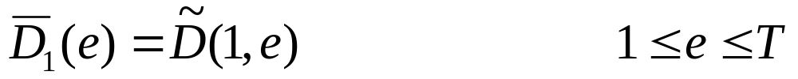
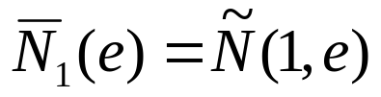
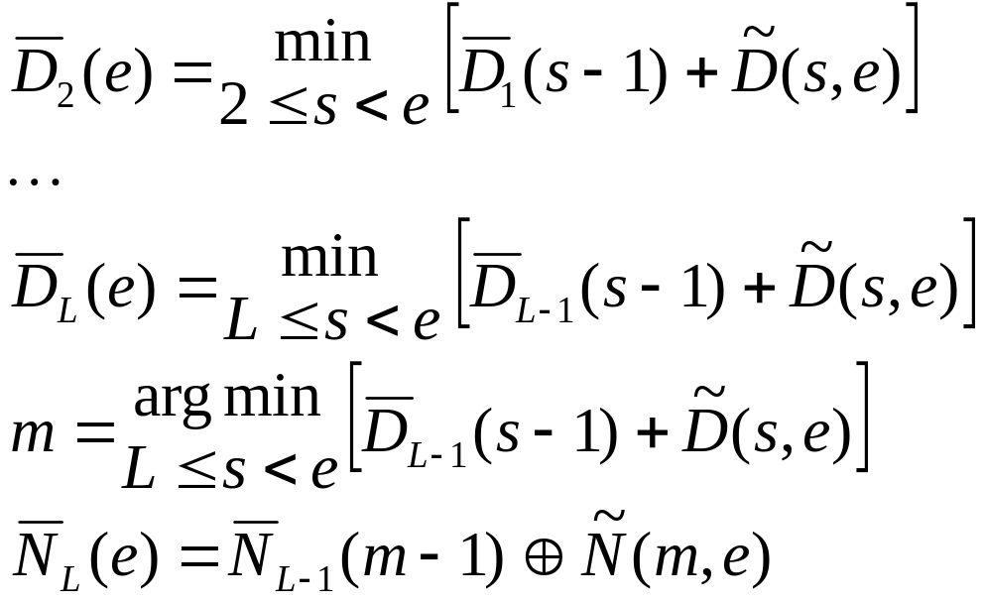
The 2-Level Dynamic Programming Algorithm
Step 2: whole algorithm:
part (1) Initialization:
part (2) Build level 1 (corresponding to a 1-word sequence):
part (3) Iterate for all values of s < e ≤ T, then all 2 ≤ L ≤ L_{max}:
an L-word sequence
must begin at least at
frame L, since each
word takes at least
one frame

Slide 18
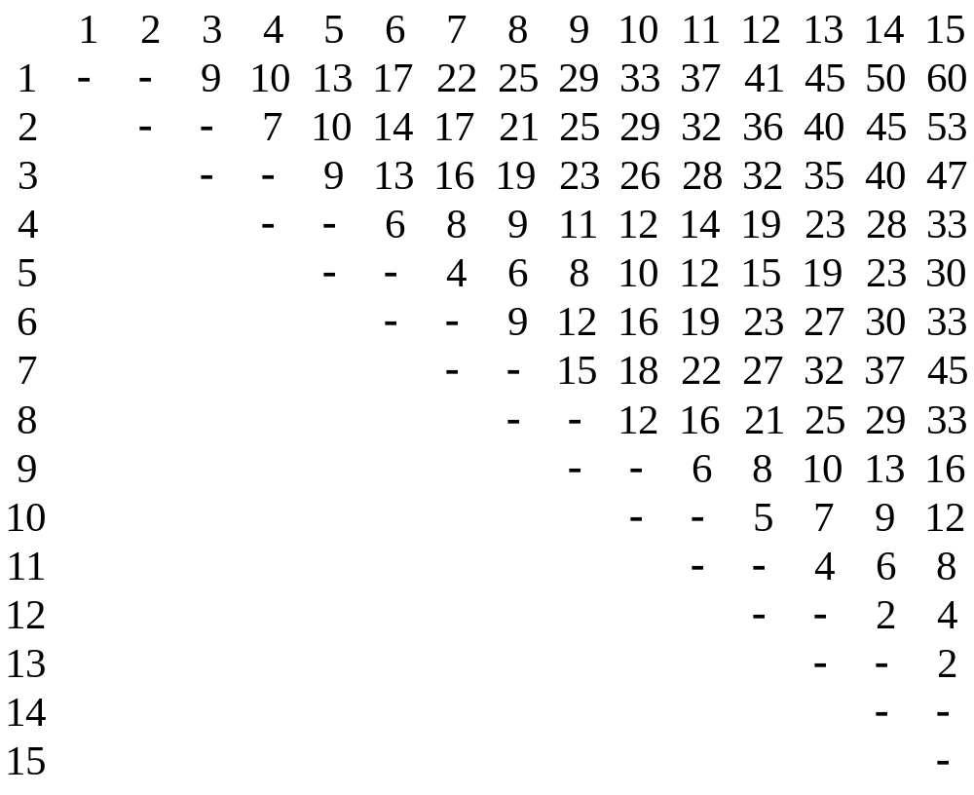
The 2-Level Dynamic Programming Algorithm
Example: (R&J p. 398) end frame
begin frame
Given these , what are best scores for 1, 2, and 3-word sequences?
In other words, compute D₁(15), D₂(15), and D₃(15).
Also, find best paths (begin and end frames for each word)

Slide 19
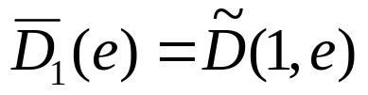
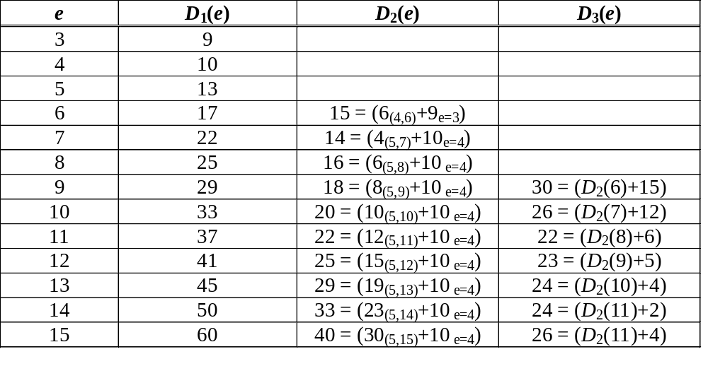
The 2-Level Dynamic Programming Algorithm
Path for best L-word sequence:
1 word with begin frame 1, end frame 15, score = D₁(15) = 60
(note: )

Slide 20
The Level-Building Dynamic Programming Algorithm
N^{th} “level” in LB = N^{th} word in hypothesized word string
Idea: instead of computing distances for all words at all
begin and end times, do this:
(1) compute distances for all words with begin time = 1,
until maximum end time for all word models λ_{w}
(2) at each possible end time, select best word #1
(3) compute distances for all words beginning where
previous words left off, until maximum end time
for all word models λ_{w}
(4) at each possible end time, select best word #2
repeat (3) and (4) until reach level (word-sequence length)
L_{max}.
This is only a savings when using DTW, where the path heuristics often constrain the minimum and maximum number of frames a word can match with the observation O.

Slide 21
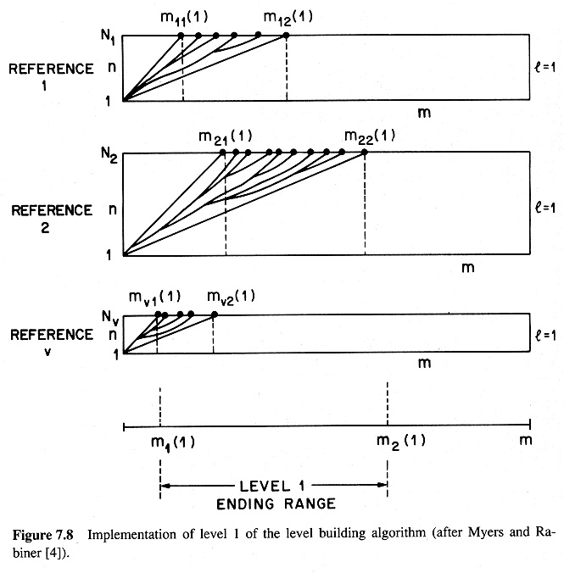
The Level-Building Dynamic Programming Algorithm
earliest end time
for level 1
latest end time
for level 1

Slide 22
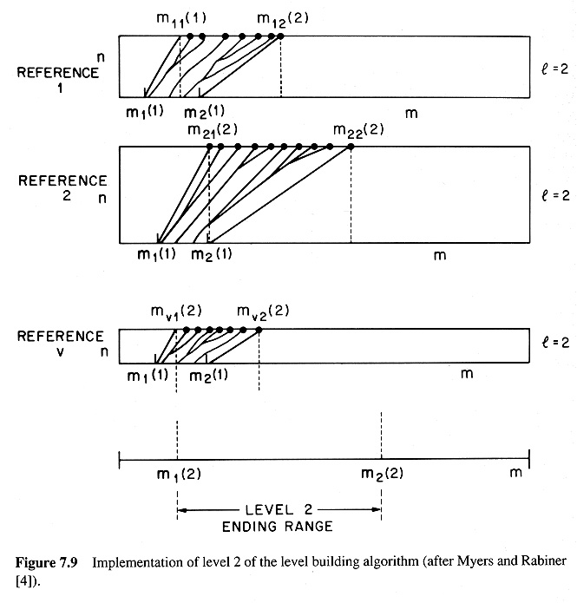
The Level-Building Dynamic Programming Algorithm
Reference_{x}
these values from previous level;
note scale difference
earliest end time
for level 2
latest end time
for level 2

Slide 23

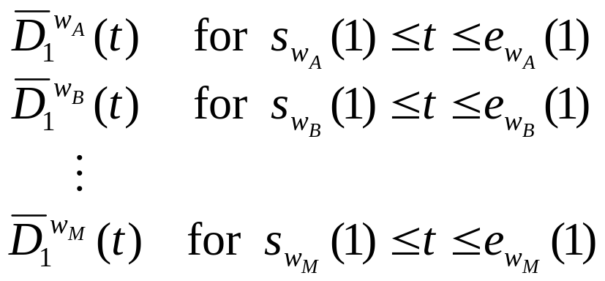
The Level-Building Dynamic Programming Algorithm
Define as minimum accumulated distance at level (word-
sequence length) L with word w, until frame t. We can evaluate
this from frame s_{w}(L) to frame e_{w}(L), which are defined as follows:
For DTW with 2:1 expansion and compression, at level 1,
s_{w}(l) = ½ × (length of reference pattern λ_{w}),
e_{w}(1) = 2 × (length of reference pattern λ_{w}).
The first output of level 1 is the matrix
where the words in V are {w_{A}, w_{B}, …, w_{M}}

Slide 24
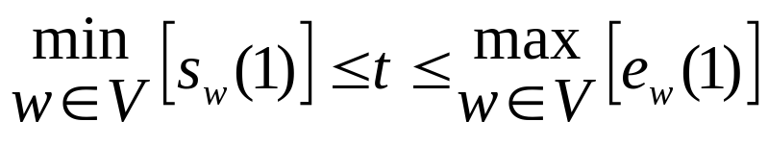
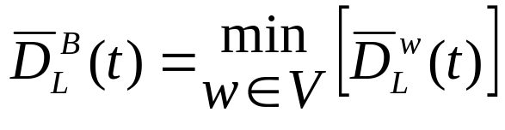
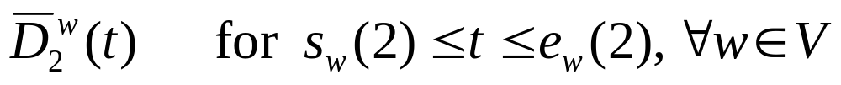
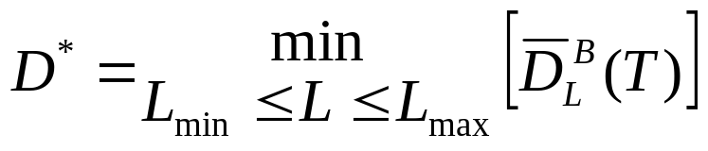
The Level-Building Dynamic Programming Algorithm
Then, for
we compute
which is the best distance at level L to frame t. We also store the
word w that resulted in this best distance and the starting frame.
Then we start the second level, with beginning frames in range
and search all words beginning at these frames with the initial
accumulated distortion scores taken from the results of the first level.
Finally,
(B=“best”)
(*=“global best”)

Slide 25
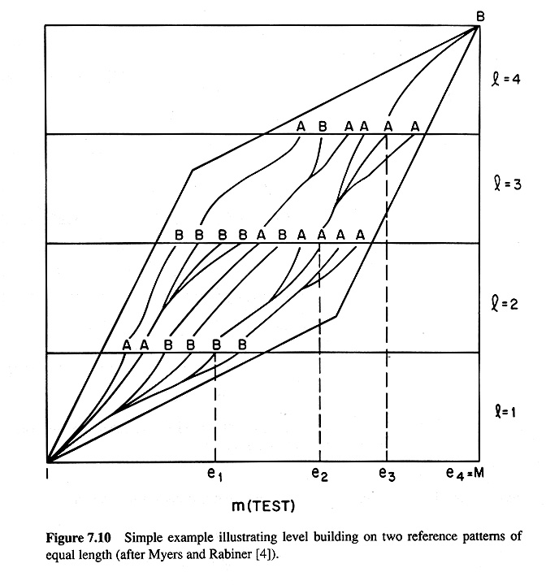
The Level-Building Dynamic Programming Algorithm

Slide 26
The One-Pass Algorithm
The one-pass algorithm creates the super-model Λ^{S}, not by explicit
enumeration of all possible word sequences, but by allowing a transition into any word beginning, from any word ending, at each time t.
We will consider the one-pass algorithm for DTW and for HMMs separately, because the implementation details depend on the method of speech recognition.
The one-pass algorithm does not have to assume a direct connection from (only) the last frame of word λ_{w(n-1)} to (only) the first frame of word λ_{w(n)}. We can transition into the first frame of word λ_{w(n)} from (a) the first frame of λ_{w(n)} (self loop), (b) the last frame of word λ_{w(n-1)} or (c) the next-to-last frame of word λ_{w(n-1)}. (In HMM notation, we can transition into the first state of word λ_{w(n)} from the last state of any word λ_{w(n-1)} with some probability, or remain in λ_{w(n)} with self-loop probability). So, the result can be identical with searching over all sequence models Λ_{W}=(λ_{w(1)},λ_{w(2)},…,λ_{w(L)}) for all possible word sequences W.

Slide 27
The One-Pass Algorithm: DTW
For DTW systems, assume the following heuristic (others can
be used, but this one is convenient):
This heuristic allows the reference word to be up to twice as long as the input word (if the longest arrow is always the best path), or as short as one frame long (so that the horizontal path is always the best path).
These three paths can be expressed as
(t-1, r) → (t, r)
(t-1, r-1)→ (t, r)
(t-1, r-2)→ (t, r)
1.0
1.0
1.0

Slide 28
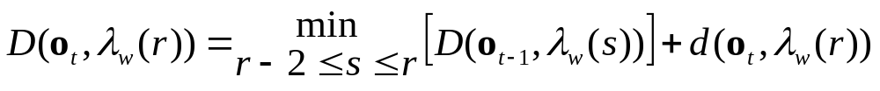
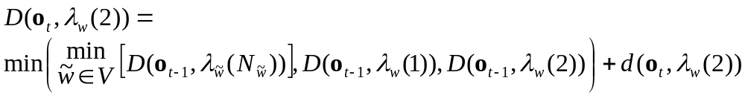
The One-Pass Algorithm: DTW
Then, the accumulated distance up to frame t of the test utterance O
and frame r of reference template λ_{w}, when r ≥ 3, is
where D(o_{t}, λ_{w}(r)) is the accumulated distance up to frame t of the observation sequence O and frame r of the reference template λ_{w}(r), and d(o_{t}, λ_{w}(r)) is the corresponding local distance.
This is the standard DTW formula, using the path heuristic given previously and weight of 1.
When r = 2, and if N_{w} is the length of reference template λ_{w}, then
minimum of accumulated distance to last frame
of all reference patterns, at t-1of O
accumulated distance to first frame
of current reference pattern, at t-1of O
accumulated distance to second frame
of current reference pattern, at t-1of O

Slide 29
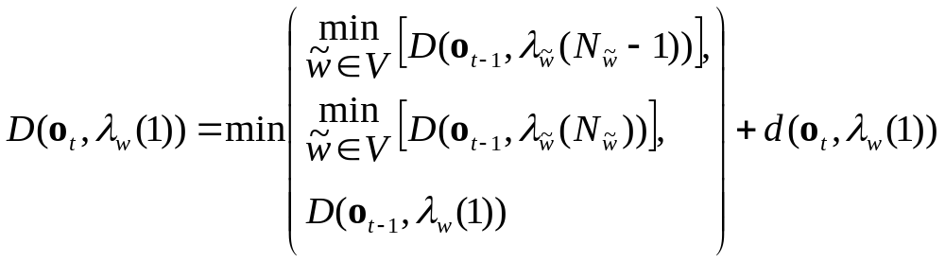
The One-Pass Algorithm: DTW
When r = 1 (at the beginning of the reference template λ_{w}), then
accumulated distance to first frame
of current reference pattern, at t-1of O
minimum of accumulated distance to last frame
of all reference patterns, at t-1of O
minimum of accumulated distance to next to last frame
of all reference patterns, at t-1of O
This yields no difference between within-word transitions and between-word transitions, in terms of lowest cost. So, this approach will yield same solution as global DTW of each reference sequence Λ_{W}=(λ_{w(1)},λ_{w(2)},…,λ_{w(L)}), and searching over Λ^{S}

Slide 30
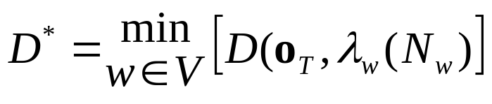
The One-Pass Algorithm: DTW
We compute the accumulated distance D at each time t (1 ≤ t ≤ T) of the input and each frame r of each possible word model λ_{w}.
Finally, we compute
namely, the accumulated distance at end of input T, for the end frame of all reference models.
And, of course, we need to keep track of back-pointer information, not just find the lowest accumulated distortion, so that we can recover the best word sequence.
This is more computation (and more storage!) than 2-Level or Level Building. We’ll look at comparisons shortly, but first, consider the HMM version of the one-pass algorithm…

Slide 31
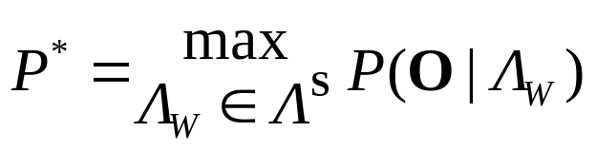
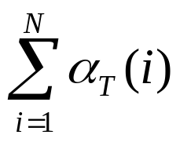
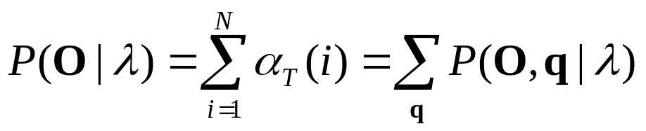
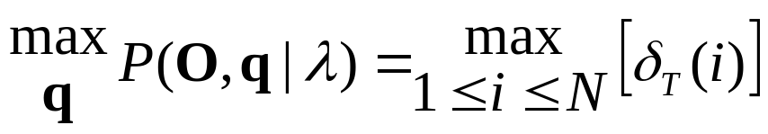
The One-Pass Algorithm: HMMs
Let’s go back to the original goal of connected word recognition,
and go back to probabilities instead of distances:
This can be solved by computing for all sequence models
Λ, since
If we then apply the Viterbi approximation, which says that the
summation can be approximated by a maximization, we can
replace the alpha computation with Viterbi, computing:
(from Lecture 8, slides 5 and 17)

Slide 32
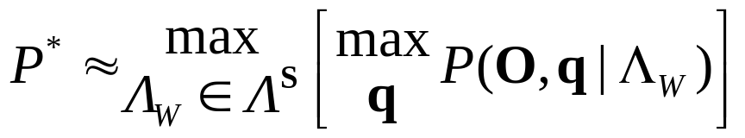

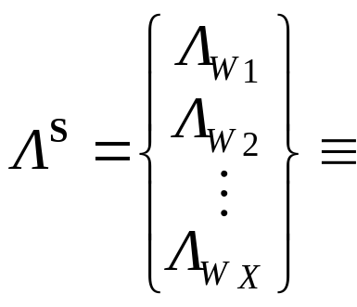
The One-Pass Algorithm: HMMs
So now our goal is to find
Instead of iteratively searching over all possible Λ_{W}, an equivalent
procedure is to build the super-model Λ^{S} as a single HMM with
all possible Λ_{W} in parallel (where X is the number of possible word sequences W):
and find the path through this super-model that maximizes P*.
“this”
“is”
“a”
“cat”
λ¹_{w(1)}
λ¹_{w(2)}
λ¹_{w(3)}
λ¹_{w(4)}
“this”
“this”
λ²_{w(1)}
λ²_{w(2)}
NULL
NULL
…
“is”
“cat”
“dog”
λ^{X}_{w(1)}
λ^{X}_{w(2)}
λ^{X}_{w(3)}

Slide 33
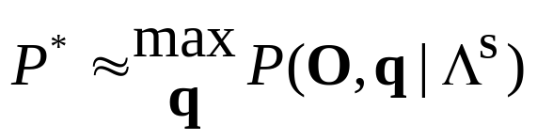
The One-Pass Algorithm: HMMs
So now our goal has become
Because our super-model is defined to be all possible word sequences
of all possible lengths, then if there are no restrictions on possible word sequences or length, we can re-write the super-model HMM as:
λ_{cat}
λ_{dog}
NULL
…
NULL
1.0
λ_{a}
λ_{is}

Slide 34
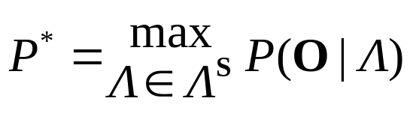
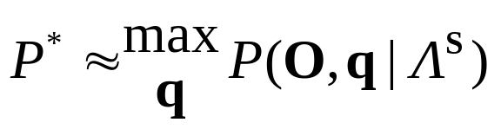
The One-Pass Algorithm: HMMs
In this model, the transition probability from the final NULL state to the initial NULL state is 1.0, and that NULL state emits no observations and takes no time, while t ≤ T. After the word model λ_{w} has emitted its final observation at t = T, then the probability of transitioning into the final NULL state is 1.0, and all other transition probabilities are zero.
This representation of the super-model loses the ability to specify L_{min} and L_{max}, because any sequence length is possible.
But, it is a very compact model, and now we can find the most likely word sequence by using Viterbi search on an HMM of this super-model, and find the probability of the most likely word sequence
by computing

Slide 35
The One-Pass Algorithm: HMMs
The only problem is that once we have computed P*, that doesn’t tell us the most likely word sequence.
But, when we do the back-trace through the Ψ values to determine the best state sequence, we can map the best state sequence to the best word sequence. There is a slight bit of additional overhead, because we need to keep track not only of backtrace ψ, but also where word boundaries occur. (When we transition between two states, mark if this transition is a word boundary or not.)
This yields a model with one λ_{w} for each word, and 2M+1 or M² connections between word models, where M is the number of vocabulary words. One advantage of this structure is that it represents Λ^{S} very compactly. One disadvantage is that it is not possible to specify L_{min} and L_{max} in Λ^{S}.
We can restrict Λ^{S} to represent only “good” word sequences, which will improve accuracy, but requires a great deal of programming to implement the grammar that specifies this restricted Λ^{S}

Slide 36
The One-Pass Algorithm: HMMs
Example of using one-pass, when transitioning into word “two”
at time t, where the word-model HMMs are for “one” and “two”:
w w w ah ah ah ah ah n n n n n tc tc t u u u u u
w
ah
n
tc
th
u

Slide 37
Comparison of Approaches
The 2-Level, LB, and one-pass algorithms in general provide (almost) the same answer… the differences (for DTW-based implementation) are:
(a) 2-Level
can be done time-synchronously,
requires more computation than LB (exact amount of
computation depends on method of implementataion)
can specify exact number of words in utterance
(b) Level-Building
can not be done time-synchronously,
requires less computation than 2-Level,
can specify exact number of words in utterance
(c) One-Pass
can be done time-synchronously,
requires more computation than 2-Level,
can not specify exact number of words in utterance
without using grammar (troublesome to implement)

Slide 38
Comparison of Approaches
Since one-pass requires more computation than 2-Level, if you want a fast HMM system, why not implement 2-Level continuous speech recognition with HMMs?
We can look at the complexity, given that there are M vocabulary words, with an average of N states per word (but only one state sequence per word), T frames in the input, and between L_{min} and L_{max} words.
Then 2-Level requires T²/2 computations of D, and each D requires Viterbi search on M words, which is O(N²T) in the general case, but in this case average duration of T/2 over 2N states (since each state has self loop or one transition). So computation of D matrix is
O(T²/2 · M(2N · T/2)) = O(T³ M N)
Then D requires L_{max}-L_{min} × T compuations of O(T/2) minimizations, or O((L_{max}-L_{min}) · T · T/2), and so the final
complexity of 2-Level search with HMMs is
O(T³ M N + (L_{max}-L_{min}) T²)

Slide 39
Comparison of Approaches
For one-pass, we do one Viterbi search on the super-model, which
means at each time t we check (M · 2N) paths (for within-word transitions) and M² paths (assuming no NULL states) (for between-word transitions), or M²+MN (dropping the constant 2) transitions, and this is repeated for each time 1≤ t ≤ T, so the HMM complexity is
O(T(M²+MN))
If the number of words is very large and the test utterance is short, then 2-Level may be faster than one-pass. But as the utterance becomes longer, 2-Level becomes worse.
Also, as we’ll see later, there are ways to reduce the one-pass computation significantly. Or, use NULL states for O(T·M(2+N))
So, for HMMs, one-pass is typically the only strategy used for connected-word recognition. The 2-Level and Level Building are presented here for historical background and for their innovative approaches to ASR, but are generally not currently used in HMMs.

