Slide 1
CSE 552/652
Hidden Markov Models for Speech Recognition
Spring, 2006
Oregon Health & Science University
OGI School of Science & Engineering
John-Paul Hosom
Lecture Notes for May 22
Search Strategies for Improved Performance

Slide 2
Next Topics: Improving Performance of an HMM
Search Strategies for Improved Performance
  Null States
  Beam Search
  Grammar Search
  Tree Search
  Token Passing
  “On-Line” Processing
  Balancing Insertion/Deletion Errors
  Stack Decoder (A*) Search
Acoustic-Model Strategies for Improved Performance
  Semi-Continuous HMMs
  Clustering
  Cloning
  Pause Models

Slide 3
Search Strategies: Null States
Null states do not emit observations and are entered and
exited at the same time t. For the projects, null states can
mostly be ignored.
So, what’s the point of null states?
Advantage:
Connecting word-end states to word-beginning states in
one-pass search and implementing grammar-based ASR makes
number of connections significantly smaller, improving
processing speed and programmer sanity.
Disadvantage:
Depending on implementation strategy, use of null states
may reduce ability to model coarticulation at word boundaries.
(If word-end state for “no” is n–ow+NULL, then /ow/ model
is context-dependent only for /n/. Coarticulation on /ow/
due to phonemes that may follow /ow/ is not modeled.)

Slide 4
Search Strategies: Null States
Advantage:
Connecting word-end states to word-beginning states in
one-pass search and implementing grammar-based ASR makes
number of connections significantly smaller, improving
processing speed and programmer sanity.
to λ_{cat} initial state
…
to λ_{dog} initial state
λ_{cat}
λ_{cat}
to λ_{is} initial state
λ_{dog}
λ_{dog}
…
NULL
…
NULL
…
λ_{a}
…
λ_{a}
to λ_{cat} initial state
to λ_{dog} initial state
λ_{is}
λ_{is}
…
to λ_{is} initial state
2M between-word connections
M² between-word connections

Slide 5
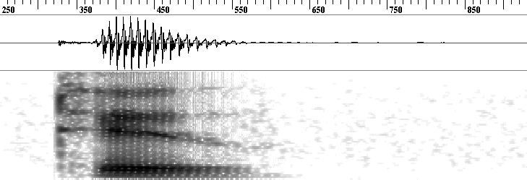

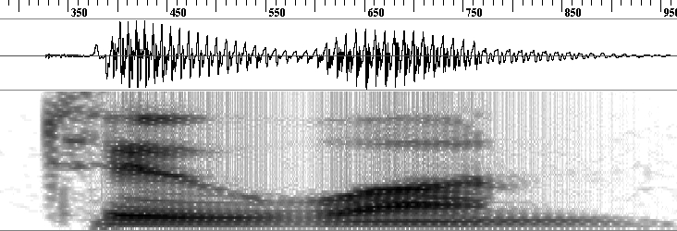
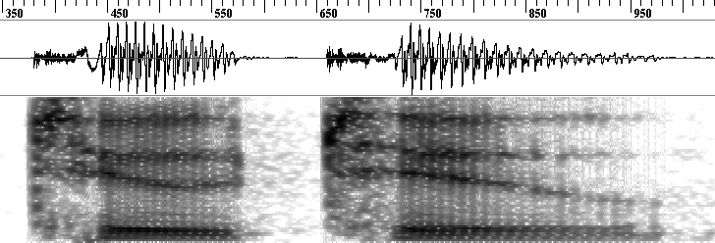
Search Strategies: Null States
Disadvantage:
Depending on implementation strategy, use of null states
may reduce ability to model coarticulation at word boundaries.
“two <silence>”
t-uw+NULL
“two one”
3rd state in
3-state
context-
dependent
triphone
“two two”

Slide 6
Search Strategies: Beam Search
Viterbi guarantees finding the most likely state sequence.
However, for connected-word recognition, the number of
state transitions is extremely large, and Viterbi can be too slow
Viterbi algorithm can be sped up using a Beam Search
Beam Search (Lowerre, 1976):
Only search those paths that have a sufficient likelihood
of success (being the best path in the end).
Keep track of current best probability at time t
If δ_{t}(j) for state j is less than a threshold relative to
the current best probability, do not consider state j
at time t+1. (In effect, setting all a_{jk} to zero for t+1).

Slide 7
Search Strategies: Beam Search
A:
π_{A}
b_{A}(1)
b_{A}(2)
b_{A}(3)
b_{A}(4)
B:
π _{B}
b_{B}(1)
b_{B}(2)
b_{B}(3)
b_{B}(4)
C:
π _{C}
b_{C}(1)
b_{C}(2)
b_{C}(3)
b_{C}(4)
t=0
t=1
t=2
t=3
t=4
Only consider those candidates that are within “beam width”:
  The top N candidates
  Candidates within a certain threshold of the best score (e.g. best_score/100 or prev_best_score/100) at time t
This no longer guarantees the best score/path, but almost always
yields equivalent result with significantly reduced computation.
Even keeping only 10% of all possible paths yields good results.

Slide 8
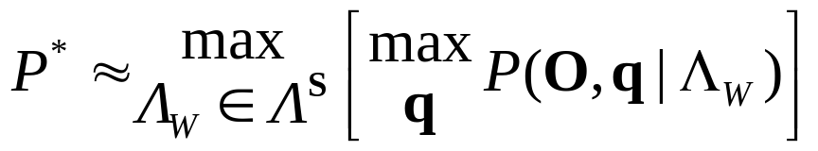
Search Strategies: Grammar Search
For connected-word recognition, we compute
(Lecture 13, slide 31), where Λ_{W} is a model of a word sequence
and Λ^{S} is the super-model set of all possible word sequences.
In the one-pass algorithm, we construct an HMM of Λ^{S} that represents all possible word sequences using HMMs of each individual word and all word-end states connected to all word-begin states. This allows all possible word combinations.
Sometimes we have a priori knowledge of what types of utterances (word sequences) the user of an ASR system is expected to say, and we can use this knowledge to hugely constrain the set of all possible word sequences. This makes
the search process much faster.

Slide 9
Search Strategies: Grammar Search
The type of search of Λ^{S} that allows only certain word sequences is called a grammar-based search.
Grammars typically used for structured dialogs, when a
certain type of speech input is expected (e.g. month,
account number, flight number, etc.) Used by banks, airlines,
telephone companies.
Concept is simple: create single large HMM with transitions
(arcs) between valid word sequences according to a finite-state
context-free grammar. Then run Viterbi search on grammar-
level HMM.
Implementation of code for grammar compiler is difficult, and
grammar specification for real-world tasks is complicated.
(Some small companies make entire business from supporting
grammar-based ASR that is developed by another company
and used by a third company.)

Slide 10
Search Strategies: Grammar Search
Grammar specification:
#ABNF 1.0;
root $time;
lexicon <lexicon.file> ;
$time = $hour [$subhour] [$ampm];
$hour = $digit | ten | eleven | twelve;
$subhour = fifteen | thirty | fortyfive | o’clock;
$ampm = a.m. | p.m.;
$digit = one | two | three | four | five | six | seven | eight | nine;
Context-free grammars are used; many implementation details
ensure flexibility and power. Standards are provided by W3C
(with both an XML form and an Augmented BNF form) and by
Microsoft via the SALT (Speech Application Language Tags).
Generic one-pass search algorithm is “simple” grammar:
$grammar = ($word) <1–>
which creates large number of between-word transitions

Slide 11
Search Strategies: Grammar Search
Issues in a grammar implementation:
  Ensuring correctness (especially complicated grammars)
  Null states: usage really simplifies connections (especially
  for optional words/phrases), but too many null states slows
  performance.
hour
subhour
ampm
one
fifteen
two
thirty
a.m.
…
fortyfive
p.m.
eleven
twelve
o’clock

Slide 12
Search Strategies: Tree Search
If implement one-pass algorithm directly using a grammar,
the search style is called “flat”:
d
d
d
ae
ae
ae
n
n
n
d ae n (dan)
w aa sh t (washed)
d ih sh ih z (dishes)
l ah n ch (lunch)
ae f t er (after)
d ih n er (dinner)
dh ax (the)
k aa r (car)
ae l ih s (alice)

Slide 13
Search Strategies: Tree Search
Can reduce number of connections by taking advantage of
redundancy in beginnings of words (with large enough vocabulary):
f
t
er (after)
l
ih
s (alice)
ae
ae
n (dan)
d
ih
sh
ih
z (dishes)
dh
n
er (dinner)
k
ax (the)
l
aa
r (car)
w
ah
n
ch (lunch)
aa
sh
t (washed)

Slide 14
Search Strategies: Tree Search
This is called “tree search” because connections separate like
branches of a tree.
In this (bad) example, reduce from 43 phoneme connections to
39 phoneme connections (10% reduction). In other cases (e.g.
larger vocabulary without using NULL states), can reduce number of connections by a huge (e.g. 98%) amount.
Why is reducing connections good?
Problem: Don’t know what word(s) correspond to a given
state until reach the end of a word. This becomes a major
problem for language modeling based on word sequences.
number of connections (and
also computation time) depends
on square of number of
states
for (t = 1; t < T; t++) {
for (j = 0; j < N; j++) {
for (i = 0; i < N; i++) {
// majority of processing goes here!
}
}
}

Slide 15
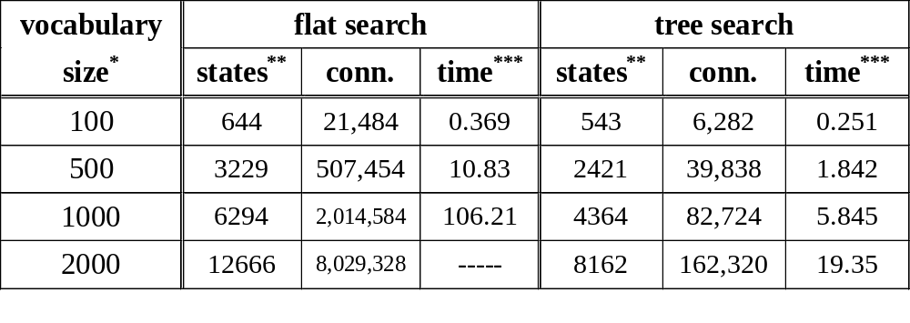
Search Strategies: Tree Search
If all NULL states are removed (yielding M² between-word connections to allow for between-word context-dependent
modeling), then a tree search yields the following reductions:
* a single pronunciation (sequence of phonemes) per word; words
randomly selected from set of 120,000 words from CMU dictionary
** number of phoneme-level states (not triphone level)
*** in number of times “real time” (xRT), using multi-state context-
dependent models, no beam search (beam search would yield
additional dramatic decrease in time), on a 2.16 GHz Pentium

Slide 16
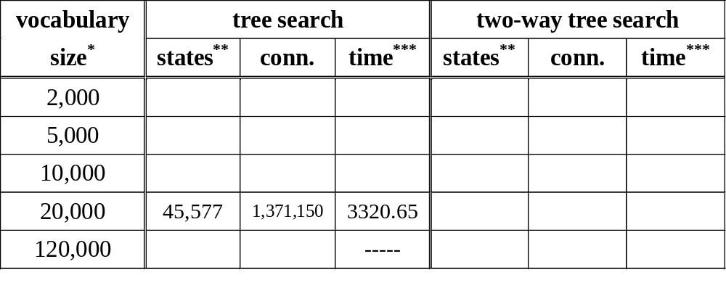
Search Strategies: Tree Search
One can apply the same process starting at the word endings (in addition to process starting at word beginnings)… but this destroys ability to keep track of all words at word boundaries (only know best word at boundary) (e.g. looked, luring, lurid, “layed,” laying)
k
d
k
d
d
U
r
I
U
r
l
N
l
I
N
ei
d
ei
I
N
11 connect.
9 connect. = 80%
bug?

Slide 17
Search Strategies: Token Passing
“Token Passing” is conceptual model for connected speech
recognition (Young et al., Cambridge University, 1989)
Each state holds a “token”; a token contains
    accumulated probability up to current time t (δ)
    pointer to token of previous state (ψ)
    the value of the current time t (t)
    word identification (e.g. “yes”).
    other information
Tokens are passed from state to state; when performing
forward pass of Viterbi search for state j at time t, a search is
performed over all previous states i, and the token with
the best score for state i at t–1 is copied into state j. The
cost of going from state i to state j is added to the accumulated
probability associated with this token.

Slide 18
Search Strategies: Token Passing
At time T, the backtrace step of Viterbi becomes a search
through the linked list of tokens back to t=0.
While this is in effect the same as standard Viterbi search,
it has two conceptual advantages:
  The same token-passing concept can be used
  for both one-pass and level-building search algorithms,
  and for both Viterbi and DTW-based recognition.
  Additional information can be easily put into token,
  so that we don’t need to keep track of more and
  more variables in addition to δ and ψ. (A token is
  a way of expressing a C-language “structure”).
Other information can be:
  When a word boundary is reached
  Language model information

Slide 19
Search Strategies: “On-Line” Processing
One problem with Viterbi search is that need to wait until
final frame before finding best state/word sequence.
For long utterances implemented in real-world “command-and-
control” or dictation applications, this delay until final time T
becomes unreasonable.
“On-line” processing allows usually smaller delay in determining
answer at cost of always increased processing time.
First, an easy method (little cost, but less chance of occurring):
in Viterbi loop at time t,
if (number of active states due to beam == 1) then {
output answer up until this active state at time t
reset δ and ψ values
}
requires small beam threshold, so has increased chance of error.

Slide 20
Search Strategies: “On-Line” Processing
Second, more involved method…
At every time interval I (e.g. 1000 msec or 100 frames):
  At current time t_{curr}, for each active state q_{tcurr}, find best path P(q_{tcurr}) that goes from from t₀ to t_{curr} (using backtrace (ψ))
  Compare set of best paths P and find last time t_{match}
  at which all paths P have the same state value at that time
  If t_{match}exists{
    Output result from t₀ to t_{match}
    Reset/Remove ψ values until t_{match}
    Set t₀ to t_{match}+1
    }
Efficiency depends on interval I, beam threshold, and
how well the observations match the HMM.

Slide 21
Search Strategies: “On-Line” Processing
Example (Interval = 4 frames):
In this case, at time 4, all best paths for all states A, B, and C
have state B in common at time 2. So, t_{match} = 2.
Now output states BB for times 1 and 2, because no matter
what happens in the future, this will not change. Set t₀ to 3
Does not require beam to reduce number of states to 1 !!
best sequence
A:
δ₁(A)
δ₂(A)
δ₃(A)
δ₄(A)
BBAA
B:
δ₁(B)
δ₂(B)
δ₃(B)
δ₄(B)
BBBB
C:
δ₁(C)
δ₂(C)
δ₃(C)
δ₄(C)
BBBC
t=1
t=2
t=3
t=4
t₀=1
t_{curr}=4

Slide 22
Search Strategies: “On-Line” Processing
Example (continued):
Now t_{match} = 7, so output from t=3 to t=7: BBABB, then
set t₀ to 8.
If T=8, then output state with best δ₈, for example C.
Final result (obtained piece-by-piece) is then BBBBABBC
Interval=4
best sequence
A:
δ₃(A)
δ₄(A)
δ₅(A)
δ₆(A)
δ₇(A)
δ₈(A)
BBABBA
B:
δ₃(B)
δ₄(B)
δ₅(B)
δ₆(B)
δ₇(B)
δ₈(B)
BBABBB
C:
δ₃(C)
δ₄(C)
δ₅(C)
δ₆(C)
δ₇(C)
δ₈(C)
BBABBC
t=3
t=4
t=5
t=6
t=7
t=8
t₀=3
t_{curr}=8

Slide 23
Search Strategies: “On-Line” Processing
Increase in computation time:
Instead of computing backtrace state sequence one time,
    compute best state sequence of each interval at least A times every interval, where A is approximately the average number of active states at one time point.
    perform pattern matching on approx. A sequences.
Can improve processing speed by doing simple optimizations;
e.g. don’t compute all best paths before checking for match.
If matching states do not occur often, potentially large increase
in time for computing best state sequences (since t₀ is not updated as often as processing always goes from t₀ to t_{curr}).
If beam threshold is reasonable, then a reasonable increase in
computation time. Still get same result as “normal” Viterbi with beam search

Slide 24
Search Strategies: “On-Line” Processing
Typically in speech, paths do “collapse” to a single state at a
single time point within reasonable interval (especially for grammar-based ASR).
Implementation becomes tricky when mapping state
sequence to word sequence and also including language model
information (probability of current word given previous
word(s)).

Slide 25
Search Strategies: Balancing Insertion/Deletion Errors
As noted on Lecture 9 slide 11, phoneme durations match a
Gamma distribution, but HMM has exponential decay in
phoneme durations.
As a result of this discrepancy between speech and HMMs,
HMMs generate more insertion errors than deletion errors
(because HMM is a priori more likely to generate several short
phonemes than one long phoneme).
One issue in HMM implementation is how to improve
performance by balancing insertion and deletion errors.
prob. of being in phn
time (frames)

Slide 26
Search Strategies: Balancing Insertion/Deletion Errors
Plot insertion errors and deletion errors using ROC curve:
Lowest total error (total_error = insertion_error + deletion_error) usually occurs when insertion_error = deletion_error. This
is called the equal-error rate (EER).
Objective: using a priori information, make average insertion
error rate equal average deletion error rate.
insertions
0%
100%
0%
deletions
100%

Slide 27
Search Strategies: Balancing Insertion/Deletion Errors
Two approaches: Insertion Penalties and Garbage Modeling
Insertion Penalty:
  Add a constant penalty to δ whenever a word is exited
  Large penalty yields more deletion errors,
  small penalty yields more insertion errors
  Using a corpus of data not used in training or testing
  (a development or cross-validation set) that is similar
  to the data that will be seen in testing, find a penalty
  value that yields EER.
Can’t use testing data because we’re computing a parameter
of the overall HMM model
Can’t use training data because other model parameters
were trained on this data set, and so this set yields lowest
possible error, not realistic error.

Slide 28
Search Strategies: Balancing Insertion/Deletion Errors
Garbage Modeling:
  Add a new state to the HMM, “G”.
  At each time frame, rank-order the observation probabilities
  Set b_{G}(o_{t}) = N^{th} observation probability (N=1 is most
  likely observation)
  Add new “word” to the vocabulary, called “garbage”:
  add “garbage” to list of words; if grammar, “garbage”
  may occur in between any other words.
If N is optimally chosen, “garbage” word will be recognized
most often there is an out-of-vocabulary word or noise in the
signal, and will be recognized least often otherwise.
Value for N depends on match between data and HMM.
“garbage” =
G

Slide 29
Search Strategies: Stack Decoder (A*) Search
One method of finding N-best sentence-level outputs, instead of “the best” sentence output.
Useful in large-vocabulary ASR systems where recognition
is performed in (at least) two passes (real-time recognition
not possible):
  First pass: perform fast recognition over entire
  vocabulary using “simple” HMM, and generate multiple recognition hypotheses
  Second pass: perform slow but more accurate recognition
  only on output from first pass, using more sophisticated
  HMM
A* search is method from symbolic reasoning (AI)
Uses heuristics to find the N best sentences; if heuristics
are good then best result will be same as Viterbi result.

Slide 30
Search Strategies: Stack Decoder (A*) Search
Description and Example (from Jurafsky & Martin, 2000)
Recognize the phrase “If music be the food of love”
(1) Start with NULL as root of sentence tree, set n to 0
(2) Determine every possible word starting at time t=1, adding
to the stack the words (now a partial sentence), their end times,
and scores (e.g. log probabilities, so closer to zero is better),
with a link to the NULL partial sentence.
If
(end=100,score=−33)
Alice
(end=280,score=−25)
NULL
(end=0, score= −INF)
Every
(end=310,score=−40)
In
(end=90,score=−250)

Slide 31
Search Strategies: Stack Decoder (A*) Search
(3) Pop partial sentence with highest score, P, off the stack
(keeping the word, time, score, and link information for
future use)
(4) If P is a complete sentence (end time of last word in partial
sentence = T), then (a) output sentence by following links
to all previous words in sentence, (b) increment n.
(c) If n == N, then stop; otherwise, go to (3)
Determine every possible word starting at time t=(end time
of last word in P), adding to the stack the new words, their
end times, and scores, with a link to the last word in P.
Go to step (3)

Slide 32
Search Strategies: Stack Decoder (A*) Search
and the next step:
If
(end=100, score=−33)
was
(end=310, score=−35)
Alice
(end=280, score=−25)
wants
(end=360, score=−41)
NULL
(end=0, score=−INF)
Every
(end=310, score=−40)
walls
(end=370, score=−321)
In
(end=90, score=−250)
music
(end=290, score=-34)
muscle
(end=350, score=-36)
If
(end=100, score=-33)
messy
(end=360, score=-40)
Alice
(end=280, score=-25)
was
(end=310, score=-35)
NULL
(end=0, score=−INF)
Every
(end=310, score=-40)
wants
(end=360, score=-41)
In
(end=90, score=-250)
walls
(end=370, score=-321)

Slide 33
Search Strategies: Stack Decoder (A*) Search
A* search is “time-asynchronous” search
The score is an evaluation of how good a partial sentence is
Possible formula for score:
  score = p(o₁ o₂ … o_{t} | w₁ w₂ … w_{n}) · p(w₁ w₂ … w_{n})
where t is the end time of the partial sentence and n is the
number of words currently in the partial sentence.
However, this results in lower scores for longer utterances.
Also, the score should reflect how good we think the final
sentence will be when we get to the end.
Better formula for score:
  score = (b + w) + e
  b = value of (b + w) from prev. word in partial sentence
  w = best score for word (given fixed begin time)
  e = score for best path to end of sentence

Slide 34
Search Strategies: Stack Decoder (A*) Search
b is easy enough to compute… what about w and e?
One method is to do A* search backward in time after
first doing Viterbi search forward in time (this is called forward-backward search)
Then, “end” of sentence is beginning of utterance, so
e (score for best path to end of sentence) is the δ value at the
end of the previous best word and w is the difference in scores between the δ value at the end of current word and δ value at last frame of previous best word and going to the current word.
(See next slide)
Now we need to keep all δ values in memory, not
just for time t–1 when doing (forward) Viterbi search.
A* is slow compared to standard Viterbi search:
Must perform two passes, maintain sorted list, and try all
word transitions. However, provides valuable information.

Slide 35
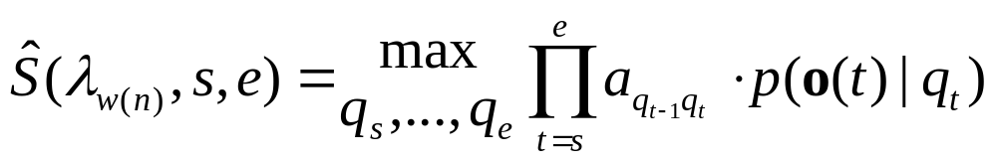
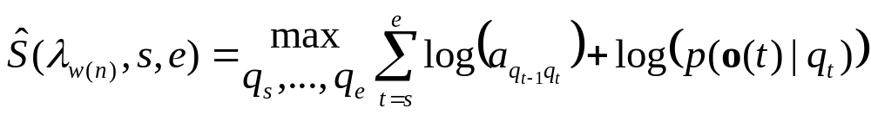
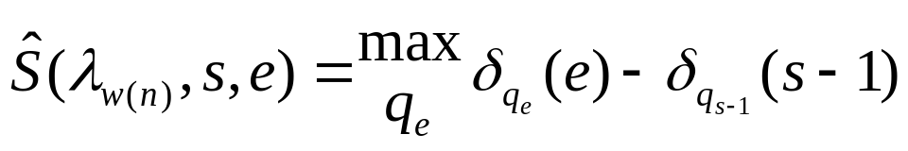
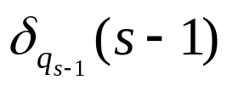
Search Strategies: Stack Decoder (A*) Search
As in Lecture 13, we can define the score, Ŝ, for word w(n) from
frame s to frame e, where (a) w(n) is modeled by HMM λ_{w(n)}, (b) a_{ij} = π_{j} when t is first frame of data, and (c) the state at q_{s-1} is the best state transitioning into w(n)’s first state at time s:
If we’re in log domain to avoid underflow errors, this equals
Which is equal to
where q_{e} are the possible ending states of λ_{w(n)} and is the delta value of the state leading into the best first state of λ_{w(n)} at time s (determined from the backtrace Ψ).

Slide 36
Search Strategies: Stack Decoder (A*) Search
Example with “yes” and “no” and 10 frames of output:
##
## = log(δ) score (closer to zero is better), arrow shows Ψ
from “o”
from “o”
y:
-2.63
-3.57
-3.71
-7.14
-10.87
-7.63
-7.88
-10.53
-15.18
e:
-1000
-6.21
-5.19
-3.87
-5.65
-8.73
-7.88
-8.01
-12.46
s:
-1000
-1000
-6.90
-7.86
-7.48
-8.97
-9.67
-12.70
-8.07
n:
-0.66
-4.35
-4.39
-5.26
-7.18
-9.82
-13.69
-11.98
-15.01
o:
-1000
-3.33
-3.92
-7.27
-5.79
-9.00
-10.57
-15.51
-13.44
t=1
t=2
t=3
t=4
t=5
t=6
t=7
t=8
T=9
Viterbi ⇒
⇐ A*
When doing A*, at each word beginning, look not only at Ψ (best transition into this word), but all possible transitions into this word!

Slide 37
Search Strategies: Stack Decoder (A*) Search
from “o”
from “o”
y:
-2.63
-3.57
-3.71
-7.14
-10.87
-7.63
-7.88
-10.53
-15.18
e:
-1000
-6.21
-5.19
-3.87
-5.65
-8.73
-7.88
-8.01
-12.46
s:
-1000
-1000
-6.90
-7.86
-7.48
-8.97
-9.67
-12.70
-8.07
n:
-0.66
-4.35
-4.39
-5.26
-7.18
-9.82
-13.69
-11.98
-15.01
o:
-1000
-3.33
-3.92
-7.27
-5.79
-9.00
-10.57
-15.51
-13.44
t=1
t=2
t=3
t=4
t=5
t=6
t=7
t=8
T=9
yes 3:5
-2.28-4.15-3.33= -9.76
yes 6:9
0-2.28-5.79= -8.07
yes 1:3
-4.15+-6.9+0.0= -11.05
NULL
no 4:5
-2.28-1.87-3.92= -8.07
no 8:9
0-3.77-9.67= -13.44
no 1:3
-4.15+-3.92+0.0= -8.07
1st best output: no (1-3), no (4-5), yes (6-9) score= -8.07

Slide 38
Search Strategies: Stack Decoder (A*) Search
from “o”
from “o”
y:
-2.63
-3.57
-3.71
-7.14
-10.87
-7.63
-7.88
-10.53
-15.18
e:
-1000
-6.21
-5.19
-3.87
-5.65
-8.73
-7.88
-8.01
-12.46
s:
-1000
-1000
-6.90
-7.86
-7.48
-8.97
-9.67
-12.70
-8.07
n:
-0.66
-4.35
-4.39
-5.26
-7.18
-9.82
-13.69
-11.98
-15.01
o:
-1000
-3.33
-3.92
-7.27
-5.79
-9.00
-10.57
-15.51
-13.44
t=1
t=2
t=3
t=4
t=5
t=6
t=7
t=8
T=9
yes 3:5
-2.28-4.15-3.33= -9.76
yes 1:2
-6.43+-INF+0.0= -INF
yes 6:9
0-2.28-5.79= -8.07
no 1:2
-6.43+-3.33+0.0= -9.76
NULL
yes 1:3
-4.15+-6.9+0.0= -11.05
no 8:9
0-3.77-9.67= -13.44
no 4:5
-2.28-1.87-3.92= -8.07
2st best output: no (1-2), yes (3-5), yes (6-9) score= -9.76

Slide 39
Search Strategies: Stack Decoder (A*) Search
from “o”
from “o”
y:
-2.63
-3.57
-3.71
-7.14
-10.87
-7.63
-7.88
-10.53
-15.18
e:
-1000
-6.21
-5.19
-3.87
-5.65
-8.73
-7.88
-8.01
-12.46
s:
-1000
-1000
-6.90
-7.86
-7.48
-8.97
-9.67
-12.70
-8.07
n:
-0.66
-4.35
-4.39
-5.26
-7.18
-9.82
-13.69
-11.98
-15.01
o:
-1000
-3.33
-3.92
-7.27
-5.79
-9.00
-10.57
-15.51
-13.44
t=1
t=2
t=3
t=4
t=5
t=6
t=7
t=8
T=9
yes 3:5
-2.28-4.15-3.33= -9.76
yes 1:2
-6.43+-INF+0.0= -INF
yes 6:9
0-2.28-5.79= -8.07
NULL
yes 1:3
-4.15+-6.9+0.0= -11.05
no 8:9
0-3.77-9.67= -13.44
no 4:5
-2.28-1.87-3.92= -8.07
3rd best output: yes (1-3), no (4-5), yes (6-9) score= -11.05

Slide 40
Search Strategies: Stack Decoder (A*) Search
from “o”
from “o”
y:
-2.63
-3.57
-3.71
-7.14
-10.87
-7.63
-7.88
-10.53
-15.18
e:
-1000
-6.21
-5.19
-3.87
-5.65
-8.73
-7.88
-8.01
-12.46
s:
-1000
-1000
-6.90
-7.86
-7.48
-8.97
-9.67
-12.70
-8.07
n:
-0.66
-4.35
-4.39
-5.26
-7.18
-9.82
-13.69
-11.98
-15.01
o:
-1000
-3.33
-3.92
-7.27
-5.79
-9.00
-10.57
-15.51
-13.44
t=1
t=2
t=3
t=4
t=5
t=6
t=7
t=8
T=9
yes 3:5
-2.28-4.15-3.33= -9.76
yes 1:2
-6.43+-INF+0.0= -INF
yes 6:9
0-2.28-5.79= -8.07
NULL
no 8:9
0-3.77-9.67= -13.44
etc.

